Slide 1
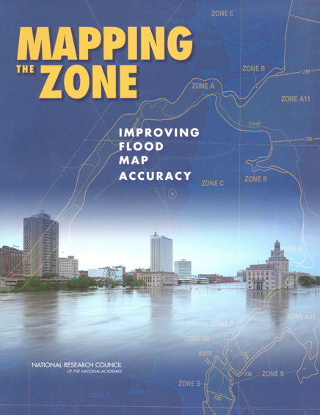
FEMA Flood Map Accuracy
David Maidment
University of Texas at Austin
http://www.nap.edu/catalog.php?record_id=12573

Slide 2
FEMA Map Modernization
Five-year program 2003-2008 to modernize the nation’s flood maps and convert them to digital form
$1billion budget for FEMA and ~ $200 million from state and local partners
Produced Digital Flood Insurance Rate Maps
How accurate are they?

Slide 3
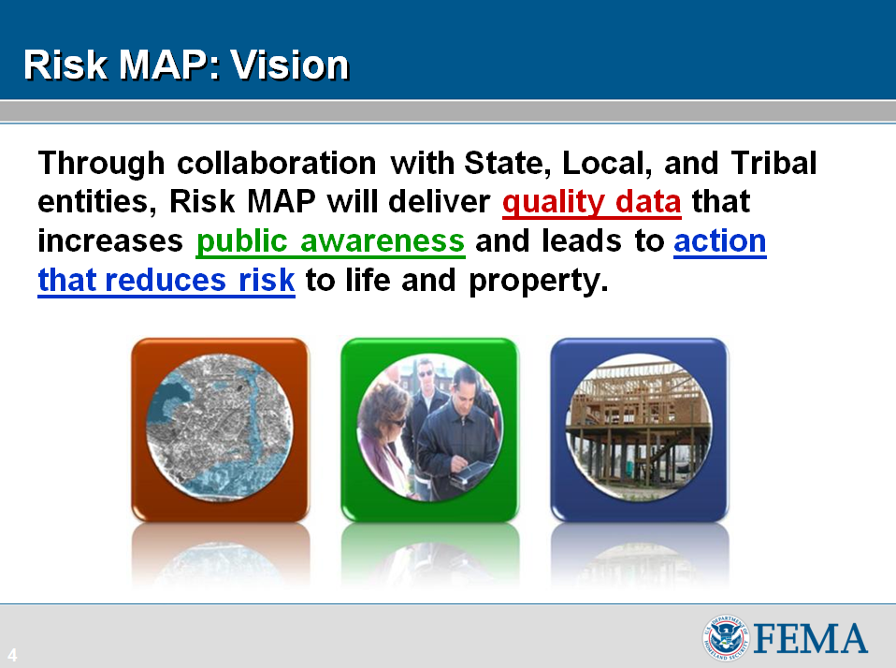

Slide 4
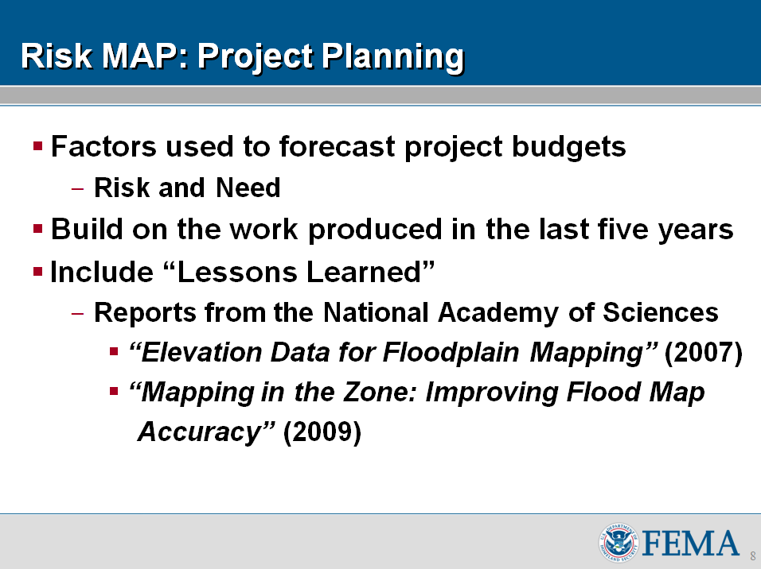
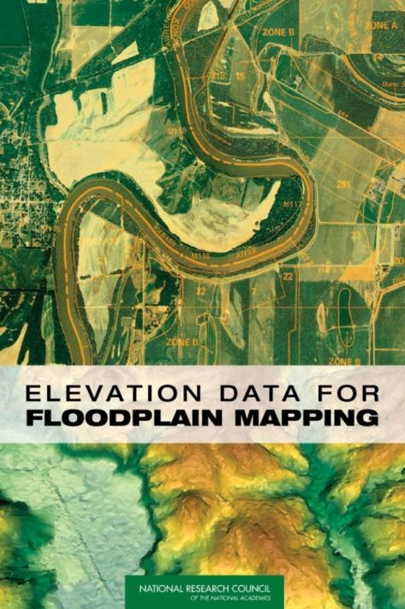

Slide 5
NRC Committee on FEMA Flood Map Accuracy
Study commissioned from the National Academies of Science and Engineering by FEMA
Tasked to examine the technical factors that affect flood map accuracy and cost-effectiveness of Detailed versus Approximate studies
Inland and coastal flooding

Slide 6
Committee Membership
David Maidment, Chair, University of Texas
David Brookshire, University of New Mexico
J. William Brown, City of Greenville, South Carolina
John Dorman, State of North Carolina
Gerald Galloway, University of Maryland
Bisher Imam, University of California, Irvine
Wendy Lathrop, Cadastral Consulting
David Maune, Dewberry
Burrell Montz, Binghamton University
Spencer Rogers, North Carolina Sea Grant
Karen Schuckman, Pennsylvania State University
Y. Peter Sheng, University of Florida
Juan Valdes, University of Arizona
Practitioners
Academics
Geodesy
Hydrology
Coastal
Economics
Risk

Slide 7
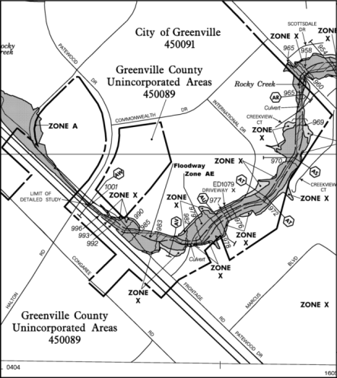
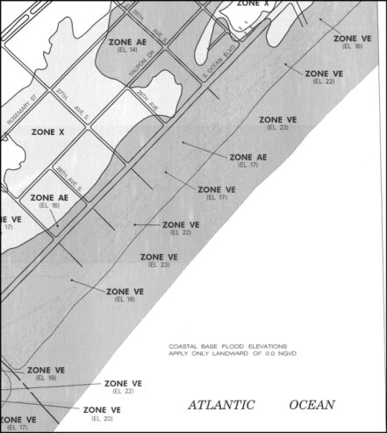
Flood Maps
Riverine
Coastal
Two very different flood modeling and mapping problems

Slide 8

Riverine Flood Mapping
Modeling and mapping technology is well established
Supported by a large observation database at stream gages
Floods flow along the line of the stream gages

Slide 9

Coastal Flood Mapping
Modeling and mapping technology and guidance are evolving
Storm surges inland transverse to the line of tide gages
Large dependence on models, less on historical flood data

Slide 10
Committee Charge: Task 3a
3. Investigate the impact that various study components (i.e., variables) have on the mapping of flood inundation boundaries:
a. Riverine flooding
      The accuracy of digital terrain information
      Hydrologic uncertainties in determining the flood discharge
      Hydraulic uncertainties in converting the discharge into a flood water surface elevation

Slide 11
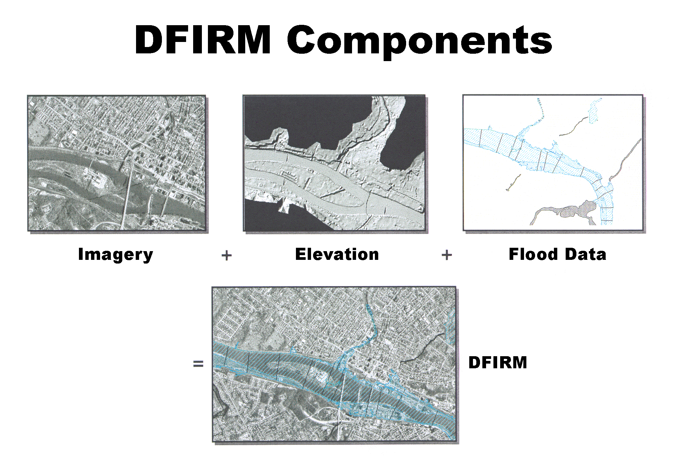

Slide 12
Previous NRC Studies:
Flood Map Technologies (2007)
An examination of the accuracy of flood base map input data
  2D imagery and planimetrics
  3D elevation
Prompted by issues raised by Senate Appropriations Committee staff

Slide 13
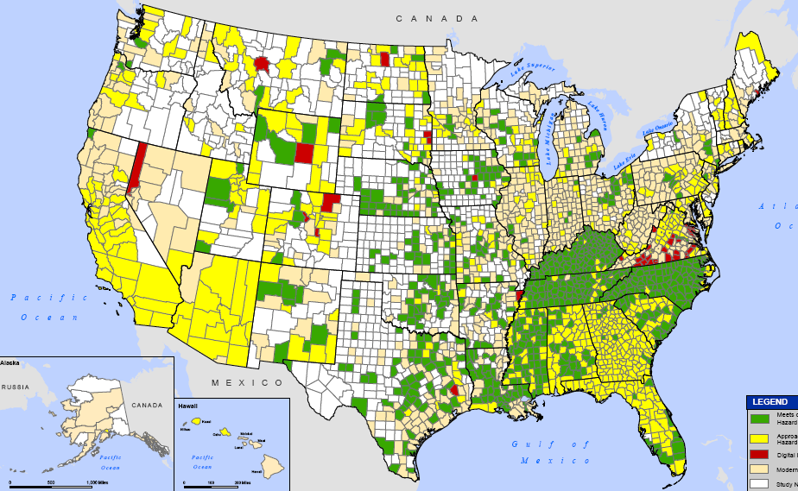
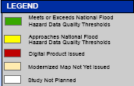
Midcourse Adjustment (2005)
Adjusted goal: 92% of population and 65% of land area will have a modernized map
21% of population has maps meeting the floodplain boundary standard and engineering study standard
Notes:
13

Slide 14
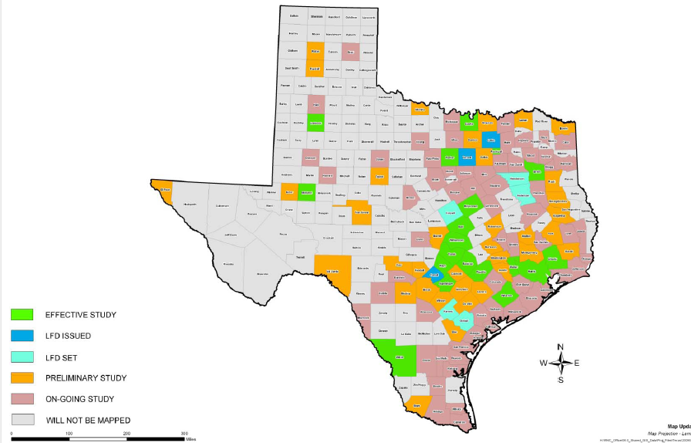
Map Modernization in Texas
Source: FEMA Region VI RMC
Half of Texas Counties have updated digital flood maps (94% of population)

Slide 15
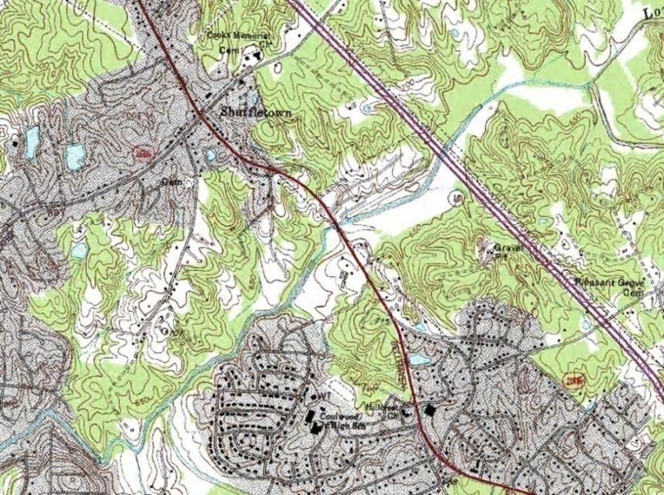
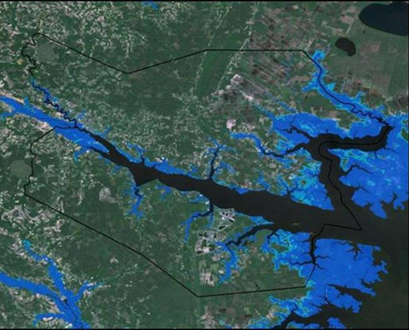
Terrain Data for Case Studies
USGS DEMs (30m)
NCFPM Lidar (3m)

Slide 16
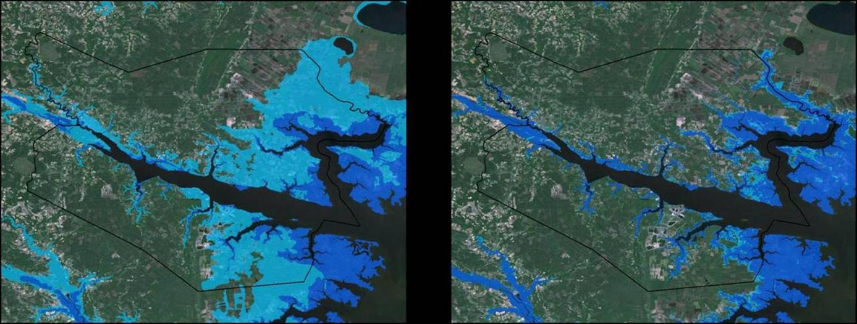
Terrain data accuracy matters
USGS NED (30m)
NCFMP Lidar (3m)
Inundation for a 1ft storm surge or sea level rise in the Tar-Pamlico estuary (Source: USGS)

Slide 17
North Carolina Case Studies http://www.ncfloodmaps.com/program_review.htm
Economics
H&H
Studies done for the NRC Committee by the North Carolina Floodplain Mapping Program (NCFMP)
Mountains of Western NC
Rolling hills of Piedmont
Flat coastal plain
H&H and Economics
(H&H = Hydrology and Hydraulics)

Slide 18
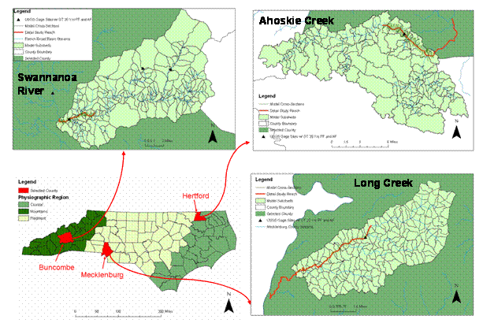
One River Reach studied in detail in each region
(each reach 5-7 miles long)

Slide 19
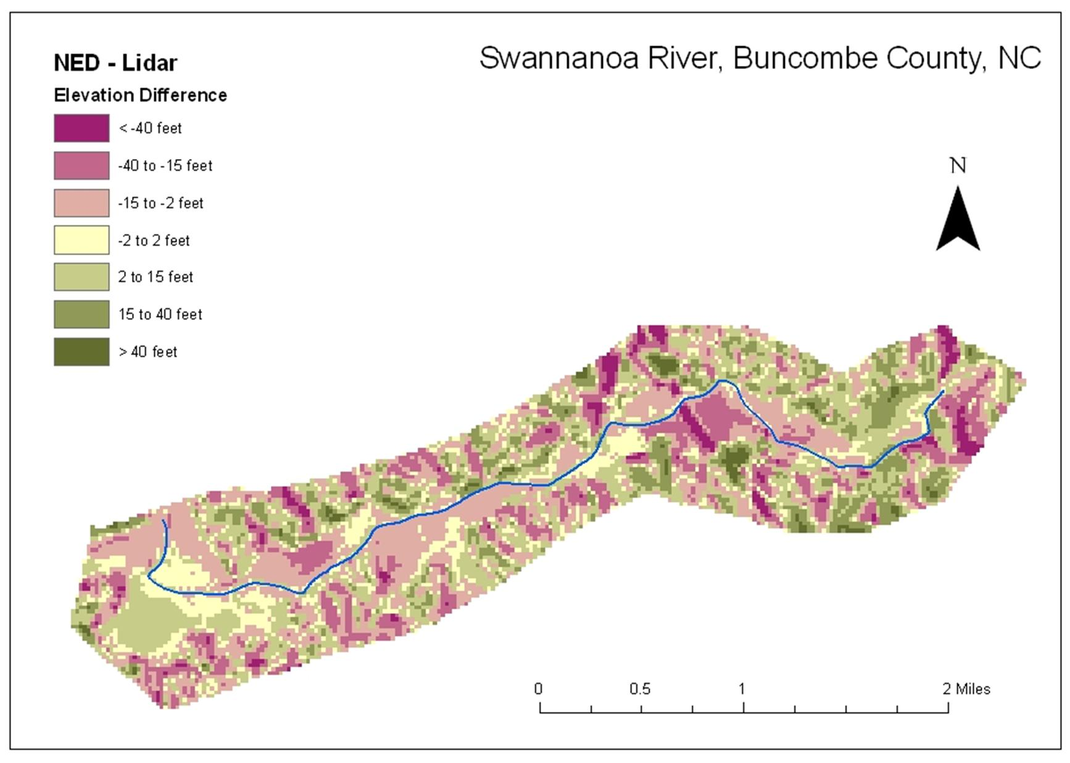
NED - Lidar | Feet
Mean | -2.0
Standard deviation | 17.5
Maximum | 89.7
Minimum | -139.3
NED is higher
(green)
Lidar is higher
(purple)

Slide 20
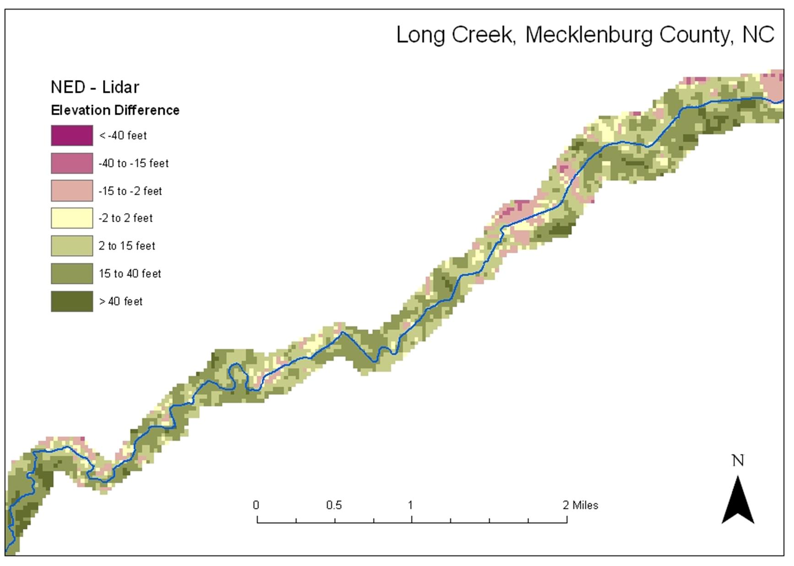
NED is higher
(green)
NED - Lidar | Feet
Mean | 14.7
Standard deviation | 15.6
Maximum | 81.5
Minimum | - 46.0
An elevation “bust”
Systematic and random errors

Slide 21
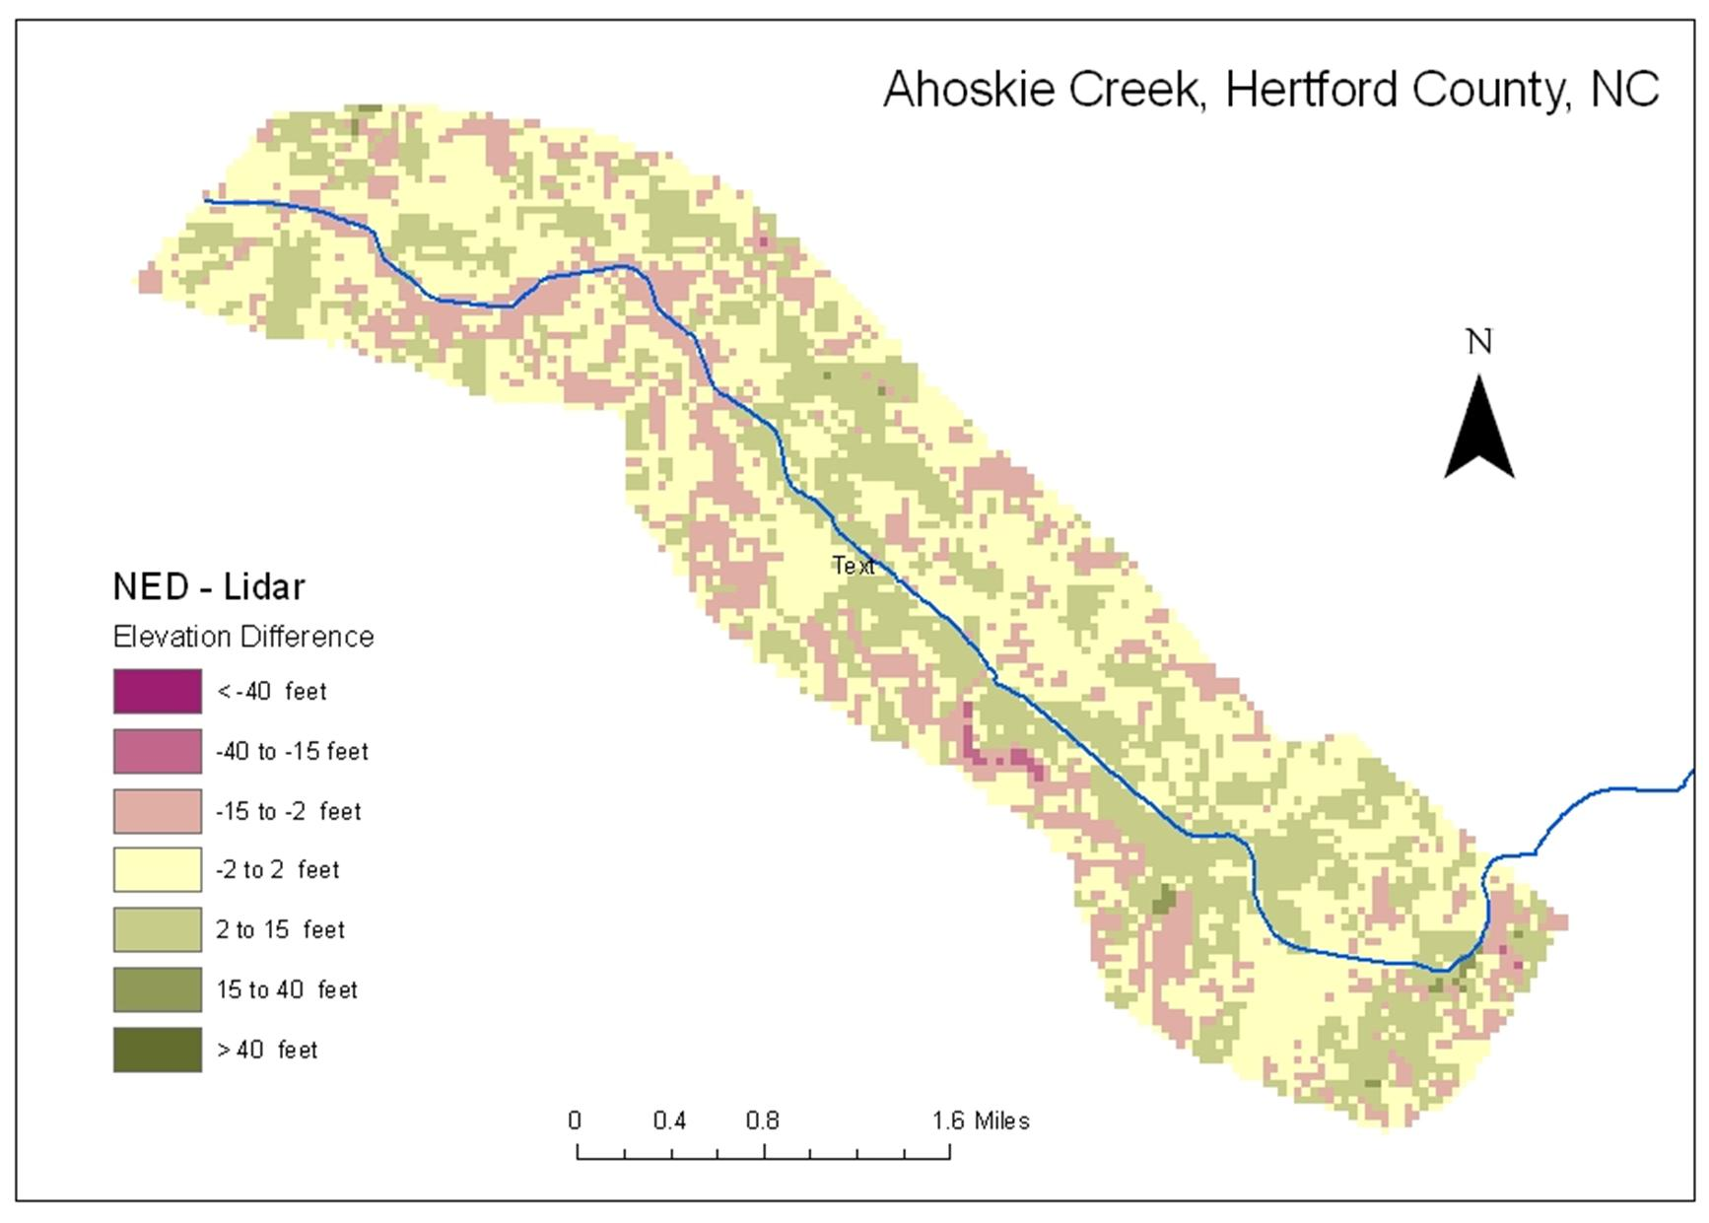
NED - Lidar | Feet
Mean | 0.5
Standard deviation | 3.9
Maximum | 34.8
Minimum | -25.3

Slide 22
Terrain Data
Our study demonstrates that there are large differences between LIDAR and NED
  Random differences everywhere
  Systematic differences in some places

Slide 23
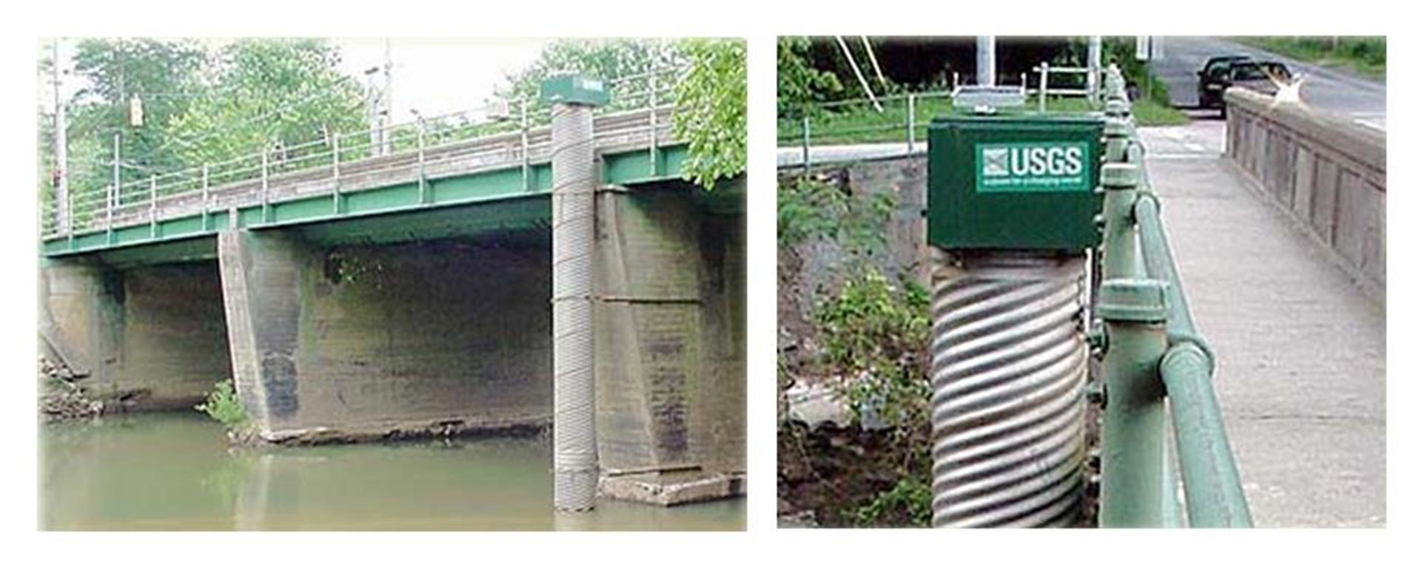
Defining Uncertainty in BFE
Long term records of extreme stages recorded at USGS gages
At each gage the peak stage is recorded for each year along with the peak flow – do a frequency analysis of these.

Slide 24
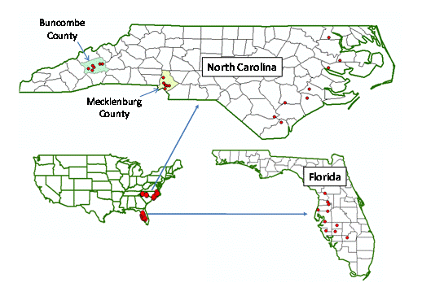
Frequency Analysis of Stage Heights at 31 gages
6
7
8
21 gages in NC
Is pitted FL landscape different?
All gages have at least 20 years record
(average is 54 years)
10 gages in FL

Slide 25
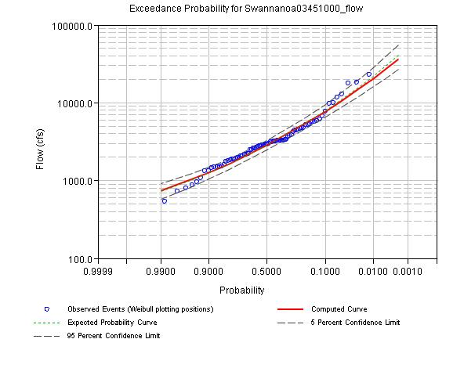
Swannanoa River at Biltmore, NC (78 years of record)
Base flood discharge
Discharge (cfs)
T = 100 years
Annual Exceedence Probability
Produced using the Corps HEC-SSP Program (Bulletin 17-B standard procedure)

Slide 26
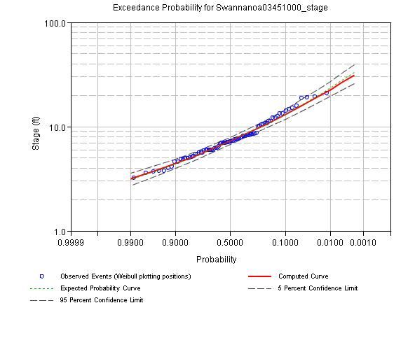
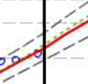
Swannanoa River at Biltmore, NC (78 years of record)
95% CL
5% CL
Stage (ft)
Sampling error =
T = 100 years
Annual Exceedence Probability
Uncertainty in BFE = Uncertainty in 100-year stage height

Slide 27
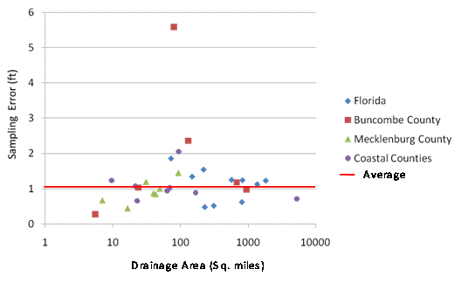
Sampling Error of 100-year Stage Heights
Outlier (skewed frequency curve)
No systematic variation in sampling error by
drainage area or topographic region
Sampling Error (ft)
Average = 1.06 ft
Drainage Area (Sq miles)

Slide 28
Uncertainty in BFE
95% CL
BFE and Base Stage Height differ by a constant amount (gage datum – geodetic datum)
This doesn’t affect uncertainty of statistical variation of sample data around the 100-year estimate
Average value of sample error at 30 of 31 gage sites is 1.06 ft
A Lower Bound on the uncertainty of the BFE is a standard error of estimate of approximately one foot
5% CL
Base Stage Height
BFE, h
Gage datum
Geodetic datum

Slide 29
Uncertainty in Floodplain Boundary Location
dw/dh = Run/Rise
Lateral channel slope is calculated on HEC-RAS cross-sections at the point of intersection of water surface with land surface (left and right banks) and averaged for all cross-sections in the reach
County | Lateral slope (%) | Run/rise (ft)
Ahoskie Creek | 2.4 | 42
Long Creek | 9.8 | 10
Swannanoa River | 12.9 | 8
w
dh
h
dw
A Lower Bound on the uncertainty of the floodplain boundary location ranges from approximately 8ft in the mountains to approximately 40 ft in the coastal plain

Slide 30
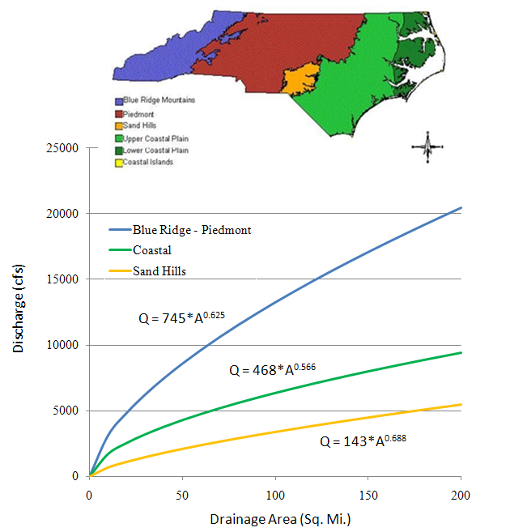
USGS
Peak-Flow
Regression Equations for 100-year discharge

Slide 31
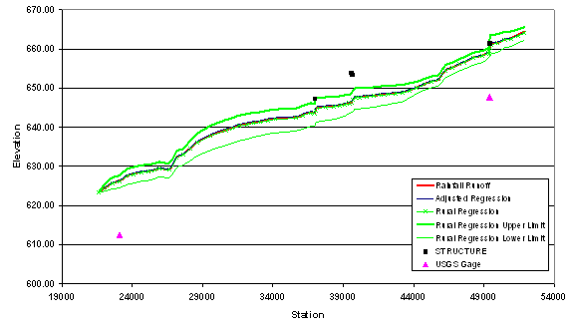
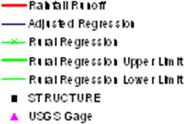
Effect on BFE of Variation in Hydrologic Methods
(Long Creek, Mecklenburg County)

Slide 32
Effect of Hydrologic methods on BFE
Choice of hydrologic method affects the BFE by usually less than 1 foot
All methods in our study are calibrated to the gage frequency curve and all our reaches have a gage, so gage calibration dominates variation in hydrologic methods
Stream gage data are important

Slide 33
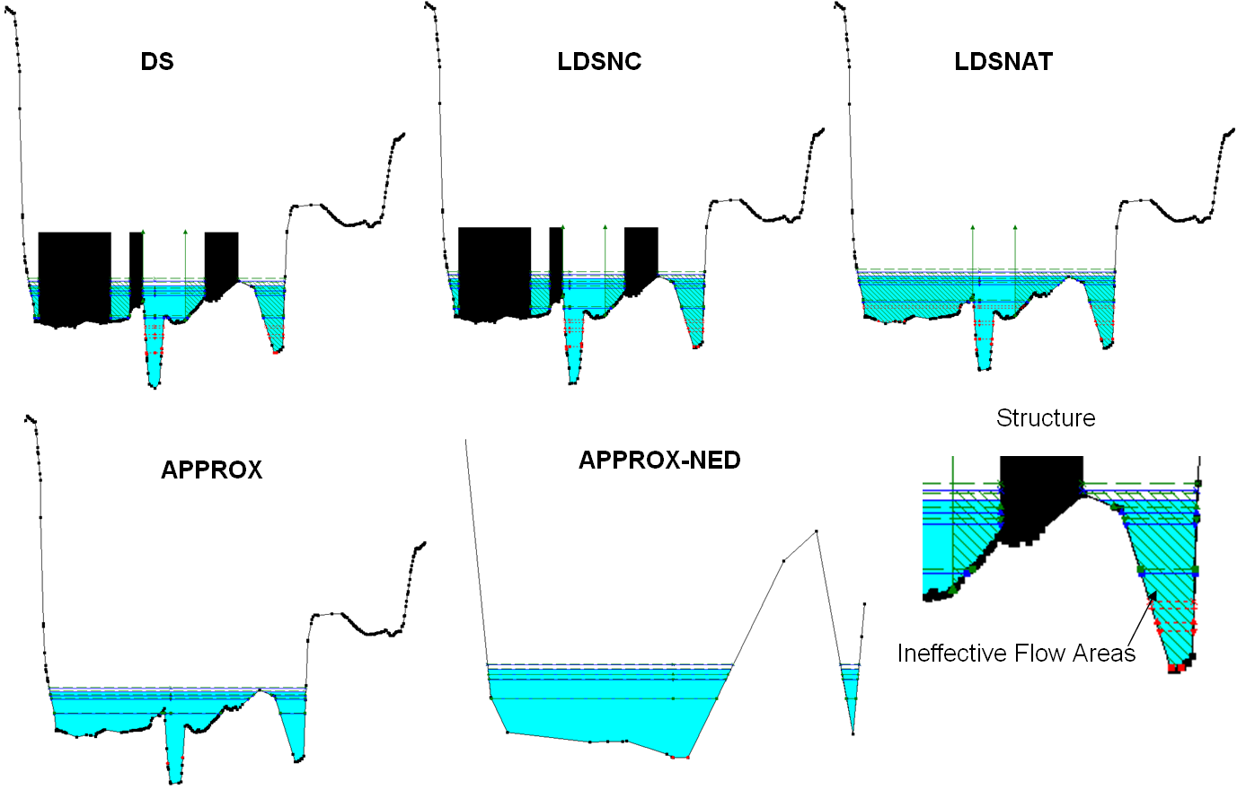
Case Study: Hydraulic Model-Terrain Variants
Detailed
Limited Detailed
Approximate
(lidar)

Slide 34
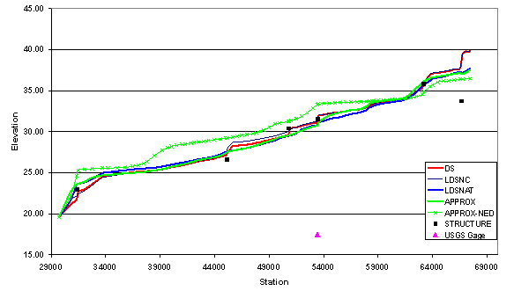
Effect on BFE of variation in hydraulic methods and terrain data (Swannanoa River)

Slide 35
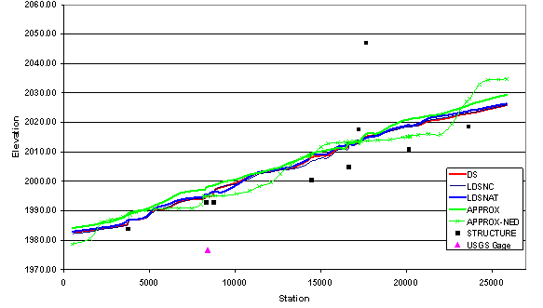
Effect on BFE of variation in hydraulic methods and terrain data (Ahoskie Creek)

Slide 36
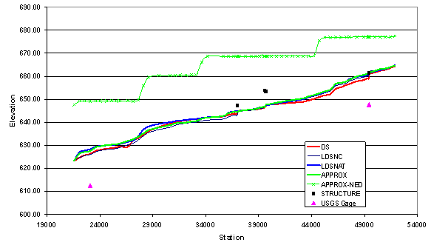
Effect on BFE of variation in hydraulic methods and terrain data (Long Creek)
Approximate Study using NED
21 ft

Slide 37
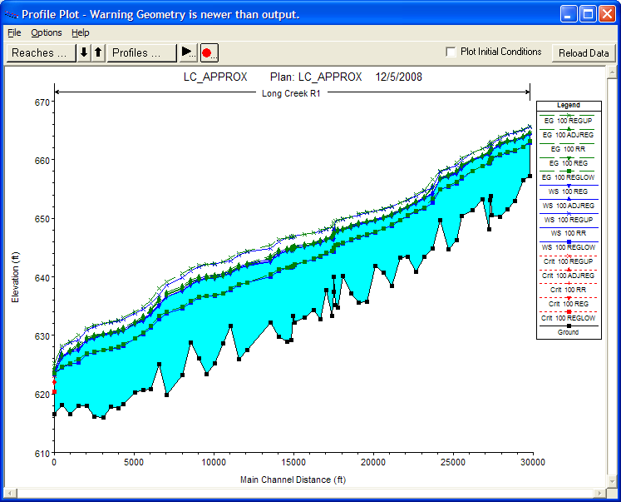
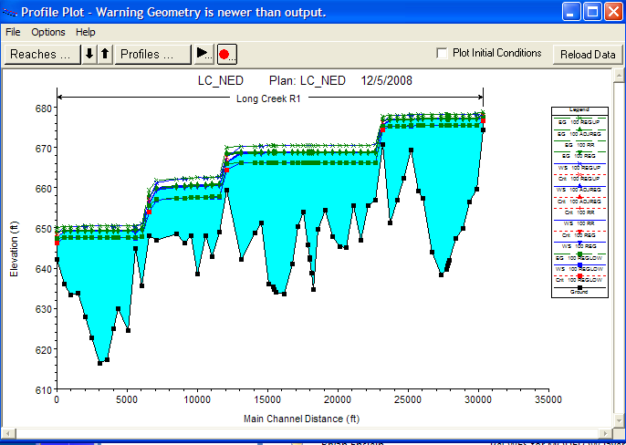
Approximate Study BFE Profiles
Approximate - Lidar
Approximate - NED
Misalignment (100 – 200 ft) of mapped 2D planimetric streamline with NED 3D elevation data

Slide 38
Alignment of planimetrics and
elevation data really matters

Slide 39
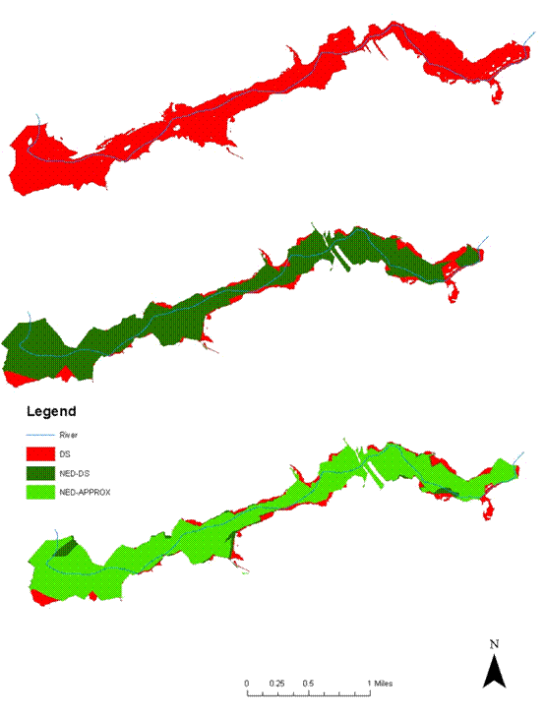
Flood Hazard Zone Areas
Swannanoa River
At Ahoskie Creek and Swannanoa River the number of acres enclosed in the SFHA by Detailed and Approximate studies differs by < 1%
Difference at Long Creek = 20%
Detailed - lidar
Detailed - NED
Approximate-NED
Approximate studies give the same area of flood zone but a different shape

Slide 40
Conclusions
Natural uncertainty in the Base Flood Elevation (BEF) is at least 1 foot, which translates to 8-40 ft horizontally depending on landscape
Terrain, terrain, terrain
  Largest impact on accuracy of the BFE is land surface elevation
  Requires Lidar or other detailed terrain data not NED
Report is available from National Academies Press: “Mapping the Zone….”

