Slide 1
Hydro Networks in GIS
Network model
Flow on Networks
Hydrologic networks
Linear referencing on networks
Some slides in this presentation were prepared by
Dr Francisco Olivera

Slide 2
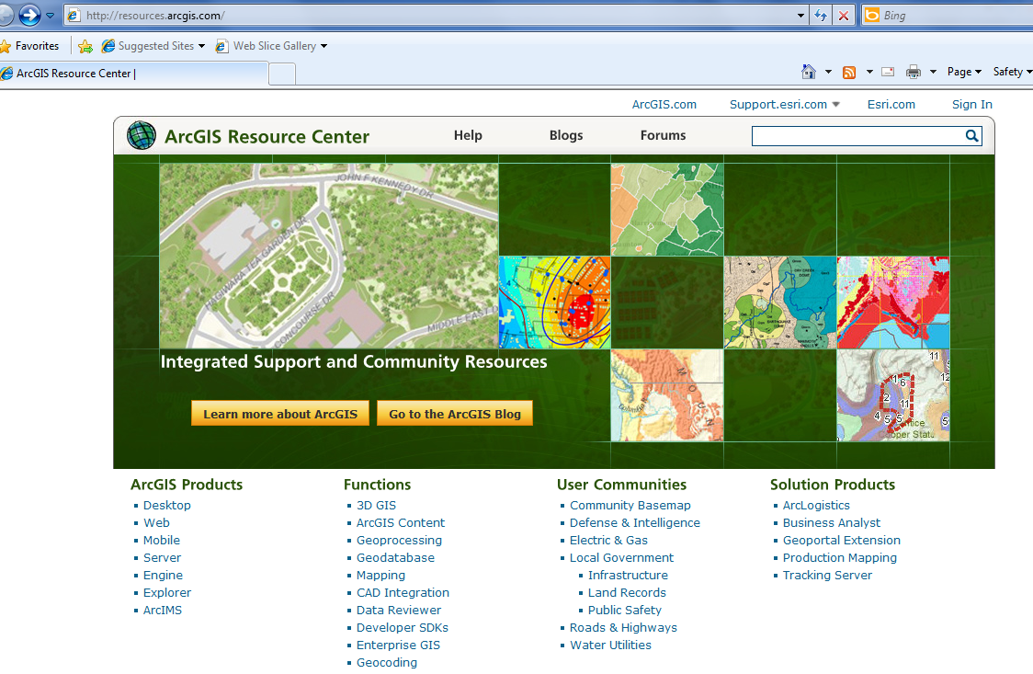
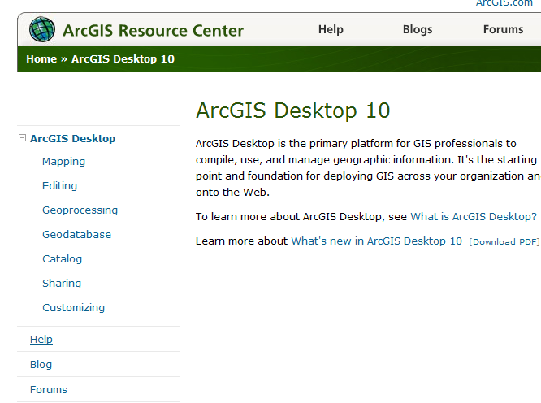
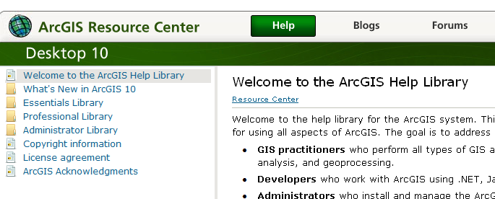
ArcGIS Resource Centers http://resources.arcgis/com
Getting to Readings in ArcGIS Resource Center Help for Desktop 10
Desktop
Help

Slide 3
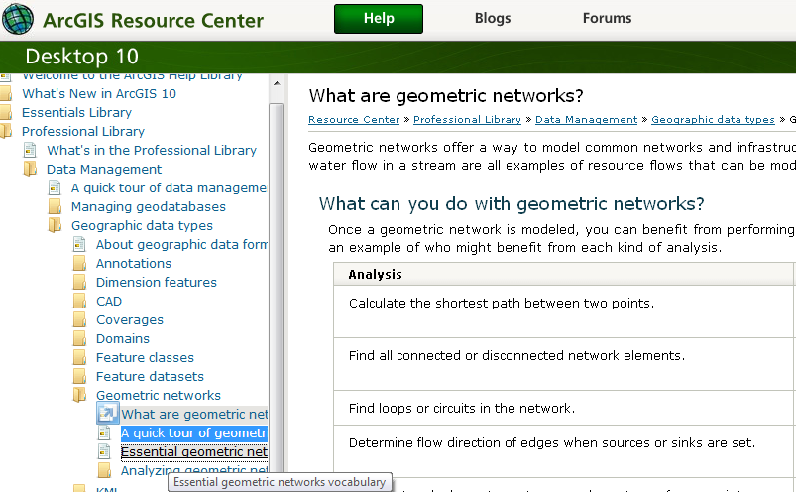
Reading (1)
ArcGIS Resource Center/Desktop 10/Help/Professional Library/Data Management/Geographic Data Types/Geometric Networks – What are geometric networks, A quick tour of geometric networks, Essential geometric networks
http://help.arcgis.com/en/arcgisdesktop/10.0/help/index.html#/What_are_geometric_networks/002r00000001000000/

Slide 4
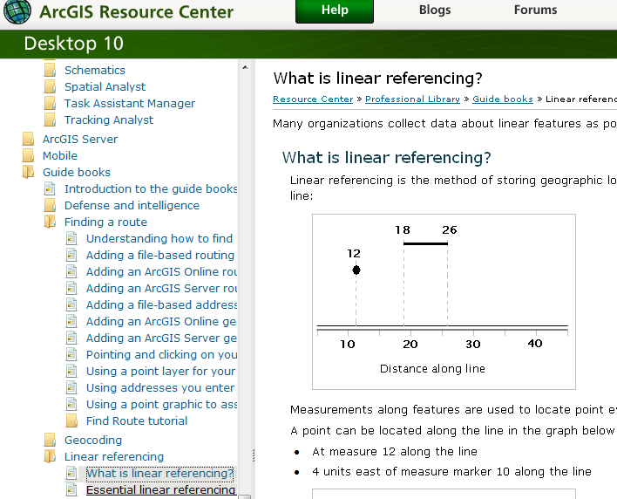
Reading (2)
ArcGIS Resource Center/ Desktop 10/Help/Professional Library/Guide books/Linear Referencing
- What is linear referencing; Essential linear referencing
http://help.arcgis.com/en/arcgisdesktop/10.0/help/index.html#/What_is_linear_referencing/003900000001000000/

Slide 5
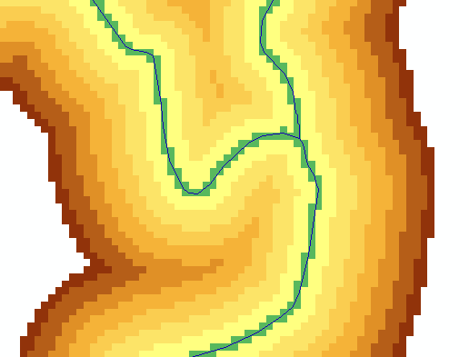
Key Concepts from Exercise 4
DEM Reconditioning as an example of quantitative raster analysis
Vector to Raster
Distance
Raster Calculation
Volume removed analysis
Subtract 10 at all stream grid cells
"smdem" - 10 * “flowLineReclas" - 0.02 * (500 - "distance") * ("distance" < 500)
500
500
Subtract an amount that tapers from 0.02*500=10 when distance is 0, to 0 when distance is 500 from stream
Only do taper when distance is less than 500, otherwise this is 0 and nothing is subtracted
10
10

Slide 6
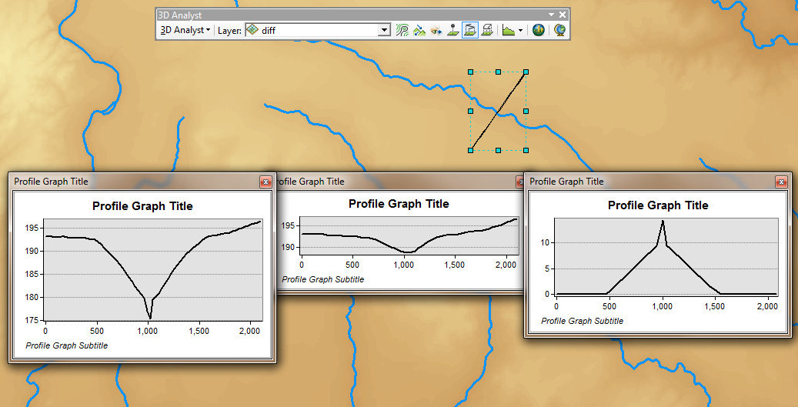
3D Analyst Profiles
smdem
diff
smrecon

Slide 7
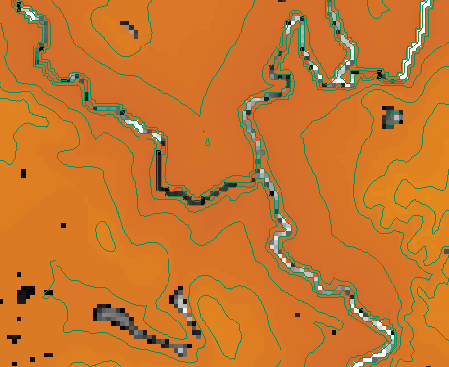
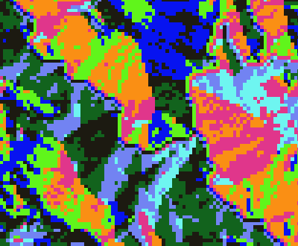
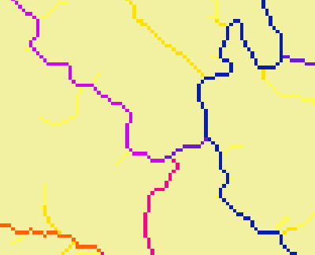
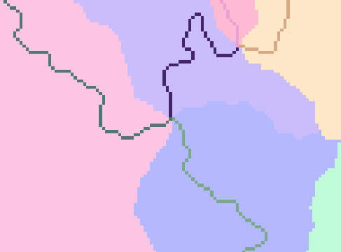
Construct the Analysis Layer
Fill
Flow Direction
Flow Accumulation
Stream Definition
Stream Links
Catchments

Slide 8
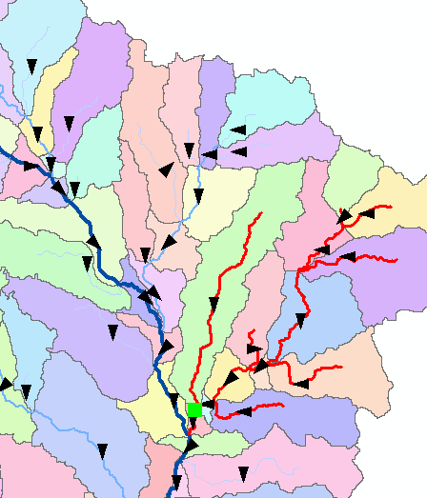
Convert to Vector
Vector streams
Vector catchments
Attribute feature with raster zonal statistics
Geometric Network
Tracing
Selection statistics

Slide 9
Raster to Vector Transition
During the last week, you have been dealing with the flow of water through the landscape based on the raster data structures
Today we are making a transition in which we are going to use vector network data to describe water pathways.
We will connect the land and water flow systems by attaching the catchments and watersheds derived from raster data processing to our vector networks

Slide 10
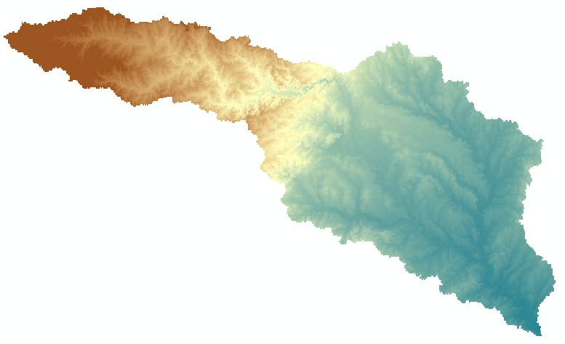
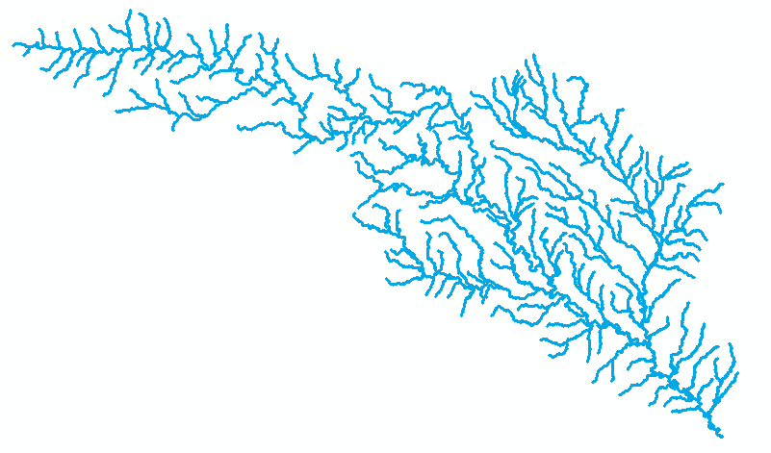
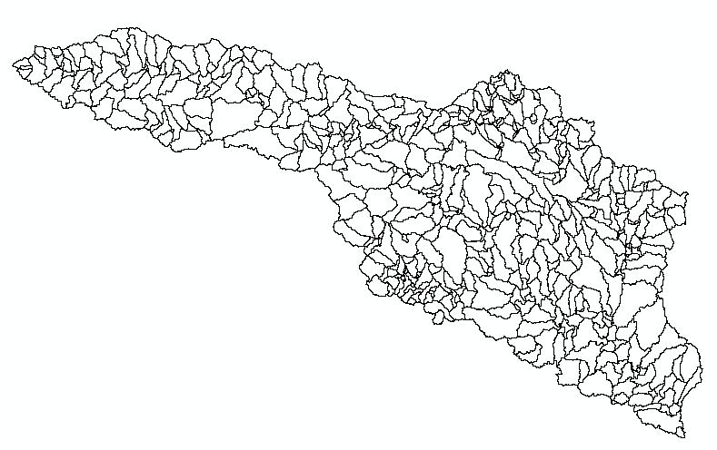
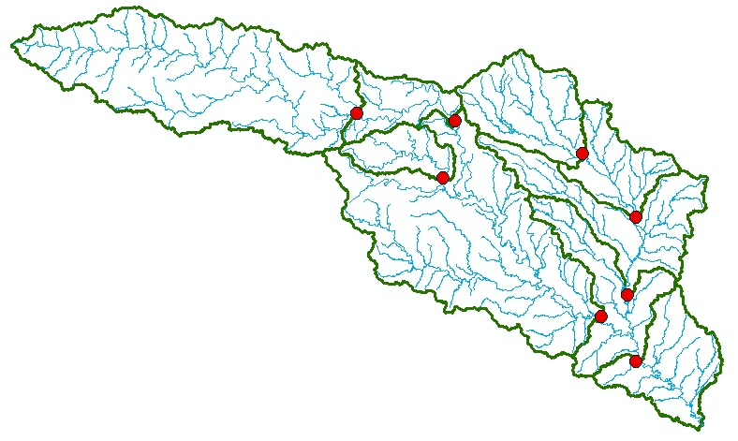
Four Key Concepts
Four key constructs
Cell to cell water movement on DEMs
Line to Line water movement on networks
Area flows to line (connect land and water systems – Reach Catchments)
Area flows to point on line (Watershed delineation from designated points)

Slide 11
Cell Flows to a Cell
Core concept of flow on digital elevation models

Slide 12
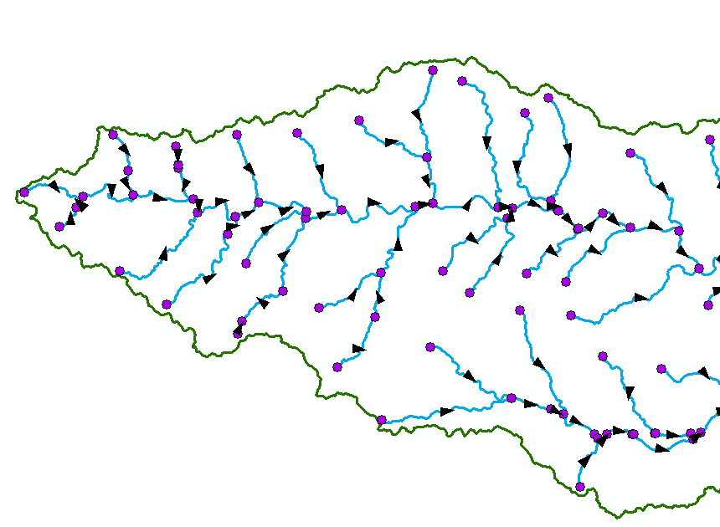
Line Flows to a Line
Geometric Network of NHDFlowlines

Slide 13
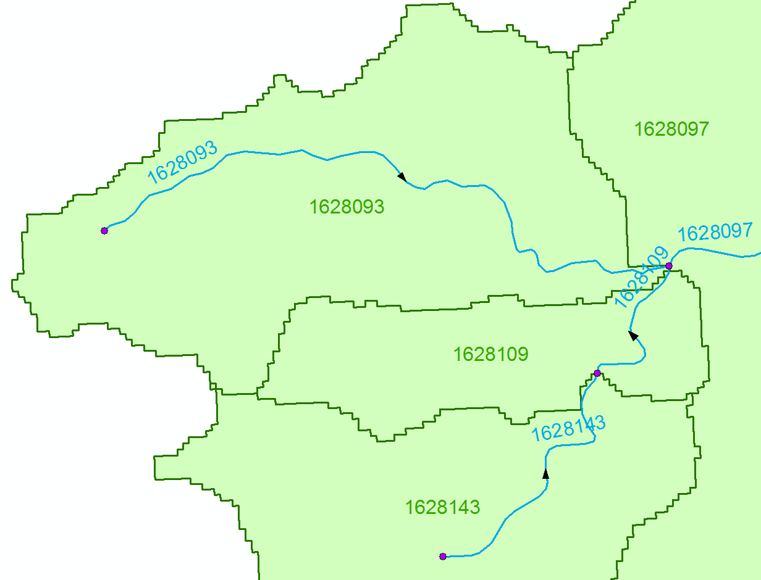
Area Flows to a Line
Reach Catchments from NHDPlus
Flowline and Catchment have the same COMID

Slide 14
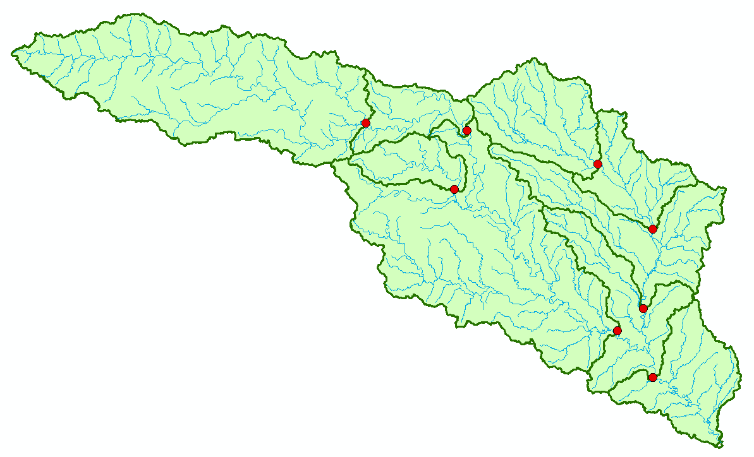
Area Flows to a Point on a Line
Watersheds for USGS Gages

Slide 15
Network Definition
A network is a set of edges and junctions that are topologically connected to each other.

Slide 16
Network Model in GIS
Three components
Geometric model: (x,y,z,m) coordinates of edges and junctions
Logical model: which edges are connected to what junctions
Addressing model: location on the network using measure

Slide 17
Edges and Junctions
Simple feature classes: points and lines
Network feature classes: junctions and edges
Edges can be
Simple: one attribute record for a single edge
Complex: one attribute record for several edges in a linear sequence
A single edge cannot be branched
No!!

Slide 18
Polylines and Edges

Slide 19
Junctions
Junctions exist at all points where edges join
If necessary they are added during network building (generic junctions)
Junctions can be placed on the interior of an edge e.g. stream gage
Any number of point feature classes can be built into junctions on a single network

Slide 20
Connectivity Table
J125
Junction
Adjacent Junction and Edge
J123 | J124, E1
J124 | J123, E1 | J125, E2 | J126, E3
J125 | J124, E2
J126 | J124, E3
E2
J124
E1
E3
J123
J126
This is the “Logical Network”

Slide 21
Build Network Tables
Establishes connectivity of Edge and Junction features
Enables tracing
Generates Generic Junctions
Geometric Network Wizard in ArcCatalog

Slide 22
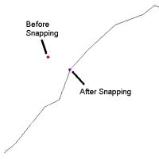
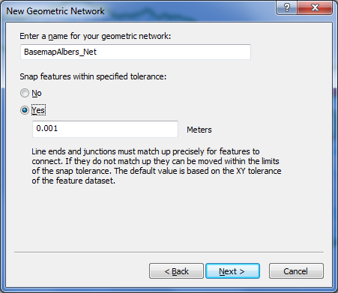
Snapping Features

Slide 23
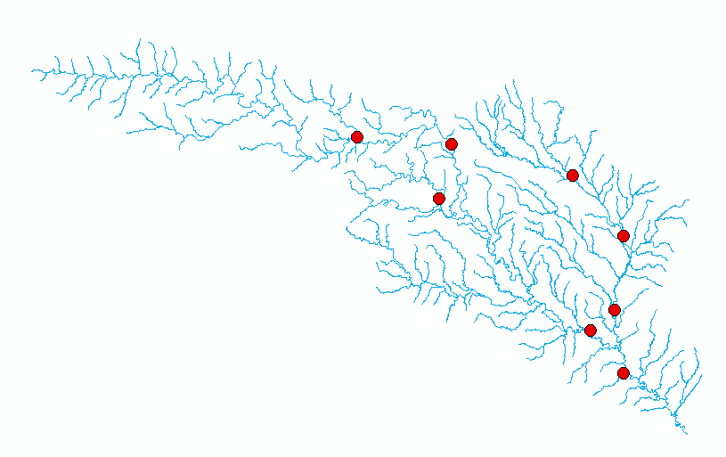
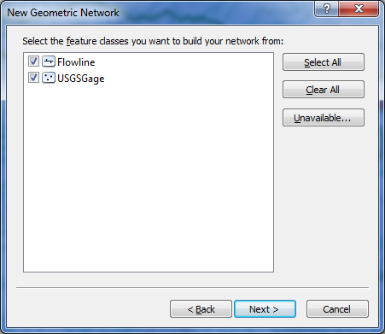

Slide 24
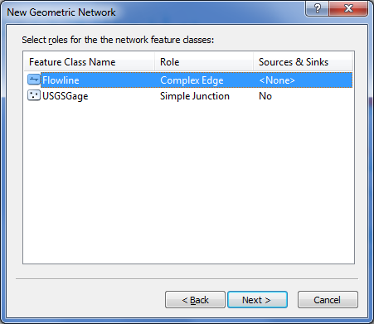
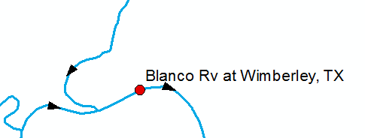
Network Sources and Sinks
Each junction
feature class
in a network can
have junctions
which are sources
or sinks for flow
Use complex edge so that junction can be interior to edge

Slide 25
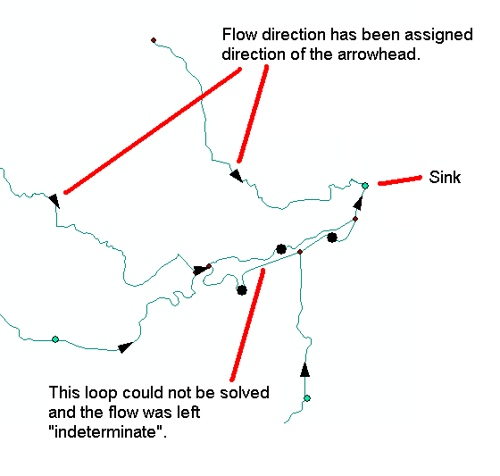
Flow to a sink

Slide 26
Flags

Slide 27
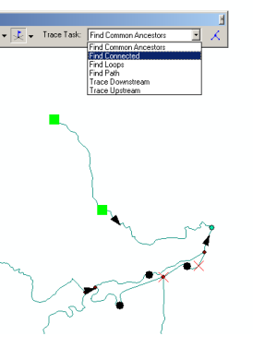
Trace Solvers

Slide 28
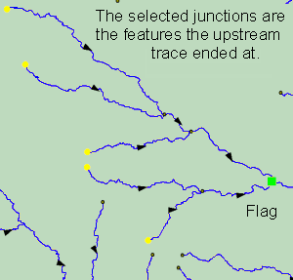
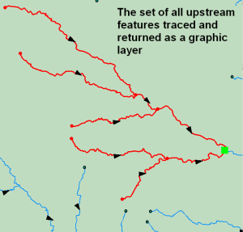
Upstream Trace Solvers

Slide 29
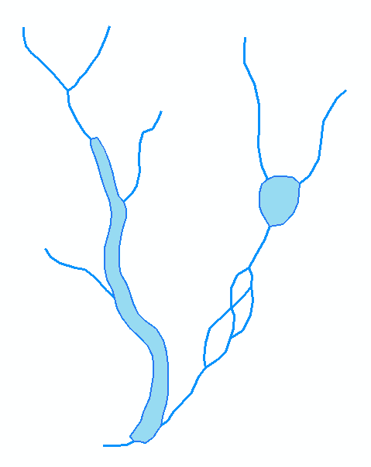
Hydrologic Networks
Hydrologic data includes:
Single-line streams
Double-line streams
Braided streams
Manmade channel systems
Waterbodies

Slide 30
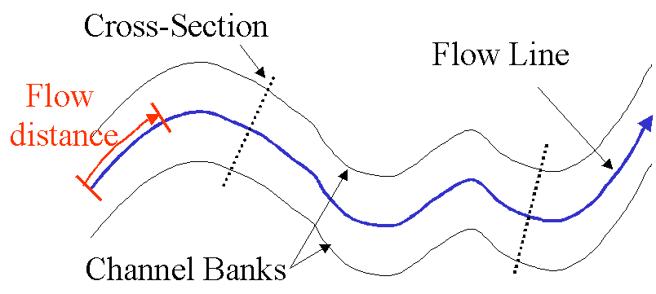
Flow Line
Traces movement of water in a one-dimensional flow system

Slide 31
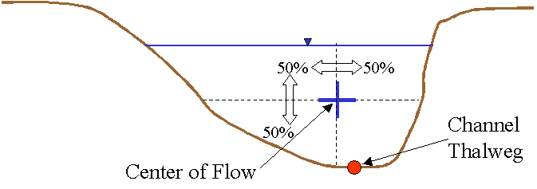
Location of the Flowline

Slide 32
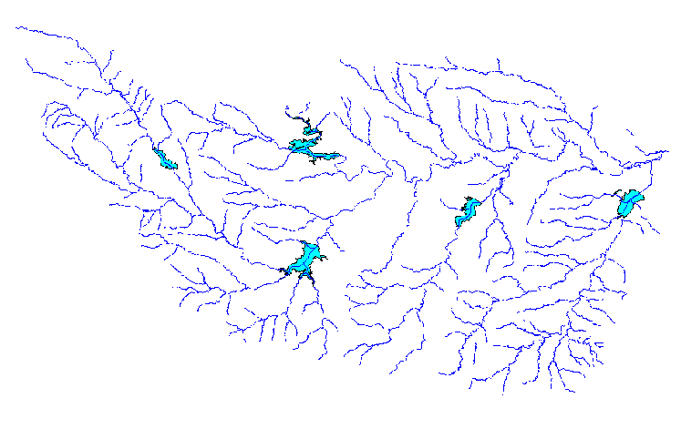
Introduction to the Hydro Network
Hydro Edge – think of Arc
Hydro Junction – think of Node
Waterbody – think of Polygon

Slide 33
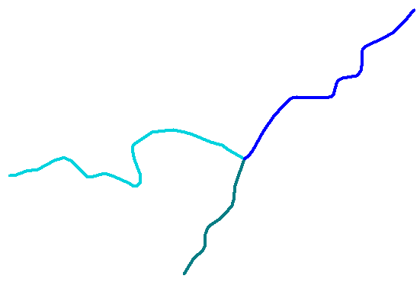
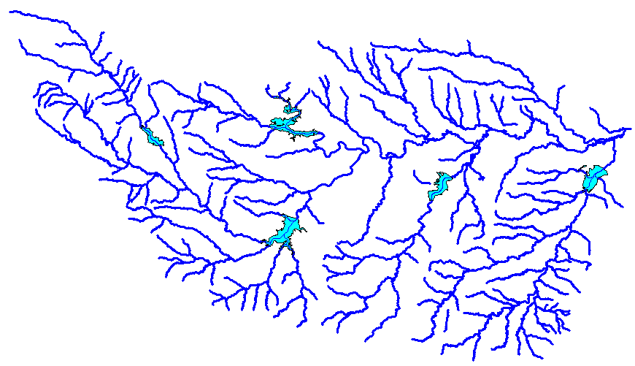
Flow Network
Edge
A connected set of flow edges
Junction

Slide 34
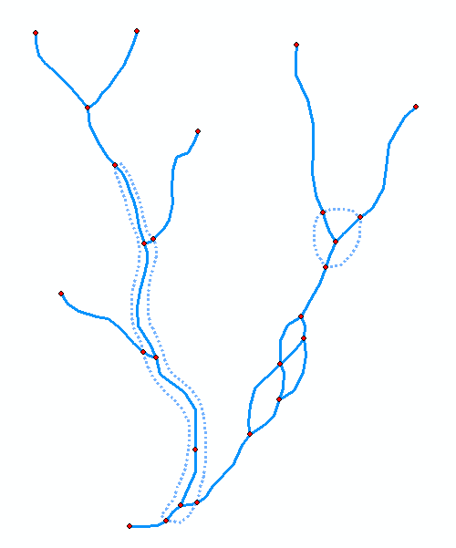
Network Building
Define flow-paths within double-line streams and waterbodies.
Define network sinks and sources.

Slide 35
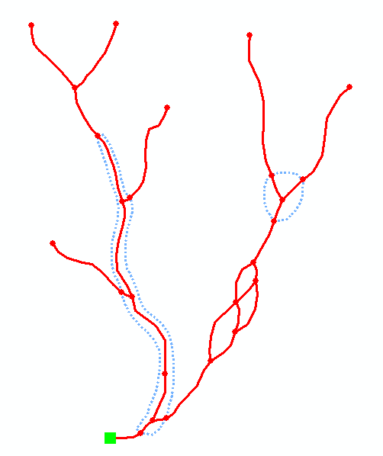
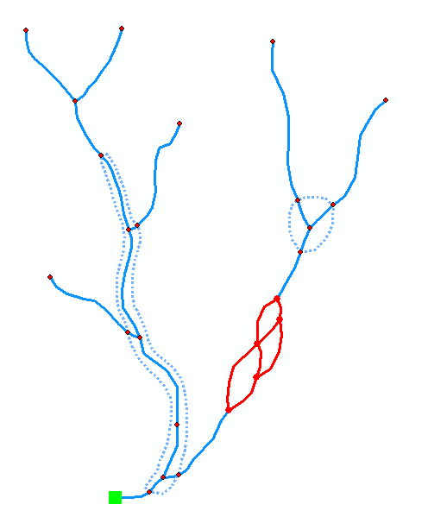
Network Connectivity
Find connected
Find loops

Slide 36
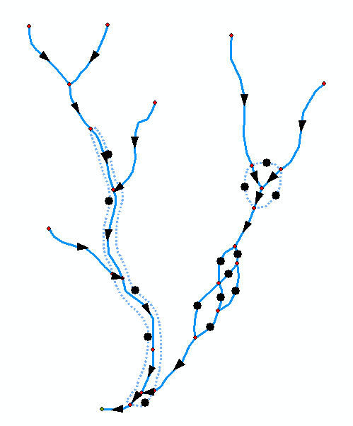
Network Flow Direction
Enable flow in flow-paths.
Disable flow in shorelines
Sink
Flow direction is unknown

Slide 37
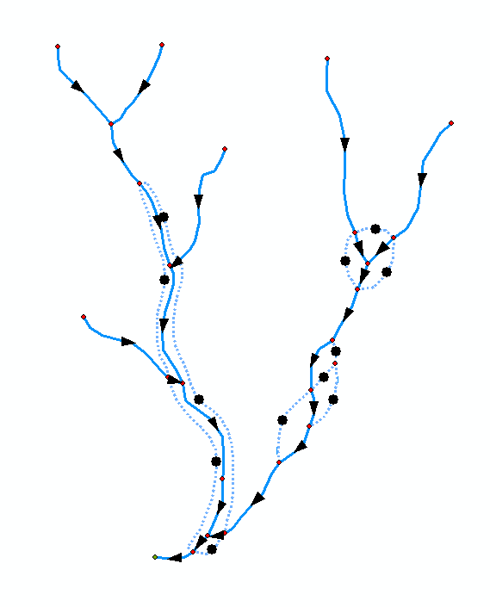
Network Flow Direction
Enable flow in flow-paths.
Disable flow in shorelines
Sink
Flow direction is known

Slide 38
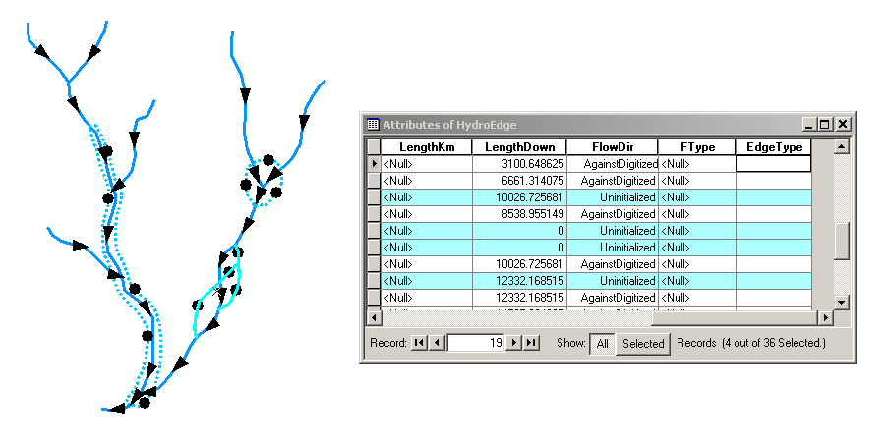
Uninitialized Flow Direction

Slide 39
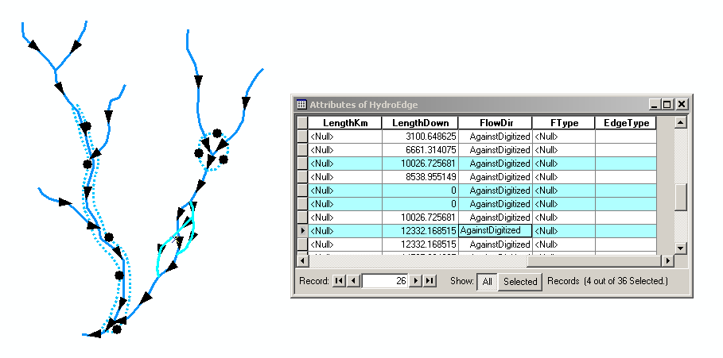
Assigned Flow Direction

Slide 40
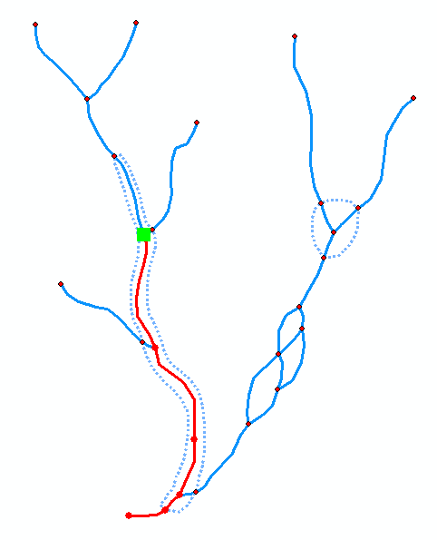
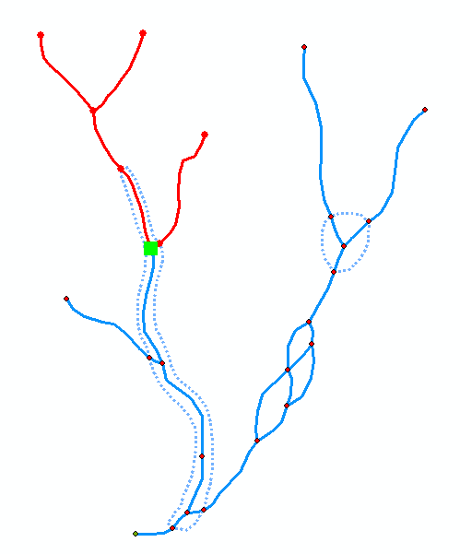
Network Tracing
Trace Upstream
Trace Downstream

Slide 41
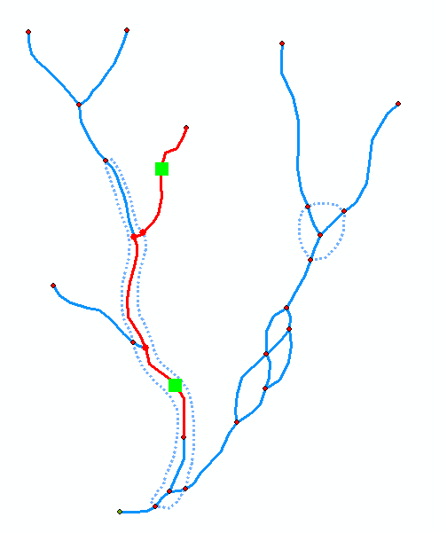
Trace Path
Find the shortest path
between two points on
the network

Slide 42
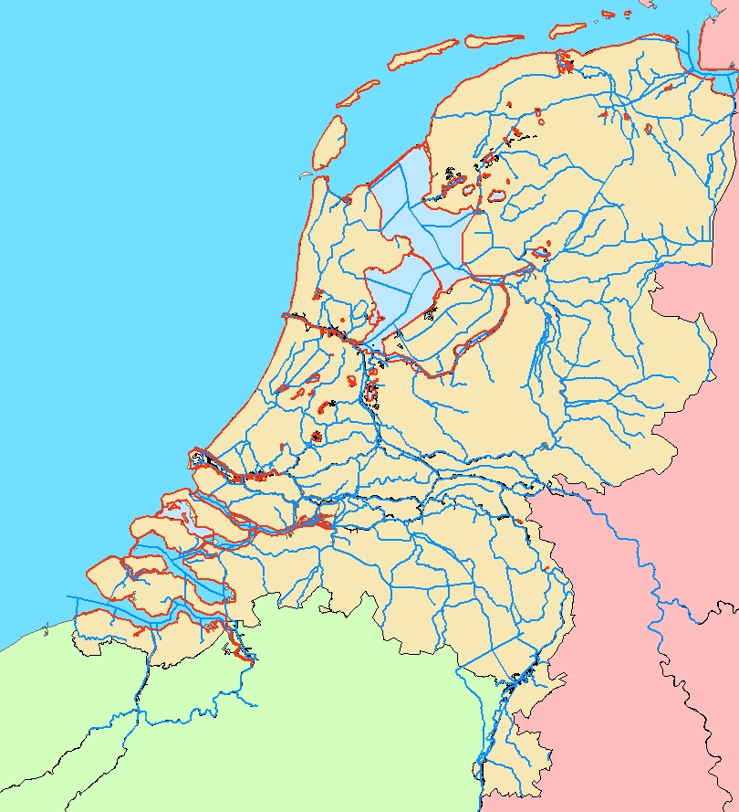
Hydro Network for Holland

Slide 43
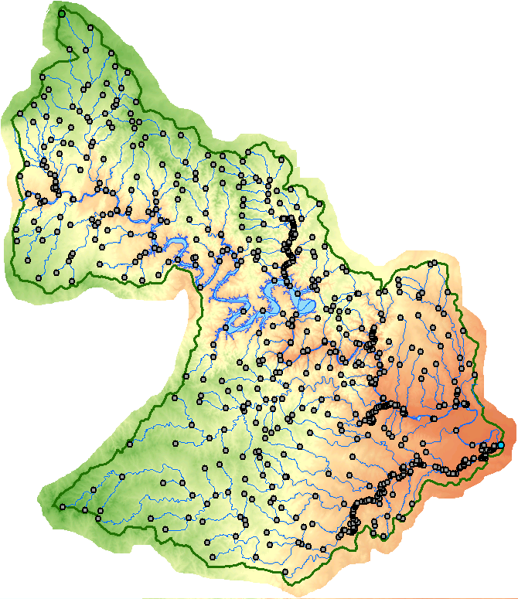
Hydro Network for Colorado River Basin around Lake Travis

Slide 44
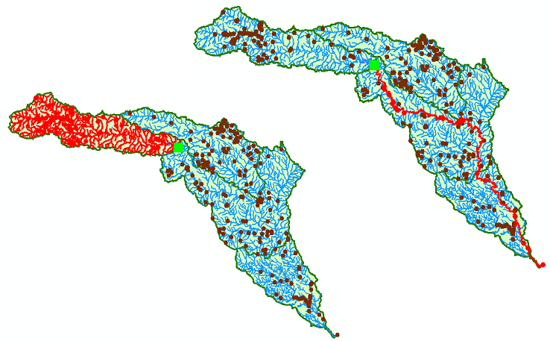
Network Tracing on the Guadalupe Basin

Slide 45
Some terminology
Hydrography – the mapping of water features
Blue line features on topographic maps (streams, rivers, lakes,…)
More generally, hydrography also includes the mapping of bathymetry and extent of estuaries and coastal waters
National Hydrography Dataset (NHD) – a data model for storing topographic map hydrography
Medium resolution (1:100K) is complete for US
High resolution (1:24K) is complete for most of the US
NHDPlus – a new data model integrating 1:100K resolution NHD with catchments and derived attributes from the National Elevation Dataset

Slide 46
National Hydrography Dataset
Key feature classes
Five feature classes with
NHDFLowline built into
A geometric network
NHDPoint, NHDLine,
NHDArea are point, line
and area water features
on map apart from flowlines
and waterbodies

Slide 47
National Hydrography Dataset

Slide 48
NHD Waterbody

Slide 49
NHD Geometric Network

Slide 50
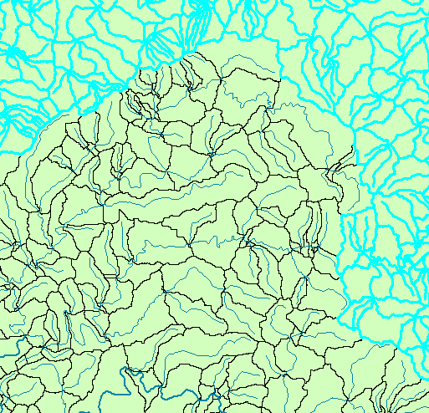
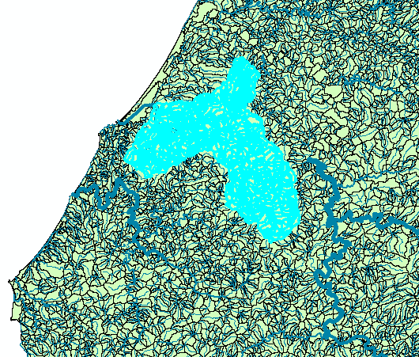
NHDPlus Reach Catchments ~ 3km²
Average reach length = 2km
2.3 million reaches for continental US
About 1000 reach catchments in each 8-digit HUC

Slide 51
Reach Attributes
Slope
Elevation
Mean annual flow
Corresponding velocity
Drainage area
% of upstream drainage area in different land uses
Stream order

Slide 53
United States Experience with DEM Improvement
1990’s
5%
Error in delineated watershed area
0.5%
2000’s
1 arcsec: 30 m
3 arcsec: 90 m
DEM Cell Size

Slide 54
National Elevation Dataset for Australia
Existing
New
9 Arc Second – 250 m
1 Arc Second – 30 m
1 cell
81 cells
Two orders of magnitude improvement! Wow!
Images: John Gallant, CSIRO

Slide 55
National River Network for Australia
Line flows to Line
Geometric Network
Geometry model: Where am I? (x,y coordinates)
Logical model: Who am I connected to? (topology)
Addressing model: Where are things on me? (linear referencing)
Image: Elizabeth McDonald, BoM

Slide 56
A challenge: those messy Aussie rivers have lots of loops and branches
Image: Michael Hutchinson, ANU

Slide 57
A fundamental innovation: Connecting the Cell to Cell and Line to Line Models
Flow divergences have multiple flow directions on a single DEM cell
Cell flows to Cell
Image and Research: Janet Stein, ANU

Slide 58
Reach Catchments Every stream reach has a local drainage area
Area flows to Line
Image: Elizabeth McDonald, BoM
Fundamental connection between the water and land systems

Slide 59
Contracted Nodes and Catchments
A standardized tessellation of the landscape – one chosen among the infinite number of tessellations possible
Contracted Nodes
Contracted Catchments
Area flows to a point on a line
Contracted nodes persist through successive versions of the geofabric
Images: Elizabeth McDonald, BoM

Slide 60
Linear Referencing
Where are we on a line?

Slide 61
Addressing

Slide 62
Coordinates of a 2-D Polyline

Slide 63
Coordinates of a 2-D Polyline M

Slide 64
Setting Line Measure

Slide 65
Proportional Aliasing
Distance is measured
Relative to the length
of the line as a percentage
0% – 100%

Slide 66
Setting Percent Measure
pMSeg.SetAndInterpolate
MsBetween 0, 100
pMSeg.SetAndInterpolate
MsBetween 100, 0
0 – 100 going upstream
0 – 100 going downstream

Slide 67
Point and Line Events

Slide 68
Summary Concepts
Four key constructs
Cell to cell water movement on DEMs
Line to Line water movement on networks
Area flows to line (connect land and water systems – Reach Catchments)
Area flows to point on line (Watershed delineation from designated points)

Slide 69
Summary Concepts (2)
A network is a connected set of points (junctions) and lines (edges) that supports tracing functions
Three data model components
Geographic (x,y,z)
Logical (point-line topology connections)
Addressing (position m along the line)

Slide 70
Summary Concepts (3)
Linear referencing can be used to locate point and line “events” on a network
This is like (x,y) event themes that you used earlier to map stream gage locations in geographic space

