Slide 1
HydroNetwork Applications
This lecture continues on from the slides we began on the last class
In this class, we talk about
  how to create HydroNetworks,
  Linear referencing on networks
  NHDPlus in the United States
  AWRIS project in Australia
There are no new additional readings

Slide 2
Summary Concepts from Last Lecture
Four key constructs
  Cell to cell water movement on DEMs
  Line to Line water movement on networks
  Area flows to line (connect land and water systems – Reach Catchments)
  Area flows to point on line (Watershed delineation from designated points)

Slide 3
Summary Concepts (2)
A network is a connected set of points (junctions) and lines (edges) that supports tracing functions
  Three data model components
    Geographic (x,y,z)
    Logical (point-line topology connections)
    Addressing (position m along the line)

Slide 4
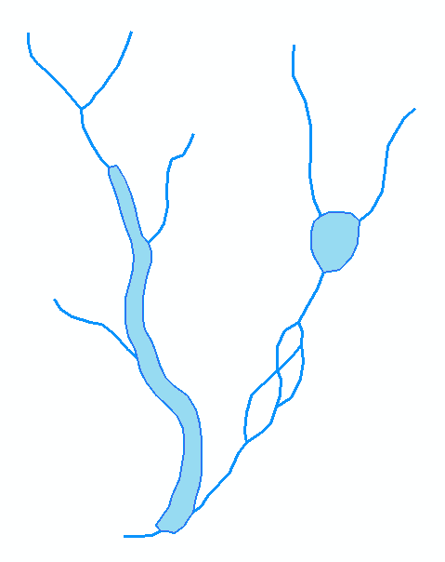
Hydrologic Networks
Hydrologic data includes:
  Single-line streams
  Double-line streams
  Braided streams
  Manmade channel systems
  Waterbodies

Slide 5
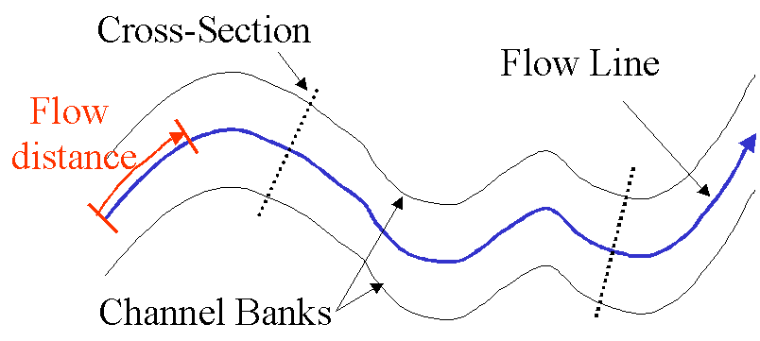
Flow Line
Traces movement of water in a one-dimensional flow system

Slide 6
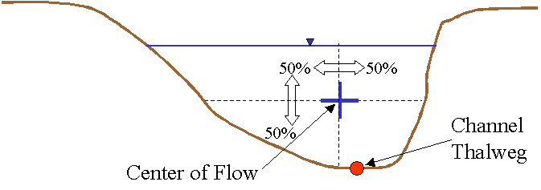
Location of the Flowline

Slide 7
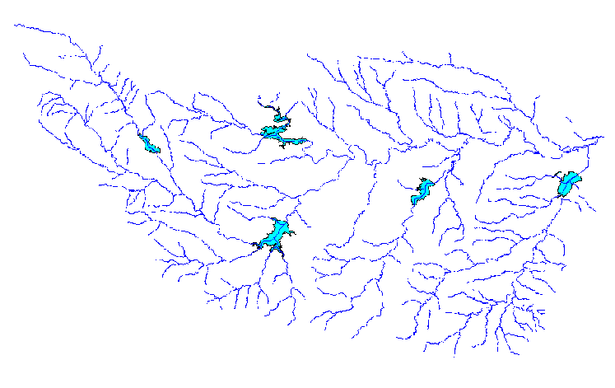
Introduction to the Hydro Network
Hydro Edge – think of Arc
Hydro Junction – think of Node
Waterbody – think of Polygon

Slide 8
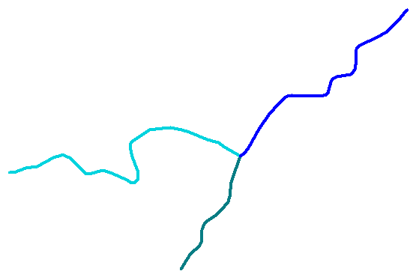
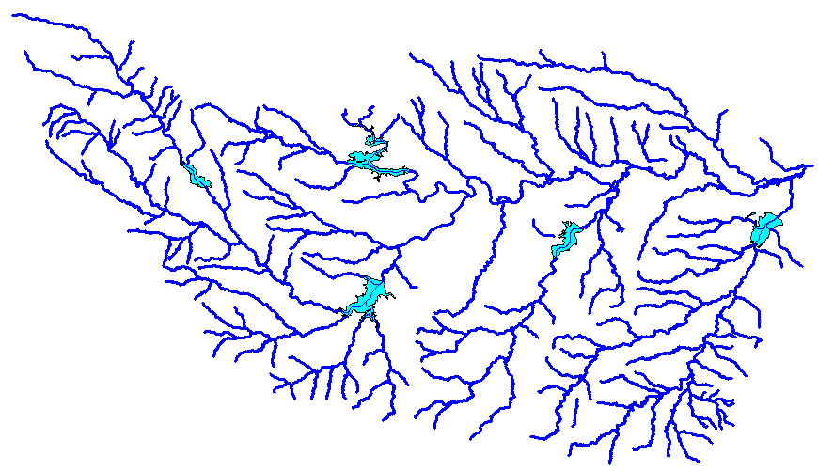
Flow Network
Edge
A connected set of flow edges
Junction

Slide 9
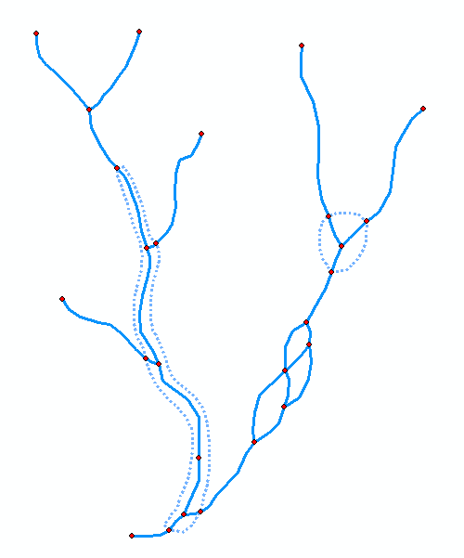
Network Building
Define flow-paths within double-line streams and waterbodies.
Define network sinks and sources.

Slide 10
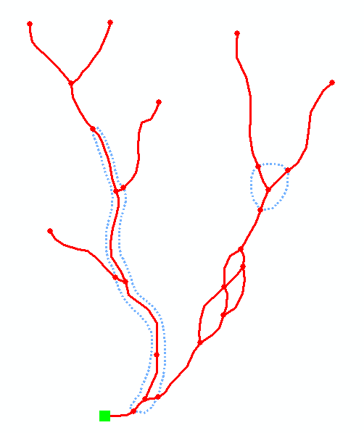
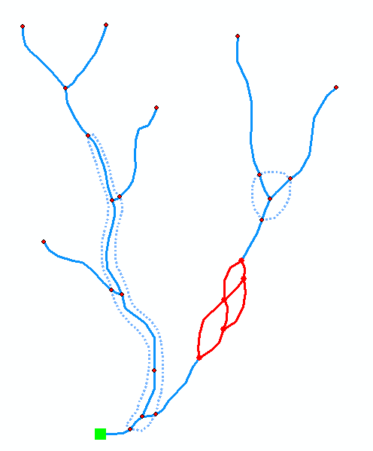
Network Connectivity
Find connected
Find loops

Slide 11
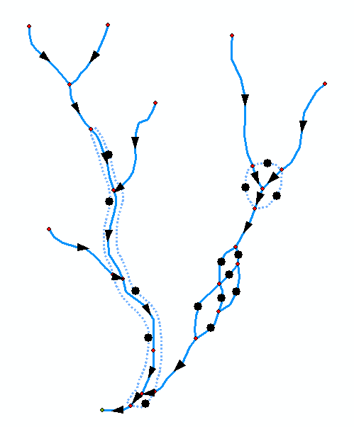
Network Flow Direction
Enable flow in flow-paths.
Disable flow in shorelines
Sink
Flow direction is unknown

Slide 12
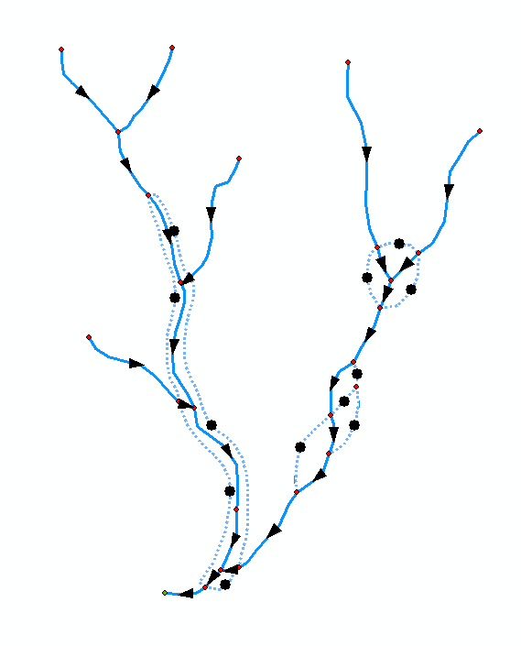
Network Flow Direction
Enable flow in flow-paths.
Disable flow in shorelines
Sink
Flow direction is known

Slide 13
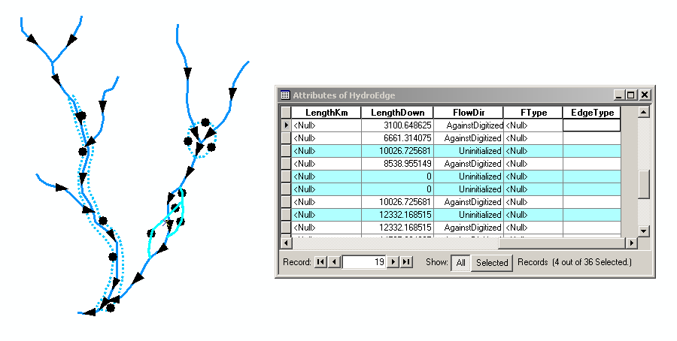
Uninitialized Flow Direction

Slide 14
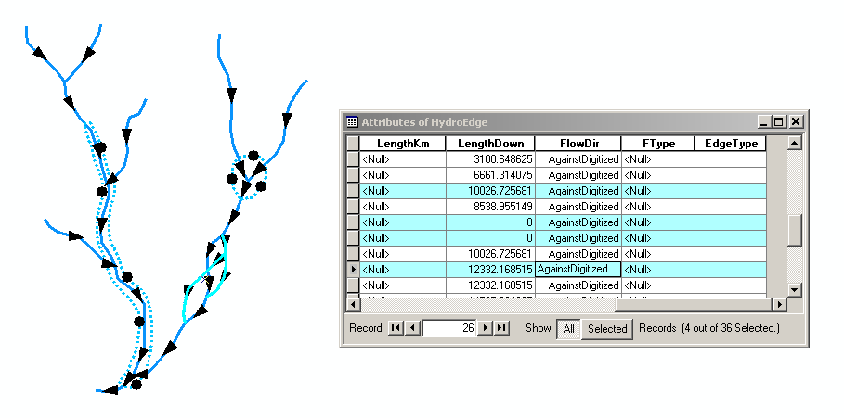
Assigned Flow Direction

Slide 15
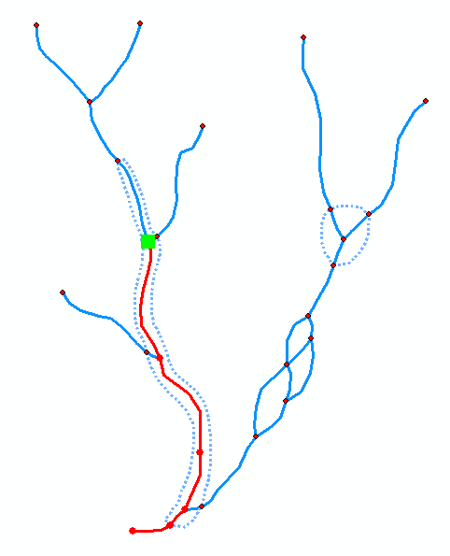
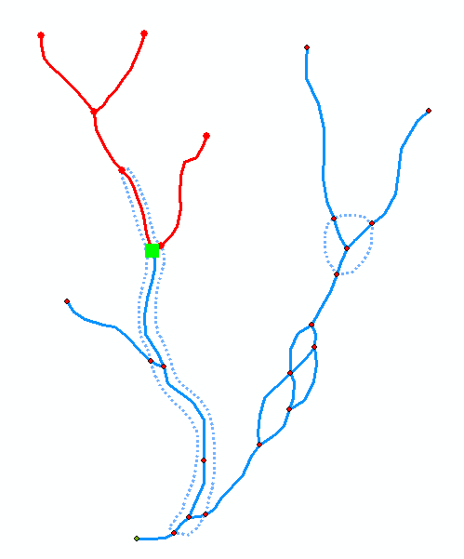
Network Tracing
Trace Upstream
Trace Downstream

Slide 16
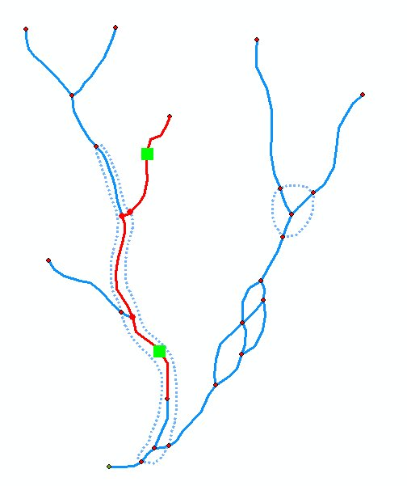
Trace Path
Find the shortest path
between two points on
the network

Slide 17
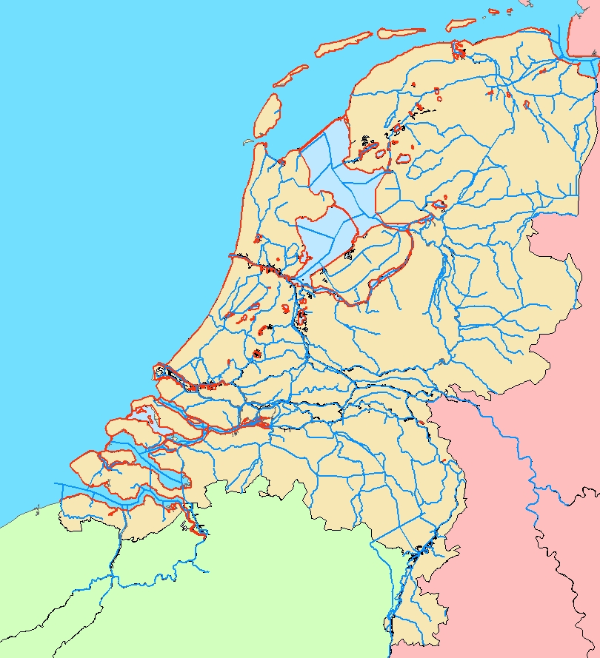
Hydro Network for Holland

Slide 18
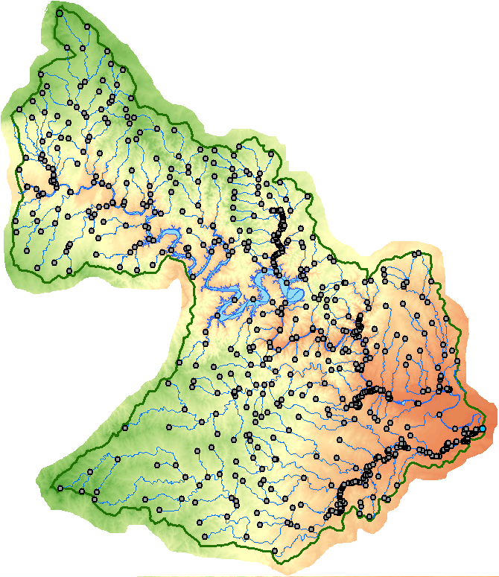
Hydro Network for Colorado River Basin around Lake Travis

Slide 19
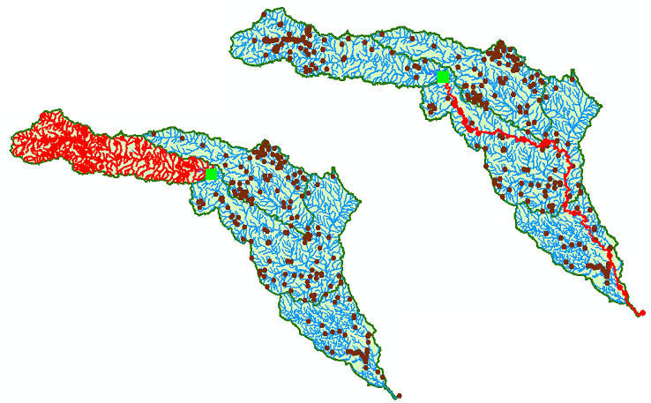
Network Tracing on the Guadalupe Basin

Slide 20
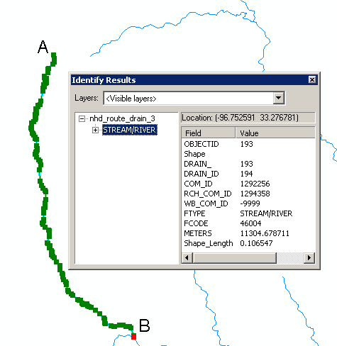
Linear Referencing
Where are we on a line?

Slide 21
Addressing

Slide 22
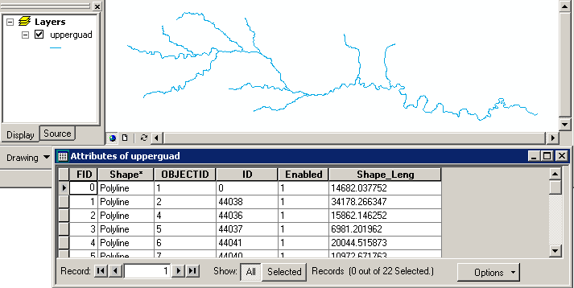
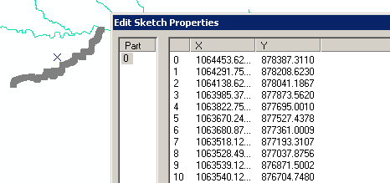
Coordinates of a 2-D Polyline

Slide 23
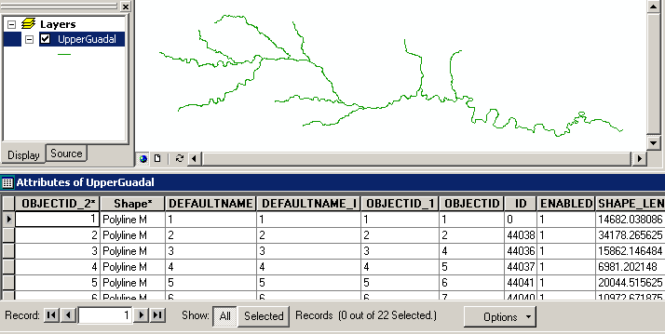
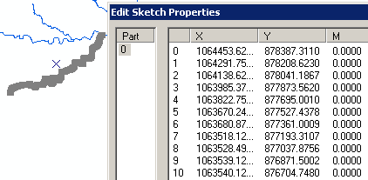
Coordinates of a 2-D Polyline M

Slide 24
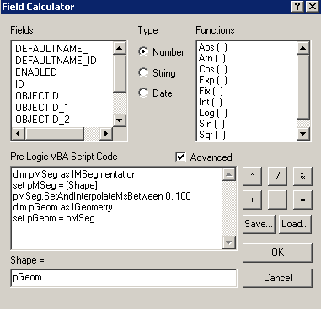
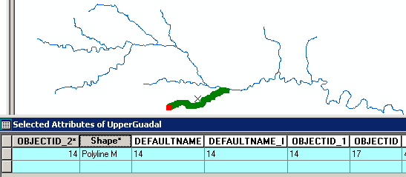
Setting Line Measure

Slide 25
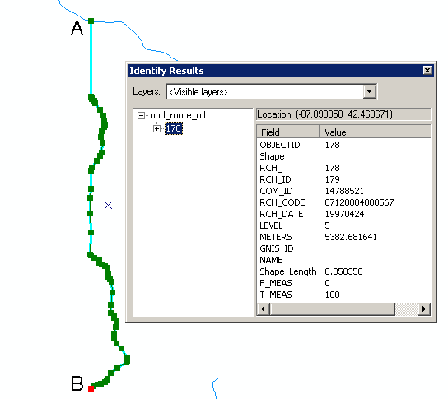
Proportional Aliasing
Distance is measured
Relative to the length
of the line as a percentage
0% – 100%

Slide 26
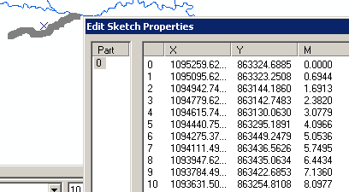
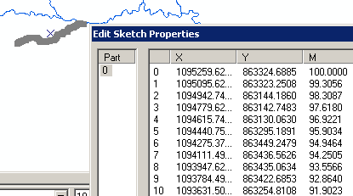
Setting Percent Measure
pMSeg.SetAndInterpolate
MsBetween 0, 100
pMSeg.SetAndInterpolate
MsBetween 100, 0
0 – 100 going upstream
0 – 100 going downstream

Slide 27
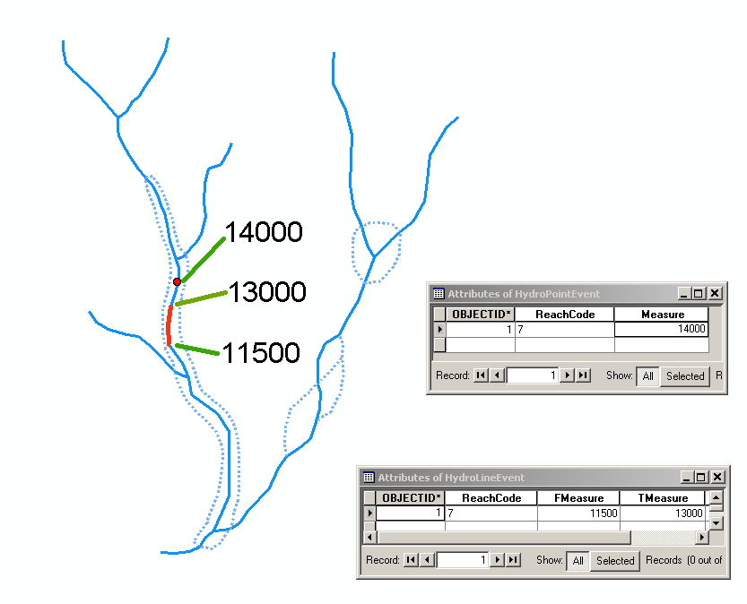
Point and Line Events

Slide 28
Some terminology
Hydrography – the mapping of water features
    Blue line features on topographic maps (streams, rivers, lakes,…)
    More generally, hydrography also includes the mapping of bathymetry and extent of estuaries and coastal waters
National Hydrography Dataset (NHD) – a data model for storing topographic map hydrography
  Medium resolution (1:100K) is complete for US
  High resolution (1:24K) is complete for most of the US
NHDPlus – a new data model integrating 1:100K resolution NHD with catchments and derived attributes from the National Elevation Dataset

Slide 29
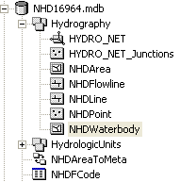
National Hydrography Dataset
Key feature classes
Five feature classes with
NHDFLowline built into
A geometric network
NHDPoint, NHDLine,
NHDArea are point, line
and area water features
on map apart from flowlines
and waterbodies

Slide 30
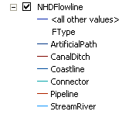
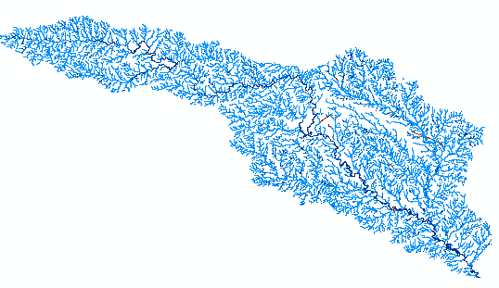
National Hydrography Dataset

Slide 31
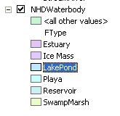
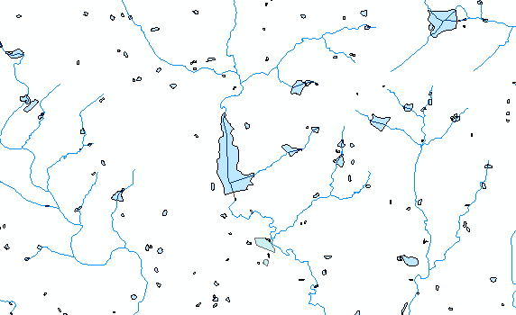
NHD Waterbody

Slide 32
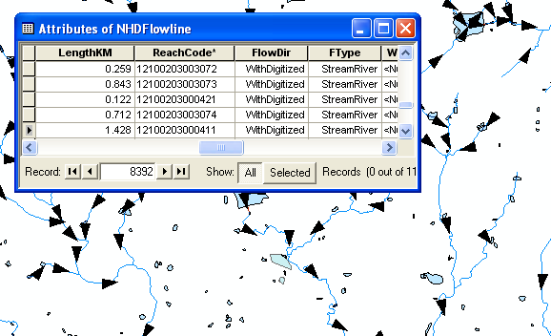
NHD Geometric Network

Slide 33
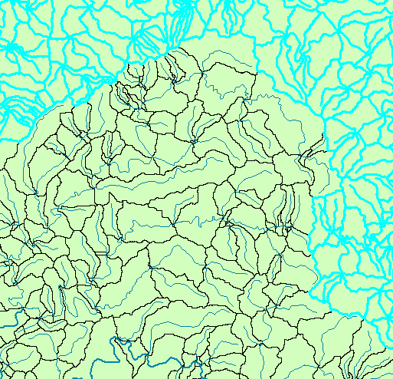
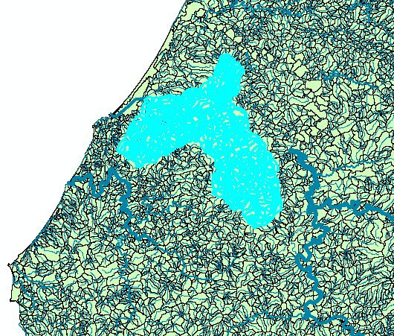
NHDPlus Reach Catchments ~ 3km²
Average reach length = 2km
2.3 million reaches for continental US
About 1000 reach catchments in each 8-digit HUC

Slide 34
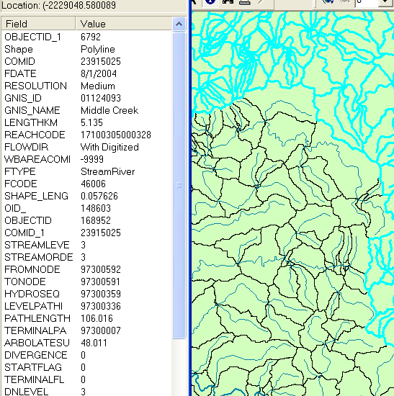
Reach Attributes
Slope
Elevation
Mean annual flow
  Corresponding velocity
Drainage area
% of upstream drainage area in different land uses
Stream order

Slide 35
Delivering on National Water Information Needs
David R. Maidment
Director, Center for Research in Water Resources
University of Texas at Austin
WIRADA Science Symposium
Melbourne, Australia
4 August 2011

Slide 36
Our Journey Begins…..
Melbourne Cup Day, November 2006
I was in Canberra doing a seminar jointly with Rob Vertessy about geospatial data for water
The Prime Minister met on this day in Canberra with the Premiers of all the States to confront the drought
The country was in crisis
The drought was already severe and its ultimate magnitude and duration were unknown
Action was needed!!!

Slide 37
What was the state of water knowledge in Australia at that time?
Science – Rich – a real legacy of historical investment in CSIRO, ANU and elsewhere
Modeling – Rich – CRC’s for Catchment Hydrology and eWater, and elsewhere
Information – Limited
  250m DEM
  No consistent digital blue line stream hydrography (ouch!!)
  37 separate stream gaging networks
AWRIS and WIRADA were prompted by these and other deficiencies in information

Slide 38
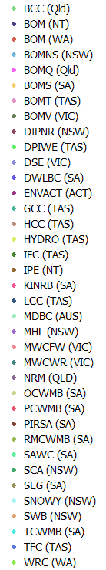
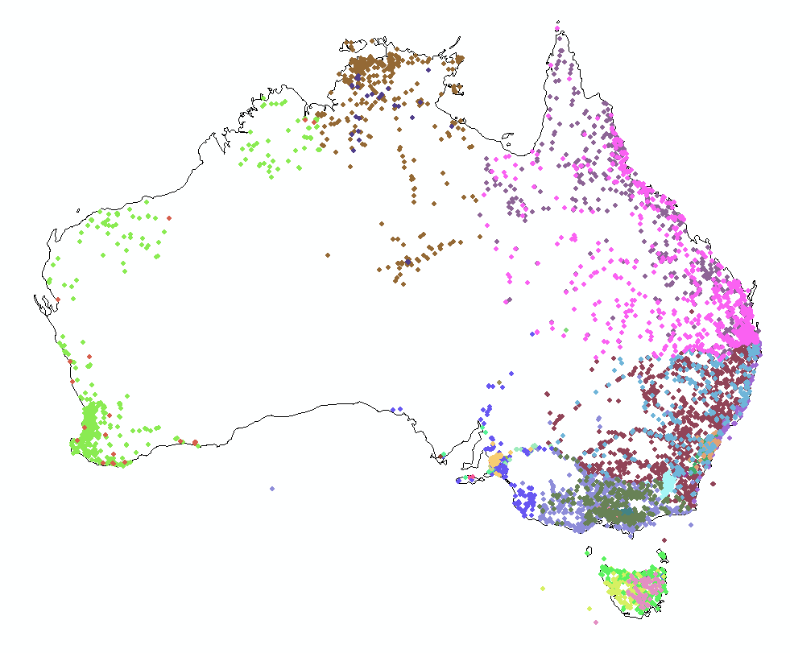
River Gage Networks
9079 gages in 37 networks
Average = 245 gages/network

Slide 39


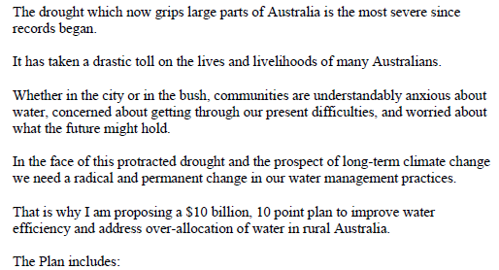
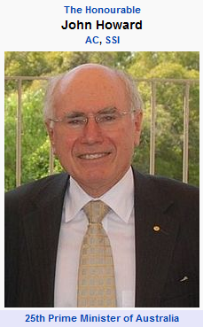

Some months pass…. then comes (Jan 2007)
http://www.nalwt.gov.au/files/national_plan_for_water_security.pdf

Slide 40
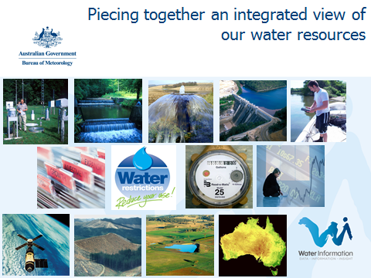
Australian Water Resources Information System (AWRIS)
Slide: Rob Vertessy

Slide 41
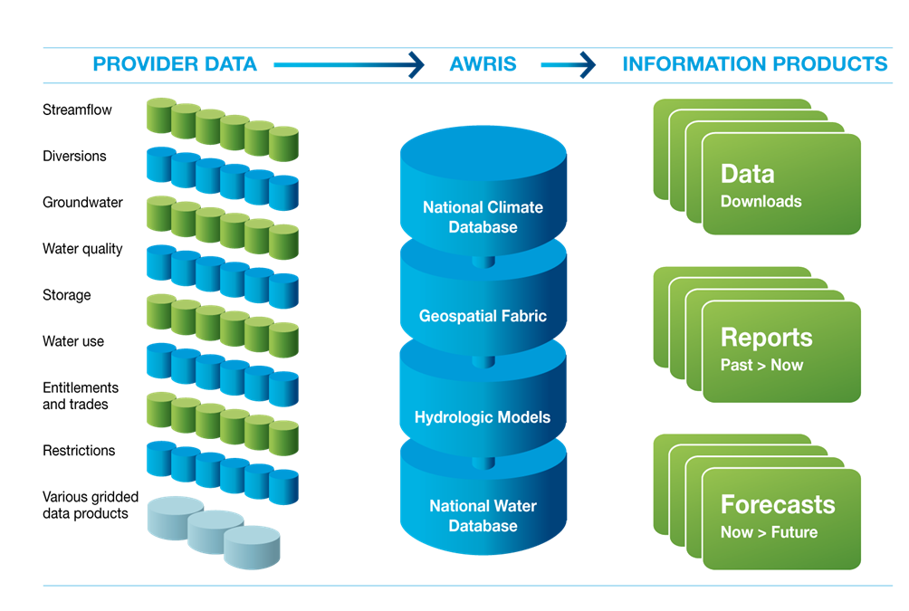
Components of AWRIS
Slide: Rob Vertessy, BoM
Notes:
41
41
AWRIS on a page.

Slide 42
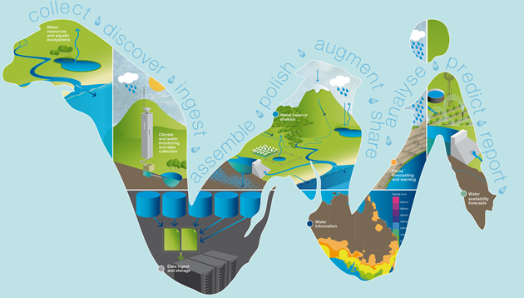
WIRADA (2008-2013)
Water Information Research and Development Alliance
CSIRO research program to support the AWRIS development being done by the Bureau of Meteorology
Slide: Rob Vertessy, BoM

Slide 43
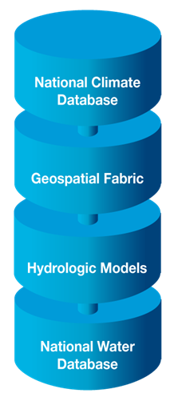
Three years in …..
What is the state of Water Information now?
Progress has been made in each of these four components
They are very different to one another
The challenge now is how to link them

Slide 44
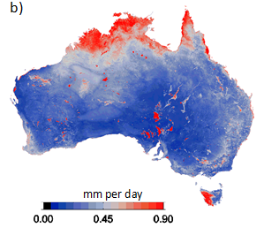
Australian National Climate Database
This is a core competency of the BoM
Augment with evaporation derived from remote sensing
Std Dev of 8 methods of estimating evaporation
Image: Albert van Dijk, CSIRO

Slide 45
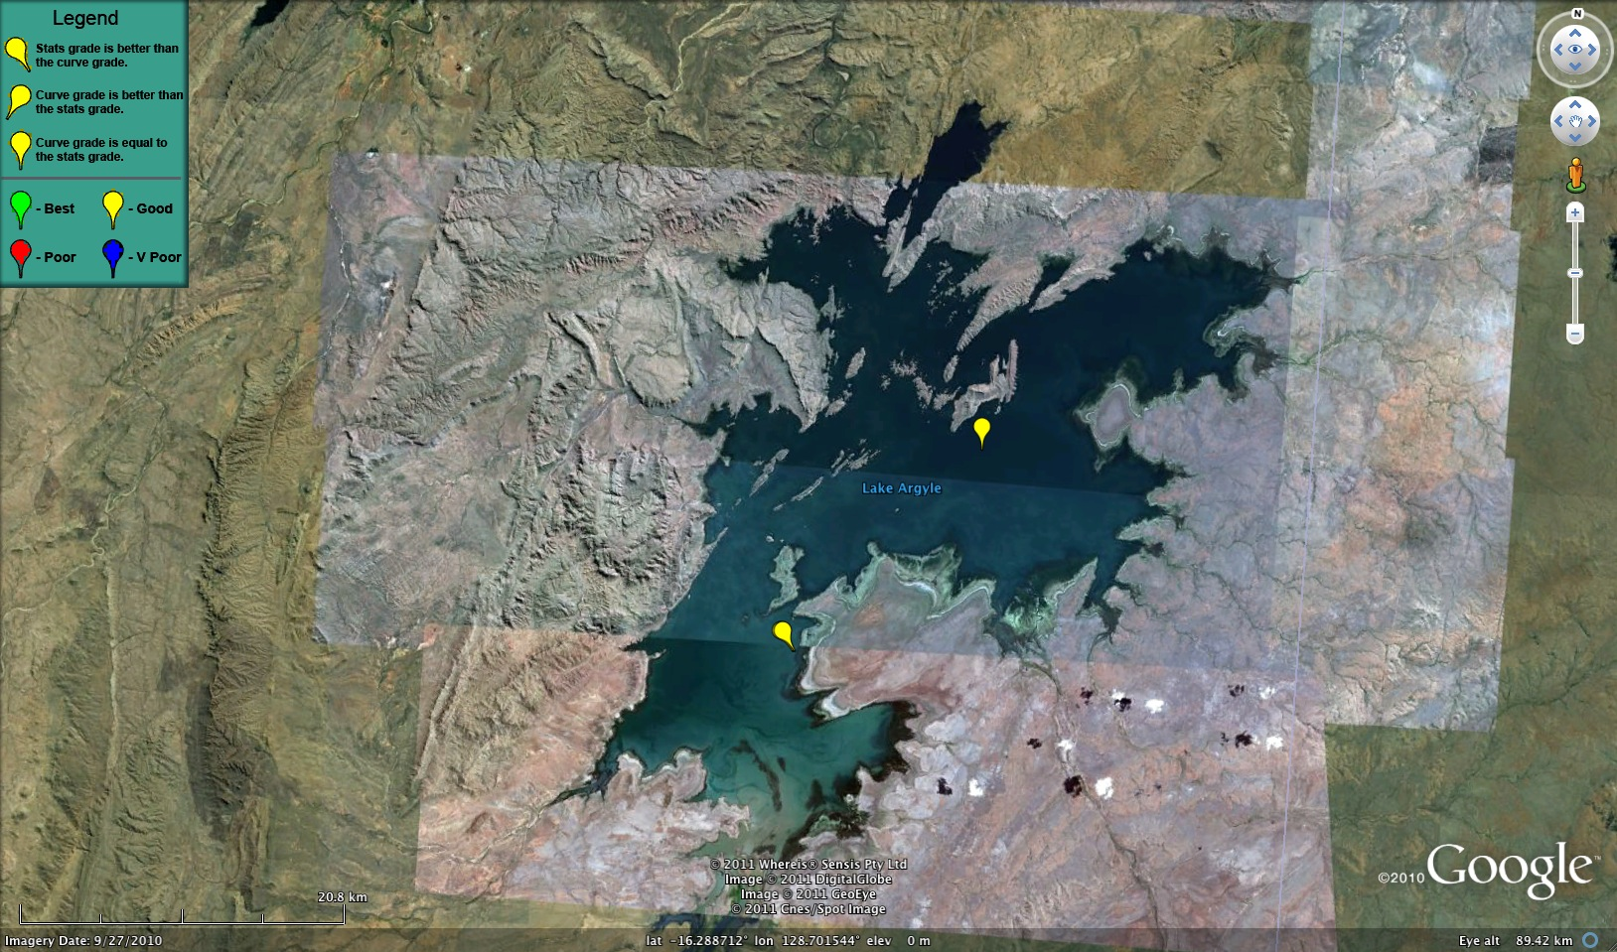
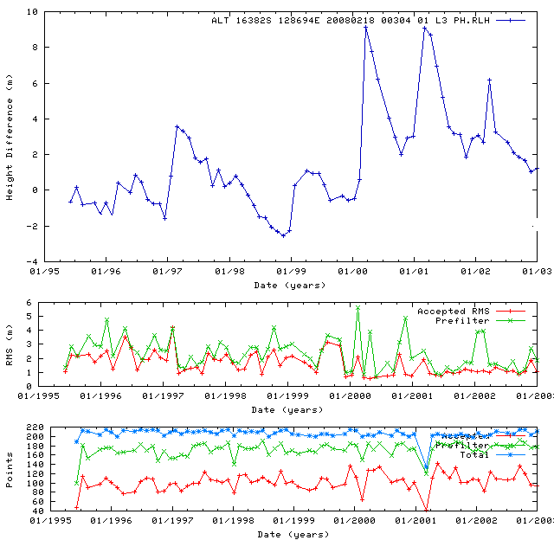





Lake Argyll – Remote Sensing as Time Series!
Lake timeseries plus statistics and curve-fiting analysis.
Slide: Philippa Berry, DeMontfort University

Slide 46
Australian Hydrological Geospatial Fabric
Four key constructs
  Cell to cell water movement on DEMs
  Line to Line water movement on networks
  Area flows to line (connect land and water systems – Reach Catchments)
  Area flows to point on line (Contracted Nodes and Catchments)

Slide 47


Slide 48

United States Experience with DEM Improvement
1990’s
5%
Error in delineated watershed area
0.5%
2000’s
1 arcsec: 30 m
3 arcsec: 90 m
DEM Cell Size

Slide 49



National Elevation Dataset for Australia
Existing
New
9 Arc Second – 250 m
1 Arc Second – 30 m
1 cell
81 cells
Two orders of magnitude improvement! Wow!
Images: John Gallant, CSIRO

Slide 50


National River Network for Australia
Line flows to Line
Geometric Network
Geometry model: Where am I? (x,y coordinates)
Logical model: Who am I connected to? (topology)
Addressing model: Where are things on me? (linear referencing)
Image: Elizabeth McDonald, BoM

Slide 51

A challenge: those messy Aussie rivers have lots of loops and branches
Image: Michael Hutchinson, ANU

Slide 52

A fundamental innovation:
Connecting the Cell to Cell and Line to Line Models
Flow divergences have multiple flow directions on a single DEM cell
Cell flows to Cell
Image and Research: Janet Stein, ANU

Slide 53


Reach Catchments
Every stream reach has a local drainage area
Area flows to Line
Image: Elizabeth McDonald, BoM
Fundamental connection between the water and land systems

Slide 54


Contracted Nodes and Catchments
A standardized tessellation of the landscape – one chosen among the infinite number of tessellations possible
Contracted Nodes
Contracted Catchments
Area flows to a point on a line
Contracted nodes persist through successive versions of the geofabric
Images: Elizabeth McDonald, BoM

Slide 55
Geofabric Summary
I’ve used test versions of these data – they work!
This enables water management to be built on a digital landscape rather than paper maps
Huge implications for all forms of water management in Australia
Large institutional and cultural change required to fully achieve benefits

Slide 56

Hydrologic Models
“I’m in hydrology heaven ……”
Long historical experience with catchment hydrology modeling in Australia (CRC for Catchment Hydrology)
AWRIS requires a transition to landscape hydrology modeling
  AWRA-L; AWRA-R, AWRA-G

Slide 57

Slide: Neil Viney, CSIRO

Slide 58
What I was thinking about on the plane
I was asked to address “Delivering on National Water Information Needs”
In hydrology, we’ve always thought of national information as being built up from state and local information
Question: to what degree is national hydrologic modeling informed by global information?
Answer: Yes, for climate drivers

Slide 59


W/m²
http://gewex-srb.larc.nasa.gov/

Slide 60


Assembly of lots and lots of time series from more than 200 organizations
Rain gages
River gages
A network of networks
Reservoir levels
Groundwater levels
Evaporation gages
Water Pumpage
Diversions

Slide 61

Slide: Brett Anderson, BoM

Slide 62

Slide: Brett Anderson, BoM

Slide 63

Slide: Brett Anderson, BoM

