Slide 1
Hydro Networks in GIS
Network model
Flow on Networks
Hydrologic networks
Linear referencing on networks
Some slides in this presentation were prepared by
Dr Francisco Olivera

Slide 2
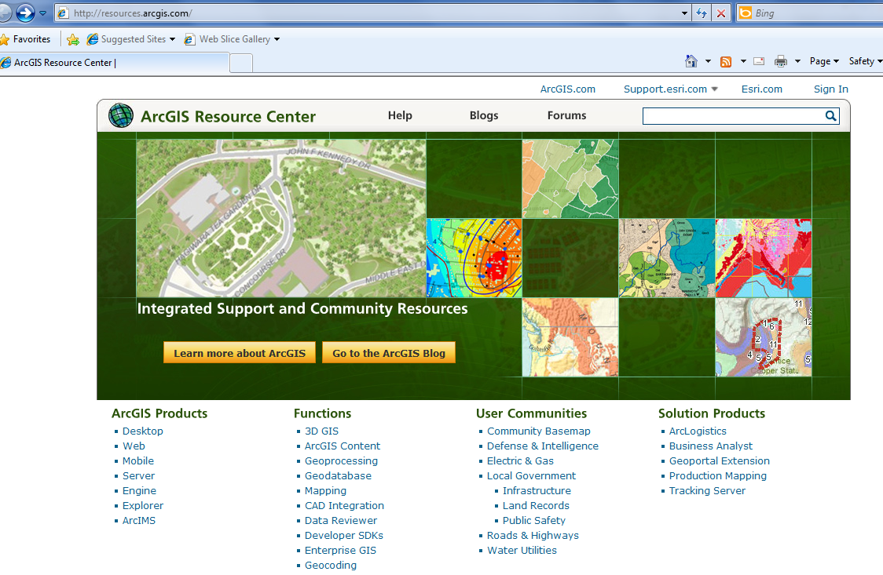
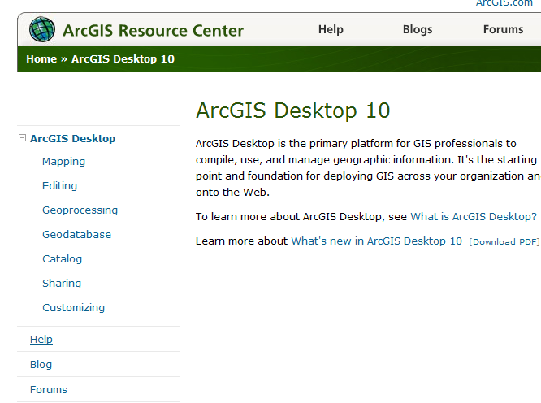
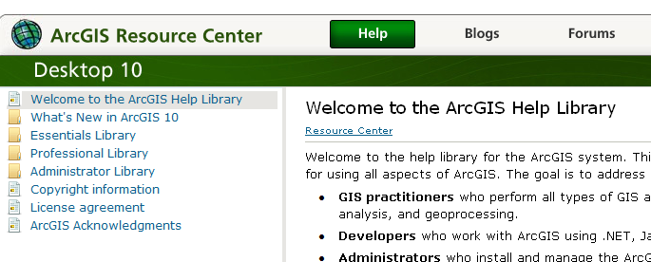
ArcGIS Resource Centers http://resources.arcgis/com
Getting to Readings in ArcGIS Resource Center Help for Desktop 10
Desktop
Help

Slide 3
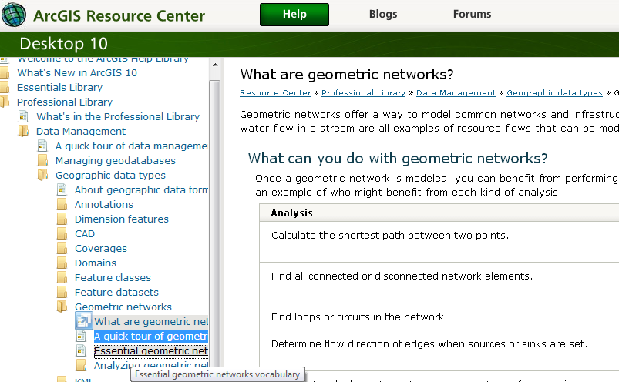
Reading (1)
ArcGIS Resource Center/Desktop 10/Help/Professional Library/Data Management/Geographic Data Types/Geometric Networks – What are geometric networks, A quick tour of geometric networks, Essential geometric networks
http://help.arcgis.com/en/arcgisdesktop/10.0/help/index.html#/What_are_geometric_networks/002r00000001000000/

Slide 4
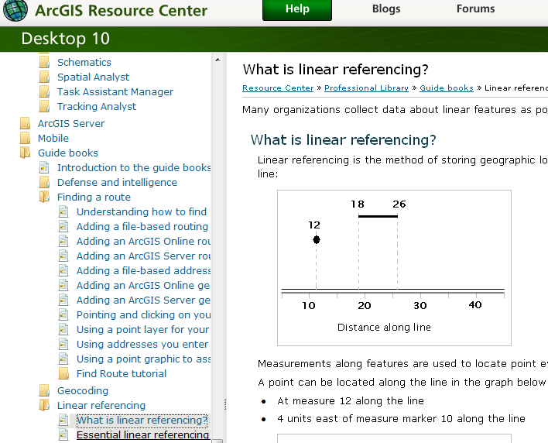
Reading (2)
ArcGIS Resource Center/ Desktop 10/Help/Professional Library/Guide books/Linear Referencing
- What is linear referencing; Essential linear referencing
http://help.arcgis.com/en/arcgisdesktop/10.0/help/index.html#/What_is_linear_referencing/003900000001000000/

Slide 5
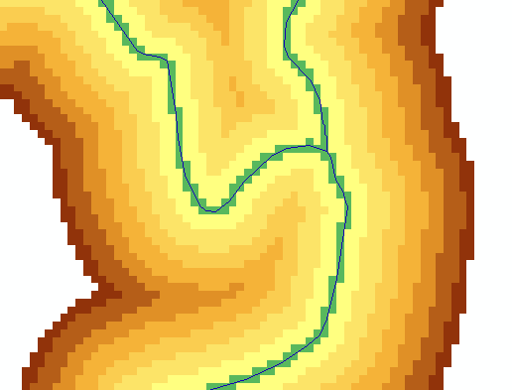
Key Concepts from Exercise 4
DEM Reconditioning as an example of quantitative raster analysis
Vector to Raster
Distance
Raster Calculation
Volume removed analysis
Subtract 10 at all stream grid cells
"smdem" - 10 * “flowLineReclas" - 0.02 * (500 - "distance") * ("distance" < 500)
500
500
Subtract an amount that tapers from 0.02*500=10 when distance is 0, to 0 when distance is 500 from stream
Only do taper when distance is less than 500, otherwise this is 0 and nothing is subtracted
10
10

Slide 6
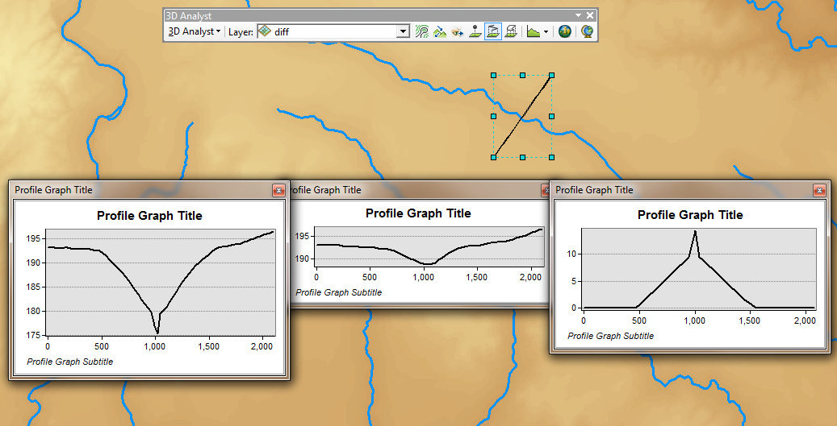
3D Analyst Profiles
smdem
diff
smrecon

Slide 7
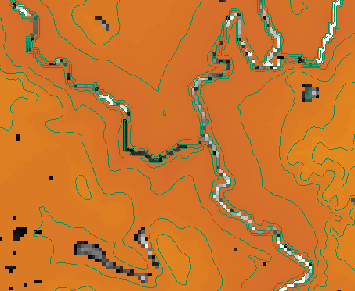
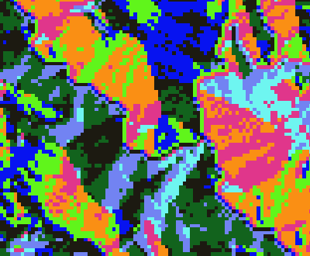
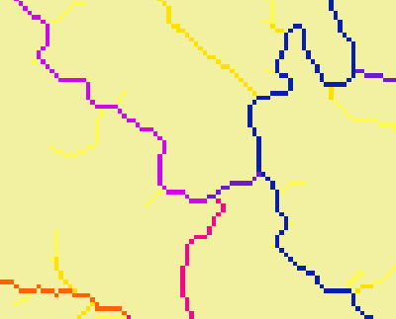
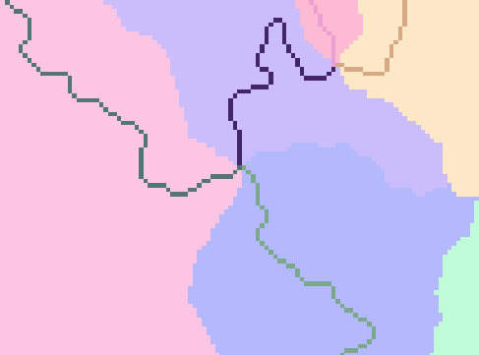
Construct the Analysis Layer
Fill
Flow Direction
Flow Accumulation
Stream Definition
Stream Links
Catchments

Slide 8
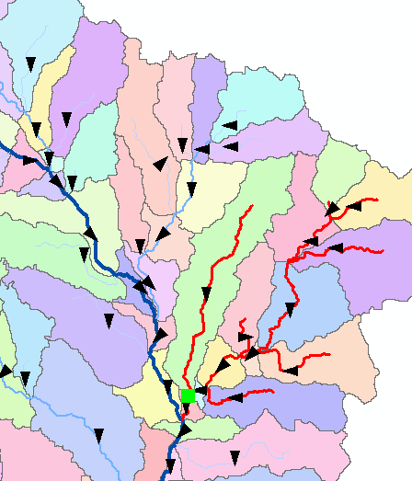
Convert to Vector
Vector streams
Vector catchments
Attribute feature with raster zonal statistics
Geometric Network
Tracing
Selection statistics

Slide 9
Raster to Vector Transition
During the last week, you have been dealing with the flow of water through the landscape based on the raster data structures
Today we are making a transition in which we are going to use vector network data to describe water pathways.
We will connect the land and water flow systems by attaching the catchments and watersheds derived from raster data processing to our vector networks

Slide 10
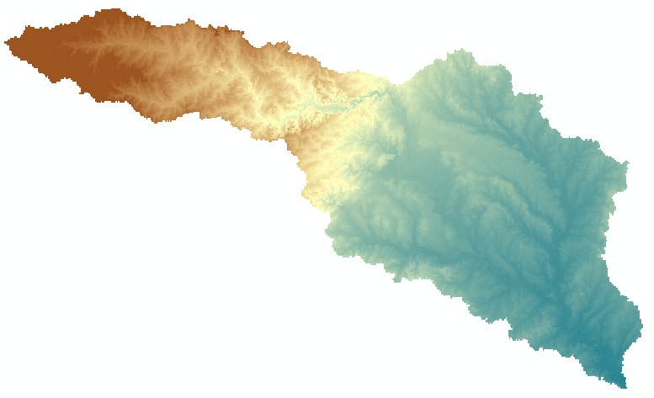
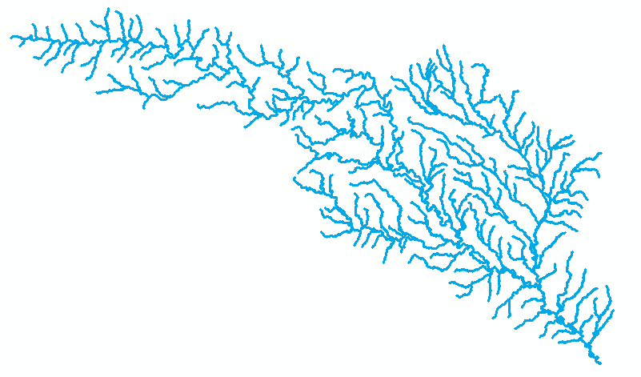
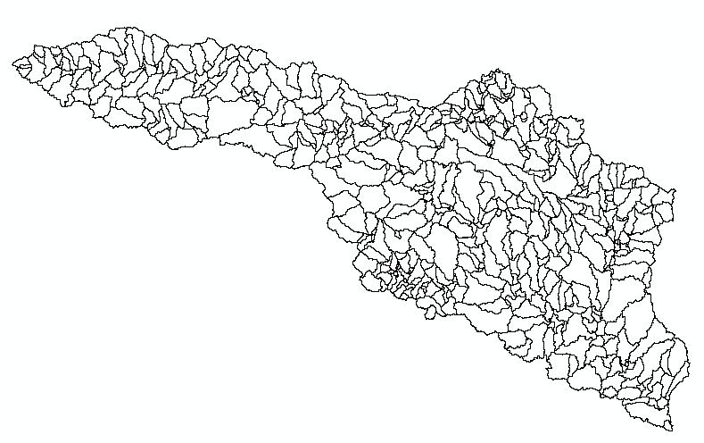
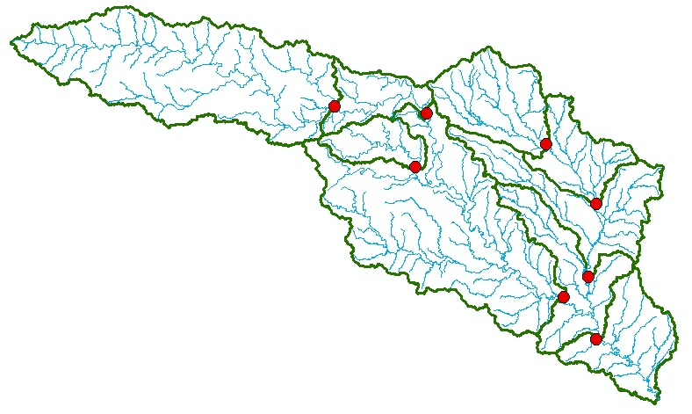
Four Key Concepts
Four key constructs
Cell to cell water movement on DEMs
Line to Line water movement on networks
Area flows to line (connect land and water systems – Reach Catchments)
Area flows to point on line (Watershed delineation from designated points)

Slide 11
Cell Flows to a Cell
Core concept of flow on digital elevation models

Slide 12
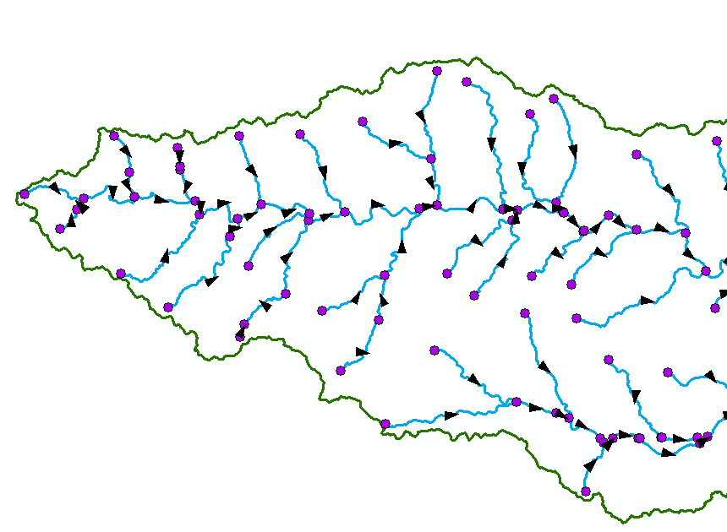
Line Flows to a Line
Geometric Network of NHDFlowlines

Slide 13
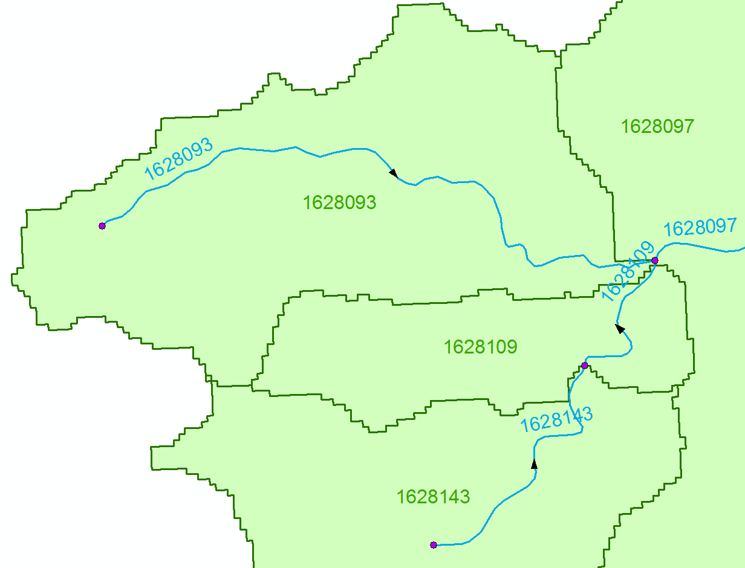
Area Flows to a Line
Reach Catchments from NHDPlus
Flowline and Catchment have the same COMID

Slide 14
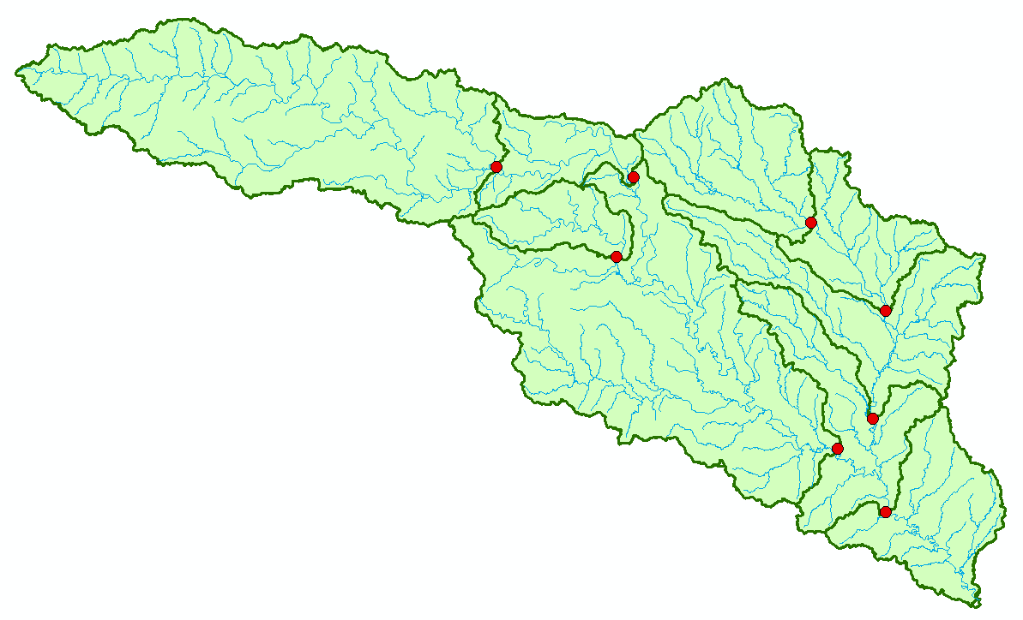
Area Flows to a Point on a Line
Watersheds for USGS Gages

Slide 15
Network Definition
A network is a set of edges and junctions that are topologically connected to each other.

Slide 16
Network Model in GIS
Three components
Geometric model: (x,y,z,m) coordinates of edges and junctions
Logical model: which edges are connected to what junctions
Addressing model: location on the network using measure

Slide 17
Edges and Junctions
Simple feature classes: points and lines
Network feature classes: junctions and edges
Edges can be
Simple: one attribute record for a single edge
Complex: one attribute record for several edges in a linear sequence
A single edge cannot be branched
No!!

Slide 18
Polylines and Edges

Slide 19
Junctions
Junctions exist at all points where edges join
If necessary they are added during network building (generic junctions)
Junctions can be placed on the interior of an edge e.g. stream gage
Any number of point feature classes can be built into junctions on a single network

Slide 20
Connectivity Table
J125
Junction
Adjacent Junction and Edge
J123 | J124, E1
J124 | J123, E1 | J125, E2 | J126, E3
J125 | J124, E2
J126 | J124, E3
E2
J124
E1
E3
J123
J126
This is the “Logical Network”

Slide 21
Build Network Tables
Establishes connectivity of Edge and Junction features
Enables tracing
Generates Generic Junctions
Geometric Network Wizard in ArcCatalog

Slide 22
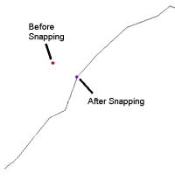
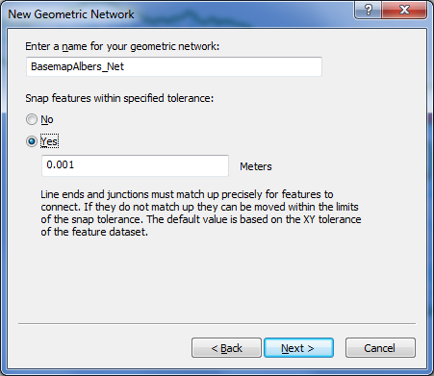
Snapping Features

Slide 23
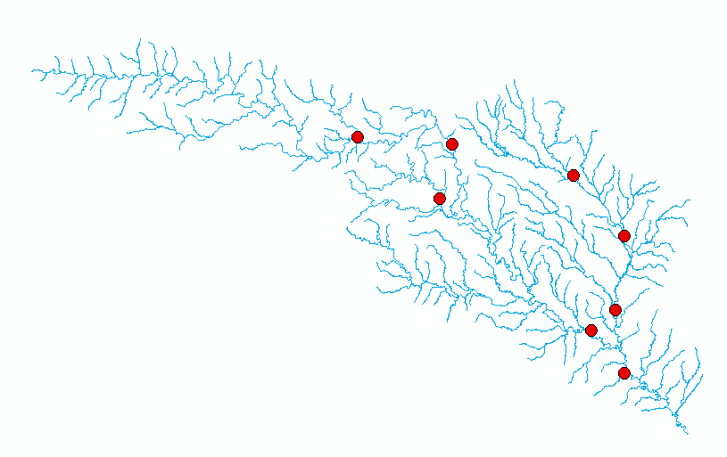
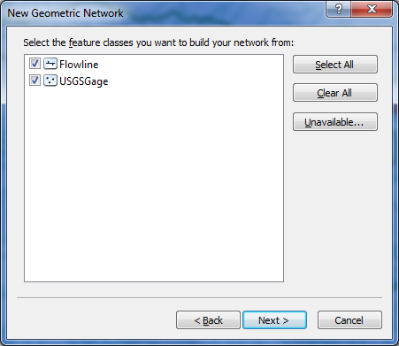

Slide 24
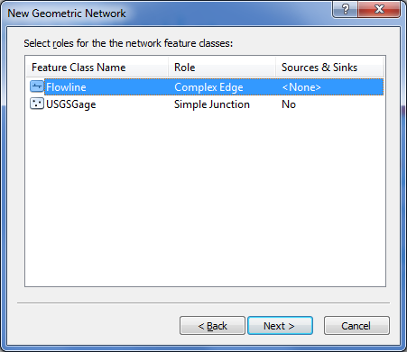
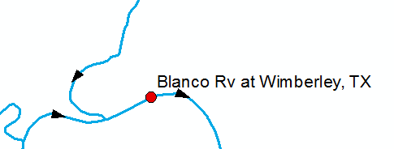
Network Sources and Sinks
Each junction
feature class
in a network can
have junctions
which are sources
or sinks for flow
Use complex edge so that junction can be interior to edge

Slide 25
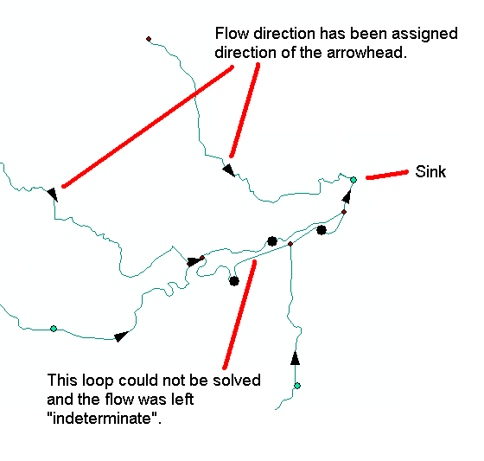
Flow to a sink

Slide 26
Flags

Slide 27
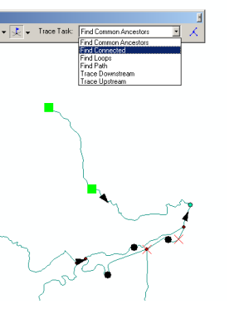
Trace Solvers

Slide 28
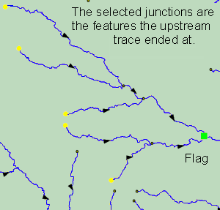
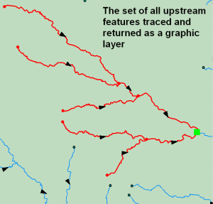
Upstream Trace Solvers

Slide 29
Summary Concepts
Four key constructs
Cell to cell water movement on DEMs
Line to Line water movement on networks
Area flows to line (connect land and water systems – Reach Catchments)
Area flows to point on line (Watershed delineation from designated points)

Slide 30
Summary Concepts (2)
A network is a connected set of points (junctions) and lines (edges) that supports tracing functions
Three data model components
Geographic (x,y,z)
Logical (point-line topology connections)
Addressing (position m along the line)

