Slide 1
GIS in Water Resources
Midterm Review 2011
David Maidment, David Tarboton and Ayse Irmak

Slide 2
Readings
Georeferencing and Coordinate Systems (Level 3) http://help.arcgis.com/en/arcgisdesktop/10.0/help/index.html#//00v20000000q000000.htm
Map Projections (Level 4) http://help.arcgis.com/en/arcgisdesktop/10.0/help/index.html#/What_are_map_projections/003r00000001000000/ )
Geographic information Elements: (Level 2) http://help.arcgis.com/en/arcgisdesktop/10.0/help/00v2/00v200000003000000.htm up to "Example: Representing surfaces"
Raster Data (Level 3) http://help.arcgis.com/en/arcgisdesktop/10.0/help/009t/009t00000002000000.htm Raster and Images, starting from "What is raster data" to end of "Raster dataset attribute tables" in "Fundamentals of raster data"
Slope http://www.ce.utexas.edu/prof/maidment/giswr2011/docs/Slope.pdf . (Level 4)
Hydrology tools (Level 5) http://help.arcgis.com/en/arcgisdesktop/10.0/help/009z/009z0000004w000000.htm to end of Hydrologic analysis sample applications in the Hydrology toolset concepts
Geometric Networks (Level 2) http://help.arcgis.com/en/arcgisdesktop/10.0/help/index.html#/What_are_geometric_networks/002r00000001000000/
Linear Referencing (Level 2) http://help.arcgis.com/en/arcgisdesktop/10.0/help/index.html#/What_is_linear_referencing/003900000001000000/

Slide 3
Review for Midterm Exam
Location on the Earth
ArcGIS as a Geographic Information System
Working with Raster Data
Working with Vector Data

Slide 4
Review for Midterm Exam
Location on the Earth
ArcGIS as a Geographic Information System
Working with Raster Data
Working with Vector Data
Georeferencing and Coordinate Systems (Level 3) http://help.arcgis.com/en/arcgisdesktop/10.0/help/index.html#//00v20000000q000000.htm
Map Projections (Level 4) http://help.arcgis.com/en/arcgisdesktop/10.0/help/index.html#/What_are_map_projections/003r00000001000000/ )

Slide 5
Latitude and Longitude on a Spherical Earth
Longitude line (Meridian)
N
W
E
S
Range: 180ºW - 0º - 180ºE
Latitude line (Parallel)
N
W
E
S
(0ºN, 0ºE)
Equator, Prime Meridian
Range: 90ºS - 0º - 90ºN

Slide 6
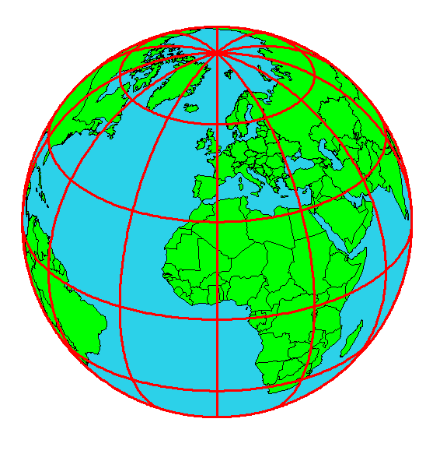
Origin of Geographic Coordinates
Equator
(0,0)
Prime Meridian

Slide 7

Length on Meridians and Parallels (Spherical Earth)
(Lat, Long) = (φ, λ)
Length on a Meridian:
AB = R_{e} Δφ
(same for all latitudes)
R
Δλ
D
30 N
R
C
R_{e}
Δφ
B
0 N
R_{e}
Length on a Parallel:
CD = R Δλ = R_{e} Δλ Cos φ
(varies with latitude)
A

Slide 8
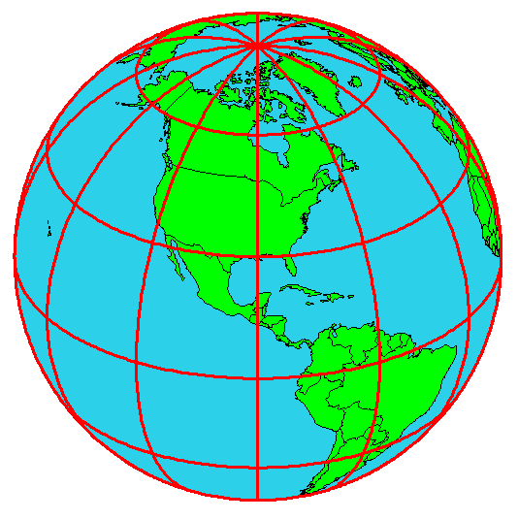
Example: What is the length of a 1º increment along
on a meridian and on a parallel at 30N, 90W?
Radius of the earth = 6370 km.
Solution:
A 1º angle has first to be converted to radians
π radians = 180 º, so 1º = π/180 = 3.1416/180 = 0.0175 radians
For the meridian, ΔL = R_{e} Δφ = 6370 ∗ 0.0175 = 111 km
For the parallel, ΔL = R_{e} Δλ Cos φ
= 6370 ∗ 0.0175 ∗ Cos 30
= 96.5 km
Parallels converge as poles are approached

Slide 9
Curved Earth Distance on a Spherical Earth
Z
Shortest distance is along a “Great Circle” (from A to B)
A “Great Circle” is the intersection of a sphere with a plane going through its center.
3. Great circle distance is Rα, where R=6378.137 km²
B
A
α
•
Y
X
Ref: Meyer, T.H. (2010), Introduction to Geometrical and Physical Geodesy, ESRI Press, Redlands, CA, p. 108

Slide 10
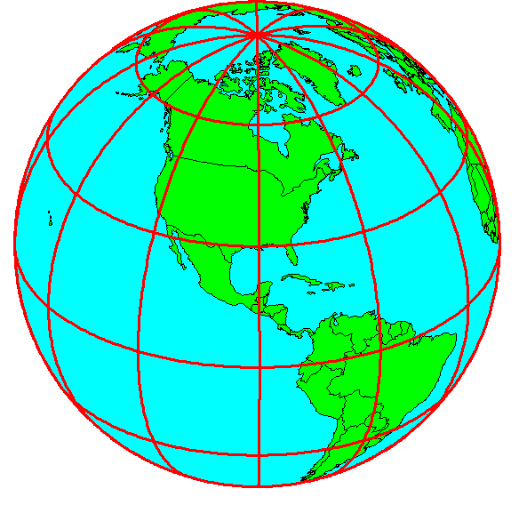
Shape of the Earth
It is actually a spheroid, slightly larger in radius at the equator than at the poles
We think of the
earth as a sphere

Slide 11
Ellipse
An ellipse is defined by:
Focal length = ε
Distance (F1, P, F2) is
constant for all points
on ellipse
When ε = 0, ellipse = circle
Z
b
O
a
X
F₁
ε
ε
F₂
For the earth:
Major axis, a = 6378 km
Minor axis, b = 6357 km
Flattening ratio, f = (a-b)/a
~ 1/300
P

Slide 12
Ellipsoid or Spheroid
Rotate an ellipse around an axis
Z
b
O
a
Y
a
X
Rotational axis

Slide 13
Horizontal Earth Datums
An earth datum is defined by an ellipse and an axis of rotation
NAD27 (North American Datum of 1927) uses the Clarke (1866) ellipsoid on a non geocentric axis of rotation
NAD83 (NAD,1983) uses the GRS80 ellipsoid on a geocentric axis of rotation
WGS84 (World Geodetic System of 1984) uses GRS80, almost the same as NAD83

Slide 14
Definition of Latitude, φ
m
S
p
O
n
φ
q
r
(1) Take a point S on the surface of the ellipsoid and define there the tangent plane, mn
(2) Define the line pq through S and normal to the
tangent plane
(3) Angle pqr which this line makes with the equatorial
plane is the latitude φ, of point S

Slide 15
Cutting Plane of a Meridian
P
Prime Meridian
Equator
Meridian
plane

Slide 16
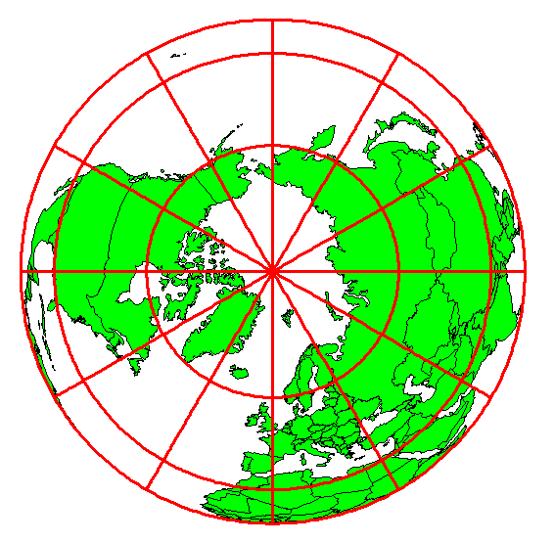
Definition of Longitude, λ
λ = the angle between a cutting plane on the prime meridian
and the cutting plane on the meridian through the point, P
180°E, W
-150°
150°
-120°
120°
90°W
(-90 °)
90°E
(+90 °)
-60°
P
λ
-60°
-30°
30°
0°E, W

Slide 17
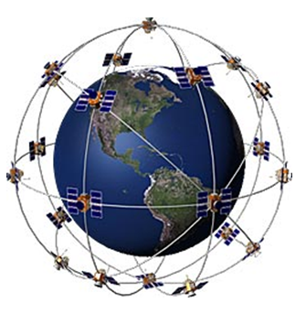
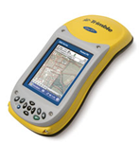
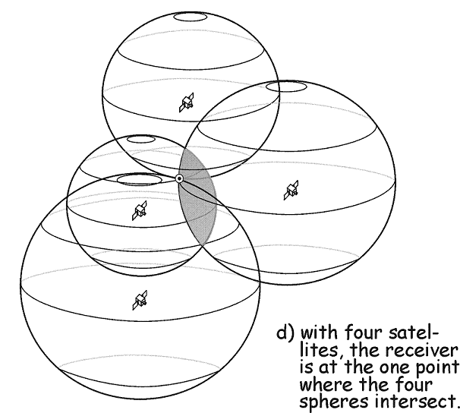
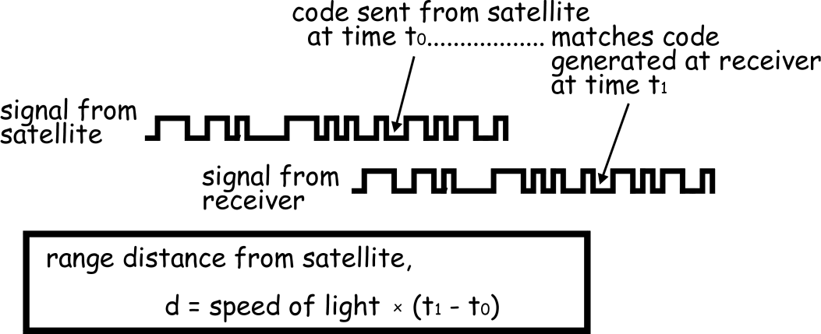
Global Positioning Systems
Distance to four satellites gives (x,y,z)
Notes:
If we then make a measurement from a third satellite and find that we're 13,000 miles from that one, that narrows our position down even further, to the two points where the 13,000 mile sphere cuts through the circle that's the intersection of the first two spheres.
So by ranging from three satellites we can narrow our position to just two points in space.
To decide which one is our true location we could make a fourth measurement. But usually one of the two points is a ridiculous answer (either too far from Earth or moving at an impossible velocity) and can be rejected without a measurement.
A fourth measurement does come in very handy for another reason however, but we'll tell you about that later

Slide 18
Representations of the Earth
Geoid is a surface of constant
gravitational potential
~ Sea surface
Ellipsoid
Earth surface
Geoid

Slide 19
Definition of Elevation
Elevation Z
P
z = z_{p}
•
z = 0
Land Surface
Mean Sea level = Geoid
Elevation is measured from the Geoid

Slide 20
Vertical Earth Datums
A vertical datum defines elevation, z
NGVD29 (National Geodetic Vertical Datum of 1929)
NAVD88 (North American Vertical Datum of 1988)
The National Elevation Dataset is in the NAVD88 datum
Heights are “elevation above datum”

Slide 21
Geodesy and Map Projections
Geodesy - the shape of the earth and definition of earth datums
Map Projection - the transformation of a curved earth to a flat map
Coordinate systems - (x,y) coordinate systems for map data

Slide 22
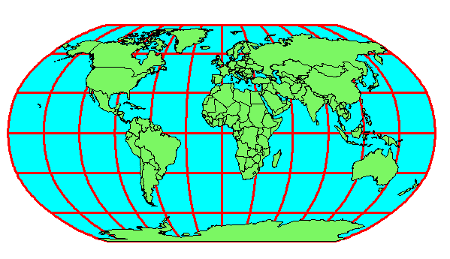
Earth to Globe to Map
Map Scale:
Map Projection:
Representative Fraction
Globe distance
Earth distance
Scale Factor
Map distance
Globe distance
=
=
(e.g. 1:24,000)
(e.g. 0.9996)

Slide 23
Types of Projections
Conic (Albers Equal Area, Lambert Conformal Conic) - good for East-West land areas
Cylindrical (Transverse Mercator) - good for North-South land areas
Azimuthal (Lambert Azimuthal Equal Area) - good for global views

Slide 24
Projections Preserve Some
Earth Properties
Area - correct earth surface area (Albers Equal Area) important for mass balances
Shape - local angles are shown correctly (Lambert Conformal Conic)
Direction - all directions are shown correctly relative to the center (Lambert Azimuthal Equal Area)
Distance - preserved along particular lines
Some projections preserve two properties

Slide 25
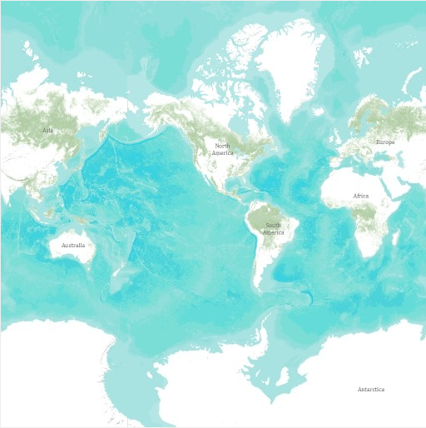
Web Mercator Projection used for cached basemaps

Slide 26
Coordinate Systems
A planar coordinate system is defined by a pair
of orthogonal (x,y) axes drawn through an origin
Y
Origin
X
(x_{o},y_{o})
(φ_{o},λ_{o})

Slide 27
State Plane Coordinate System
Defined for each State in the United States
East-West States (e.g. Texas) use Lambert Conformal Conic, North-South States (e.g. California) use Transverse Mercator
Texas has five zones (North, North Central, Central, South Central, South) to give accurate representation
Greatest accuracy for local measurements

Slide 28
Review for Midterm Exam
Location on the Earth
ArcGIS as a Geographic Information System
Working with Raster Data
Working with Vector Data
Geographic information Elements: (Level 2) http://help.arcgis.com/en/arcgisdesktop/10.0/help/00v2/00v200000003000000.htm up to "Example: Representing surfaces"

Slide 29
Data Model
Conceptual Model – a set of concepts that describe a subject and allow reasoning about it
Mathematical Model – a conceptual model expressed in symbols and equations
Data Model – a conceptual model expressed in a data structure (e.g. ascii files, Excel tables, …..)
Geographic Data Model – a conceptual model for describing and reasoning about the world expressed in a GIS database

Slide 30
Linking Geography and Attributes
GIS has a one to one association between a geographic feature and a record in an attribute table.
Geographic coordinates
Tabular attributes

Slide 31
Themes or Data Layers
Vector data: point, line or polygon features
How each of these features could be represented using vector or raster?

Slide 32
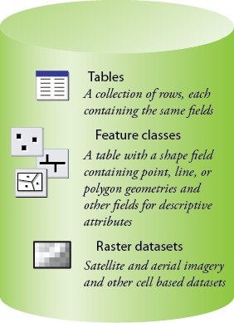
Common Geospatial Information Types
Image: Michael Zeiler, ESRI

Slide 33
Raster and Vector Data
Raster data are described by a cell grid, one value per cell
Vector
Raster
Point
Line
Zone of cells
Polygon

Slide 34
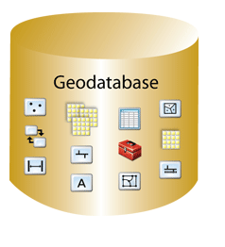
Geodatabase – a store for all types of geospatial information

Slide 35
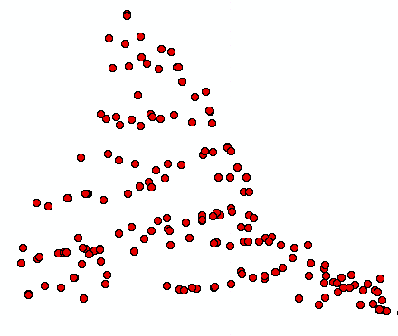
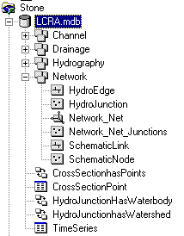
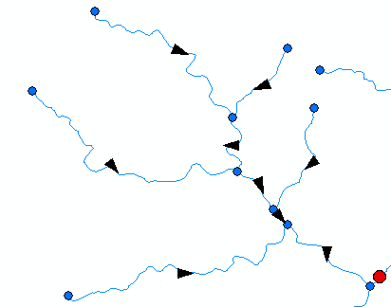
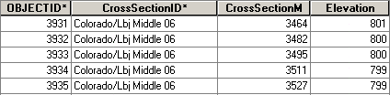
ArcGIS Geodatabase (what is in a geodatabase)
Workspace
Geodatabase
Feature Dataset
Feature Class
Geometric
Network
Relationship
Object Class

Slide 36
Geodesy, Map Projections and Coordinate Systems
Geodesy - the shape of the earth and definition of earth datums
Map Projection - the transformation of a curved earth to a flat map
Coordinate systems - (x,y) coordinate systems for map data
Spatial Reference = Datum +
Projection +
Coordinate system

Slide 37
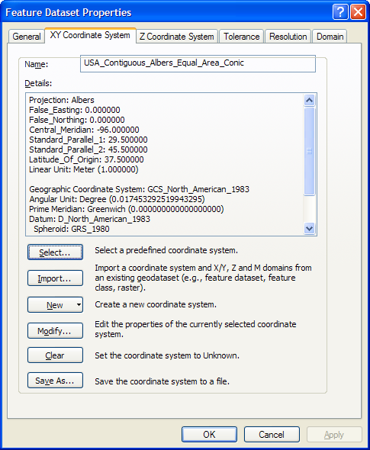
ArcGIS Spatial Reference Frames
Defined for a feature dataset in ArcCatalog
XY Coordinate System
  Projected
  Geographic
Z Coordinate system
Tolerance
Resolution
M Domain

Slide 38
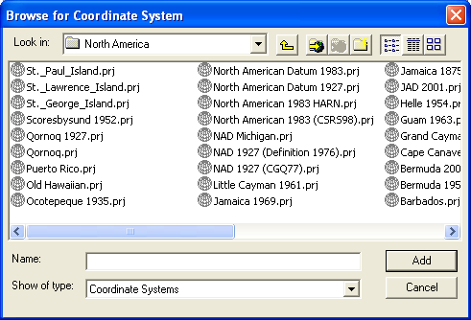
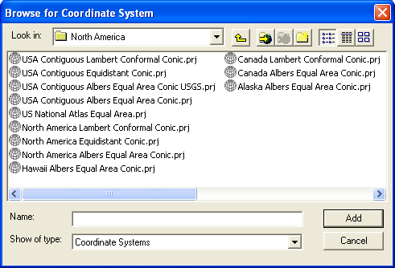
Horizontal Coordinate Systems
Geographic coordinates (decimal degrees)
Projected coordinates (length units, ft or meters)

Slide 39
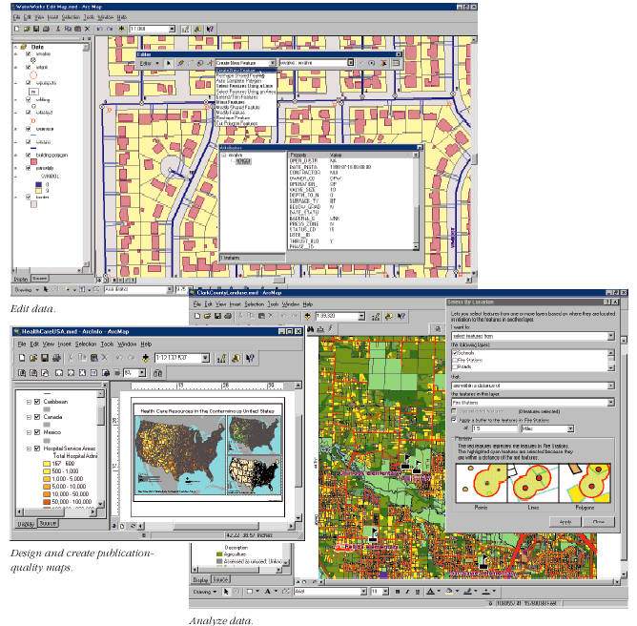
Key ArcGIS Software Components
ArcMap
ArcCatalog
ArcToolbox
Extensions
Geoprocessing

Slide 40
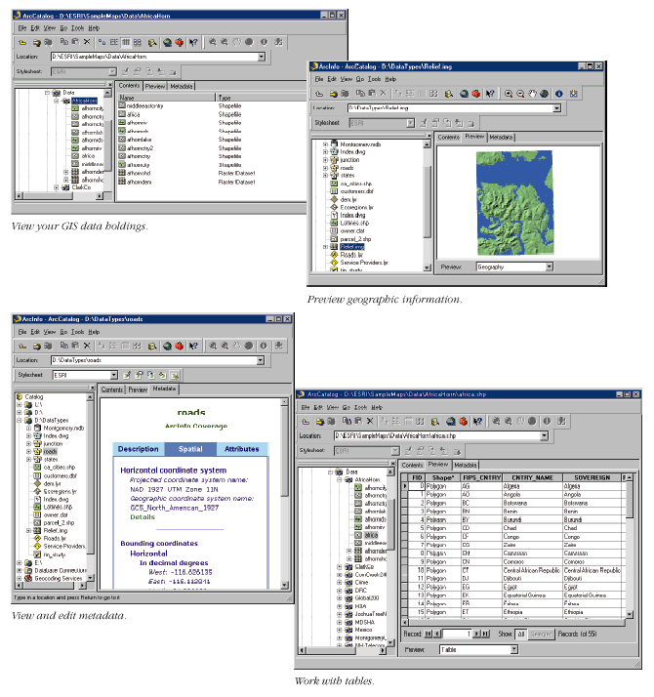
Arc Catalog
Graphical
previews
View data
(like Windows Explorer)
Tables
Metadata

Slide 41
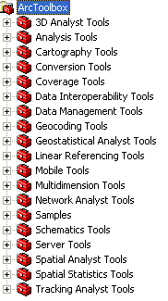
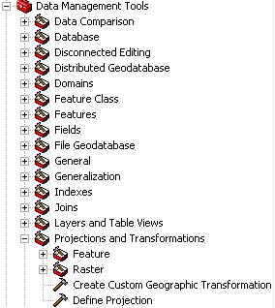
Arc Toolbox
Tools for commonly used tasks
Map Projections

Slide 42
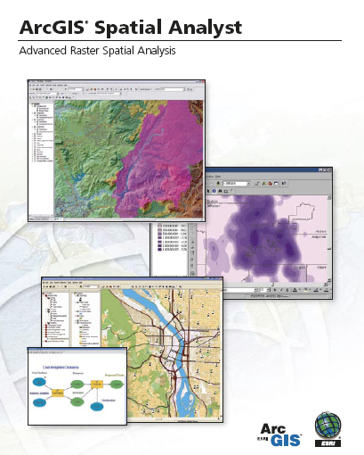
Spatial Analyst
Analysis of land surface terrain as a grid
Key means of defining drainage areas and connectivity to stream network

Slide 43
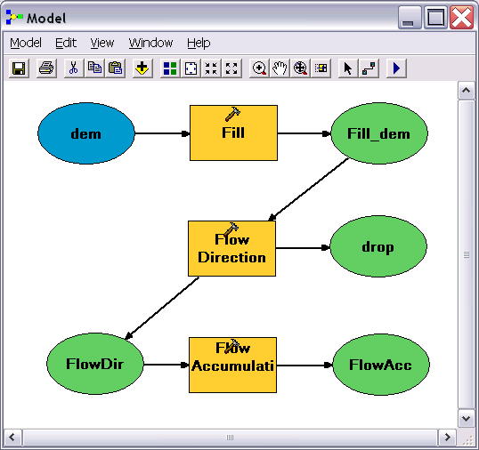
Geo-Processing
Toolbox tools linked together using the model builder to automate data processing

Slide 44



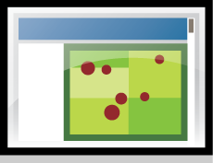











Web-centered GIS
ArcGIS
Online

Slide 45









An Integrated Systems Approach
ArcGIS
Online
ArcGIS
Desktop
ArcGIS
Server

Slide 46
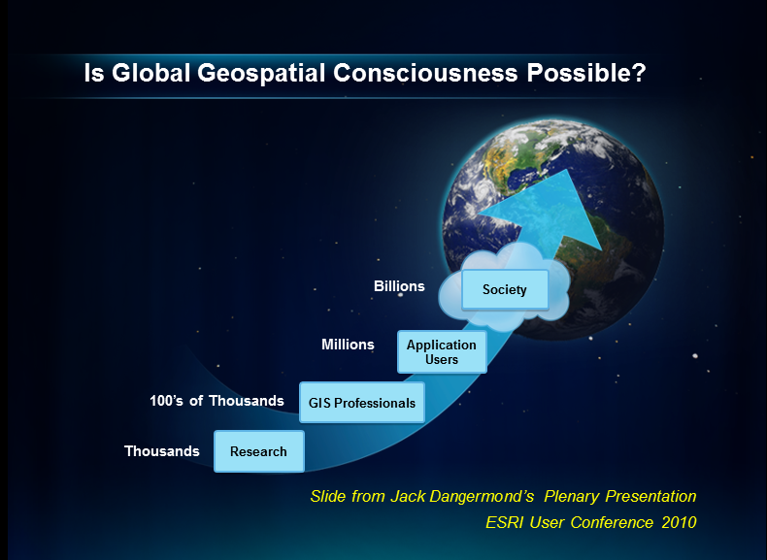

Slide 47
Review for Midterm Exam
Location on the Earth
ArcGIS as a Geographic Information System
Working with Raster Data
Working with Vector Data
Raster Data (Level 3) http://help.arcgis.com/en/arcgisdesktop/10.0/help/009t/009t00000002000000.htm Raster and Images, starting from "What is raster data" to end of "Raster dataset attribute tables" in "Fundamentals of raster data"
Slope http://www.ce.utexas.edu/prof/maidment/giswr2011/docs/Slope.pdf . (Level 4)
Hydrology tools (Level 5) http://help.arcgis.com/en/arcgisdesktop/10.0/help/009z/009z0000004w000000.htm to end of Hydrologic analysis sample applications in the Hydrology toolset concepts

Slide 48
f(x,y)
y
x

Slide 49
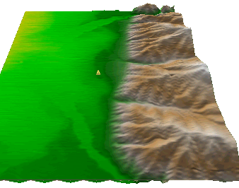
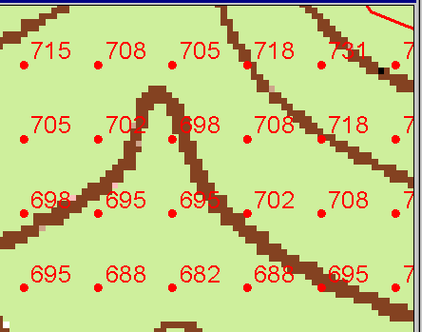
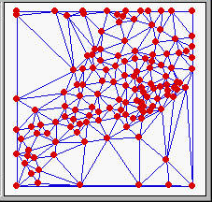
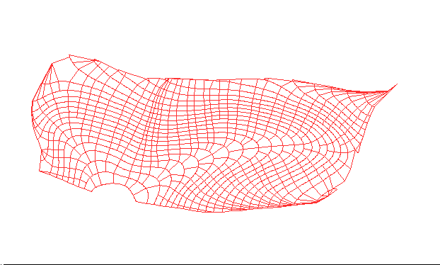
Numerical representation of a spatial surface (field)
Grid
TIN
Contour and flowline

Slide 50
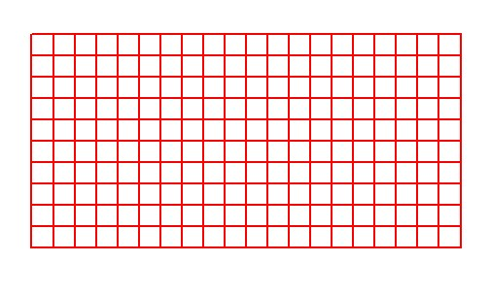
Grid Datasets
Cellular-based data structure composed of square cells of equal size arranged in rows and columns.
The grid cell size and extent (number of rows and columns), as well as the value at each cell have to be stored as part of the grid definition.
Number of columns
Cell size
Number of rows

Slide 51
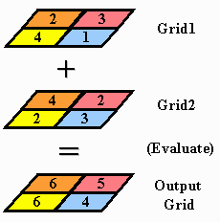
Raster Calculator
Cell by cell evaluation of mathematical functions

Slide 52



Nearest Neighbor Resampling with Cellsize Maximum of Inputs
100 m
40
50
55
40-0.5*4 = 38
42
47
43
55-0.5*6 = 52
38
52
42
44
41
42-0.5*2 = 41
41-0.5*4 = 39
41
39
150 m
4
6
2
4

Slide 53
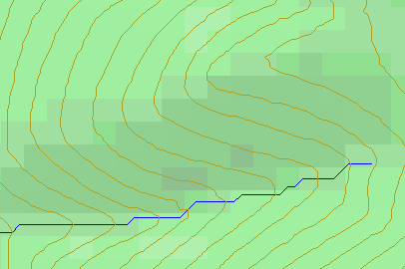
Topographic Slope
Defined or represented by one of the following
  Surface derivative ∇z
  Vector with x and y components
  Vector with magnitude (slope) and direction (aspect)

Slide 54
DEM Based Watershed and Stream Network Delineation Steps
DEM Reconditioning/Burning in Streams
Fill Sinks
Eight direction pour point model to evaluate flow directions
Flow accumulation
Threshold stream network definition
Stream segmentation
Watershed delineation
Raster to vector conversion of streams and watersheds

Slide 55
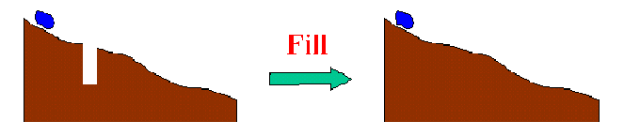
Filling in the Pits
DEM creation results in artificial pits in the landscape
A pit is a set of one or more cells which has no downstream cells around it
Unless these pits are filled they become sinks and isolate portions of the watershed
Pit filling is first thing done with a DEM

Slide 56
Identifying and Removing Pits/Sinks in a DEM
Contains pits
Filled
5 | 5 | 4 | 5 | 5 | 5 | 5 | 3 | 5 | 5
6 | 6 | 5 | 6 | 6.1 | 5 | 6 | 6 | 6 | 6
7 | 7 | 6 | 7 | 7 | 4 | 7 | 5 | 7 | 7
9 | 9 | 8 | 9 | 9 | 3.9 | 9 | 5 | 9 | 9
11 | 11 | 10 | 11 | 11 | 11 | 11 | 9 | 11 | 11
12 | 12 | 8 | 12 | 12 | 12 | 12 | 10 | 12 | 12
13 | 12 | 7 | 12 | 13 | 13 | 13 | 11 | 13 | 13
14 | 7 | 6 | 11 | 14 | 14 | 14 | 12 | 14 | 14
15 | 7 | 7 | 8 | 9 | 15 | 15 | 8 | 15 | 15
15 | 8 | 8 | 8 | 7 | 16 | 16 | 14 | 16 | 16
15 | 11 | 9 | 11 | 11 | 17 | 17 | 17 | 17 | 17
15 | 15 | 8 | 15 | 15 | 18 | 18 | 15 | 18 | 18
5 | 5 | 4 | 5 | 5 | 5 | 5 | 3 | 5 | 5
6 | 6 | 5 | 6 | 6.1 | 5 | 6 | 6 | 6 | 6
7 | 7 | 6 | 7 | 7 | 4 | 7 | 5 | 7 | 7
9 | 9 | 8 | 9 | 9 | 3.9 | 9 | 5 | 9 | 9
11 | 11 | 10 | 11 | 11 | 11 | 11 | 9 | 11 | 11
12 | 12 | 8 | 12 | 12 | 12 | 12 | 10 | 12 | 12
13 | 12 | 7 | 12 | 13 | 13 | 13 | 11 | 13 | 13
14 | 7 | 6 | 11 | 14 | 14 | 14 | 12 | 14 | 14
15 | 7 | 7 | 8 | 9 | 15 | 15 | 8 | 15 | 15
15 | 8 | 8 | 8 | 7 | 16 | 16 | 14 | 16 | 16
15 | 11 | 9 | 11 | 11 | 17 | 17 | 17 | 17 | 17
15 | 15 | 8 | 15 | 15 | 18 | 18 | 15 | 18 | 18
5 | 5 | 4 | 5 | 5 | 5 | 5 | 3 | 5 | 5
6 | 6 | 5 | 6 | 6.1 | 5 | 6 | 6 | 6 | 6
7 | 7 | 6 | 7 | 7 | 4 | 7 | 5 | 7 | 7
9 | 9 | 8 | 9 | 9 | 3.9 | 9 | 5 | 9 | 9
11 | 11 | 10 | 11 | 11 | 11 | 11 | 9 | 11 | 11
12 | 12 | 8 | 12 | 12 | 12 | 12 | 10 | 12 | 12
13 | 12 | 7 | 12 | 13 | 13 | 13 | 11 | 13 | 13
14 | 7 | 6 | 11 | 14 | 14 | 14 | 12 | 14 | 14
15 | 7 | 7 | 8 | 9 | 15 | 15 | 8 | 15 | 15
15 | 8 | 8 | 8 | 7 | 16 | 16 | 14 | 16 | 16
15 | 11 | 9 | 11 | 11 | 17 | 17 | 17 | 17 | 17
15 | 15 | 8 | 15 | 15 | 18 | 18 | 15 | 18 | 18
5 | 5 | 4 | 5 | 5 | 5 | 5 | 3 | 5 | 5
6 | 6 | 5 | 6 | 6.1 | 5 | 6 | 6 | 6 | 6
7 | 7 | 6 | 7 | 7 | 4 | 7 | 6 | 7 | 7
9 | 9 | 8 | 9 | 9 | 3.9 | 9 | 6 | 9 | 9
11 | 11 | 10 | 11 | 11 | 11 | 11 | 9 | 11 | 11
12 | 12 | 9 | 12 | 12 | 12 | 12 | 10 | 12 | 12
13 | 12 | 9 | 12 | 13 | 13 | 13 | 11 | 13 | 13
14 | 9 | 9 | 11 | 14 | 14 | 14 | 12 | 14 | 14
15 | 9 | 9 | 9 | 9 | 15 | 15 | 12 | 15 | 15
15 | 9 | 9 | 9 | 9 | 16 | 16 | 14 | 16 | 16
15 | 11 | 9 | 11 | 11 | 17 | 17 | 17 | 17 | 17
15 | 15 | 8 | 15 | 15 | 18 | 18 | 15 | 18 | 18
A pit is a set of one or more cells which has no downstream cells around it.

Slide 57
Hydrologic Slope
- Direction of Steepest Descent
30
30
67
56
49
67
56
49
52
48
37
52
48
37
58
55
22
58
55
22
Slope:

Slide 58
Eight Direction Pour Point Model
32
64
128
16
1
8
4
2
Water flows in the direction of steepest descent

Slide 59
Flow Accumulation Grid.
Area draining in to a grid cell
0
0
0
0
0
0
0
0
0
0
0
2
2
2
0
0
2
2
2
0
0
0
10
0
1
0
0
1
0
10
1
0
0
14
0
1
0
0
0
14
0
4
1
19
1
0
4
1
1
19
Flow Accumulation > Threshold
ArcHydro Page 72

Slide 60
Watershed Draining to Outlet

Slide 61
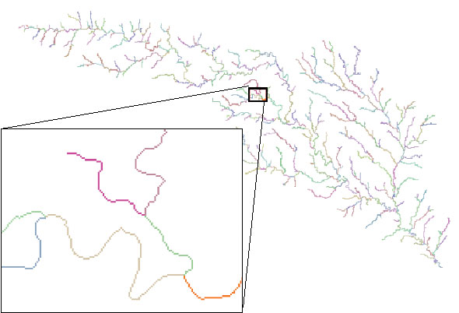
Stream links grid for the San Marcos subbasin
201
172
202
203
206
204
209
Each link has a unique identifying number

Slide 62
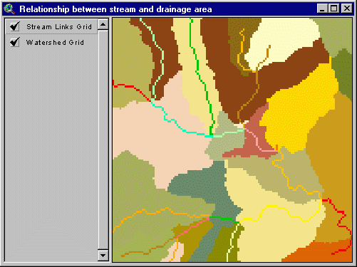
Catchments for Stream Links
Same Cell Value

Slide 63
Review for Midterm Exam
Location on the Earth
ArcGIS as a Geographic Information System
Working with Raster Data
Working with Vector Data
Geometric Networks (Level 2) http://help.arcgis.com/en/arcgisdesktop/10.0/help/index.html#/What_are_geometric_networks/002r00000001000000/
Linear Referencing (Level 2) http://help.arcgis.com/en/arcgisdesktop/10.0/help/index.html#/What_is_linear_referencing/003900000001000000/

Slide 64
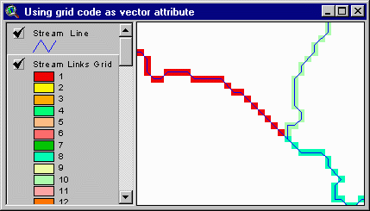
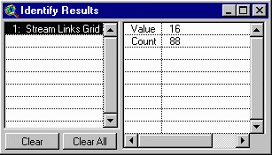
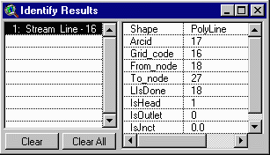
Vectorized Streams Linked Using Grid Code to Cell Equivalents
Vector
Streams
Grid
Streams

Slide 65
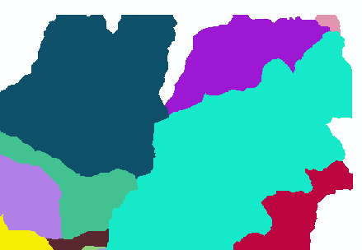
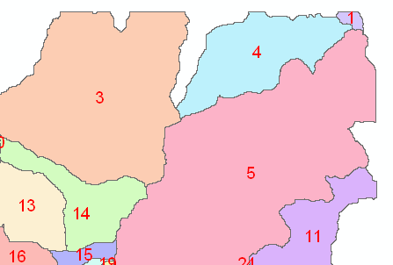
Raster Zones and Vector Polygons
One to one connection
Raster pixel value
Catchment Grid_code
4
3
5
Raster Zones
Vector Polygons

Slide 66
Relationship
A relationship is an association or link between two objects in a database.
A relationship can exist between spatial objects (features in feature classes), non-spatial objects (objects in object classes), or between spatial and non-spatial objects.

Slide 67
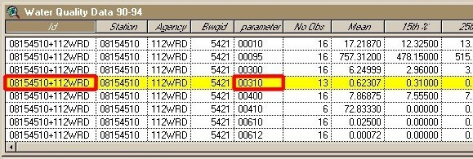
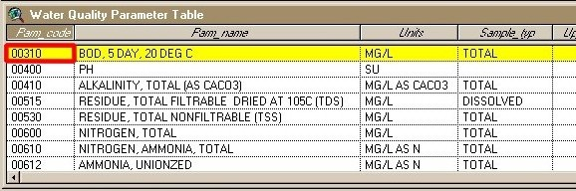
Relationship
Relationship between non-spatial objects
Water
Quality
Data
Water
Quality
Parameters

Slide 68
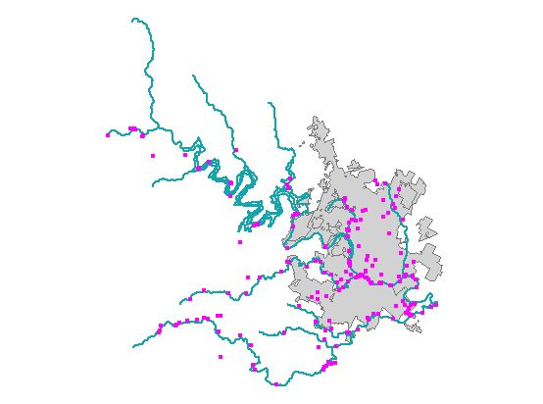
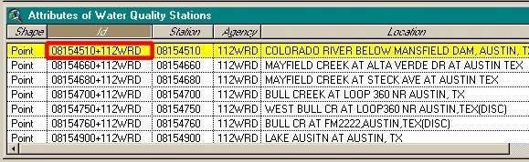
Relationship
Relationship between spatial and non-spatial objects
Water quality data
(non-spatial)
Measurement station
(spatial)

Slide 69
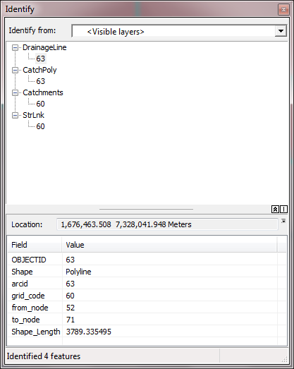
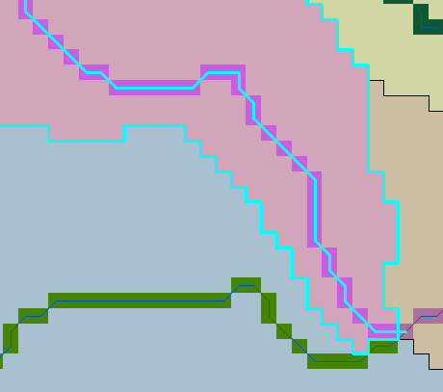
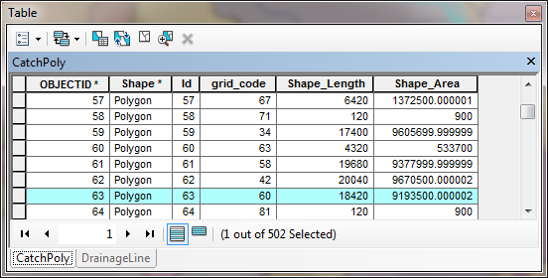
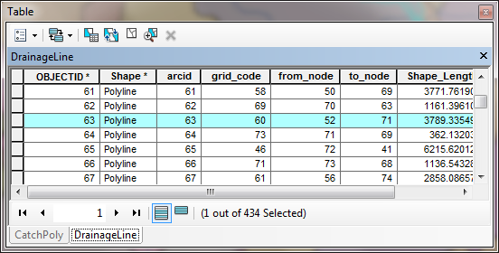
Relationships linking Catchments and Drainage Lines

Slide 70



Zonal Average of Raster over Subwatershed joined to Subwatershed table
Join

Slide 71

Catchment, Watershed, Subwatershed.
Subwatersheds
Catchments
Watershed
Watershed outlet points may lie within the interior of a catchment, e.g. at a USGS stream-gaging site.

Slide 72

Hydro Networks in GIS
Network Definition
A network is a set of edges and junctions that are topologically connected to each other.

Slide 73
Edges and Junctions
Simple feature classes: points and lines
Network feature classes: junctions and edges
Edges can be
  Simple: one attribute record for a single edge
  Complex: one attribute record for several edges in a linear sequence
A single edge cannot be branched
No!!

Slide 74
Connectivity Table
p. 132 of Modeling our World
J125
Junction
Adjacent Junction and Edge
J123 | J124, E1
J124 | J123, E1 | J125, E2 | J126, E3
J125 | J124, E2
J126 | J124, E3
E2
J124
E1
E3
J123
J126
This is the “Logical Network”

Slide 75

Network Tracing on the Guadalupe Basin

Slide 76

Linear Referencing
Where are we on a line?

Slide 77




Data Sources for GIS in Water Resources
National Hydro Data Programs
National Elevation Dataset
(NED)
National Hydrography Dataset
(NHD)
What is it?
What does it contain?
What is the GIS format?
Where would it be obtained
NED-Hydrology
Watershed Boundary Dataset

Slide 78


National River Network for Australia
Line flows to Line
Geometric Network
Geometry model: Where am I? (x,y coordinates)
Logical model: Who am I connected to? (topology)
Addressing model: Where are things on me? (linear referencing)
Image: Elizabeth McDonald, BoM

Slide 79


Reach Catchments
Every stream reach has a local drainage area
Area flows to Line
Image: Elizabeth McDonald, BoM
Fundamental connection between the water and land systems

Slide 80

A challenge: those messy Aussie rivers have lots of loops and branches
Image: Michael Hutchinson, ANU

Slide 81




Four Key Concepts
Four key constructs
  Cell to cell water movement on DEMs
  Line to Line water movement on networks
  Area flows to line (connect land and water systems – Reach Catchments)
  Area flows to point on line (Watershed delineation from designated points)

Slide 82

Cell Flows to a Cell
Core concept of flow on digital elevation models

Slide 83


Line Flows to a Line
Geometric Network of NHDFlowlines

Slide 84

Area Flows to a Line
Reach Catchments from NHDPlus
Flowline and Catchment have the same COMID

Slide 85

Area Flows to a Point on a Line
Watersheds for USGS Gages

