Slide 1
The Schematic Processor
Presented by Dr. Tim Whiteaker
The University of Texas at Austin
18 October, 2011

Slide 2
Outline
Background – Arc Hydro
Schematic Processor
Use Case – Bacterial loading

Slide 3
Linking GIS and Water Resources
Water
Resources
GIS

Slide 4
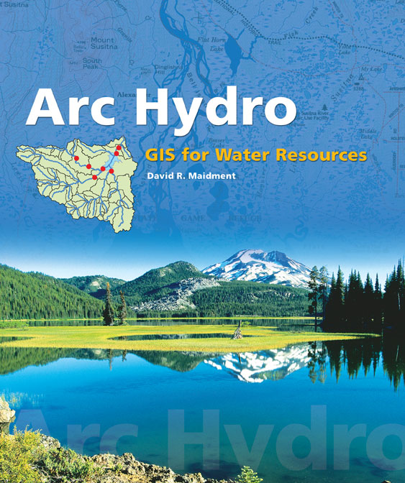
Arc Hydro: GIS for Water Resources
Published in 2002, now in revision for Arc Hydro II
Arc Hydro
  An ArcGIS data model for water resources
  Arc Hydro toolset for implementation
  Framework for linking hydrologic simulation models
The Arc Hydro data model and
application tools are in the public
domain
Notes:
Notes:
Industrial partners: ESRI, Danish Hydraulic Institute, Camp,Dresser and McKee, Dodson and Associates
Government partners:
Federal: EPA, USGS, Corps of Engineers (Hydrologic Engineering Center)
State: Texas Natural Resource Conservation Commission, Texas Water Development Board
Local: Lower Colorado River Authority, City of Austin, Dept of Watershed Protection
Academic Partners: University of Texas, Brigham Young University, Utah State University

Slide 5
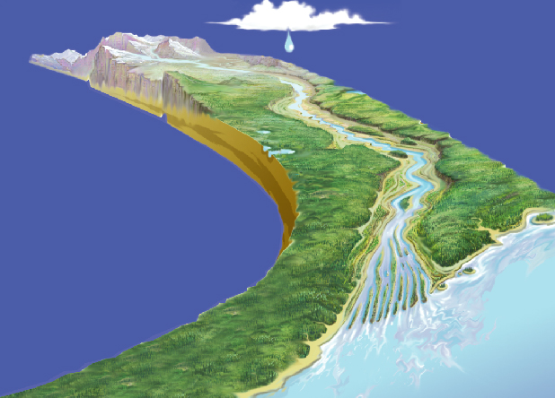
What is a hydrologic data model
Booch et al. defined a model: “a simplification of reality created to better understand the system being created”
Objects
Aquifer
Stream
Well
Catchment
R.M. Hirsch, USGS

Slide 6
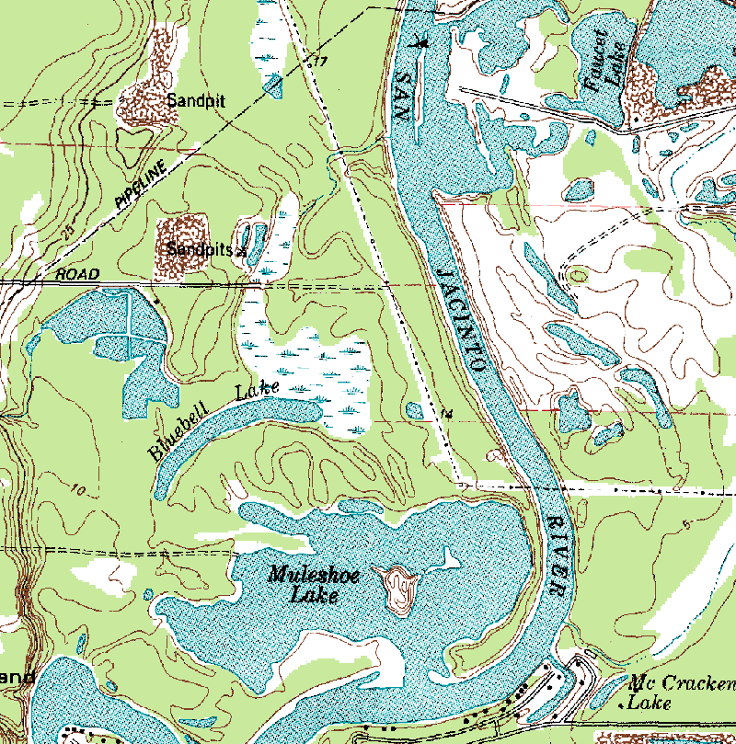
Arc Hydro—Hydrography
The blue lines on maps

Slide 7
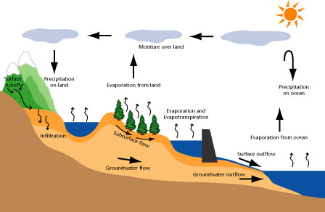
Arc Hydro—Hydrology
The movement of water through the hydrologic system

Slide 8
What’s in Arc Hydro
Drainage
Network
Flow
Hydro Features
Time
Time Series
Hydrography
Channel

Slide 9
What makes Arc Hydro different?
ArcGIS: All features have a unique ObjectID
within a feature class.
Arc Hydro: All features have a unique HydroID
within a geodatabase.
HydroID to ID relationships
link features and help to trace water movement.

Slide 10
HydroID Relationships
Watershed
HydroID - 23
JunctionID - 7
HydroJunction
HydroID - 7
NextDownID - 8
HydroJunction
HydroID - 8

Slide 11
What makes Arc Hydro different?
Arc Hydro connects space and time:
hydro features are linked to time series.
TimeSeries
Value - 35 cfs
Time - May 7, 2011
FeatureID - 23
Flow
HydroID
Time
Time Series
Hydro Features

Slide 12
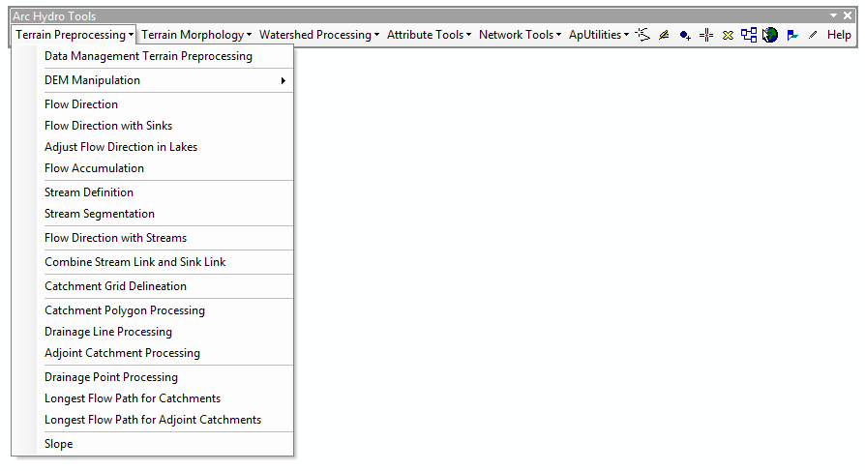
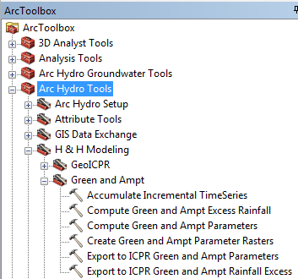
Arc Hydro Tools
Dozens of tools for hydrologic
data development and analysis
…including schematic network creation

Slide 13
Schematic networks represent connectivity
1) watersheds and streams
2) stream nodes
3) stream links
4) watershed centroids
5) watershed to stream
6) wetland

Slide 14
We can move things through the network…
Node
Bacterial Input
Link
Direction of Flow
Bacterial Input
Decay
…simulating processes along the way

Slide 15
We process values with receiving and passing behaviors
Incremental value, i
Link or Node
Received value(s), r
Receiving behavior
Total value, t
Passing behavior
Passed value, p
t = f(r,i)
p = g(t)

Slide 16
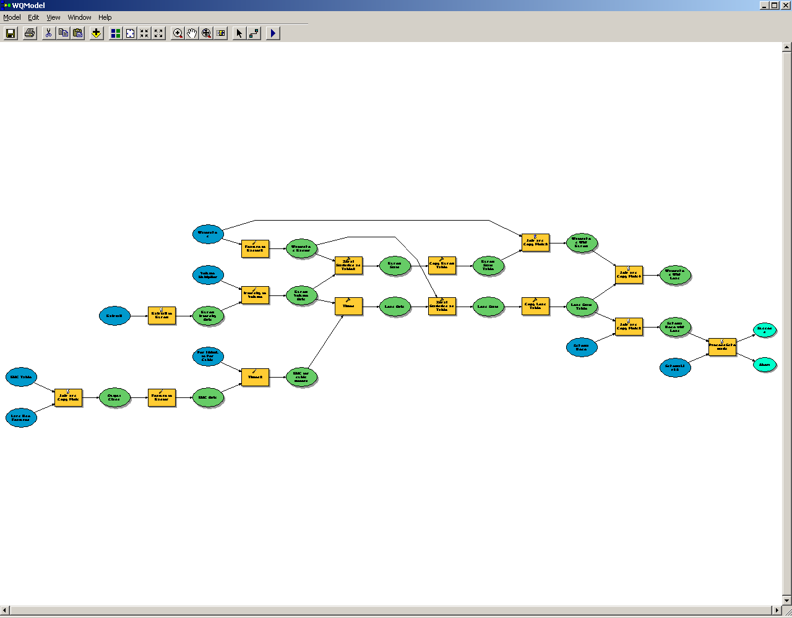
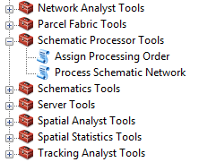
This is implemented in GIS with the Schematic Processor

Slide 17
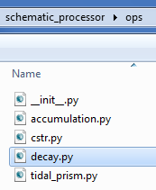
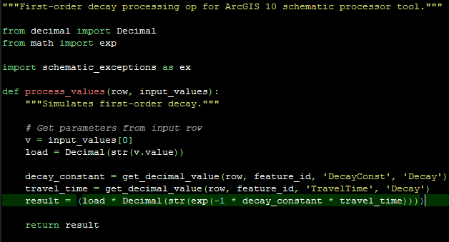
You can create your own behaviors using Python
First-order decay
Build a
library of ops

Slide 18
Total Maximum Daily Load Use Case
Bacterial loading in Copano Bay
(Slides courtesy of Dr. Stephanie Johnson)

Slide 19
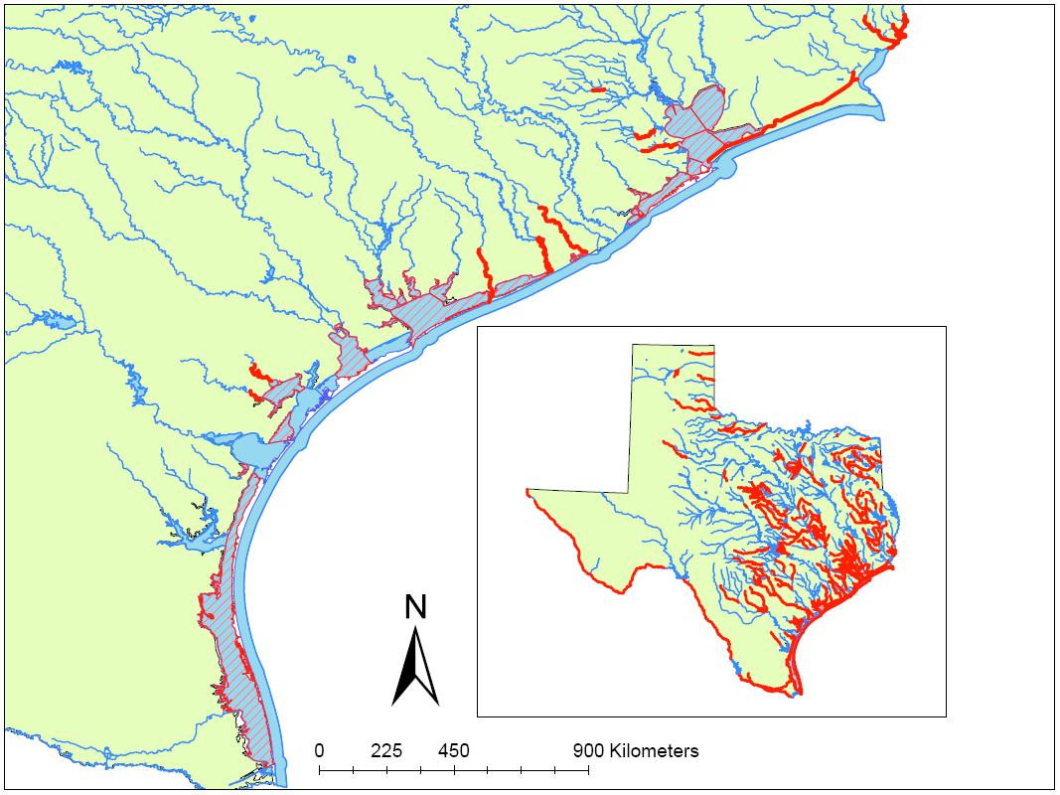
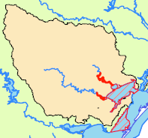
Motivating Factors
As of August 2009:
Tidal Rivers:
20 impaired
12 impaired for bacteria
(Task Force, 2007) Tier 2 Part 3: “… develop simple load duration curve, GIS [geographic information systems], and/or mass balance models.”
Statewide:
399 impaired
310 impaired for bacteria
Bays:
28 impaired
21 impaired for bacteria
Notes:
A main motivator of this work was the LARGE number of bacterial impairments in the State. Also, the language in the Task Force report released in 2007 that said that the majority of the bacteria TMDL studies done in the state should use simple methods.
Classified waterbodies
399 violating for something
310 violating for bacteria
44 Classified Bays
28 violating for something 63.6%
21 violating for bacteria 47.7%
33 Classified Tidal Streams
20 violating for something 60.606%
12 violating for bacteria 36.364%

Slide 20


What is a “Load”?
Load (#/year)
Amount (volume/year)
Concentration (#/volume)
Concentration of bacteria: CFU/100 m³
Amount of water:
m³/day
Bacterial load:
CFU/year
Notes:
We are using loading models. First question is – what is a “load”?
Load is a function of two things - the amount of water and the concentration of bacteria in the water. So for all of our bacterial sources, we need to get info on those two things.
Watershed loading is calculated through a simple loading equation, where the mean annual load of bacteria = the mean annual volume of water * the expected bacterial concentration

Slide 21
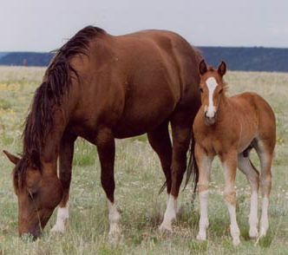
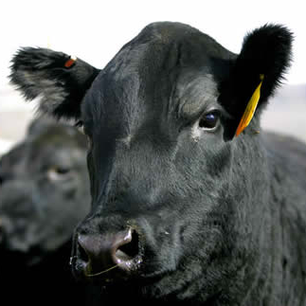
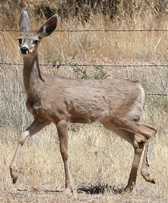
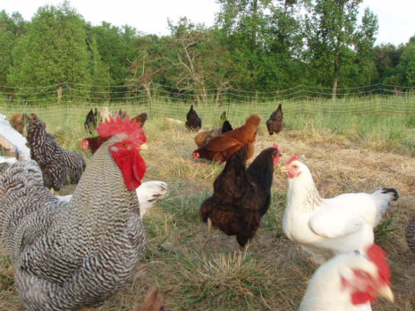
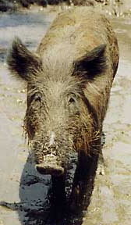
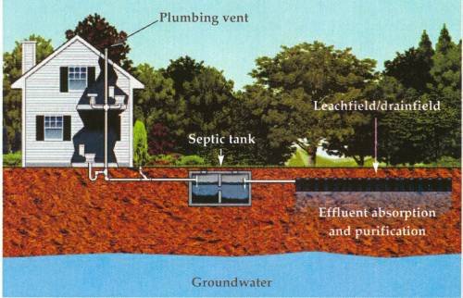

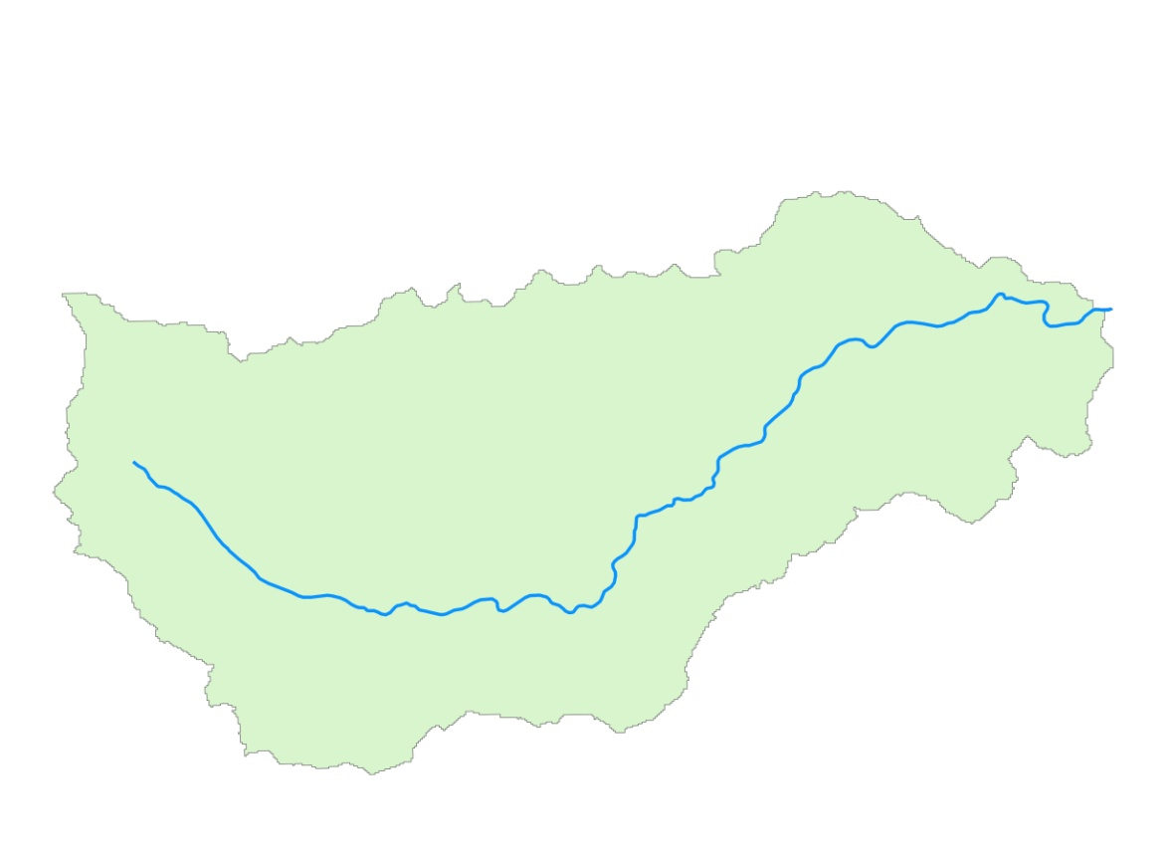
Non-Point Sources
Overland
“Net” decay =
f (regrowth, resuspension, death)
First Order Decay:
QC = QC_{o}*e^{-kτ} L = L_{o}*e^{-k τ}
C = concentration (CFU/100mL)
Q = flow (m³/yr)
L = load (CFU/yr)
L_{o} = initial load (CFU/yr)
k = net decay rate (yrs⁻¹)
τ = residence time (yrs)
decay
Non-Tidal Rivers
Notes:
Overland Flow and Non-tidal streams

Slide 22
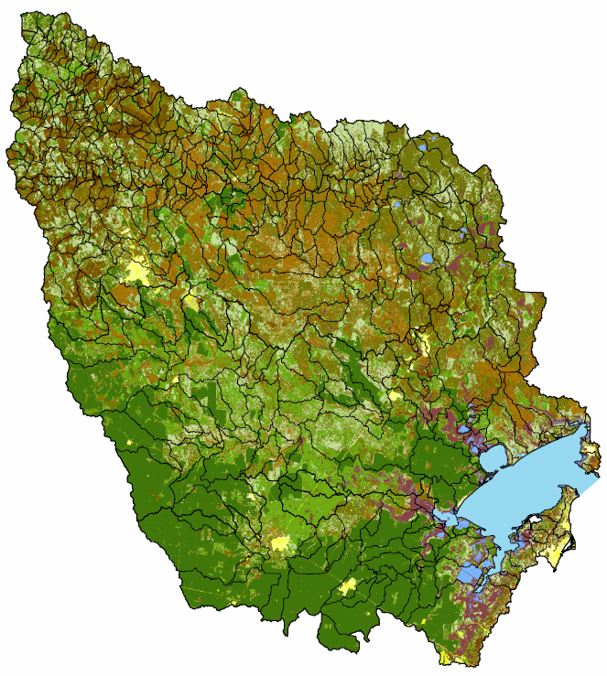
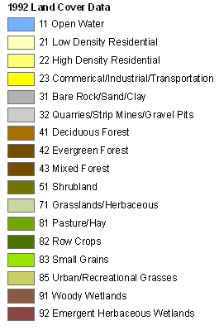
Loading from Landscape
By land use category:
Load (CFU/yr)
Runoff (m³/yr)
Concentration (CFU/m³)
Data sources:
  Land use/Land cover: NLCD 1992, NHDPlus ‘catchmentattributesnlcd’ table
  Unit runoff by LULC: Quenzer, 1997
  Bacteria concentrations by LULC: Zoun, 2003
* Loading from other land uses accounted for with animal
specific loadings.

Slide 23
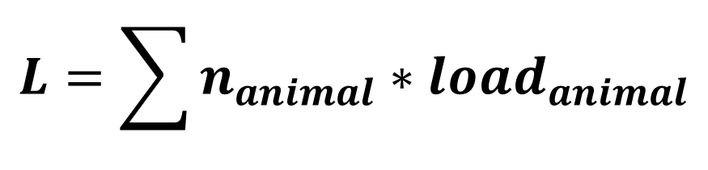
Loading from Animals (Ag & Wildlife)
Data sources:
  Land use/Land cover: NLCD 1992, NHDPlus ‘catchmentattributesnlcd’ table
  # animals: Moench & Wagner, 2009
  Loading per animal: Moench & Wagner, 2009
By land use category¹:
$$L=\sum{n_{animal}∗{load}_{animal}}$$
Load (CFU/yr)
# animals
Load/animal
(CFU/yr)
¹ Animals were distributed across the watershed by land use.
Notes:
A similar process was done for all of the agricultural animals and wildlife
Here we see the total number of animals in the watershed
Similar to cattle, these were all divided up amongst the catchments

Slide 24
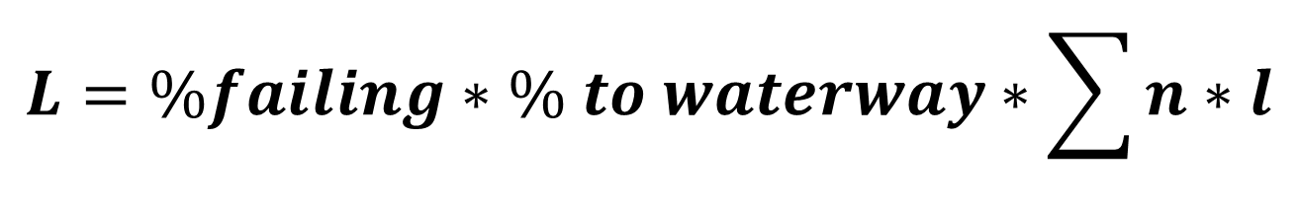
Septic Systems in Upper Watershed
Data sources:
  Land use/Land cover: NLCD 1992, NHDPlus ‘catchmentattributesnlcd’ table
  # septics: 1990 Census, TCEQ OARS, county data
  Loading per septic: Protocol for Developing Bacteria TMDLs (EPA, 2005)
  % septics failing: estimated from literature values & local info (see App. C of dissertation)*
  % of load from failing system that reaches the bay: estimated from literature values (see App. C of dissertation)*
$$L=\%failing∗\% to waterway∗\sum{n∗l}$$
Load (CFU/yr)
% of systems that fail each yr
% of load from failed septic that reaches the stream
# septics
Load/septic
(CFU/yr)
Notes:
Also have septic systems in the upper watershed
Get data from TCEQ/local data source

Slide 25

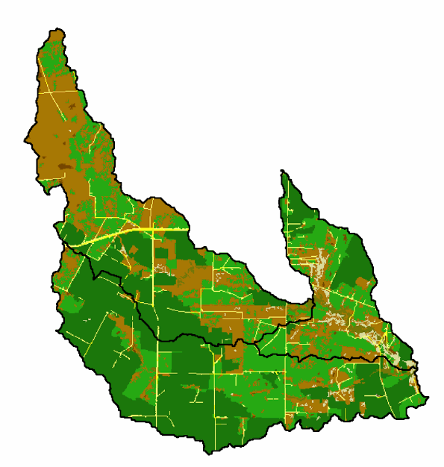
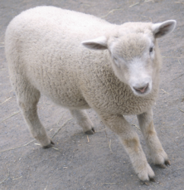
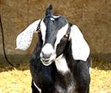
Total Nonpoint Source Load per Catchment
Total nonpoint source load:
l_{i} = 2.6 x 10¹⁵ CFU/yr
643*CFU/yr/deer
20*CFU/yr/horse
8*CFU/yr/sheep
+ LULC
630*CFU/yr/cow
30*CFU/yr/goat
0*CFU/yr/failure
300*CFU/yr/hog
5*CFU/yr/hog
Notes:
5 goats, 2 sheep, 1 dom hog, 0.2 poultry

Slide 26
“Net” Decay
Bacteria Load In
In-Segment Processes
Bacteria Load Out
move right through …..
Q₀, C₀
Q, C
settle, death
resuspension
Death, regrowth
Non-Tidal River
In-segment processes as a “black box” approach,
where “net” decay = f(settling, death, regrowth, resuspension, etc.) = k
QC = QC_{o}*e^{-kτ}
Reminder: L (CFU/yr) = Q (m³/yr) *C (CFU/m³)

Slide 27
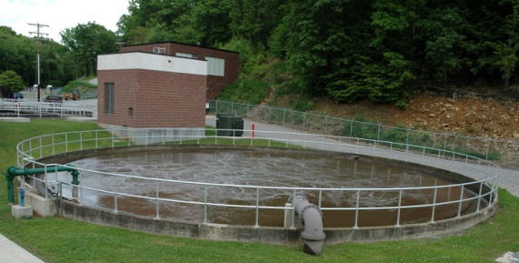
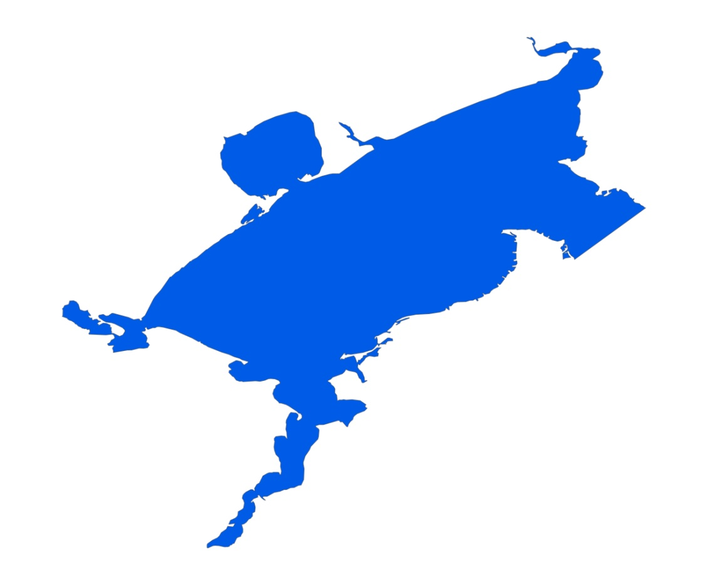

Point Sources
Wastewater treatment plants
Failing septic systems around the bay
Bird colonies
decay
decay
Notes:
Overland Flow and Non-tidal streams

Slide 28
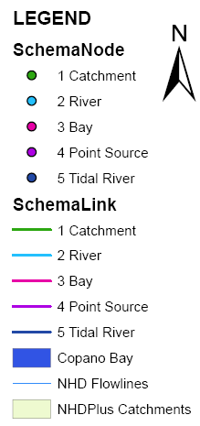
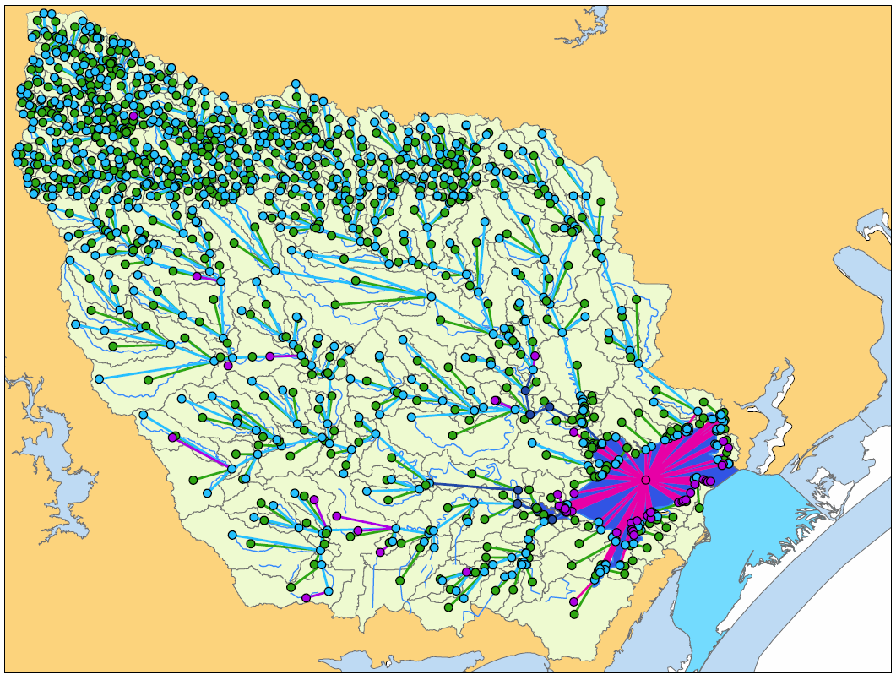
Build the Schematic Network
Notes:
Go through how to build the network (in generality …….) Use appendix and rely on cached layers to flip through things.

Slide 29
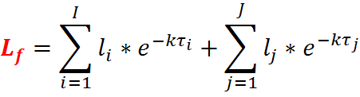


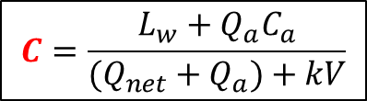
Apply Equations Using Schematic Processor
Nonpoint Sources
Decay
WWTP
$$C=\frac{L_{w}+Q_{a}C_{a}}{(Q_{net}+Q_{a})+kV}$$
Bird colony

Slide 30

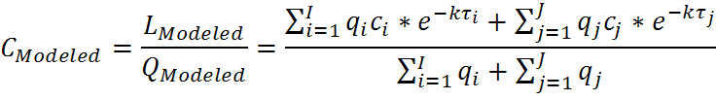
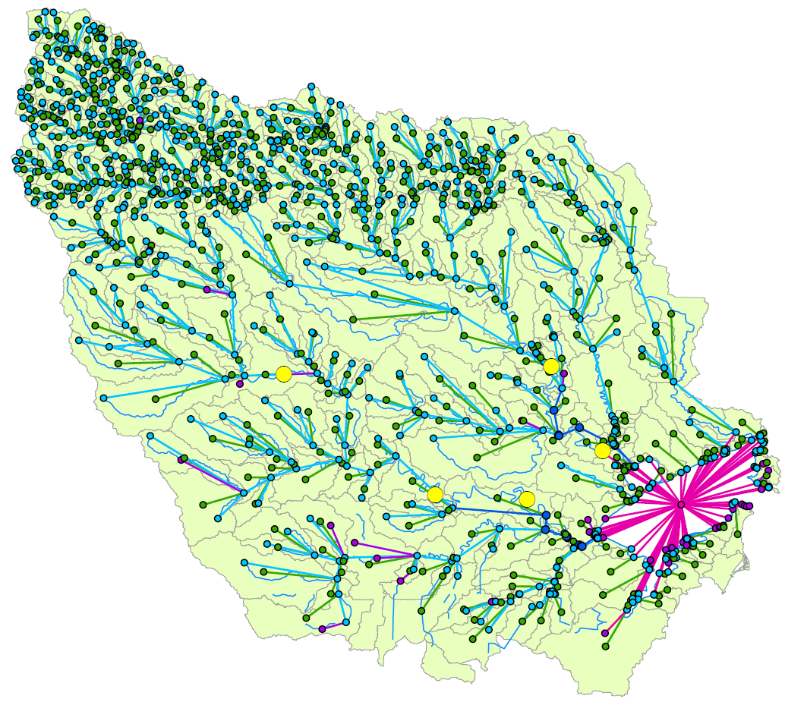
Calibrate Based on Monitoring Data
When:
Station | Mean (CFU/100mL)
12943 | 107
12944 | 251
12948 | 394
12952 | 158
12952
12944
12943
12948
Notes:
OK, so we have our governing equations here.
Let’s concentrate on the loading from the watershed and how we calibrate to that value.
We have a number of locations throughout the watershed that we “know” what the mean annual bacterial load is.

Slide 31
Evaluate Strategies To Reduce Load
Eliminate nearby septic systems
Implement best management practices to reduce non-point loads from watersheds
Published in:
http://repositories.lib.utexas.edu/handle/2152/10654

Slide 32
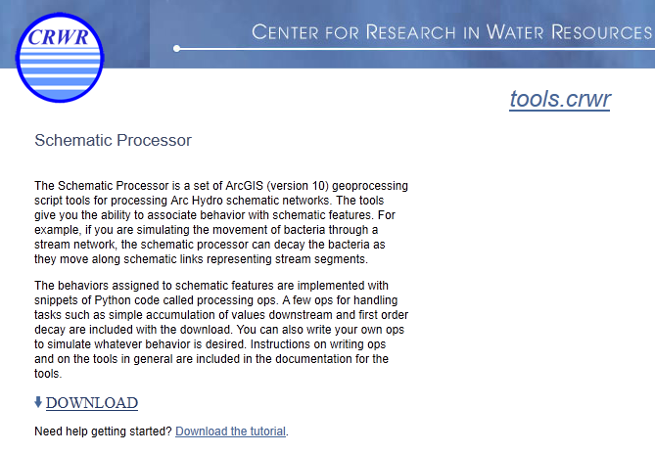
Free Download
http://tools.crwr.utexas.edu/

