Slide 1
Spatial Analysis Using Grids
Learning Objectives
Continuous surfaces or spatial fields representation of geographical information
Grid data structure for representing numerical and categorical data
Map algebra raster calculations
Interpolation
Calculate slope on a raster using
ArcGIS method based in finite differences
D8 steepest single flow direction
D∞ steepest outward slope on grid centered triangular facets

Slide 2
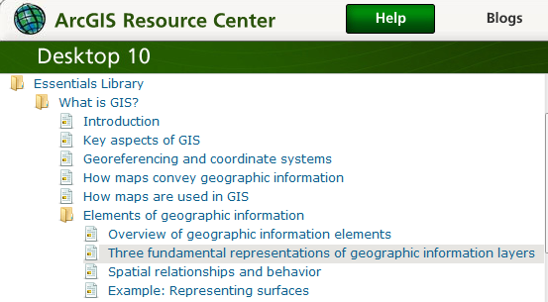
Readings – at http://help.arcgis.com
Elements of geographic information starting from “Overview of geographic information elements” http://help.arcgis.com/en/arcgisdesktop/10.0/help/00v2/00v200000003000000.htm to “Example: Representing surfaces”

Slide 3
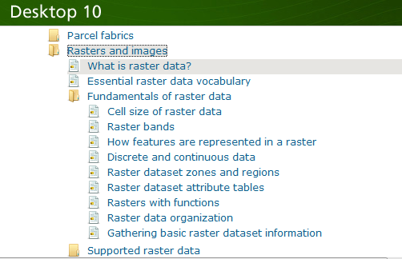
Readings – at http://help.arcgis.com
Rasters and images starting from “What is raster data” http://help.arcgis.com/en/arcgisdesktop/10.0/help/009t/009t00000002000000.htm to end of “Raster dataset attribute tables”

Slide 4
f(x,y)
y
x
Notes:
DRM

Slide 5
Raster and Vector Data
Raster data are described by a cell grid, one value per cell
Vector
Raster
Point
Line
Zone of cells
Polygon
Notes:
DRM

Slide 6
Raster and Vector are two methods of representing geographic data in GIS
Both represent different ways to encode and generalize geographic phenomena
Both can be used to code both fields and discrete objects
In practice a strong association between raster and fields and vector and discrete objects
Notes:
DRM

Slide 7
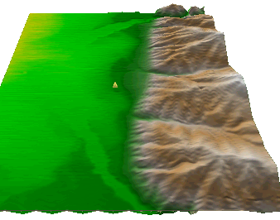
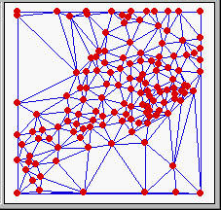
Numerical representation of a spatial surface (field)
Grid
TIN
Contour and flowline

Slide 8
Six approximate representations of a field used in GIS
Regularly spaced sample points
Irregularly spaced sample points
Rectangular Cells
Irregularly shaped polygons
Triangulated Irregular Network (TIN)
Polylines/Contours
from Longley, P. A., M. F. Goodchild, D. J. Maguire and D. W. Rind, (2001), Geographic Information Systems and Science, Wiley, 454 p.

Slide 9
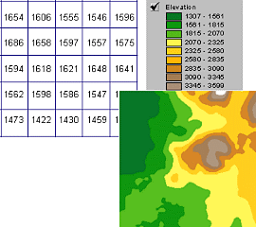
A grid defines geographic space as a mesh of identically-sized square cells. Each cell holds a numeric value that measures a geographic attribute (like elevation) for that unit of space.

Slide 10
The grid data structure
Grid size is defined by extent, spacing and no data value information
Number of rows, number of column
Cell sizes (X and Y)
Top, left , bottom and right coordinates
Grid values
Real (floating decimal point)
Integer (may have associated attribute table)

Slide 11
Definition of a Grid
Cell size
Number
of
rows
NODATA cell
(X,Y)
Number of Columns

Slide 12
Points as Cells

Slide 13
Line as a Sequence of Cells

Slide 14
Polygon as a Zone of Cells

Slide 15
NODATA Cells

Slide 16
Cell Networks

Slide 17
Grid Zones

Slide 18
Floating Point Grids
Continuous data surfaces using floating point or decimal numbers

Slide 19
Value attribute table for categorical (integer) grid data
Attributes of grid zones

Slide 20
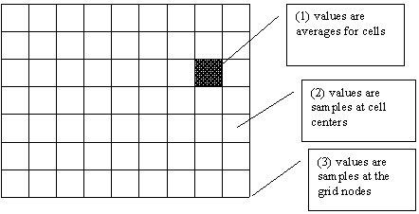
Raster Sampling
from Michael F. Goodchild. (1997) Rasters, NCGIA Core Curriculum in GIScience, http://www.ncgia.ucsb.edu/giscc/units/u055/u055.html, posted October 23, 1997

Slide 21
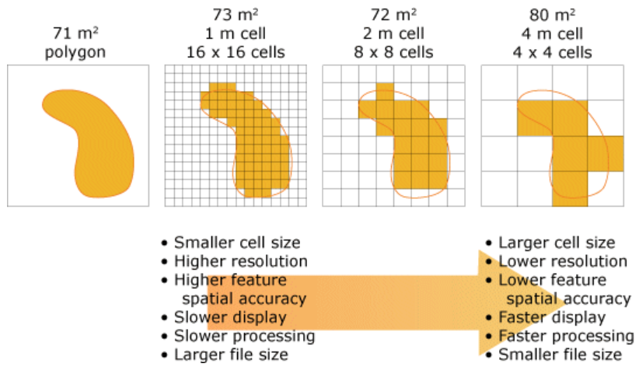
Cell size of raster data
From http://help.arcgis.com/en/arcgisdesktop/10.0/help/index.html#/Cell_size_of_raster_data/009t00000004000000/

Slide 22
Raster Generalization
Largest share rule
Central point rule

Slide 23
Map Algebra
Example
5
6
Precipitation
-
Losses (Evaporation, Infiltration)
=
Runoff
Cell by cell evaluation of mathematical functions
7
6
-
3
3
2
4
=
2
3
5
2

Slide 24
Runoff generation processes
P
Infiltration excess overland flow
aka Horton overland flow
P
f
P
q_{o}
f
Partial area infiltration excess overland flow
P
P
P
q_{o}
f
Saturation excess overland flow
P
P
P
q_{o}
q_{r}
q_{s}

Slide 25
Runoff generation at a point depends on
Rainfall intensity or amount
Antecedent conditions
Soils and vegetation
Depth to water table (topography)
Time scale of interest
These vary spatially which suggests a spatial geographic approach to runoff estimation

Slide 26
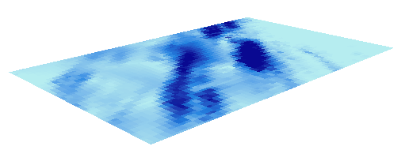
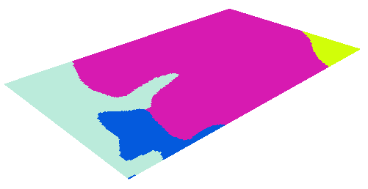
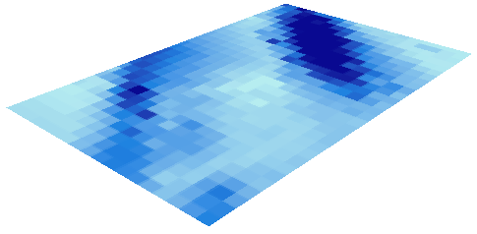
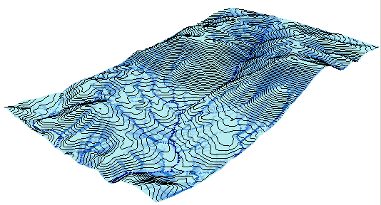
Cell based discharge mapping flow accumulation of generated runoff
Radar Precipitation grid
Soil and land use grid
Runoff grid from raster calculator operations implementing runoff generation formula’s
Accumulation of runoff within watersheds

Slide 27
Raster calculation – some subtleties
Resampling or interpolation (and reprojection) of inputs to target extent, cell size, and projection within region defined by analysis mask
+
=
Analysis mask
Analysis cell size
Analysis extent

Slide 28
Spatial Snowmelt Raster Calculation Example
100 m
150 m
100 m
40
50
55
150 m
4
6
42
47
43
2
4
42
44
41

Slide 29
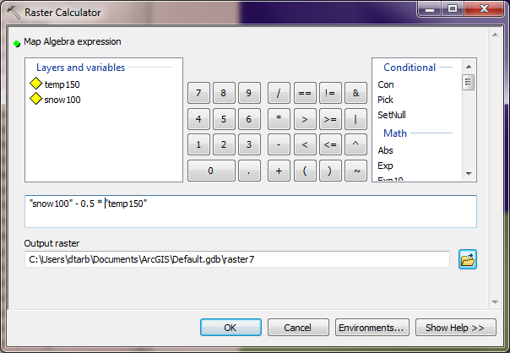
New depth calculation using Raster Calculator
“snow100” - 0.5 * “temp150”

Slide 30
Example and Pixel Inspector

Slide 31
The Result
Outputs are on 150 m grid.
How were values obtained ?
38
52
41
39

Slide 32
Nearest Neighbor Resampling with Cellsize Maximum of Inputs
100 m
40
50
55
40-0.5*4 = 38
42
47
43
55-0.5*6 = 52
38
52
42
44
41
42-0.5*2 = 41
41-0.5*4 = 39
41
39
150 m
4
6
2
4

Slide 33
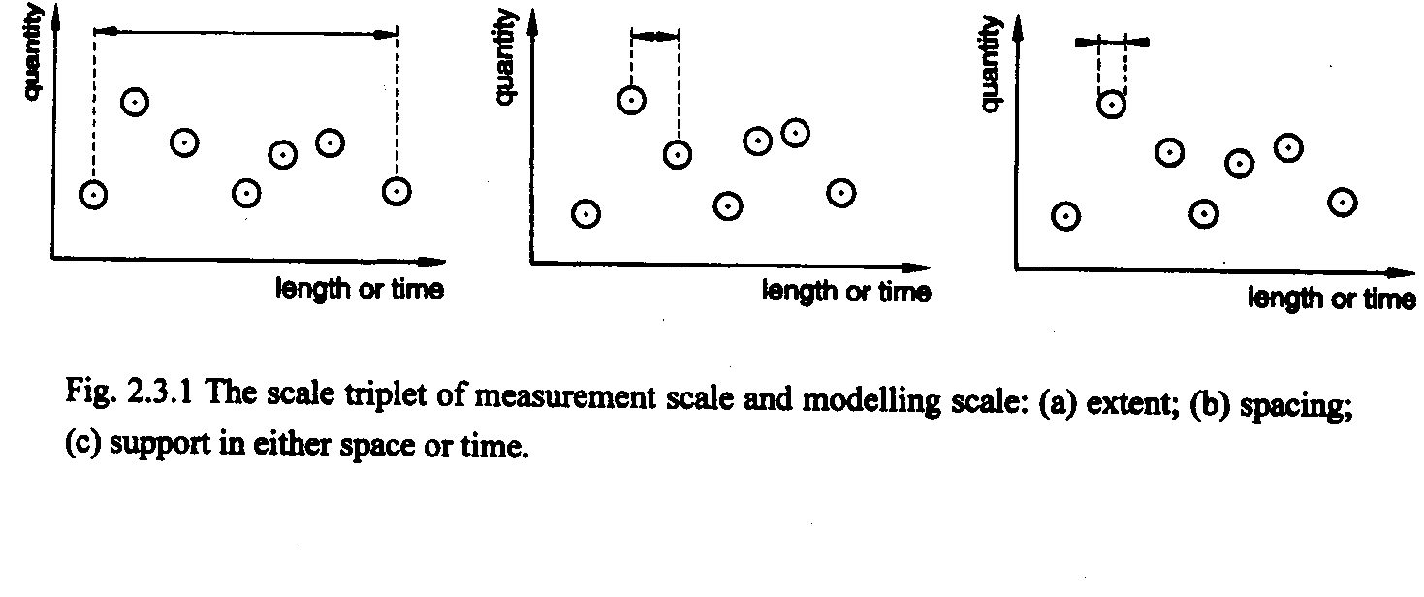
Scale issues in interpretation of measurements and modeling results
The scale triplet
a) Extent
b) Spacing
c) Support
From: Blöschl, G., (1996), Scale and Scaling in Hydrology, Habilitationsschrift, Weiner Mitteilungen Wasser Abwasser Gewasser, Wien, 346 p.

Slide 34
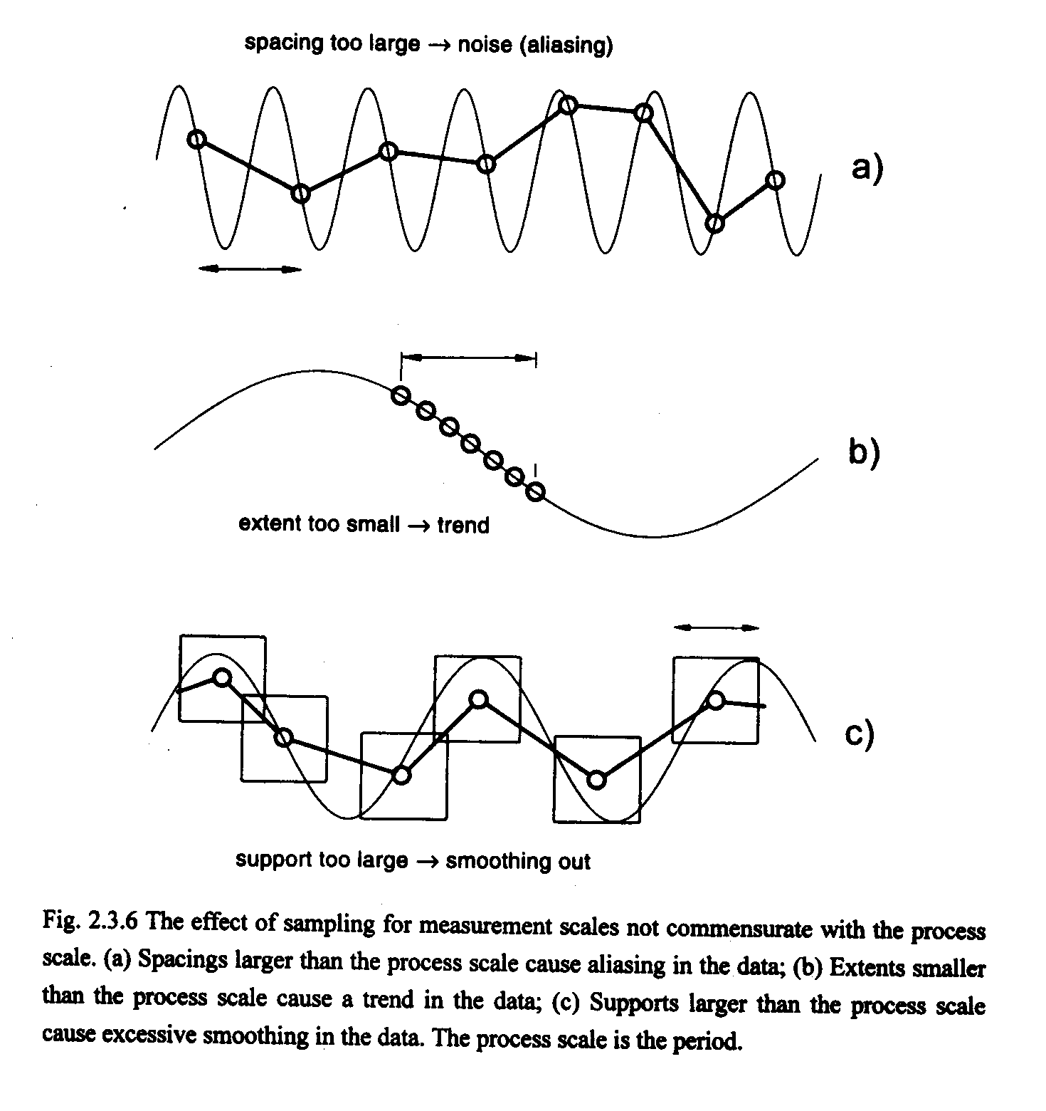
From: Blöschl, G., (1996), Scale and Scaling in Hydrology, Habilitationsschrift, Weiner Mitteilungen Wasser Abwasser Gewasser, Wien, 346 p.

Slide 35
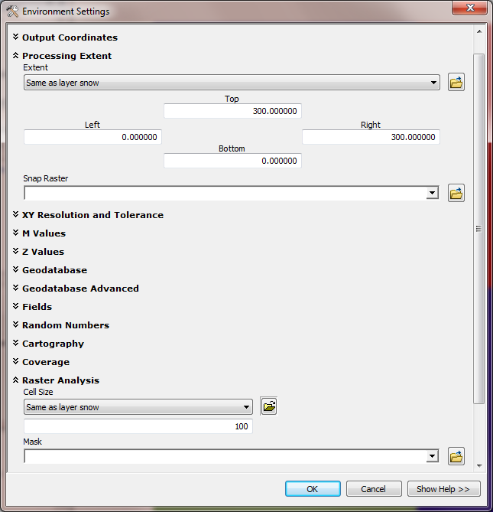
Use Environment Settings to control the scale of the output
Extent
Spacing & Support

Slide 36
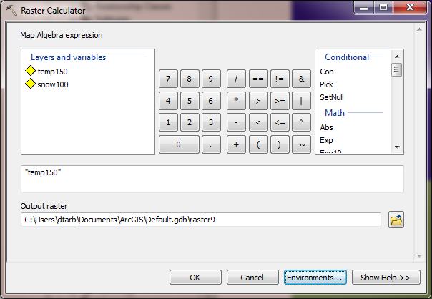
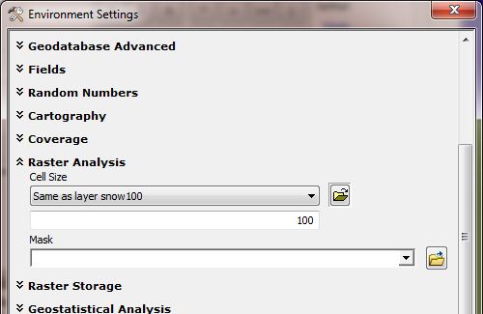
Raster Calculator “Evaluation” of “temp150”
4
4
6
6
6
2
4
4
2
4
2
4
4
Nearest neighbor to the E and S has been resampled to obtain a 100 m temperature grid.

Slide 37
Calculation with cell size set to 100 m grid
“snow100” - 0.5 * “temp150”
Outputs are on 100 m grid as desired.
How were these values obtained ?
38
47
52
41
45
41
41
42
39

Slide 38
100 m cell size raster calculation
40-0.5*4 = 38
100 m
40
50
55
50-0.5*6 = 47
55-0.5*6 = 52
42
47
43
42-0.5*2 = 41
47-0.5*4 = 45
38
47
52
42
44
41
43-0.5*4 = 41
41
45
41
42-0.5*2 = 41
4
6
6
44-0.5*4 = 42
150 m
41
42
39
4
6
41-0.5*4 = 39
2
4
4
2
4
Nearest neighbor values resampled to 100 m grid used in raster calculation
2
4
4

Slide 39
What did we learn?
Raster calculator automatically uses nearest neighbor resampling
The scale (extent and cell size) can be set under options
What if we want to use some other form of interpolation?
From Point
Natural Neighbor, IDW, Kriging, Spline, …
From Raster
Project Raster (Nearest, Bilinear, Cubic)

Slide 40
Interpolation
Estimate values between known values.
A set of spatial analyst functions that predict values for a surface from a limited number of sample points creating a continuous raster.
Apparent improvement in resolution may not be justified

Slide 41
Interpolation methods
Nearest neighbor
Inverse distance weight
Bilinear interpolation
Kriging (best linear unbiased estimator)
Spline

Slide 42
Nearest Neighbor “Thiessen” Polygon Interpolation
Spline Interpolation

Slide 43
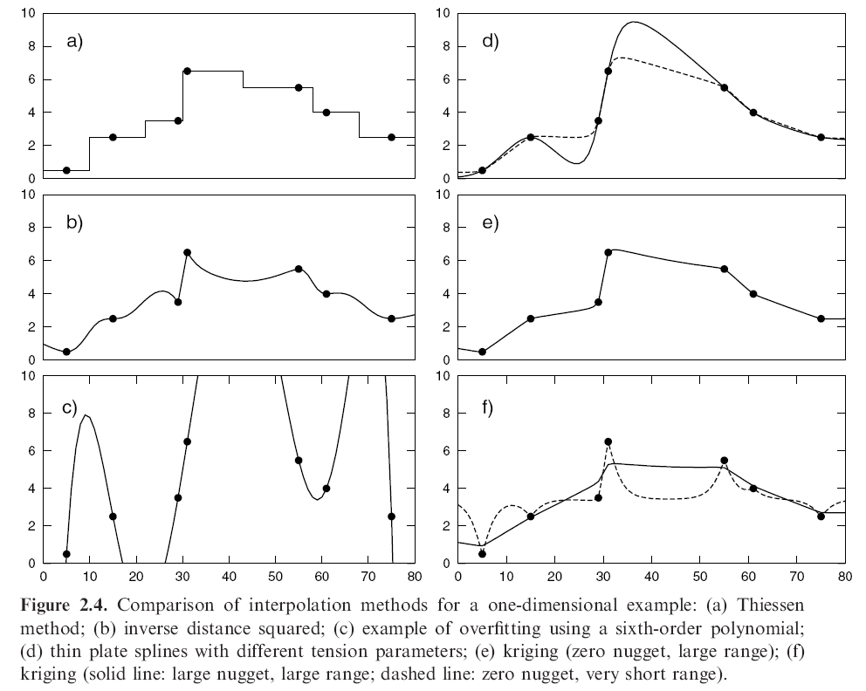
Interpolation Comparison
Grayson, R. and G. Blöschl, ed. (2000)

Slide 44
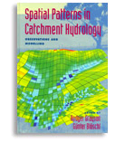
Further Reading
Grayson, R. and G. Blöschl, ed. (2000), Spatial Patterns in Catchment Hydrology: Observations and Modelling, Cambridge University Press, Cambridge, 432 p.
Chapter 2. Spatial Observations and Interpolation
Full text online at:
http://www.catchment.crc.org.au/special_publications1.html

Slide 45
Spatial Surfaces used in Hydrology
Elevation Surface — the ground surface elevation at each point

Slide 46
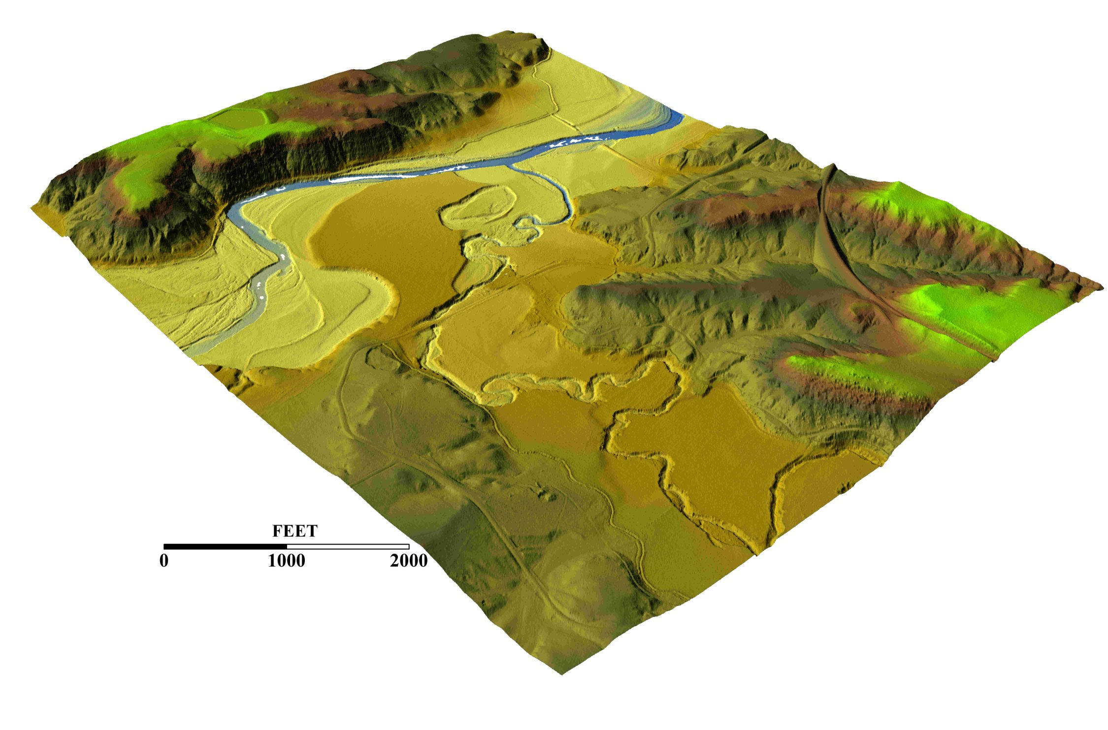
3-D detail of the Tongue river at the WY/Mont border from LIDAR.
Roberto Gutierrez
University of Texas at Austin

Slide 47
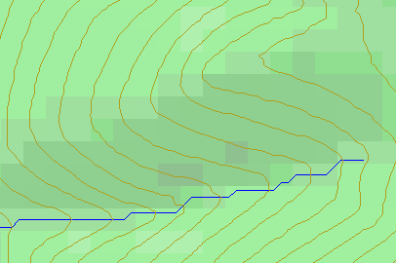
Topographic Slope
Defined or represented by one of the following
Surface derivative ∇z (dz/dx, dz/dy)
Vector with x and y components (S_{x}, S_{y})
Vector with magnitude (slope) and direction (aspect) (S, α)

Slide 48
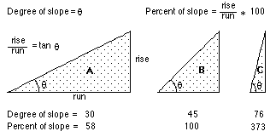
ArcGIS “Slope” tool
a
b
c
d
e
f
g
h
i

Slide 49
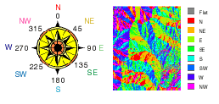
ArcGIS Aspect – the steepest downslope direction

Slide 50
Example
30
a
b
c
80
74
63
d
e
f
145.2º
69
67
56
g
h
i
60
52
48

Slide 51
Hydrologic Slope (Flow Direction Tool)
- Direction of Steepest Descent
30
30
80
74
63
80
74
63
69
67
56
69
67
56
60
52
48
60
52
48
Slope:

Slide 52
Eight Direction Pour Point Model
32
64
128
16
1
8
4
2
ESRI Direction encoding

Slide 53
Limitation due to 8 grid directions.
?

Slide 54
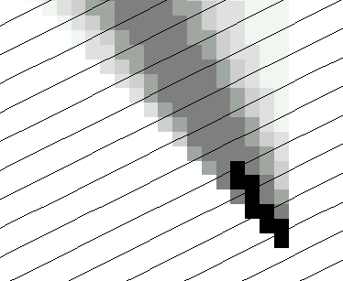
The D∞ Algorithm
Tarboton, D. G., (1997), "A New Method for the Determination of Flow Directions and Contributing Areas in Grid Digital Elevation Models," Water Resources Research, 33(2): 309-319.) (http://www.engineering.usu.edu/cee/faculty/dtarb/dinf.pdf)

Slide 55
The D∞ Algorithm
Δ
If α₁ does not fit within the triangle the angle is chosen along the steepest edge or diagonal resulting in a slope and direction equivalent to D8

Slide 56
D∞ Example
30
80
74
63
69
e_{o}
67
56
60
e₇
e₈
52
48
284.9º
14.9º

Slide 57
Summary Concepts
Grid (raster) data structures represent surfaces as an array of grid cells
Raster calculation involves algebraic like operations on grids
Interpolation and Generalization is an inherent part of the raster data representation

Slide 58
Summary Concepts (2)
The elevation surface represented by a grid digital elevation model is used to derive surfaces representing other hydrologic variables of interest such as
Slope
Drainage area (more details in later classes)
Watersheds and channel networks (more details in later classes)

Slide 59
Summary Concepts (3)
The eight direction pour point model approximates the surface flow using eight discrete grid directions.
The D∞ vector surface flow model approximates the surface flow as a flow vector from each grid cell apportioned between down slope grid cells.

