Slide 1
Water Resources to Develop Natural Gas from Shale Plays
Yael Hirsch
12/04/2012
GIS in Water Resources

Slide 2
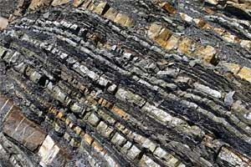
What is Shale Gas?
Shale Gas: Natural gas trapped within fine-grained sedimentary rocks rich in oil and natural gas called shale formations.

Slide 3
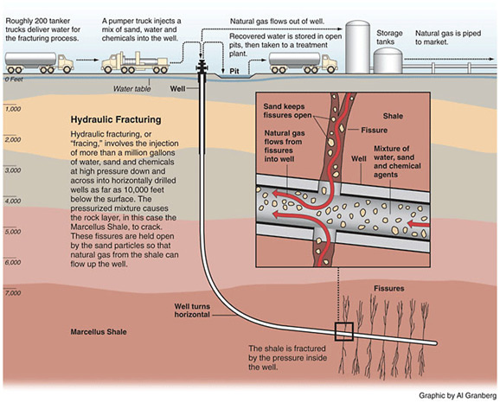
Shale Gas Extraction
Notes:
Partnership between the gas industry and the Department of Energy

Slide 4
Shale Gas Production Drivers
Natural gas burns clean
482 trillion cubic feet of shale gas
Creates domestic jobs
Increases our energy security and independence
Notes:
-Better for emissions/environment, is a cleaner burning energy source than oil or coal natural gas combustion can emit less than half as much CO2 as cola per unit electical output, also 80% lower for NO and close to 100% for SO2;
-Political reasons: domestic jobs and increased energy security.

Slide 5
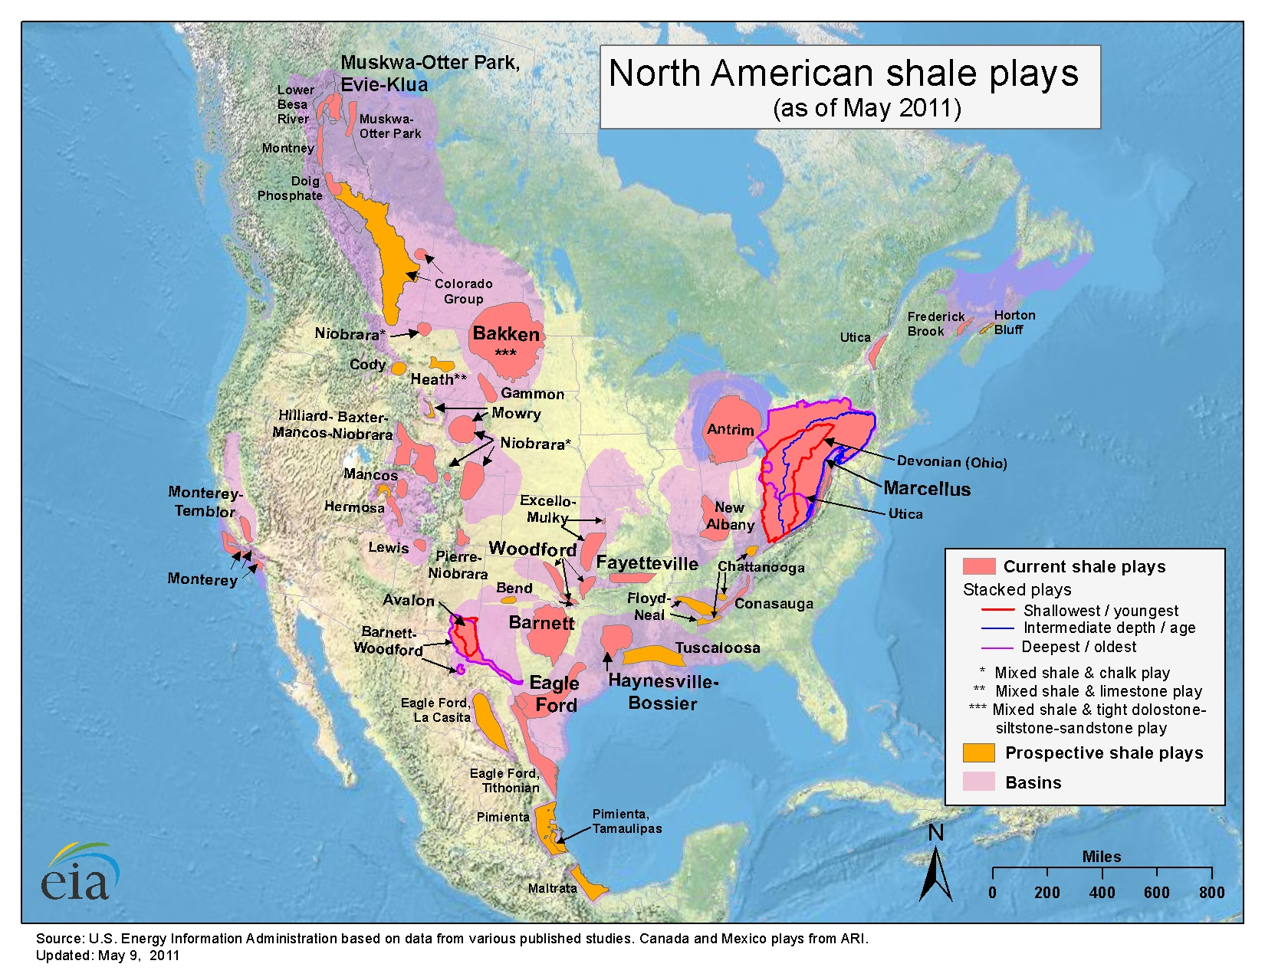
Shale Plays in the US
Chattanooga & Floyd Shale Plays
Notes:
Fracking requires a lot of water!...
Shale gas exploration was a joint effort btn the DOE and energy companies. This map shows the shale plays in the US. Pink shales are already in development (that is, gas is being extracted). Yellow regions are prospective shales.
It turns out that Texas was among the first to start fracking in the 90s and as such, we can learn a lot from the industry here to help develop other prospective regions.

Slide 6
Environmental Concerns of
Shale Gas Production
Produces large amounts of wastewater
Groundwater contamination
Surface contamination
May cause earthquakes!
Notes:
Aside from large amount of water…
Uses a tremendous amount of water so water strained areas may decide against fracking as a result.
B’c of sand and chemicals added to fracking process, a large amt of wasterwater is produced
Bullet 3 & 4: if not done properly, fracking process can lead to contamination of groundwater or leaks at the surface
Bullet 5 – earthquakes!!! Some waste waters are re-injected into deep wells and can potentially cause earthquakes.

Slide 7
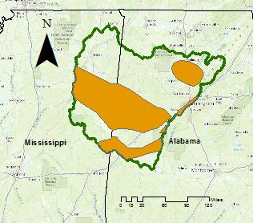
Black Warrior Basin
Chattanooga & Floyd Shale Plays
Black Warrior Basin
Notes:
Specifically wanted to look at the Black warrior Basin because……. Could be a nice case study on water requirements for fracking… knowing competing priorities.
Floyd and Consasuaga estimated 4 trillion cubic feet. Which is less than 1% of the US reserve but could be beneficial if there is water in the region.

Slide 8
Research
Is there enough water annually to support municipal uses and fracking in the Black Warrior Basin?
Extractable Gas = (w-m)*k
… where:
w = total water availability
m = municipal water usage
k = amount of shale gas extracted per m³ of water required
Future Work
Include water usage of other industries in model

Slide 9
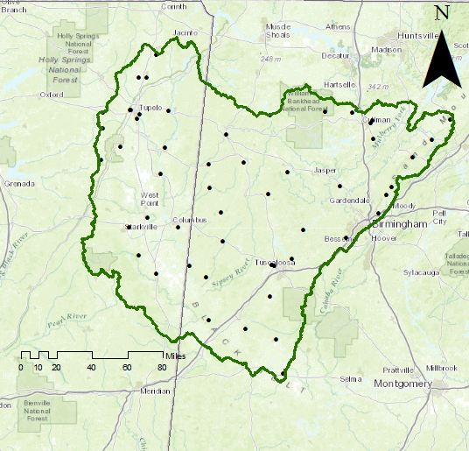
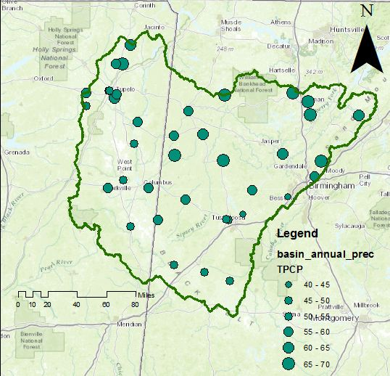
Step 1: Determine Water Availability
Water Availability = Precipitation – Evapotranspiration
(Gauge data obtained from NOAA National Climatic Data Center)
Notes:
Why GW: drilling anyway way below the water table and pumps are involved so it makes sense to be able to use the H2O locally. And also totally eliminates dependency on surface water that may or may not be anywhere near the drill site.
So I set out to obtain the data for the region. I mentioned that I was first interested in GW but after much searching, realized that data set was not going to cut it. My next step was to obtain precipitation and evapotranspiration data. I did find a data set on NOAA for precipitation at gauges in the region, that also claimed to have evapotranspiration data at those same sites! This was exciting because I figured I could use the point data and do a spatial interpolation over the region by associating the areas with the closest rain guage.

Slide 10
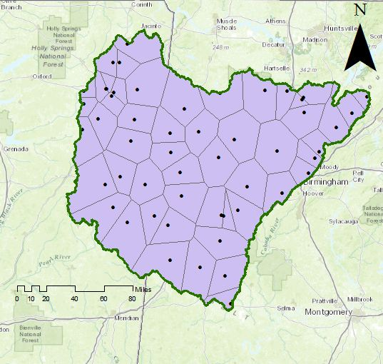
Step 1: Determine Water Availability
Notes:
Spatial interpolation using thiessen polygons I could get the average precipitation over the region.

Slide 11
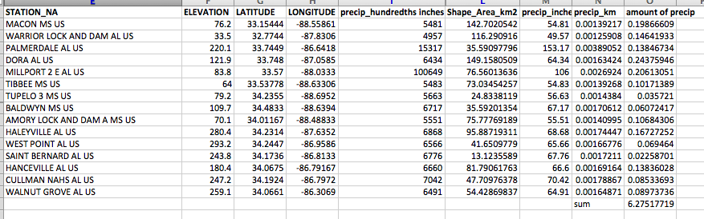
Step 1: Determine Water Availability
Annual Precipitation = 6.28 km³
Water Availability = Precipitation – Evapotranspiration
???

Slide 12
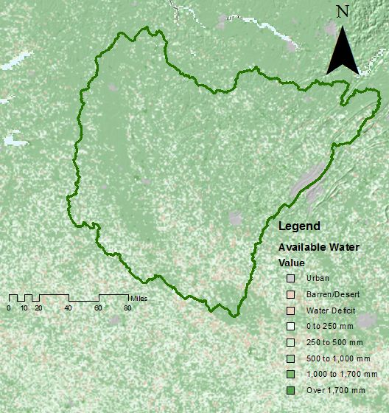
World Available Water Map Service
(Map layer obtained from Daniel Siegal on ArcGIS online)
Notes:
One possible solution to issue of not having the pan evaporation data for the region is to use the world available water web viewer. For now, I can only use the web viewer.. But would like to obtain the raster data set in order to bring into Arc GIS in order to calculate the region’s available water this way.

Slide 13
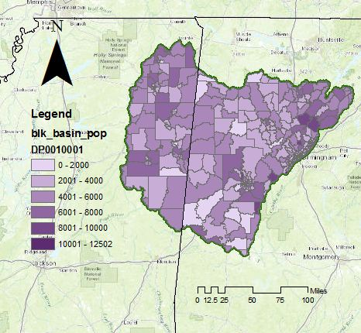
Step 2: Municipal Water Usage
Annual Municipal Water Reqs= (Population)(ave water usage/person-day)(365 days/year)
55 trillion gallons of water per year = (1.5 million)(100 gallons/person-day)(365 days/year)
(Population data obtained at census.gov)
Notes:
The region has a population of about 1.5 million people. On average a person uses 100 gallons h20 a day (Data from EPA). So annually, the region needs roughly 55 trillion gallons or 0.21 cubic kilometers of water just for municipal usage.
Population data found at census.gov, imported and clipped for the black warrior basin region.

Slide 14
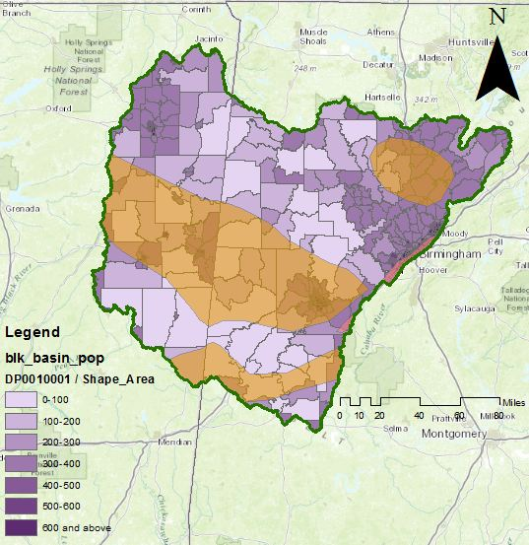
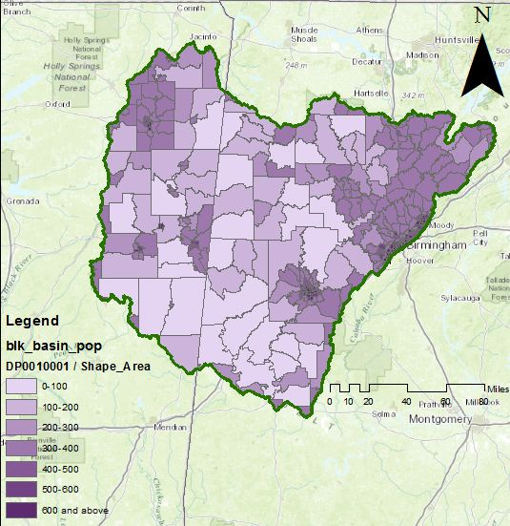
Step 3: Population Density
Birmingham
Tuscaloosa
Notes:
Taking this to the next level

Slide 15
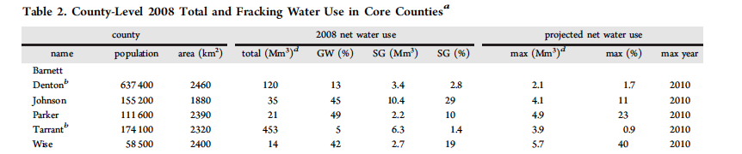
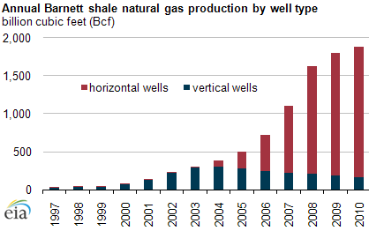
Step 4: Gas per Water
1812 m³ gas/1 m³ H₂0
Notes:
Top is from a paper
Bottom is from EIA
1 meter cubed of water is enough for 3 people for one day.
1812 meters cubes of gas can be used for one person for one year (on average)

Slide 16
Lessons Learned & Future Work
Lessons Learned
  Shale gas data and groundwater data are very hard to find!
Future Work
  Import raster data set for World Water Availability to determine water availability of the region
  Add agriculture water requirements to formula
  Apply strategy to other prospective shale regions
Notes:
Shale gas industry is still pretty new and not every state has same regulations around what they companies have to report in terms of water usage.
Groundwater data is hard to come by b’c each state is on their own and so again, have different standards or needs.

Slide 17
Acknowledgements
Dr. Maidment
Gonzalo Espinoza
Thanks!!

Slide 18
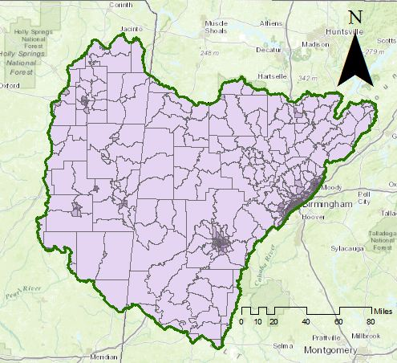
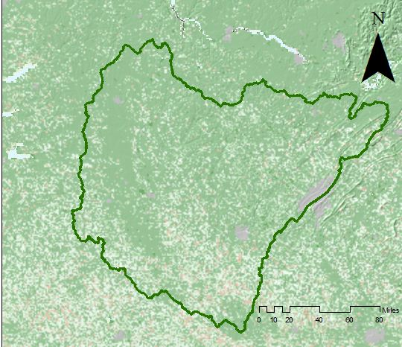
Step 3: Population Density
Birmingham
Tuscaloosa

Slide 19
Step 5: Amount of Shale Gas
2.34 trillion m³ gas in the Black Warrior Basin
Notes:
0.5% shale 1.13 *10¹¹ m³ gas/2.4 km² area = 1.67 trillion m³/km² in Floyd & Consasuaga Shale Plays
2.34 trillion m³ gas in the Black Warrior Basin.
Enough gas to supply the entire country for 4 years.

Slide 20
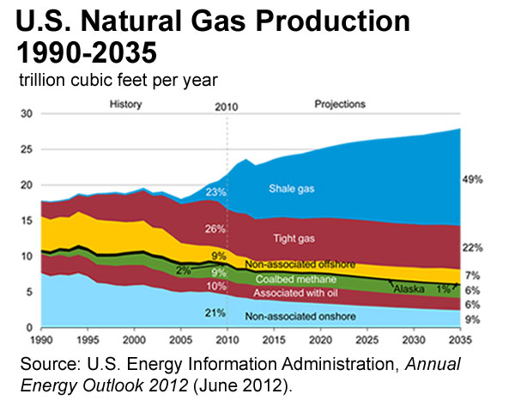
Notes:
production of shale gas is going to dramatically to increase over the next 20 years.
As of the end of last year, 22 of the 50 states were shale gas producers, and production increased by an annual average rate of ~50% btn 2006 and 2010.
From graph we can see that by 2035 49% of the US’ natural gas will come from shale gas.

