Slide 1
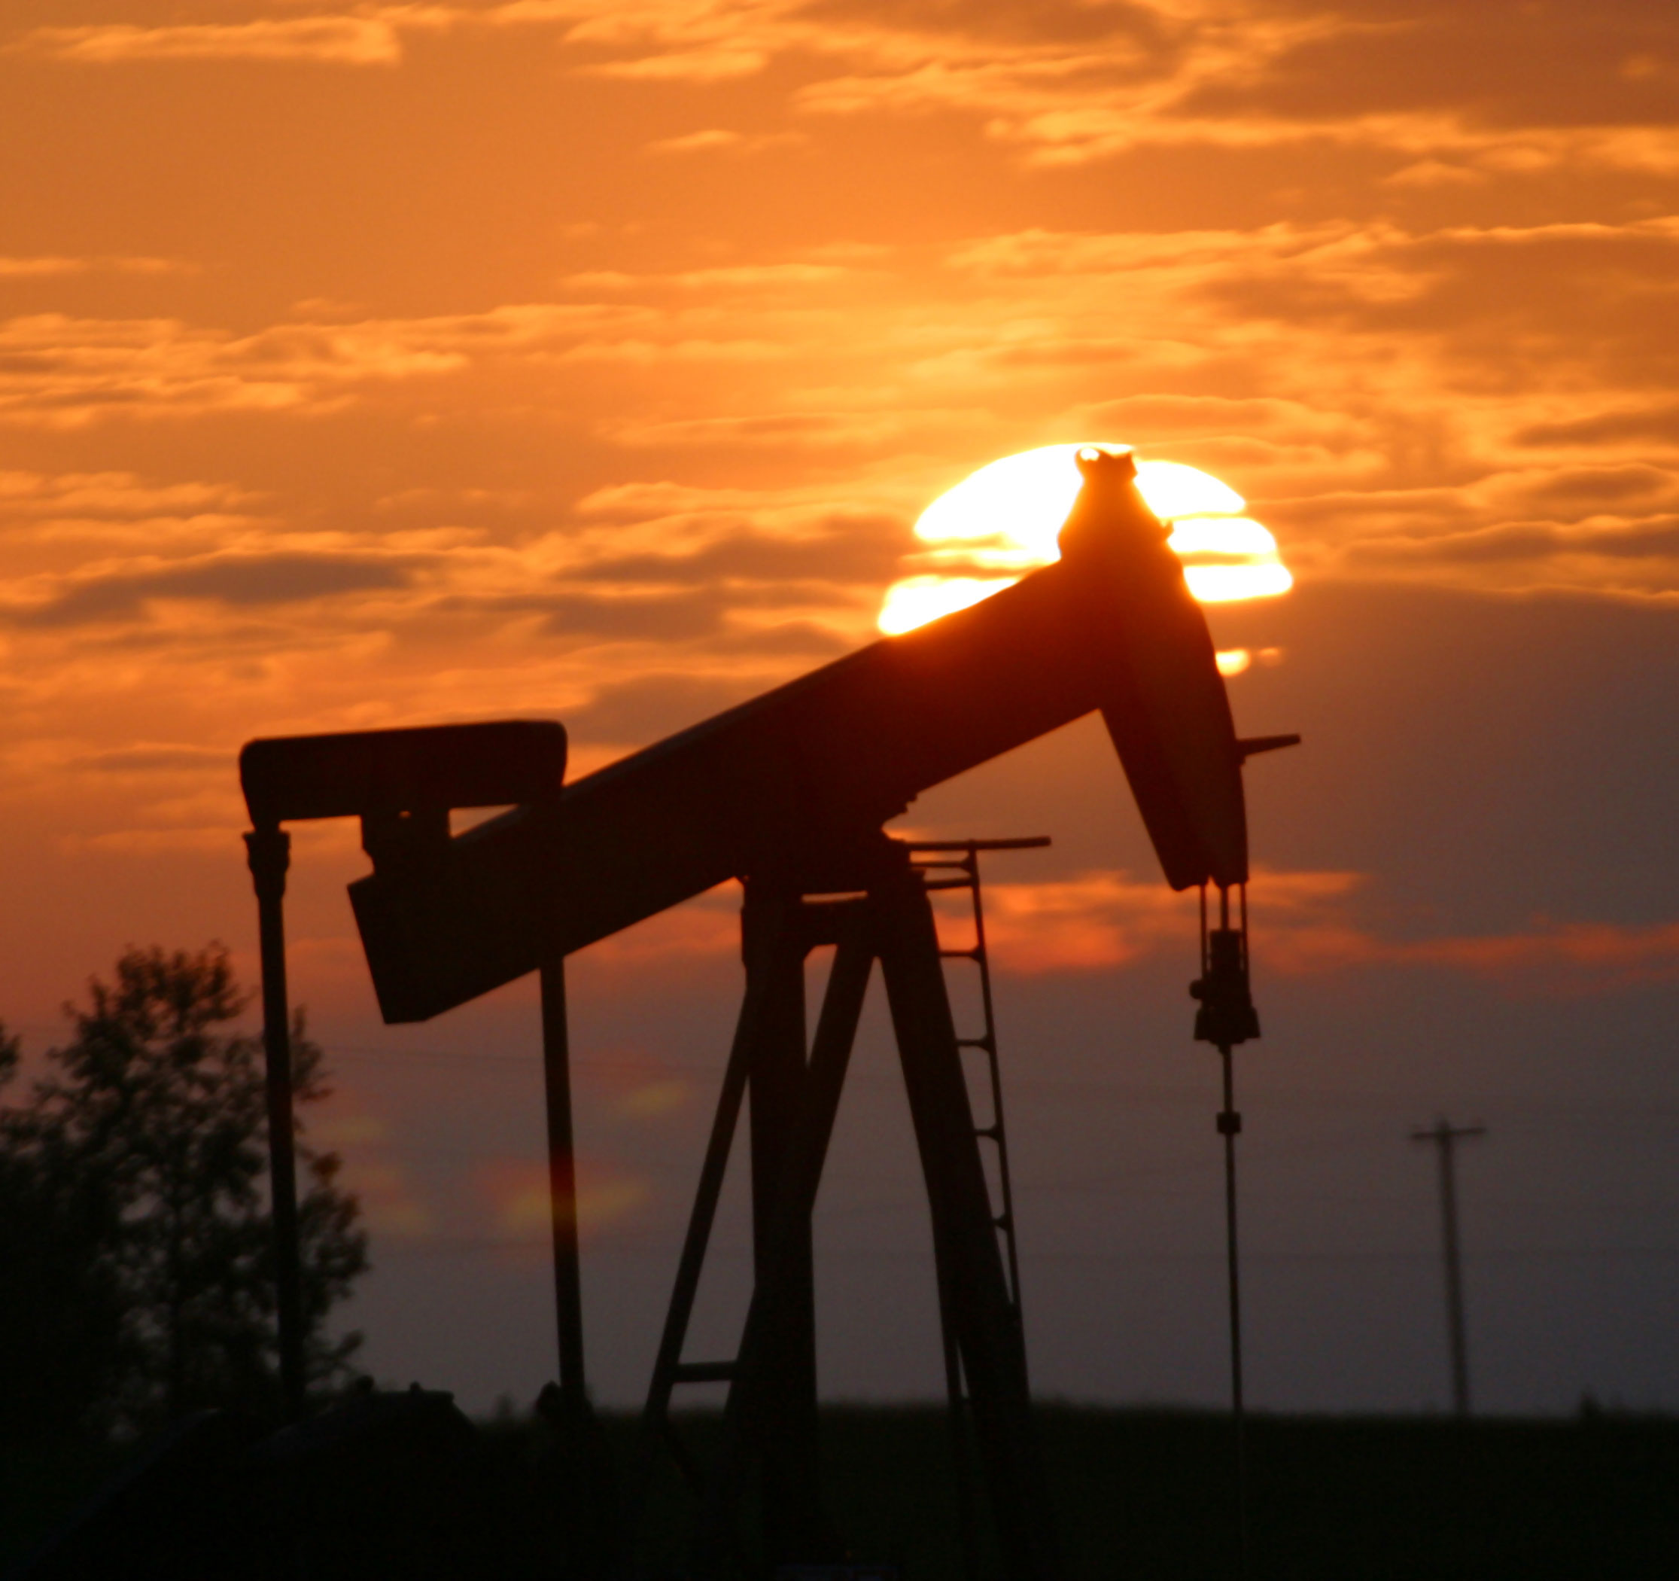
Performance of the Recovery System of an Oil Refinery
Prepared by
Ibrahim Kahraman

Slide 2
Foreknowledge
Objective: Analyze the existing performance of recovery system in an oil refinery
Groundwater Recovery
Oil Recovery
Site: Corpus Christi, Nueces County
Projected coordinate system: NAD_1927_StatePlane_Texas_South_FIPS_4205
Geographic Coordinate System: GCS_North_American_1927

Slide 3
Geology of the Area
Source: Texas Water Development Board – Geologic Database of Texas
Notes:
Qd – Deweyville Formation – Sand, silt, clay, and gravel, includes point bar, natural levee, and stream channel deposits, surface characterized by relict meanders of much larger radius of curvature than those of present streams; occurs along Nueces River at three levels: 5-20, 20-30, and 40-55 feet above level of Recent floodplain
Qb- Beaumont Formation – with barrier island and beach deposits.
Mostly clay, sild, and sand, and gravel: includes mainly stream channel, point bar, natural levee, backswamp deposits, and to a lesser entent coastal marsh, mud flat. Lagoonal.
Dominantly clay and mud of low permeability, high water holding capacity, high compressibility, high to very high shrink-swell potential, poor drainage, level of depressed relief, low shear strength

Slide 4
All Petroleum Facilities’ Well in the Area

Slide 5
Onsite Wells

Slide 6
Why are those wells for?
CPT (Cone Penetrating Testing) – method used to provide soil properties and delineating soil stratigraphy(6 wells)
Recovery Wells – Used for Extraction LNAPL (Light Non-Aqueous Phase Liquid) and Groudwater (88 wells)
Observation Wells – Used for gauging only (85 wells
Monitoring Wells – Used for Gauging and Sampling (24 wells)

Slide 7
Groundwater Quality Parameters
 | Well ID:
Parameters | Critical PCLs
Metals (SW846 6010 & 6020A)
Arsenic | 1
Barium | 200
Chromium (Total) | 10
Lead | 1.5
Nickel | 150
Volatile Organics (SW846 8260B)
1,2-Dichloroethane | 0.5
1,4-Dioxane | 19
2-Butanone (MEK) | 4400
Benzene | 0.5
Carbon disulfide | 730
Chloroform | 4.3
Ethylbenzene | 70
Methyl tert-butyl ether (MTBE) | 73
Toluene | 100
m & p-Xylenes | 1000
o-Xylene | 1000
Semivolatile Organics (SW846 8270C)
1-Methylnaphthalene | 510
2,4-Dimethylphenol | 150
2-Methylphenol (o-Cresol) | 370
4-Methylphenol/3-Methylphenol | 37
Benzenethiol (Thiophenol) | 0.073
Bis(2-ethylhexy)phthalate | 0.6
Diethylphthalate | 5800
Naphthalene | 57
Phenol | 2190

Slide 8
ANT Effect on Confined/Unconfined LNAPL
Figures were provided from H2A Environmental Ltd.

Slide 9
Source: H2A Environmental Ltd.

Slide 10
LNAPL Isolepth Map

Slide 11
Groundwater Surface Contour

Slide 12
Total Recovery Rates of Wells in first half of 2011
Total Groundwater Recovery
Total Hydrocarbon Recovery

Slide 13
Recovery Rates of Wells – 1998 thru 2011

Slide 14
Questions?
Thank you!
ibrahimkahraman@utexas.edu
ibohero.3e@gmail.com

