Slide 1
Land Cover and Soil Properties of the San Marcos Basin
Cody McCann

Slide 2
Agenda
1. Study Area
2. NDVI and SAVI
3. Future Endeavors

Slide 3
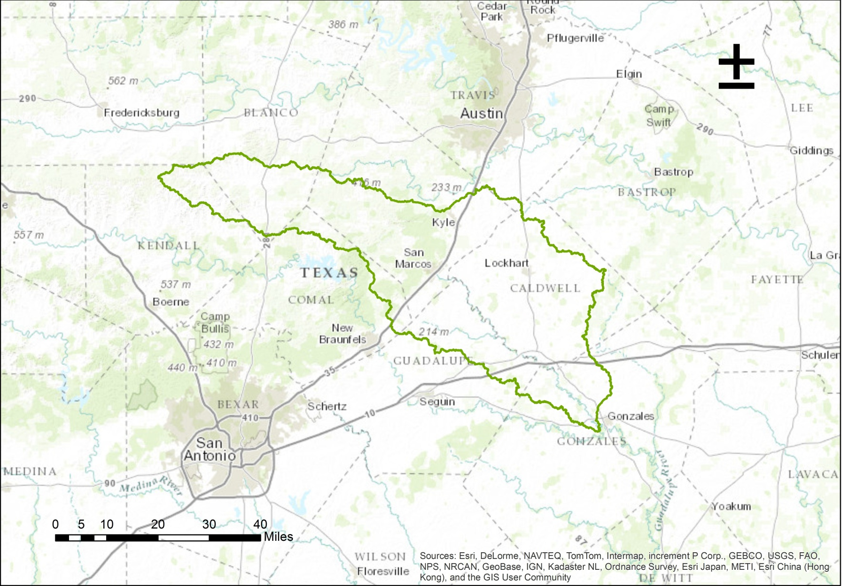
The Good Ol’ San Marcos Subbasin

Slide 4
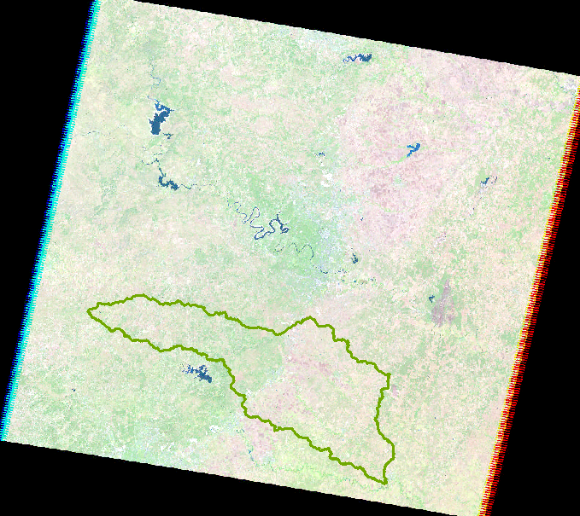
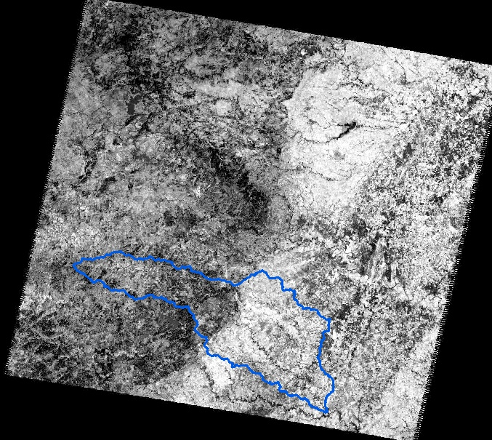
Raw Landsat Data
Thermal Imagery DN: 8-bit, ranging from 0-255
Normal Imagery: Red, Green, and Blue Composite Bands

Slide 5
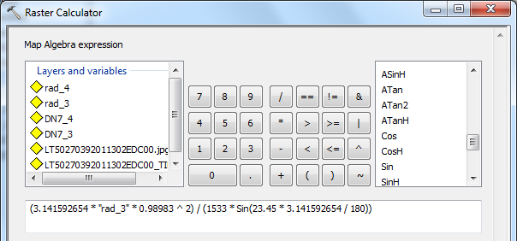
NDVI and SAVI Progress Diagram
Conversion
Radiance
Reflectance
Correction
Calculate the Radiance from Landsat 7
Landsat 5 TM to Landsat 7 ETM+
Convert the Radiance into Reflectance
Correct Reflectance Data

Slide 6
NDVI

Slide 7
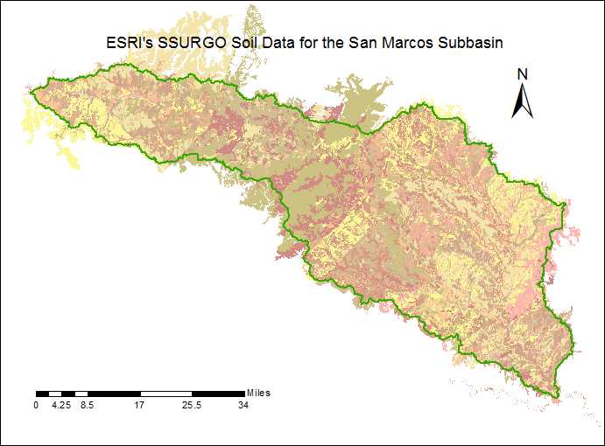
Why SAVI?
Soil-Adjusted Vegetation Index
Best used when:
Low Vegetative Cover
Different Soil Types
Modification of NDVI

Slide 8
SAVI of the Subbasin

Slide 9
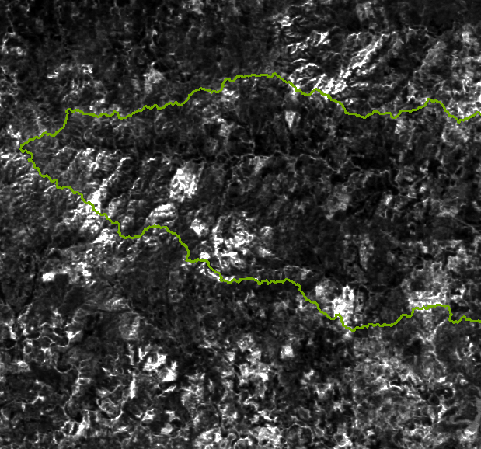
Direct Relation to Water

Slide 10
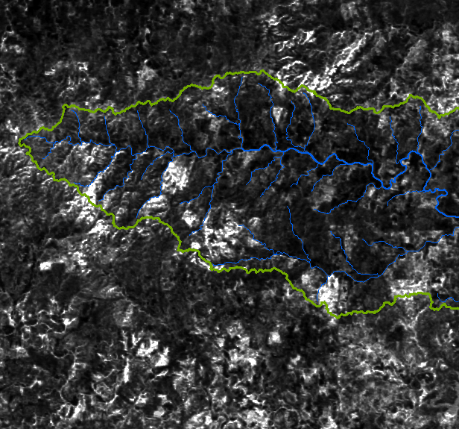
Direct Relation to Water

Slide 11
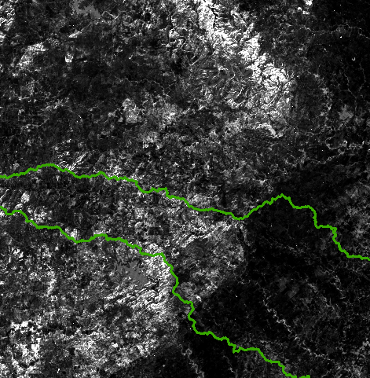
Relation to the Edwards Aquifer

Slide 12
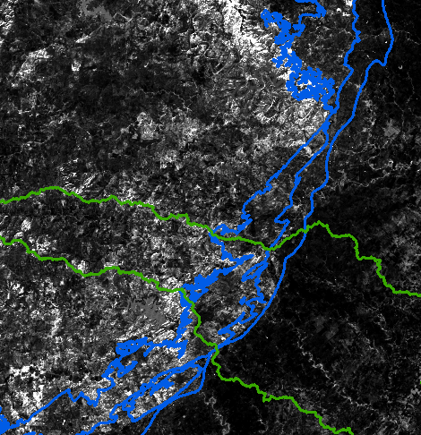
Relation to the Edwards Aquifer

Slide 13
Future Endeavors
Soil Brightness
Soil and Land Cover
Soil and Stream Network

Slide 14

Questions?
Thanks!
Dr. Maidment and Dr. Kilic

