Slide 1
Applications of ArcGIS in Transportation Planning (Analysis of Downtown Austin Network as case study)
Moggn Motamed
GIS in Water Resources

Slide 2
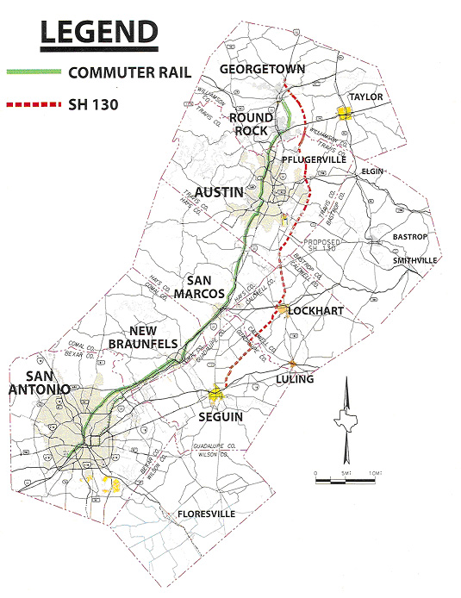
What is important Here?
what would be the impact
on traffic be if an extra lane was added on I-35?
If the toll on SH-130 was reduced?
If incident happens during rush hours?
And so many question…
Notes:
Transportation planning is an important process in ensuring that transportation spending and policies are as effective as possible. As transportation engineers and researchers, we support this process by developing and running models which predict the impact of potential projects or policies for instance, in Austin, what would be the impact on city traffic and emissions be if an extra lane was added on I-35? If the toll on SH-130 was reduced? If streetcar lines are installed downtown? In this way, the benefits of projects can be compared with their costs, and funding and implementation priorities established. Depending on the models used, a variety of measures of effectiveness can be
considered, and one may want to know the impacts of a project on mobility, congestion, emissions, equity, toll revenue, transit ridership, infrastructure maintenance needs, and any one of a vast pantheon of metrics.

Slide 3
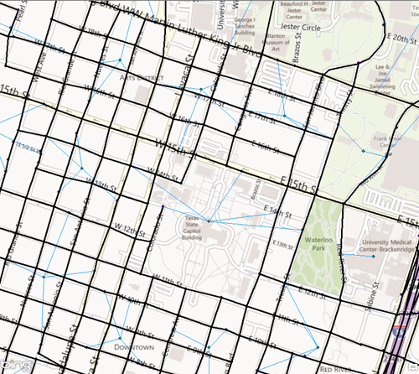
Network Terminology
Notes:
To predict ridership on a new transit line with complete accuracy would require knowing how many trips every single possible rider makes, and the decision process each one of these potential riders uses when deciding whether or not to use transit.
There are many possible measures of effectiveness for evaluating the impacts of a transportation project or policy. Many of these can be calculated if one can predict the number of drivers on each roadway segment, the number of passengers on each bus route, and so forth. These are called link flows. Predicting link flows allows a city or state government to evaluate different options. Link flows are the output of a planning model, the main input is demographic data. Census records form an invaluable resource for this, often supplemented with travel surveys.
a network consists of links and nodes. In transportation applications, a link usually represents a means of travel from one point to another: a road segment between two intersections.
It is usually convenient to use a node to represent each zone; such nodes are called centroids, and all trips are assumed to begin and end at centroids.

Slide 4
Traffic Assignment
X=3
X=6
Notes:
How to obtain the link flow?! There is 2 different approach
Dynamic network models have the potential to more accurately model traffic, but are harder to calibrate, are more sensitive to having correct input data, and require more computer time.
The question of whether a static or dynamic model is more appropriate depends on the application at hand. Speaking very broadly, dynamic models are often preferred when you want relatively detailed information on the traffic flow itself.
On the other hand, static models tend to be preferred (1) if there are a large number of scenarios to study; (2) the input data are not known with a high degree of accuracy (e.g., long-range predictions); (3) your network is not highly congested;

Slide 5
Agenda
ArcGIS Network Analysis Tool box (STA)
Create a network data set
Find the quickest route to visit a set of stops
Find the closest fire stations
Create a model for route analysis
Configure live traffic on a network dataset
VISTA & ArcGIS to Analyze Downtown Austin Network (DTA)
Scenario 1: Base Network
Scenario 2: Having Construction on 2nd St. (advance info to driver)
Scenario 3: Incident happened in 2nd St. (drivers do Not have info)
Scenario 4: Proportional ( half of drivers know about closure on 2nd St.)

Slide 6
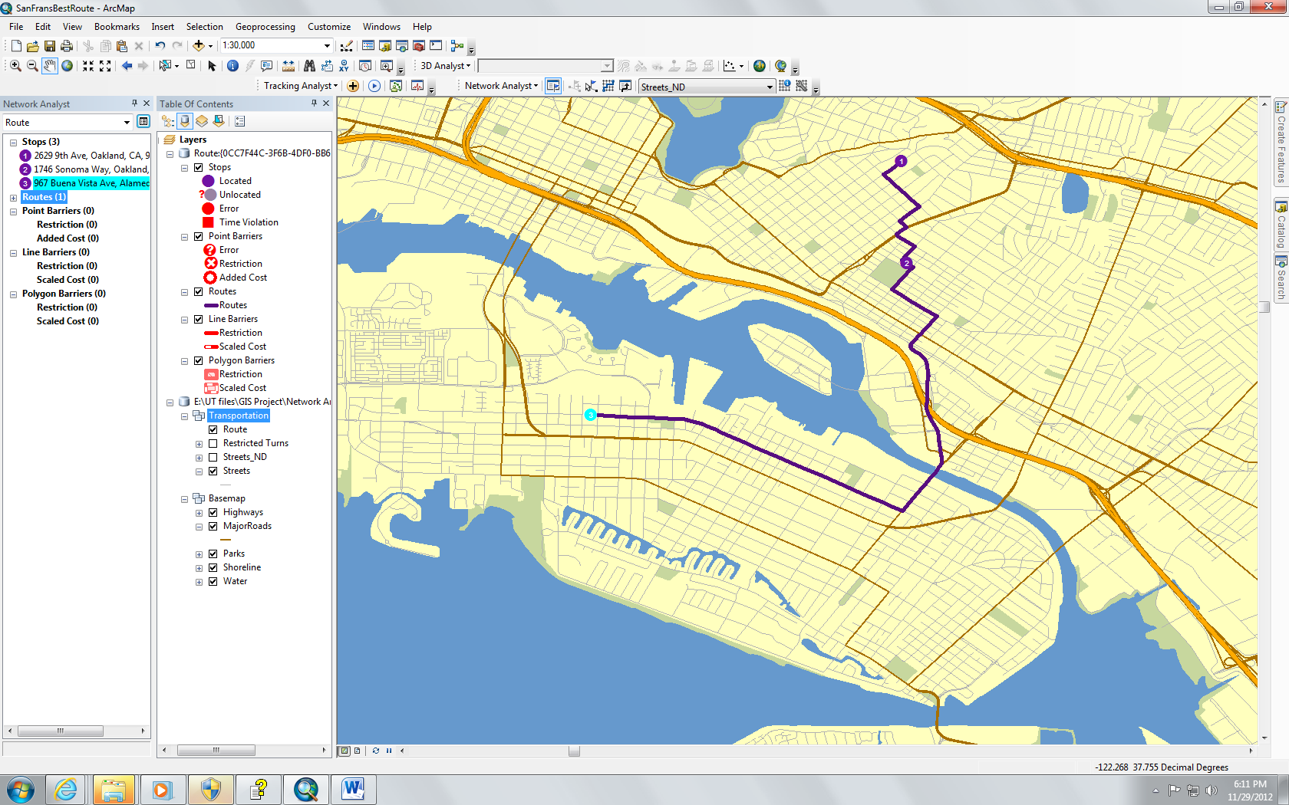
Network Analysis: Find the quickest route to visit a set of stops
Notes:
as a first step we need to create a network data set. It is not possible to just add a streets feature class to ArcMap and start finding shortest routes or perform other network analyses. Simple features, like the line features that represent streets, are not aware of one another. Network datasets, however, store the connectivity of features. Therefore, instead of using street features directly, you need to create a network dataset in ArcCatalog from the streets, then the ArcGIS Network Analyst extension can reference the network dataset for everything it does.
you will find the quickest route to visit a set of stops in a predetermined order. This network dataset has historical traffic data associated with the TravelTime (Minutes) attribute.

Slide 7
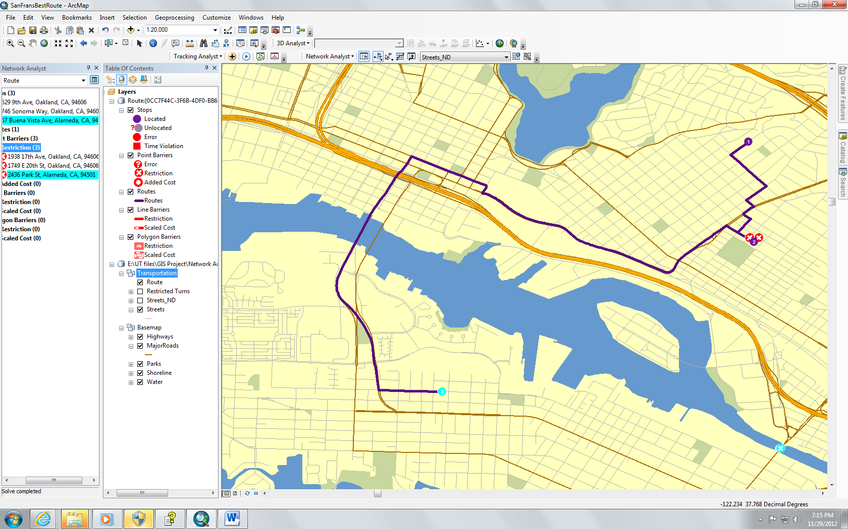
Network Analysis: Find the quickest route to visit a set of stops with barriers

Slide 8
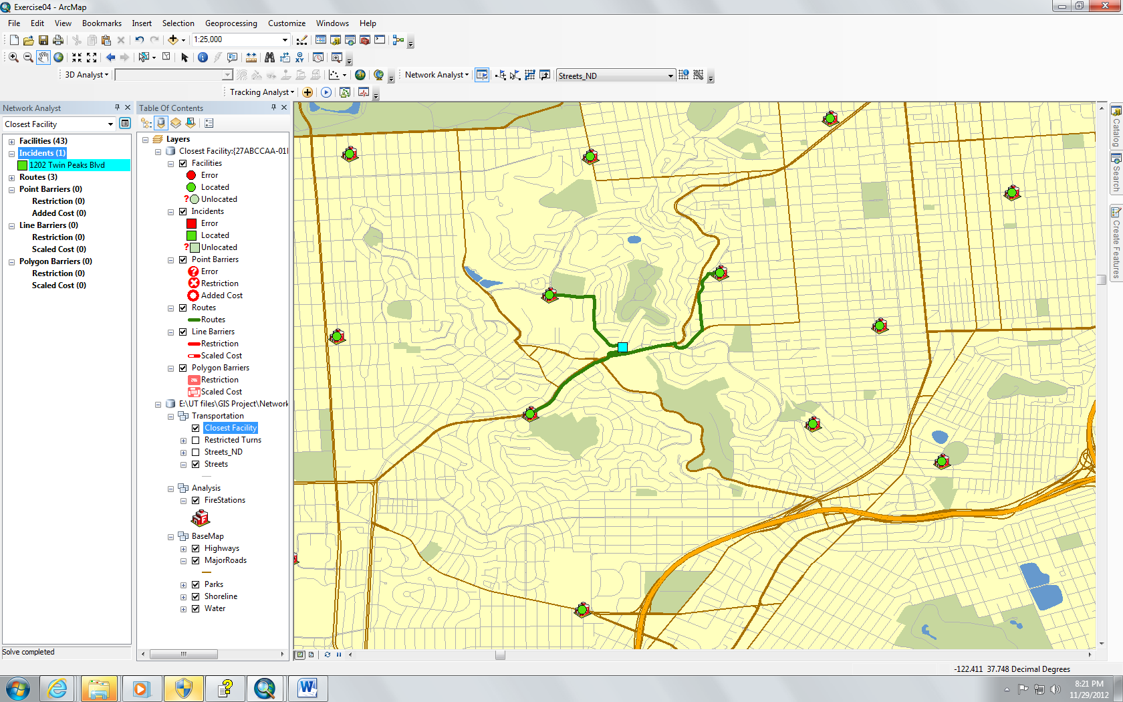
Network Analysis: Finding the closest fire stations

Slide 9
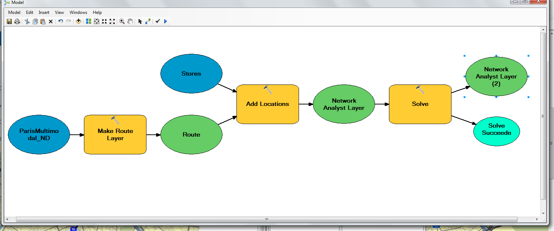
Network Analysis: Creating a model for route analysis
Notes:
Network analysis has the capability of creating a model to optimize the fastest delivery route connecting 21 stores in Paris.

Slide 10
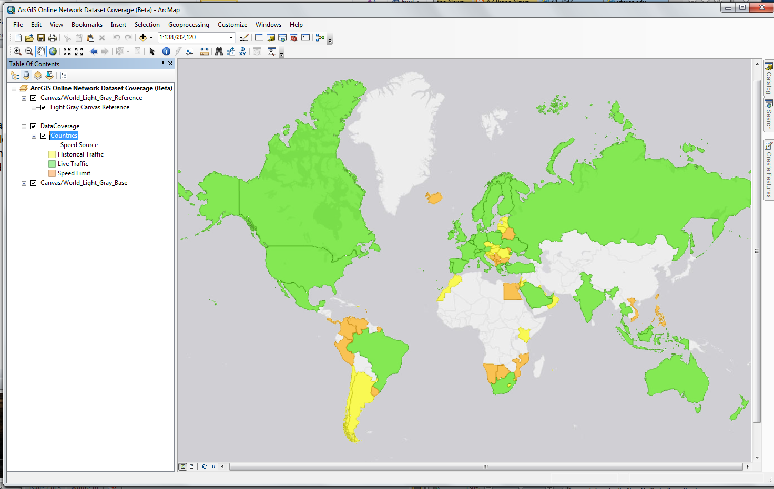
Network Analysis: Configuring live traffic on a network dataset
Notes:
Click thumbnail to change image. This map shows which countries are partially or fully covered by ArcGIS Online's network dataset. We can perform network analyses and access live traffic feeds through ArcGIS Online services.

Slide 11
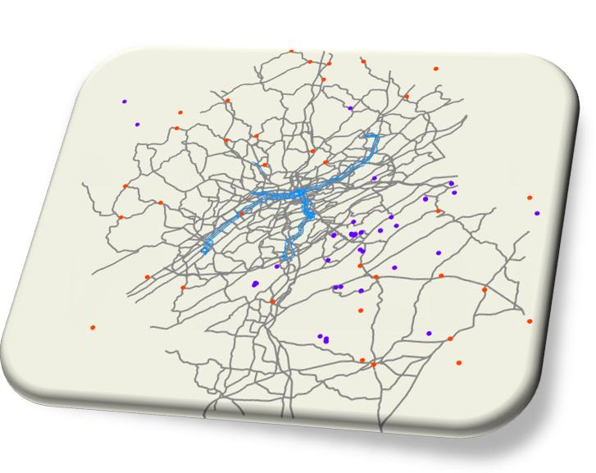
Network Analysis: Configuring live traffic on a network dataset
Notes:
I created a network dataset in a geodatabase using San Diego street, turn, and signpost features. The network dataset will also include historical and, optionally, live traffic data, which makes it possible to view travel speeds for different times of day and solve time-dependent network problems.
The ArcGIS Network Analyst extension recognizes the schema of the tables and automatically configures the historical traffic sections of this page in the wizard. It also configures the table for the live-traffic section, but not the Traffic Feed Location property.

Slide 12
VISTA & ArcGIS to Analyze Downtown Austin Network (DTA)
Scenario 1: Base Network
Scenario 2: Having Construction on 2nd St. (advance info to driver)
Scenario 3: Incident happened in 2nd St. (drivers do Not have info)
Scenario 4: Proportional ( half of drivers know about closure on 2nd St.)

Slide 13
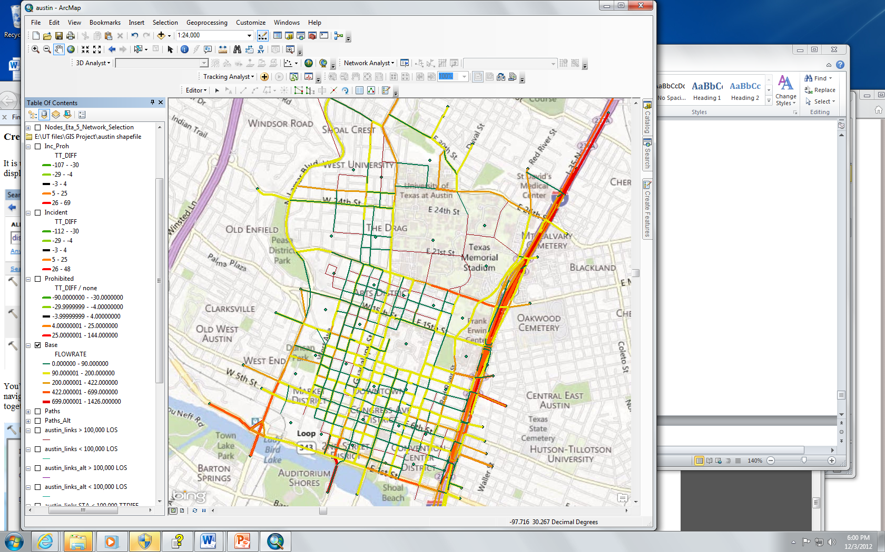
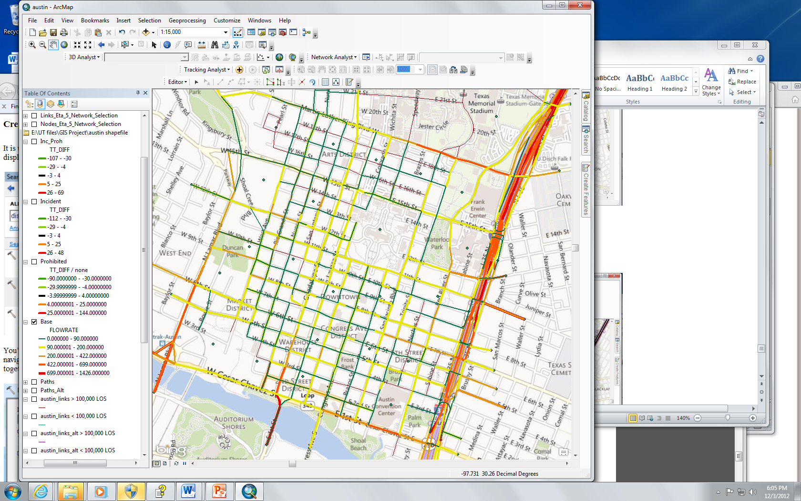
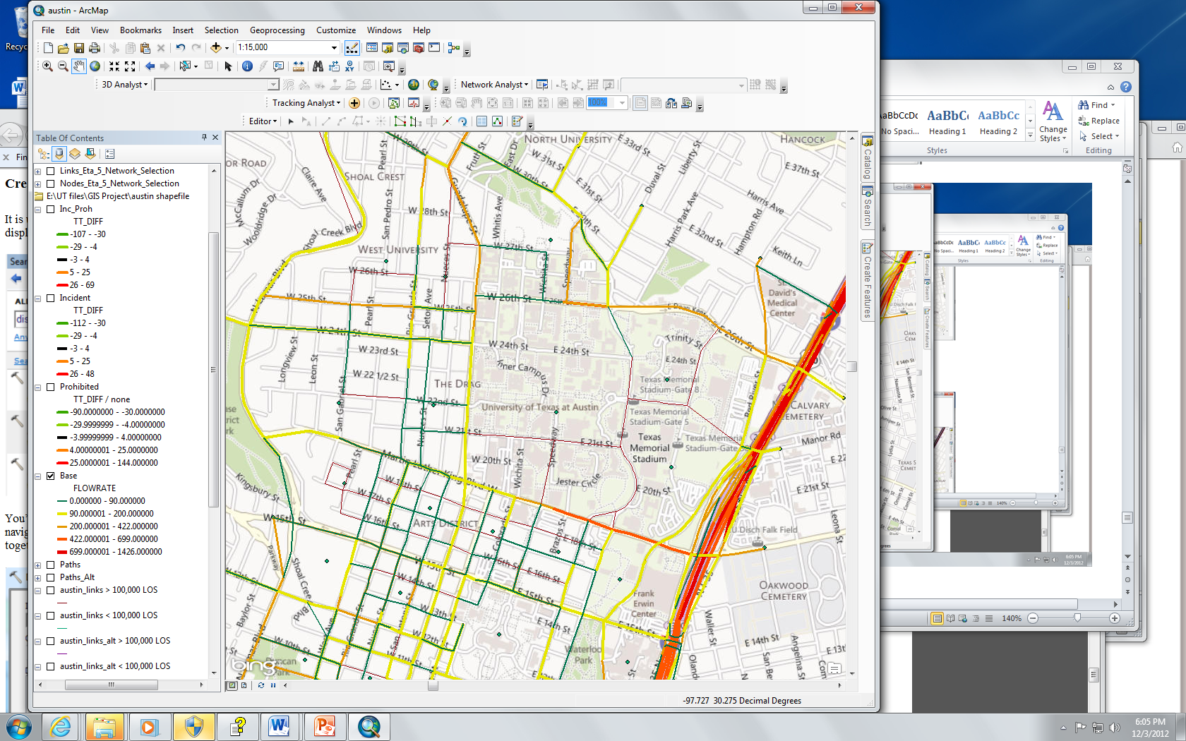
VISTA & ArcGIS Scenario 1: Base Network

Slide 14
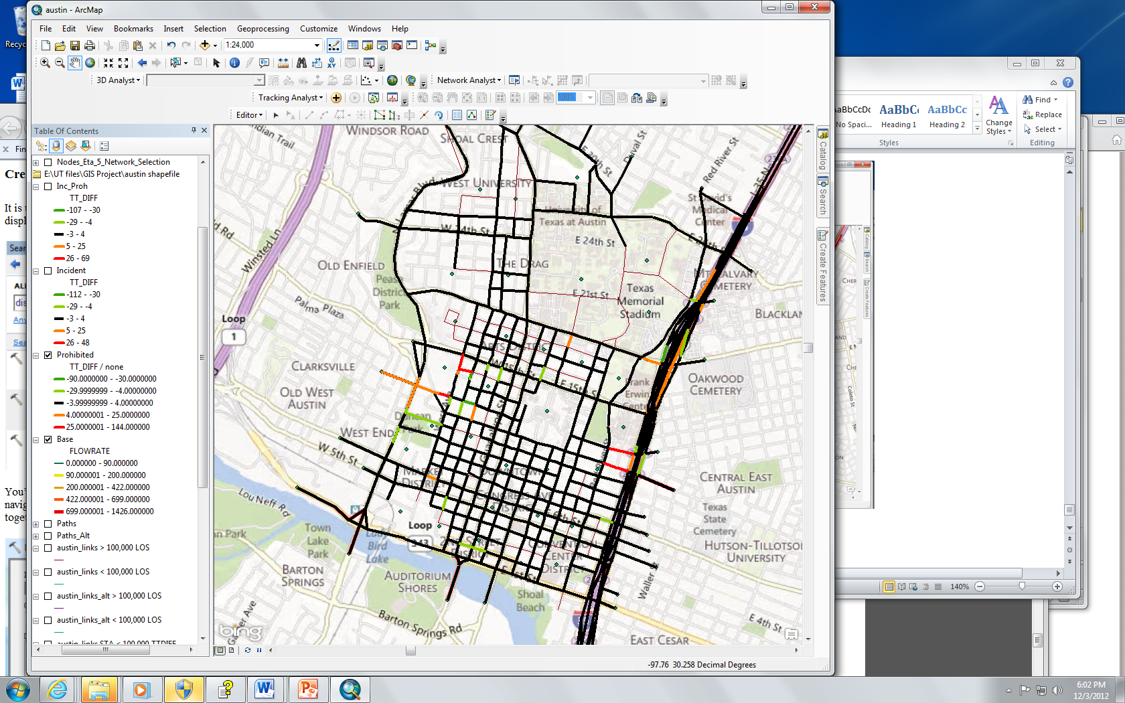
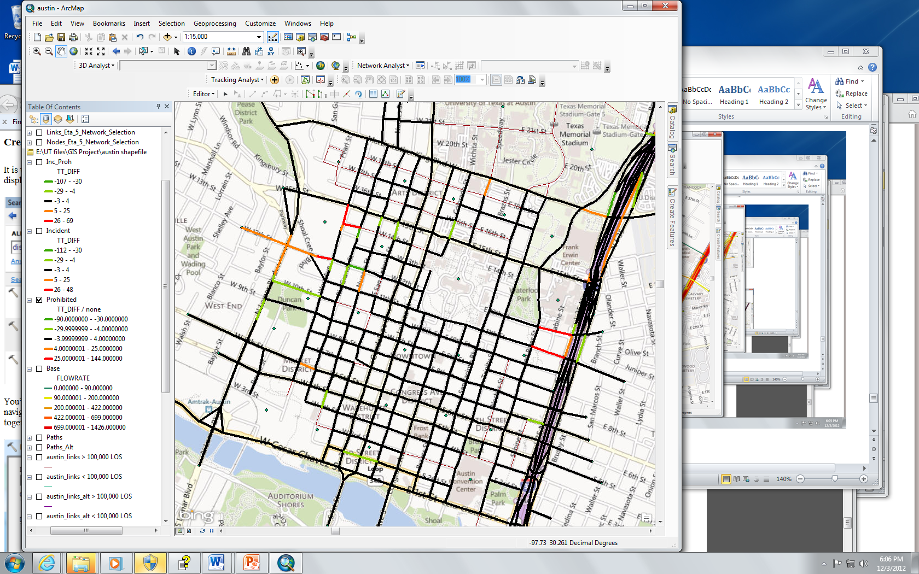
VISTA & ArcGIS Scenario 2: Having Construction on 2nd St. (advance info to driver)

Slide 15
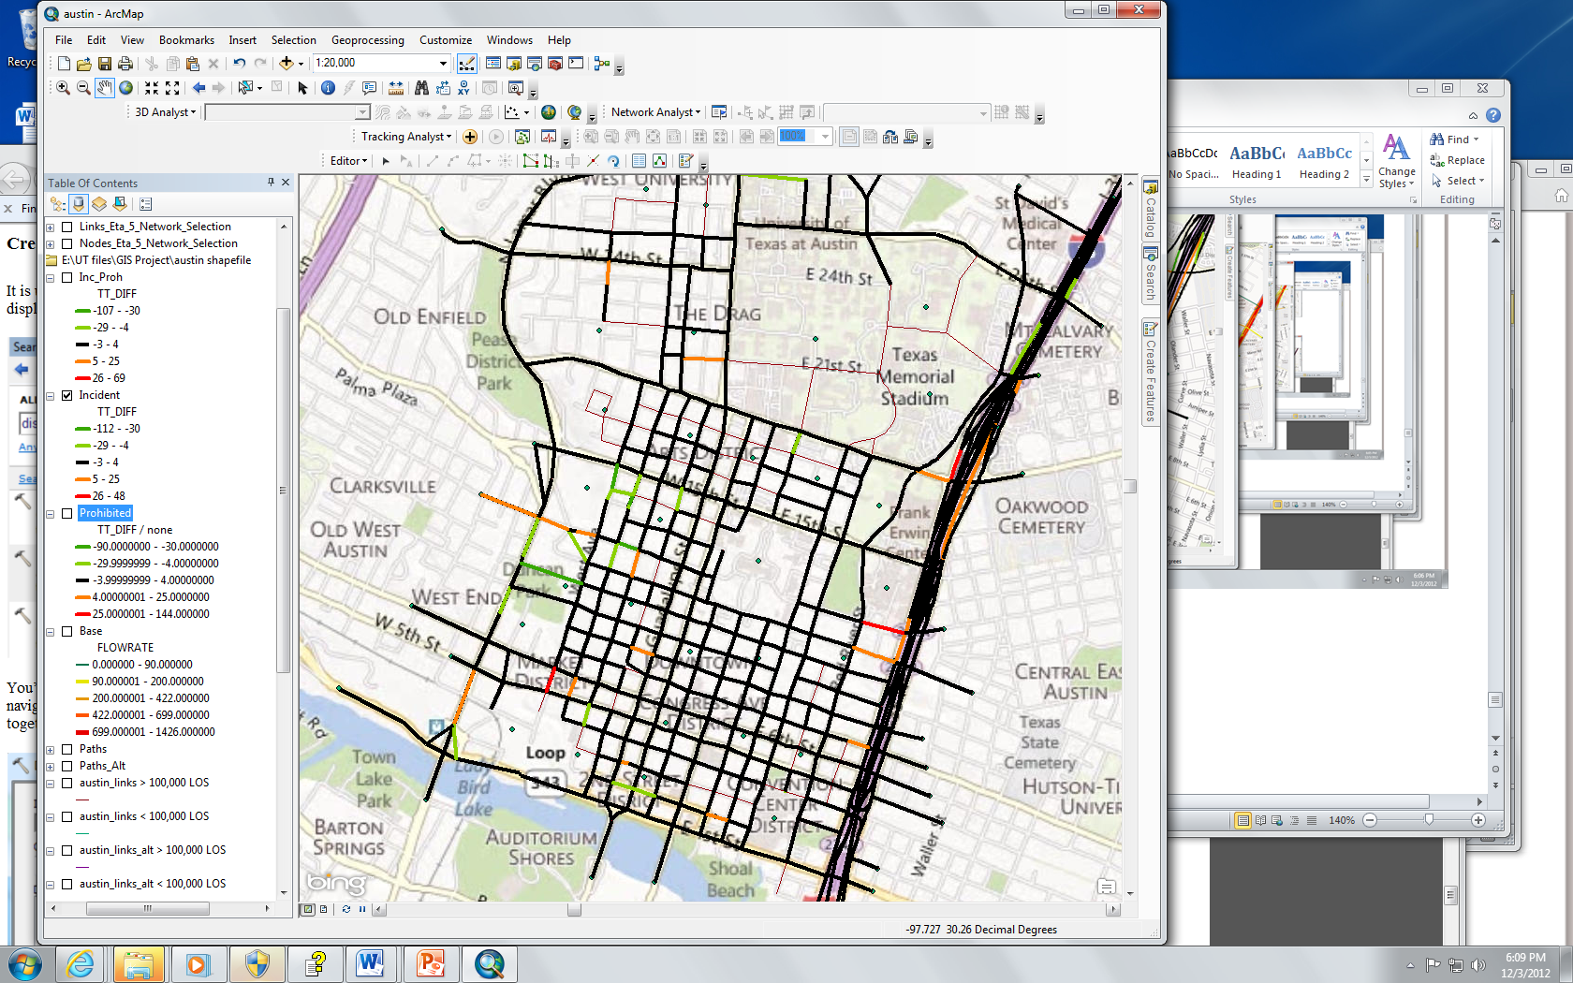
VISTA & ArcGIS Scenario 3: Incident happened in 2nd St. (drivers do Not have info)

Slide 16
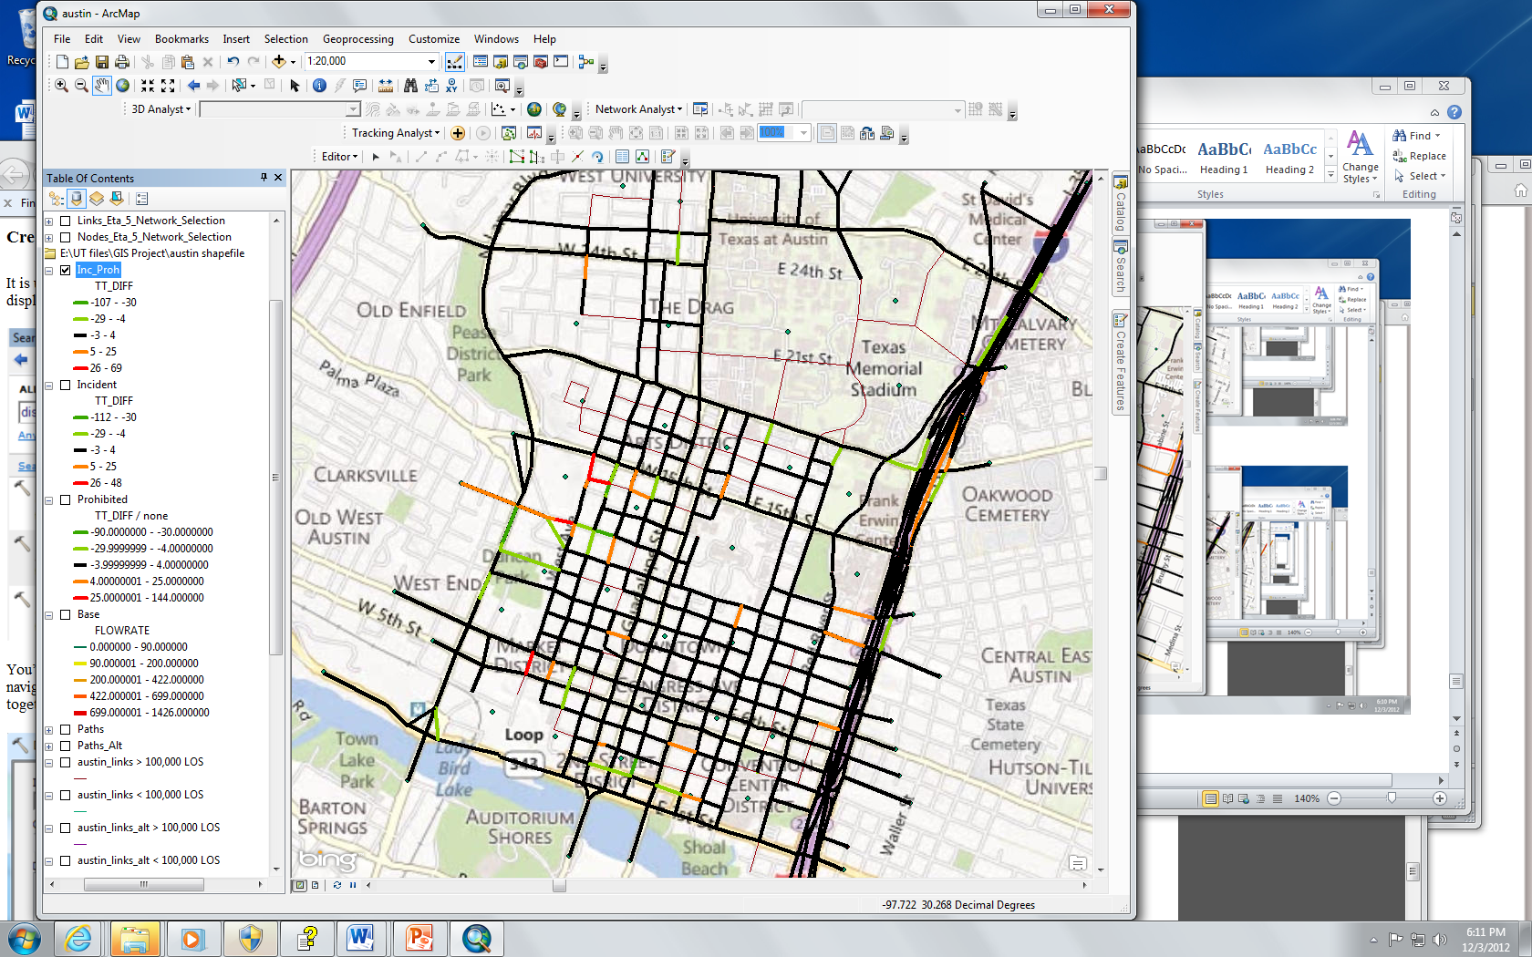
VISTA & ArcGIS Scenario 4: Proportional ( half of drivers know about closure on 2nd St.)

Slide 17
Conclusion & Future work
So many application
Easy to use
Develop an extension based on more accurate method
Using ArcGIS to improve VISTA

Slide 18
Thank you for your attention

