Slide 1
NWIS Snapshot Tool
A User Experience
Prepared By: David Navar

Slide 2
Overview of Presentation
Background Information
Process I used to Evaluate the Tool
Commentary On Using the Tool

Slide 3
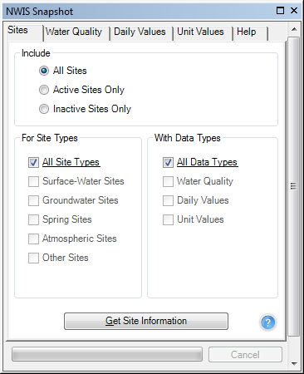
What is the Snapshot Tool?
Add-on to ArcGIS
Search for NWIS Data Geographically
Populate a Geodatabase in ArcGIS

Slide 4
Available Data
National Water Information System (NWIS)
USGS water data uniting all state water data
1.5 million sites across all 50 states.
Surface water, groundwater Spring and atmospheric
Water quality, Daily values and Unit values.

Slide 5
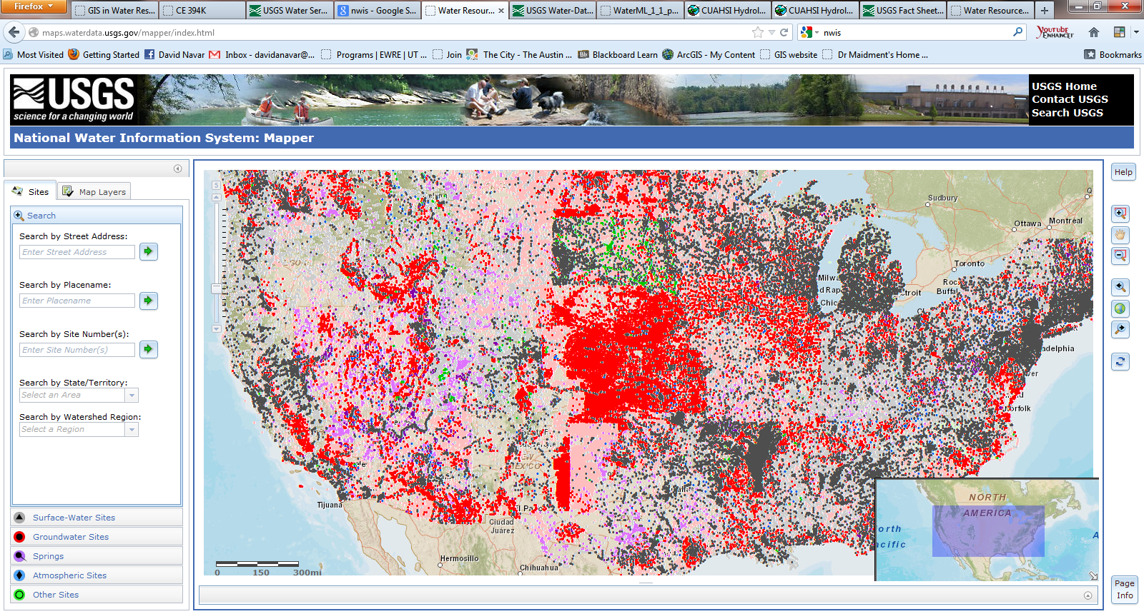
NWIS Site Monitoring Locations

Slide 6
What did I do?
Used the tool to evaluate surface water in the Los Angeles HUC 8 watershed.

Slide 7
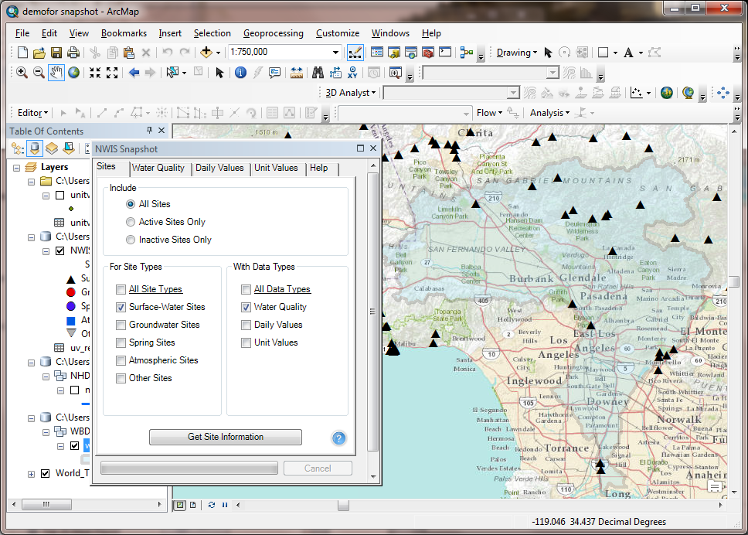

Slide 8
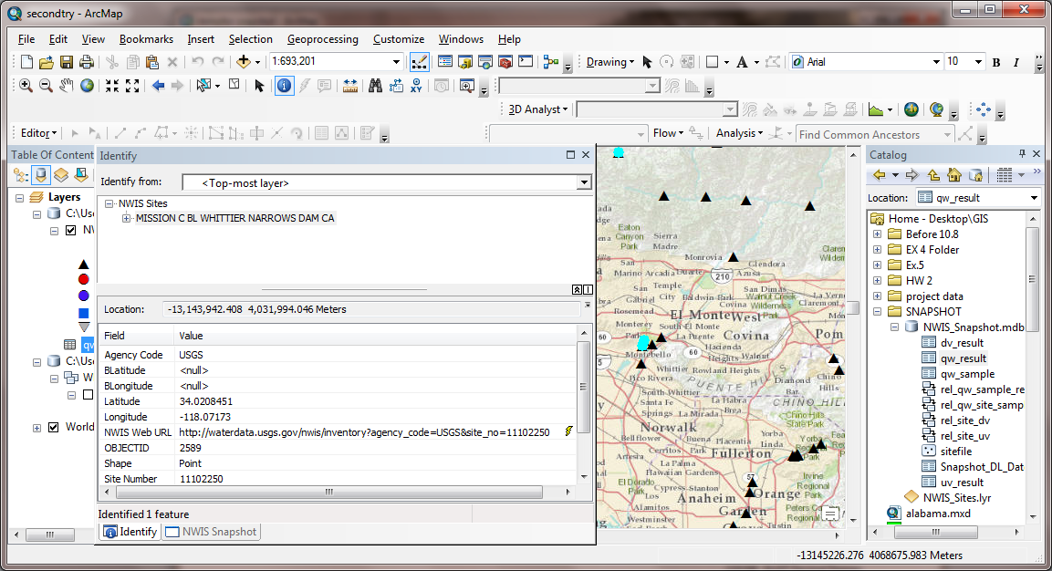

Slide 9
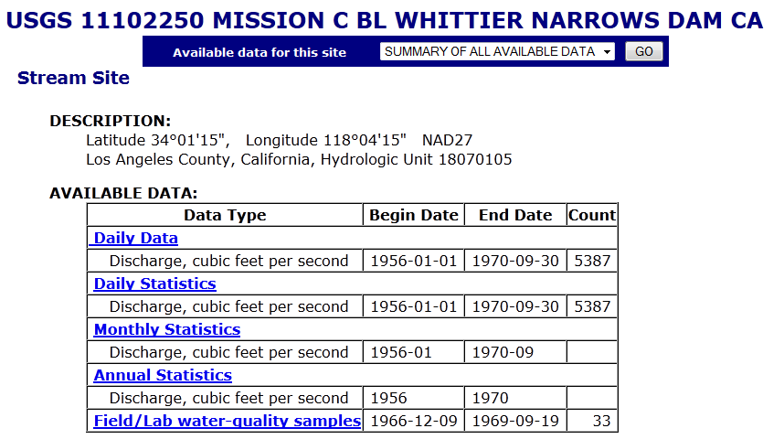

Slide 10
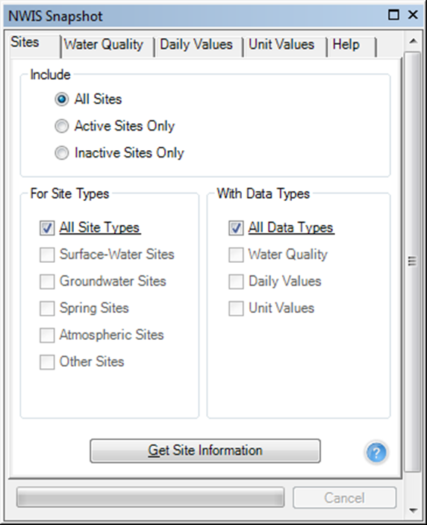
What did I do?
Water Quality Data
USGS & USEPA water quality data. Fewer data points in time
Daily Values
Historical daily data. Sites include mean, median, maximum, minimum, and/or other derived values.
Unit Values
Instantaneous, current stream flow and other real-time data. Uses WaterML.

Slide 12
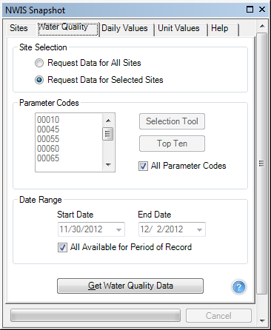
Water Quality Analysis Process
WQ Sample
WQ Result
Site Information
Joined by SampleID Number

Slide 13
Data Formatting
Must Use Join and Relate Table function for three Tables
All retrieved data is in string format
Must copy and paste data into “double” format
Often changed in importing and exporting of Data
Date and Time format was unusable by GIS
Must export data to excel to reformat
Essentially have to Manage data outside of GIS

Slide 14
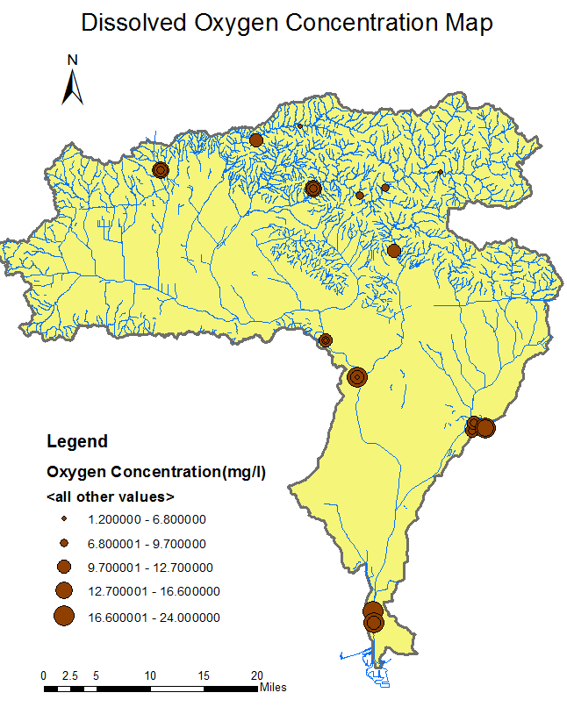

Slide 15
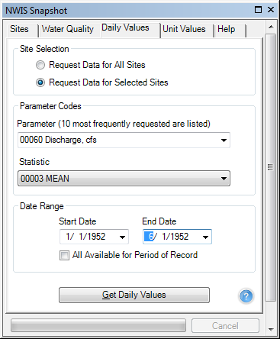
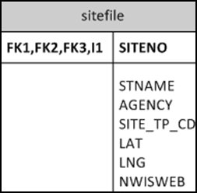
Daily Value Analysis Process
Site Information
Daily Values

Slide 16
Data Formatting
Must join and relate two tables instead of 3
Same Data format Problems as before

Slide 19
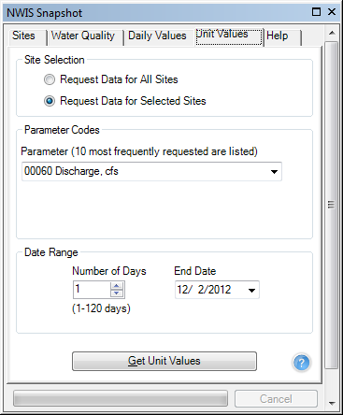
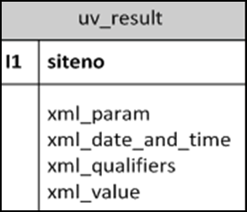
Unit Values Analysis Process
Instantaneous Values
*Joined by Site Number

Slide 20
Data Formatting
Must Join and Relate two tables instead of 3
More Data formatting issues than before
Complexity of the value data type
Automatically reverts data to sting upon import and export of Data

Slide 22
Issues
Output Data is not ArcGis friendly
All data is in String format
“double” is preferred
Data Points are not linked to a position
Should be linked to Longitude and Latitude
Must use outside service for data management
Ex. Excel
Nuances Importing and exporting in ArcGis

Slide 23
Commentary
Very Powerful data acquisition tool
Minimizes User-End Complexity in finding data
The future of finding water data
Needs Development

Slide 24
Acknowledgements
Dr. Maidment
Gonzalo Espinosa
Sally Holl, “NWIS Web Services Snapshot for ArcGISUSGS” Texas Water Science Center Austin, Texas

Slide 25
Questions?
Thanks for Listening!

