Slide 1
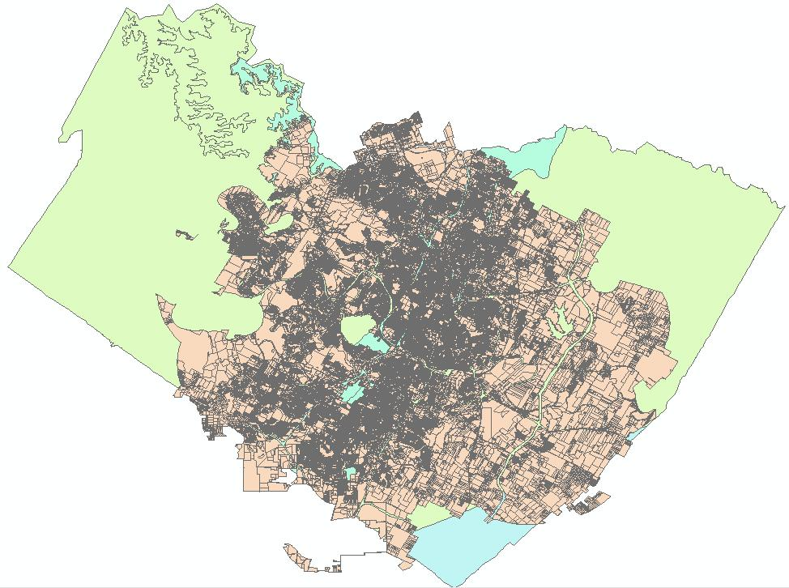
The DRASTIC Assessment of Travis County
Brian Au

Slide 2
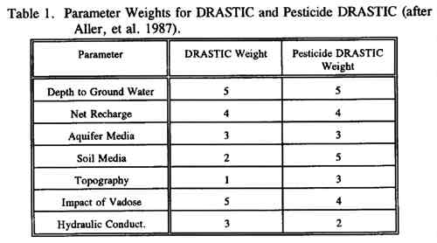
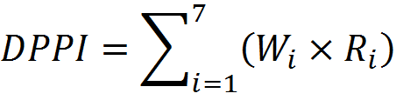
What is DRASTIC?
EPA Model (1985) groundwater susceptibility to pollution
Governing Equation:

Slide 3
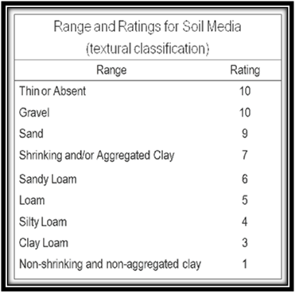
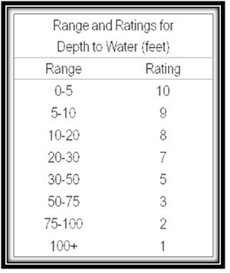
Examples of Parameter Ratings

Slide 4
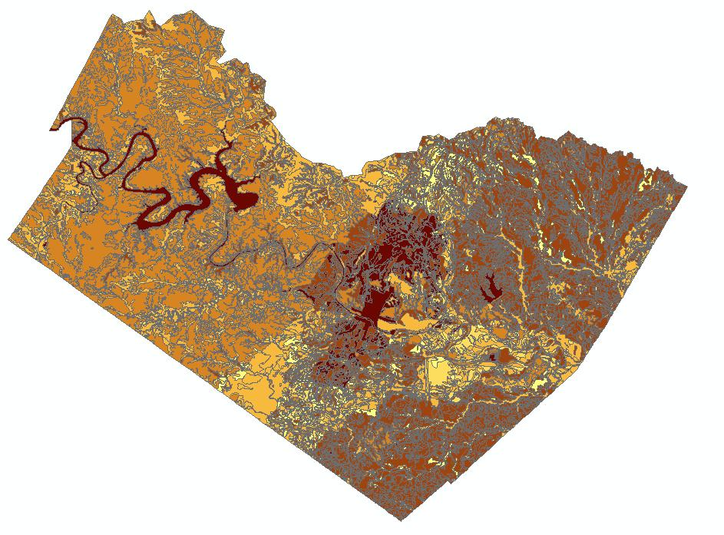
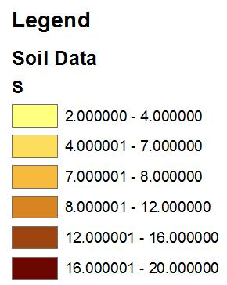
Example of a DRASTIC Parameter Map

Slide 5
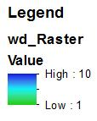
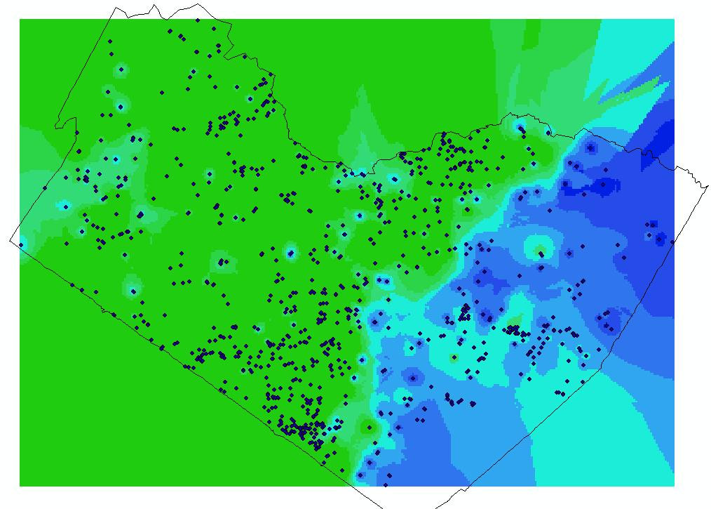
Works in Progress (water depth)
Almost half is downdip
from the Trinity aquifer!

Slide 6

Why should we care?
Because we’re environmental engineers!
  And why should everyone else care?
Better allocation of resources
Cheap!
Pretty maps

Slide 7
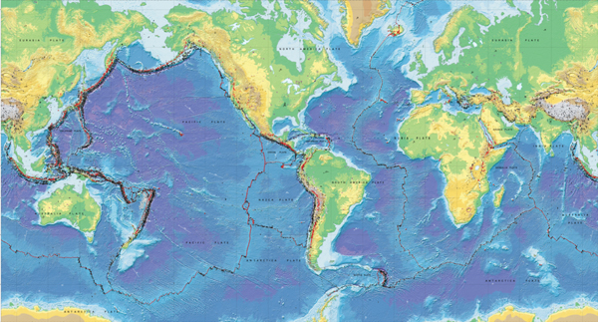
Where in the world is vadose zone data?

