Slide 1
The Impact of Large Storm Events on Nutrient Loadings in Texas Rivers
Paul Bireta
December 4, 2012

Slide 2
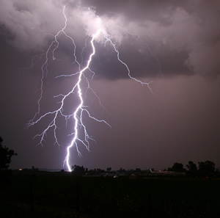
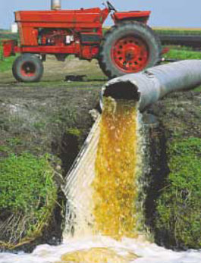
Project Objectives
What effects do storm events have on water quality in Texas river?
Are storm events the main driver for contaminated runoff?
?

Slide 3
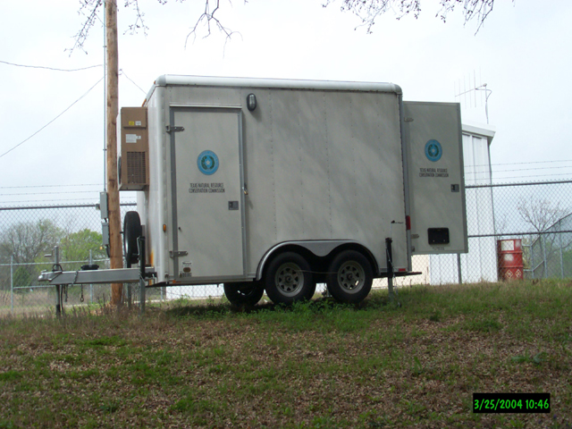
TCEQ CWQMN
Continuous Water Quality Monitoring Network
Data is available for 12 Texas basins
and 2 conservation districts
Near real time data
Some parameters include:
Nitrate, ammonia, turbidity,
dissolved oxygen, chloryphyll,
pH, specific conductance…
Many sites are no longer active
Some holes in data due to maintenance issues

Slide 4
Target Contaminants
Nitrate
EPA drinking water MCL of 10 mg/L
Can be harmful to infants – blue baby syndrome
Ammonia
Potentially harmful to wildlife – under review by EPA
Phosphorous
Can lead to eutrophication
Main source in water is from soil erosion
Dissolved Oxygen (deficit)
Oxygen is used by microorganisms in breaking down waste
Low dissolved oxygen levels can be harmful to wildlife

Slide 5
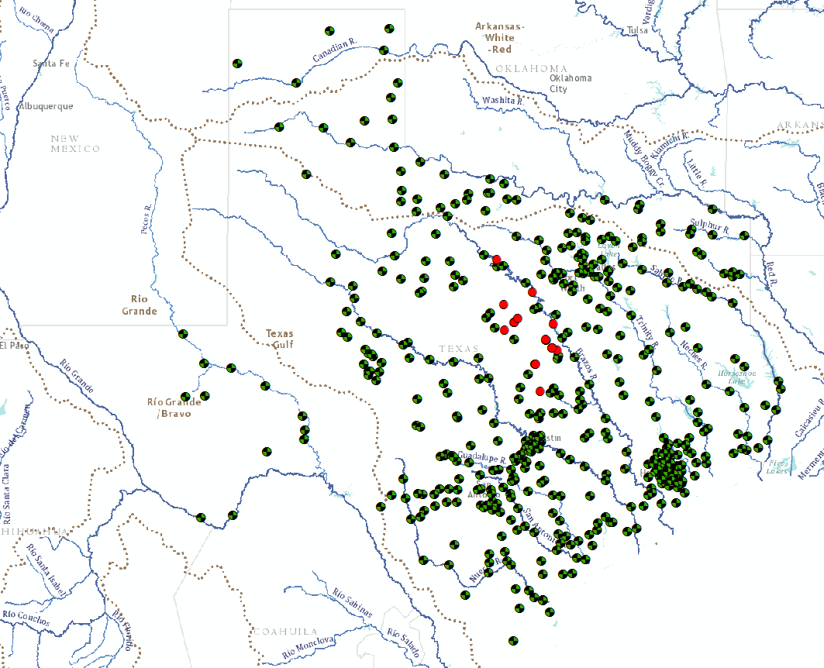
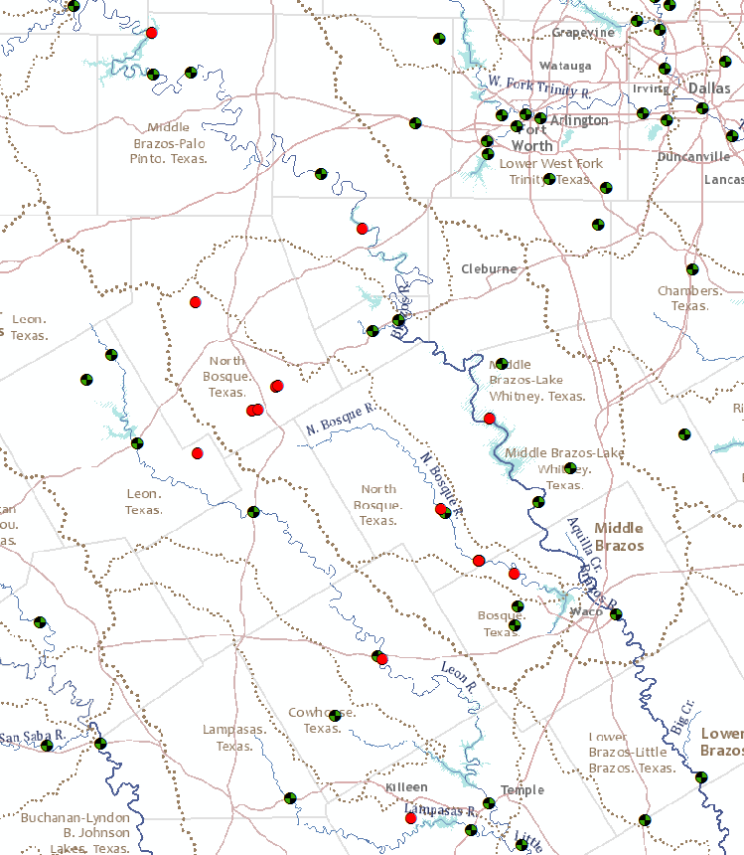
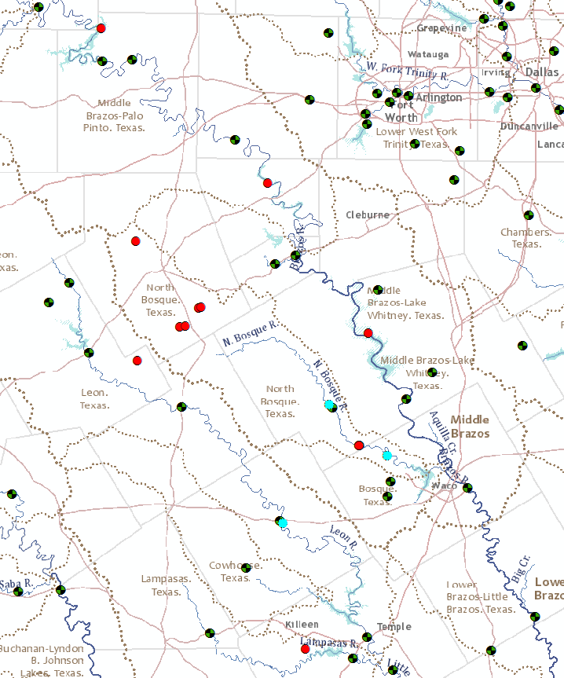
Site Background
Brazos watershed was selected due to available water quality data
Specific sites chosen which had the most complete data and were paired with USGS stream gages

Slide 6
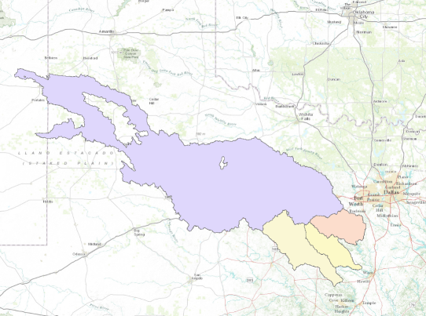
Watershed Mapping
Drainage areas were found using ‘Watershed_nosimp’ tool from Worldwatershed
Outlet point was selected as TCEQ CWQMN station
Only watersheds with significant data were analyzed further
3 out of 13

Slide 7
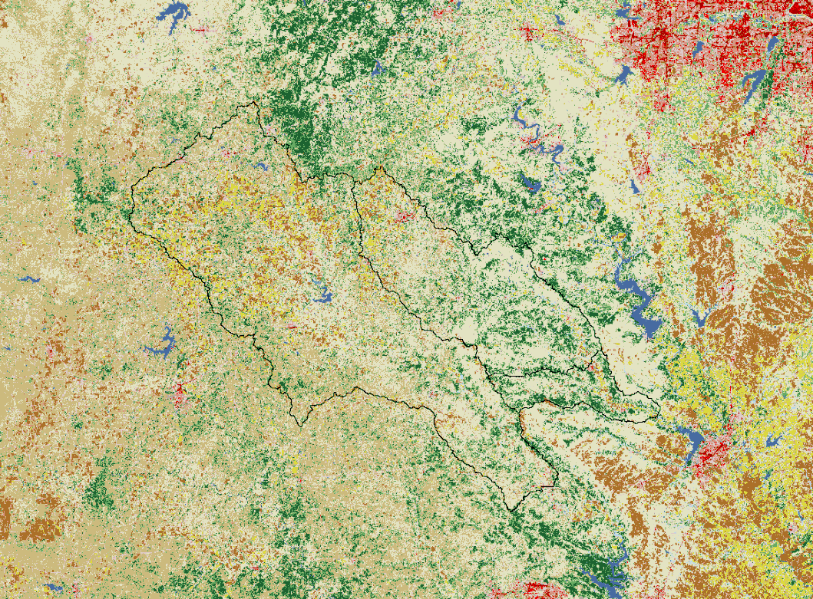
National Land Cover Database
National Land Cover Database from the Multi-Resolution Land Characteristics Consortium used to characterize land use in each watershed.
30m resolution
Uses Landsat data
Released every 5 years
Used NLCD2006
8 categories of land type
20 total subcategories

Slide 8
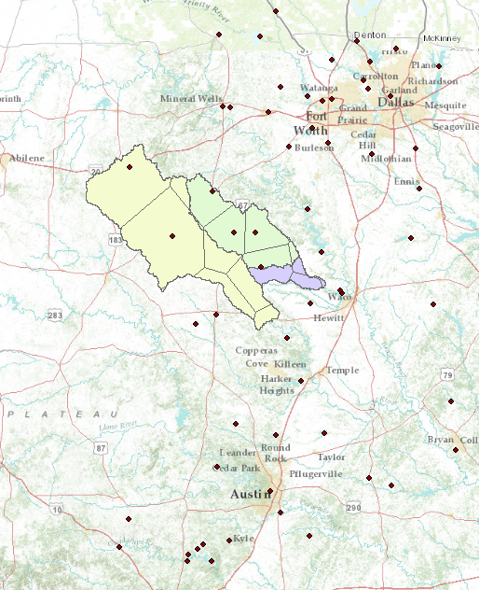
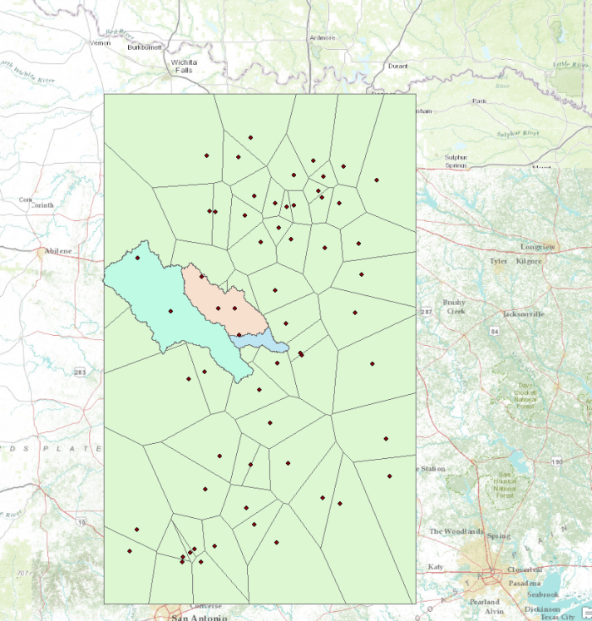
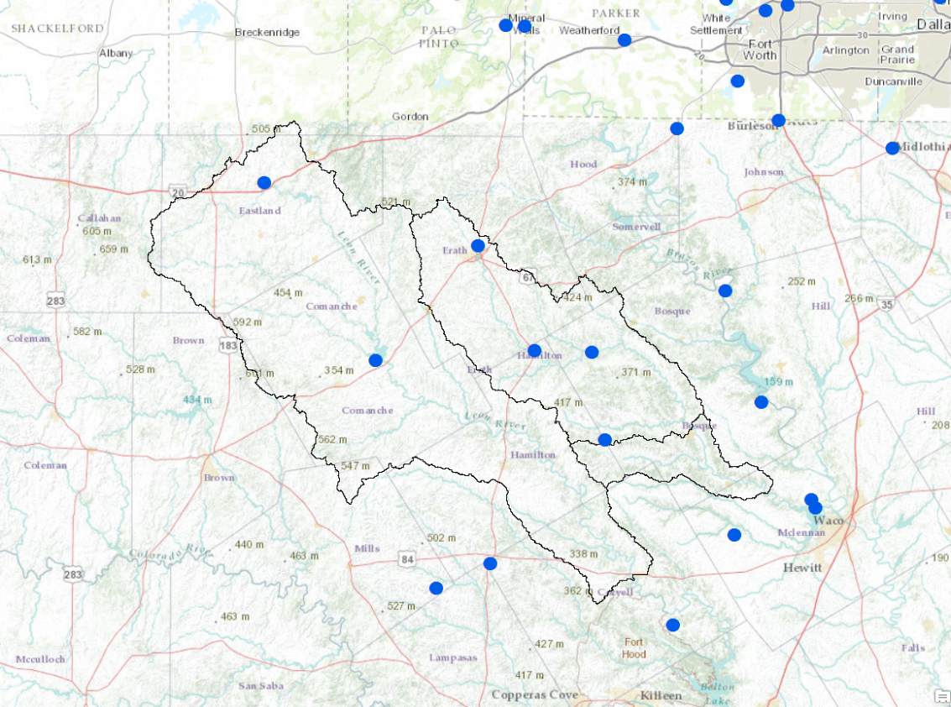
Precipitation Data
National Climactic Data Center
National Oceanic and Atmospheric Administration
Hourly data gathered over period of interest
Thiessen polygons created to assign proper weights from each rain gage

Slide 9
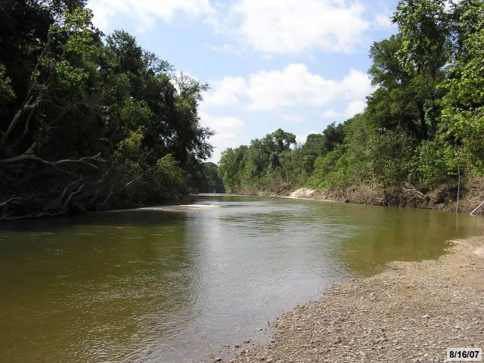
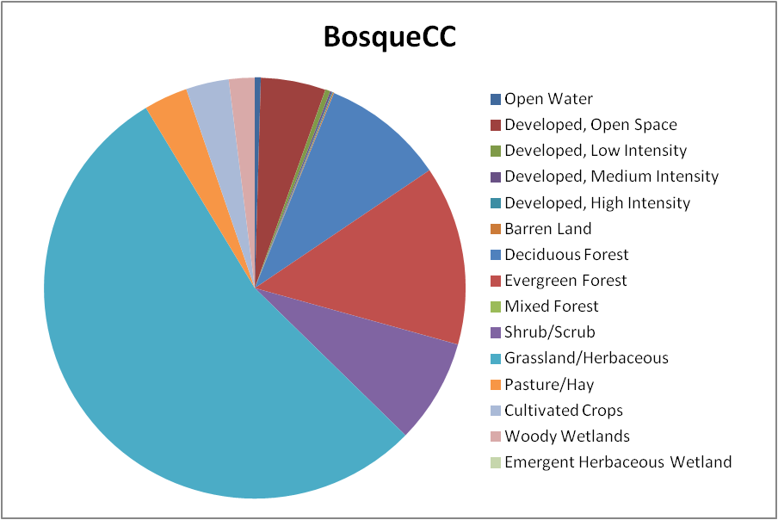
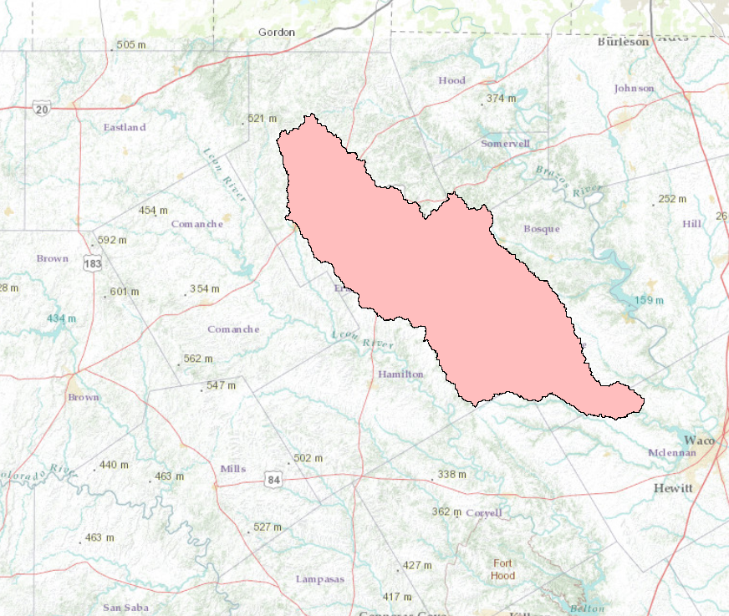
Bosque River at Coopers Crossing
Drainage area of 1140.8 square miles
Majority is grassland
3.4% pasture land
3.3% cultivated agriculture

Slide 10
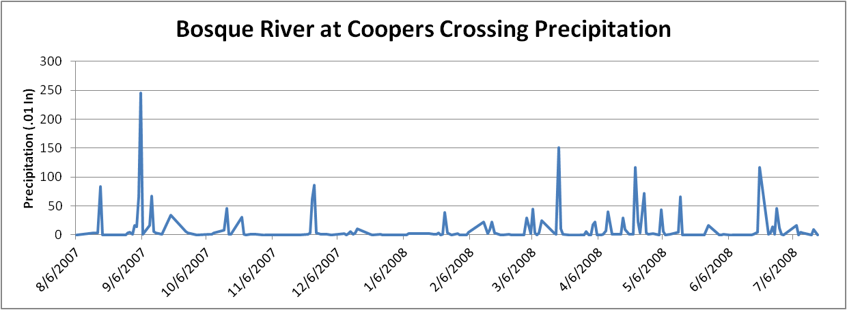
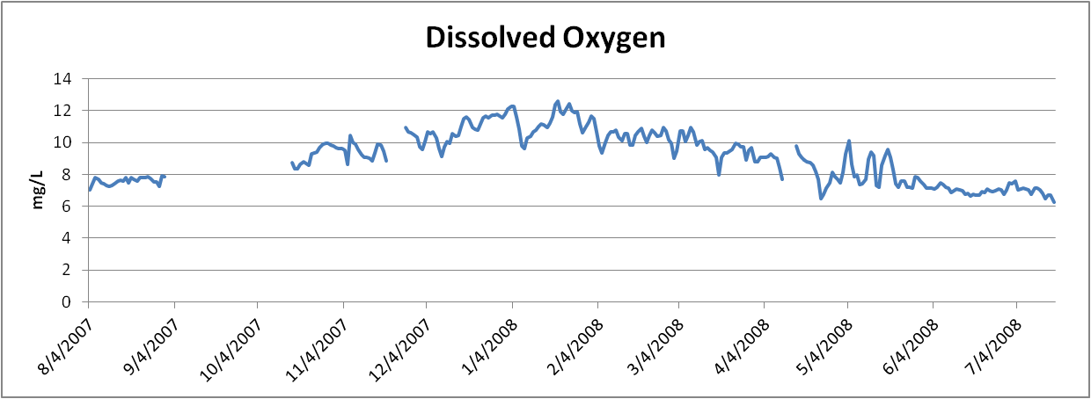

Slide 12
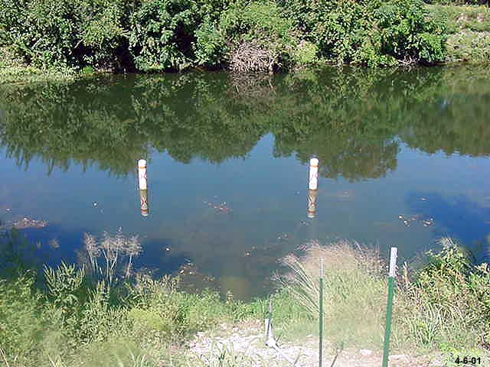
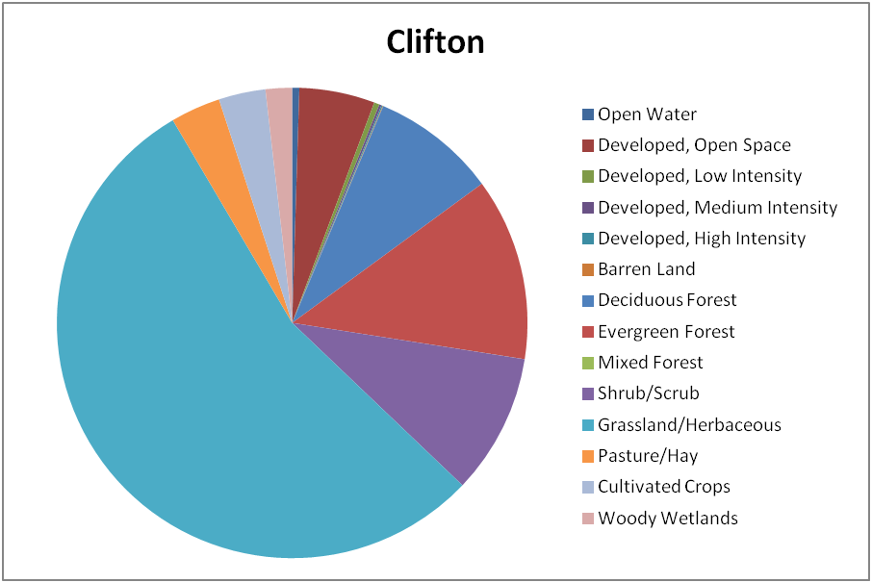
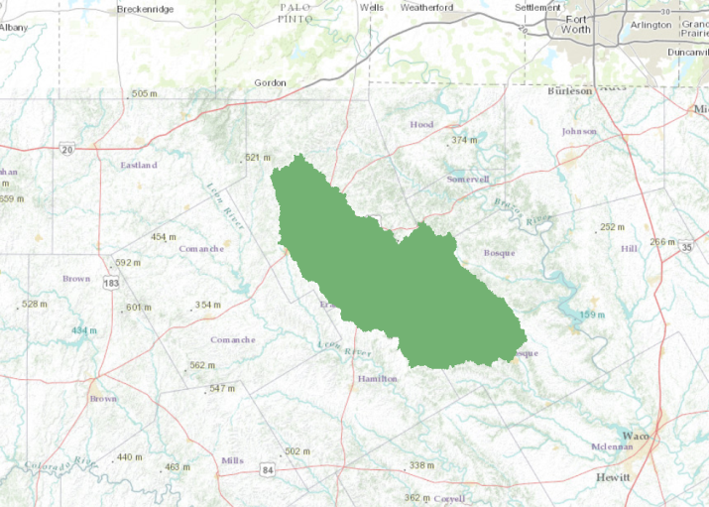
Bosque River at Clifton
Drainage area of 962 square miles
Subwatershed of Bosque River at Coopers Crossing
3.4% pasture land
3.2% cultivated agriculture

Slide 13
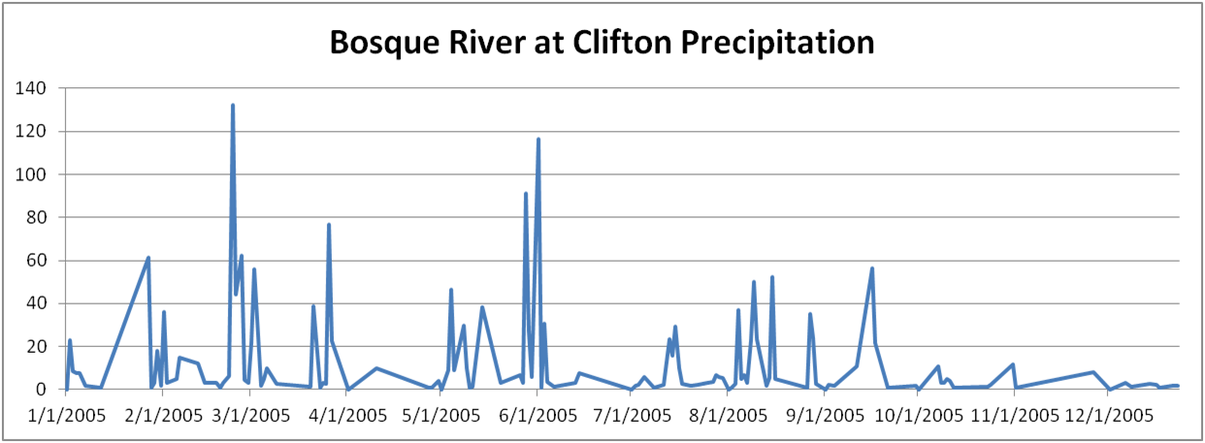
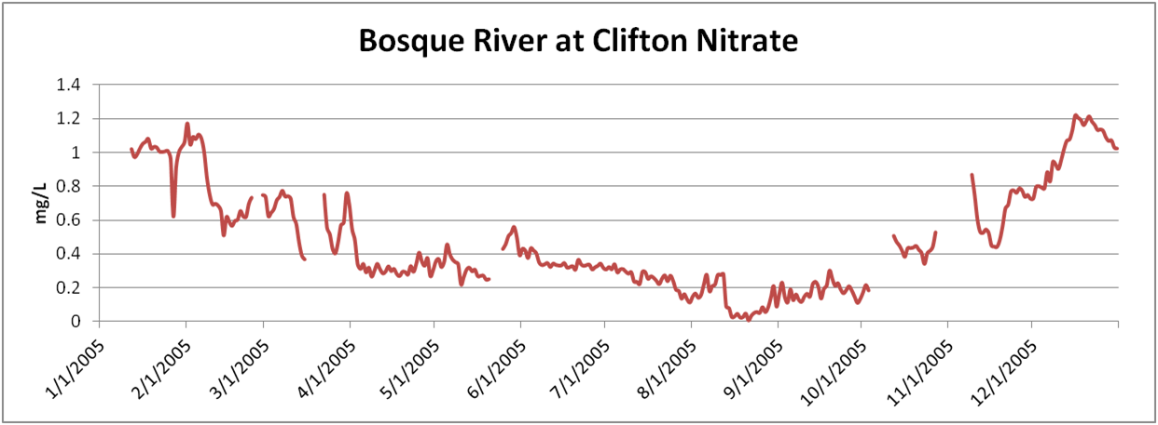

Slide 14
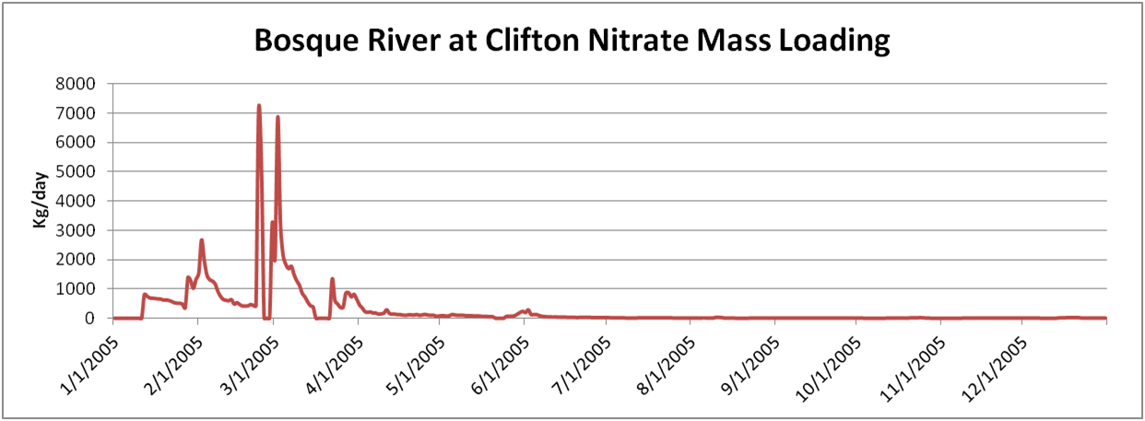

Slide 15
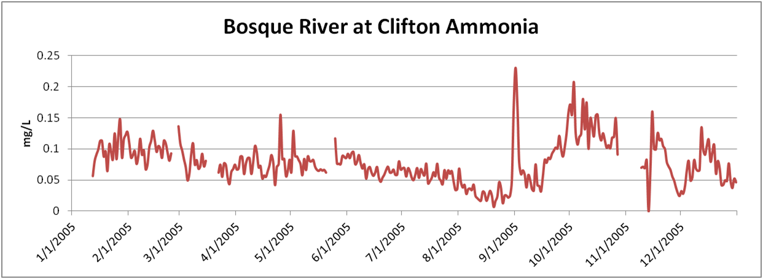

Slide 16
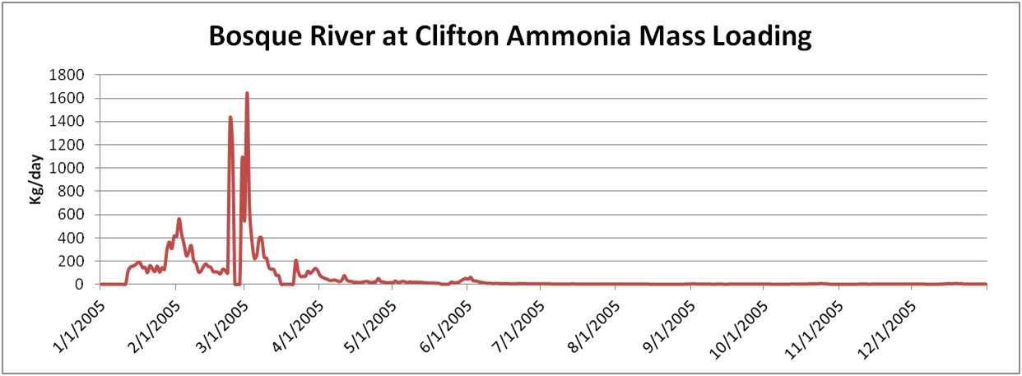

Slide 17
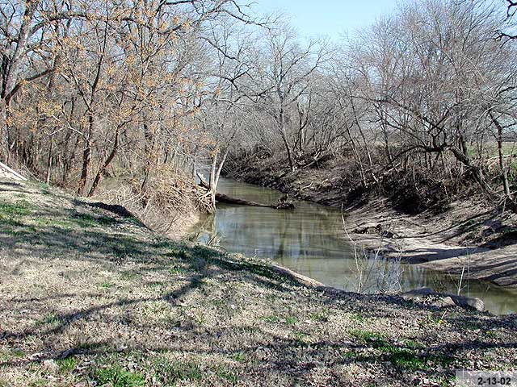
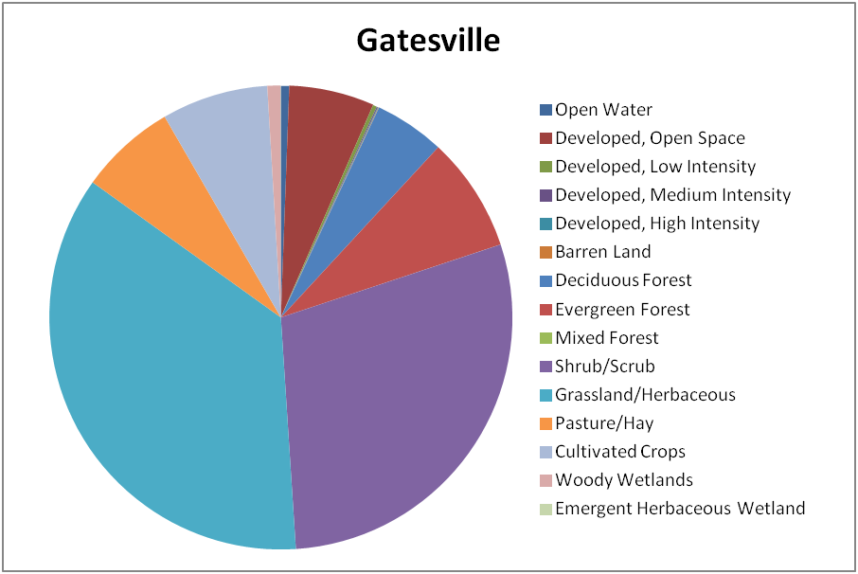
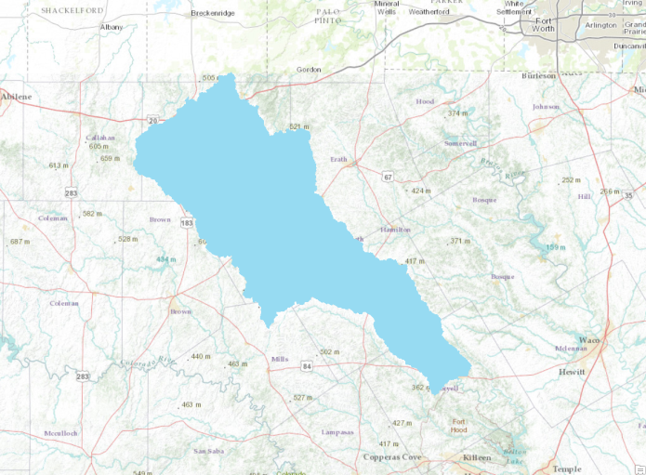
Leon River at Gatesville
Drainage area of 2381 square miles
Large amount of grassland and scrub
6.7% pasture land
7.4% cultivated agriculture

Slide 18
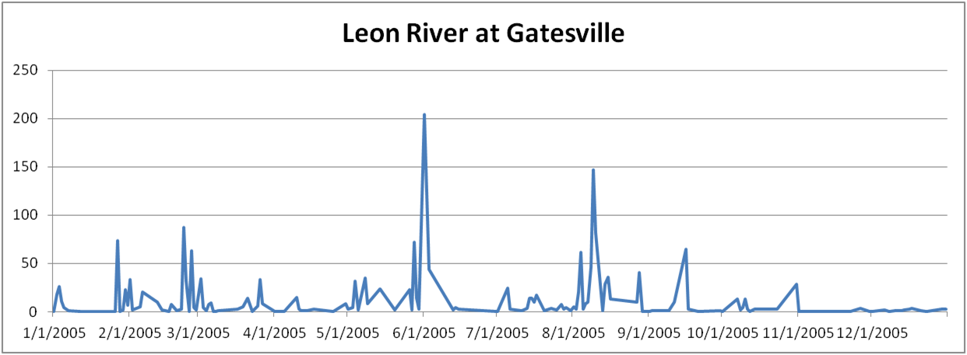
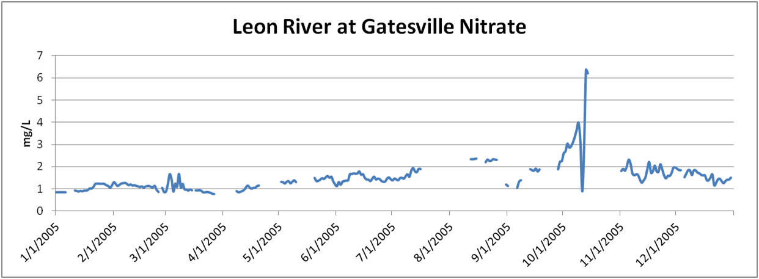

Slide 19
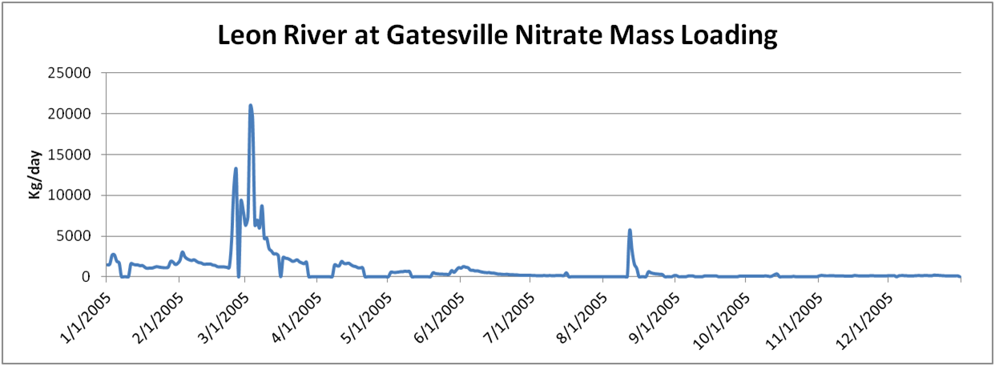

Slide 20
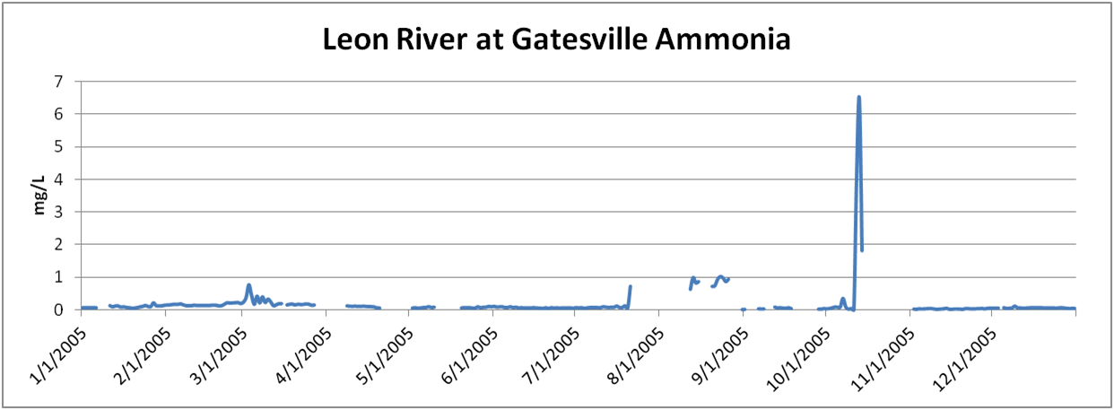

Slide 21
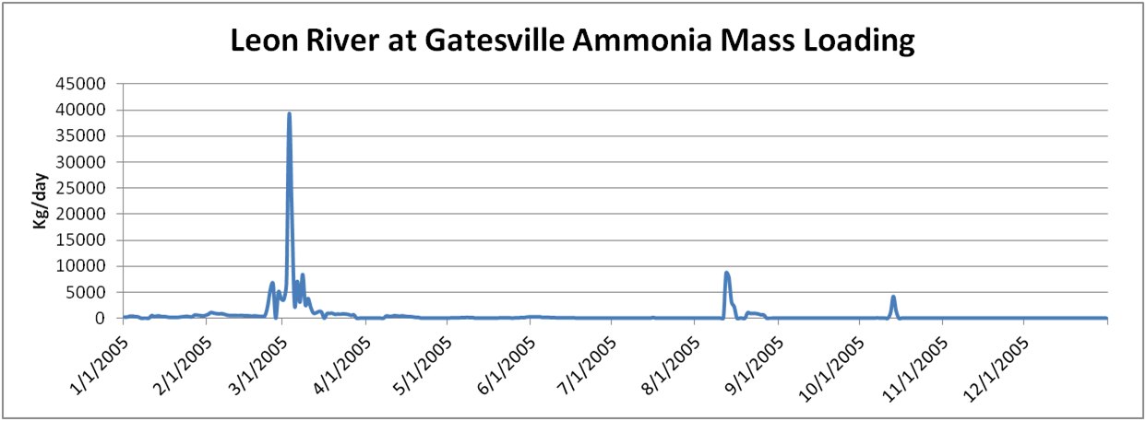

Slide 22
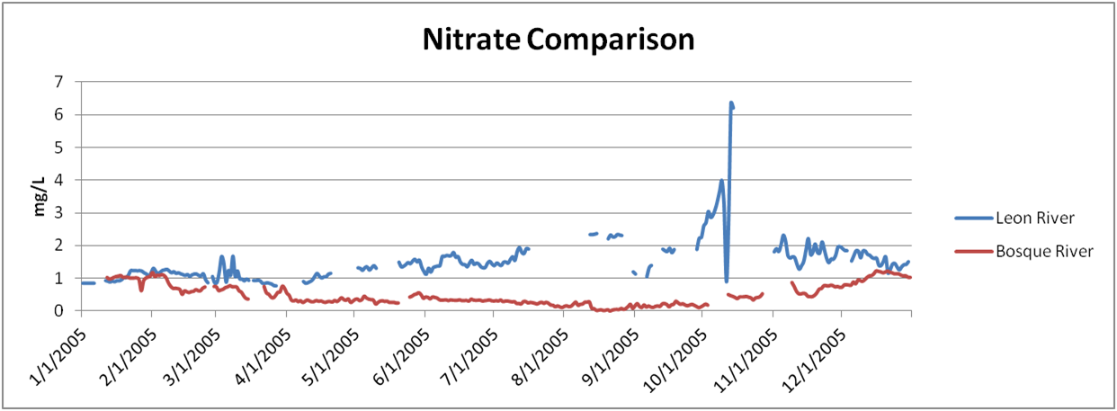
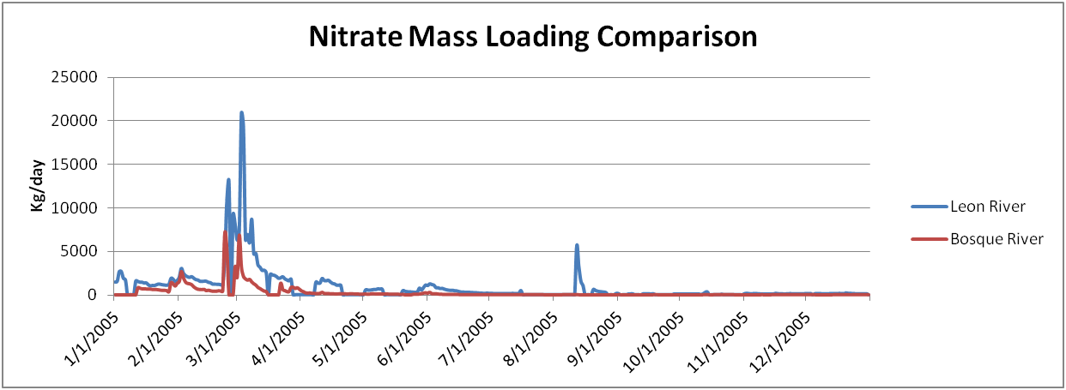

Slide 23
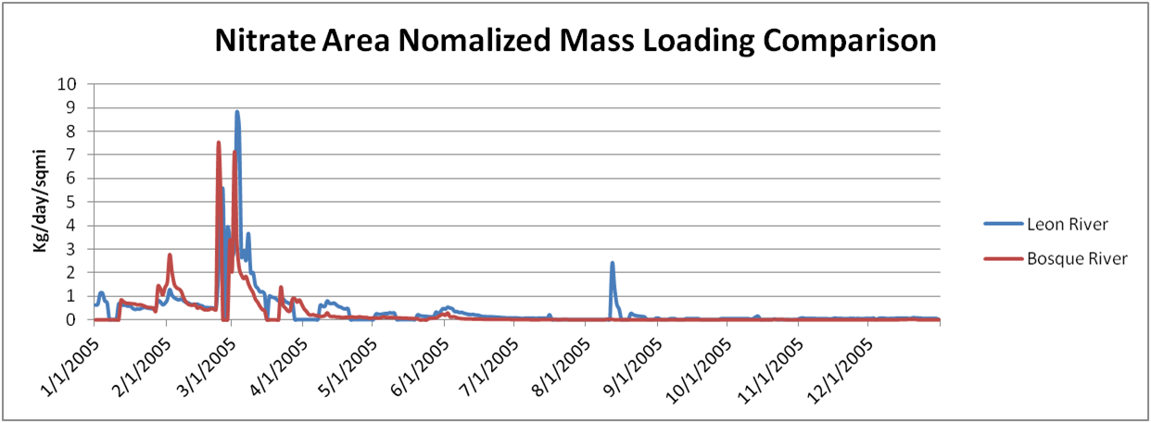
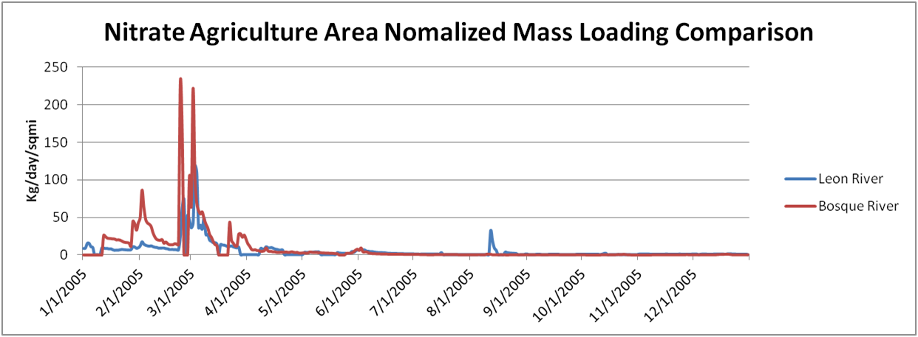

Slide 24
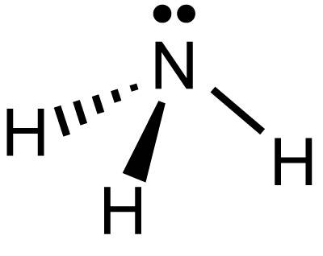
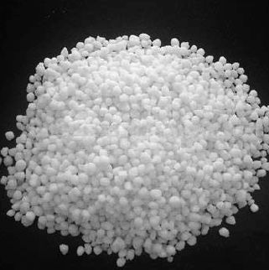
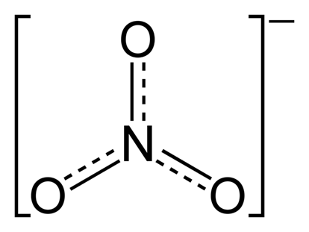
Ammonium Nitrate Mass Balance
Ammonium nitrate is a commonly used fertilizer
Reacts to form ammonia and nitrate
Each gram on ammonium nitrate produces:
.213 g ammonia
.774 g nitrate

Slide 25
Ammonium Nitrate Mass Balance
50-150 lb of ammonium nitrate fertilizer is applied per acre
Depends on soil characteristics, crop type
After accounting for chemical reaction,
Leon River watershed loses 5.4-16.2% of nitrate added
12.4-37.1% of ammonia added
Bosque River watershed loses 8.9-26.8% of nitrate added
7.1-21.3% of ammonia added
 | Ammonia (kg/acre) | Nitrate (kg/acre)
Leon River | 1.79 | 2.85
Bosque River | 1.03 | 4.71

Slide 26
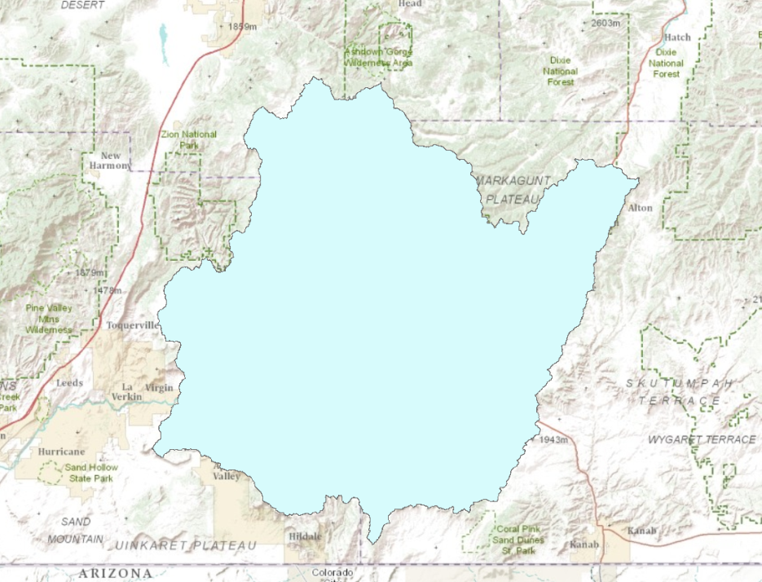
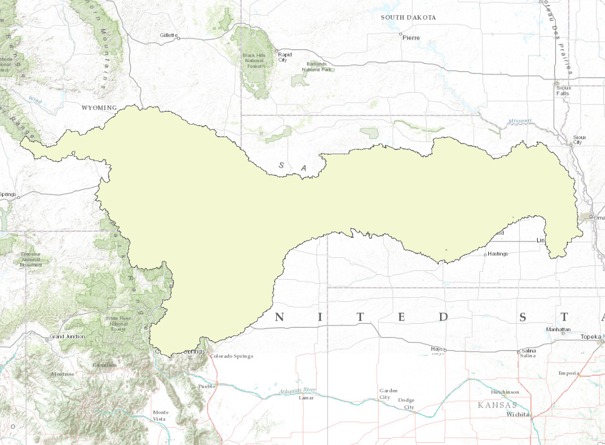
Other Example Watersheds
Examined 3 watersheds
Colorado River, TX – 10.7% Agriculture
Virgin River, UT – 0% Agriculture
Platte River, NE – 21.3% Agriculture
Not sufficient water quality data to finish analysis

Slide 27
Summary
Large storm events may lead to decreases in dissolved oxygen
Difficult to determine from noise in data
Large storm events play a role in nutrient loadings in runoff
However, seasonal variations in fertilizer application seems to control when the release into runoff occurs
A significant percentage, up to 37.1%, of nutrients added as fertilizer could be lost due to runoff

Slide 28
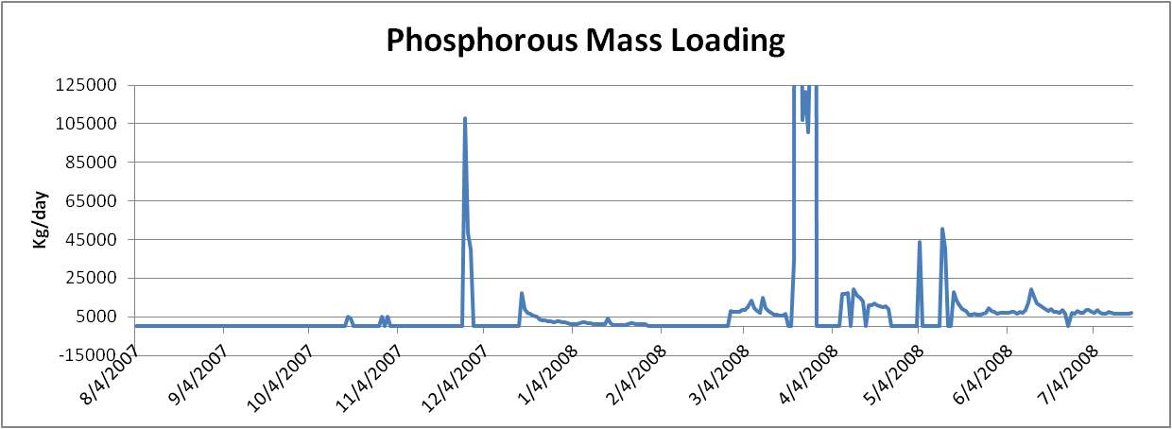
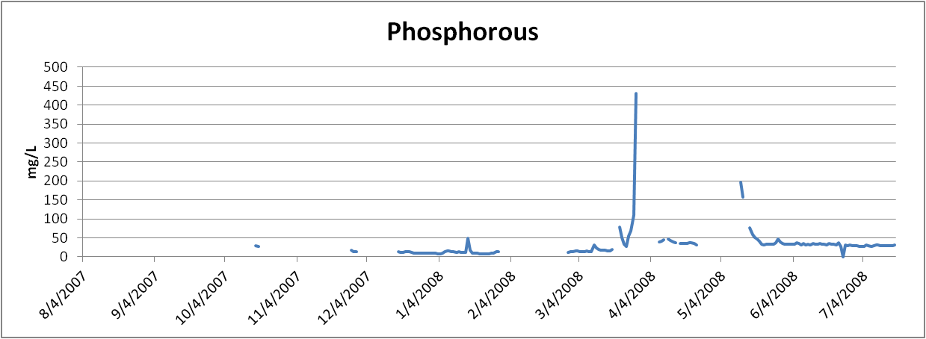

Slide 31
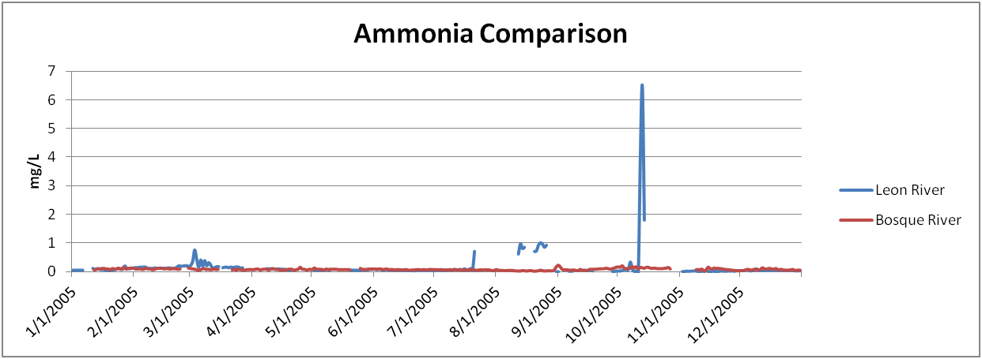
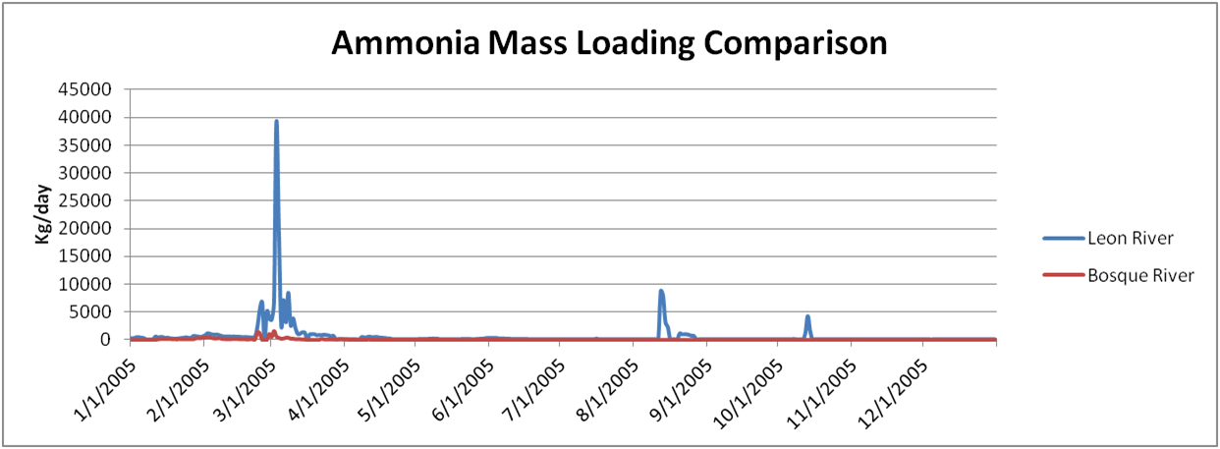

Slide 32
