Slide 1
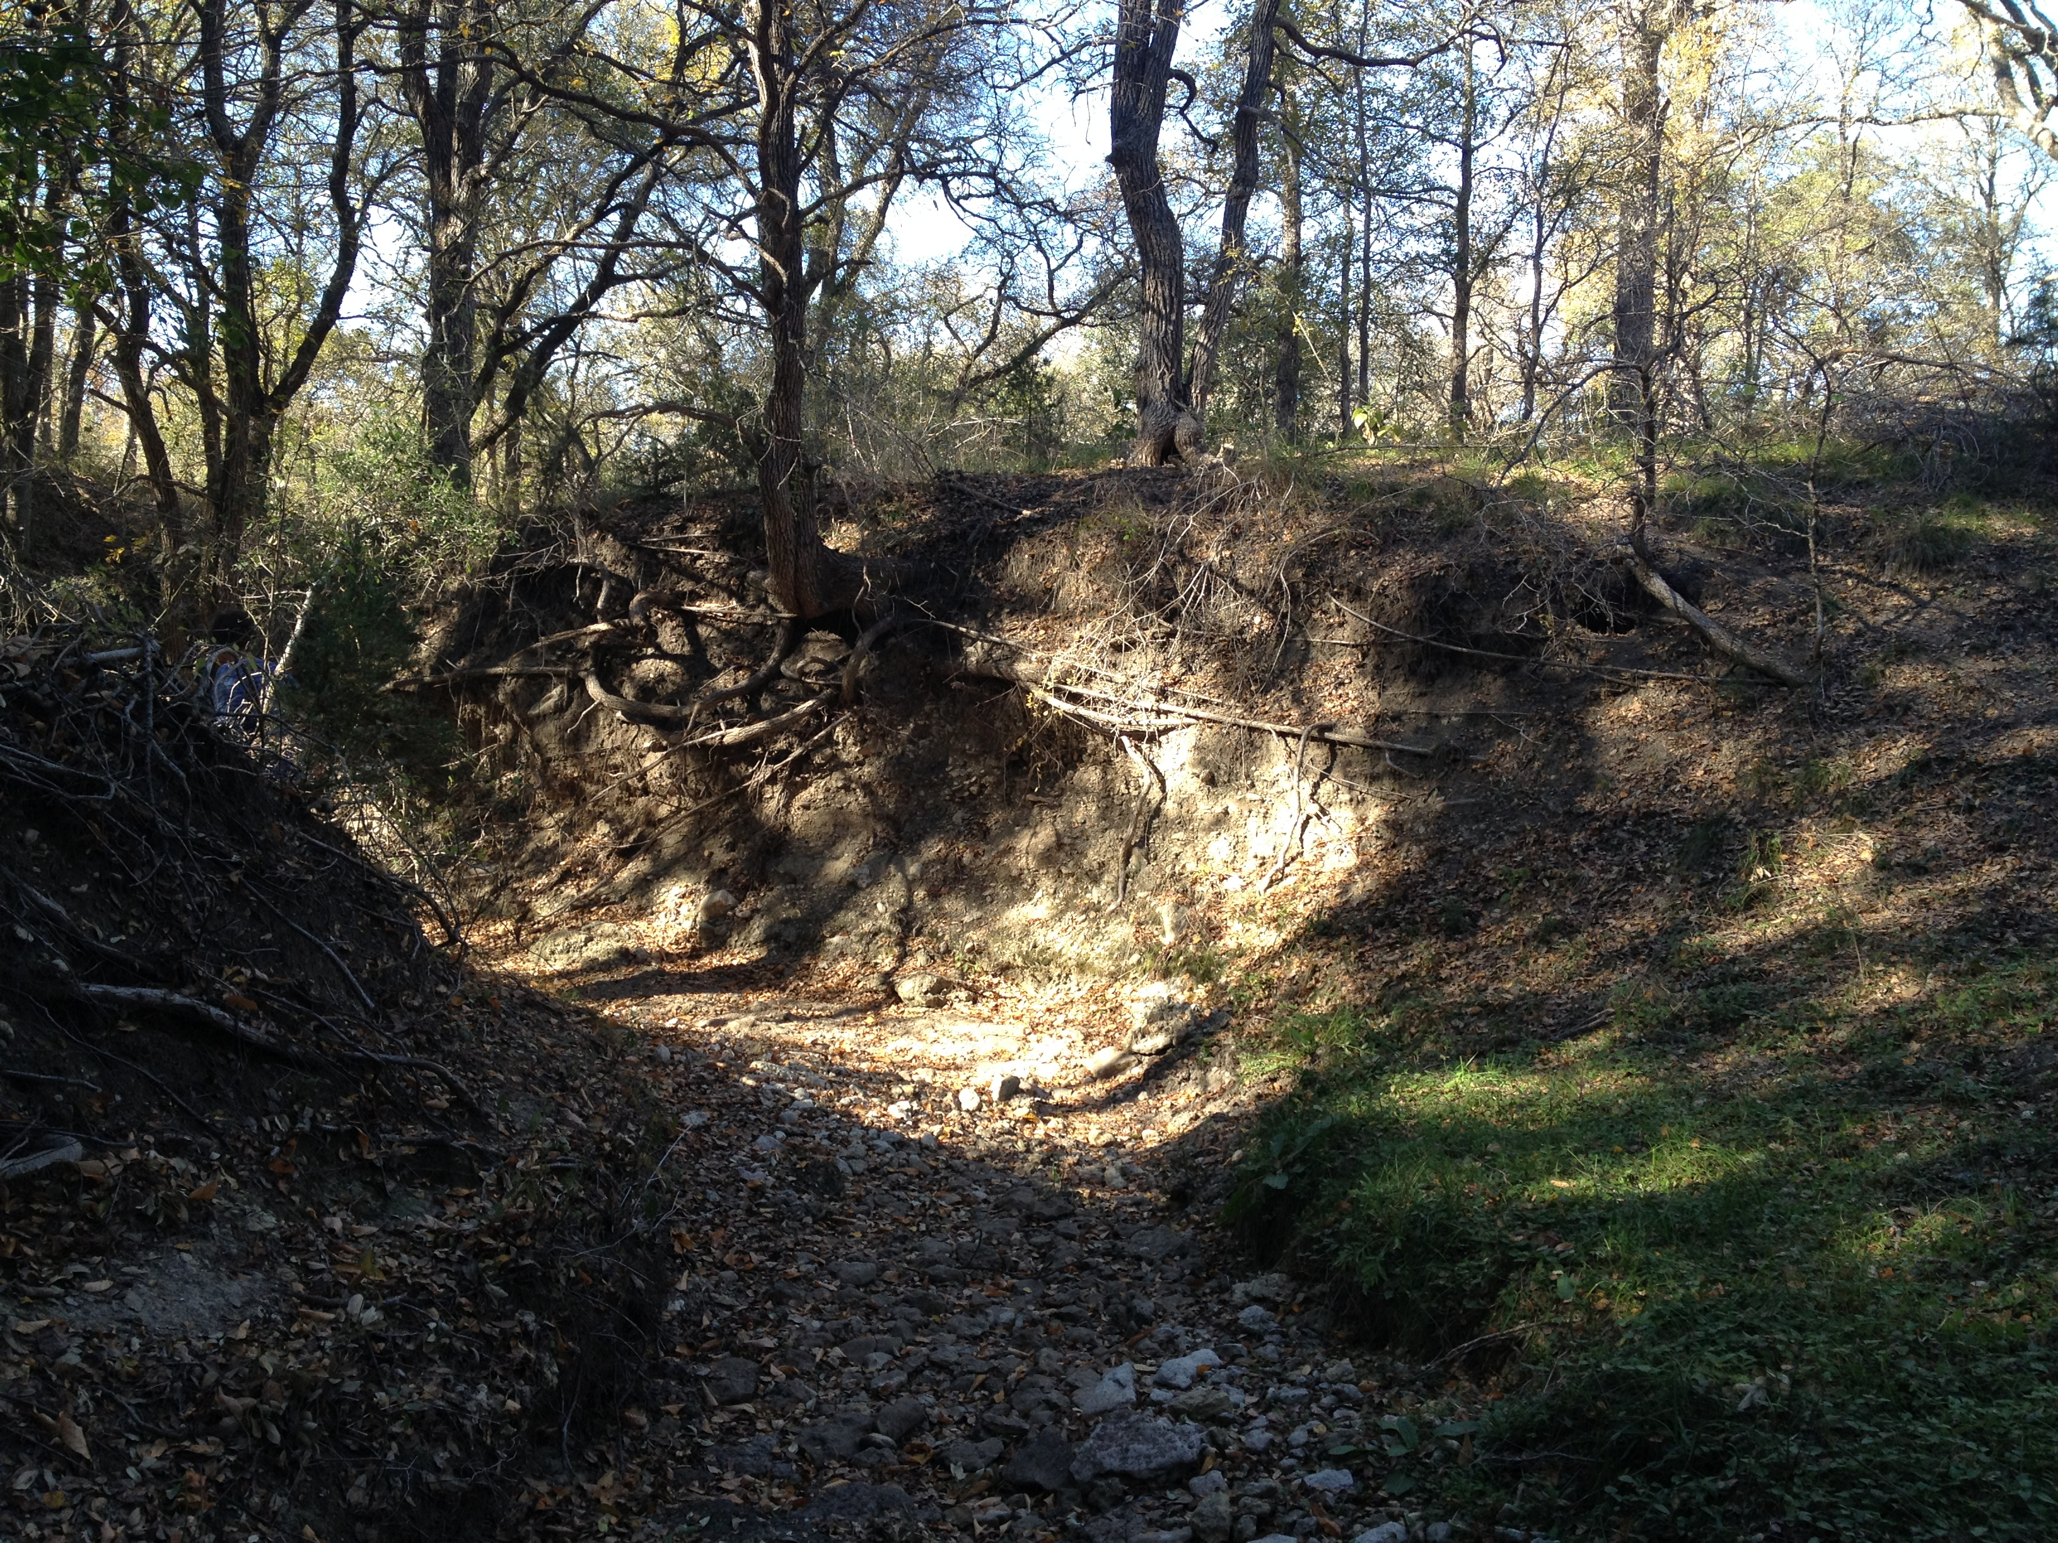
Terrain Study for Floodplain Remapping of Edgar’s Ranch in Burnet County
Prepared by Roxana Darvari
For Professor David Maidment
Department of Environmental and Water Resources Engineering
Fall 2012

Slide 2
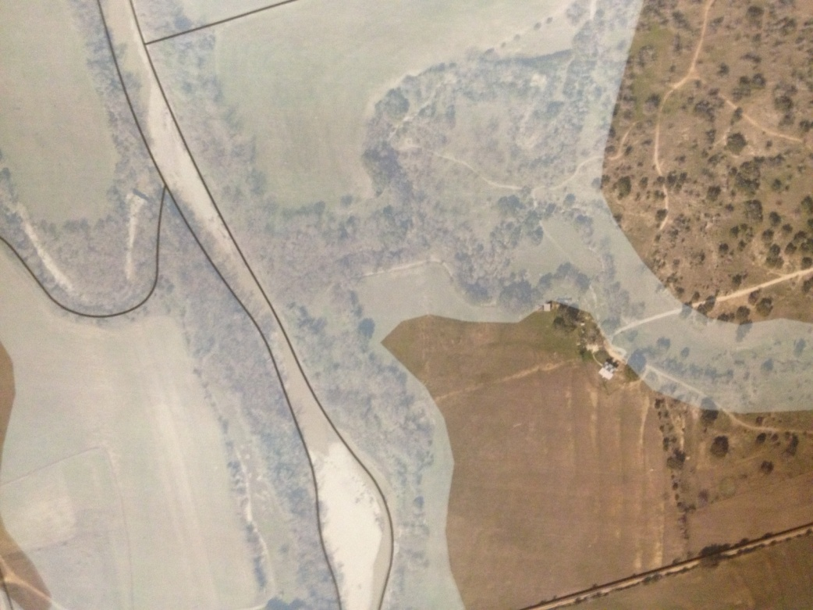
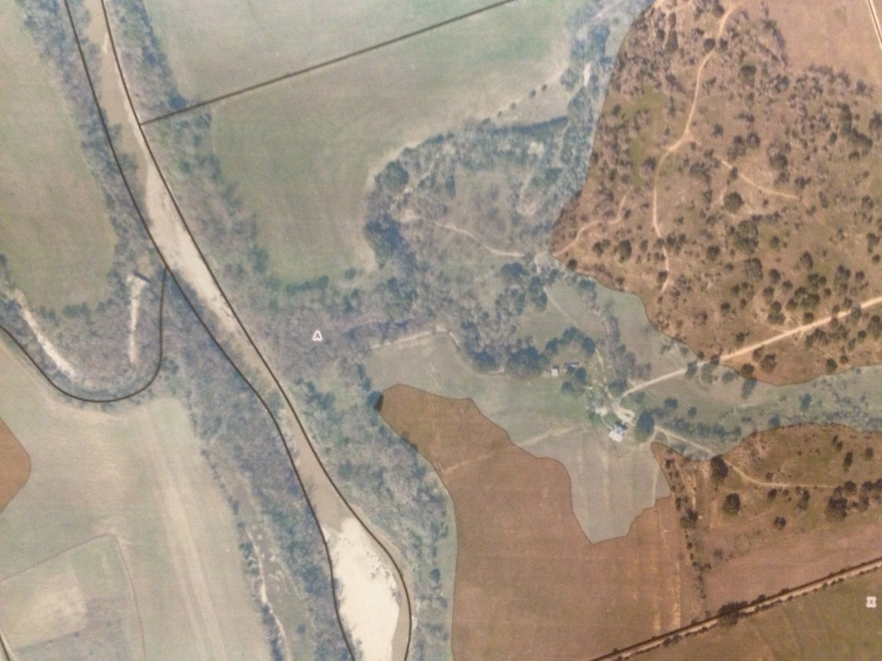
Edgar’s House Story…
Edgar Ranch located in northeast Burnet County
The study area includes two reaches, Moss Branch and Edgar Draw
Recreate a floodplain map for Edgar Ranch
In the old floodplain map, the Edgar Ranch was out of the flooding zone but in the new map issued in 2011 by FEMA; Edgar Ranch locates in Zone “A” floodplain
Moss Branch
Moss Branch
Edgar’s House
Edgar’s House
Edgar Draw
Edgar Draw
Old floodplain Map
New floodplain Map

Slide 3
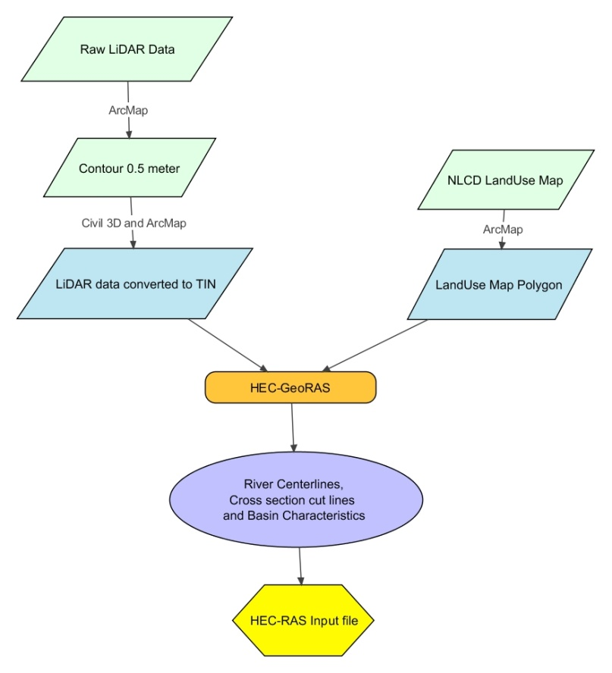
How to create an accurate terrain?
Use LiDAR data, currently the most accurate data
Utilize HEC-GeoRAS tool in ArcGIS to make layers
Use LandUse Map to extract the Manning’s value
Task 1
Task 2
Task 3

Slide 4
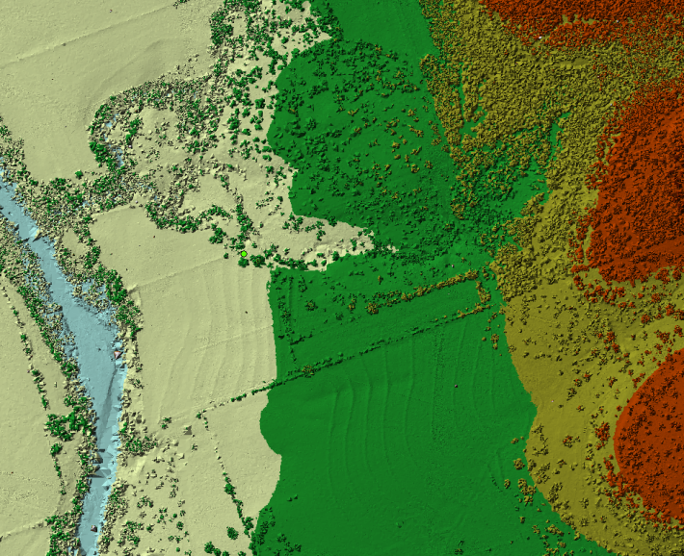
Task 1:How to work with raw LiDAR data?
LiDAR dataset (LAS extension files) can be displayed surface elevation using LAS Dataset tool

Slide 5
Task 1:How to work with raw LiDAR data?
To work with HEC-GeoRAS toolbar, the raw LiDAR dataset should be converted to TIN
ArcGIS has the limitation of point numbers of 5,000,000. However the number of points of LiDAR data in study area is almost 2 billions.

Slide 6
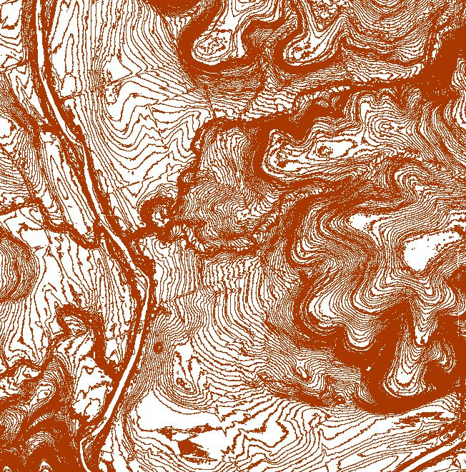
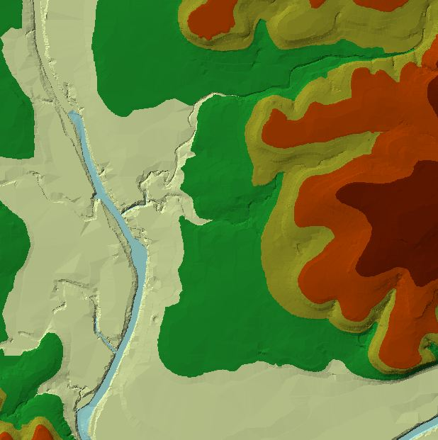
Task 1:How to work with raw LiDAR data?
In order to obtain a detailed terrain model to be used for the HEC-RAS:
extracted the 0.5 meter interval contour from provided LiDAR data
imported contours to AutoCAD civil 3D and manually draw a 3D polyline along the channel bottom
Imported the contours and polylines to ArcGIS
converted the combination of contours and polylines to TIN

Slide 7
Task 2: How to add LandUse Map and Manning’s value?
Used NLCD LandUse Map
Land use feature class with NLCD code for different land use types
Added the NLCD manning’s to the attribute table

Slide 8
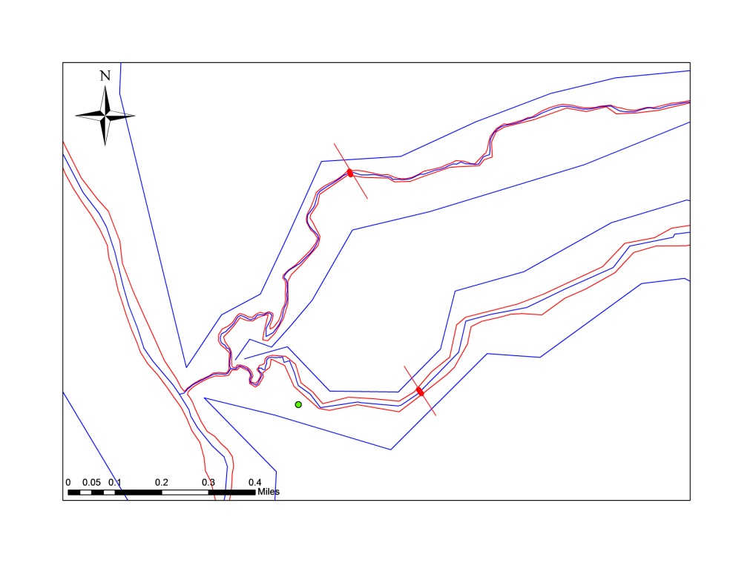
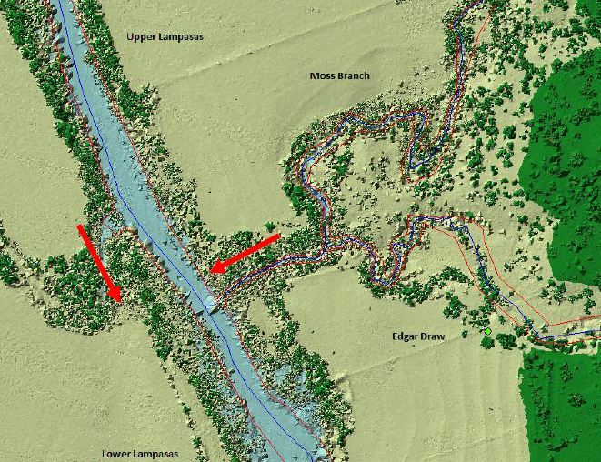
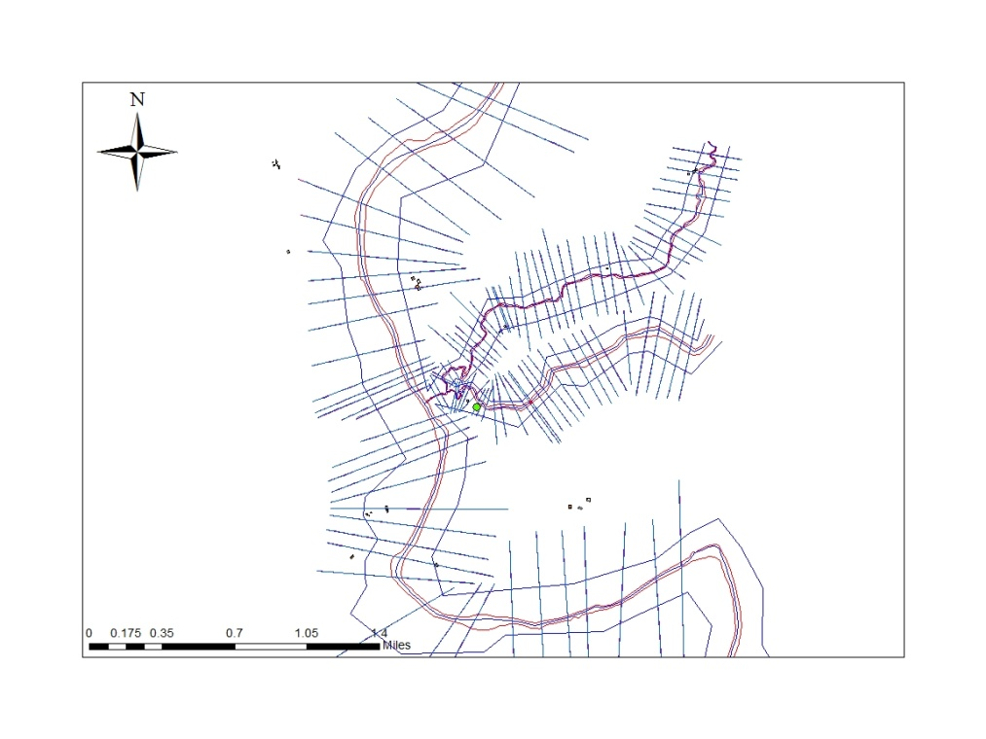
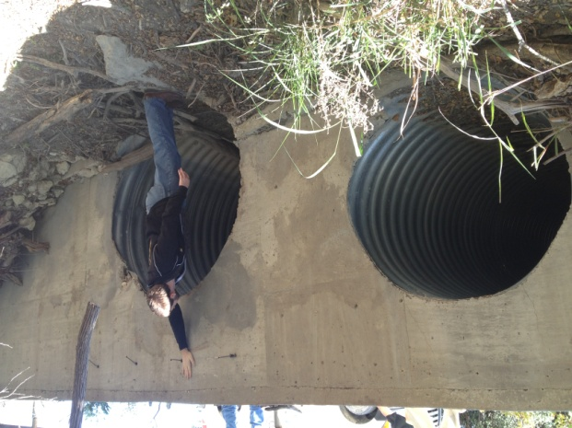
Task 3: How to use HEC-GeoRAS to create a terrain?
    River Centerlines, Banks and Flowpaths: used to establish the river reach network for HEC-RAS
    Cross Section cutline: used to extract the elevation data from the terrain to create a ground profile across channel flow to being used in hydraulic analysis (HEC-RAS)
    Culverts/Bridges
    Obstructions: represent blocked flow areas (areas with no water and no flow)

Slide 9
HEC-GeoRAS Output
Task 1
After setting up the HEC-GeoRAS, Convert them from 2D to 3D using the underlying terrain to extract the elevations
The terrain is ready to be imported to HEC-RAS for Hydraulic Modeling:
Task 2
Task 3

Slide 10
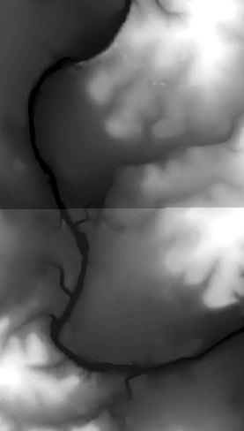
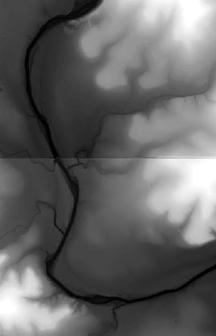
Discussion: compare LiDAR with USGS surface display
USGS surface display
LiDAR surface display

Slide 11
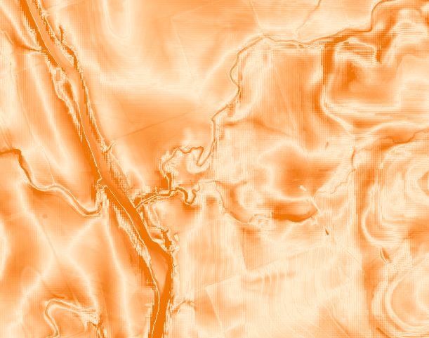
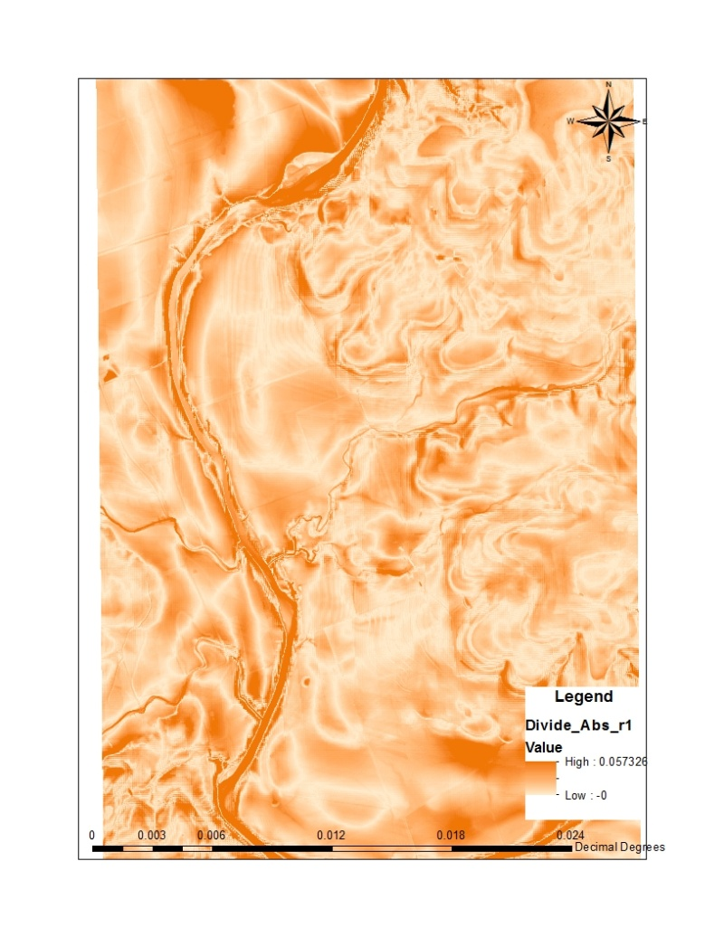
Discussion: compare LiDAR with USGS data display
5% difference between USGS data and
LiDAR which may effect on the cross sections profile and consequently the hydraulic model.

Slide 12
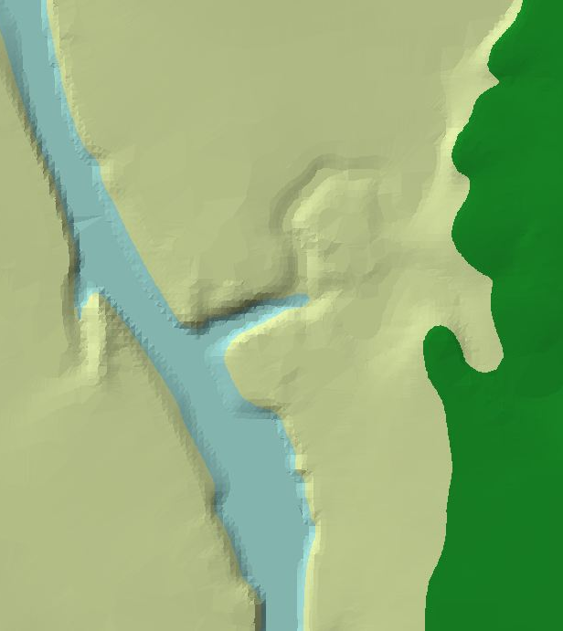
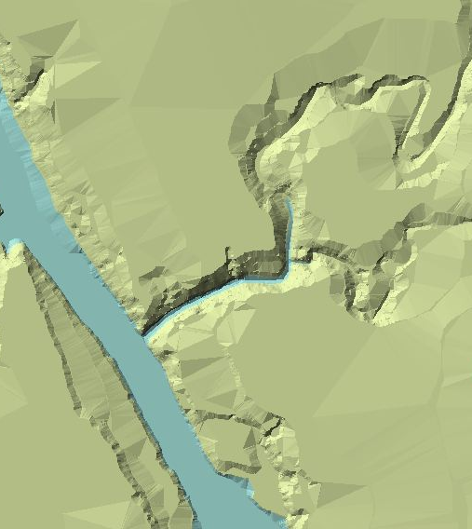
Discussion: compare LiDAR with USGS TIN surface
USGS TIN surface
LiDAR TIN surface
Notes:
.

Slide 13
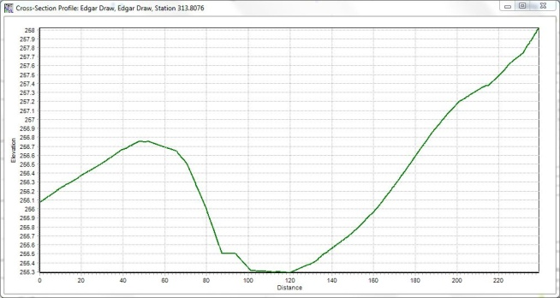
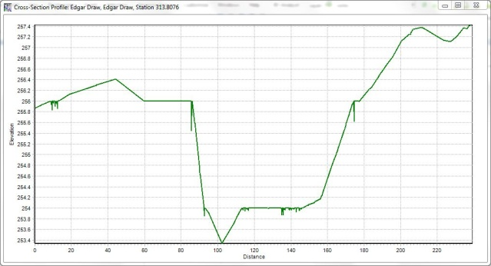
Discussion: compare LiDAR cross-sections with USGS
As the LiDAR elevations are more accurate than USGS elevations, the cross-sections
based on LiDAR data should be more reliable than USGS cross-sections
USGS cross section
LiDAR cross section

Slide 14
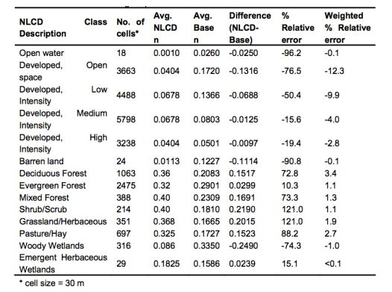
Discussion: Land Use-based Surface Roughness
Kalyanapu et al. (2009) has done a study on effects of land use-based surface roughness on hydraulic model output. They calculated the Manning’s by visual inspection and compared it with the NLCD Manning’s and found that there is a significant difference between them, especially in urban areas.
FUTURE WORK
Do these differences in Manning’s cause the similar differences in hydraulic model?

Slide 15
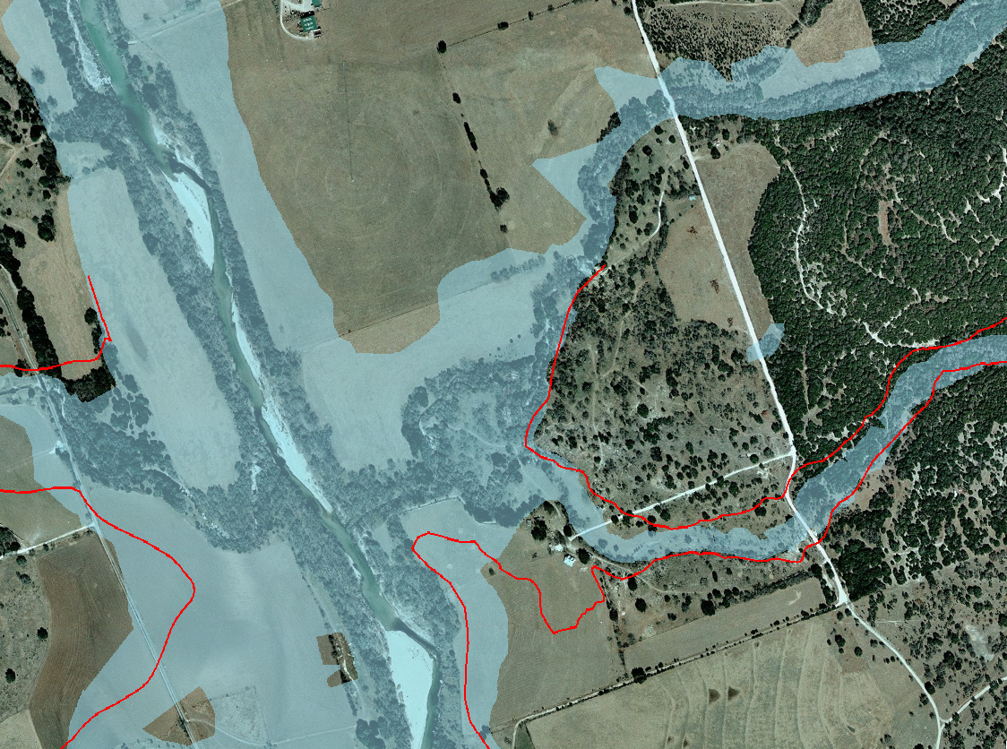
Conclusion
Since the LiDAR data are more accurate than USGS data
So the cross sections based on LiDAR data are more reliable than the ones based on USGS data
Calculated flood extent based on the LiDAR terrain shows that the Edgar Ranch locates out of the Zone A

Slide 16
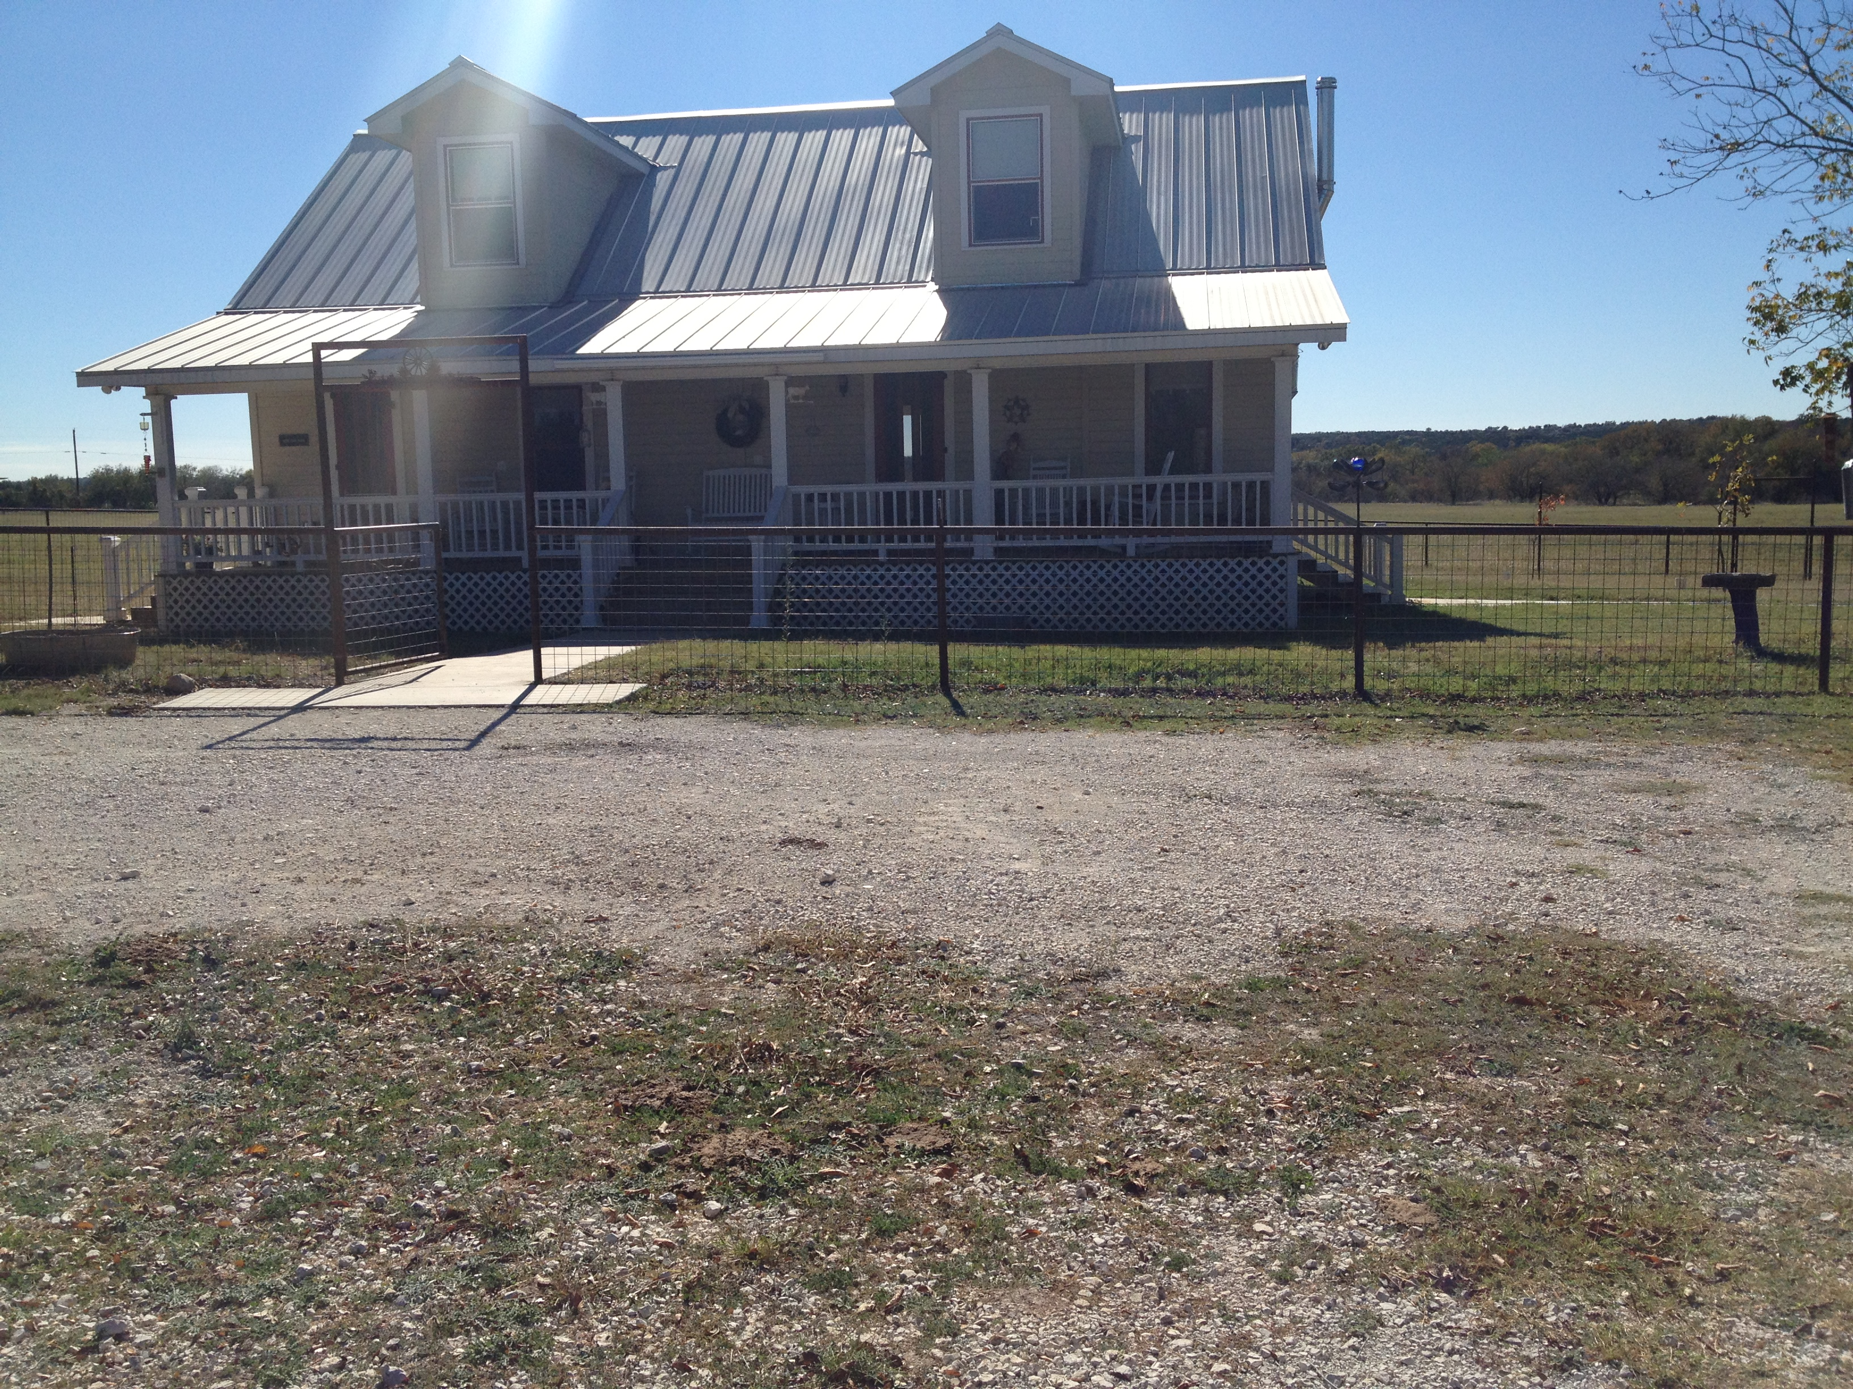
Thank You for Your Attention
Acknowledgement:
Dr. David Maidment
Donna Edgar
Herb Darling
Lilly Xu
Melinda Luna
Stephen Jackson
Sean Sutton
Sofia Reyes

