Slide 1
Anthropogenic Contamination of the Lower Fox River, WI
Alyssa Offutt
UT Austin, EWRE Masters Candidate
GIS in Water Resources Section 2
12/4/2012

Slide 2
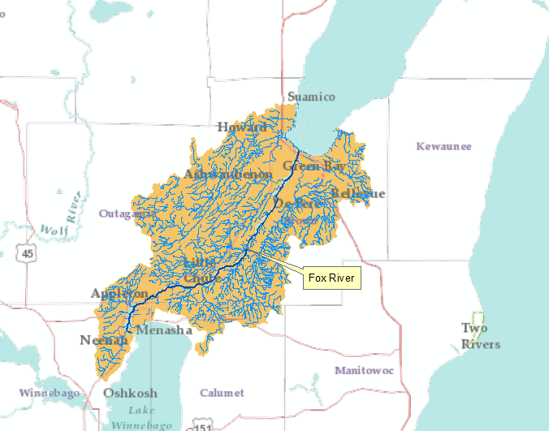
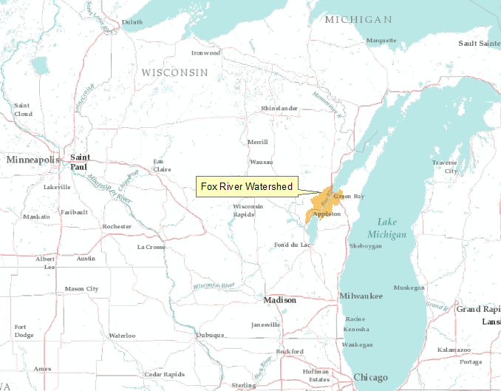
Lower Fox River Watershed
Water Quality Concerns
Total Phosphorus
Total Suspended Solids
Polychlorinated Biphenyls (PCBs)

Slide 3
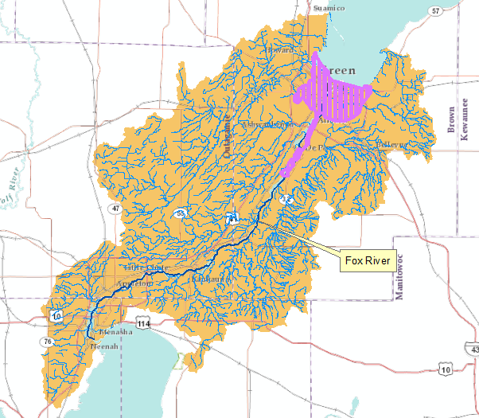
History of Water Quality Degradation
Paper mills congregate on the
Lower Fox River in the 1840s
In 1954, Appleton Paper
begins to discharge PCBs
(Polychlorinated biphenyls)
1957-1971 an estimated 250,000
lbs of PCBs are discharged into
the Lower Fox River
1980s the Lower Fox River is Designated an Great Lakes Area of Concern (AOC)
  11 reported and 2 suspected beneficial use impairments
Notes:
Beneficial Use Impairments
Restrictions on fish and wildlife consumption
Tainting of fish and wildlife flavor (suspected)
Degradation of fish and wildlife populations
Fish tumors or other deformities (suspected)
Bird or animal deformities or reproductive problems
Degradation of benthos
Restrictions on dredging activities
Eutrophication or undesirable algae
Restrictions on drinking water, or taste and odor problems
Beach closings
Degradation of aesthetics
Degradation of phytoplankton and zooplankton populations
Loss of fish and wildlife habitat
http://dnr.wi.gov/topic/greatlakes/greenbay.html

Slide 4
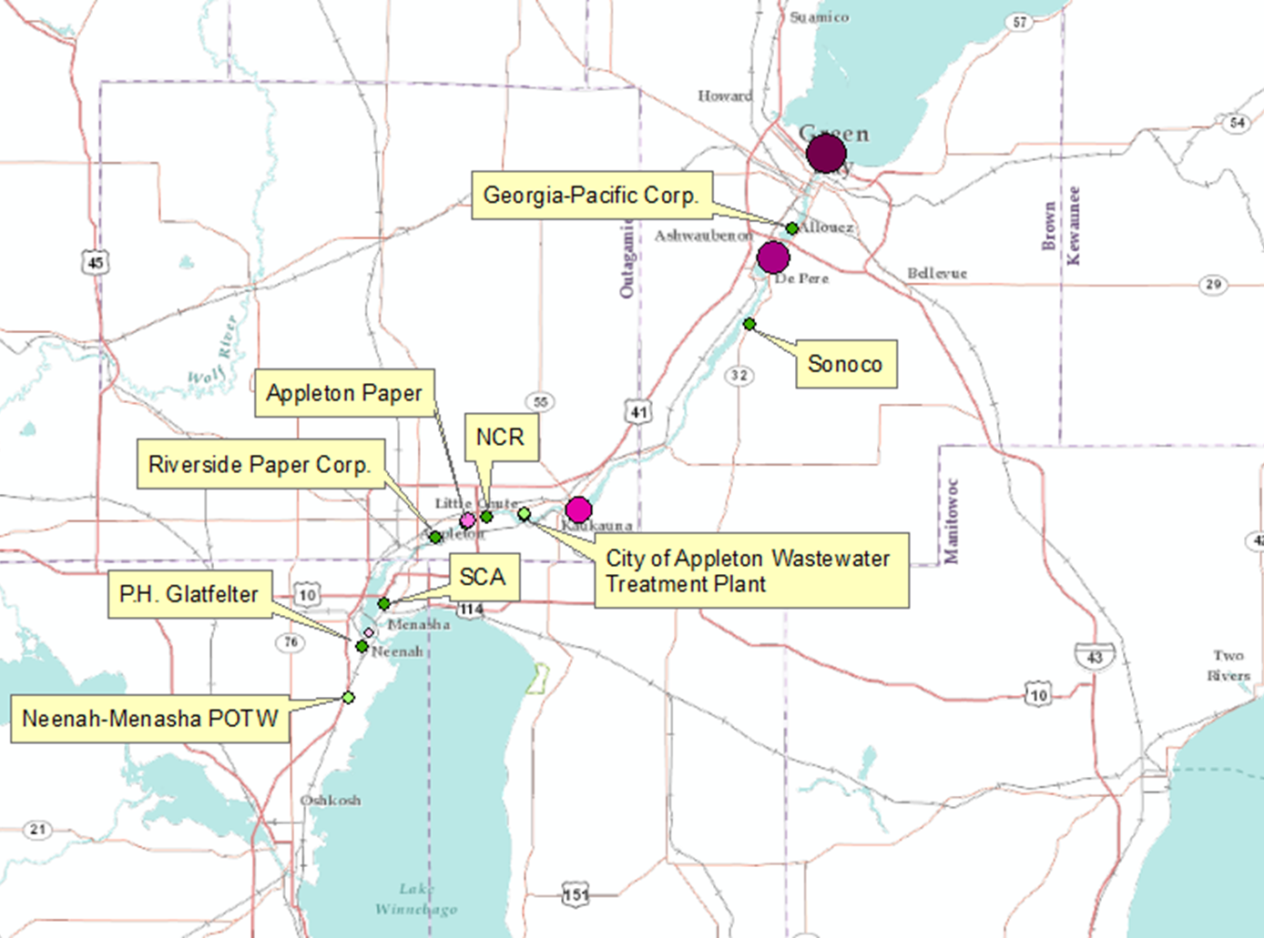
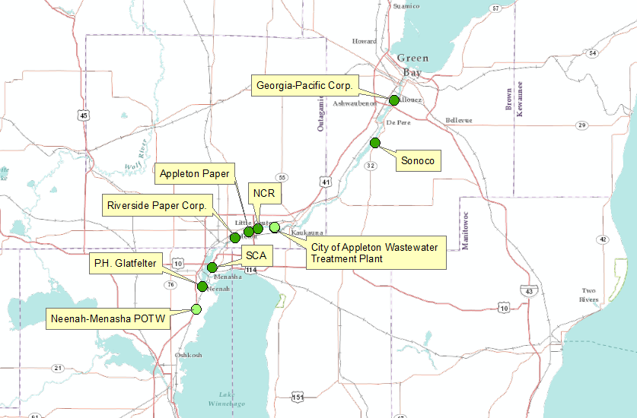
Point Sources of PCBs
Notes:
http://www.fws.gov/midwest/es/ec/nrda/FoxRiverNRDA/documents/pathways.pdf (PCB Data on River)

Slide 5
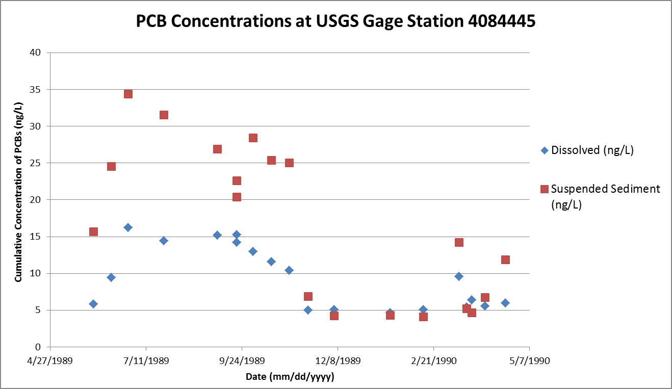
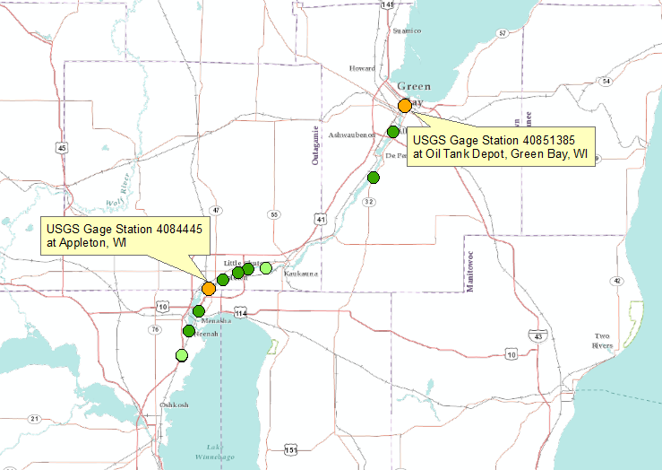
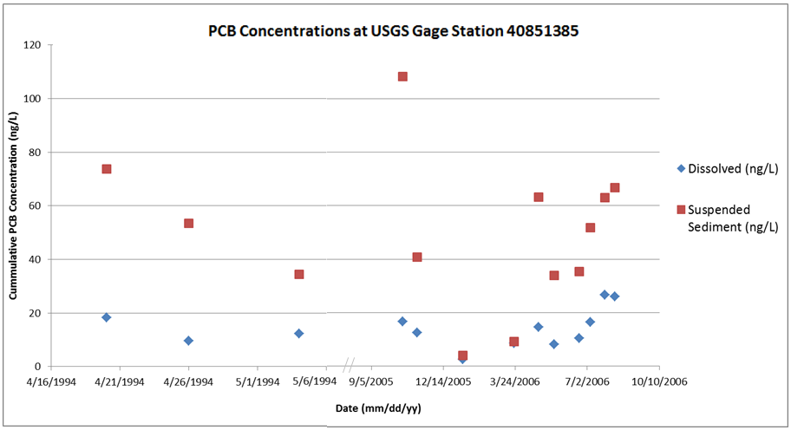
USGS Gage Station PCB Loading
Notes:
http://waterdata.usgs.gov/nwis/qw

Slide 6
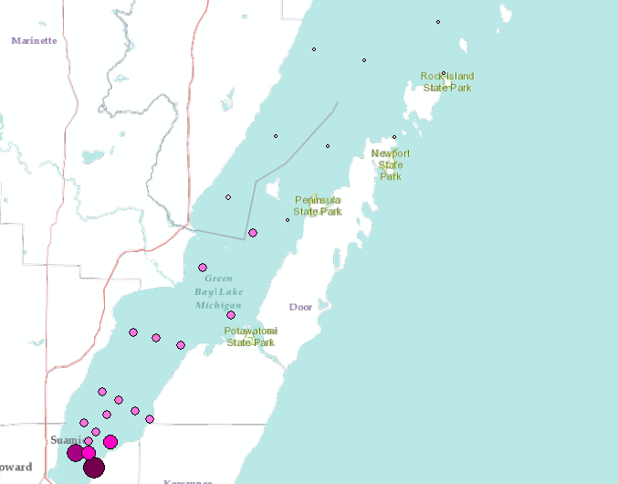
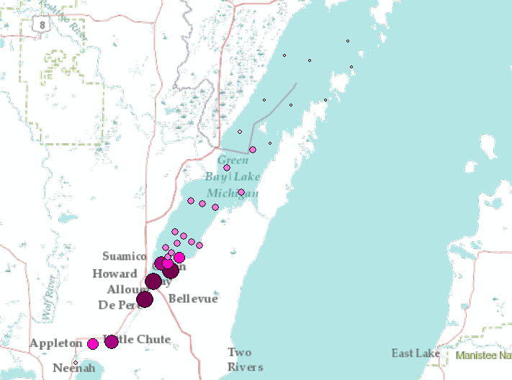
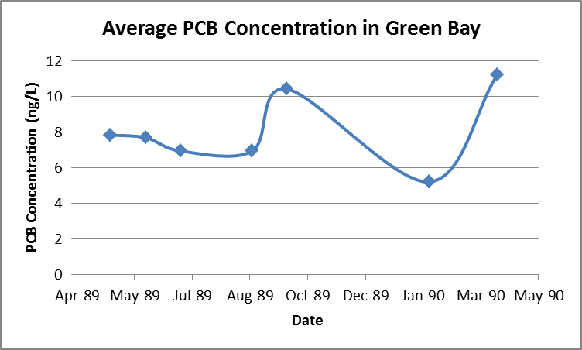
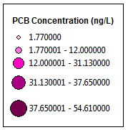
GO INTO THE BAY
PCB Loading in Green Bay
Notes:
http://www.fws.gov/midwest/es/ec/nrda/FoxRiverNRDA/documents/pathways.pdf

Slide 7
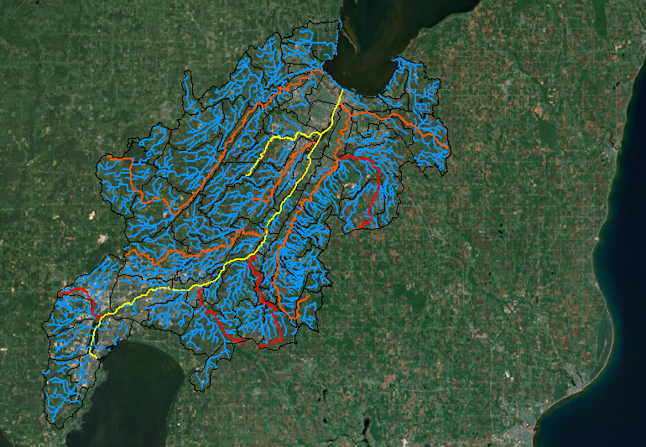
Stream Impairments
Notes:
Impairment Data, . Impairments of water quality within the Lower Fox River watershed which include degraded habitat (DH), and low dissolved oxygen concentrations which limit aquatic life (Low DO).

Slide 8
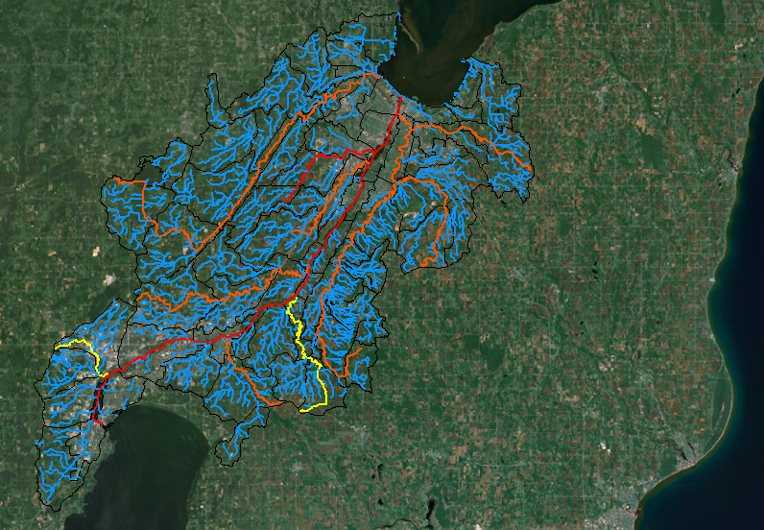
Water Pollutants

Slide 9
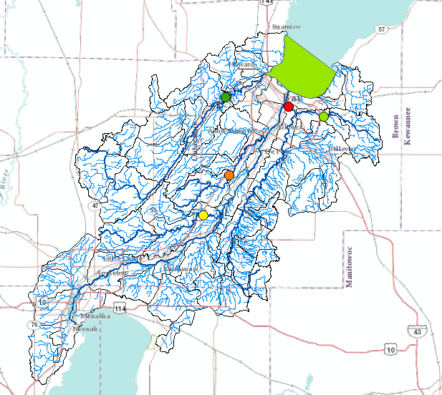
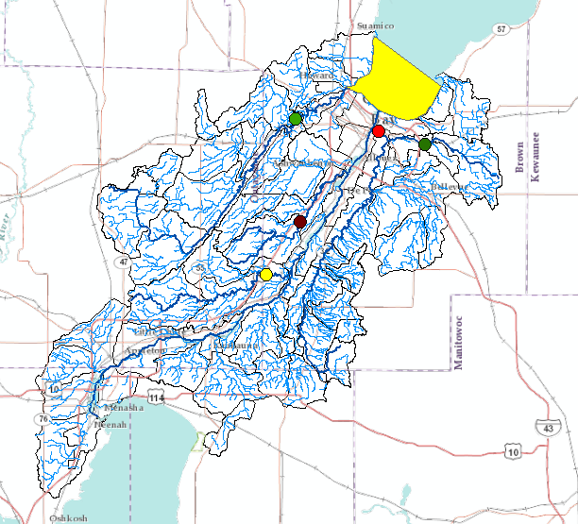
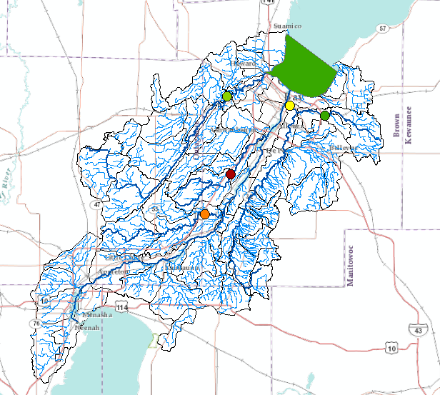
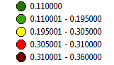
Notes:
Discharge Permits in Wisconsin generally allow maximum of 0.1 mg/L
http://www.fwwa.org/custom-1/LFR_TMDL_EPA_Submittal_Aug_2011.pdf

Slide 10
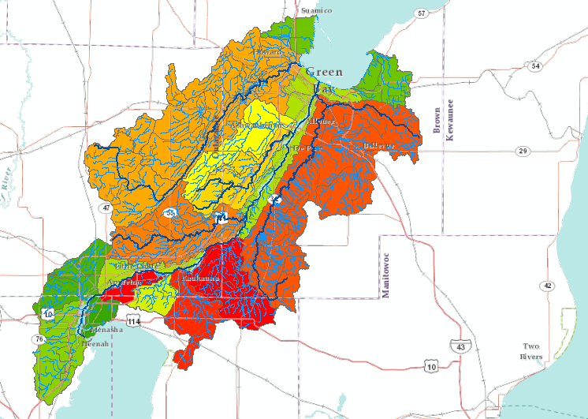
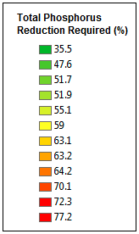
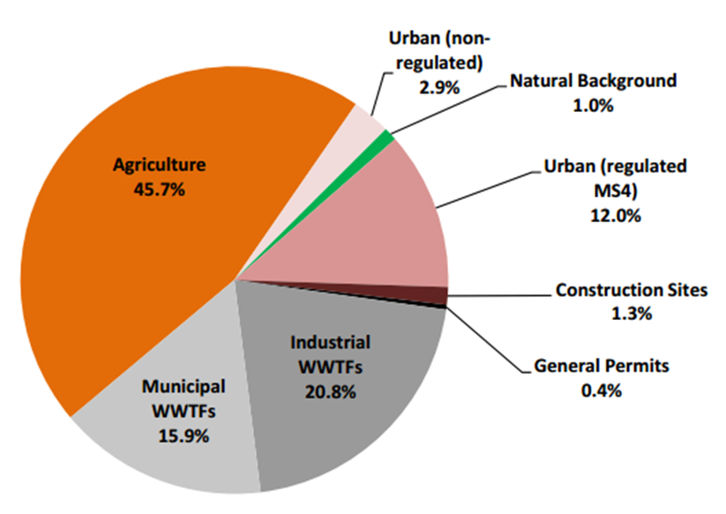
Total Phosphorus Reduction Required
Source: www.fwwa.org (August 2011).
Notes:
TP Reduction Needed http://www.fwwa.org/custom-1/LFR_TMDL_EPA_Submittal_Aug_2011.pdf

Slide 11
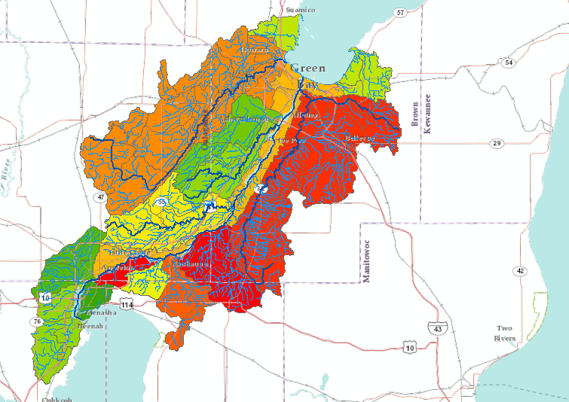
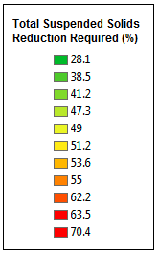
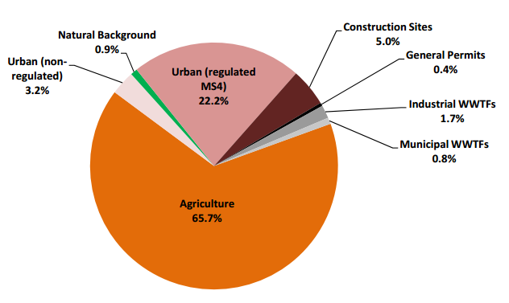
TSS Reduction Required
Source: www.fwwa.org (August 2011).
Notes:
TSS Reduction Needed http://www.fwwa.org/custom-1/LFR_TMDL_EPA_Submittal_Aug_2011.pdf

Slide 12
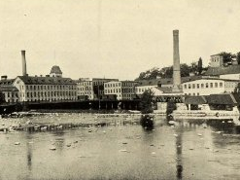
Conclusions
The Lower Fox River continues
to face and environmental and
human health hazards
This has a significant impact on
Green Bay and Lake Michigan
Requires further remediation
and reduction actions
Past contamination and water quality degradation are relevant
Postcard of the Appleton Paper Mill on the Lower Fox River.
Source: www.flickr.org (2012).
Notes:
Restoration Projects:
http://www.epa.gov/greatlakes/aoc/greenbay/index.html where they will use the sediments (Cat Island restoration project)

Slide 13
Acknowledgments
Dr. David Maidment, University of Texas at Austin
Dr. David Tarboton, Utah State University
Dr. Ayse Kilic, University of Nebraska-Lincoln
Gonzalo Espinoza, UT Austin Teaching Assistant
Marsha Burynski, WI Department of Natural Resources
James Killian, WI Department of Natural Resources

Slide 14
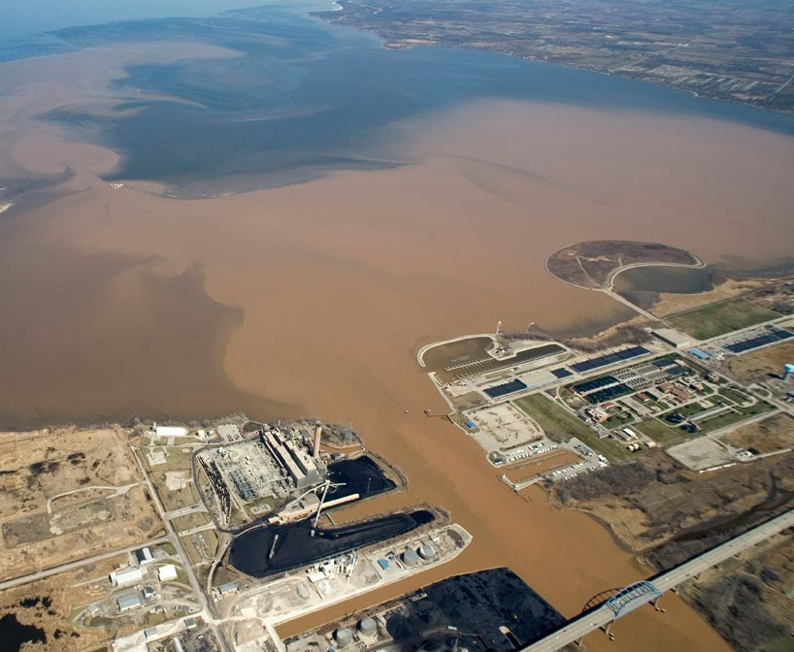
Questions?
Alyssa Offutt
aoffutt@utexas.edu
Suspended sediment at the mouth of the Lower Fox River following a rain event.
Source: www.foth.com (2012).

