Slide 1
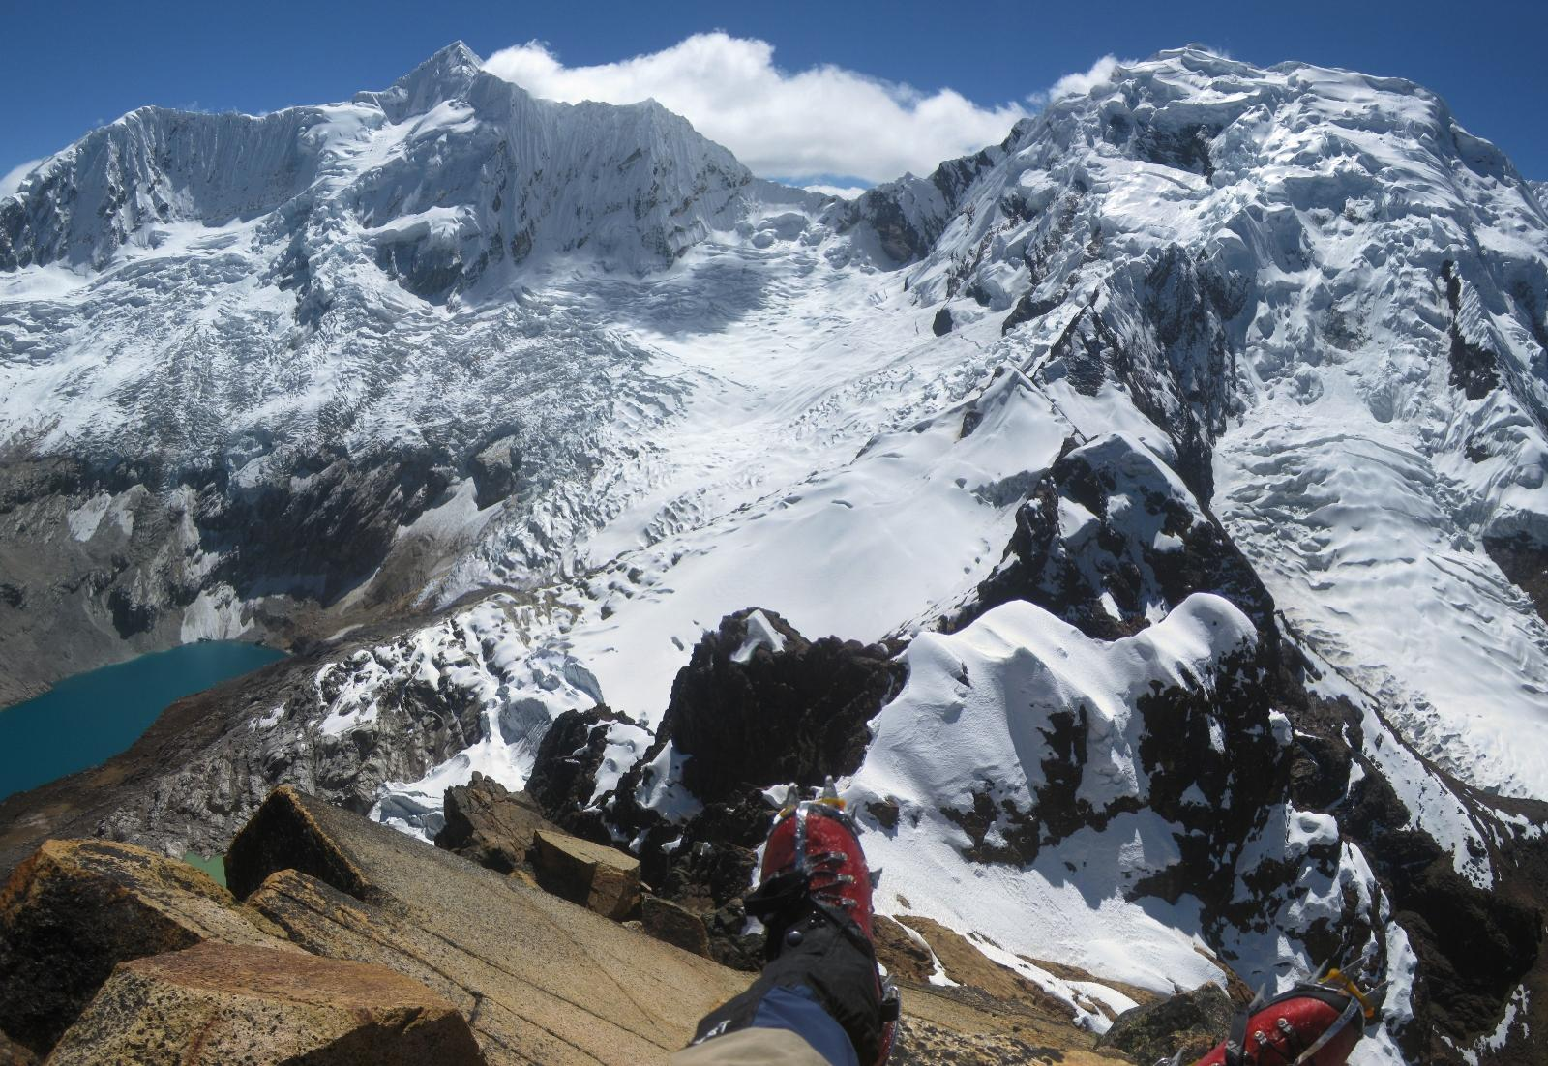
Glacial Lake Outburst Flood (GLOF)
Palcacocha Lake, Peru.
My presentation description
add your description here
Denny Rivas
2012

Slide 2
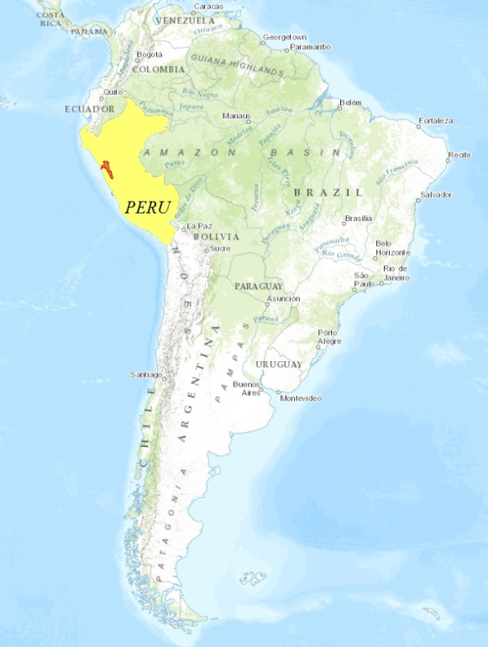
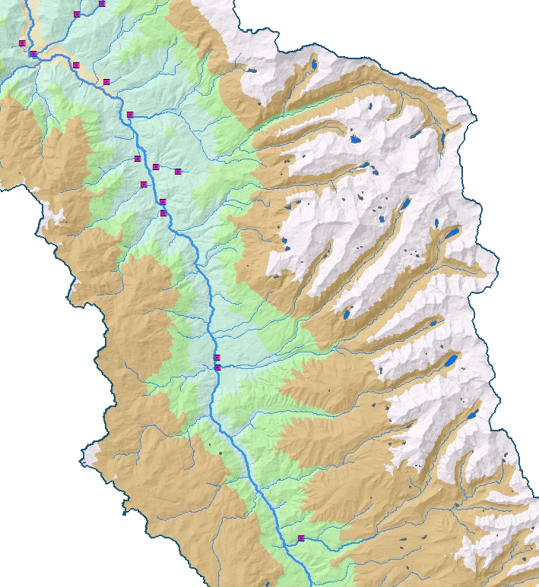
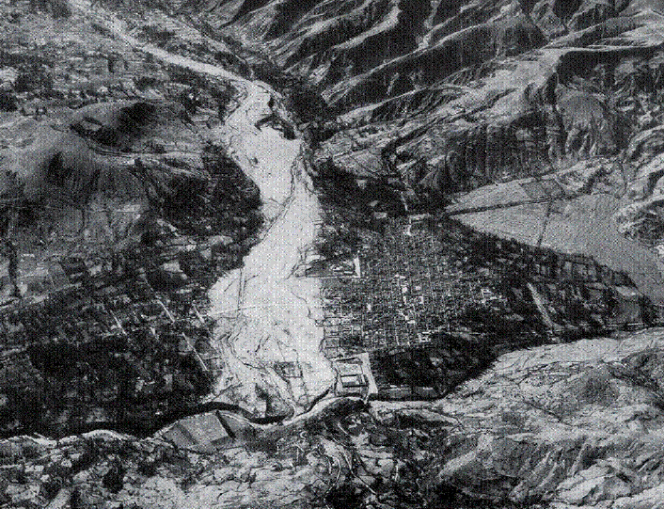
Study Area. What is the problem?
Palcaraju
Glacier
Palcacocha Lake
(4567 masl)
Huaraz city covered by the 1941 flood
Huaraz City
Year | Volume (millions m³) | Max. depth (m)
1941 | 12.0 | ---
1972 | 0.5 | 14
1974 | 0.5 | 13
2003 | 3.9 | 15
2009 | 17.3 | 73

Slide 3
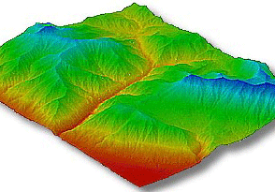
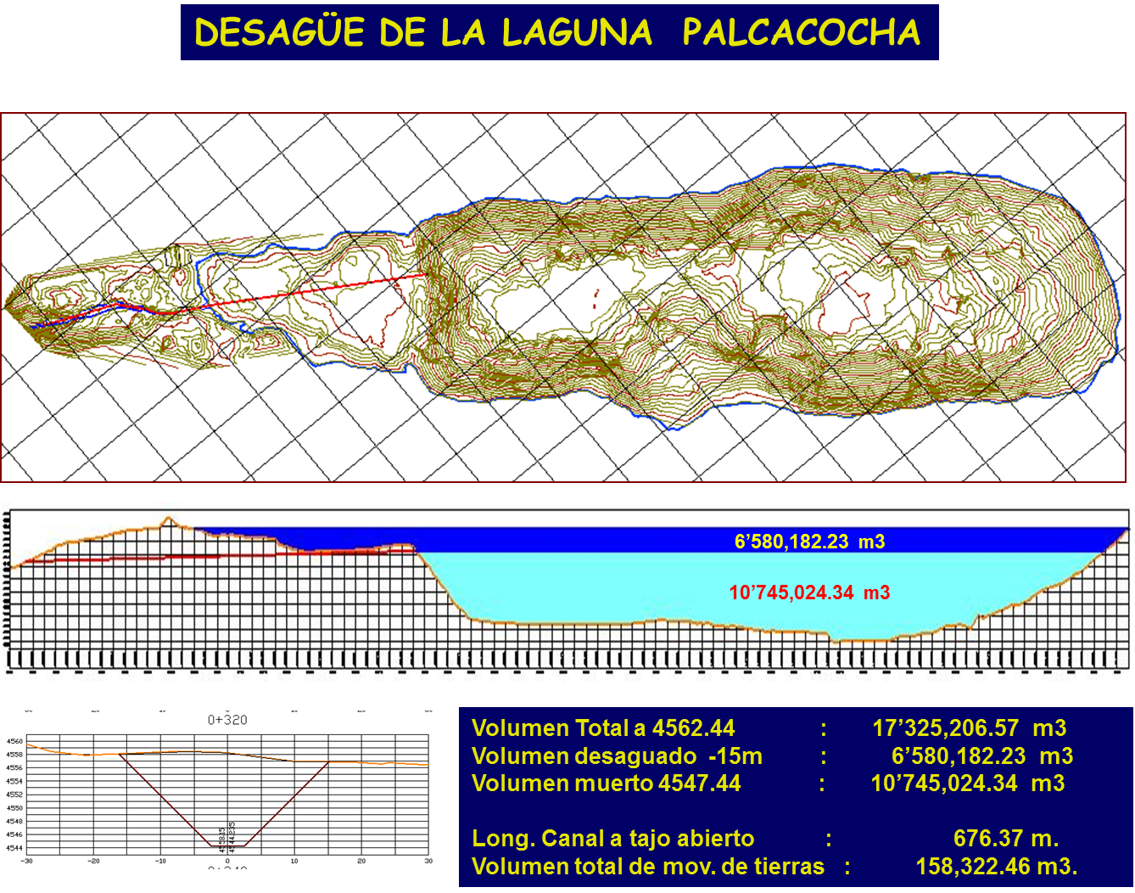
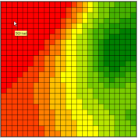
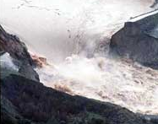
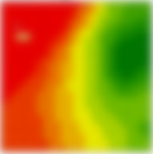
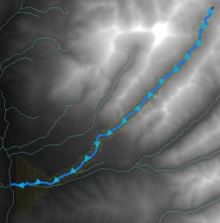
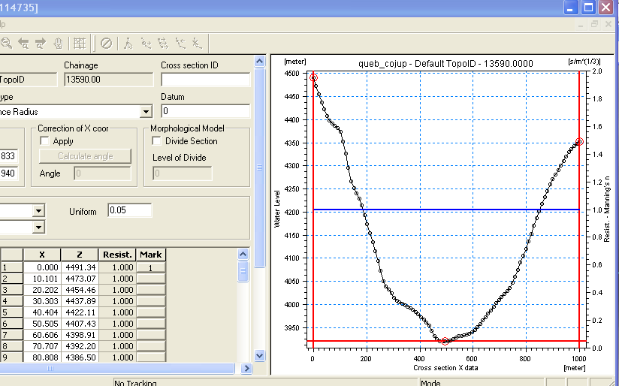
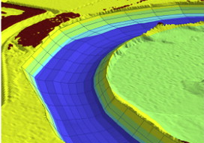
Spatial – hydrodynamic model
SIMULATION TIME
LAKE BATHYMETRY
LIDAR
DTM
(5m)
ASTER
DEM
(30m)
+
Terrain
t (h)
t = 4hr
BREACH FORMATION HYPOTHESIS
MSE = 135.32m²
Average deviation = ±11.6m
CALCULATIONS TIME STEP
e
MORAINE:
- ROCK
- SOIL
- ICE DEPOSITS
Δt = 1s
30m
1
t = 30min
1
Dam break model
MANNING’S COEFFICIENT
50m
Q (m3/s)
14,445 m3/s
Extraction
MIKE 11 - GIS
n = 0.05
STEEP TERRAIN
CHOW (1959)
Hydrodinamic parameters
t (h)

Slide 4
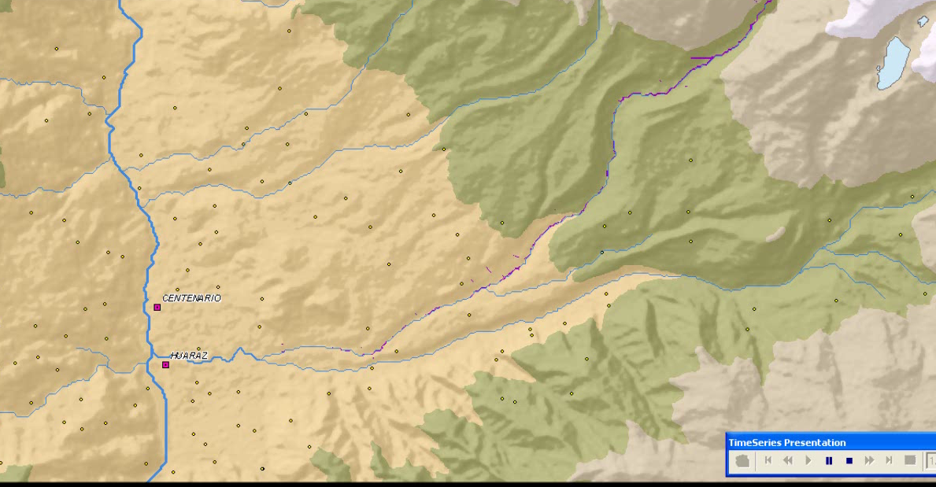
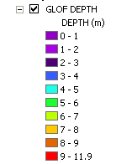
Results
Dinamic map (flow depth)
Capulipamba and
Unchos
Cantu and
Cantun
Huaraz urban area
Neighbors | Arrival time (min) | Max. Velocity (m/s)
Capulipamba and Unchos | 19 | 48.5
Cantu and Cantun | 20 | 25.0
Huaraz urban area | 22 | 20.0

Slide 5
ACKNOWLEDGEMENTS
McKinney research group
  Amanda Cuellar
  Marcelo Somos
Dr. David Maidment
  Gonzalo Espinoza
All of you

