Slide 1
Subsidence Mapping in Harris County, Texas
Taryn Tigges
CE 394K – GIS in Water Resources
Fall 2012

Slide 2
Project Background

Slide 3
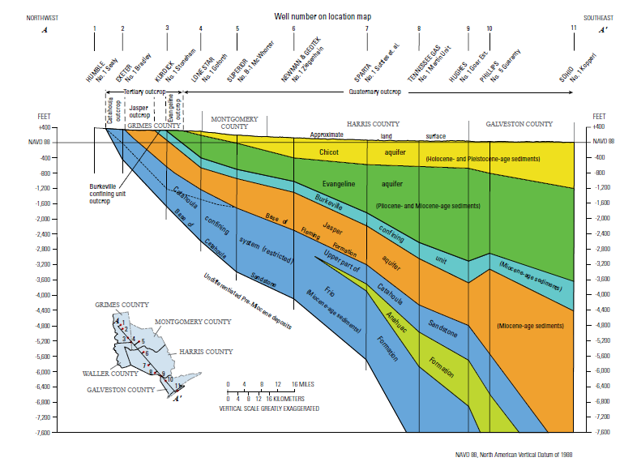

Slide 4
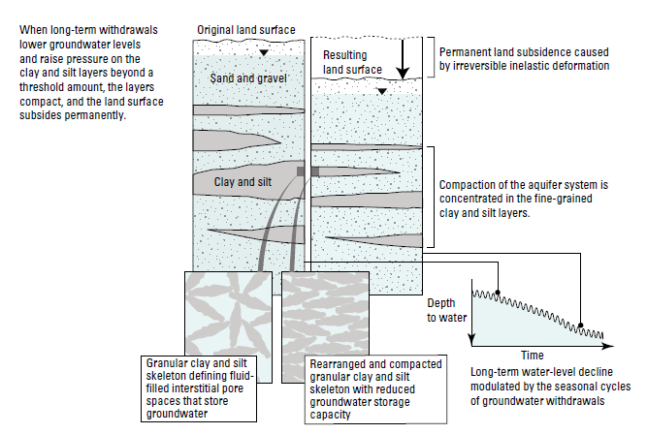
Compaction

Slide 5
Methods: Water Level Mapping
Obtain and format data
Create geodatabase
Import wells and water level measurements
Distinguish well types
Assign HydroIDs
Create transient data feature set
Create Graphs of Transient Clay Compaction Measurements
Create Time Series Statistics for Specific Time Intervals
Interpolate water levels to create rasters
Create animation of water level rasters

Slide 6
Data Sources
Water Levels
Groundwater Database Reports were obtained from the Texas Water Development Board website. These tables contain data on the GIS coordinates of the wells and the water levels recorded in each well as far back as 1921.
Base Maps
The shapefile for the counties of Texas was obtained from Geospatial Data Gateway, which contains county shapefiles under NRCS Counties by State.
Shapefiles of the major aquifers of Texas, including the Gulf Coast Aquifer, can be found at the Texas Water Development Board website.

Slide 7
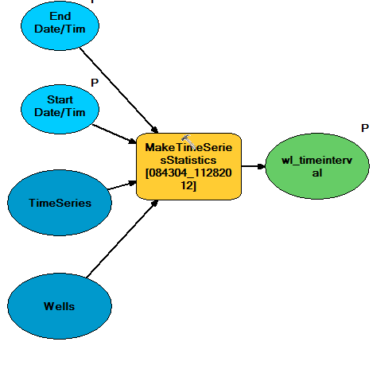
Model

Slide 8
Well Types
Code | Well Type
M | Mine
O | Observation
P | Oil or Gas
R | Recharge
S | Spring
T | Test hole
W | Withdrawal

Slide 9
Frequency of Water Level Meaurements

Slide 12
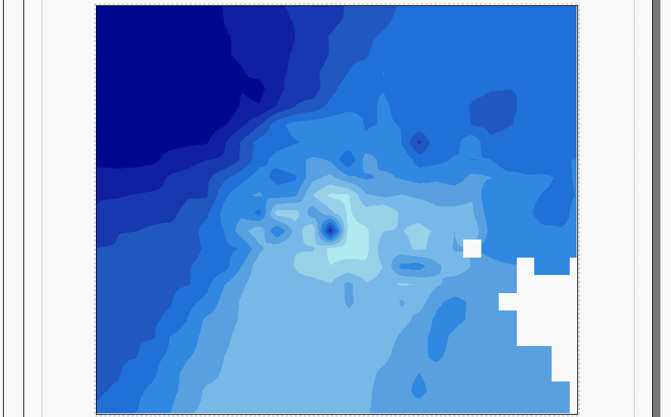
Water Levels in Harris County 1980 - 2011

Slide 13
Methods: Clay Compaction Mapping
Obtain and format data
Create geodatabase
Import monitoring points and clay compaction measurements
Create transient data feature set
Create Graphs of Transient Clay Compaction Measurements
Create Time Series Statistics for Specific Time Intervals
Interpolate Clay Compaction Measurements to create rasters

Slide 14
Data Sources
Clay Compaction Measurements
11 extensometer measurements are from the USGS and the Harris Galveston Subsidence district
Latitude and longitude of each site can be found at on the USGS website by going to the Groundwater Watch page

Slide 15
Frequency of Clay Compaction Meaurements

Slide 20
Summary
Water management has helped Houston increase groundwater levels since 1973
Subsidence has increased in Harris County since 1973
More monitoring points exist for water level measurements than for clay compaction measurements
Groundwater levels and subsidence are related

