Slide 1


Increasing Adaptive Capacity in Vermilion Parish, Louisiana
Danica Adams

Slide 2
Adaptive capacity is one way to measure resilience.
Adaptive capacity is the ability of a system
– in this case, Vermilion Parish as a political unit –
to adapt to changing circumstances while still retaining its fundamental functions as a system.
An analysis of the adaptive capacity and vulnerability of cattle ranching will necessarily include social, environmental, and economic concerns within Vermilion Parish.

Slide 3
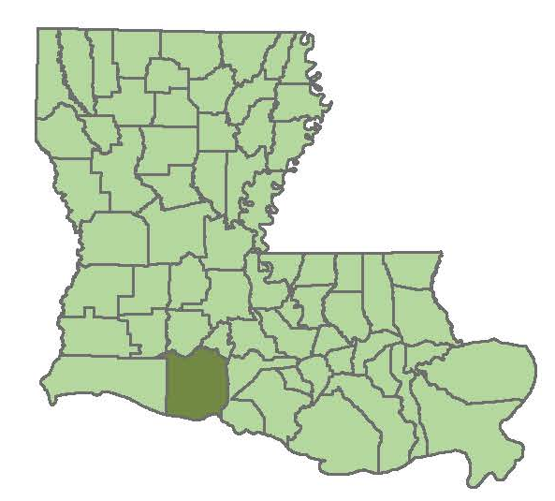
Vermilion Parish is in the Southwestern portion of Louisiana, on the coast

Slide 4

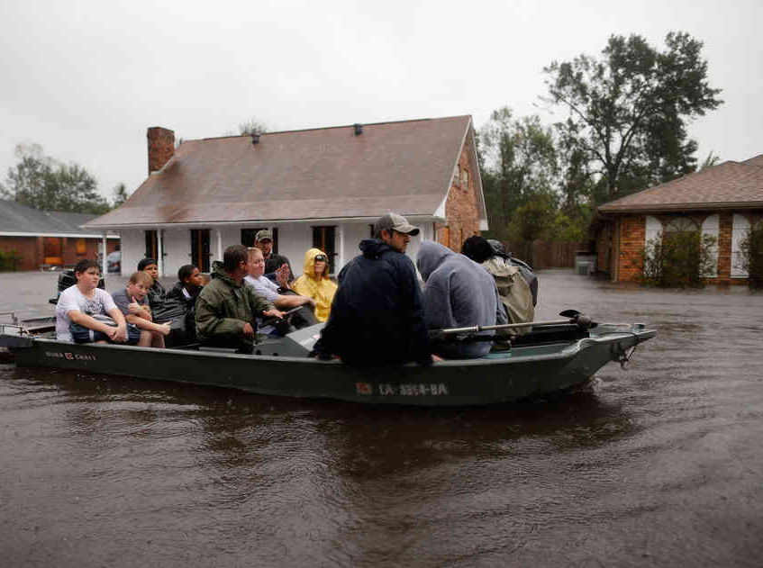
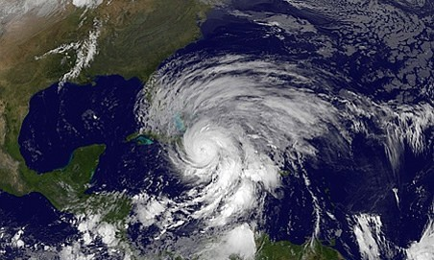
In coastal Louisiana, sometimes conditions change rapidly

Slide 5
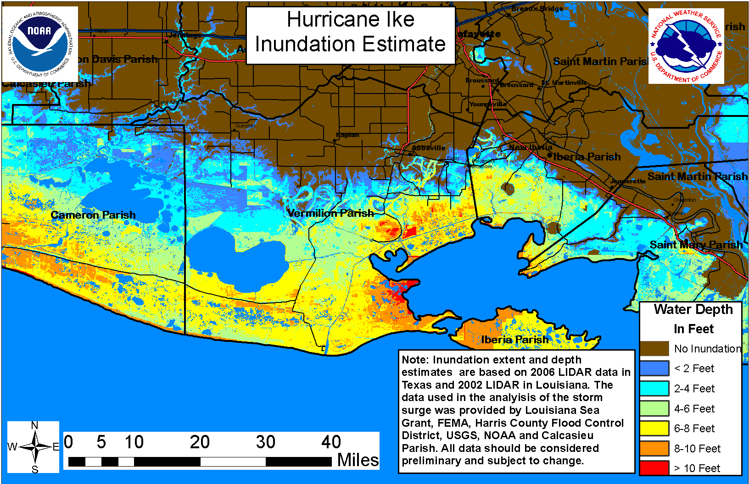

Slide 6
To properly assess, and eventually increase the adaptive capacity of Vermilion Parish, we must first begin with a base analysis of social, environmental and economic factors.

Slide 7


Slide 8
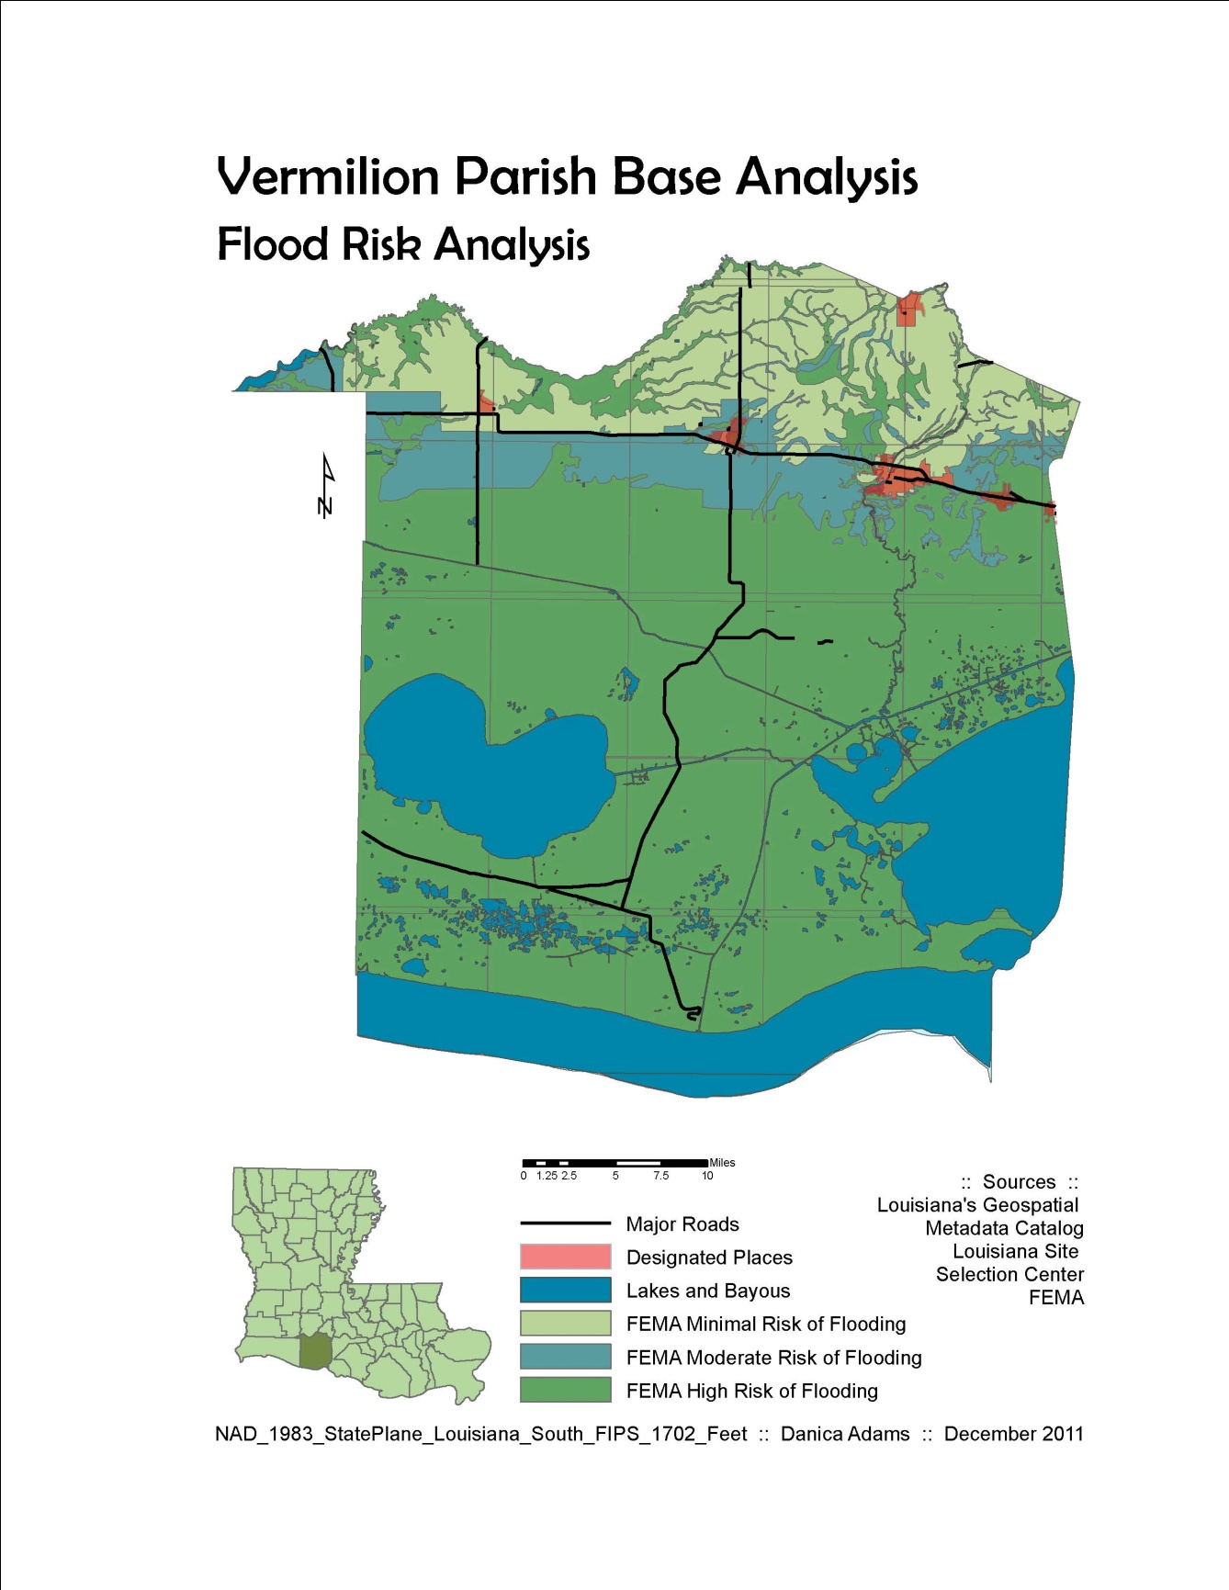

Slide 9
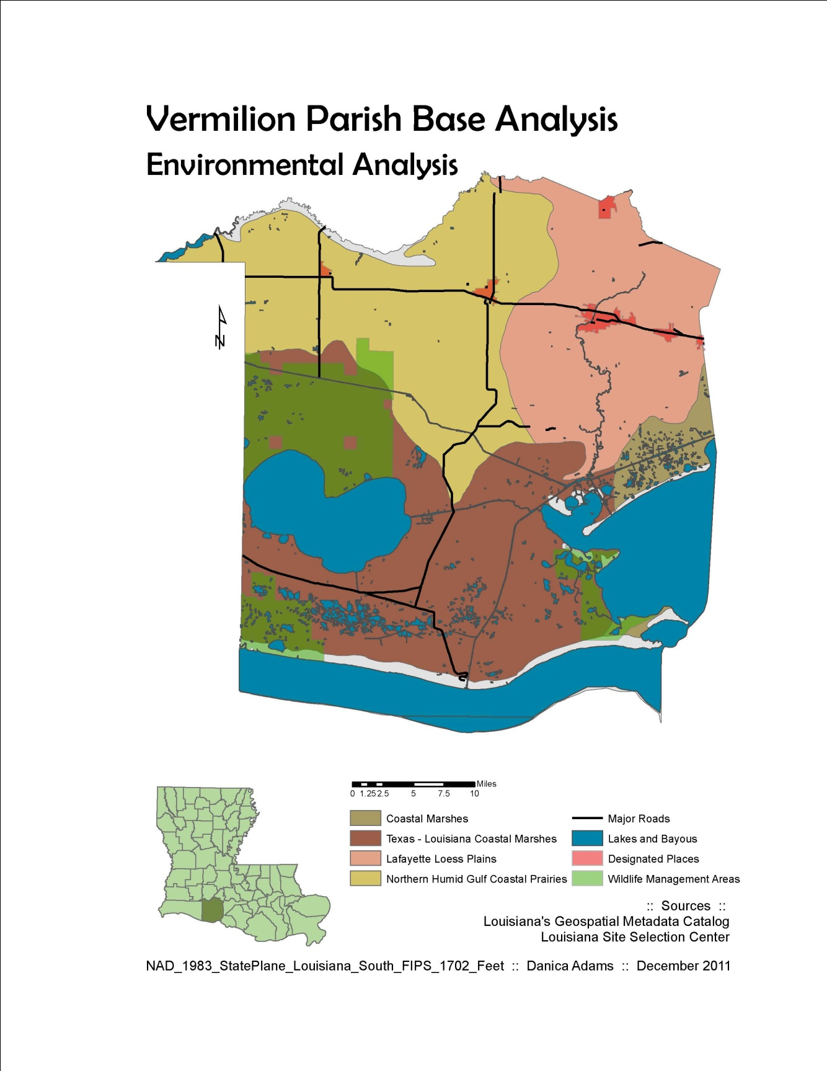

Slide 10
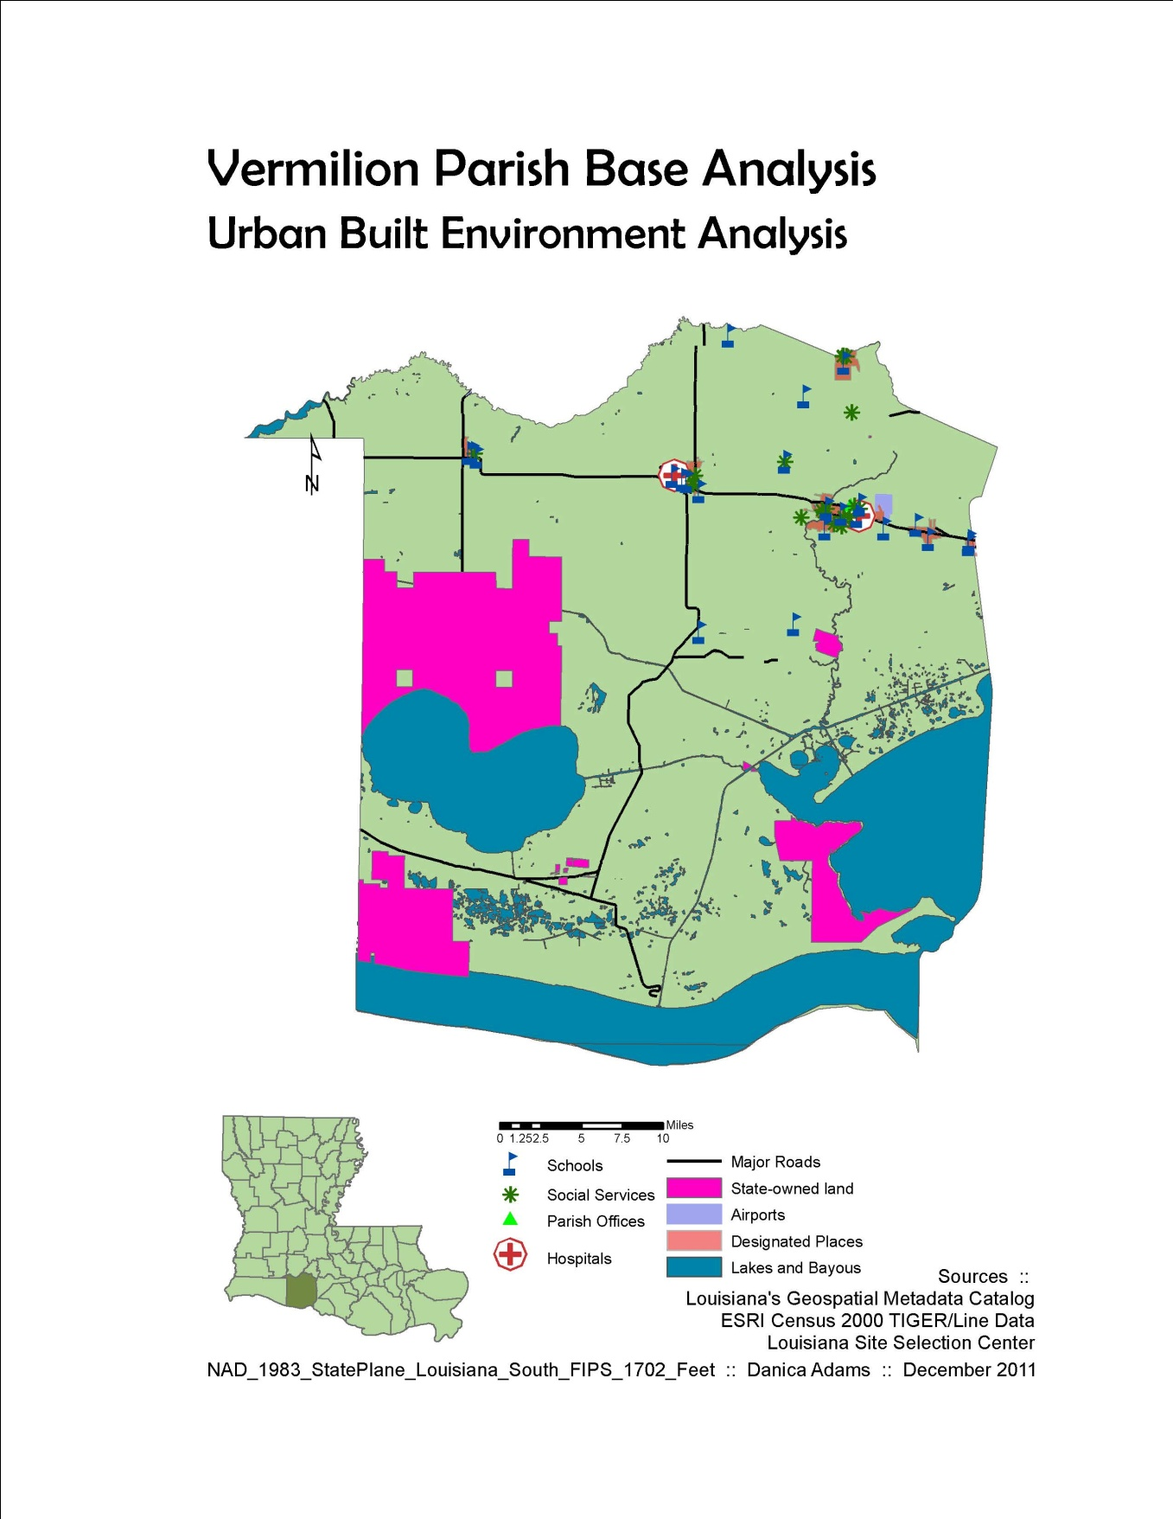

Slide 11
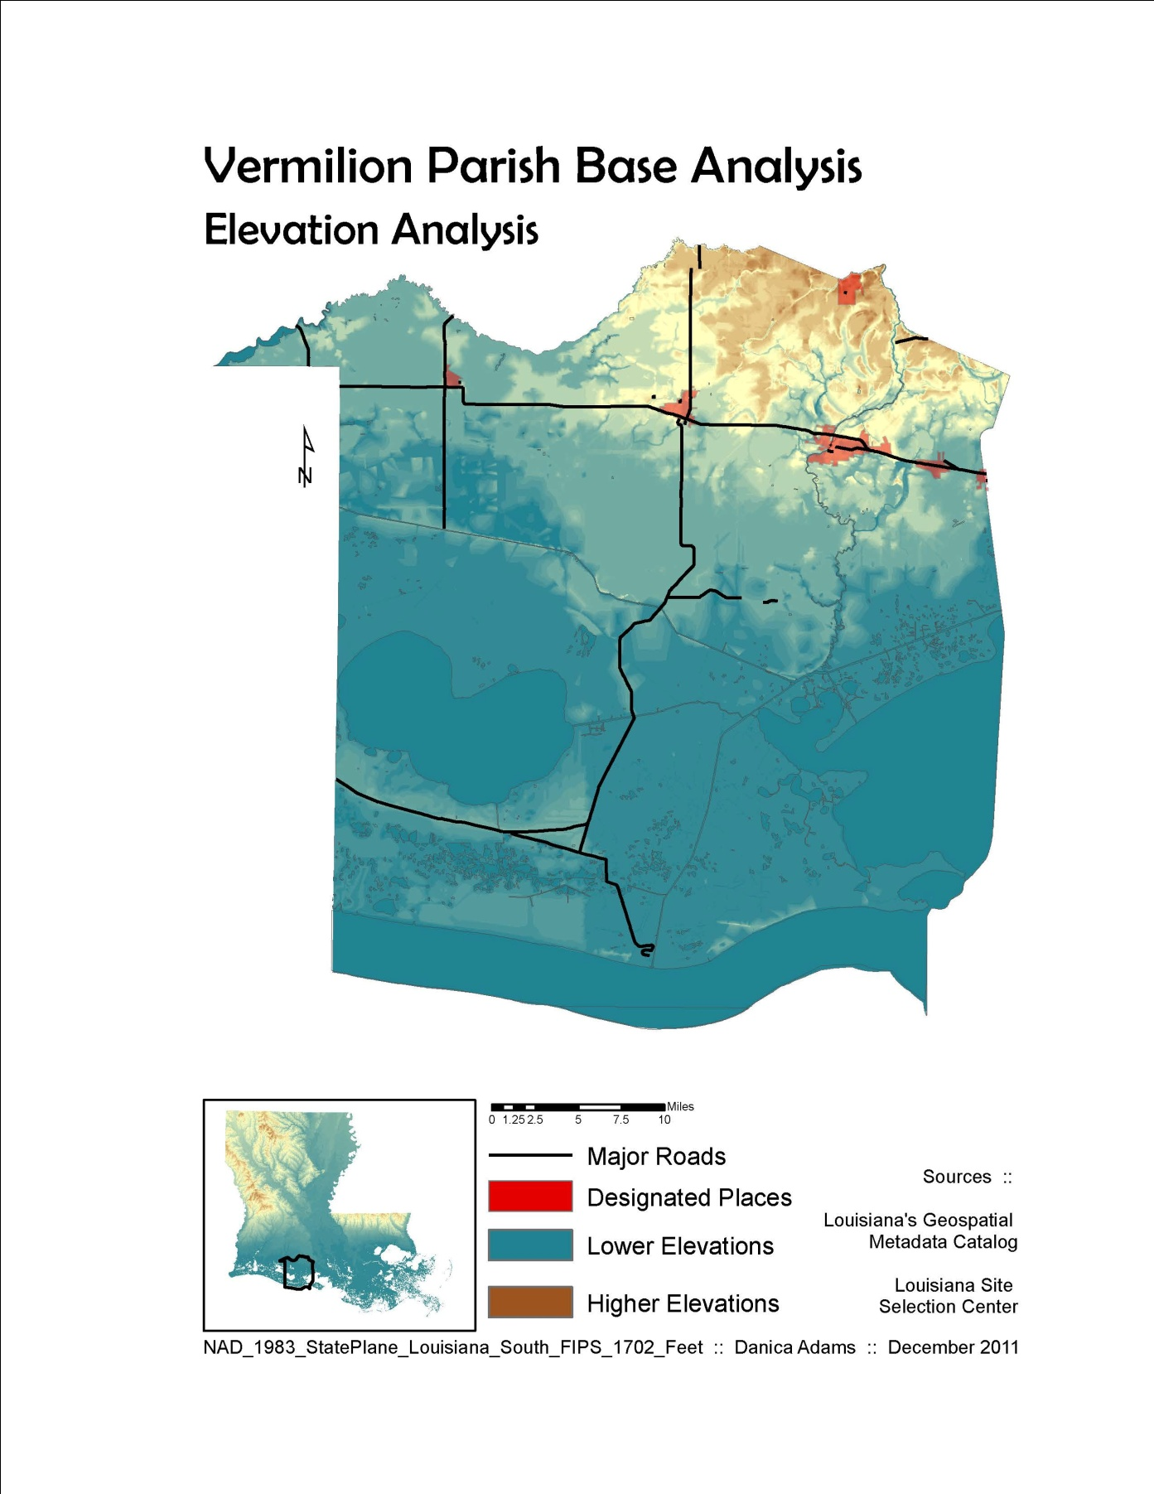

Slide 12
The biggest limitation with GIS data analysis in this context is access to census tract data instead of parish-wide data.
My next steps will be to obtain economic and livelihood numbers, put them into table format, and join them to a parish shapefile.

Slide 13

Thank you

