Slide 1
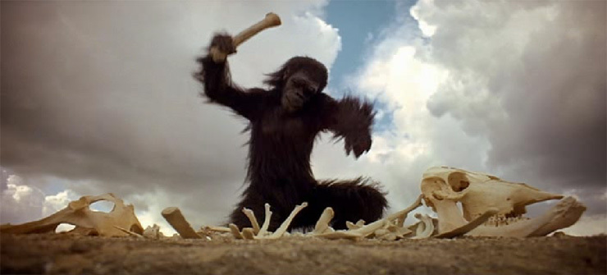

Expanding the Functionality of ArcGIS Through
Tool Building
Designing an Optimized
Pit Removal Tool for
Digital Elevation Models
Stephen Jackson
Environmental and Water Resources Engineering
University of Texas at Austin

Slide 2
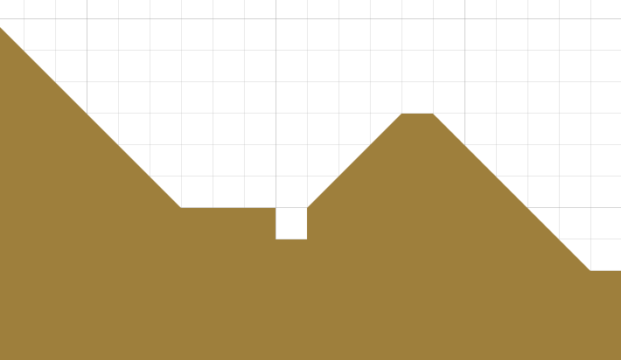
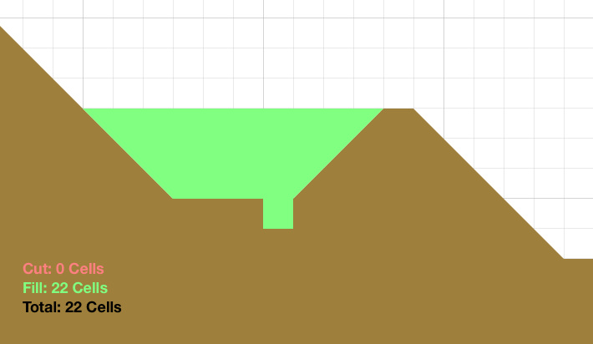
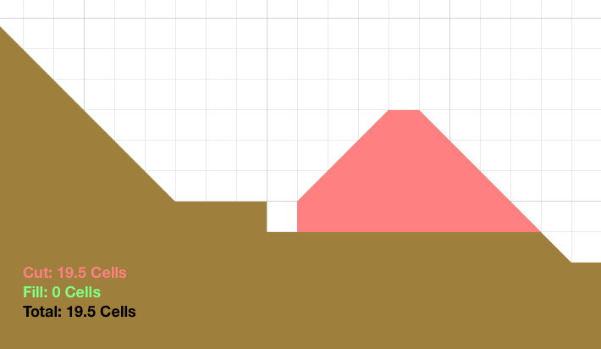
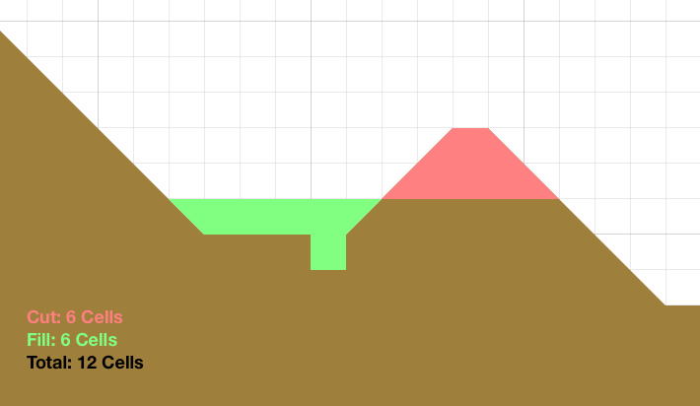
Desired Tool: Optimal Pit Removal

Slide 3
Tool Building Options in ArcGIS
Model Builder
Accessed from ArcGIS
ArcGIS Tool
Composed of ArcGIS Tools
Composed of Python Script and Metadata
Accessed from ArcGIS
Standalone Program
Accessed independently
Composed of executable from any scripting language (Python, C++, Visual Basic, etc.)

Slide 4

Selected Tool Structure
Model
Builder
Python Script
C++ Console Application
ArcGIS Tool
Input
Output
Original File(s)
Visualization
Input
Output
(Linked)
Input
Output
Input
New File(s)
MAGIC

Slide 5
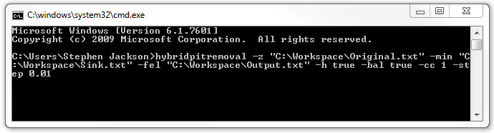
C++ Console Application
Standalone
Can be run from command line without ArcGIS installed or running
Written in any language
C++, Python, Visual Basic, etc.
No Complex User Interface
All required inputs are formatted as a single line of text
Work with any file types
ASCII, TIF, SHP, etc.
Durable
Adapt to future changes in ArcGIS with minimal revisions
Integrate with other GIS software

Slide 6
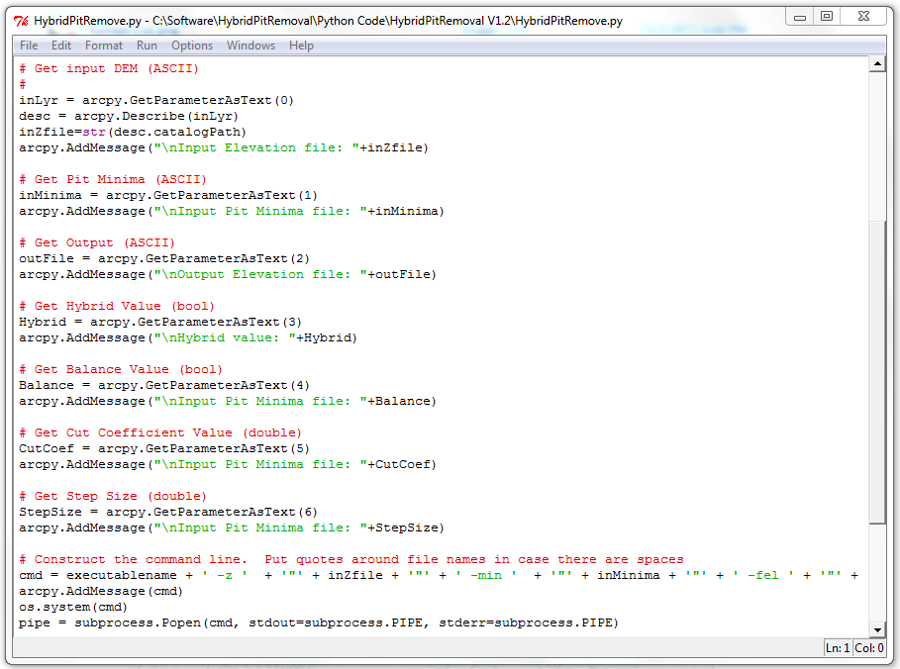
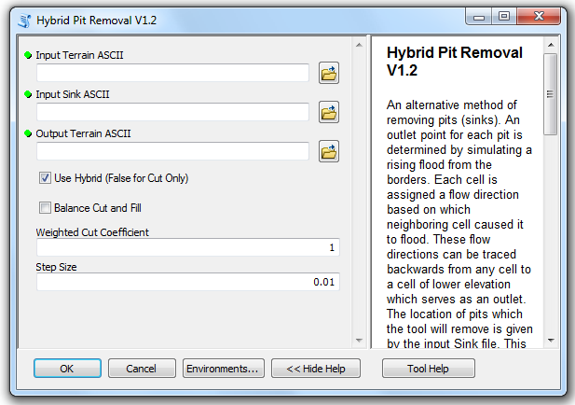
Python Script → ArcGIS Tool
Translates user inputs into console application inputs
Uses short code, easily adaptable to new tools
Native integration and support with ArcGIS provided by ESRI

Slide 7
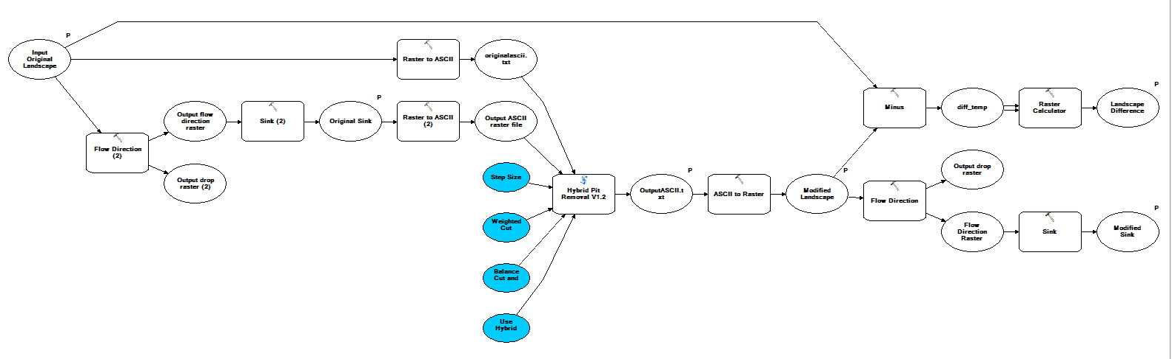
Model Builder
Perform simple tasks such as file type conversions
Incorporate tool into more complex workflows

Slide 8
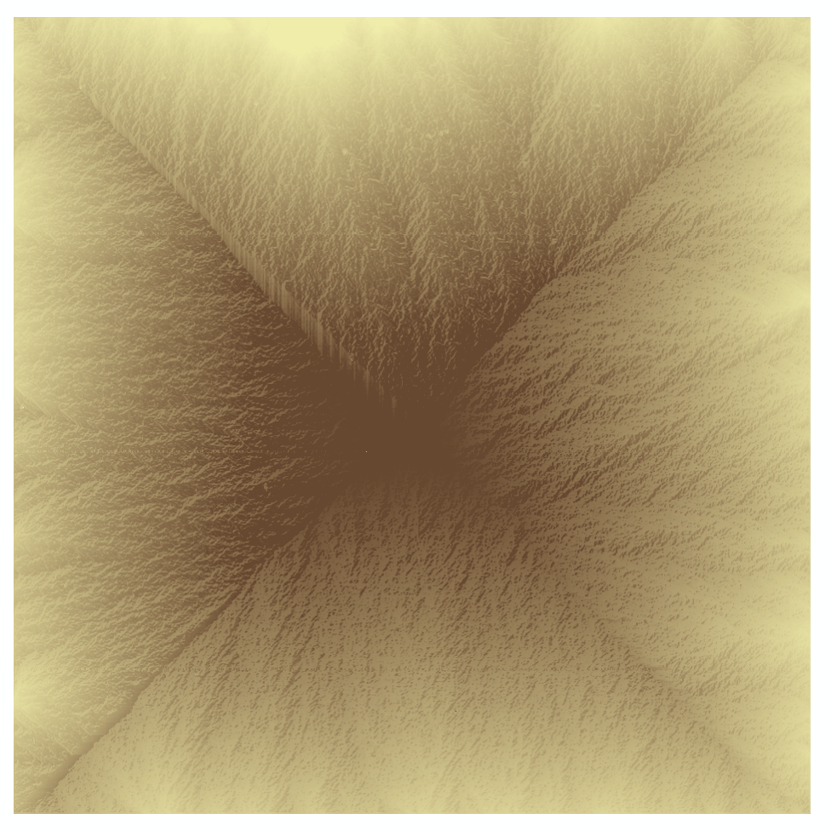

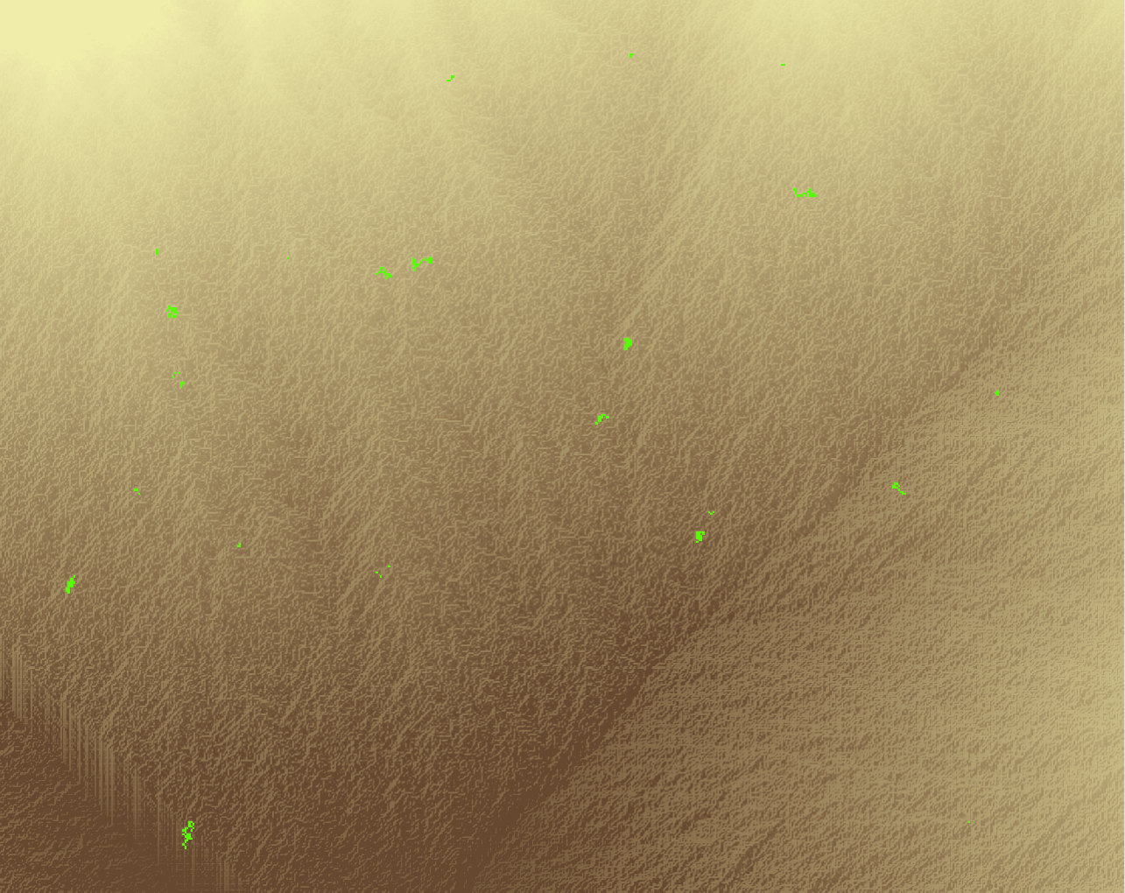


Optimal Pit Fill Tool Results
Total Average Change
Fill: 5.85
Cut: -21.08
Optimal: 1.02
Artificially Generated Terrain
1000 x 1000 Cells
(Equivalent to 1 sq. km at 1m resolution)

Slide 9
Further Work and Acknowledgements
Further Work:
Finish debugging and documenting current tool
Experiment with LiDAR and explore potential uses
Modify code to use multiple processors and different input file types
Acknowledgements:
Pierre Soille (Joint Research Centre, European Commission, Italy)
Dr. Tarboton (Utah State University)
Dr. Maidment and the GIS Research Group (University of Texas at Austin)
Dr. Jackson (Cornell University)

Slide 10
Questions?
What is the air speed velocity of an unladen swallow?
When’s lunch?
What is the meaning of Life, the Universe, and Everything?
What has it got in its pocketses?
How do you solve a problem like Maria?
How many helium balloons does it take to lift a squirrel?

