Slide 1
New Zealand Paleoclimate
John Swartz
12/6/2012
CE 394K

Slide 2
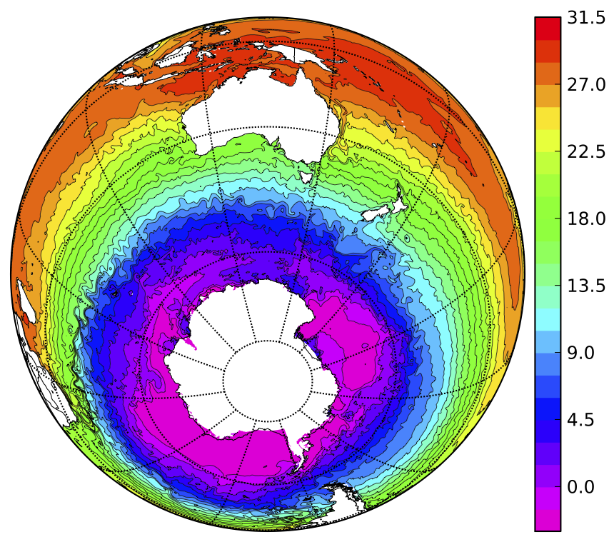
Sea Surface Temperature (SST)
Australian National University

Slide 3
Towards a Climate Stratigraphy
Inter-hemisphere phasing major paleoclimate question, especially in mid-latitudes
New Zealand one of few land-masses located in this zone in the Southern Hemisphere
What drivers control its climate? How are these recorded?
NZ-INTIMATE major ongoing collaboration involving UT Paleoclimate research group

Slide 4
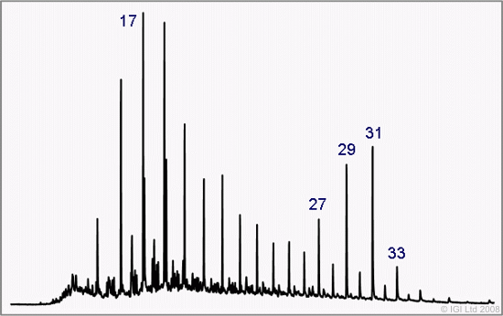
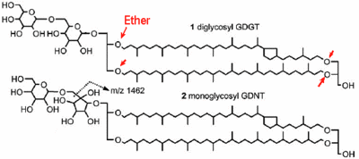
UT Paleoclimate
Organic biomarkers preserved within lake sediment cores
Main focus- CSIA lipid n-alkanes, and glycerol dialkyl glycerol tetraethers (GDGTs)
Provide precipitation and temperature variability, respectively
Schouten et al, 2012

Slide 5
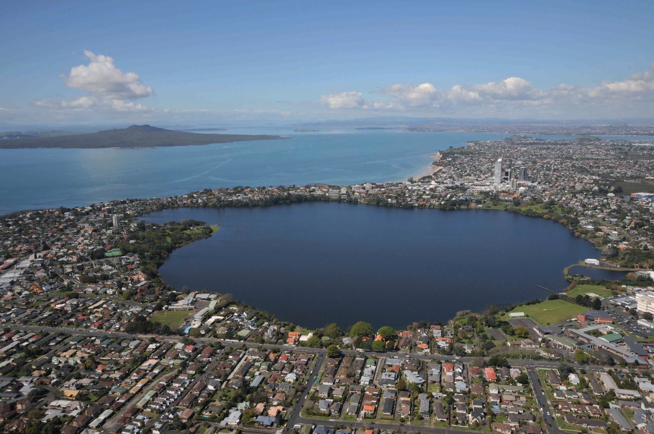
Lake Pupuke
Volcanic maar lake north of Auckland, North Island
55,000 years of mud, near annual resolution(!)

Slide 6
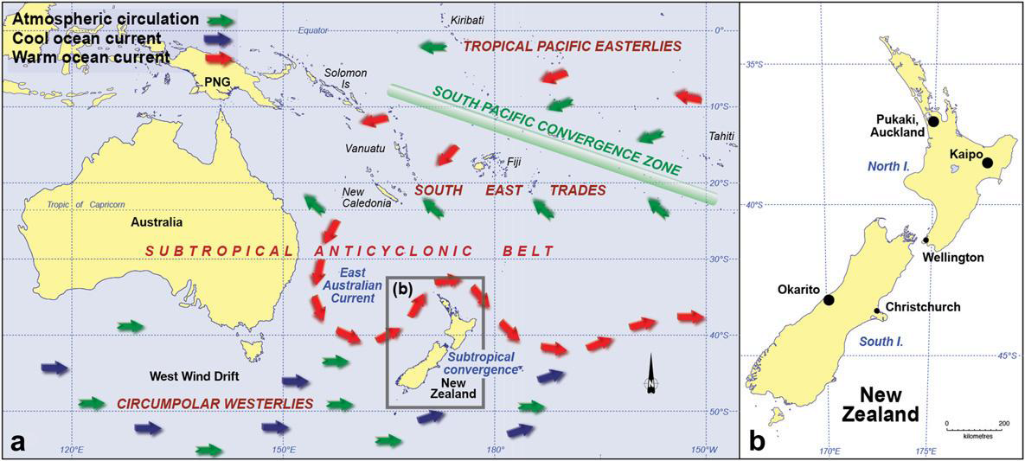
Climatic Influences
Newnham et al, 2011

Slide 7
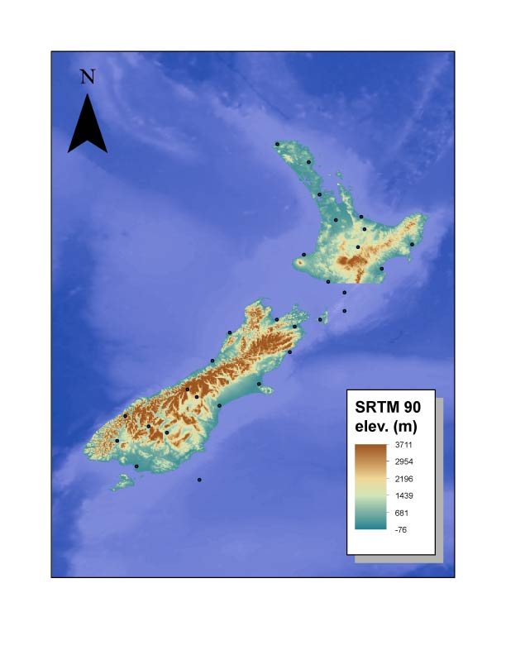
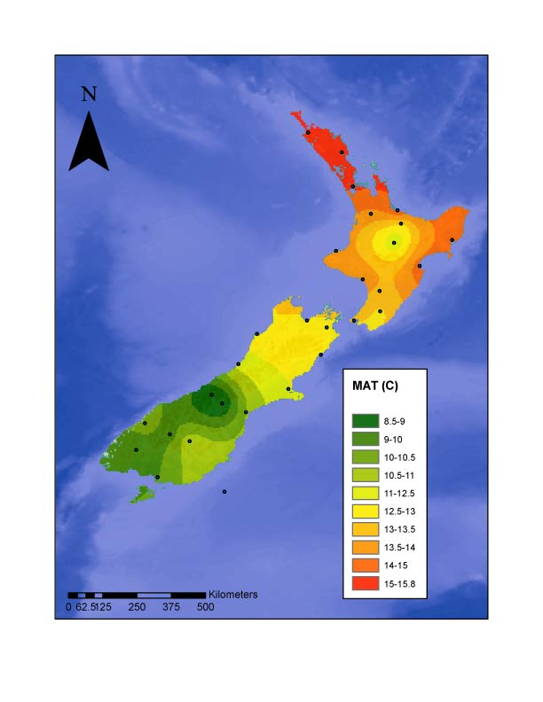
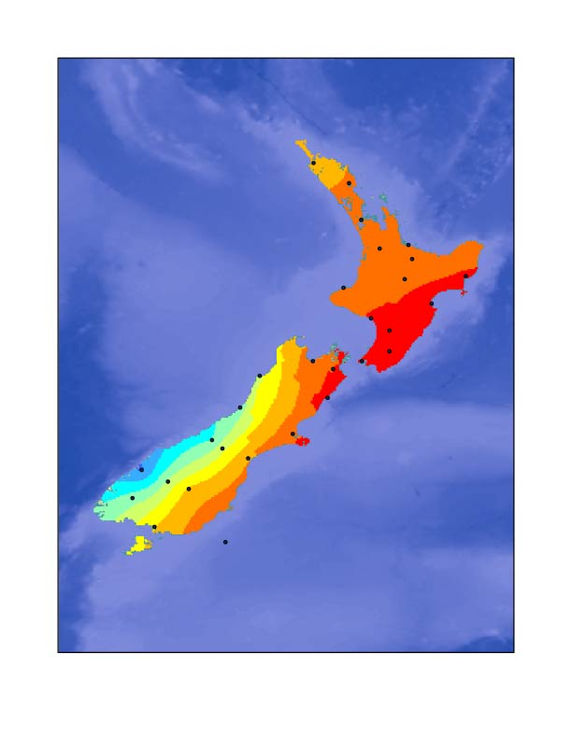
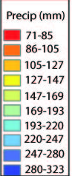
Physical Setting
Elevation
Mean Annual Temperature (air)
Average Monthly Precipitation
North Island volcanic, flat or hilly
South Island = Southern Alps
Orographic Precipitation
on South Island

Slide 8
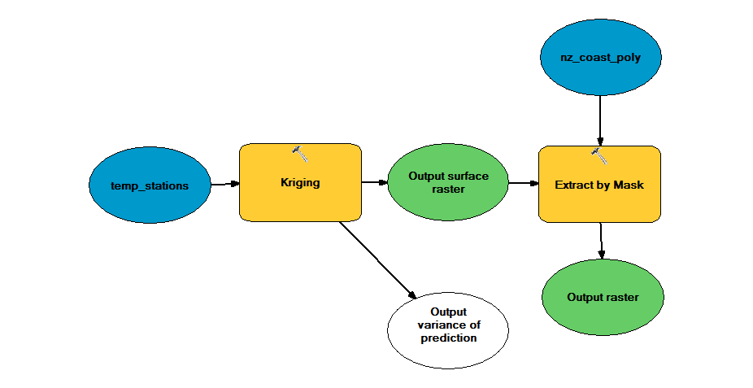
What is seasonal precipitation and temperature variability?
NIWA provides excellent station coverage
Interpolate!
Use kriging scheme and model builder to automate for monthly averages

Slide 9
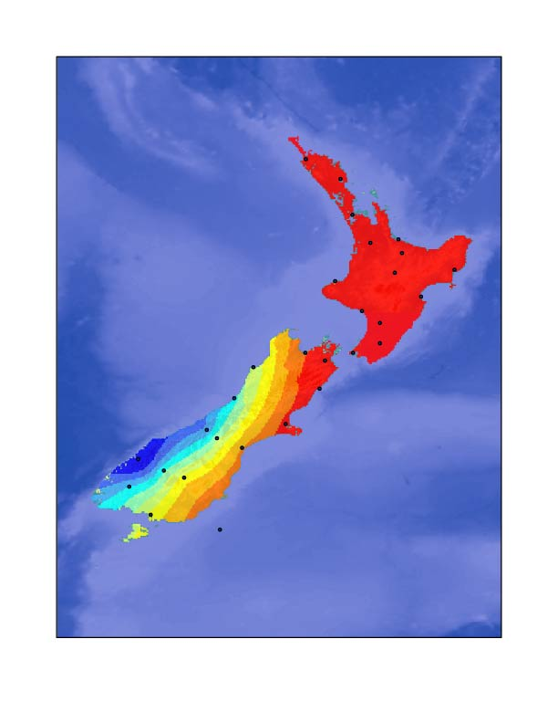
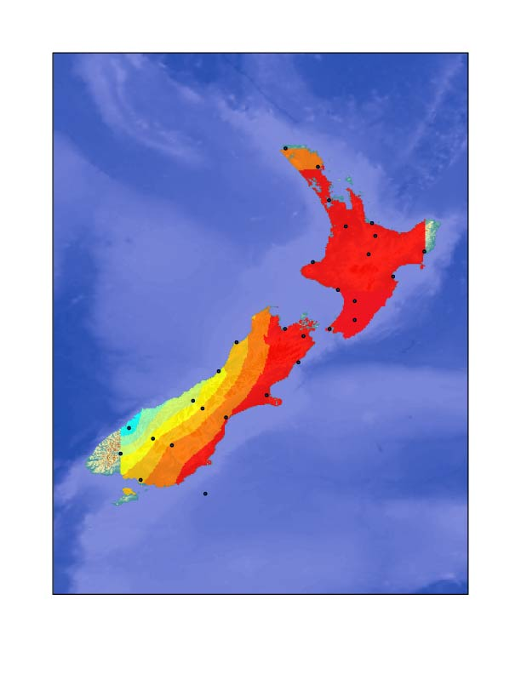
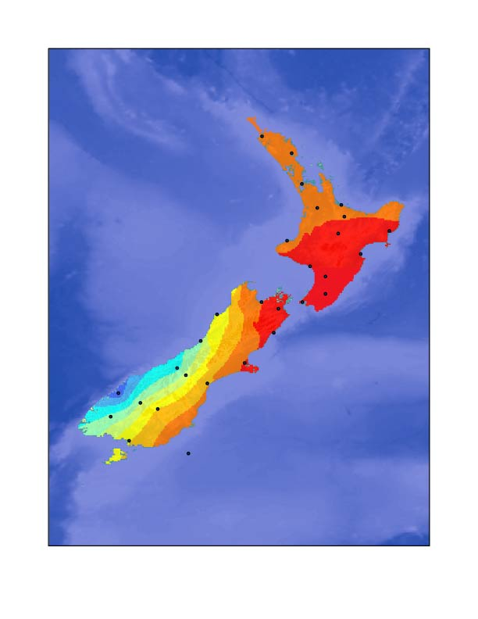
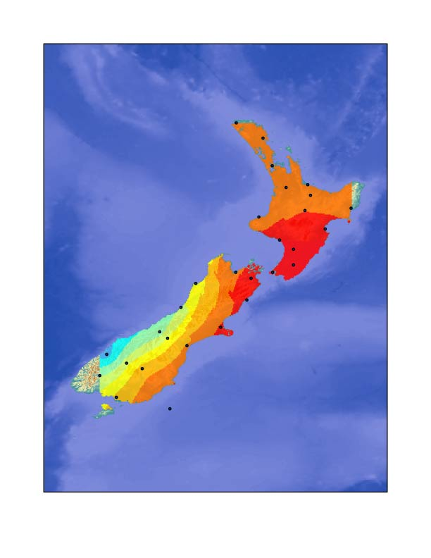
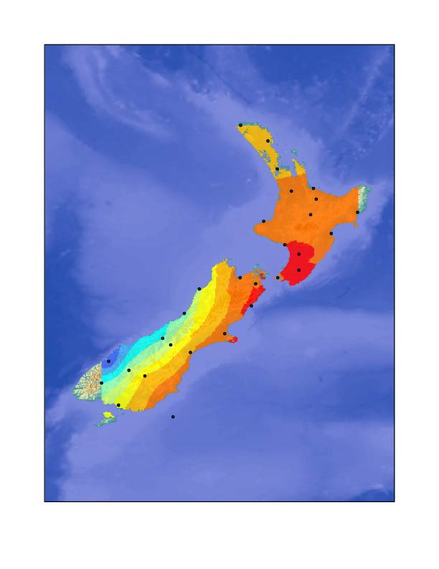
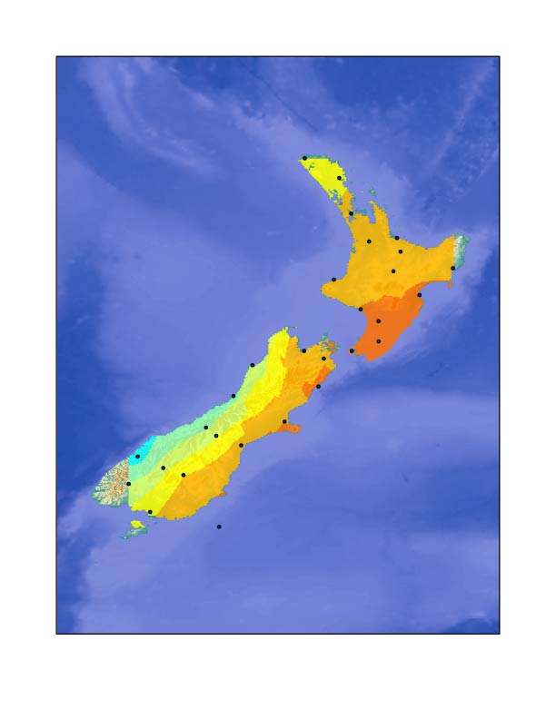
JANUARY
FEBRUARY
MARCH
APRIL
MAY
JUNE
Raw Data
NIWA, NOAA

Slide 10
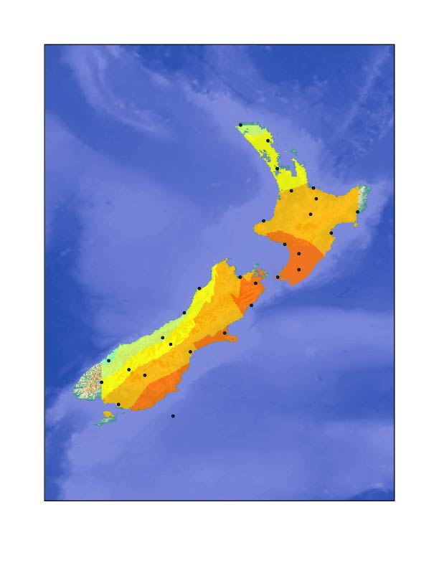
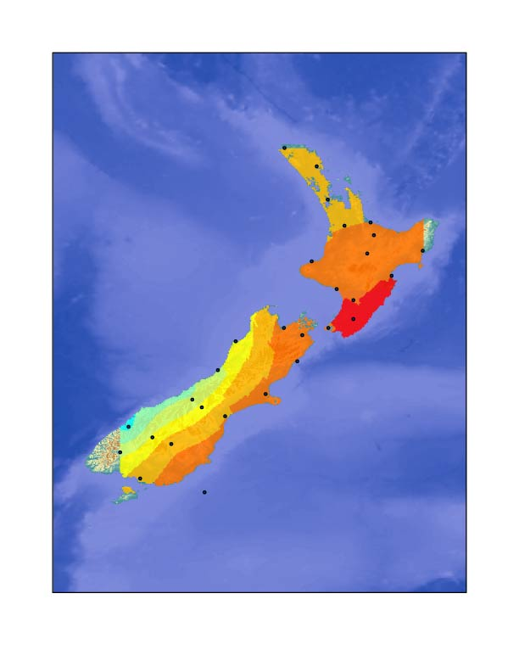
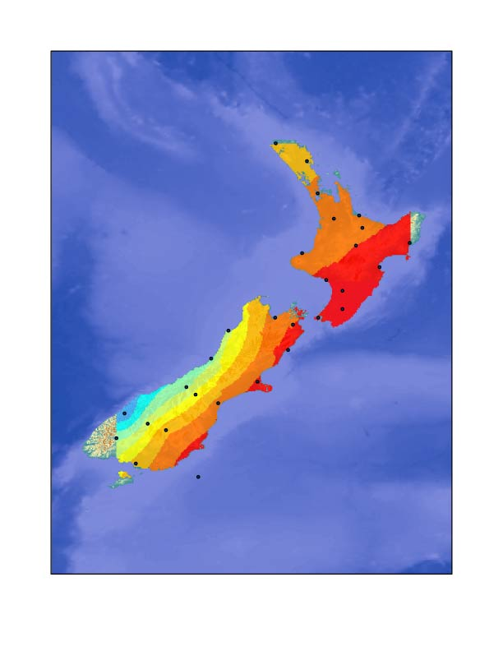
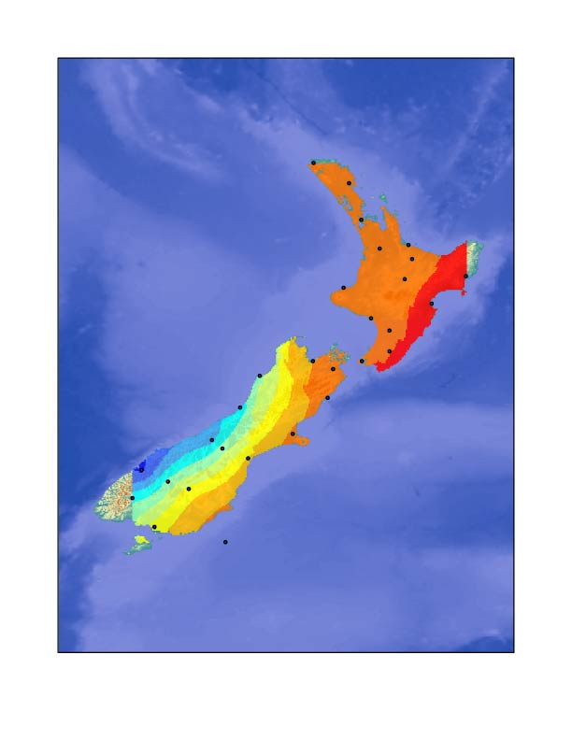
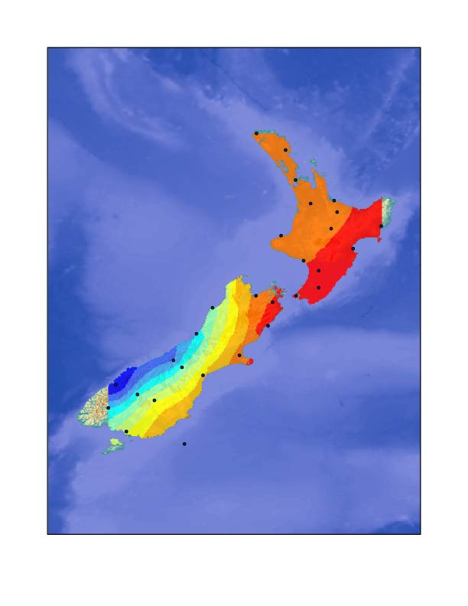
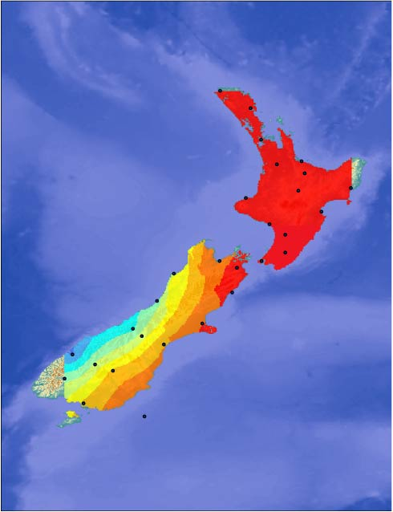
JULY
AUGUST
SEPTEMBER
OCTOBER
NOVEMBER
DECEMBER
Raw Data
NIWA, NOAA

Slide 11
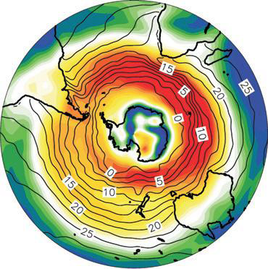
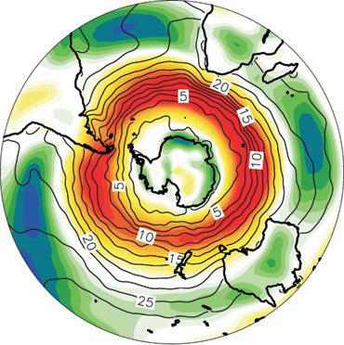
What drives this variability?
Austral Winter
Austral Summer
Westerly wind positions expand and contract with SH climate
Cold = Expansion and weakening
Warm = Contraction and intensification
Lamy et al, 2010

Slide 12
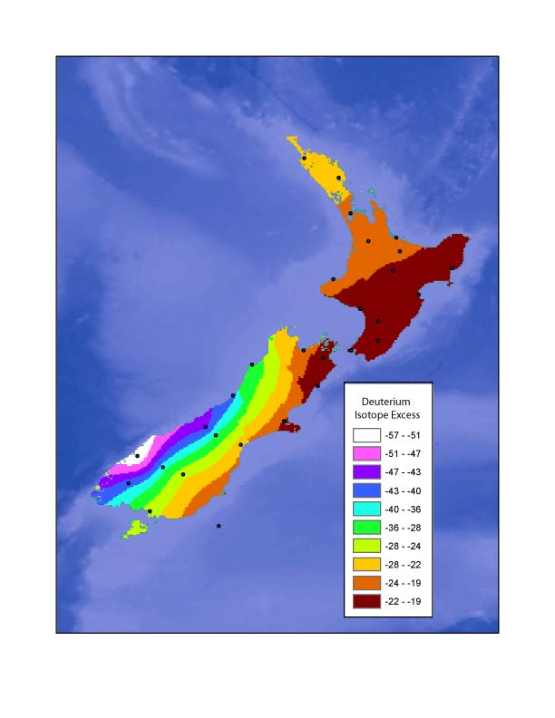
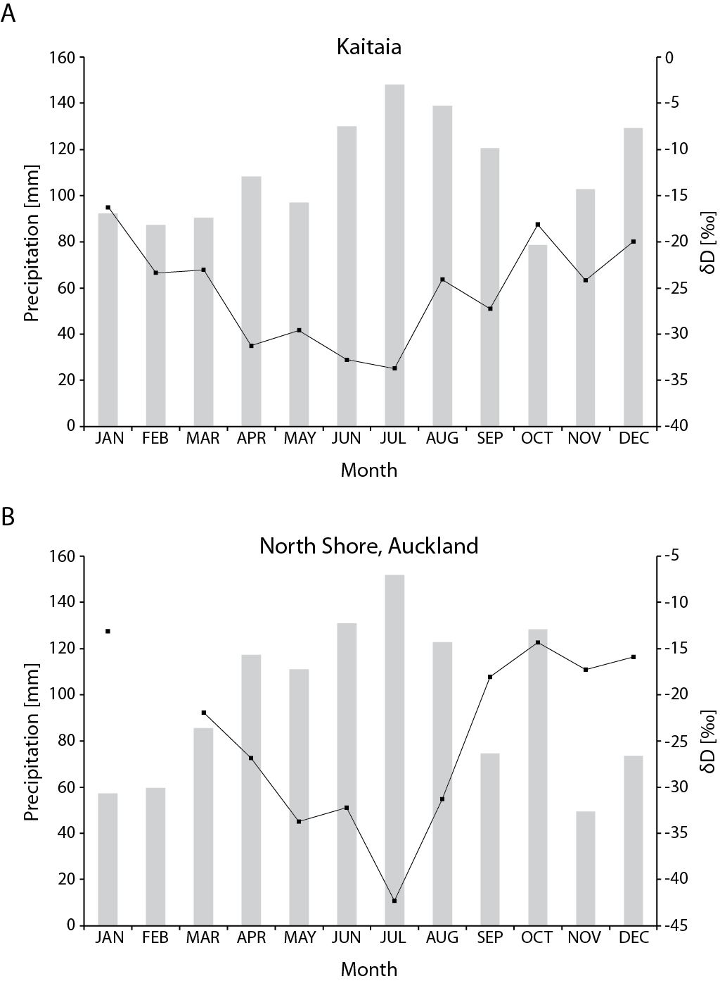
Precipitation and dD relation
NIWA, NOAA
Frew, unpublished
Monthly Average Precipitation
Interpolated dD
Atkin, 2011

Slide 13
Precipitation and dD relation
NIWA, NOAA
Frew, unpublished
Monthly Average Precipitation
Interpolated dD

Slide 14
Record of shifting westerlies?
Newnham et al, 2011

Slide 15
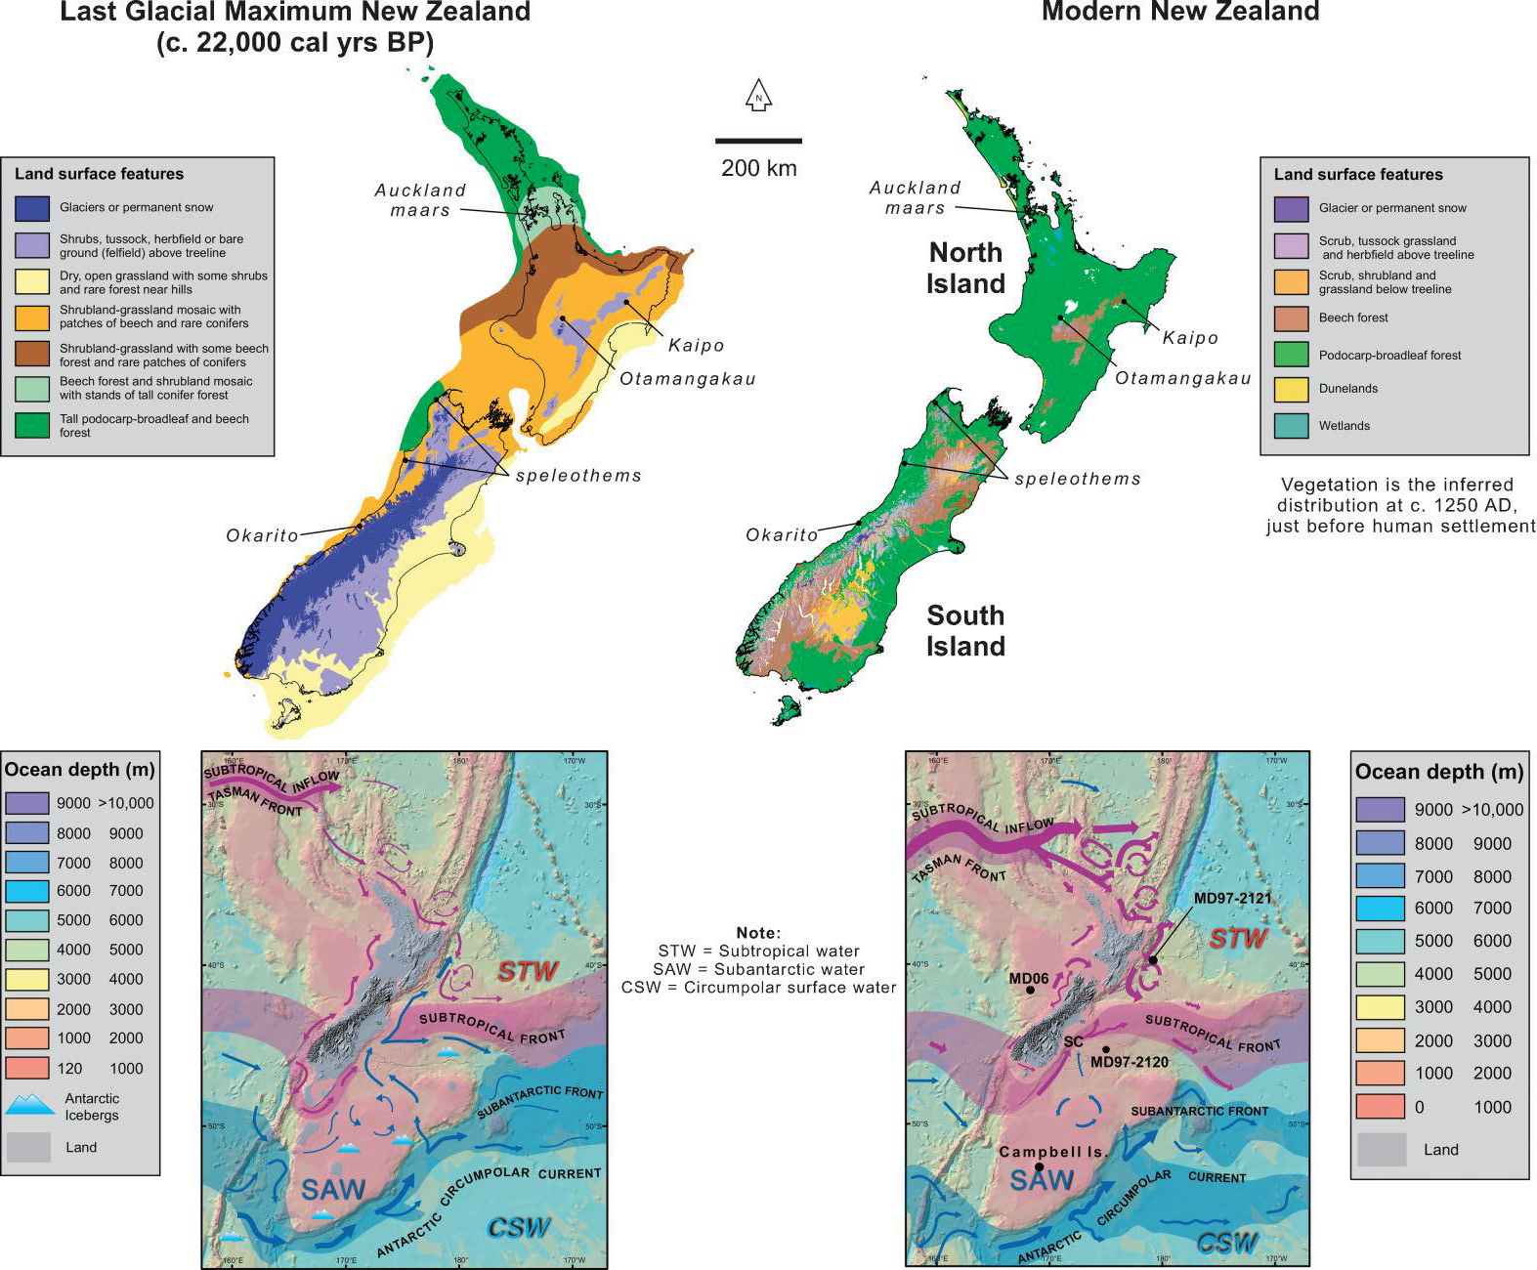
What else is out there?
Alloway et al, 2007

Slide 16
Speleothem climate signals
Is uranium controlled by climate and weathering regimes (yes)
Zonal analysis of sub-watersheds draining to collection points
Develop relationship between uranium activity, slope, and precipiation
Whats different between the east and west coasts?

Slide 17
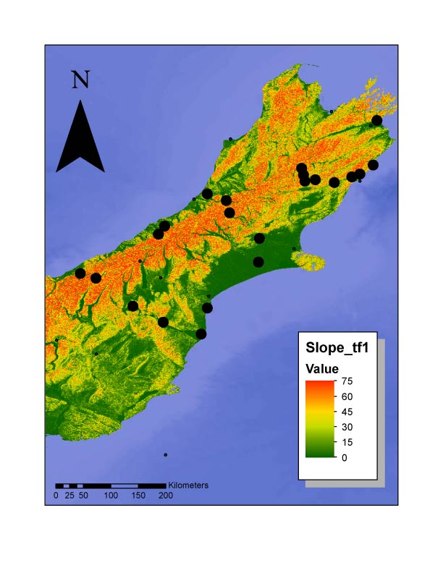
Watershed delineation
DEM(SRTM 90M) to Slope (Degree)

Slide 18
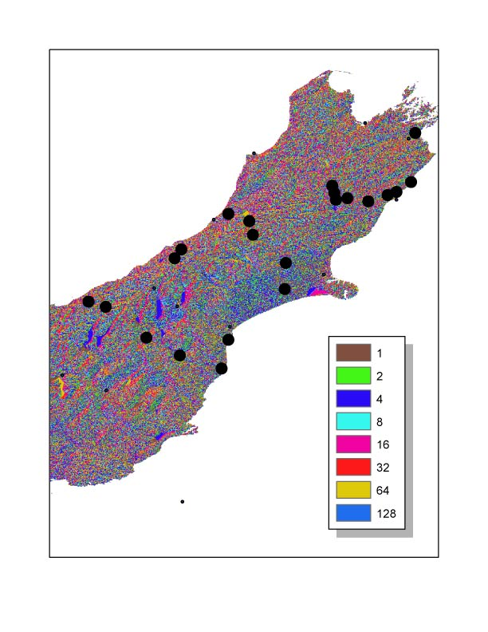
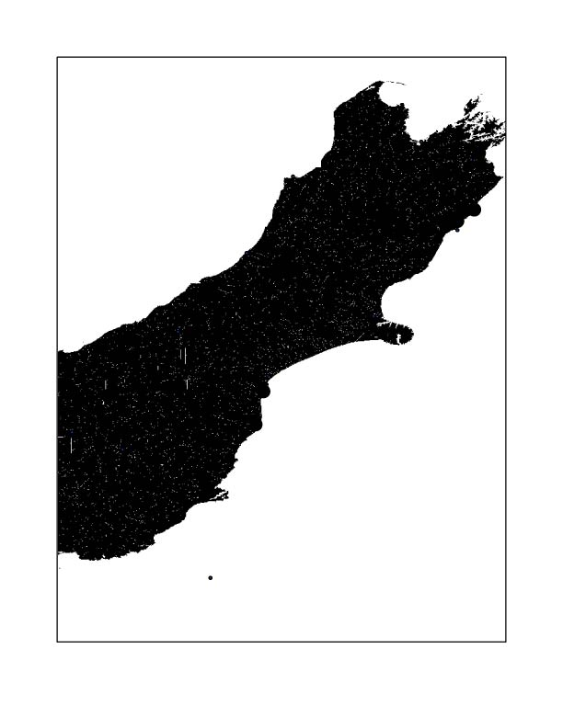
Watershed delineation
Slope to Flow Direction to Flow Accumulation

Slide 19
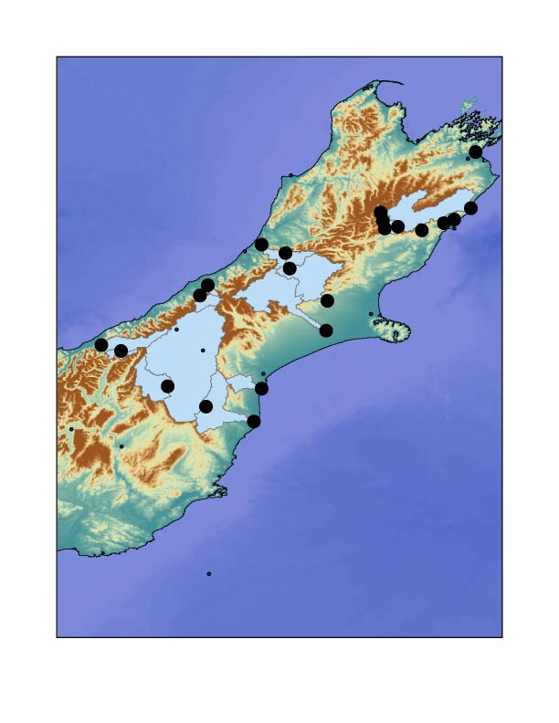
…to watershed!
Analyse Precipiation
Analyse Slope

Slide 20
Future Work (and that unsaid)
Develop our downcore record
Integrate with NZ-INTIMATE climate stratigraphy to correlate climatic shifts across different areas of New Zealand
Develop climatic controls of speleothem uranium signature, further constrain precipitation record of New Zealand

Slide 21
Thank you!
Dr. Maidment for an excellent course
Dr. Augustinus and the rest of the NZ-INTIMATE team
Woods Hole Oceanographic Institution, Bristol University, University of Auckland, and others for funding

Slide 22
References
New Zealand. Ph.D. Thesis. The University of Auckland: N.Z. Alloway, B.V., Lowe, D.J., Barrell, D., Newnham, R.M., Almond, P.C., Augustinus, P.C., Bertler, N., Carter, L., Litchfield, N.J., McGlone, M.S., Shulmesiter, J., Vandergoes, M.J., and Williams, P.W. (2007) Towards a climate event stratigraphy for New Zealand over the past 30000 years (NZ-INTIMATE). Journal of Quaternary Science 22, 9-35
Atkins, D.(2011) Geochemical Proxies for Environmental Change in Lake Pupuke, Auckland,
New Zealand. Ph.D. Thesis. The University of Auckland: N.Z.
Lamy, F., Kilian, R., Helge, W.A., Francois, JP., Kaiser, J., Prange, M., and Steinke, T. (2010) Holocene changes in the position and intensity of the southern westerly wind belt. Nature Geoscience 3, 695-699 Atkins, D.(2011) Geochemical Proxies for Environmental Change in Lake Pupuke, Auckland,
Alloway, B.V., Lowe, D.J., Barrell, D., Newnham, R.M., Almond, P.C., Augustinus, P.C., Bertler, N., Carter, L., Litchfield, N.J., McGlone, M.S., Shulmesiter, J., Vandergoes, M.J., and Williams, P.W. (2007) Towards a climate event stratigraphy for New Zealand over the past 30000 years (NZ-INTIMATE). Journal of Quaternary Science 22, 9-35
NIWA, Taihoro Nukurangi!
GNS Science, Te Pu Ao!

