Slide 1
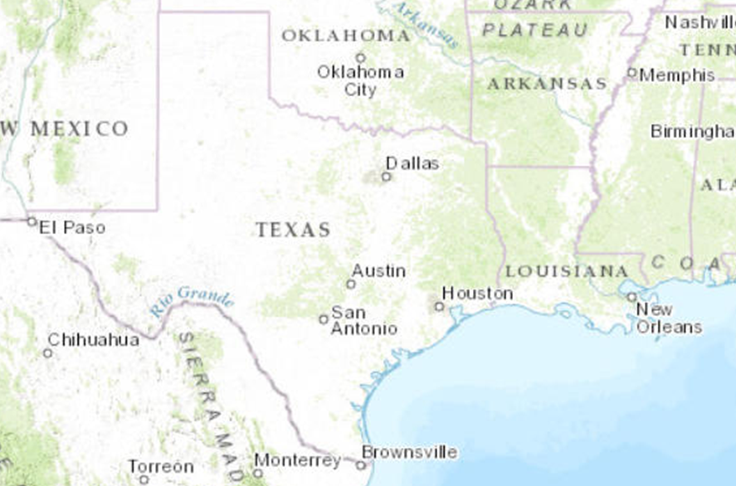
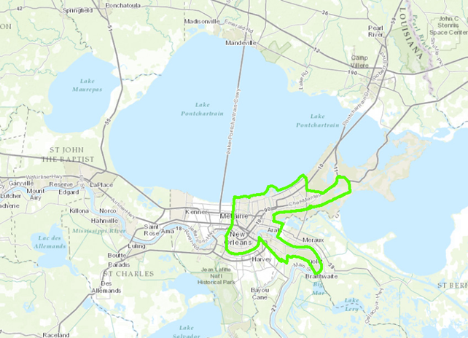
Drainage of New Orleans
Jena Milliner
Fall 2012

Slide 2

Objectives
Compare FEMA Flood maps to major recent flooding event
Analyze pumping stations of the city
Find areas at high risk for unpredicted flooding

Slide 3
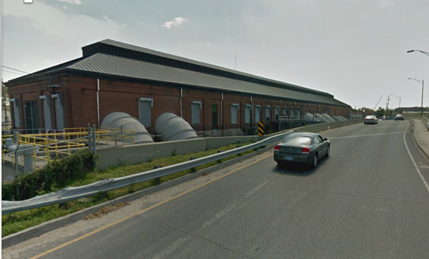
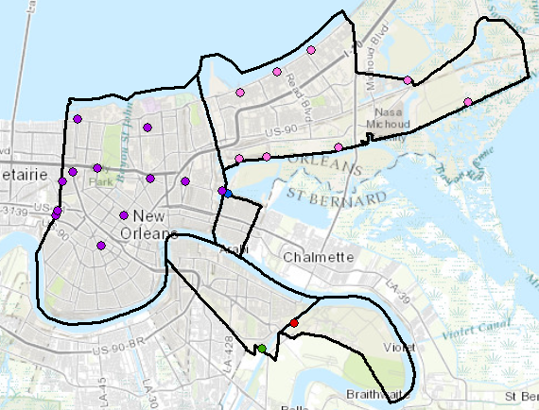
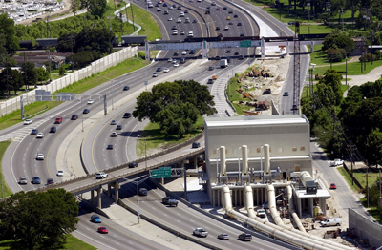
Pumping Stations
Drains all water the city
23 main pumping stations
Some largest in the world
Divided into 5 regions of the city

Slide 4
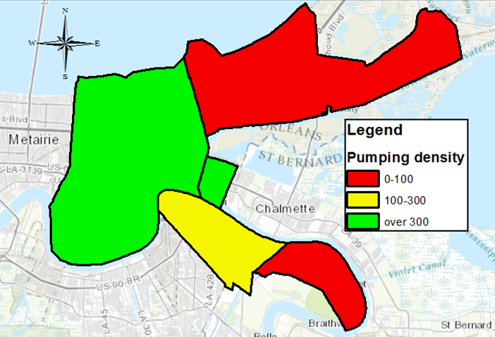
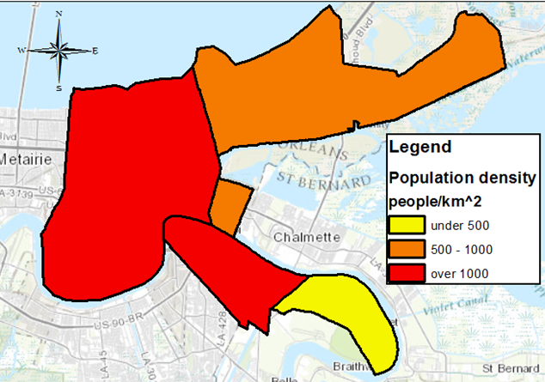
Drainage capacity
Pumping density =
(∑ pumping capacity for region)/ area of region
East and Lower Algiers regions had the lowest pumping density
BUT East has 8 pumping station while Algiers, Lower Algiers, and Lower 9th have only 1
Metro and Algiers have highest population density, Lower Algiers has lowest.

Slide 5
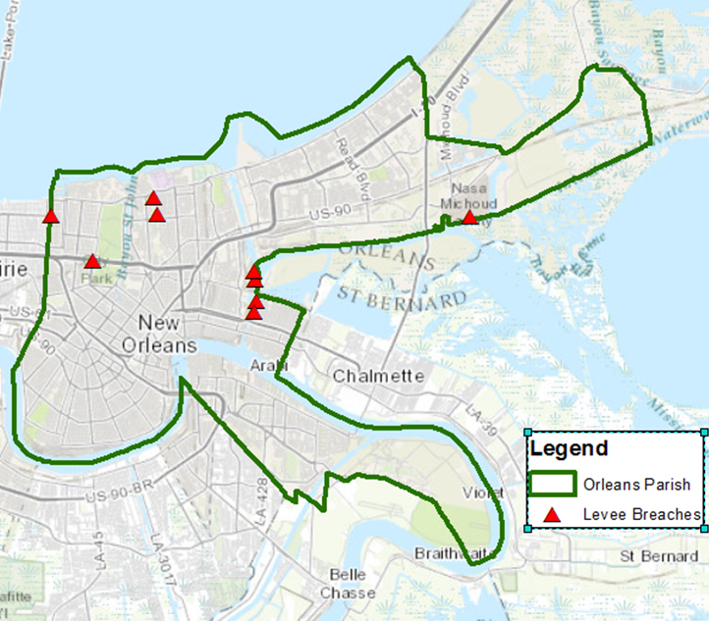
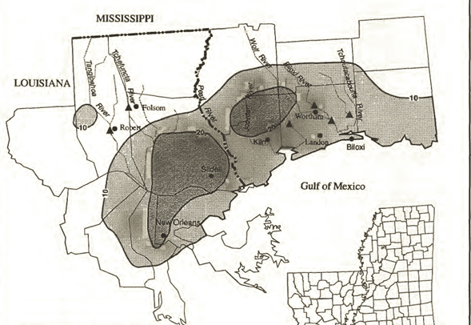
Recent flooding events
Flood of May 1995: rained 20 inches! in 48 hours
Hurricane Katrina: Storm surge caused breaches in levee system
Flooded areas of New Orleans from 1995 Flood not available
Used areas from Katrina instead

Slide 6
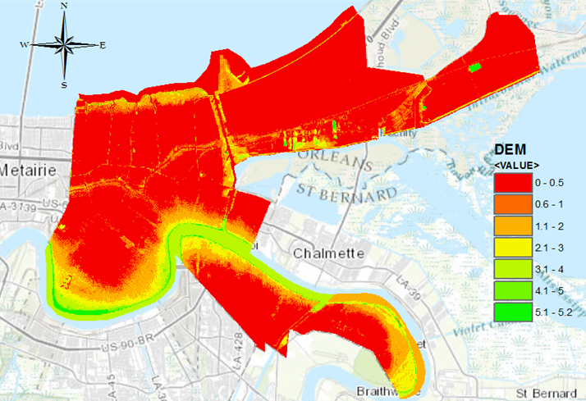
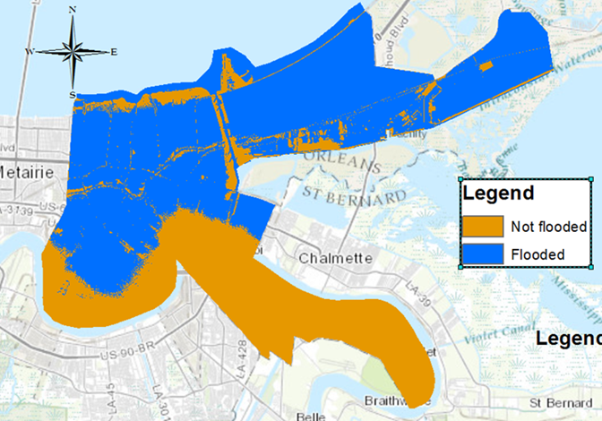
Katrina Flooding
Water stopped rising when level with Lake Pontchartrain
Water level on September 1, 2005 was 2.5ft
Little /No flooding west bank of Mississippi River

Slide 7
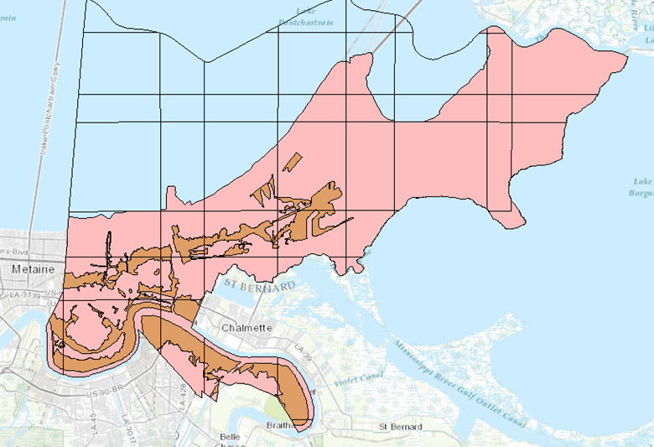
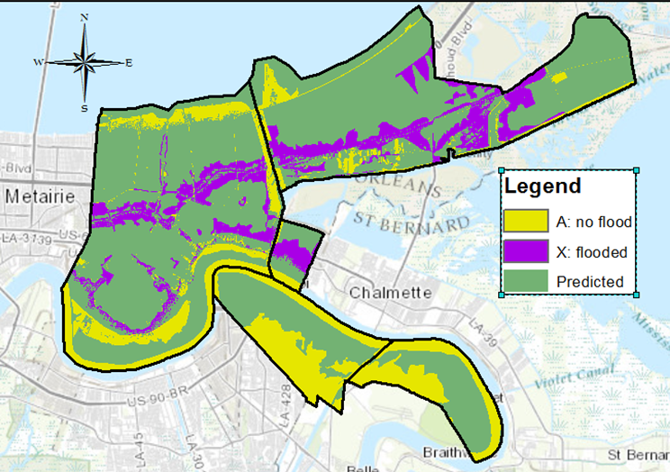
Comparison to FIRM
Pink areas A: Flood in 100 year event
Orange areas X: Do NOT flood in 100 year event
Purple areas had unpredicted flooding
Yellow areas did not flood when expected
Some error with yellow area

Slide 8
Summary
East and Lower Algiers have lowest pumping density
Lower Algiers, Algiers, and Lower 9th have only 1 pumping station
Lower 9th and East had most unexpected flood
East, Lower 9th, and Lower Algiers have greatest risk of unexpected flooding

Slide 9
Addition analysis
Compare to May 1995 Flooding
Analysis a pumping station level
Infiltration rates – soil and land use
Runoff calculation
Critical Rainfall event

Slide 10
Questions?
References
Data/information sources:
FEMA FIRM shapefiles @ http://atlas.lsu.edu/
Tiger shapefiles @ http://www.census.gov/geo/www/tiger/tgrshp2011/tgrshp2011.html
American Fact Finder @ http://factfinder2.census.gov/faces/nav/jsf/pages/index.xhtml
http://danswenson.com/paper/katrina.html
http://www.nolaenvironmental.gov/nola_public_data/projects/usace_levee/docs/original/OrleansEAErrata.pdf
http://blog.nola.com/stormwatch/2007/05/no_pump_stations_ready_to_face.html
Turnipseed, D. P., W. T. Baldwin, L. M. Cooper, and P.C. Floyd, 1995: "Flooding in Coastal Areas of Mississippi and Southeastern Louisiana, May 9-10, 1995", U.S. Department of the Interior, U.S. Geological Survey, Fact Sheet FS-155-95.
ArcGIS basemap
Davis, W. D., 2000: “Historical Perspective on Crevasses, Levees, and the Mississippi River”, Transforming New Orleans and Its Environs, University of Pittsbrugh Press, 89.
Images:
http://www.bkiusa.com/services-projects/engineering/drainage-pump-stations/i-10-railroad-underpass-pump-station.aspx
Google maps streetview
ArcGIS basemap
Turnipseed, D. P., W. T. Baldwin, L. M. Cooper, and P.C. Floyd, 1995: "Flooding in Coastal Areas of Mississippi and Southeastern Louisiana, May 9-10, 1995", U.S. Department of the Interior, U.S. Geological Survey, Fact Sheet FS-155-95.

