Slide 1
Distributions of C₃ and C₄ Plants
Travis Wicks

Slide 2
What are C₃/C₄ Plants?
Different photosynthetic pathways

Slide 3
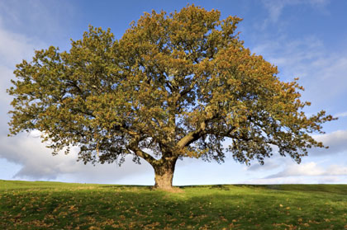
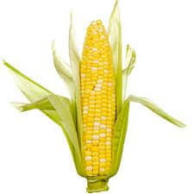
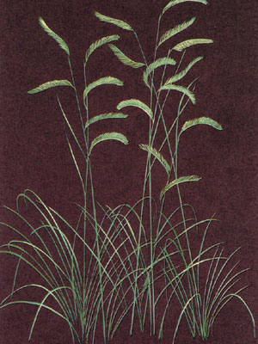
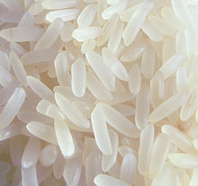
C₃-C₄ Examples
C₃
C₄
Treesdirect.co.uk
Scientificamerican.com
En.wikipedia.org
Kaupag.com
Most plants
Warm-season grasses

Slide 4
Influences on Distribution
Temperature
CO₂ concentration
Precipitation patterns
Light intensity

Slide 5
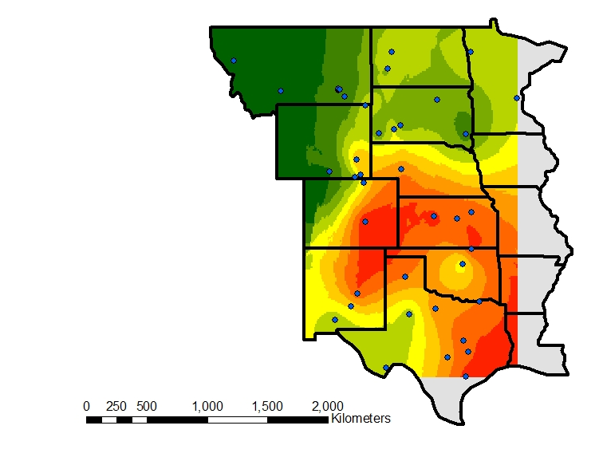
Goals
Modern C₄ Distribution
Compare with:
  Koch et al. (2004)
  Still and Powell (2010)

Slide 6
Models
Koch et al. (2004)
  Based on regressions on modern distributions
  Purely climate-based
  Inputs:
    mean annual temperature
    mean annual precipitation
    mean summer precipitation

Slide 7
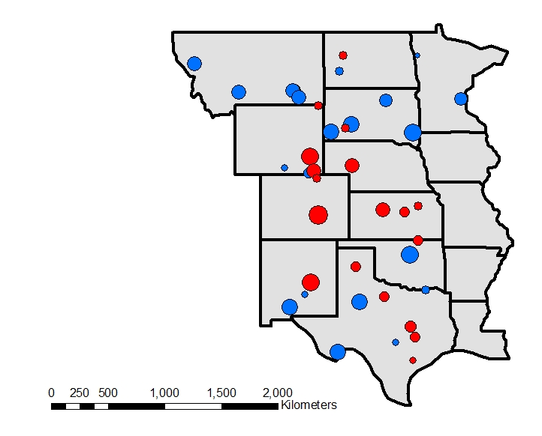
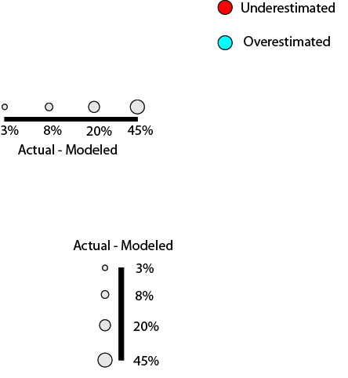
Koch Results

Slide 8
Models
Still and Powell (2010)
  Climate aspect based on experimental data
  MODIS and Global Land Cover (GLC) vegetation data included
    Eliminates problem of plant physiology distributions
  Inputs:
    Mean monthly precipitation
    Mean monthly temperature
    MODIS % herbaceous layer
    Global Land Cover Map 2000

Slide 9
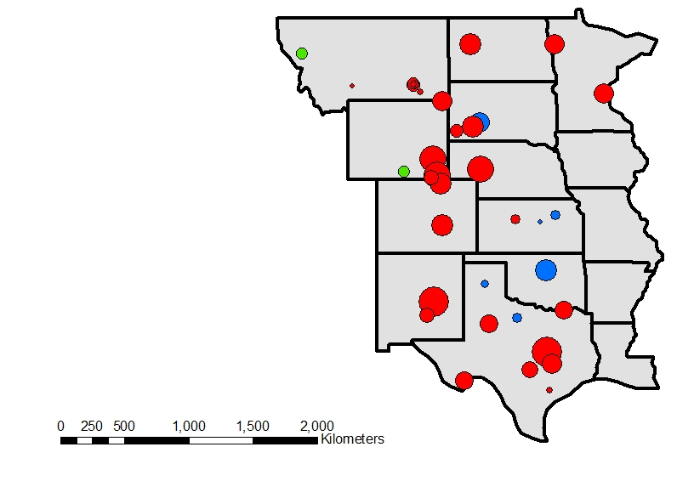
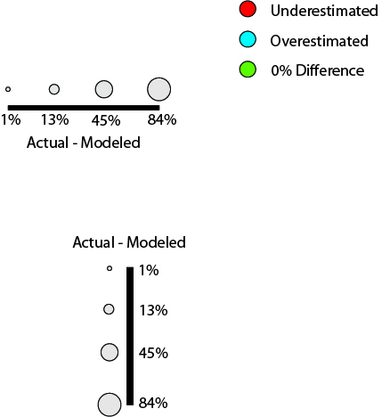
Still and Powell Results

Slide 10
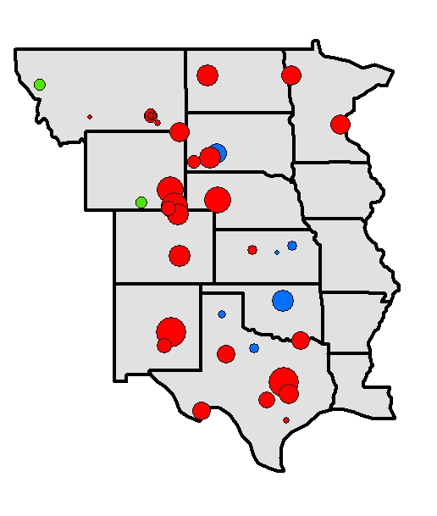
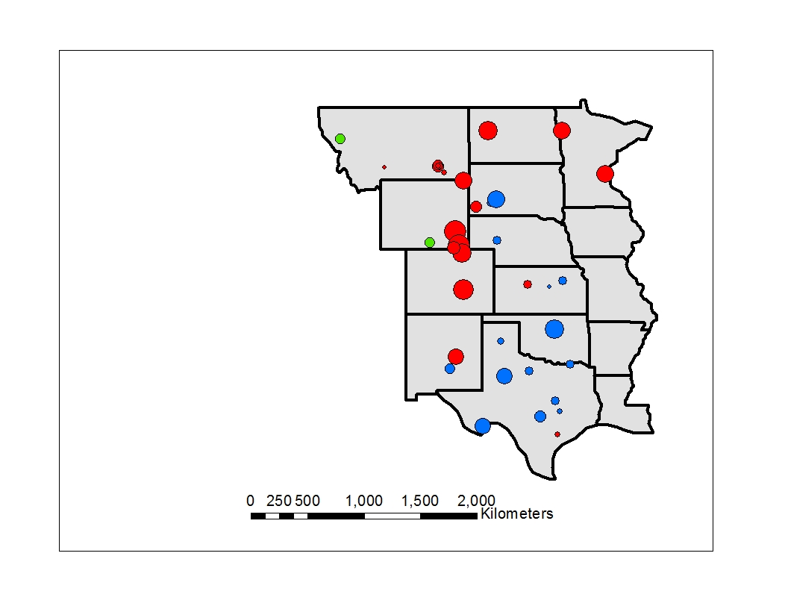
Still and Powell Results
With GLC
Without GLC

Slide 11
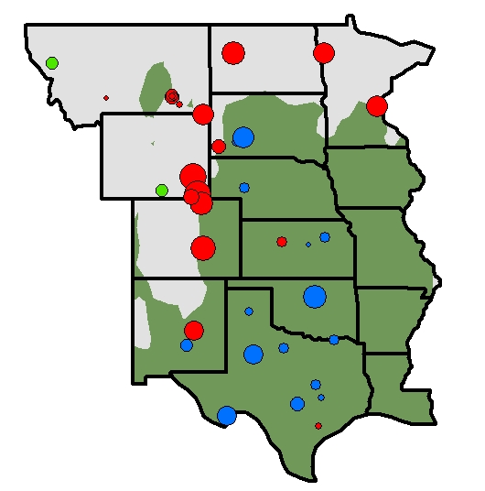
Still and Powell (non-GLC) Results

Slide 12
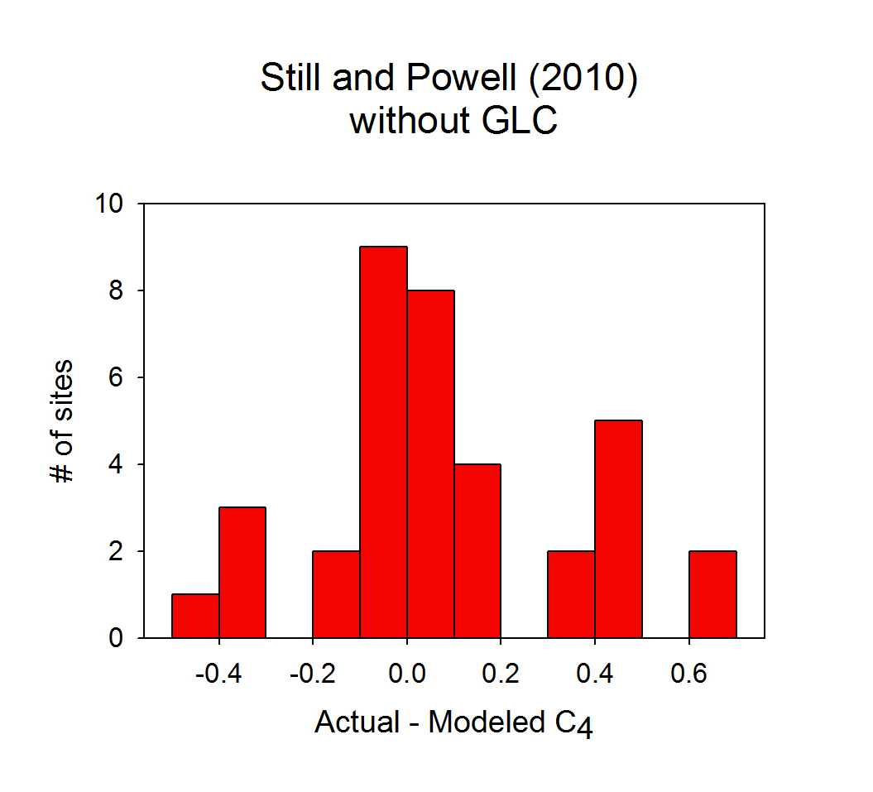
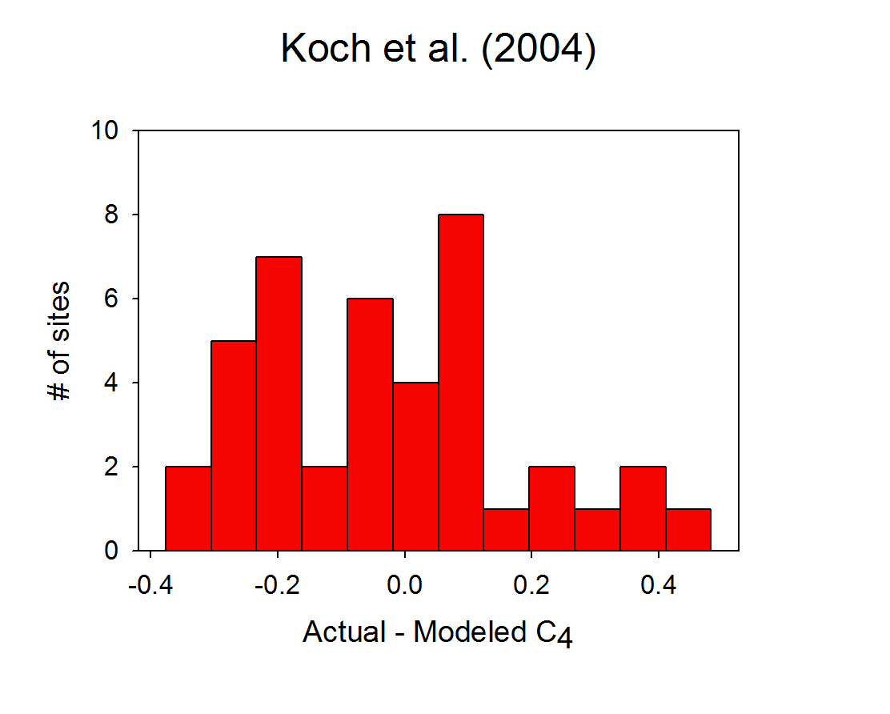
Intermodel comparison
Mean difference: 0.17
Mean difference: 0.20

Slide 13
Conclusions
Both models have their respective problems
  Hybridize the two
Other possible factors:
  Fire regime
  Herbivores
Are the systems truly in equilibrium?
  Natural variability

Slide 14
The End!
Thanks to:
-Gonzalo Espinoza
-Dr. Maidment
-You, for listening

