Slide 1
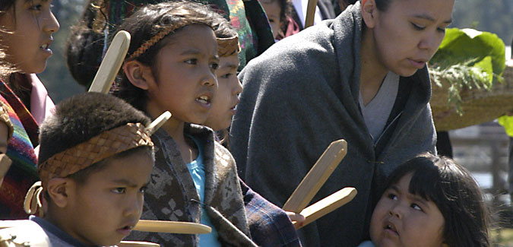
Climate Change Effects on the Swinomish Indian Tribal Community
Chloe Wooldridge
GIS in Water Resources
December 6th, 2012

Slide 2
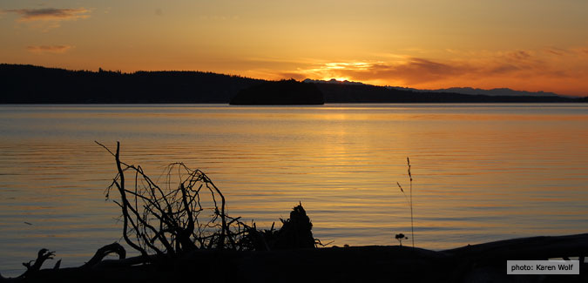
Overview
Background on the Swinomish Indian Tribal Community
Climate change related issues faced by the Swinomish Reservation
Swinomish Adaptation Action Plan created to cope with these issues
My recreation of part of this adaptation plan
Conclusions
Chloe Wooldridge
GIS in Water Resources
December 6th, 2012
Notes:
Picture is of the Swinomish Channel

Slide 3
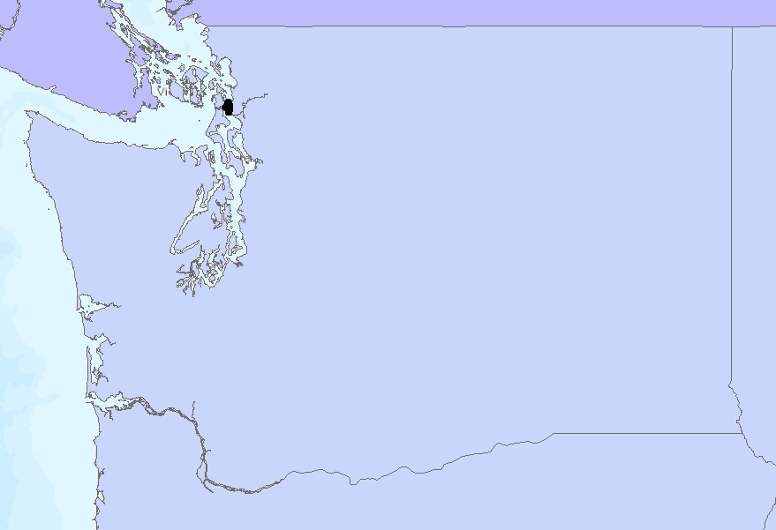
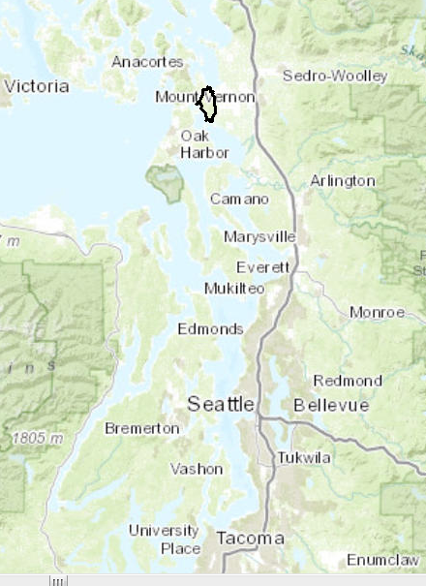
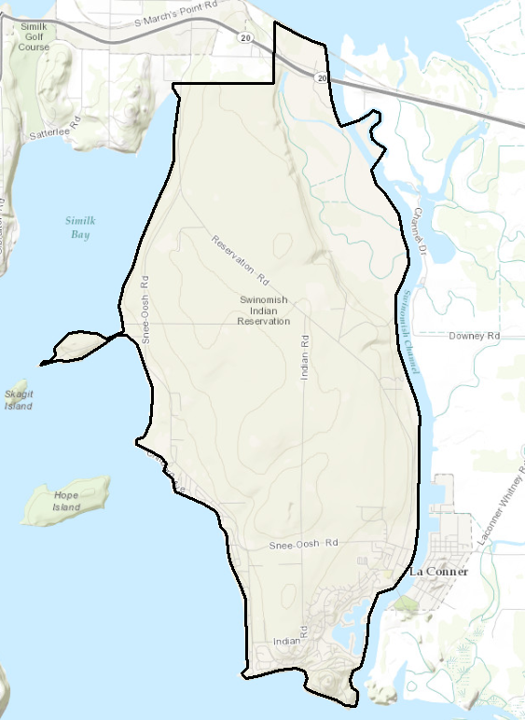
Where is the Swinomish Reservation?
Washington
Chloe Wooldridge
GIS in Water Resources
December 6th, 2012
Notes:
The Swinomish Reservation is located in northwest washington, in the puget sound area.
The middle map shows the reservation’s location in relation to Seattle
The third map shows a full extent view of the reservation
-One thing I would like to point out is that it is only connected to mainland Washington in two places: State Highway 20 on the north end of Swinomish Channel and by a 2-lane bridge Reservation Road on the south end.
-Point out the Swinomish Channel

Slide 4
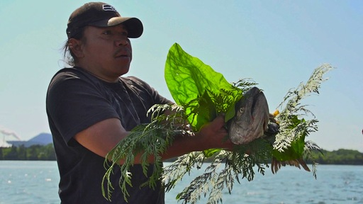
Who are the Swinomish People?
Dependent on natural resources: Salmon, shellfish and forest resources
“We are the People of the Salmon and our way of life is sustained by our connection to the water and the lands where we have fished, gathered, and hunted since time immemorial” –Larry Campbell, Swinomish Elder
Chloe Wooldridge
GIS in Water Resources
December 6th, 2012
Notes:
A community of Coast Salish People
Culture centered around salt water resources and inland forest resources: Salmon, shellfish, marine mammals, cedar, camas, berries, wild game.
All of these resources will be heavily affected by climate change, but so will many other aspects of the Swinomish way of life
*Picture is of an annual tribal ceremony celebrating the return of salmon to the rivers

Slide 5
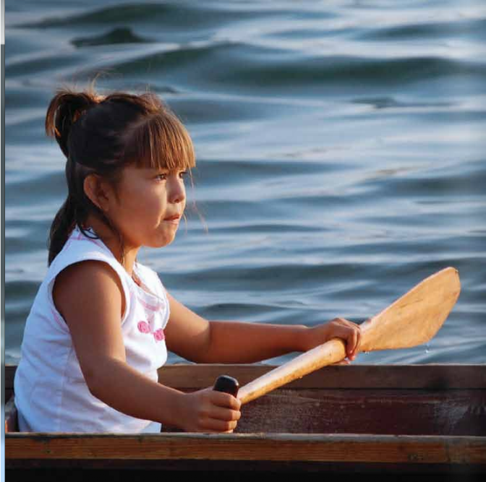
Potential Impacts of Climate Change
Inundation of land area, structures, and access routes to the Reservation
Increased risk of wildfire
Destruction of shellfish and salmon habitats
Increased health risk to ill and elderly
Chloe Wooldridge
GIS in Water Resources
December 6th, 2012
Notes:
-inundation of over 1100 acres from sea level rise
-~180 structures at risk from inundation/tidal surge
-access to mainland washington could be cut off. Only two roads that connect the reservation
-wildfire risk from temperature rise, much of the Reservation if forrested area
-Salmon and shellfish habitats as risk of being destroyed by both sea level and temperature rise. Salmon can’t live in waters hotter than 70 degrees, and the mean temp rise is expected to exceed this.
-picture is of a little girl in a canoe on the Swinomish Channel

Slide 6
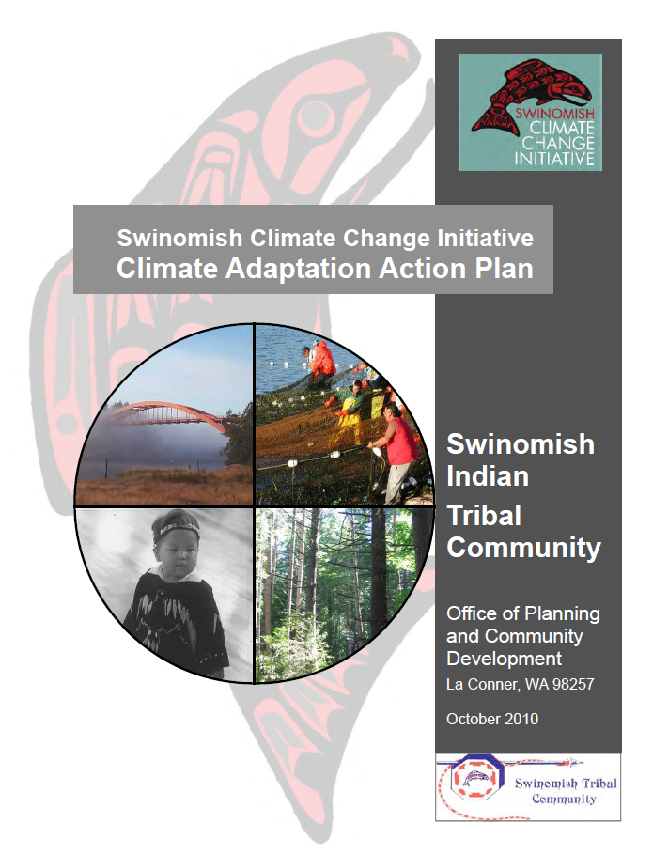
Swinomish Adaptation Plan
First tribe in the country to conduct a comprehensive climate adaptation assessment
Partnership:
The University of Washington Climate Impacts Group
Representatives from surrounding counties
Chloe Wooldridge
GIS in Water Resources
December 6th, 2012
Notes:
So, being aware of these potential impacts of climate change, the Swinomish Indian Tribe decided to complete a comprehensive assessment of the impacts of climate change and what they can do to cope with those impacts.
-In 2010 They generated an extensive 144 page report investigating the impact of climate change in the region and what their plan of action should be to cope with these impacts
-They are the first tribe in the country to complete this kind of climate change assessment and adaptation plan
-They partnered with the U of W climate impacts group as well as reps from surrounding counties outside of the reservation to complete the document

Slide 7
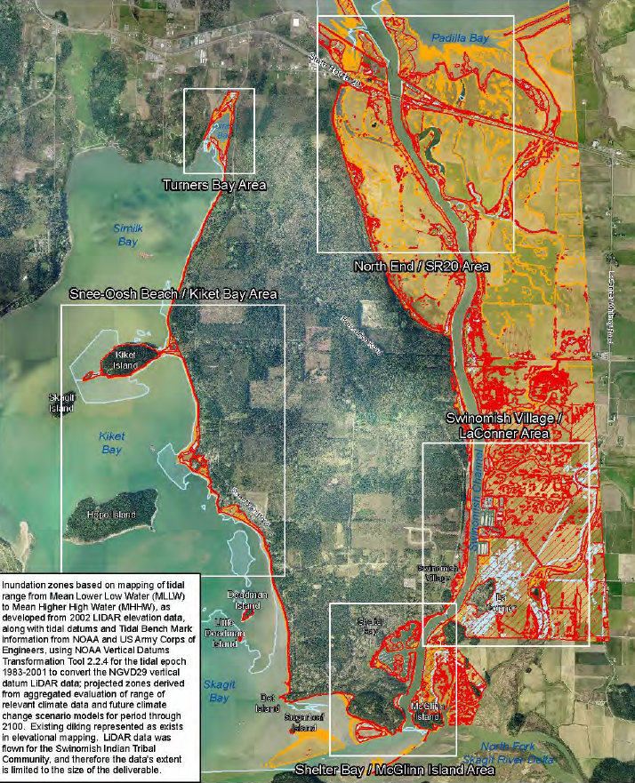
Areas at Risk of Inundation from Sea Level Rise and Storm Surge
Red = Storm Surge
Yellow = Sea Level Rise
Can I recreate the projected impact from sea level rise and storm surge presented in the report using ArcGIS?
Chloe Wooldridge
GIS in Water Resources
December 6th, 2012
Notes:
So where does my GIS project come in?
Well, the Swinomish Adaptation plan…
And I wanted to see if I could recreate part of this report over a short time period as one inexperienced individual using information available on the internet.
Specifically,

Slide 8
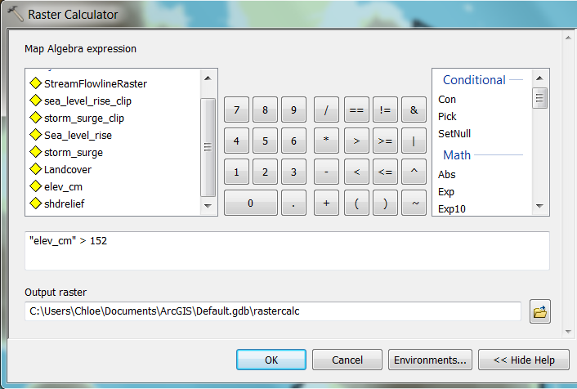
Modeling Sea Level Rise and Storm Surge in ArcGIS
Swinomish Adaptation Plan Report:
Sea Level Rise = 5 feet above current sea level
Storm Surge = 8 feet above current sea level
In ArcGIS:
Raster calculation on 30 m DEM for elevation < 5 feet and < 8 feet above sea level
Chloe Wooldridge
GIS in Water Resources
December 6th, 2012
Notes:
Sea level rise over the next century

Slide 9
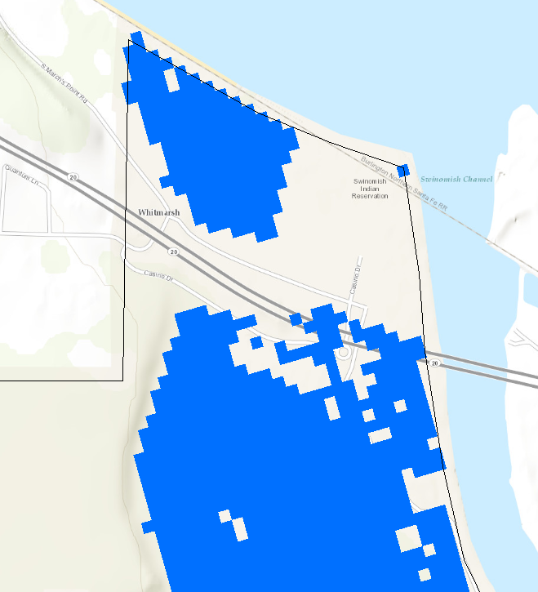
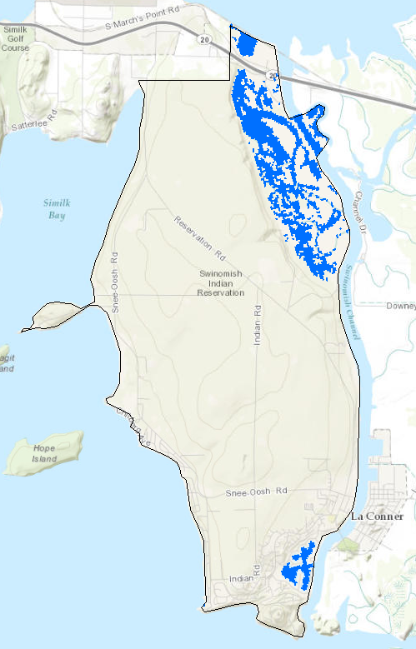
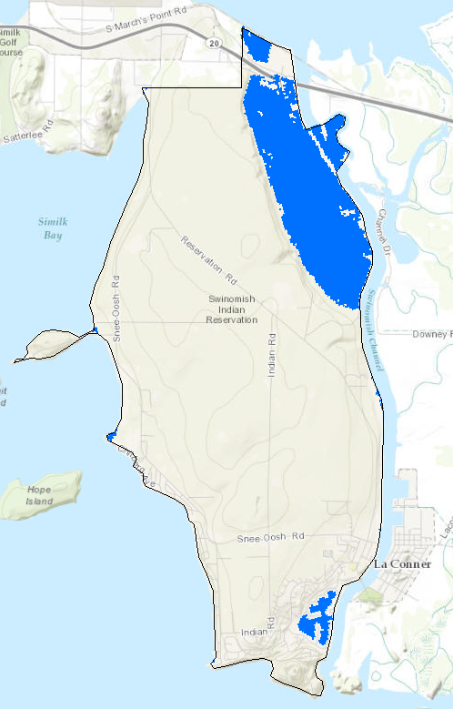
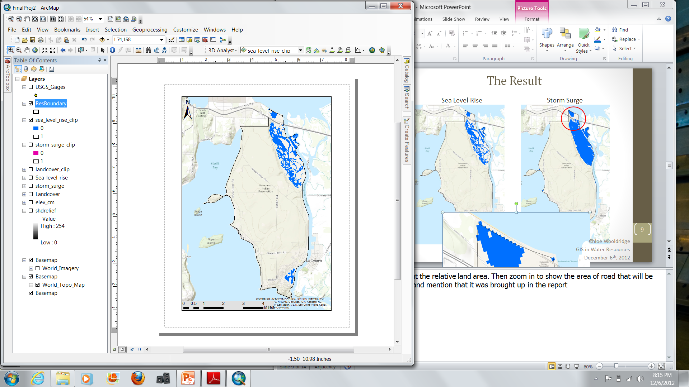
The Result
Sea Level Rise (5 ft)
Storm Surge (8 ft)
Chloe Wooldridge
GIS in Water Resources
December 6th, 2012
Notes:
Talk about the relative land area. Then zoom in to show the area of road that will be affected and mention that it was brought up in the report

Slide 10
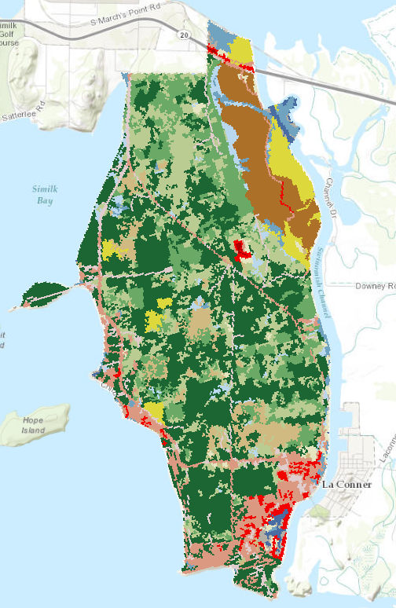
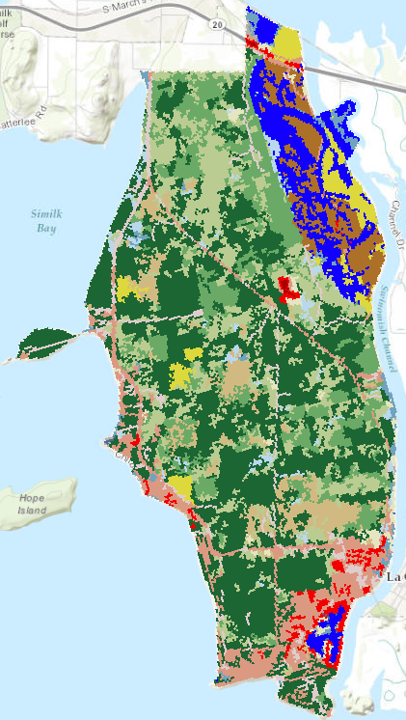
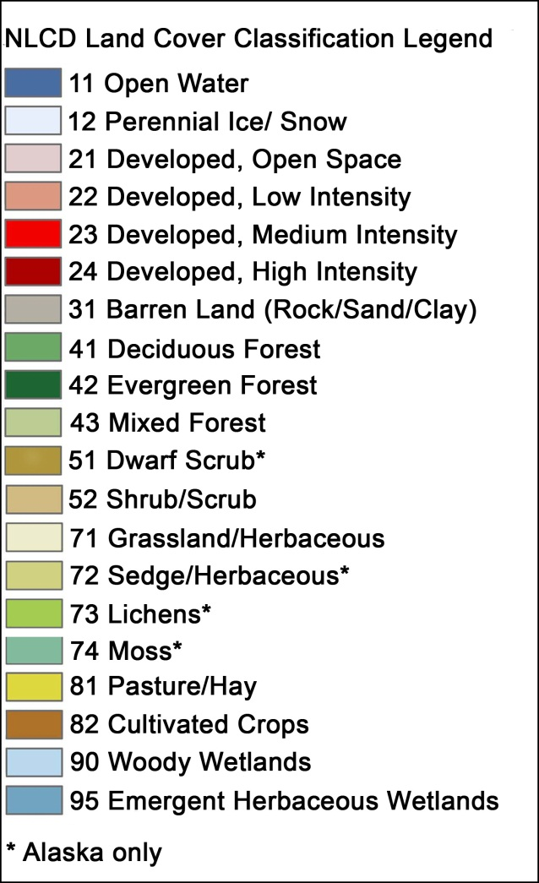
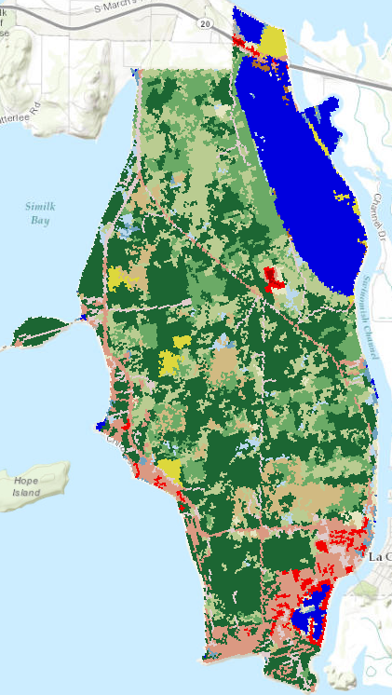
Types of Land Use that are Affected
Land Cover for the Reservation
Sea Level Rise
Storm Surge
Chloe Wooldridge
GIS in Water Resources
December 6th, 2012
Notes:
Talk about how the areas that are being inundated are their only agricultural lands and developed lands.

Slide 11
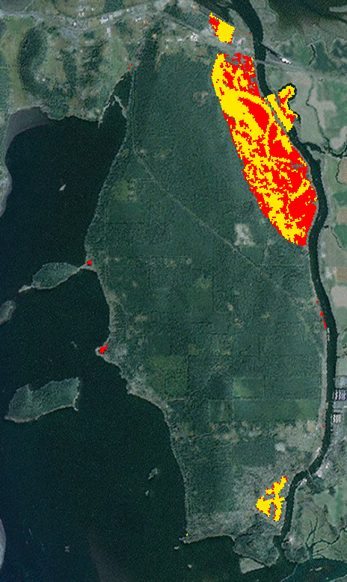
How does this compare to the Swinomish Adaptation Plan?
Adaptation Plan
ArcGIS
Notes:
Mention that the yellow areas are the projected inundation zone from sea level rise, and the red is the projected storm surge zone. Say that you put your sea level and surge data on top of each other for comparison. Also mention that they extend the analyses to areas not directly in the Swinomish Reservation (probably because they got help from individuals in the La Conner and surrounding cities when compiling the report).

Slide 12
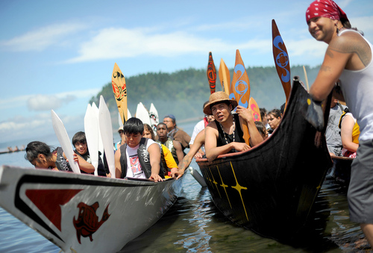
Differences in Data
The Swinomish Adaptation Plan used 2002 LIDAR data at 1 m or better resolution for the elevation
I used a 30 m resolution Digital Elevation Model from the National Elevation Dataset
However, even with the differences in elevation data, the results are comparable.
Chloe Wooldridge
GIS in Water Resources
December 6th, 2012
Notes:
The NHD website says that the DEM is updated about once every two months.
*Picture is of the annual tribal canoe journey where tribal canoes travel from their home territories to a common destination.

Slide 13
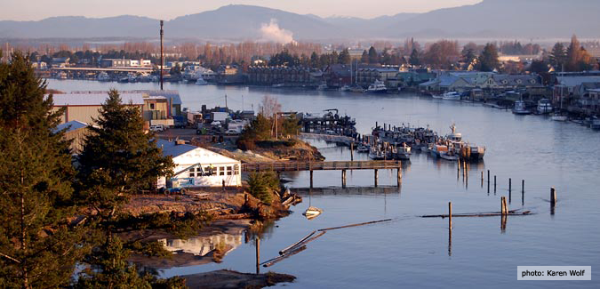
Conclusions
I was able to generate a similar map of inundation from sea level rise and storm surge compared to the Swinomish Adaptation Plan
ArcGIS is so user friendly that I can use skills acquired in one semester to validate a professional report
A basic understanding of the ArcGIS software and knowledge of where to access data online allows ordinary people to investigate water resources questions of interest
Chloe Wooldridge
GIS in Water Resources
December 6th, 2012
Notes:
With limited GIS experience, and free online data
This shows that…
This is important because it indicates that anyone with the ArcGIS software and a basic education in its functionality can investigate all sorts of water resources problems they find interesting.
Picture is of the Swinomish Channel

Slide 14
References
Swinomish Climate Change Initiative: Climate Adaptation Action Plan. October 2010. Swinomish Indian Tribal Community Office of Planning and Community Development. La Conner, WA.
http://www.swinomish.org/
http://www.pbs.org/newshour/bb/climate-change/july-dec12/salmon_07-18.html
http://viewer.nationalmap.gov/viewer/ (Land cover data)
http://nhd.usgs.gov/data.html (NED DEM)
I’d be happy to take any questions.
Chloe Wooldridge
GIS in Water Resources
December 6th, 2012

