Slide 1

Inflow and Infiltration:
A Qualitative Approach
Anna Boersma
GIS for Water Resources
November 20, 2012

Slide 2
Outline
Project Overview
Design Factors
Model Spreadsheet
Results
Conclusion

Slide 3
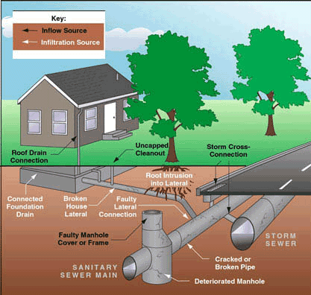

Slide 4
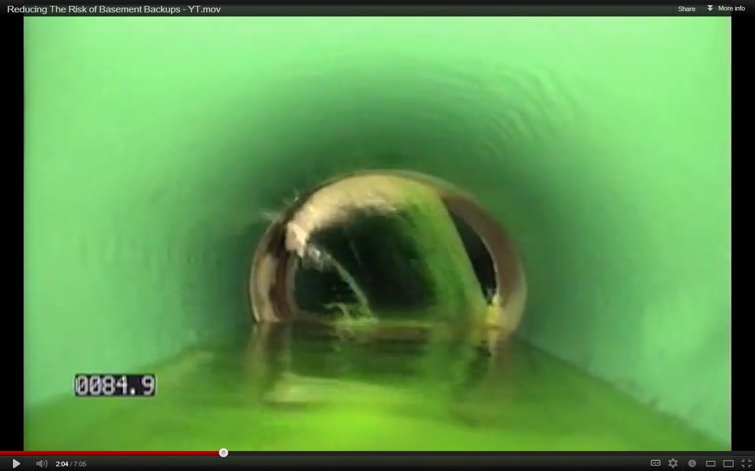
Notes:
50gpm flow (~26million gal/yr)
Ave person – 0.07gal/min
This is why I & I is a problem
Those interested in conveyance – capacity
2. water treatment – additional flow during rains/design + operate
Everyone else - $$$ (1gpm = ~800$/yr) (with $1.1631/100cfs)

Slide 5
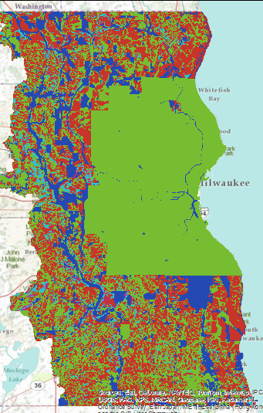

Design Factors
Pipe age
Empirical coefficient
Sewer type
Pipe area
Soil properties

Slide 6
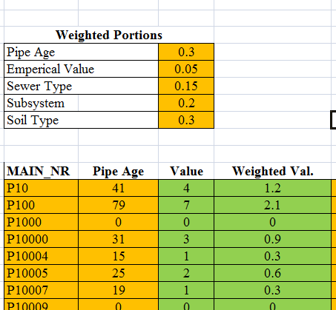

Slide 7



Slide 8
Conclusions/Future Work
Process provides good starting areas
GIS a needed tool for analysis
Future: Correlate spreadsheet to field data

