Slide 1
The Texas State Water Plan:
A citizen’s view
Sam Marie Hermitte
Water Resources GIS
November 20, 2012

Slide 2

2012 Texas state water plan
5 year planning cycle
16 regions
562 unique water supply projects
$53 billion price tag
Accessibility?
Image Source: www.TexasTribune.org
Notes:
Will discuss: source, demand, supply, need, strategy supply

Slide 3

Water supply Source
(2010)
Surface Water
  49.5% of total supply
Groundwater
  47.5% of total supply
Reuse
  3% of total supply
  Used by 23% of TX counties
  > 10% of supply for 4% of TX counties
Image Source: TopNews.Net.nz

Slide 4
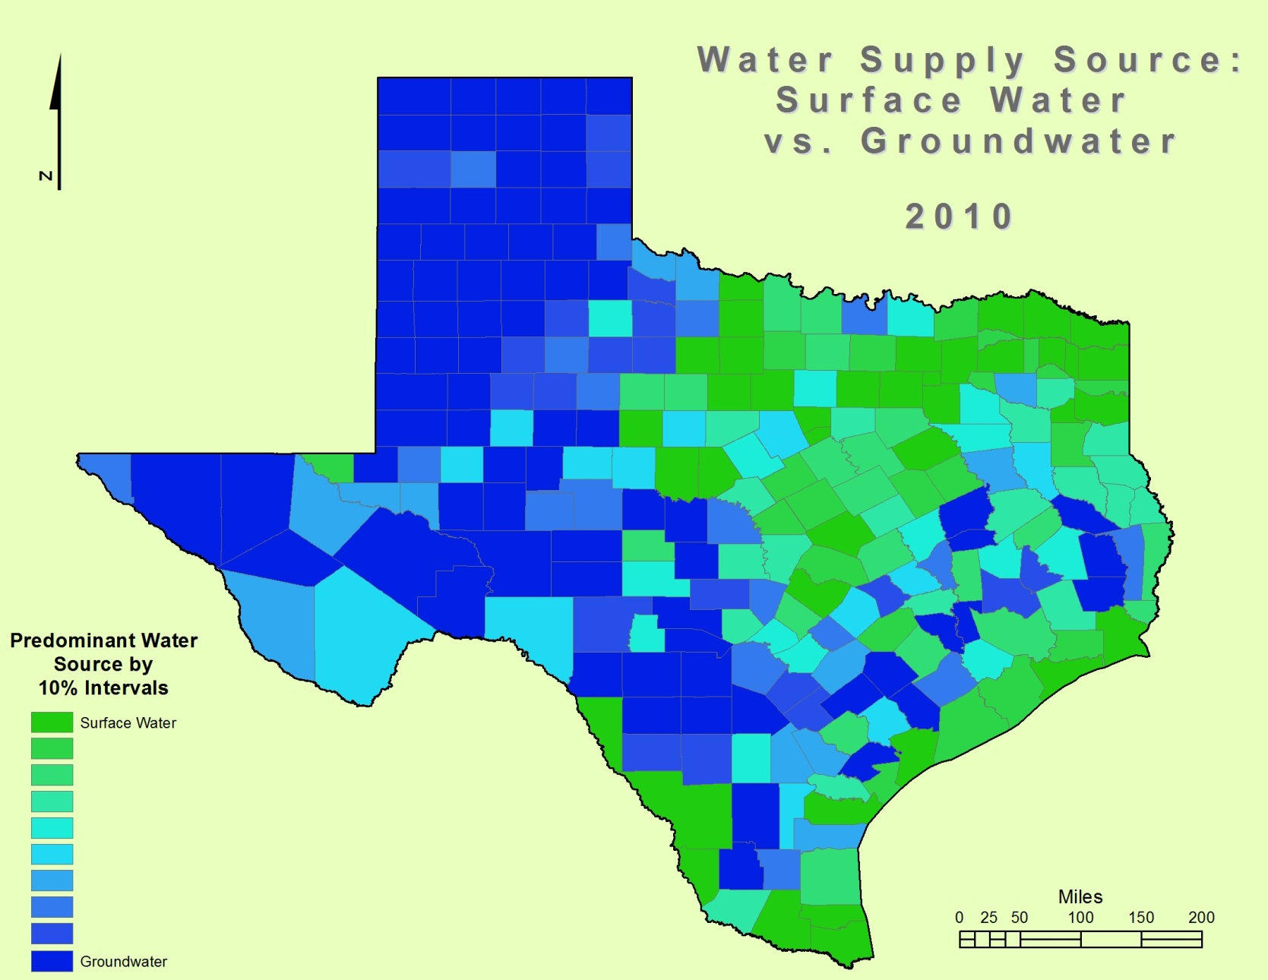

Slide 5
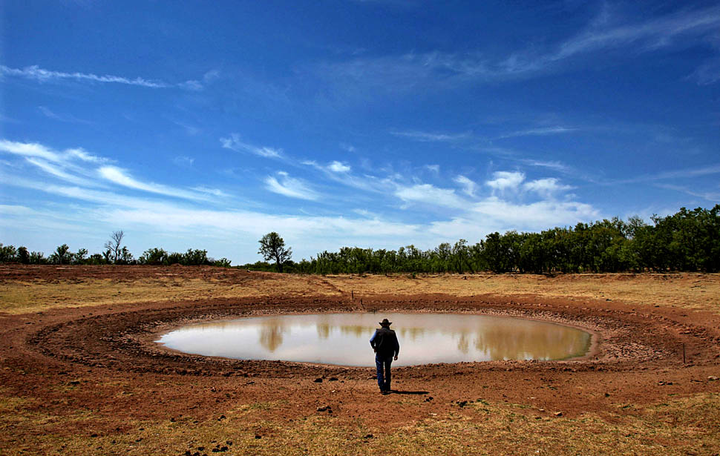
Cumulative change in demand
Quantity of water required to meet all needs for all users
Reference year: 2010
Varies across the state
Image Source: http://blog.chron.com/texaspolitics/2011/05/
Notes:
Redder the area, the greater the increase in demand for water

Slide 6
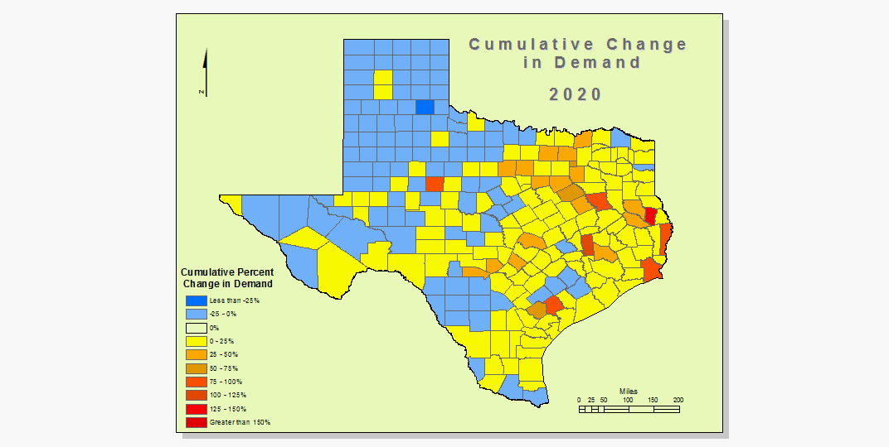

Slide 7
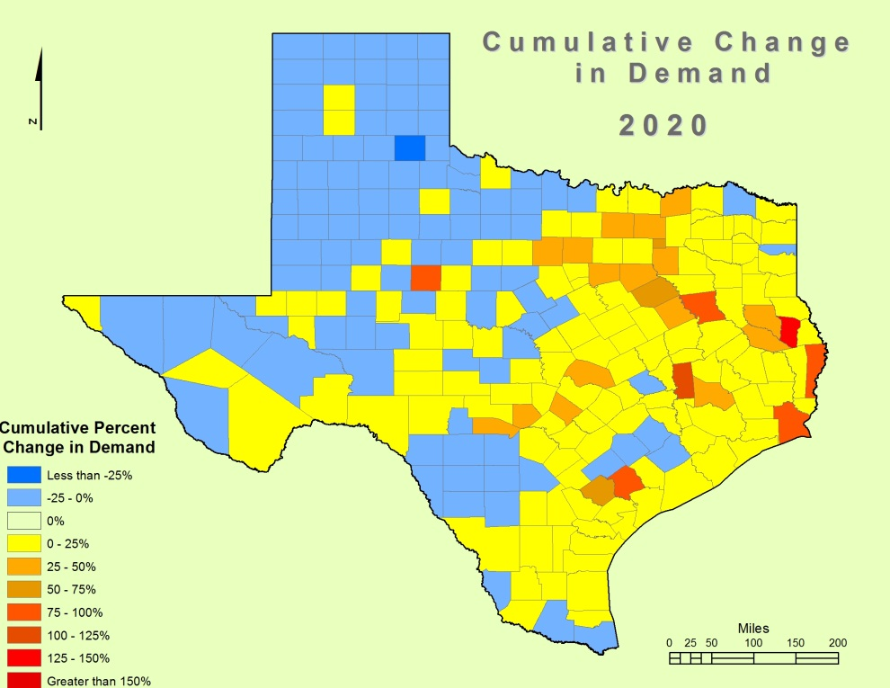
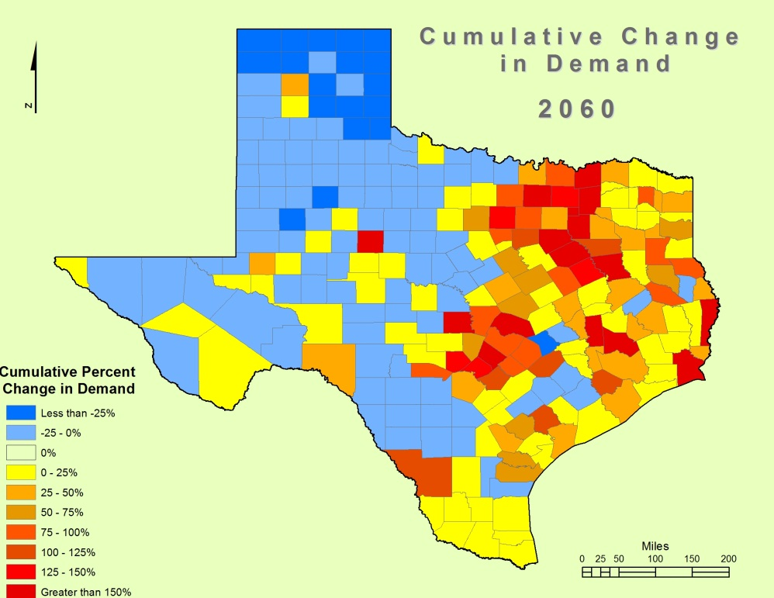
Demand

Slide 8
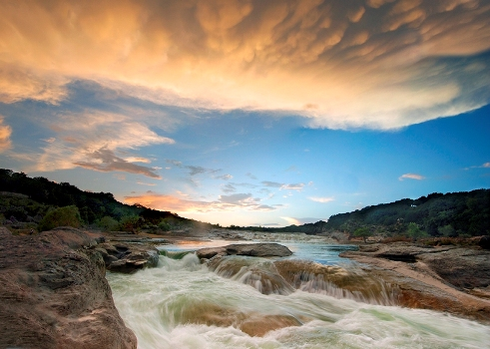
Cumulative change in Existing supply
“Maximum amount of water available from existing sources for use during drought of record conditions that is physically and legally available for use.”
  Texas Water Development Board
Reference year: 2010
Image Source: www.hillcountryalliance.org/HCA/WaterResources
Notes:
Red means that supply is decreasing
Blue means increasing
How can existing supplies increase?
Jefferson County

Slide 9
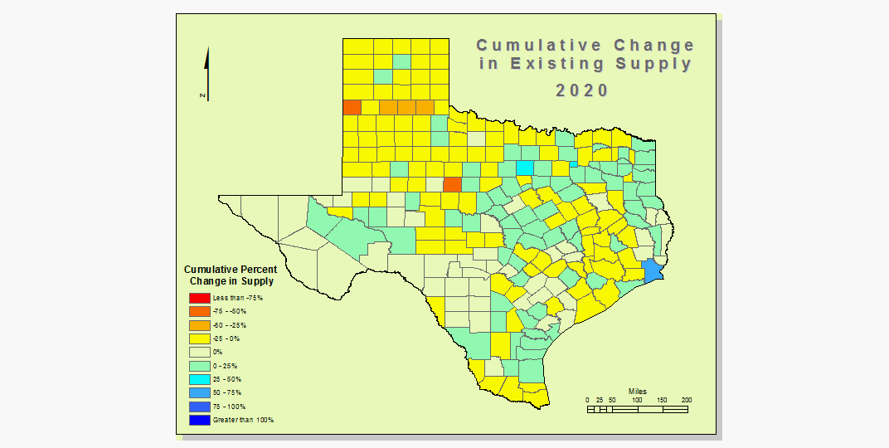

Slide 10
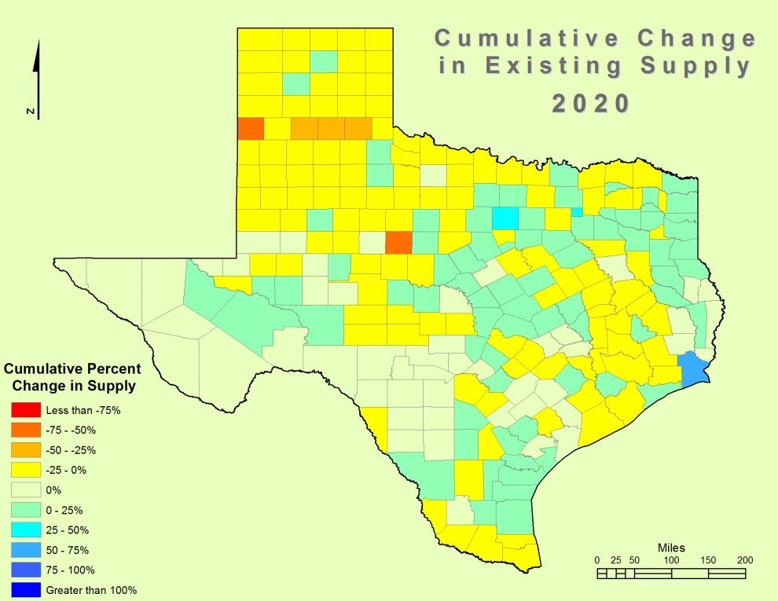
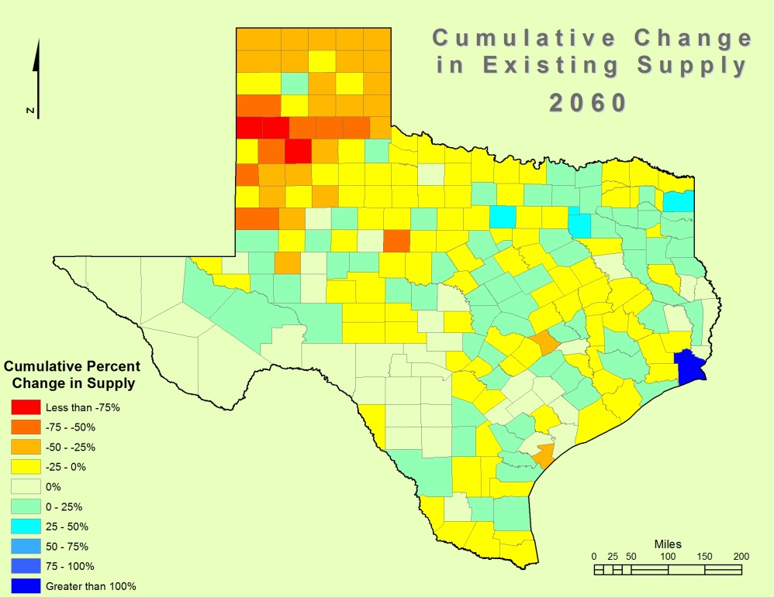
Existing supply

Slide 11
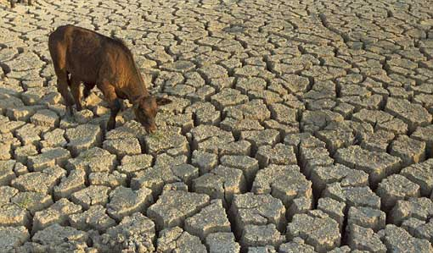
Need
“Projected water demand in excess of existing water supplies.”
  Texas Water Development Board
Variation by sector
  Irrigation ↓
  Municipal ↑
Image Source: www.worldculturepictorial.com/
Notes:
More red = more need

Slide 12
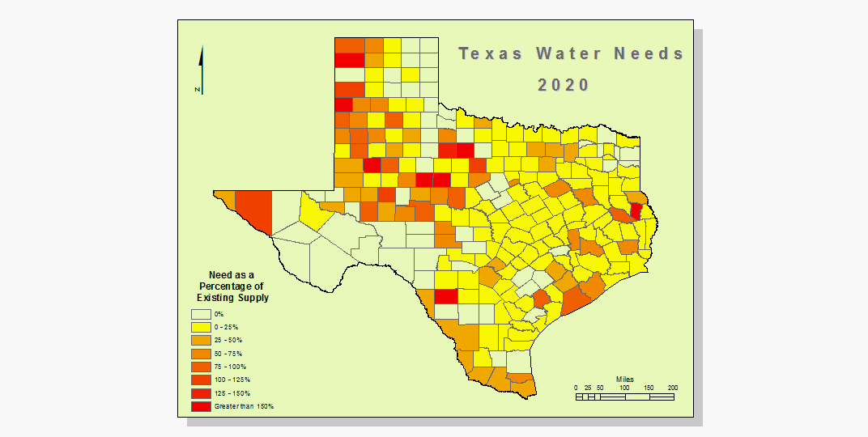

Slide 13
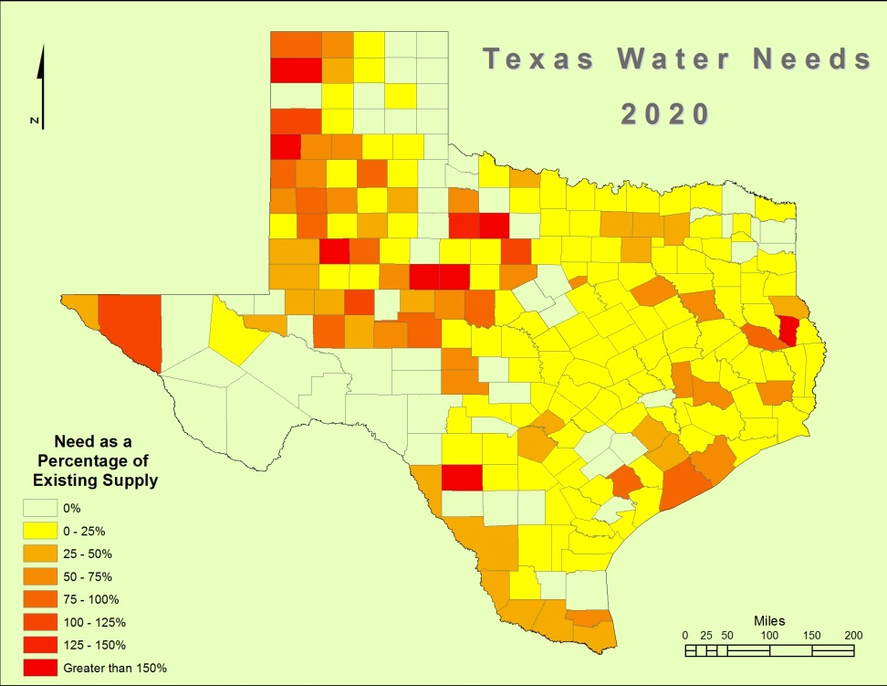
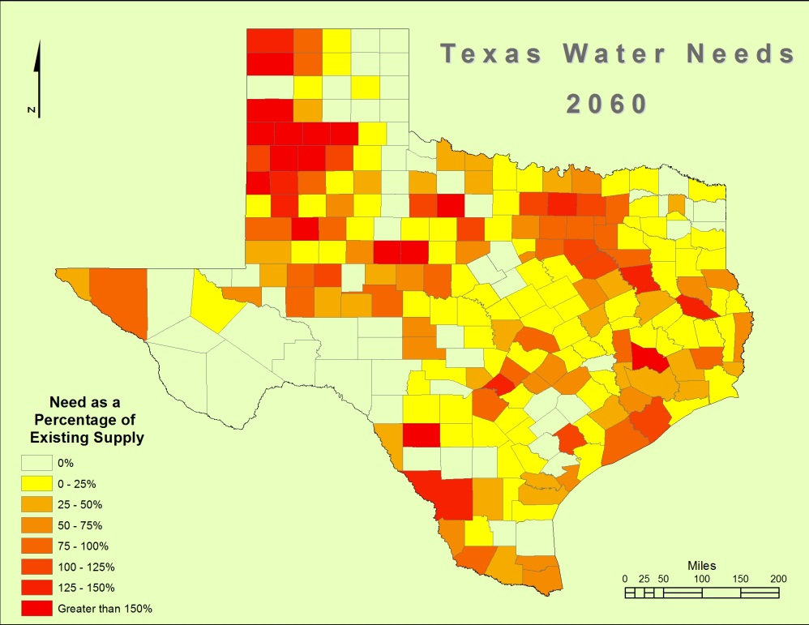
Need

Slide 14
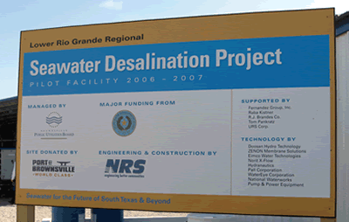
Supply from strategies
Additional water supplies resulting from implementation of State Water Plan strategies
Unmet needs remain (2060)
  Irrigation: 98%
  Steam-electric: <1%
  Mining: <1%
  Livestock: <1%
Image Source: http://blogginallthingsbrownsville.blogspot.com/
Notes:
More blue means more water from strategies

Slide 15
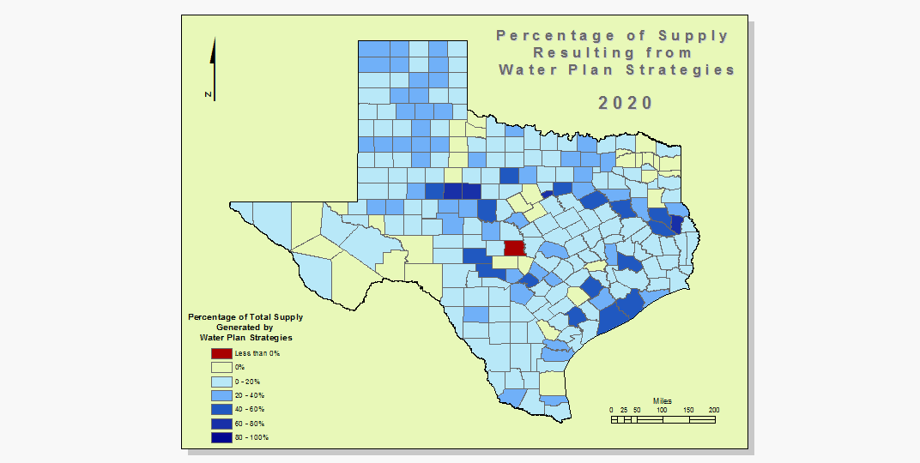

Slide 16
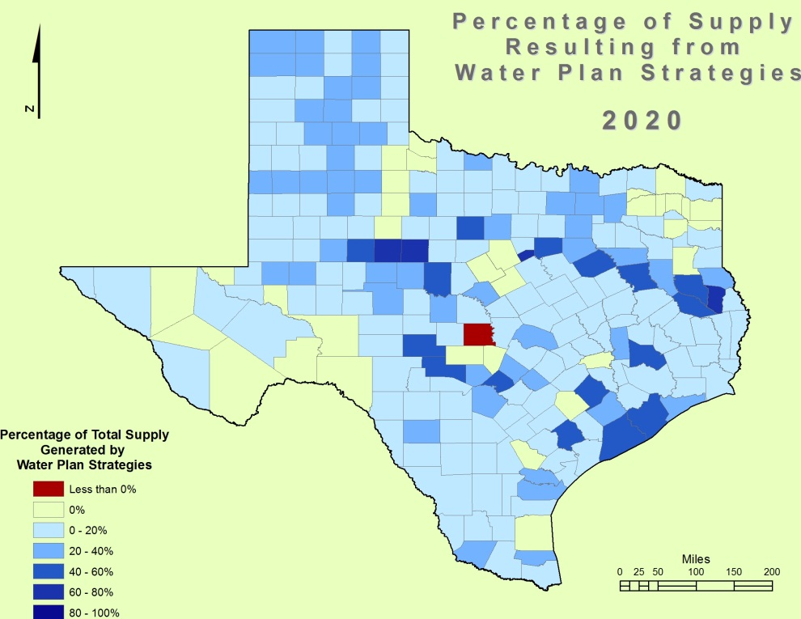
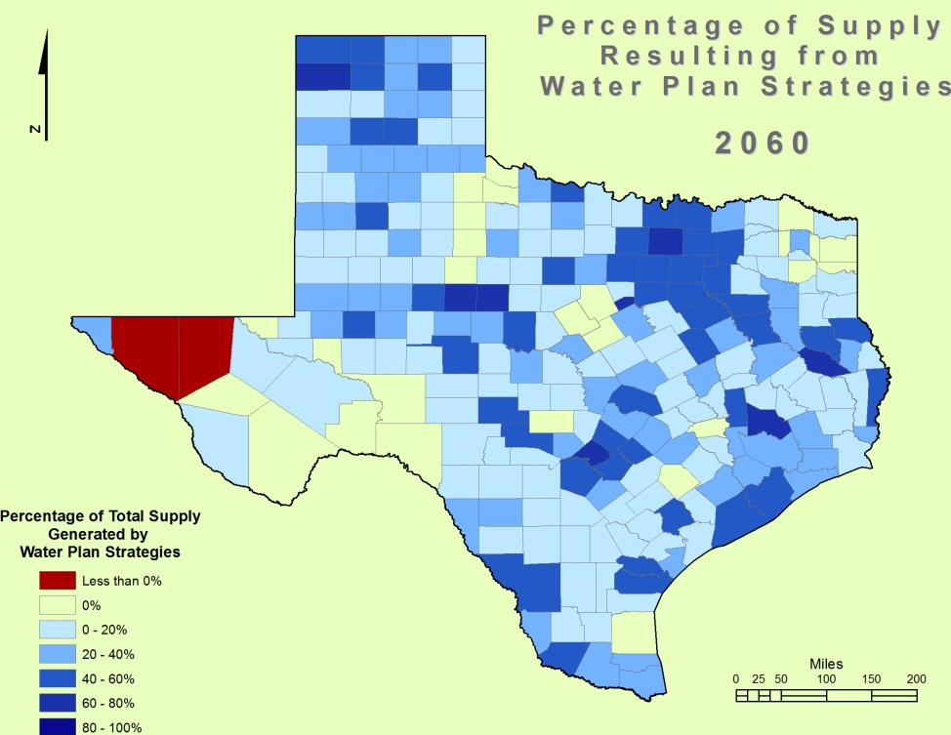
Supply from strategies

Slide 17
Questions or feedback
sam.marie.hermitte@gmail.com

