Slide 1
Energy for public water supplies in Texas
Kelly T. Sanders
November 20, 2012

Slide 2

A lot of energy is embedded in the US water system
Recent analysis suggests that 12.6% of US energy use is consumed to pump, treat, distribute, and recondition water (Sanders and Webber 2012)
However, the energy embedded in water varies a great deal regionally
Image courtesy of www.easyart.com

Slide 3
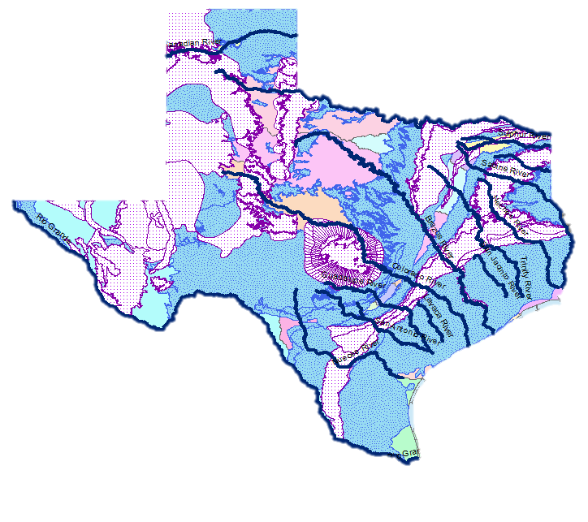
We selected Texas as a case study to assess regional variability in energy-relate water use
Relatively good data availability at the state-level
Texas is projected to get drier and more populated
Large variations in climate and terrain make it an interesting case study
Small enough to model but big enough to serve as a proxy for the rest of the nation
[TWDB]
Hydrological Characteristics of Texas

Slide 4
Based on my national analysis, I calculated the energy-intensity of water in six sectors…
US Water Withdrawals:
410 billion GPD
US Water-related Energy:
35 trillion BTU per Day
(Billion Gallons per Day)
(Trillion BTU per Day)
[USGS]
[Sanders and Webber 2012]
Energy Intensity in BTU per Gallon

Slide 5
Water withdrawals and water-related energy consumption are not correlated within sectors
Texas Water Withdrawals
Texas Water-related Energy
Consumption
1 Billion
Gallons
Per Day
[USGS]
160 Billion
BTU Per Day
Public
Supply
Industry
Irrigation
Mining
Power
Livestock

Slide 6
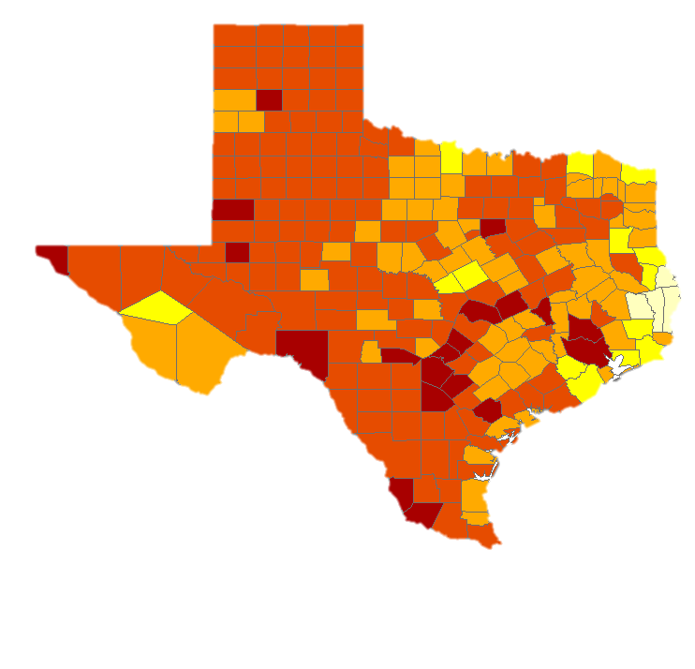
Water scarcity in Texas will affect future statewide water and water-related energy use
Water scarcity metric considers:
  Future water demand
  Available precipitation
  Changes in available precipitation
  The ratio of groundwater withdrawals to total withdrawals
  Surface storage
  Changes in summer deficits in 2050
Expected Water Scarcity in TX in 2050
[data from NDRC & Tetratech]
Notes:
Metrics to evaluate 5 criteria in 2050:
available renewable water
groundwater use
susceptibility to drought
increased need for storage
growth and water demand

Slide 7
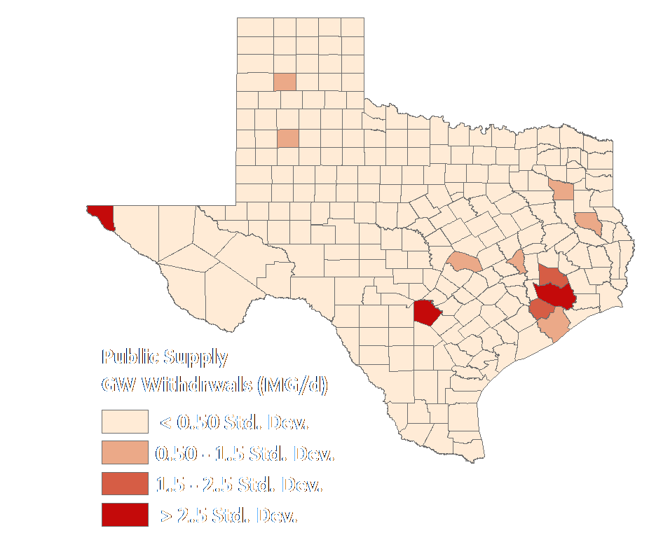
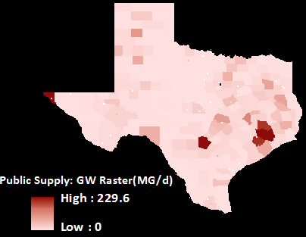
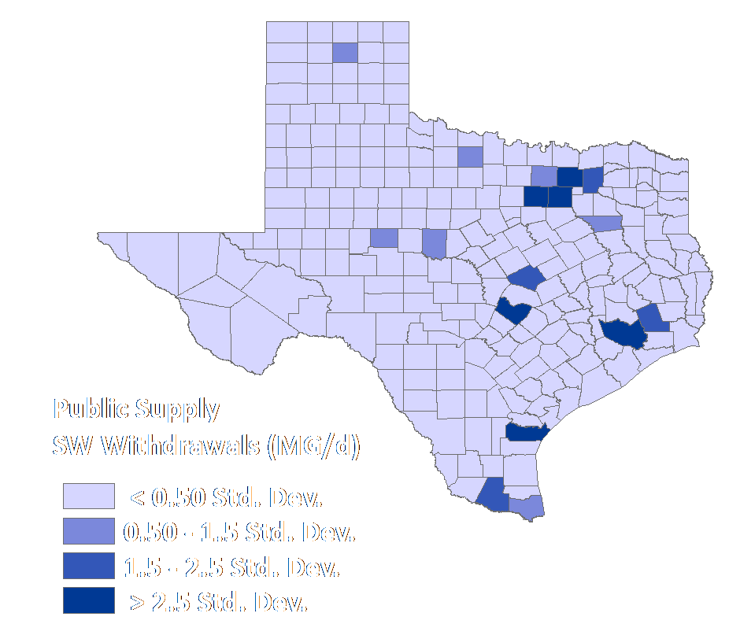
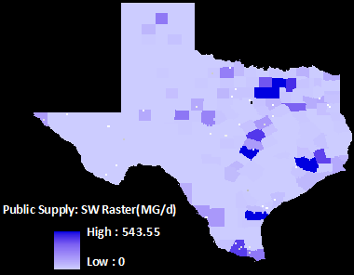
USGS data were converted from vector to raster format to enable raster calculations
GCS_North_American_1983

Slide 8
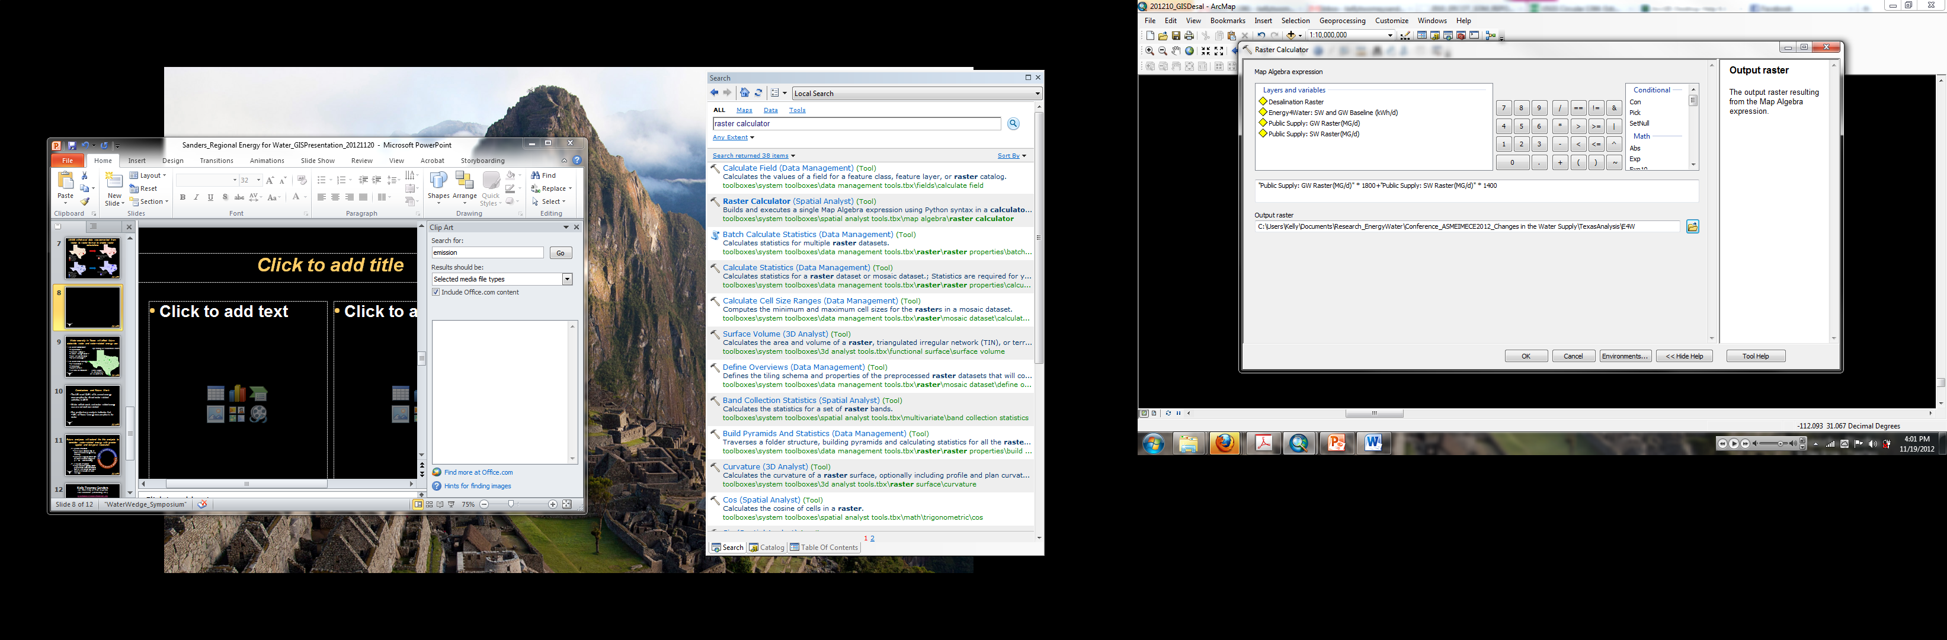
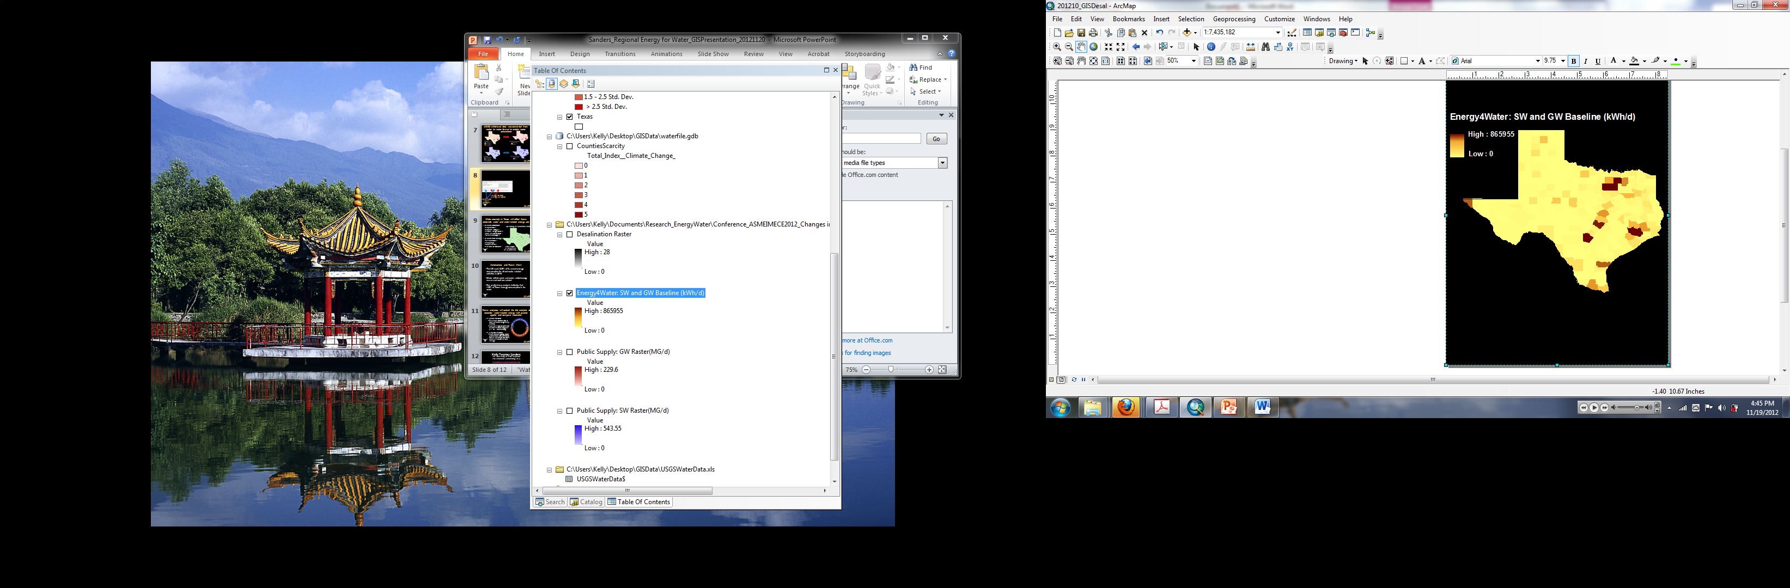
The energy consumed for SW and GW treatment was calculated across the state
Energy Intensity
(Energy per Volume)
Raster Data Layer
(Volume)

Slide 9
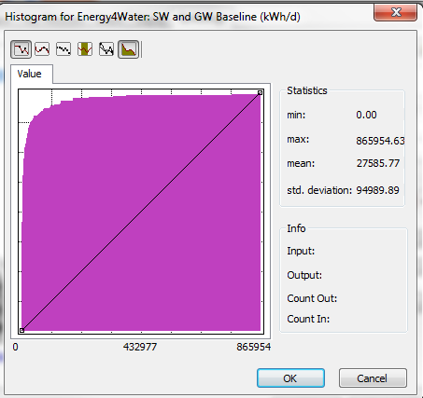
The energy consumed for SW and GW treatment was calculated across the state
Electricity consumption per county per day:
Mean = 27.6 MWh
Max = 866 MWh
Total for all counties: 7.0 GWh per day (<1% of ERCOT load)

Slide 10
Thus, pumping and treating water are much less energy intensive than end-use preparation
Texas Water-related Energy Consumption:
~15% of total primary energy consumption
Treatment = <<1% of total primary energy consumption (0.2%)*
160 Billion
BTU Per Day
*Average Heat Rate for TX power plants: ~7,200 BTU/ kWh [EPA]
Public
Supply
Industry
Irrigation
Mining
Power
Livestock

Slide 11
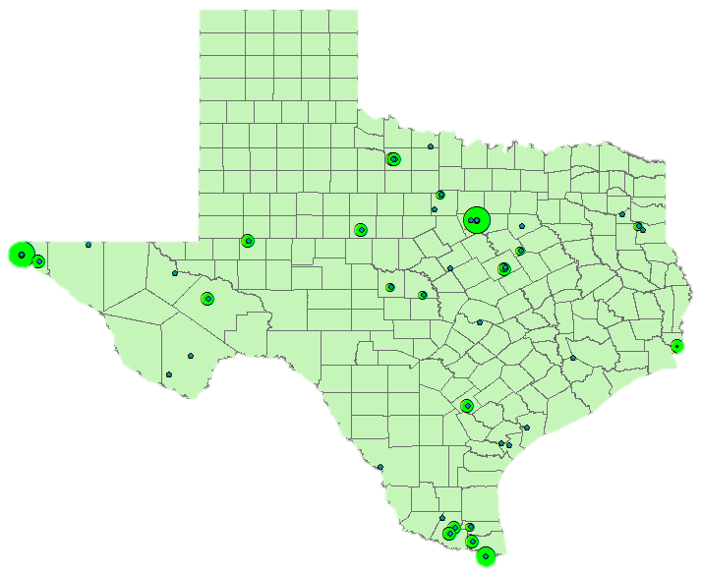
Water scarcity in Texas will affect future statewide water and water-related energy use
∆ in Water Withdrawals:
  Population ↑
  Climate Change ↑
  Future energy sources?
  Role of conservation?
  New technologies?
∆ in Water-related Energy:
  Desalination ↑
  Pumping↑
  Water Reuse↑
  Treatment standards?
Operating Desalination Plants
Total output:
~85 MGD (<1%
of TX water use)
[TWDB and GWI]

Slide 12
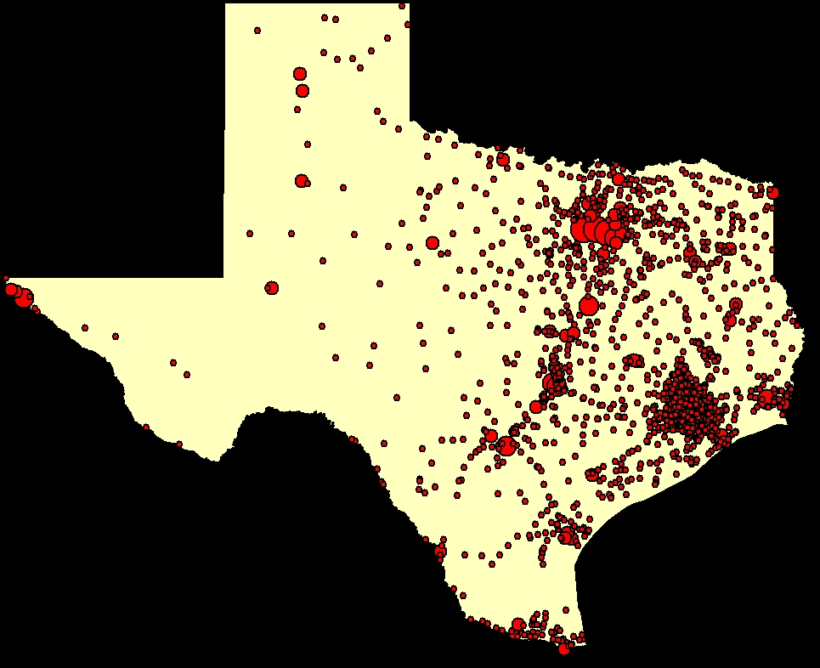
Conclusions and Future Work
Water withdrawals and water-related energy use are not well-correlated
My preliminary analysis concludes:
  ~15% of Texas’ energy consumption is for water
  ~0.2% is for public water supply treatment and pumping
Future analyses will consider wastewater treatment and changes to treatment technologies
[EPA]
Texas’ Publicly owned
treatment works (wastewater)

Slide 13

Kelly T. Sanders
The University of Texas at Austin
kellytwomeysanders@utexas.edu
www.webberenergygroup.com

Slide 14
