Slide 1
Urbanization in the Bull Creek Watershed, Austin, TX
Jeff Senison
CE394K

Slide 2
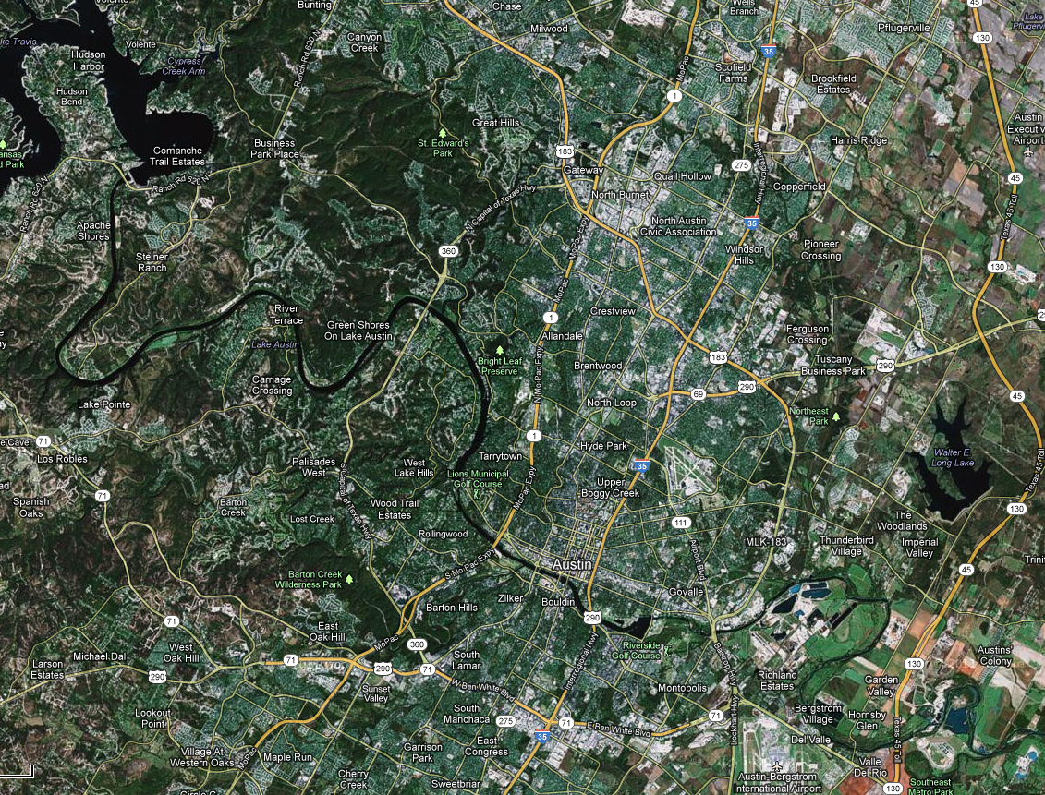
Austin, TX – Our Home

Slide 3
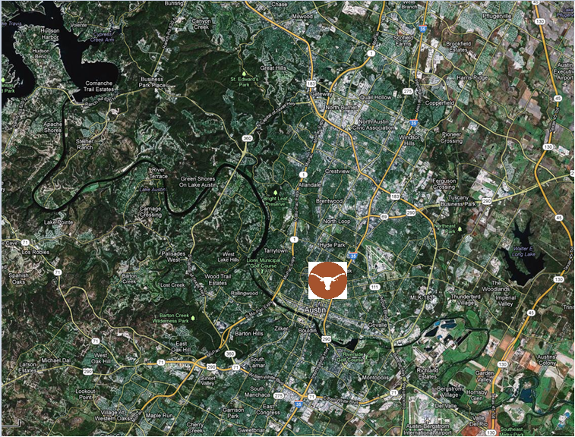

Ahh, That’s Better

Slide 4
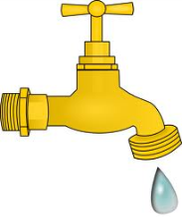
Municipal Tap Water

Slide 5
Let’s Take a Little Trip . . .

Slide 6
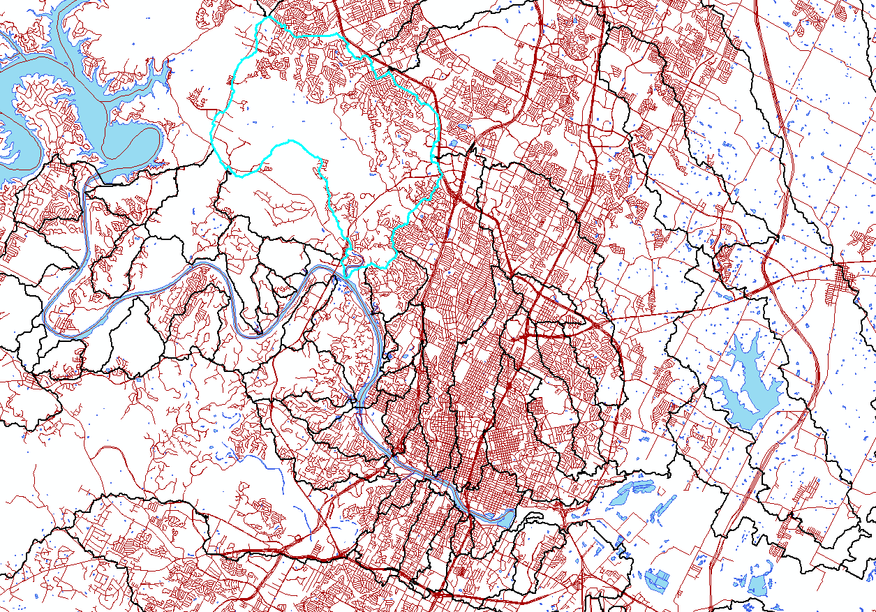
To The Bull Creek Watershed

Slide 7
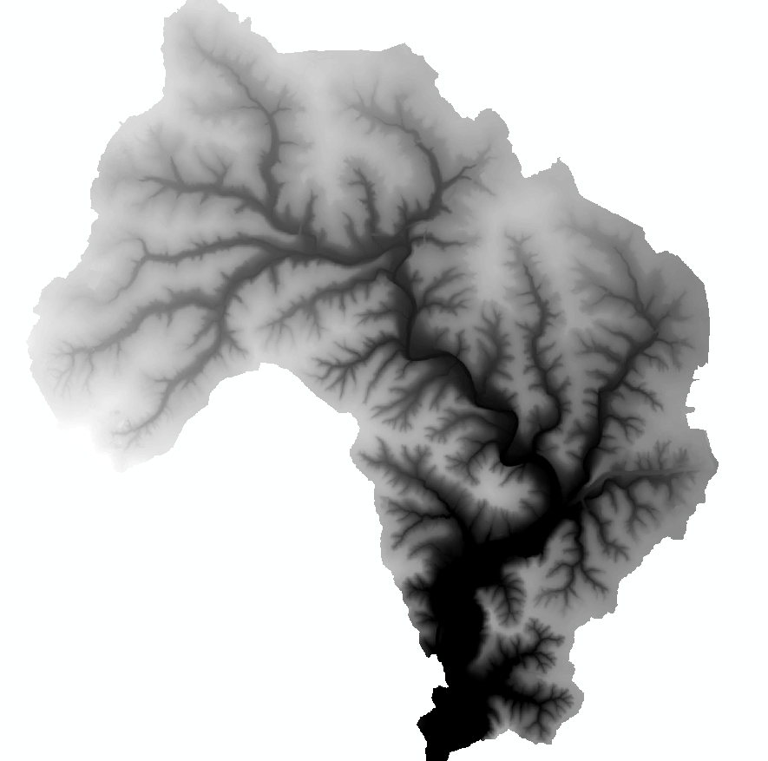
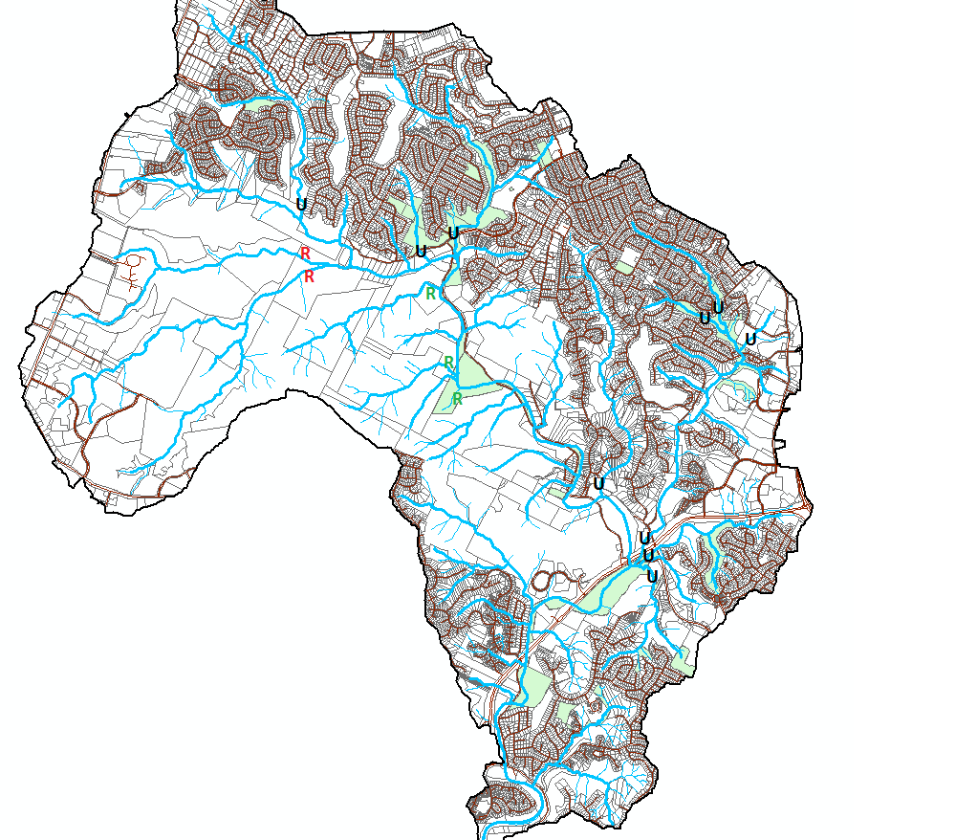
Sample Sites and 1 m DEM
Exciting place to study the effects of urbanization on water quality!

Slide 8
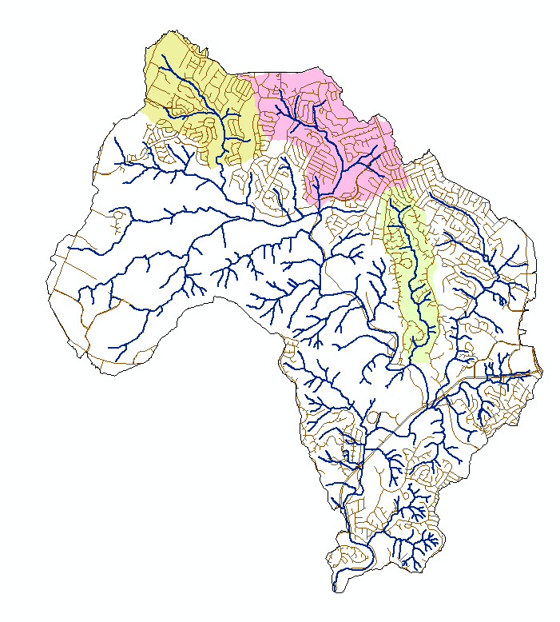
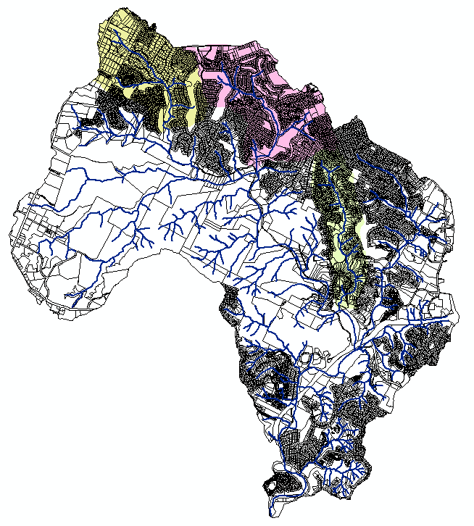
3 Watersheds, Roads, Land Use

Slide 9
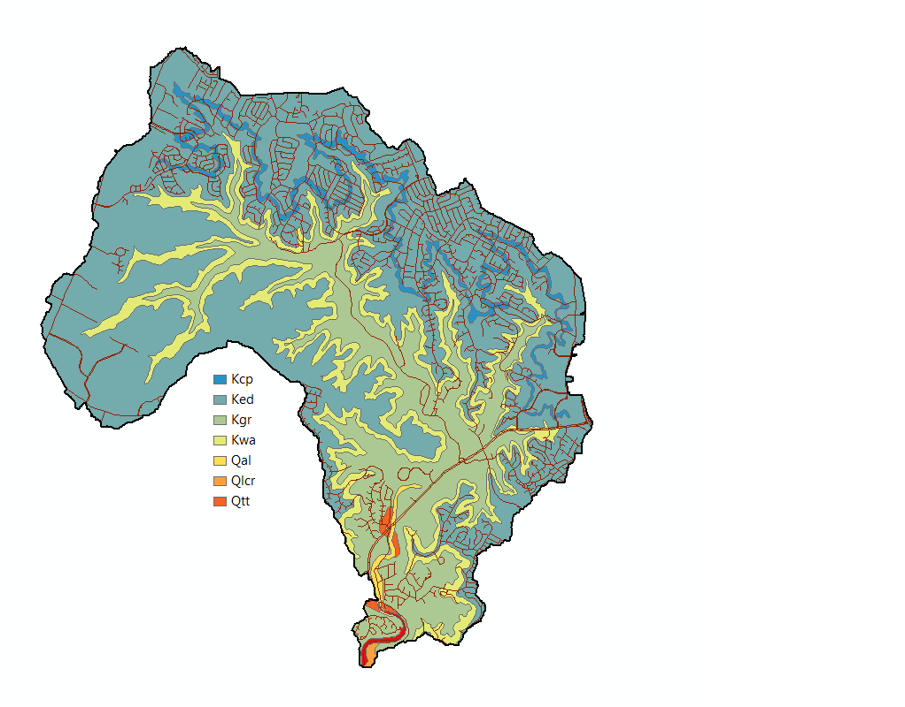
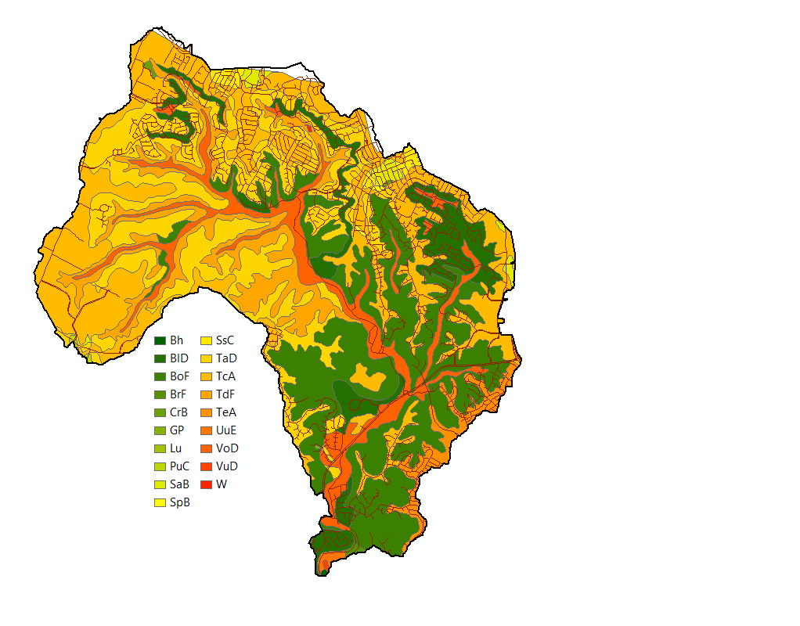
Bedrock and Soil Exposures

Slide 10
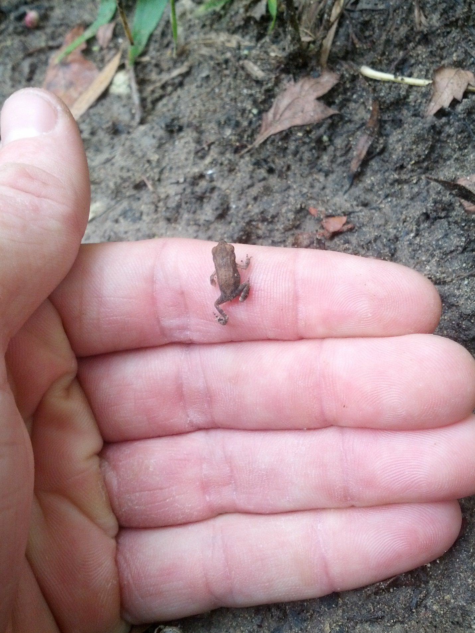
Amphibian
Friend

