Slide 1
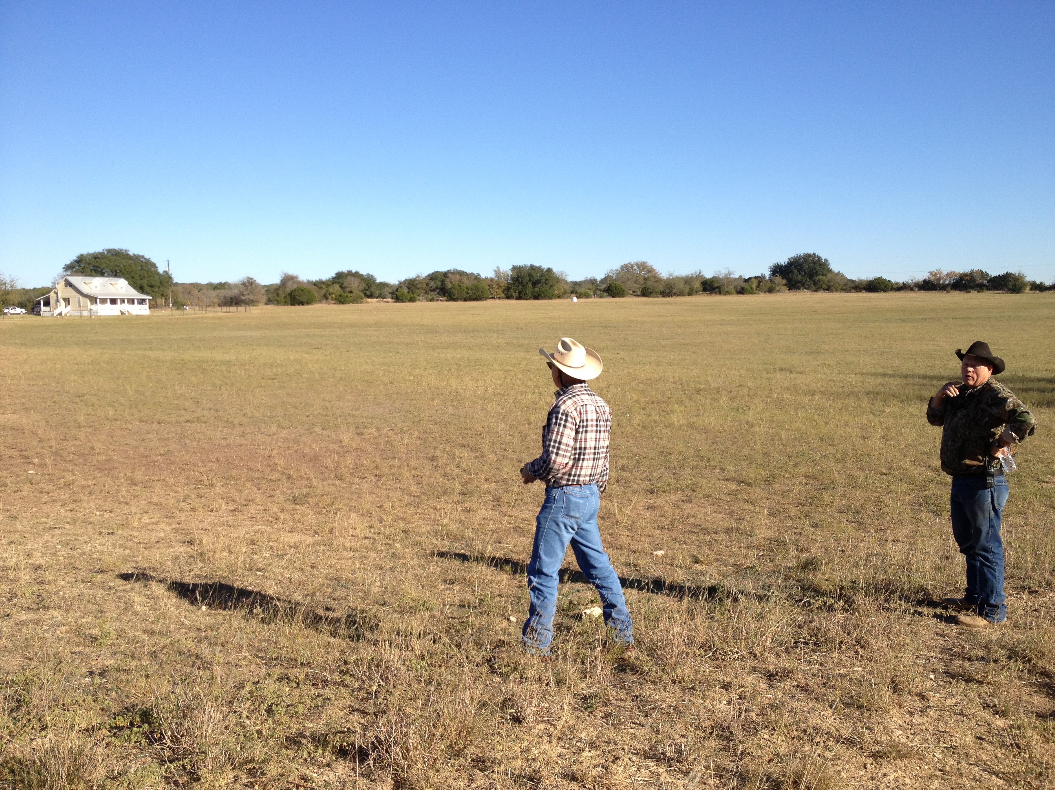
Edgar’s Ranch
Lily Xu
A Floodplain Remapping Effort
Prepared for Professor Maidment’s Class on Nov. 19, 2012

Slide 2
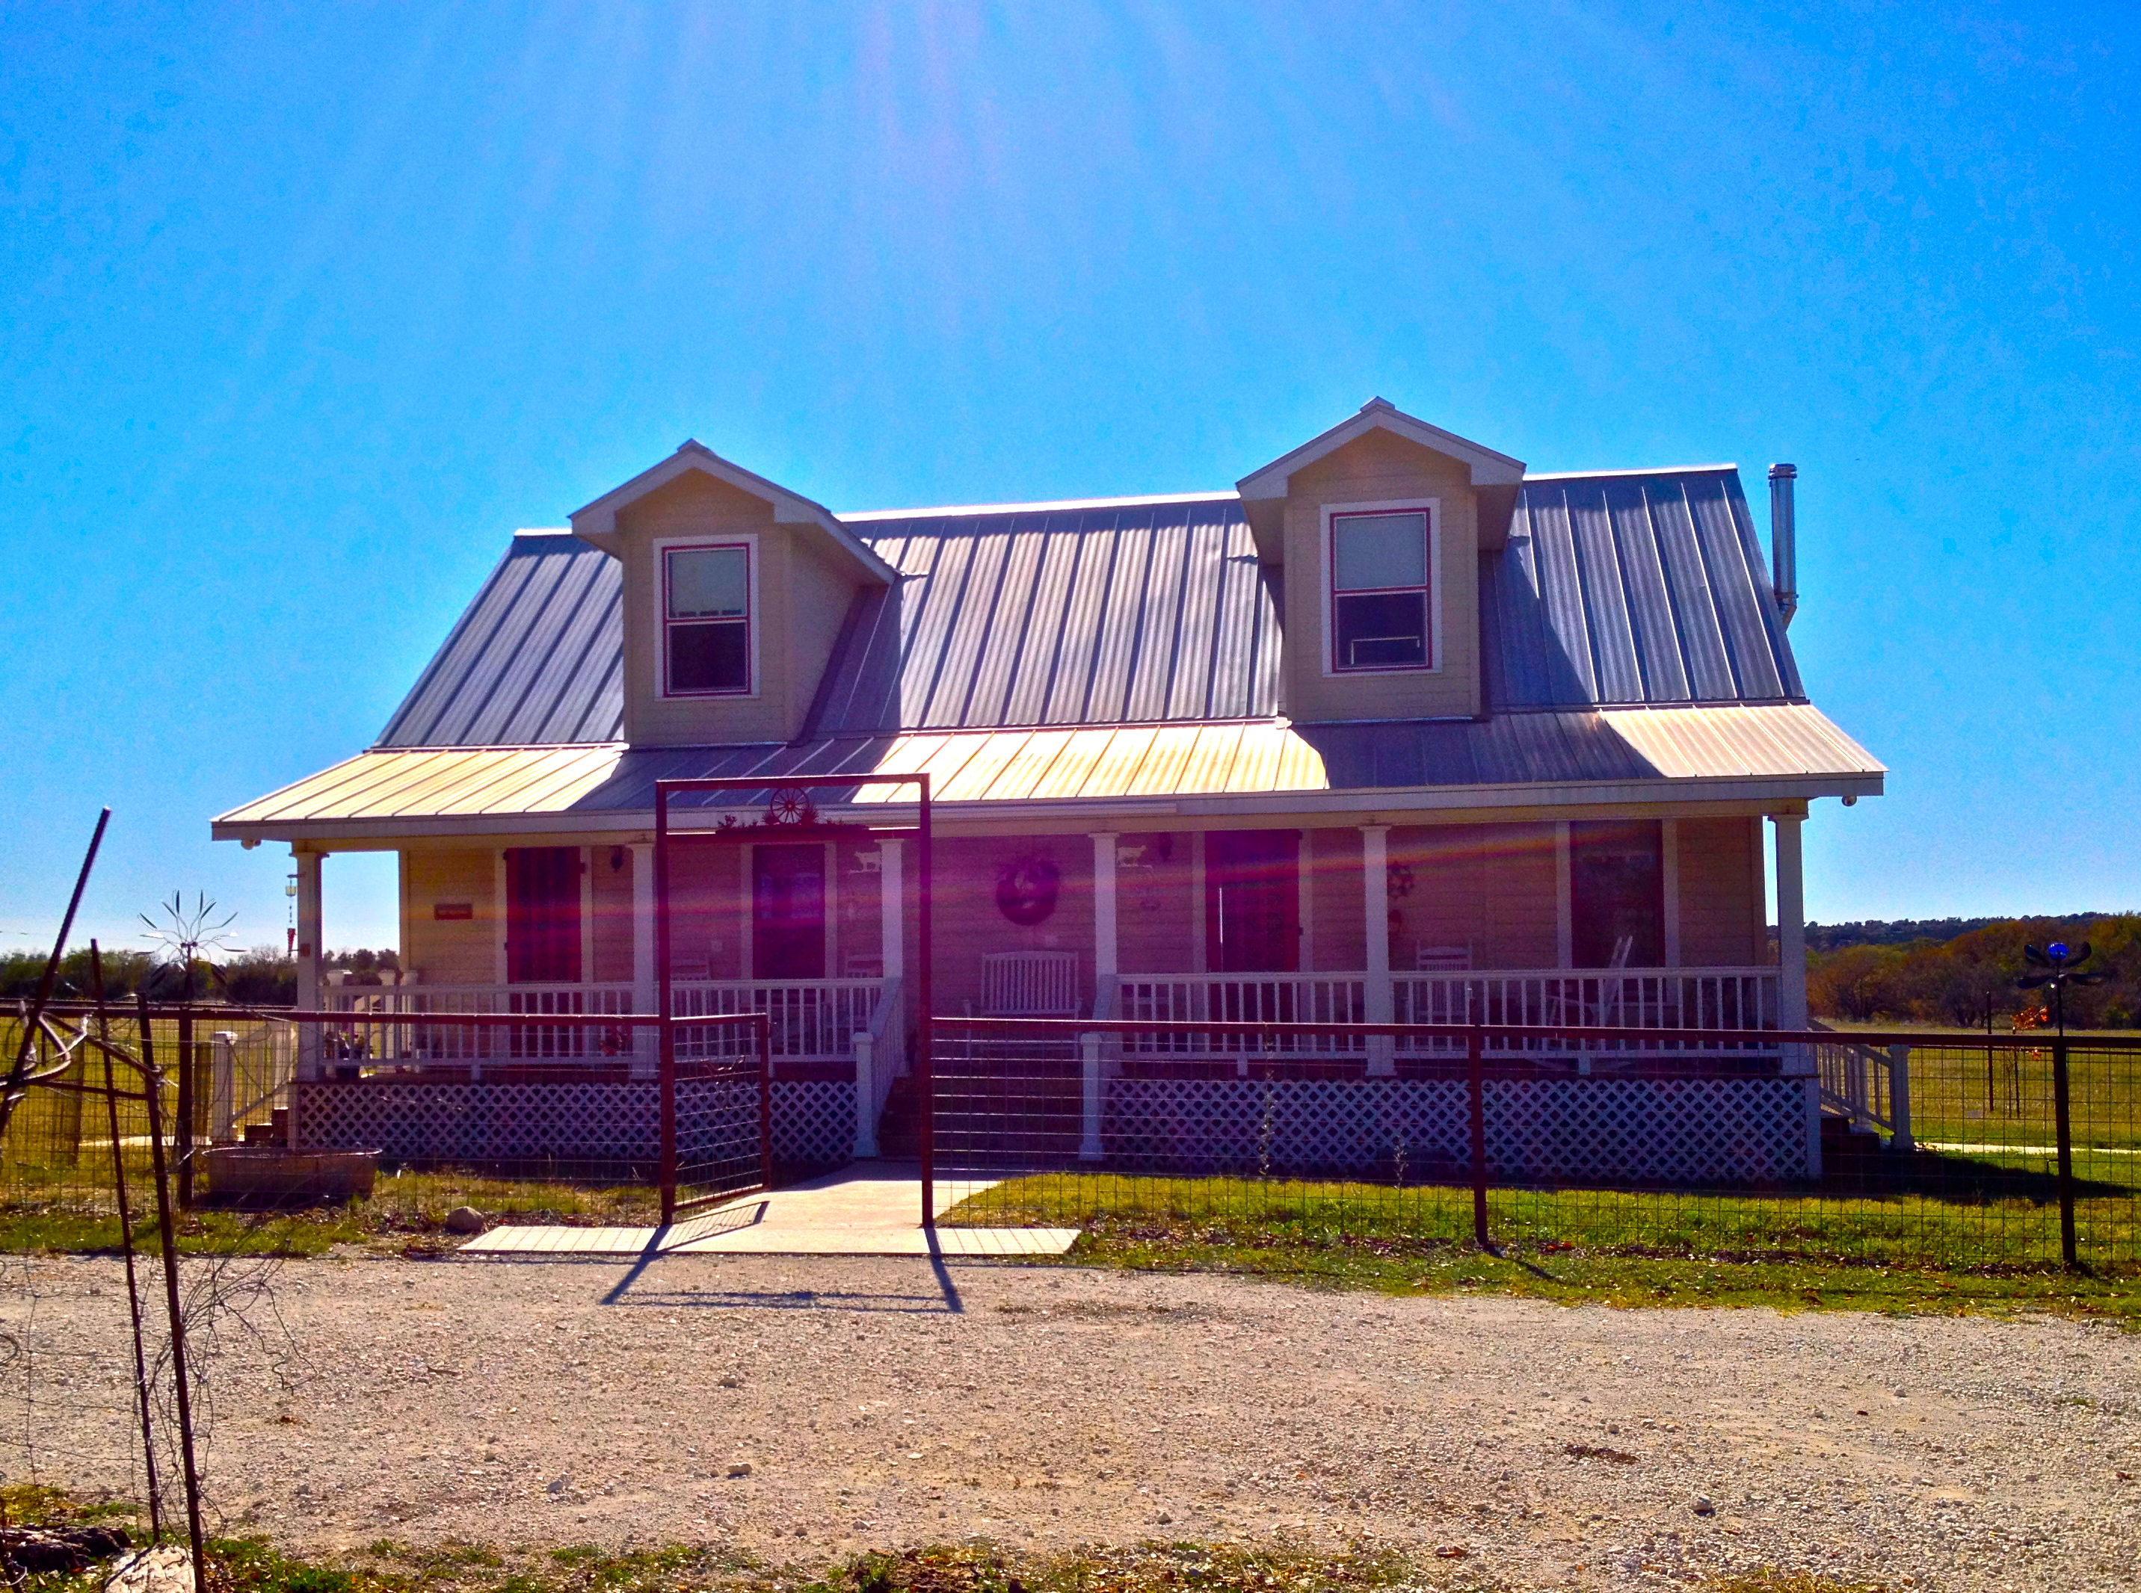
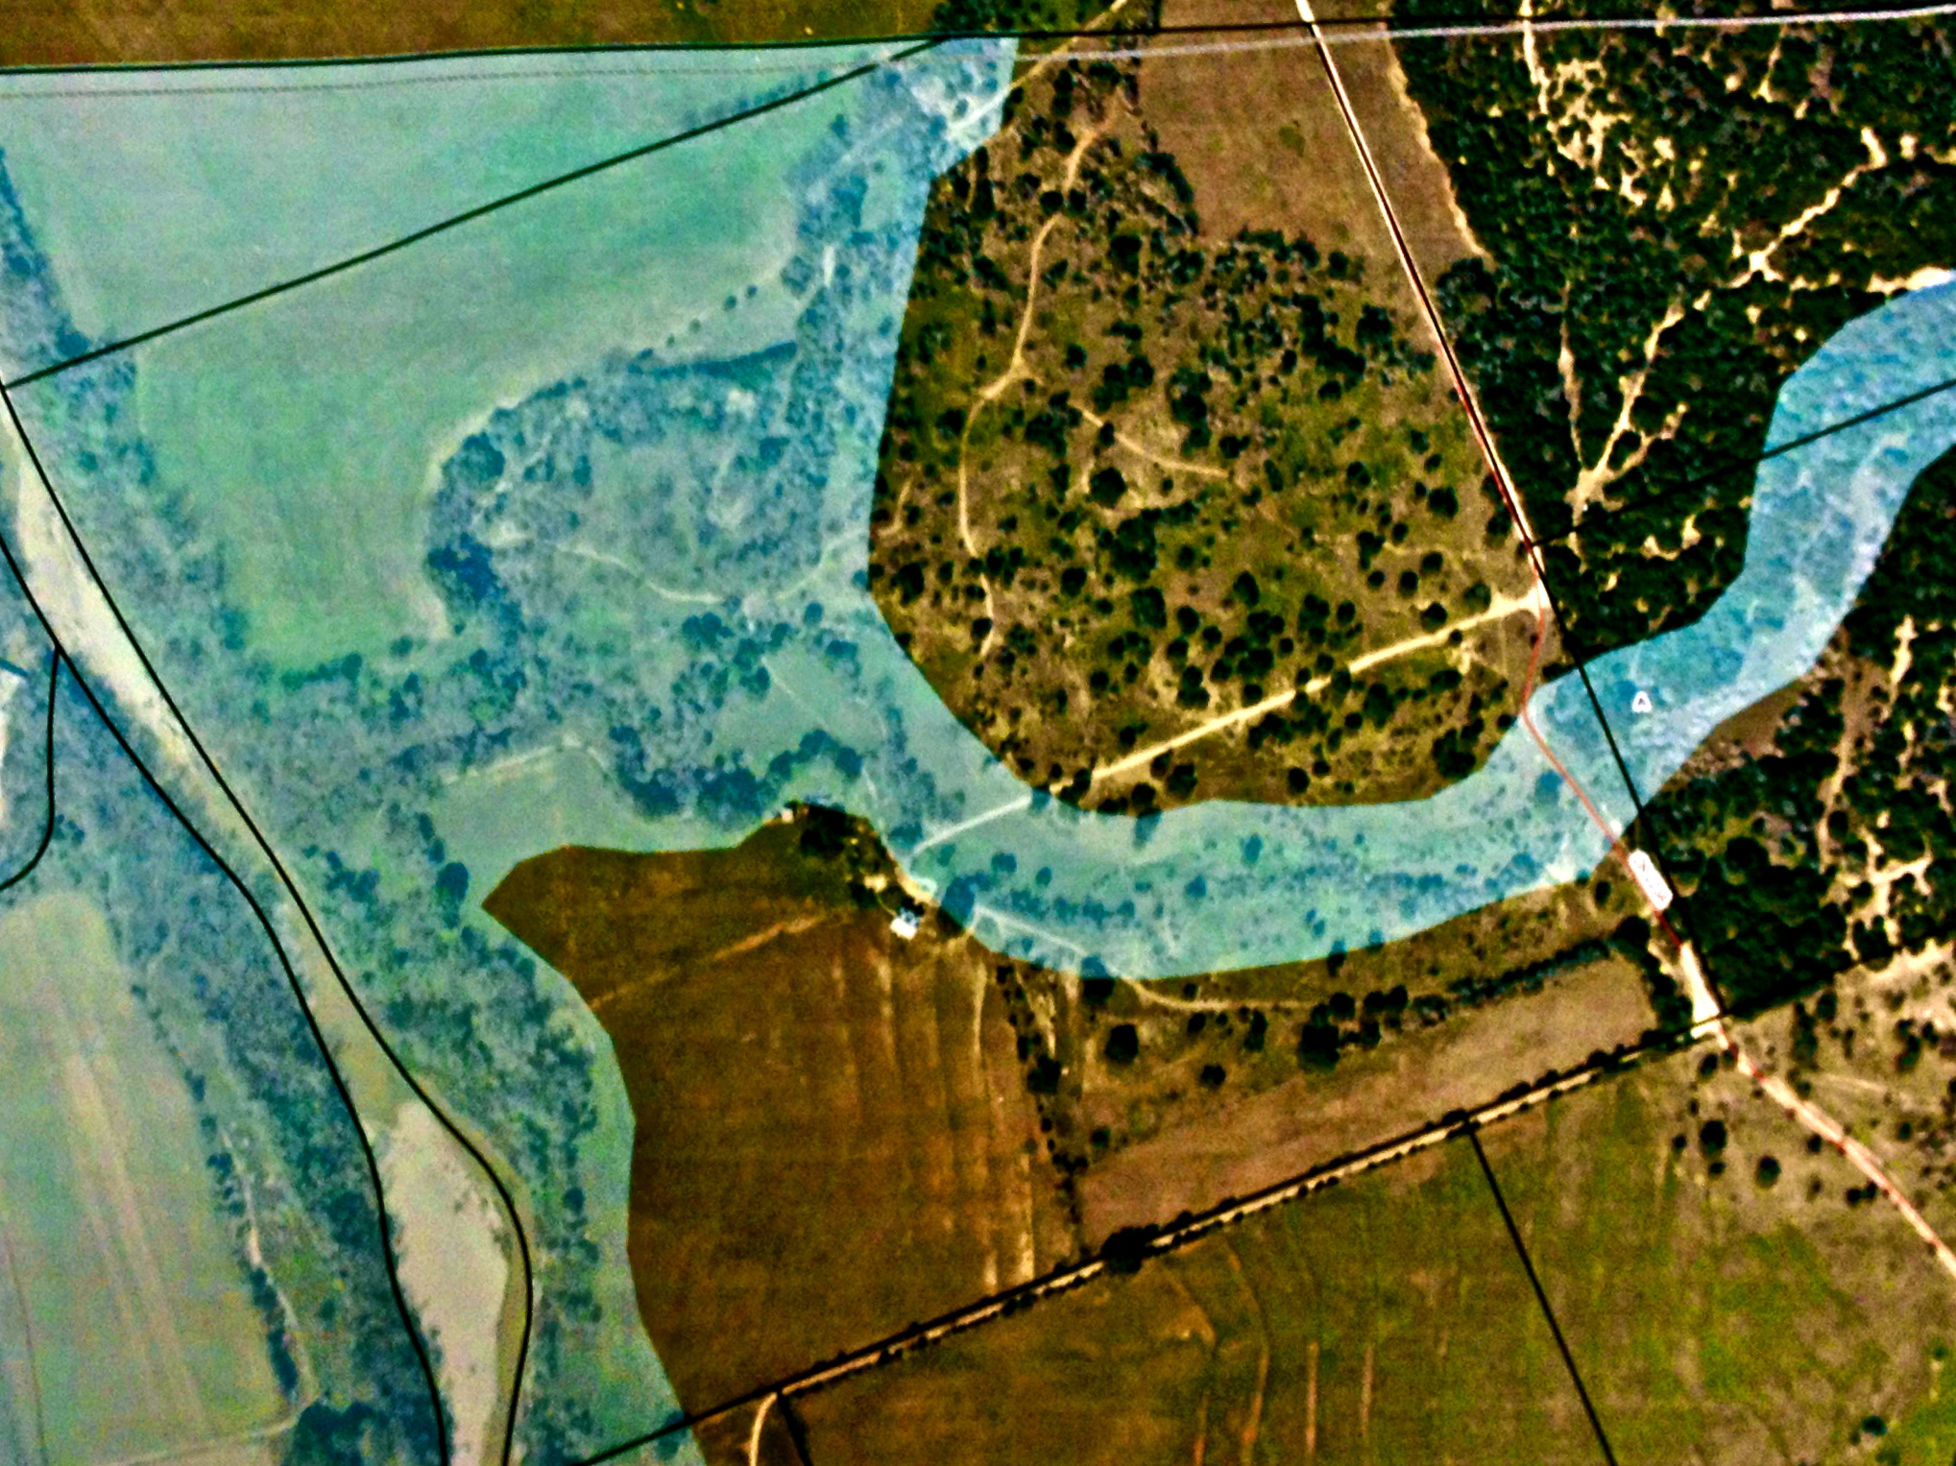
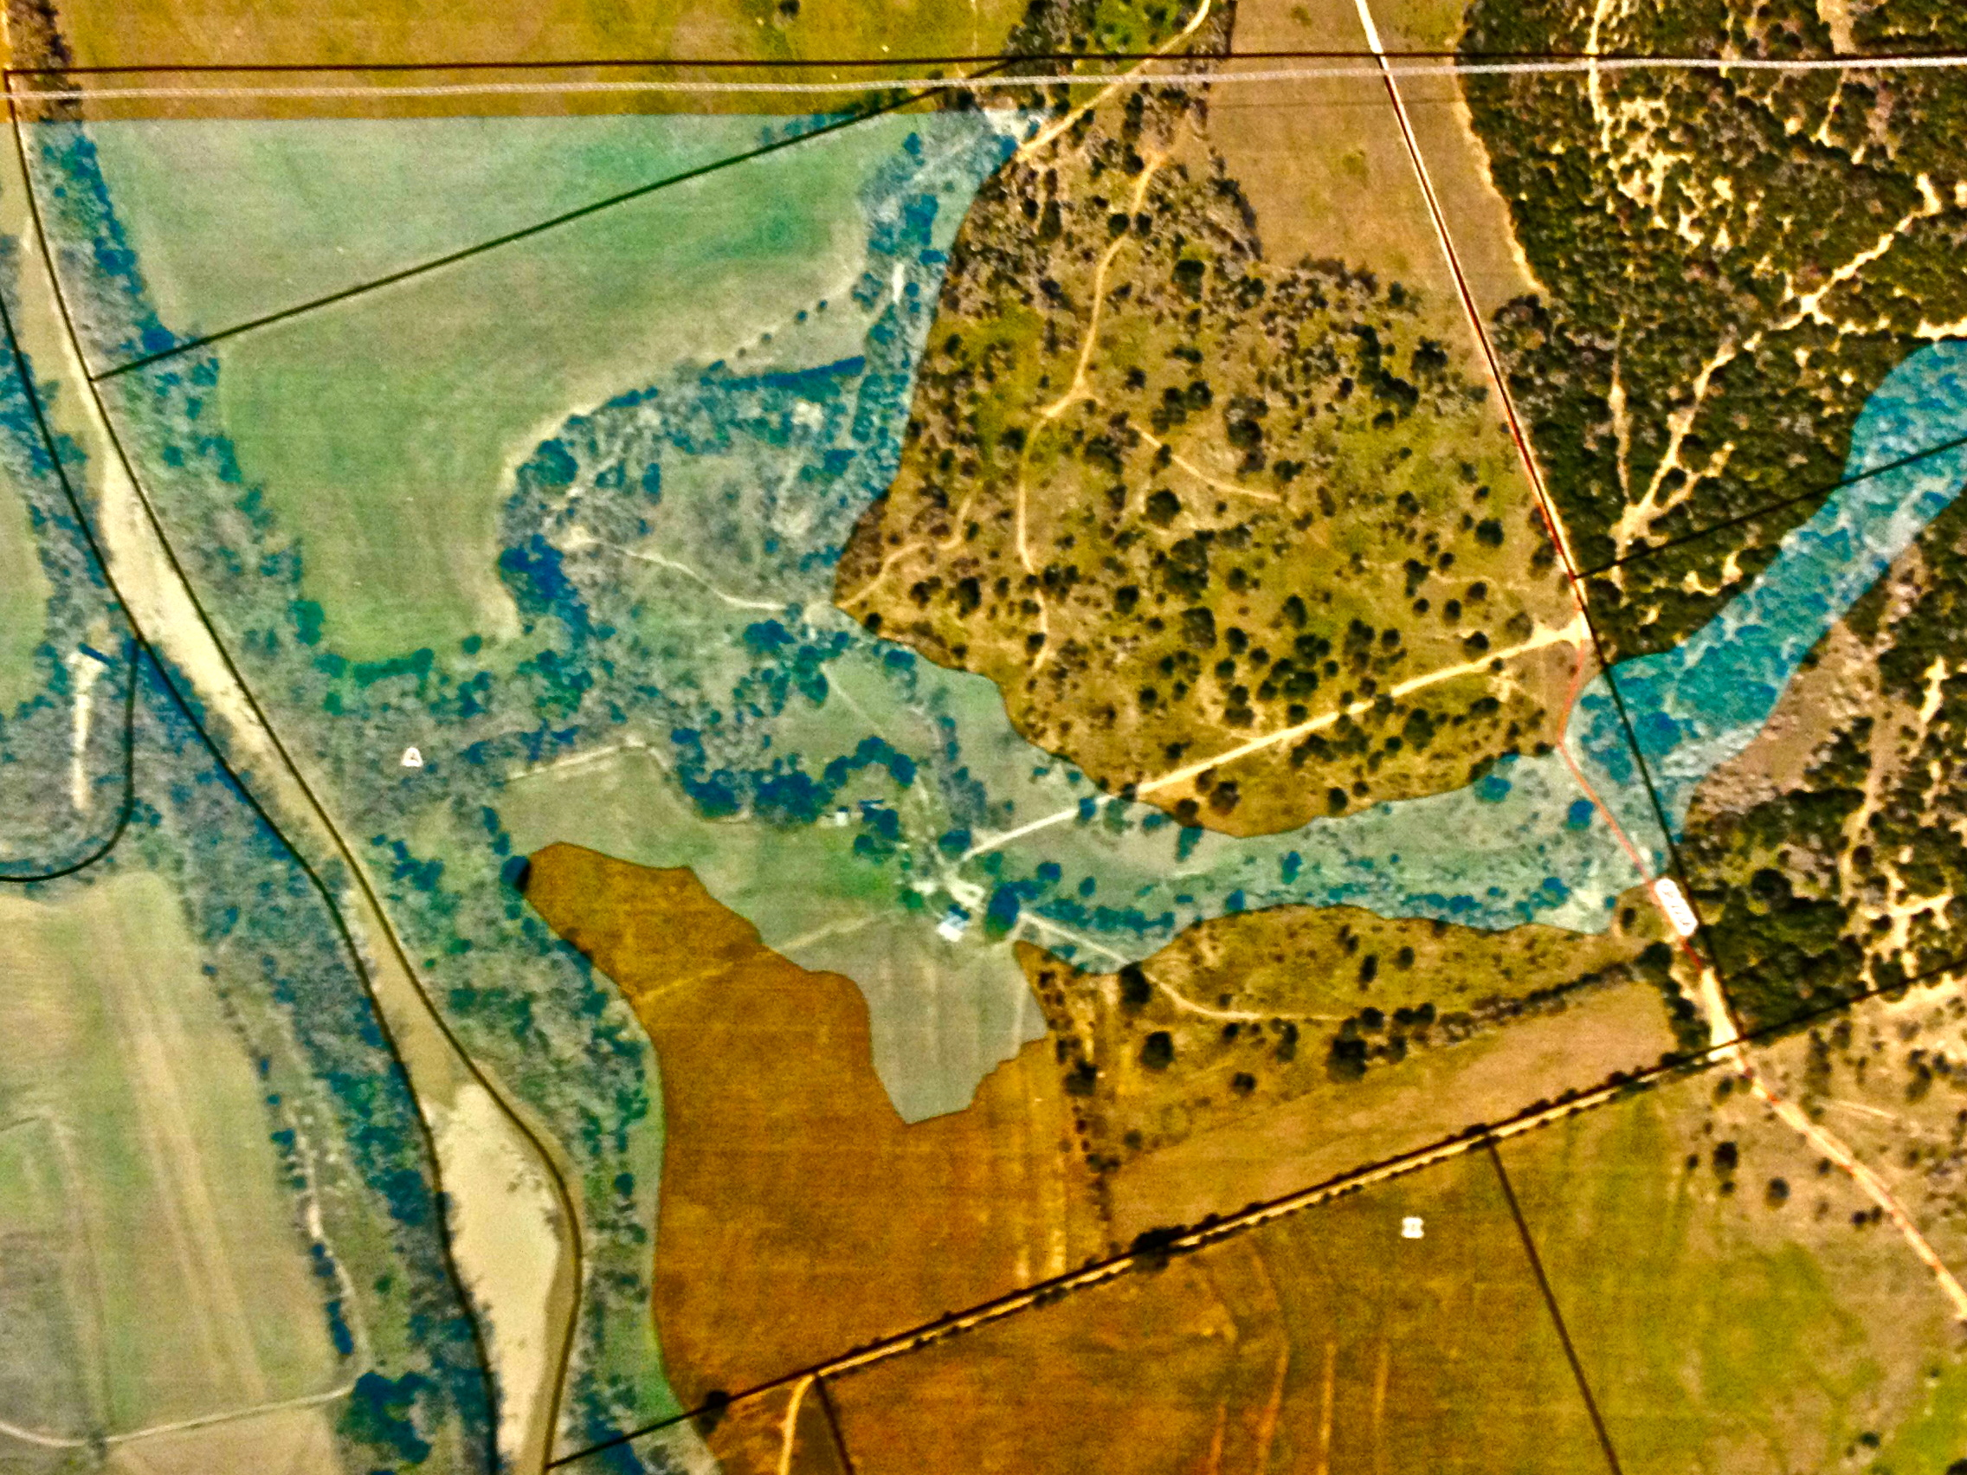
Their Story
“… uses 40+ year old USGS contour data”
Old Flood Map
New Flood Map
2011

Slide 3
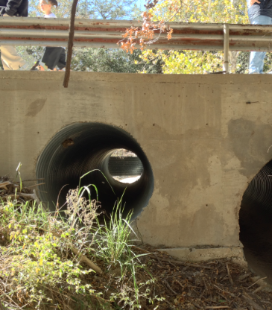
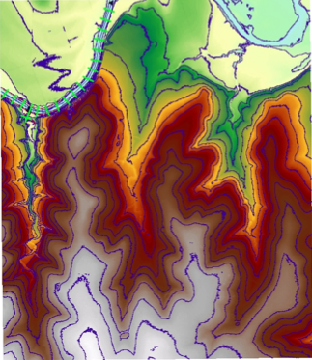
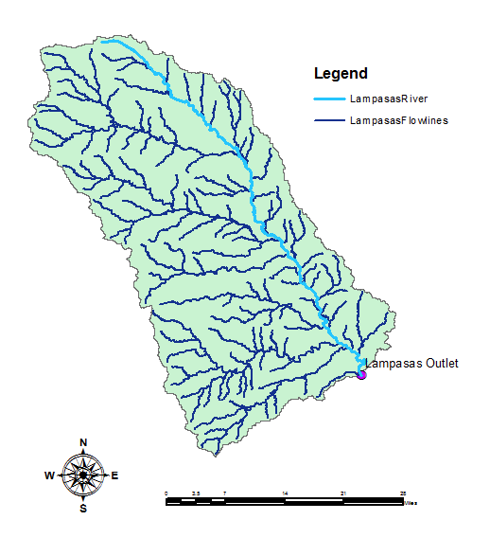
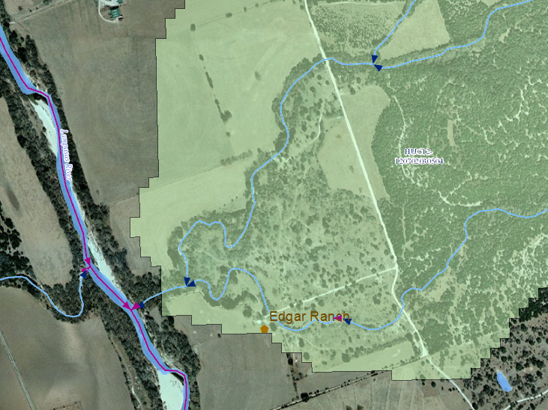
Our Job To recreate a floodplain map using up-to-date data and resources (LiDAR)
Hydraulics
Terrain
Hydrology
My Job
To create design flows and quantify flow through the Lampasas River, Moss Branch, and Edgars Draw
Moss Branch
Lampasas River
Edgars Draw

Slide 4
Peak Stream Flow Regressions Equations
State-wide
Brazos River
Notes:
Figure 3. Rivers in Texas with superimposed values of OmegaEM parameter that represents a generalized terrain and climate index for regionalization of peak-streamflow frequency.

Slide 5
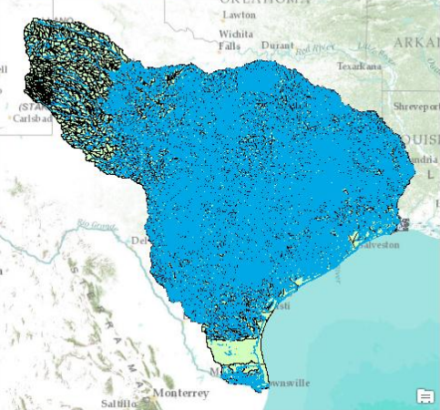
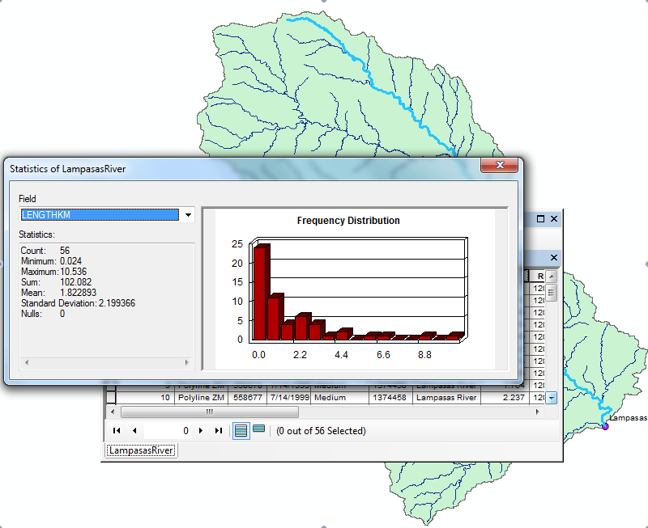
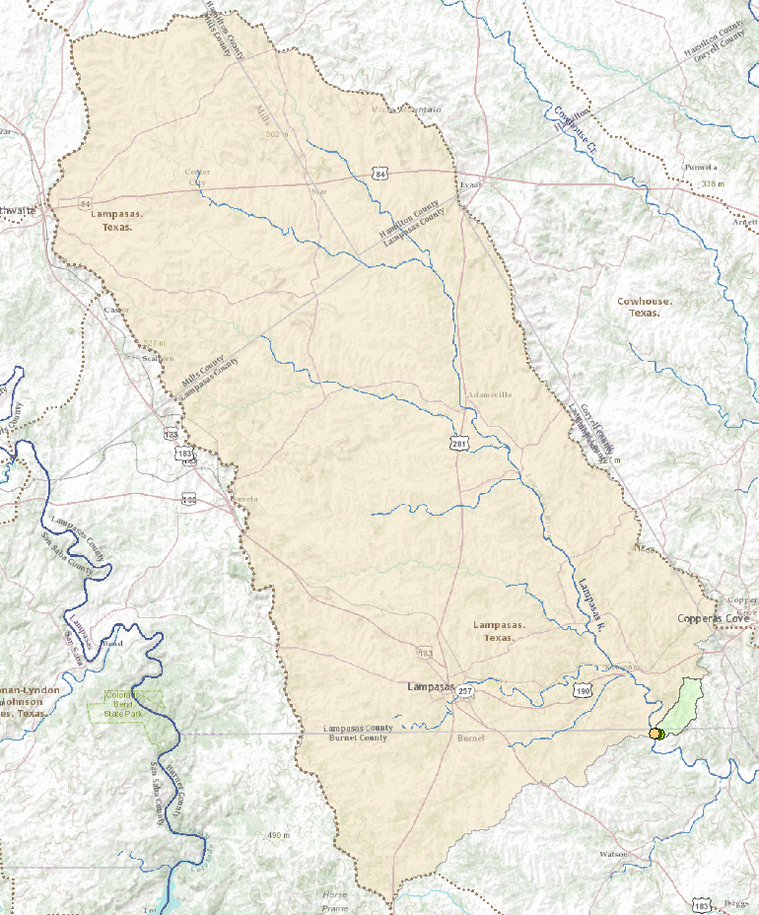
Basin & Stream Analysis

Slide 6
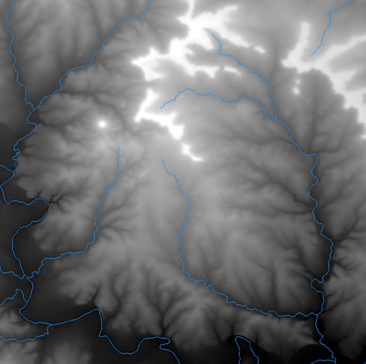
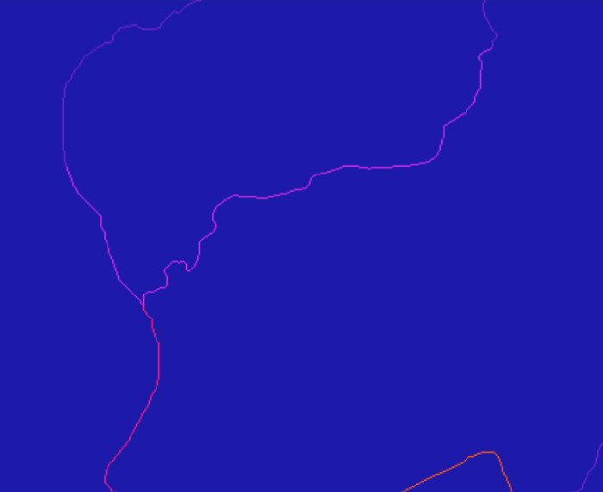
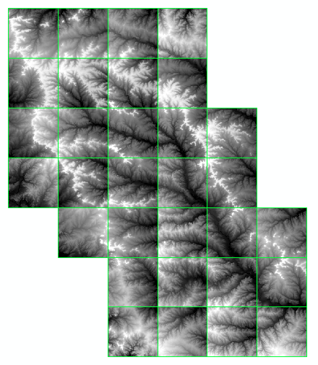
Hydrologic Terrain Analysis
DEM
FAC
Edgars Draw
Edgars Draw
To delineate Edgars Draw watershed
To calculate channel slope, elevations, length

Slide 7
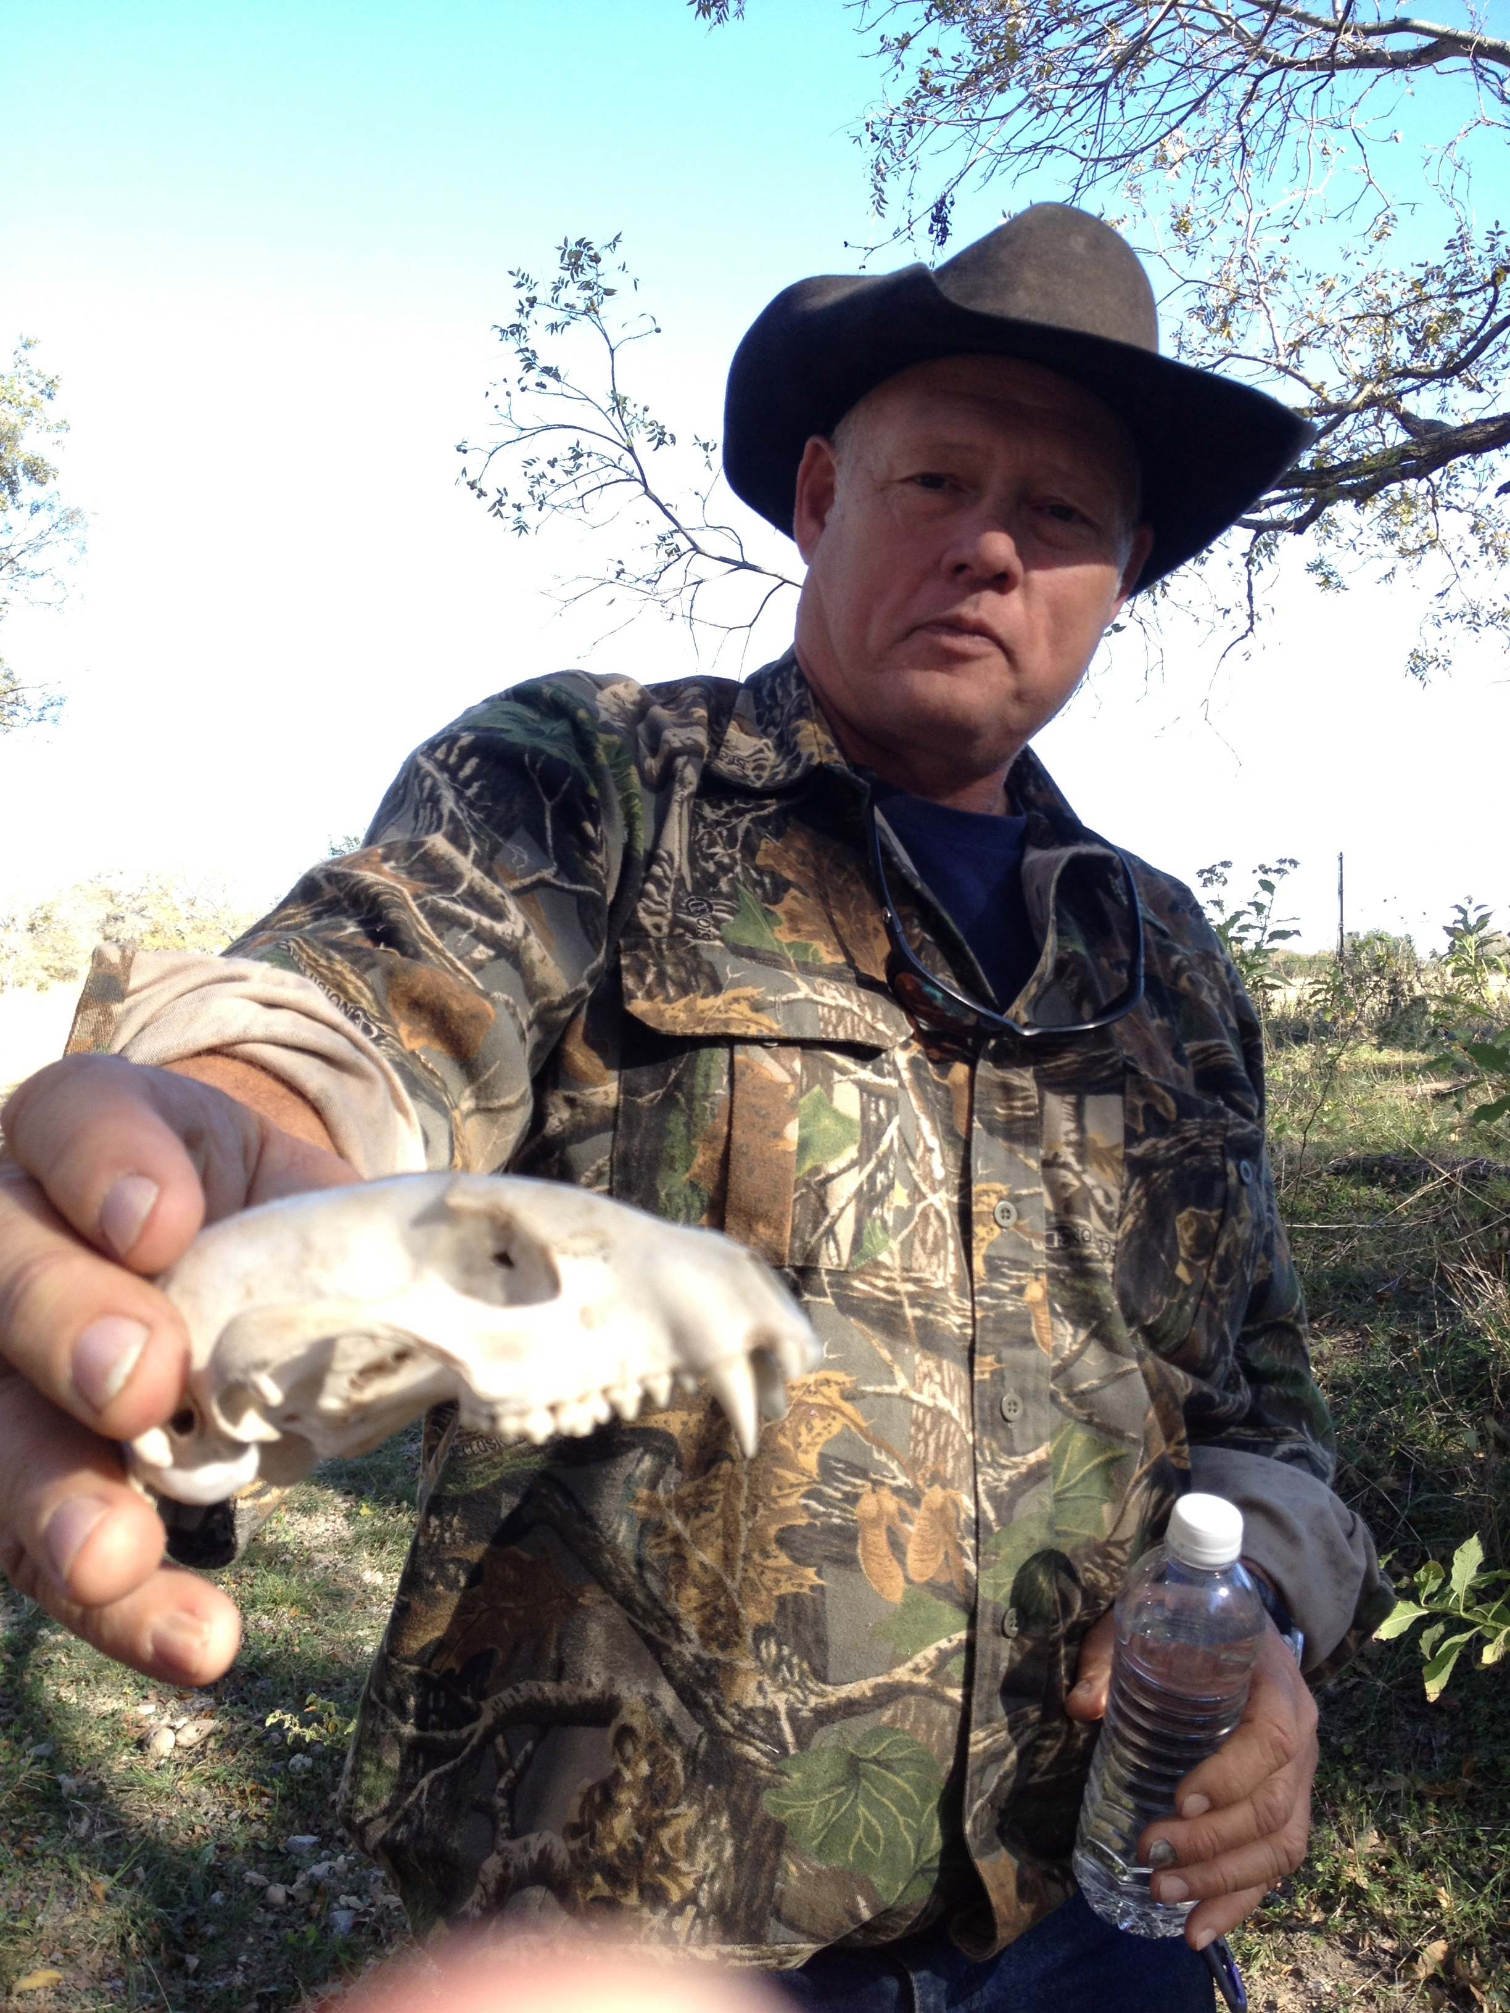
Acknowledgements
Stephen Jackson!
Sean Sutton
The Edgars
Herb Darling
Roxana Darvari & Sofia Reyes
and of course, Professor Maidment

