Slide 1
Empirical Calibration of a Lipid-Based Paleothermometer in the Eastern Cordillera of Colombia
Veronica Anderson

Slide 2
GDGT-based paleothermometers
GDGT’s (Glycerol Dialkyl Glycerol Tetraethers) are membrane lipids produced by soil bacteria
9 individual branched GDGT’s
Slight structural variations represent adaptations to different temperature regimes
Strong correlation between relative abundances of GDGT’s and mean annual temperature

Slide 3
Measurement of GDGT’s

Slide 4
Measuring Paleotemperatures With GDGT’s
Peterse et al, 2012
Collect soil samples across the globe
Measure GDGT abundances
Compare to nearby climate station data
Create a statistical correlation between measured GDGT’s and mean annual temperature (MAT)
$$MAT=0.81 −5.67×CBT+31.0∗MBT′$$
$$MBT^{′}= \frac{(Ia+Ib+Ic)}{(Ia+Ib+Ic+IIa+IIb+IIc+IIIa)}$$
$$CBT=−\log\left(\frac{Ib+IIb}{Ia+Ia}\right)$$

Slide 5
Problems with current calibration
Soil temperature not necessarily the same as temperature at climate station
can differ by as much as 8 degrees in our study!
How much scatter does this mismatch introduce into the regression?
How does this affect reported errors?
Can interpolation solve some of these problems with site data?

Slide 6
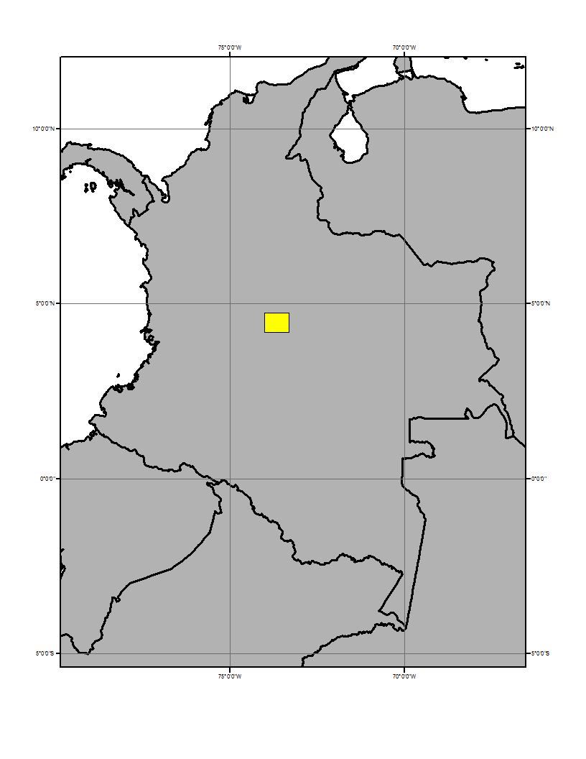
Installed temperature loggers across elevation transect
Recorded temperature every 10 mins for a year
Measured GDGT’s in soils from each location

Slide 7
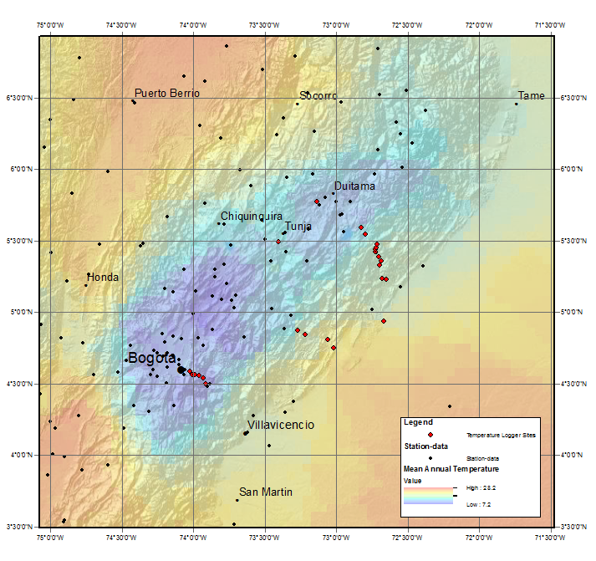
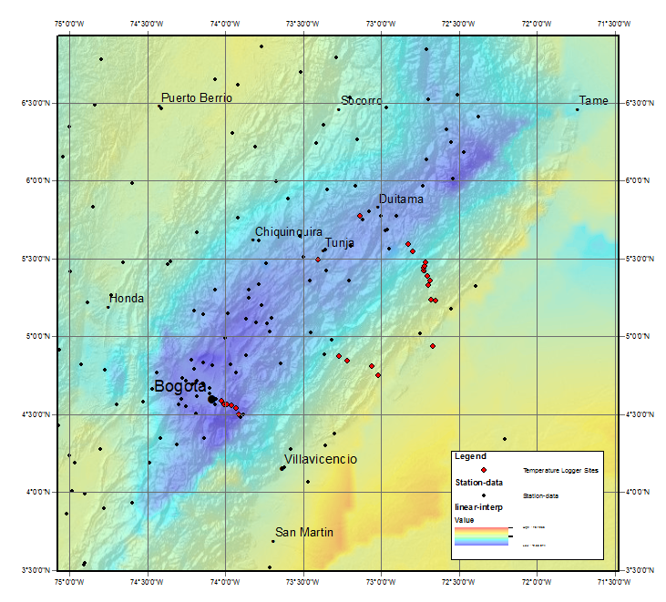
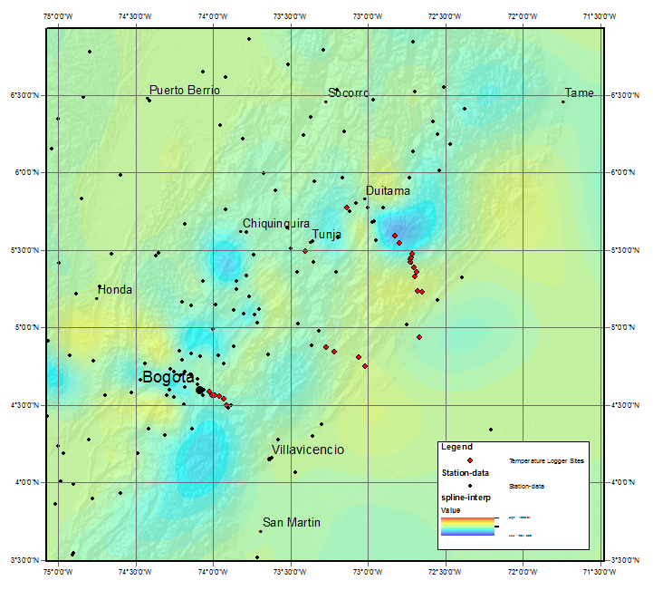
3 different interpolations
Kriging
Linear Interpolation
12-pt Spline

Slide 9
Conclusions
Simple linear interpolation actually does a pretty good job!
Original authors happened to pick a good interpolation scheme.
R² still = 0.8, even with in-situ temperature loggers → suggests that 20% of the variation in GDGT compounds cannot be explained by temperature alone!

Slide 10
Future Work
Soil sample locations used by Peterse et al, 2012

Slide 11
Thanks for Listening! ……Any Questions?

