Slide 1
Water Supply in Bulawayo, Zimbabwe
Justin Baker
GIS in Water Resources
27 November 2012
Notes:
Hi, I’m Justin Baker, a student at the LBJ school.
Today I’ll be talking about water supply challenges and opportunities in Bulawayo, Zimbabwe.

Slide 2
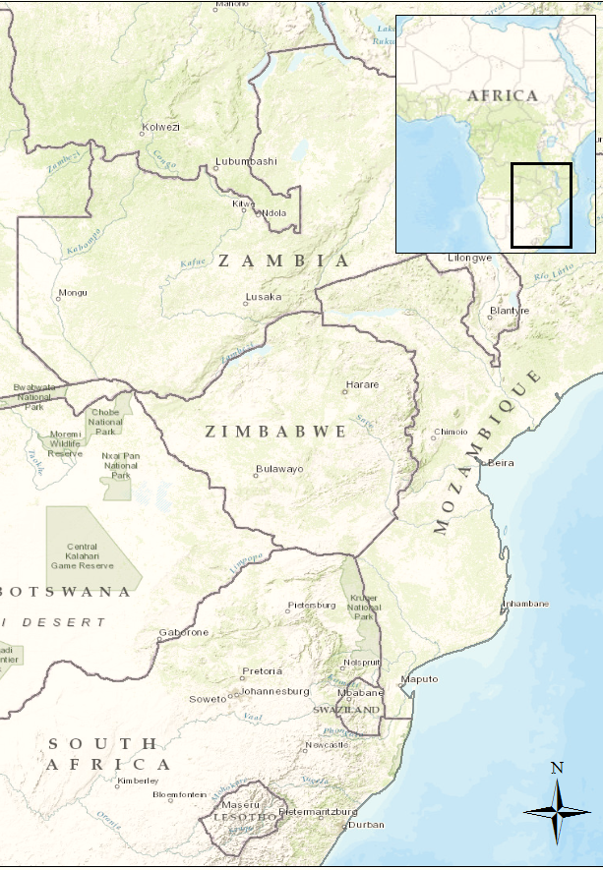
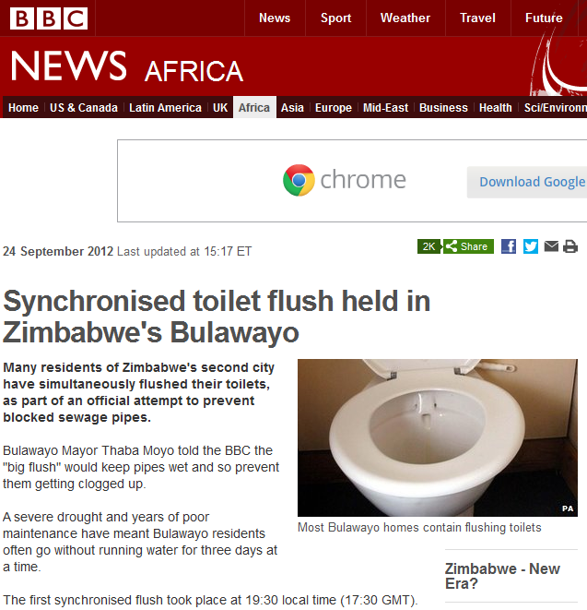
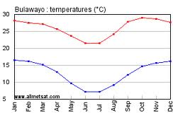
Why Bulawayo?
Population: ~1 million (2010)
Rainfall: 590 mm annual average (Austin 850 mm)
Temperature: 78F – 54F
Notes:
So where is Bulawayo? Southern Africa, Southwest Zimbabwe, one of the hotter, drier areas.
[CHANGE PICTURE]
So, now that you know where it is, the obvious question then is: why Zimbabwe and why Bulawayo?
The answer to that is that water supply in Bulawayo is a real problem. This article really got me thinking – the city council decided that they would have a weekly coordinated flush, all residents flushing their toilets at the same time (730pm), something they’re still doing now. This was done to keep the pipes from becoming blocked, due to the three-day-at-a-time water restrictions.
But this isn’t a one off thing – Bulawayo has been struggling to keep up a sufficient supply of water for close on 80 years, through all sorts of changes in the city.
Bulawayo is a good case study for at least 3 reasons:
It is growing rapidly.
It needs water.
It has infrastructure set up (and people are used to running water).
And finally, I grew up near Bulawayo, so I have some personal interest in this ongoing story.

Slide 3
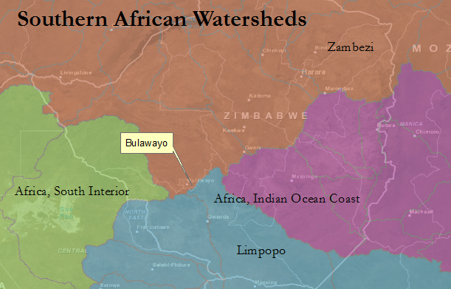
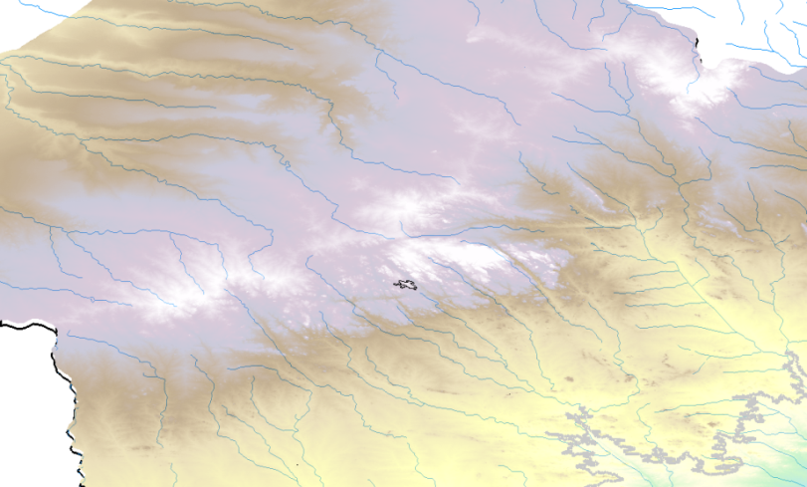
Questions
1. Why the struggle?
2. What is the best option for the future?
3. How might GIS be useful in this developing country context?
Elevation in Southeastern Zimbabwe
Bulawayo
Notes:
So, to keep some order, I’ve narrowed down the topic to three main questions which GIS can help answer (though they’re pretty big still):
What is keeping Bulawayo from having a steady supply of water?
Is it just population growth?
Is it lack of maintenance and funding?
Is it climate change?
Several options, short- and long-term have been proposed. Which might be best?
Finally, more broadly, how can we use GIS in this data-poor region to help with research, planning, and design? As someone who would like to work long-term in Africa, this is particularly important.
So, we’ll keep these questions in mind as we carry on to looking at Current Supply, Current & Future Demand, and Possible Options for the future.

Slide 4
Demand in the City
Notes:
So, let’s look now at the other side of the equation – the city’s DEMAND.
Here, the trend confirms what people are feeling. Demand is going up, and supplies are going down, leaving a gap. In fact, this demand is not even actual demand, it is suppressed.

Slide 5
Future Demand
Notes:
Looking at future demand, then, we see a continuing trend, higher demands for water each year, in step with the growth of the city. Even the most intense ‘demand management program’ will not be able to keep demand from growing by 15%.
So the city needs a LOT MORE WATER.

Slide 6
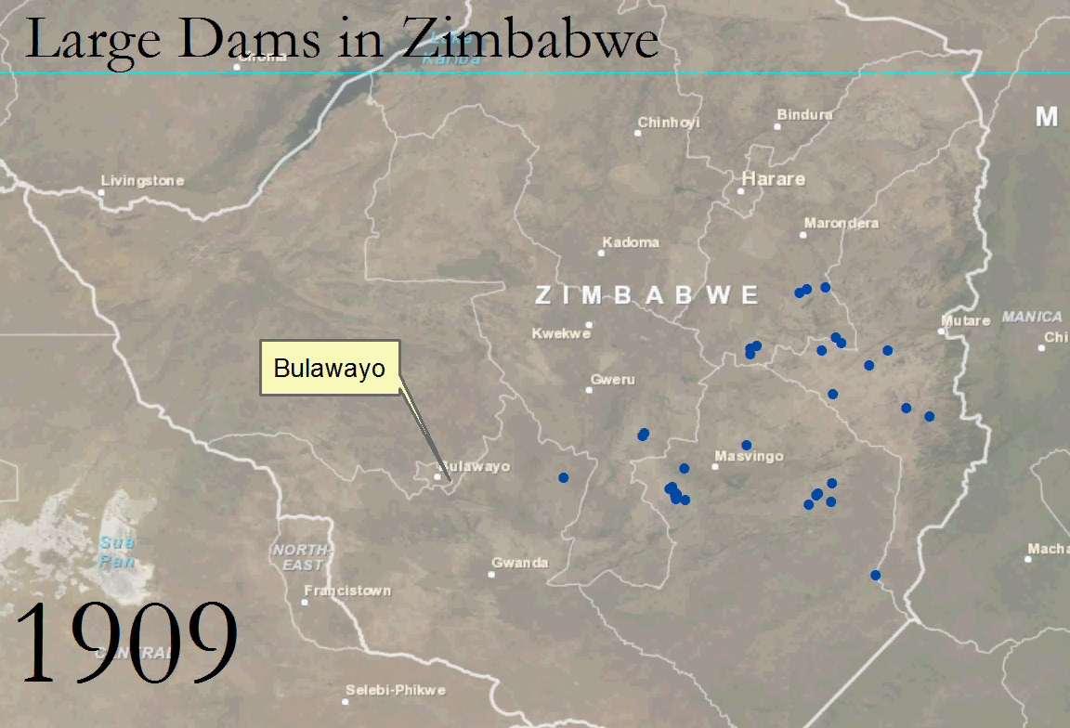
Supply – A Dam Country
Notes:
Zimbabwe -- is a country of dams. It has over 10 000 dams at the moment, quite a lot more than other countries in its region.
This has helped with its agricultural sector (traditionally the backbone of its economy – till recently), and also supply its urban centers.
[CHANGE TO VIDEO]
Here’s a quick video I made of dam building over time for Zimbabwe. Keep in mind, this excludes a lot of the smaller dams that don’t have dates readily available.

Slide 7
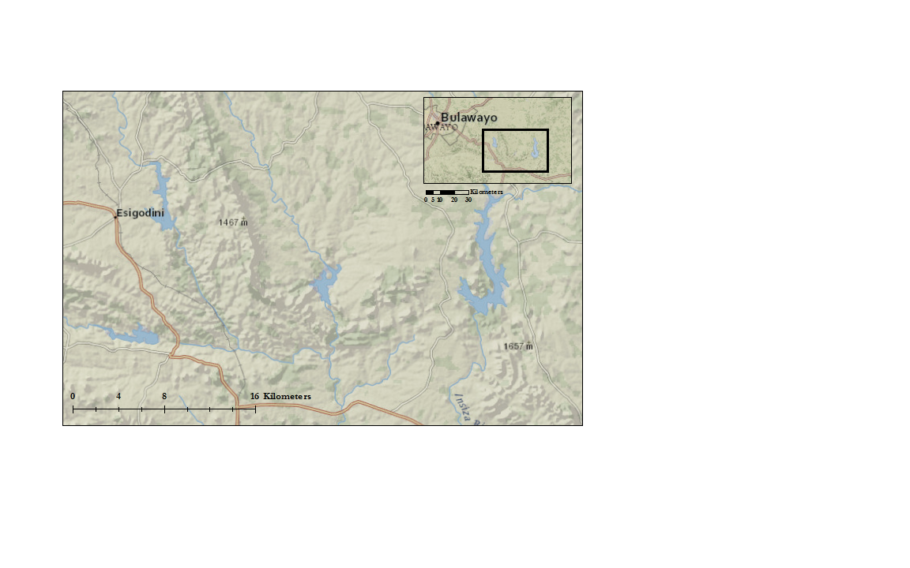
Current Supply – City Dams
Dams:
1– Umzingwane (1958)
2– Upper Ncema (1973)
3– Lower Ncema (1943)
4– Inyakuni (1965)
5– Insiza (1976/92)
2
3
4
5
1
Notes:
So here are Bulawayo’s 5 supply dams.
It’s funny, this basemap (National Geographic), doesn’t even show lower Ncema anymore.
And, it does make some sense, as 3 of the dams have been decomissioned within the last few years:
Umzingwane
Upper Ncema
Lower Ncema
And at this point the newest dam (1976), Insiza, supplies most of the city’s water.
There is an aquifer available on the other side of the city, and a few thousand wells have been dug in it, but due to lack of funding and maintenance, this doesn’t supply much water at the moment.

Slide 8
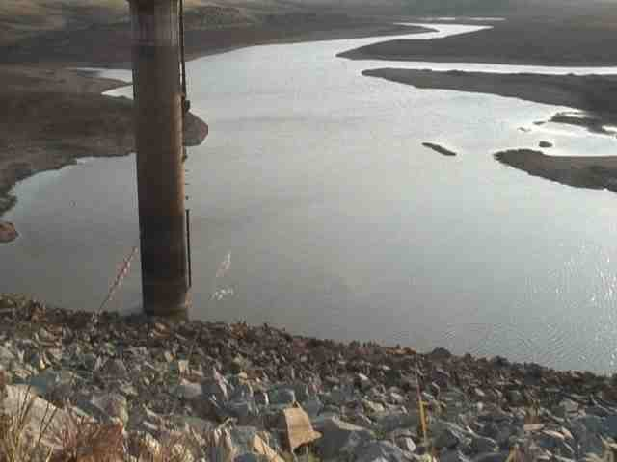
Current Supply – City Dams
Dams:
1– Umzingwane (1958)
2– Upper Ncema (1973)
3– Lower Ncema (1943)
4– Inyakuni (1965)
5– Insiza (1976/92)
Notes:
For example, here is Lower Ncema earlier this year. Not in great shape – not going to get much water from this dam anytime soon.

Slide 9
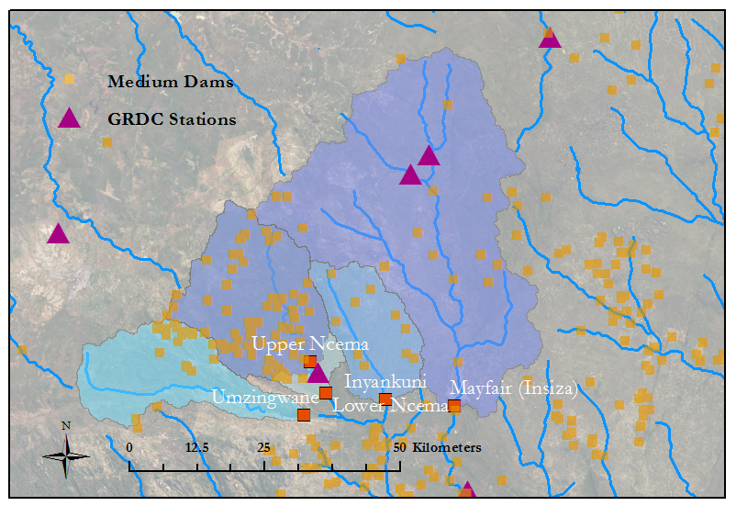
Current Supply – Watersheds
Notes:
So, this gets to the GIS part of the talk.
Using a 30m DEM, I went through the familiar steps of delineating the stream network and watersheds for each of the dams. I’m quite interested in why 3 of the dams have become useless – especially looking at what might happen with the other two (which are very low at the moment, by the way).
My next steps will be looking at:
Precipitation
Runoff
ETC
I’m particularly interested in the number of smaller dams that have been built on these three watersheds. At first look, it seems that the three watersheds feeding the decommissioned dams have more smaller dams than the others. I’m waiting on the runoff data, and then I can look more closely at this.
As we’ll see, this might have implications for building another dam.

Slide 10
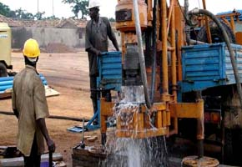
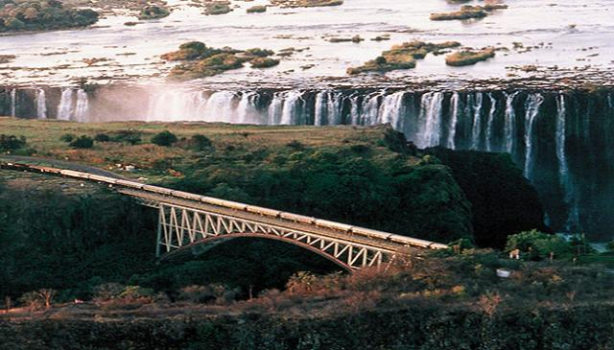
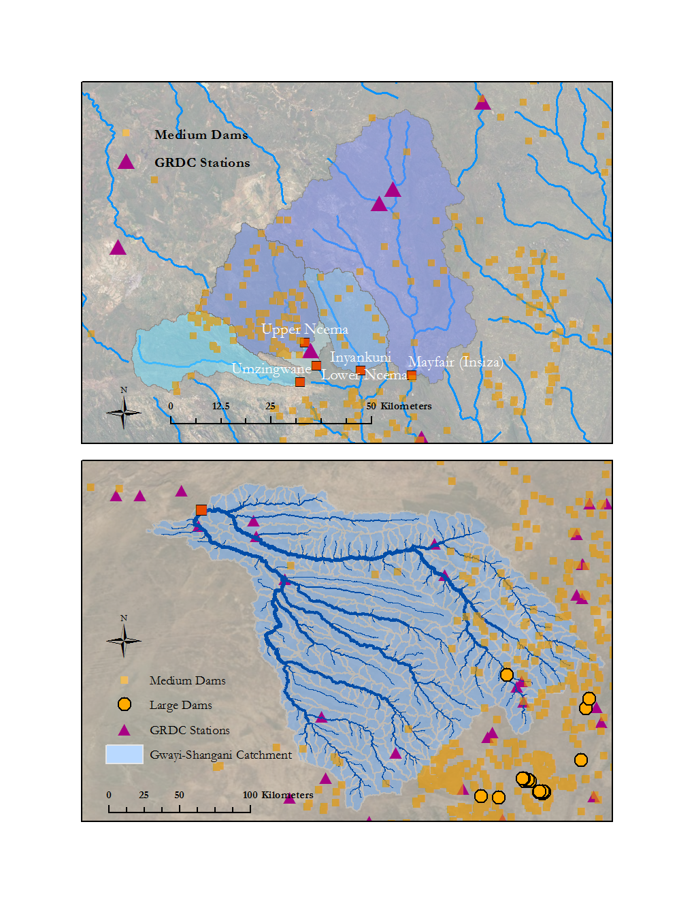
Supply Options
Notes:
So, we’re left with the fact that supply MUST be increased. Demand management won’t do enough, though it can greatly help (especially until a new source has been put in place).
That leaves three options:
Boreholes – good idea – but hard to regulate, not sure about supply, and difficult to maintain.
Bringing water in from the Zambezi by train – extremely expensive.
Build a new supply dam – right at the confluence of the Gwayi-Shangani river.
This is the option I’m looking at.

Slide 11
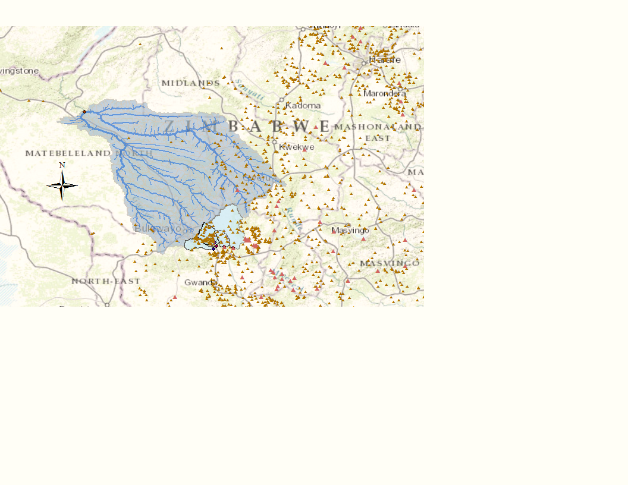
Matabeleland Zambezi Water Project
Current Plan
Dam built
Bulawayo-Dam pipeline
Zambezi-Dam pipeline (+400 km of pipe altogether)
Notes:
The Matabeleland Zambezi Water Project was first proposed 100 years ago in 1912.
The current iteration has three phases:
Dam on the Gwayi-Shangani
Pipeline from the GS dam to Bulawayo
Pipe water from the Zambezi to the GS dam
------------------------------------------------------------
Here is the fully delineated watershed corresponding to the proposed dam. I’ve also included the current dams and watersheds Bulawayo uses, and you can see the large difference in size.
Also, and I will look into this more in my project – There seems to be much more dam activity, medium and large, in the other Limpopo watershed, rather than this Gwayi-Shangani Watershed.
I imagine that this will only help to allow supply to reach Bulawayo.

Slide 12
‘100 Years of a Pipe Dream’

Slide 13
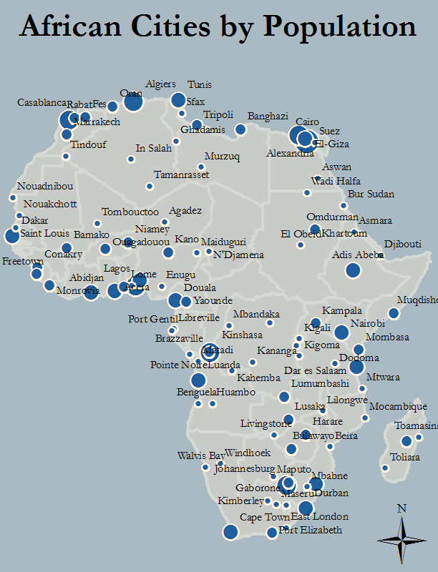
Conclusions
Bulawayo has ‘perfect storm’ of conditions.
New dams must be designed and built with the future in mind.
Even under the poorest conditions (data and otherwise), GIS can be a great help.
Urban areas are crucial
Notes:
Africa is urbanizing, and quickly, so engineers and policymakers will need to adapt to that. Supplying water to Africa in the future will mean less boreholes and more large-scale systems. Some people have even go so far as to say that there is a ‘rural bias’ in development projects – where urban systems are left out because they are seen to be not as much ‘in need.’

