Slide 1
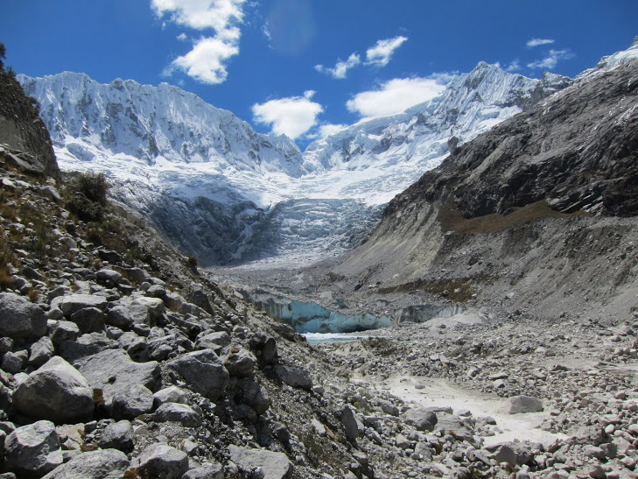
Rio Santa Geodatabase Project
Presented by
Amanda Cuellar

Slide 2
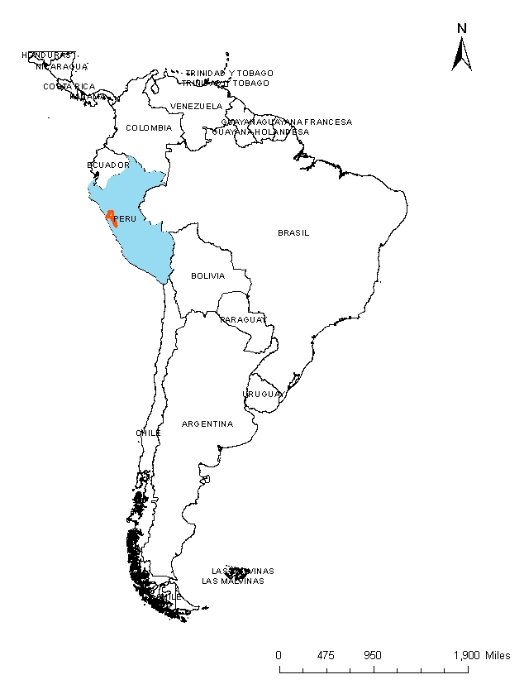
Where is the Rio Santa Basin?
Rio Santa Basin

Slide 3
Project Background
Expanding high altitude glacial lakes pose risks to downstream communities
Various organizations are collaborating to study the lakes in the Rio Santa basin
Each organization records, processes, and keeps their own data
Researchers are in Peru, Texas, Massachusetts

Slide 4
Project Objective
Create a GIS map database for the data gathered by the McKinney group and collaborators for the Rio Santa Basin
  Easy to share and view remotely
  Data available for download
  Researchers can upload their own data to share

Slide 5
First task: Gather data
Collect data held by the McKinney group from current and prior members
Collect data from collaborators at The Mountain Institute in Peru
Collect data from Peruvian government
Collect data from the community of practice

Slide 6
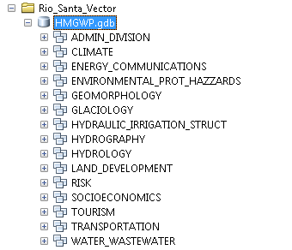
Second task: Design organization structure
-Logical, easy to understand structure to organize data

Slide 7
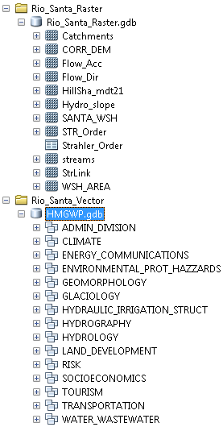
Third task: Integrate data into one geodatabase
Complicated by inclusion of raster data sets
Combined various data into two geodatabases– Raster and vector
All datasets in WGS_1984 coordinate system

Slide 8
Fourth task: Create new layers
Present tabular social data as vectors
  Unfortunately social data did not have sufficient geographic information or resolution to create a meaningful map
Use remote sensing data to fill in any missing information
  Downloaded Landsat images for the Rio Santa Basin
  Calculated NDVI and working on classifying ground cover

Slide 9
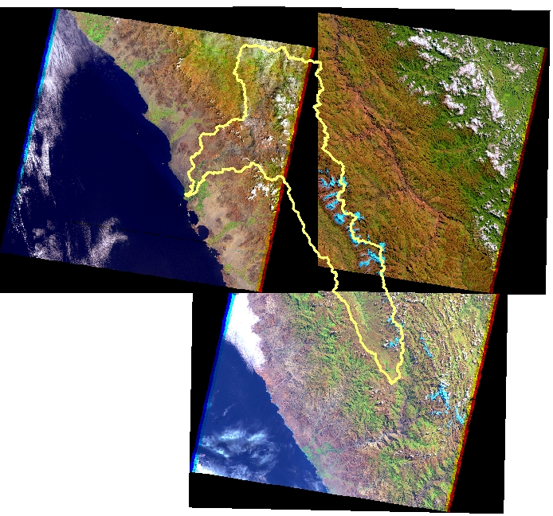
Landsat data

Slide 10
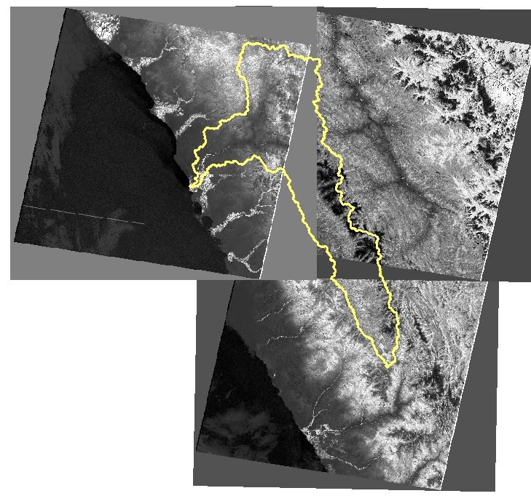
NDVI Calculation

Slide 11
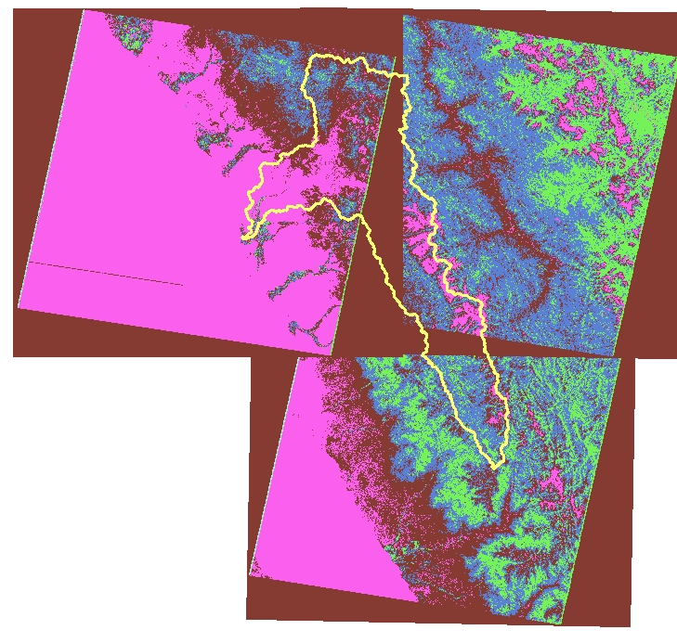
NDVI classification using natural jumps

Slide 12
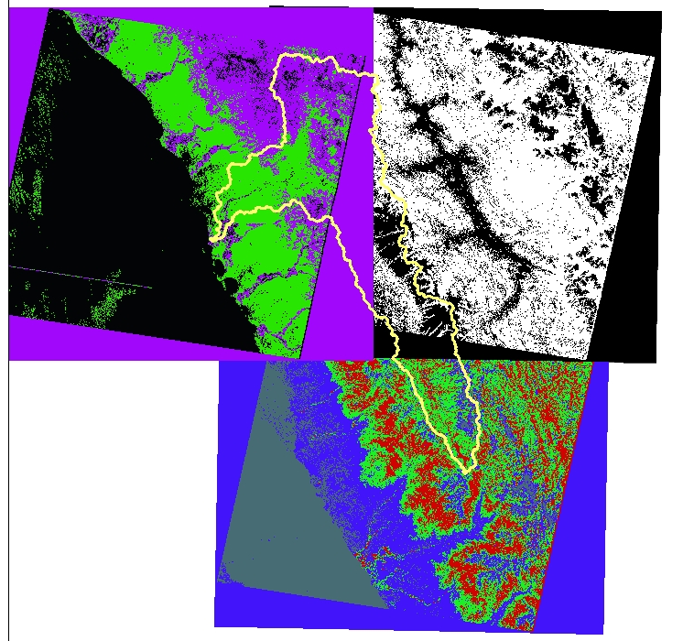
NDVI unsupervised classification
-What do the classifications mean?
-ArcGIS tool gives 2-4 classifications

Slide 13
Fifth task: Share geodatabase
Task is complicated because many researchers have slow internet or don’t have ArcGIS
Working with other group members to find a low bandwidth sharing platform

Slide 14
Future Work
Experiment with literature NDVI classifications for different land cover
Compare classification results to known land cover
Trip to Peru in January to work directly with TMI and government researchers

Slide 15
Acknowledgements
Daene McKinney, Denny Rivas, David Rounce
Kate Voss, Jorge Recharte, Oscar Roman
Dr. Maidment

