Slide 1
GIS in Water Resources
Fall 2012
Term Project Proposal
Delineation of Subglacial Water Catchments of Antarctica
Brad Gooch, PhD student
Graduate Research Assistant
Institute for Geophysics
John A. and Katherine G. Jackson School of Geosciences
The University of Texas at Austin

Slide 3
BEDMAP 1 data (c. 2000 release)
BEDMAP 2 data (Oct. 2012 release)
http://www.antarctica.ac.uk/bas_research/our_research/az/bedmap2/

Slide 4
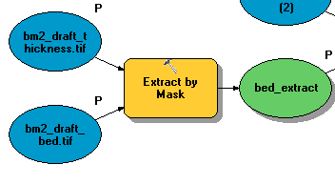

Slide 5
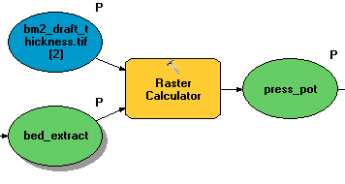
P = rho_w*g*bed_elev + rho_i*g*(thickness)

Slide 6
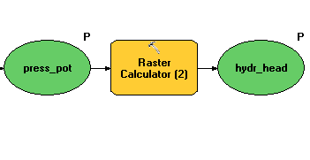
Hydr. Head = P / (rho_w*g)

Slide 7
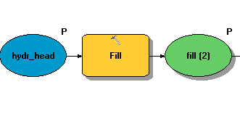

Slide 8
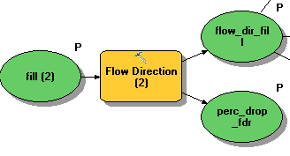
32
64
128
16
1
8
4
2

Slide 9
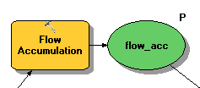

Slide 10

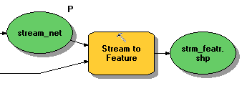

Slide 11
<- Strahler
Shrieve ->

Slide 12
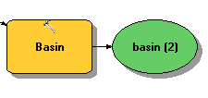

Slide 13
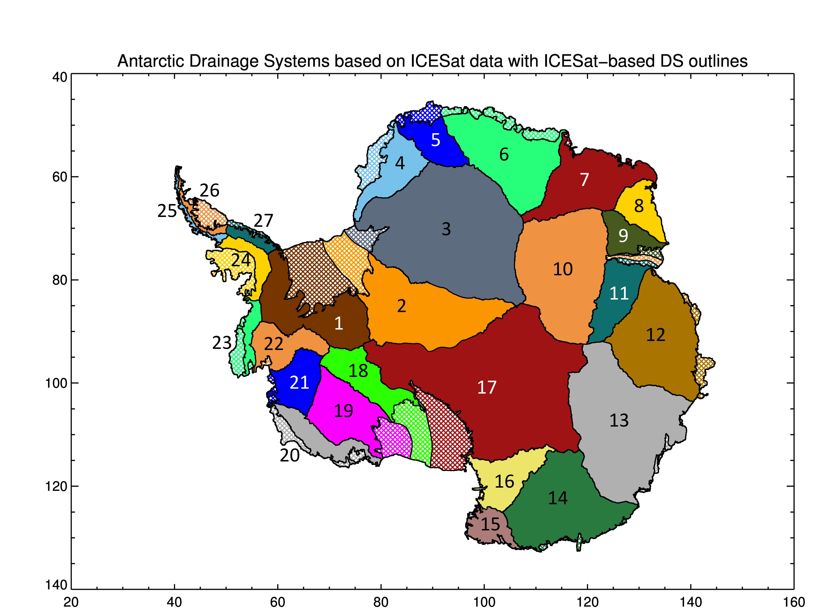
Comparison to ice catchments
http://icesat4.gsfc.nasa.gov/cryo_data/ant_grn_drainage_systems.php

