Slide 1

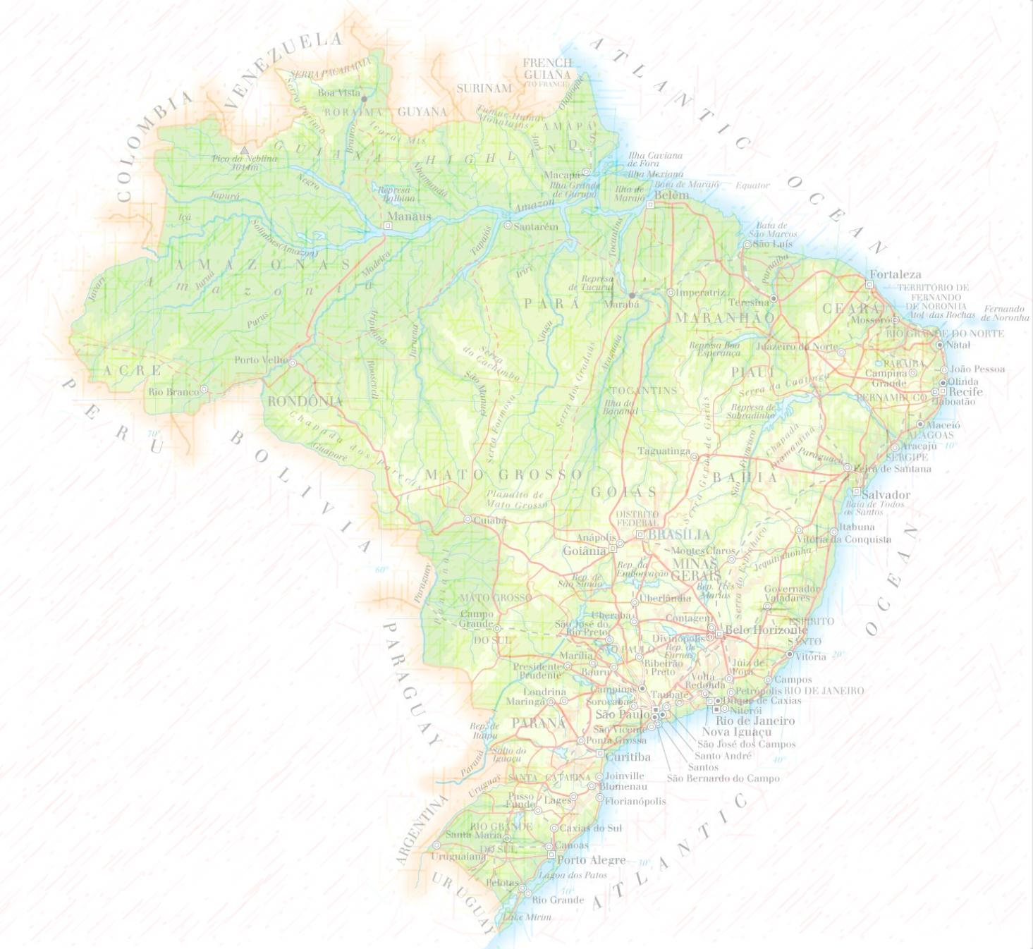
Iguaçu River: drought season and the impact in the hydroelectric power in Brazil
Amanda Reichert - M.Sc. - EWRE

Slide 2
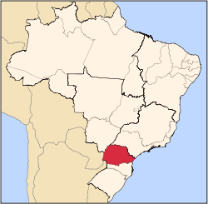
Project objective
Correlate the droughts in Iguaçu River with the supply of energy from hydroelectric power plants using the ArcGIS tools
Location
Iguaçu River - Paraná State - Brazil

Slide 3
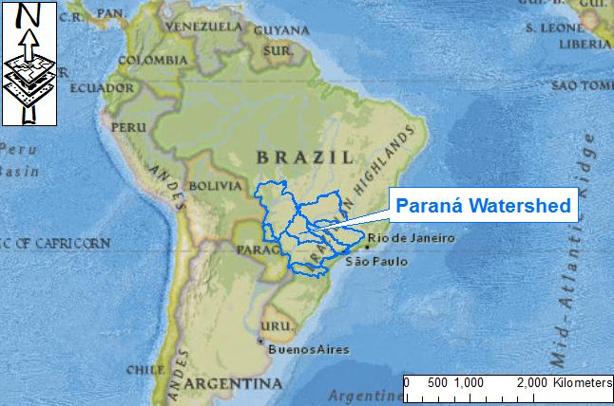
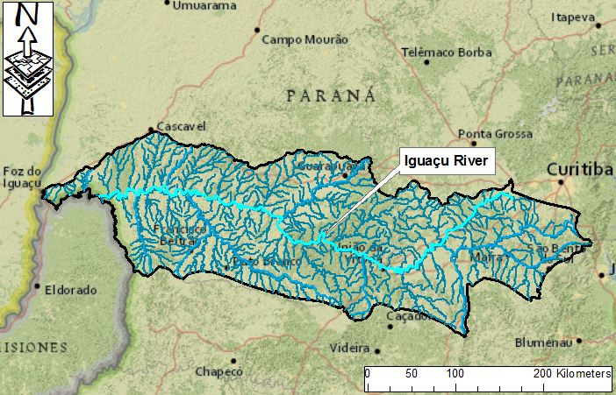
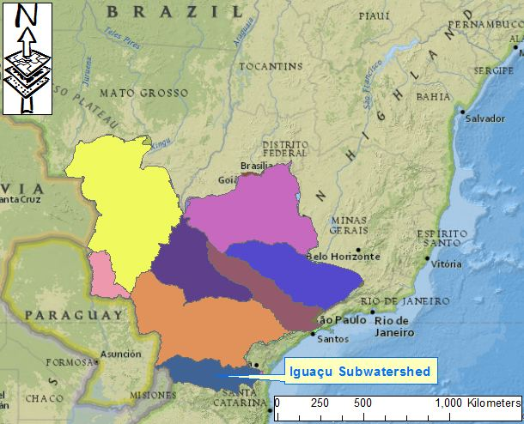
Hydrology description
Iguaçu River has an average flow rate of 1,746 m³/s
1,320 kilometres (820 mi) long
5 Hydroelectric power plants
Iguaçu Falls

Slide 4
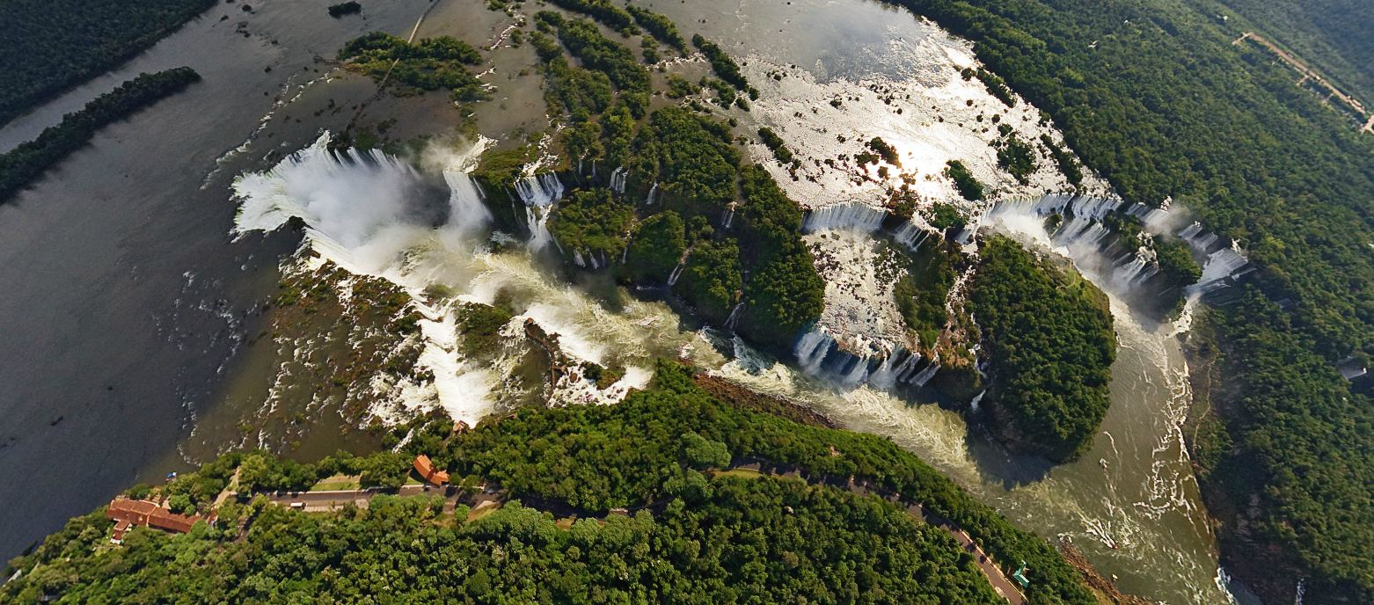
The Iguaçu Falls has the second-greatest average annual flow, after Niagara Falls, with an average rate of 1,746 m³/s (Niagara Falls: 2,400 m³/s)
Maximum recorded flow 12,800 m³/s (Niagara Falls: 8,300 m³/s)

Slide 5
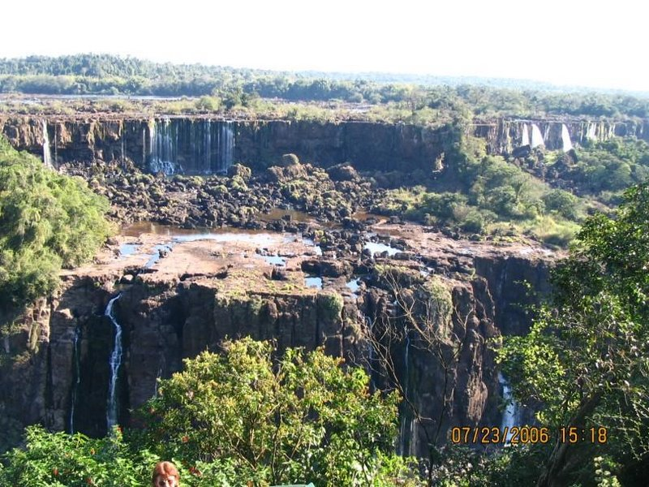
Why I chose this topic?

Slide 6
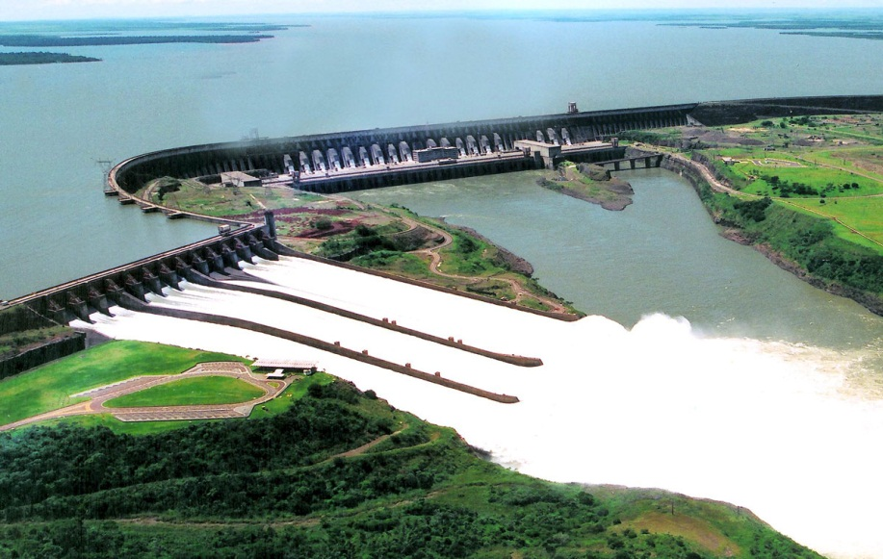
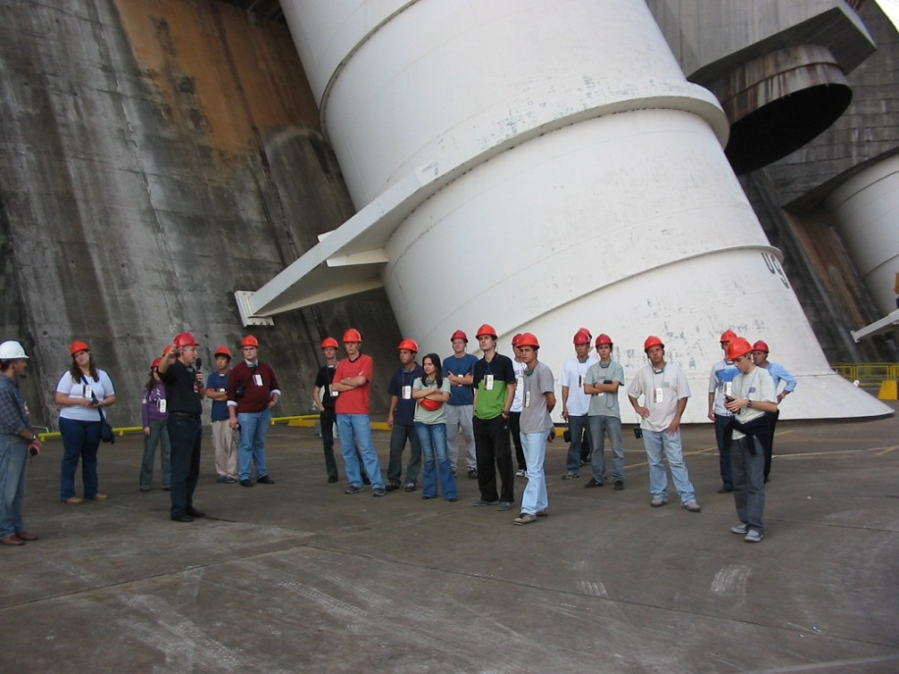
Importance of Hydroelectric Power in Brazil
Hydroelectric power plants produce over 90% of the electrical energy consumed in Brazil
Itaipu Dam corresponds to 25% (14,000 MW)
Iguaçu River: 5 Hydroelectric Power Plants – distribute its energy to Paraná State and the remaining (almost 40%) to other regions in Brazil

Slide 7
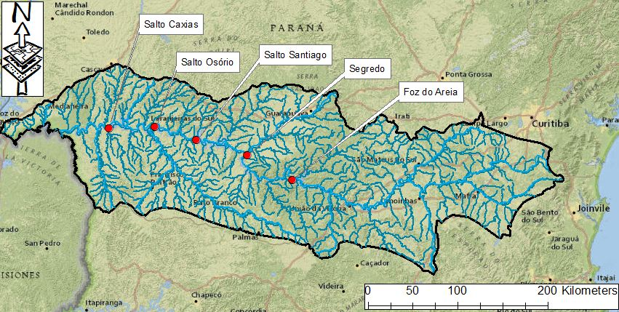
Power from the Iguaçu River
Foz do Areia (1,676 MW)
Salto Osório (1,078 MW)
Segredo (1,260 MW)
Salto Santiago (1,420 MW)
Salto Caxias (1,240 MW)

Slide 8
Monthly Average Flow Rate (time series tables)

Slide 9
Precipitation data analysis (1990_2010)

Slide 10
Precipitation data analysis (1990_2010)

Slide 11
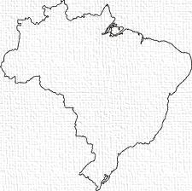
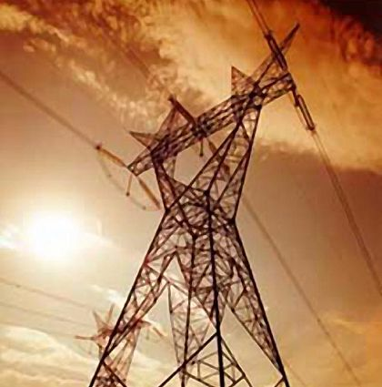
What happened in 2006?
The energy supply in Brazil is interconnected and controlled by the National Interconnected System (SIN) - system allows different regions to exchange power among them
During the drought season of 2006, the Paraná State had their energy supplied by other regions

Slide 12
Conclusion
ArcGIS can be very useful to SIN system to demonstrate graphically and predict the impact of a drought year
Questions?

