Slide 1
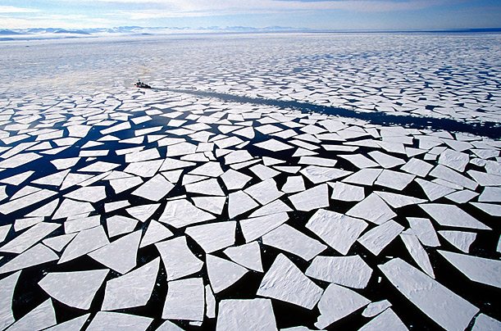
Chemical Parameters of Arctic
Coastal Lagoons
Stephanie Smith
GISWR Fall 2012
Marine Science Department
Notes:
Hi Everyone, my name is Stephanie Smith and I will be presenting my project about the chemical parameters of Arctic coastal lagoons.
This is the first GIS class that I have taken, and I have to say…there is a steep learning curve for GIS, but it is a very useful tool for explaining data spatially and temporally, especially for chemical oceanography research.

Slide 2
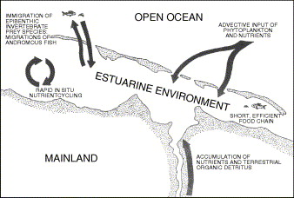
Scope of Project
Coastal estuaries
  highly productive
  dependent on freshwater inflow to maintain gradients in environmental characteristics and delivery of nutrients and carbon that fuel production
How do river inputs and sea-ice cover interact to shape microbial and metazoan communities in coastal waters of the Beaufort Sea?
  Seasonally & Spatially

Slide 3
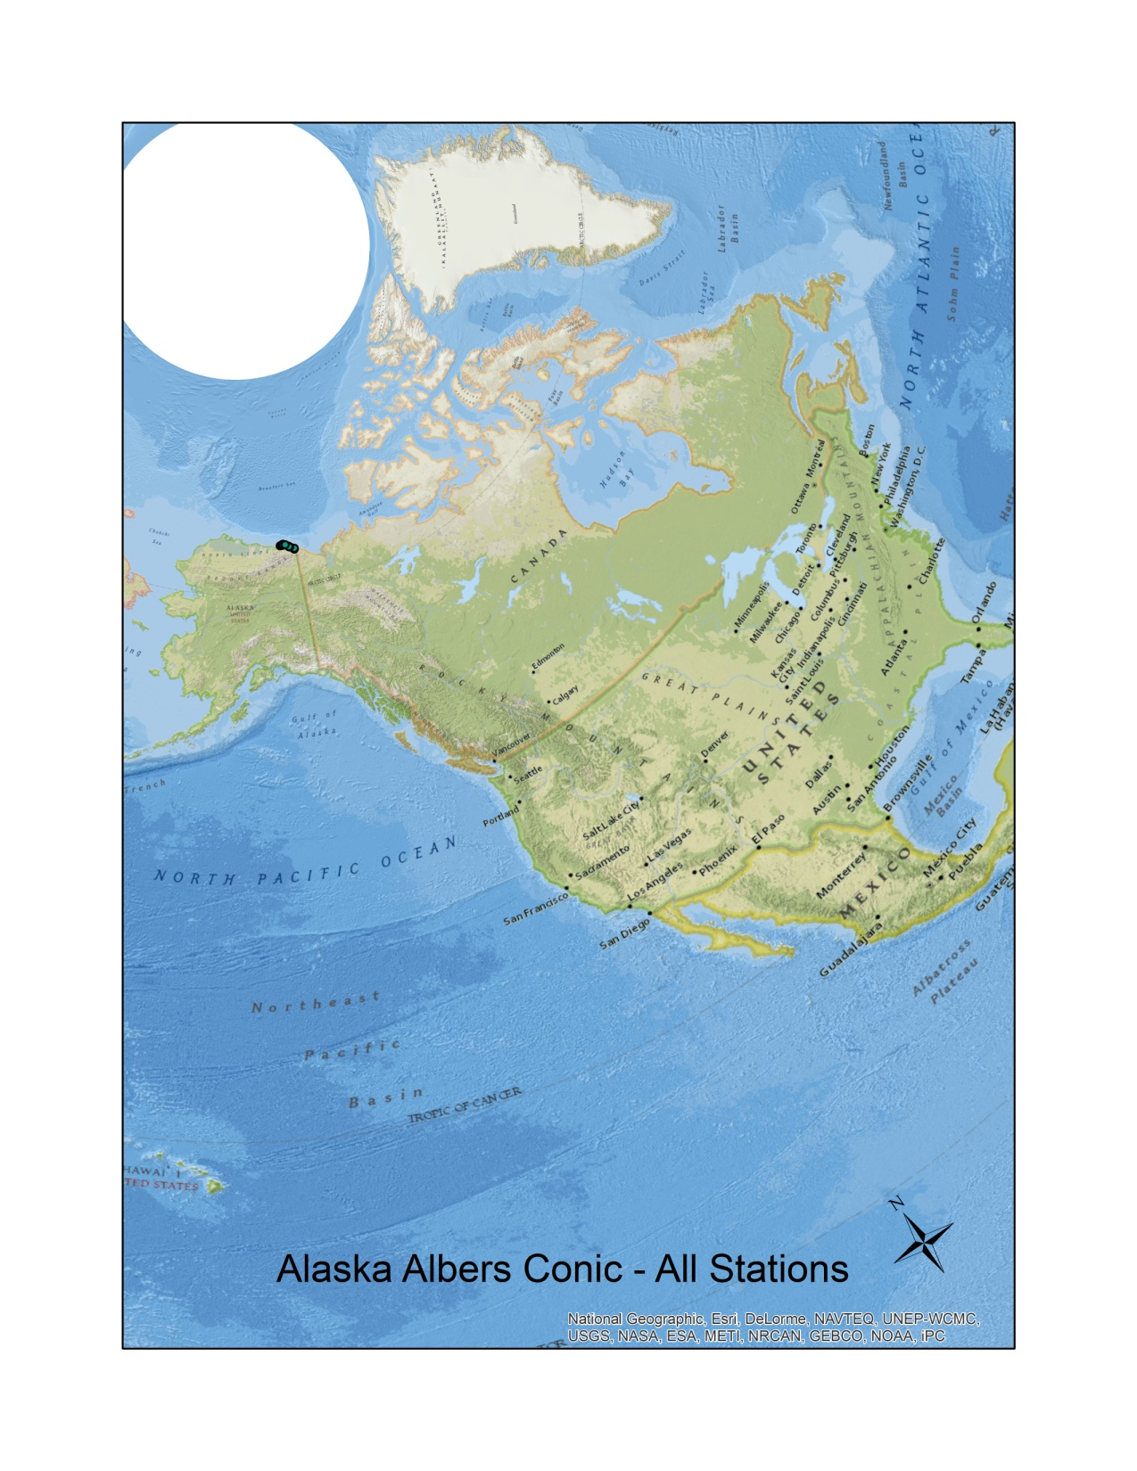
Background
North Slope field study
  Kaktovik, AK
30 nm radius of Barter Island
12 study sites
  Various amounts of freshwater runoff from small rivers

Slide 4
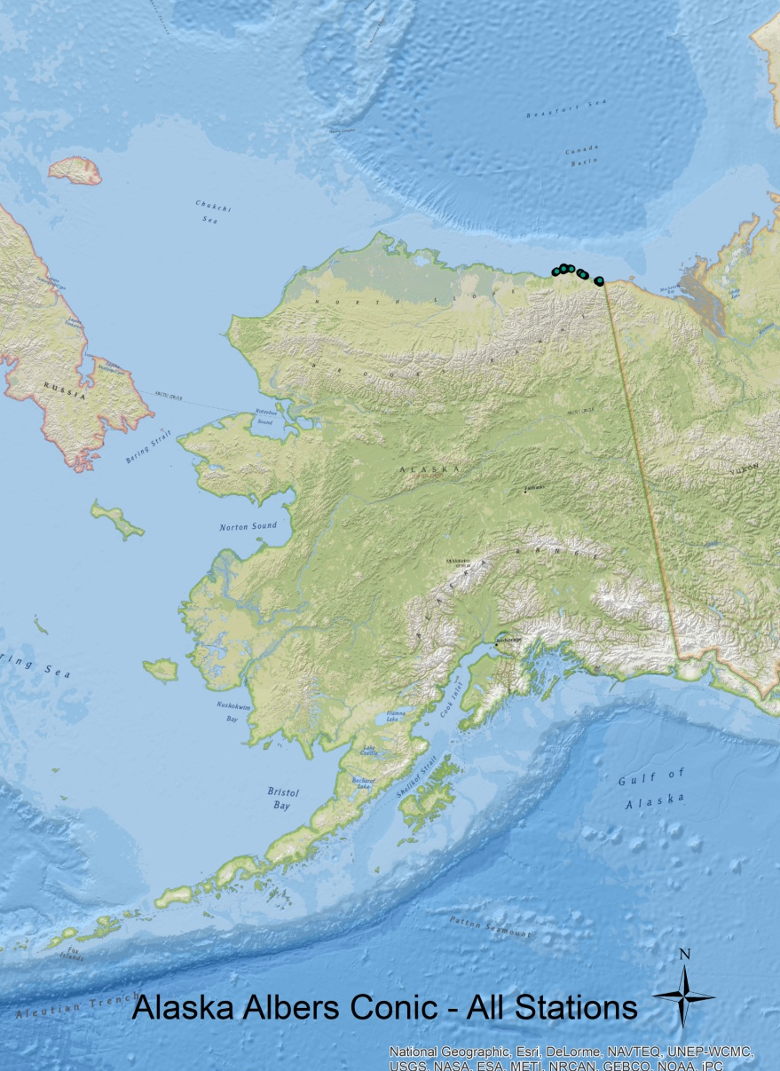
Water Samples from 2 and 3 meters
Chemical parameters
  Salinity
  Dissolved Oxygen (DO mg/L)
  Optics (absorbance)
    a250
    SUVA
    a250:365
Sampling Seasons
  April 2012
  June 2012
  August 2011/12

Slide 5
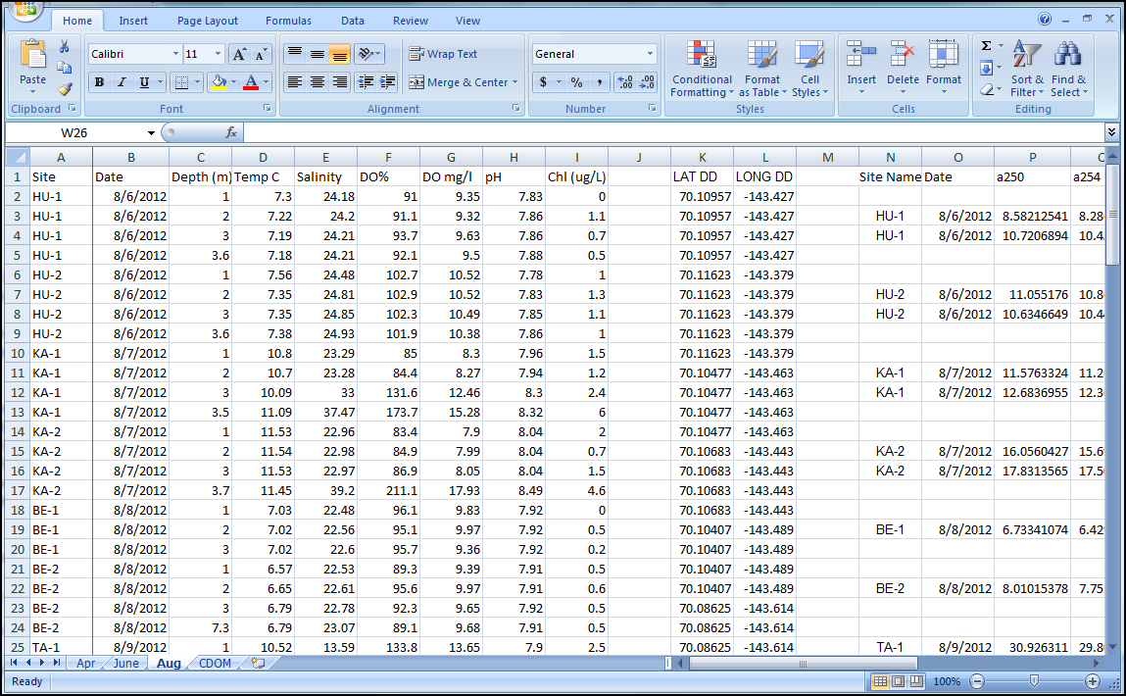
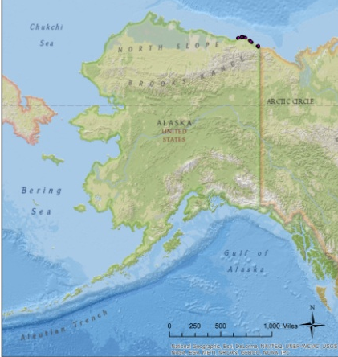
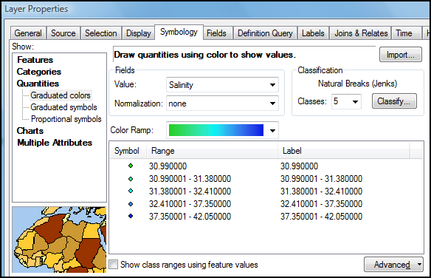
Steps to Map Creation
Compile Excel data → .csv
Add Basemap – Nat Geo
  WGS_1984_WebMercator_Auxillary_Sphere
Add .csv → Display X,Y
  GCS_NAD 1983
Export to Shapefile
Symbology – Graduated colors
(Interpolation would misrepresent the data)

Slide 6
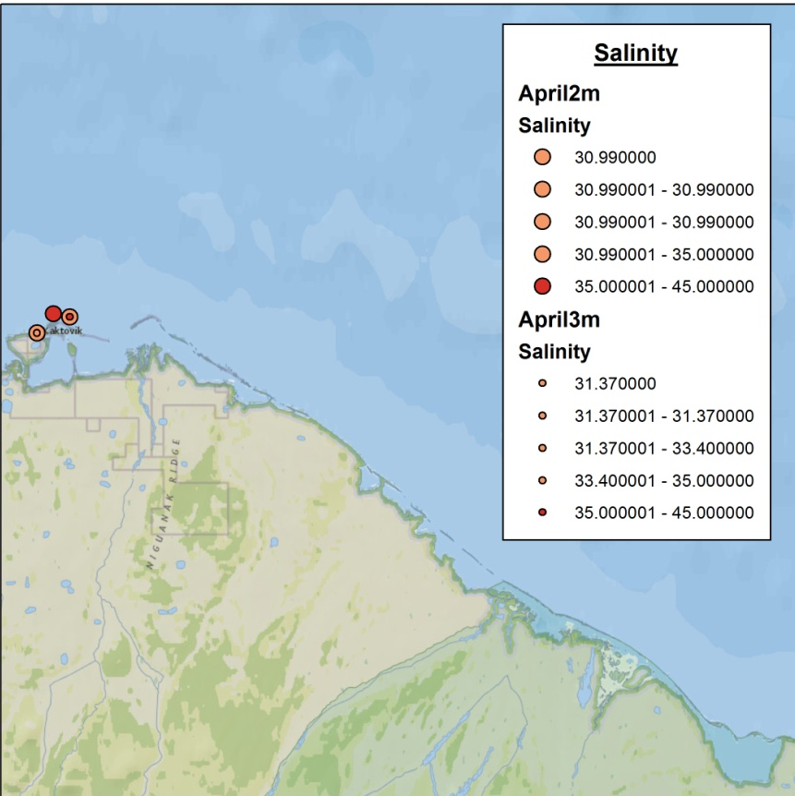
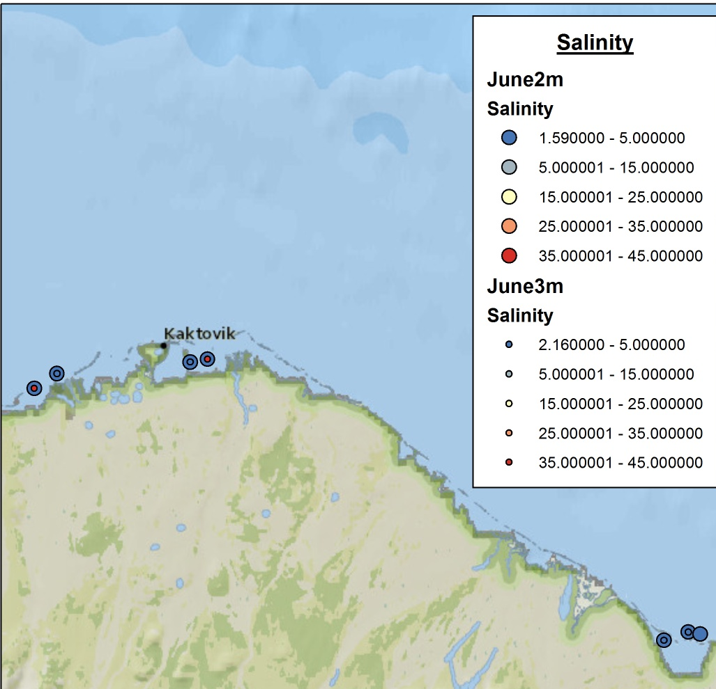
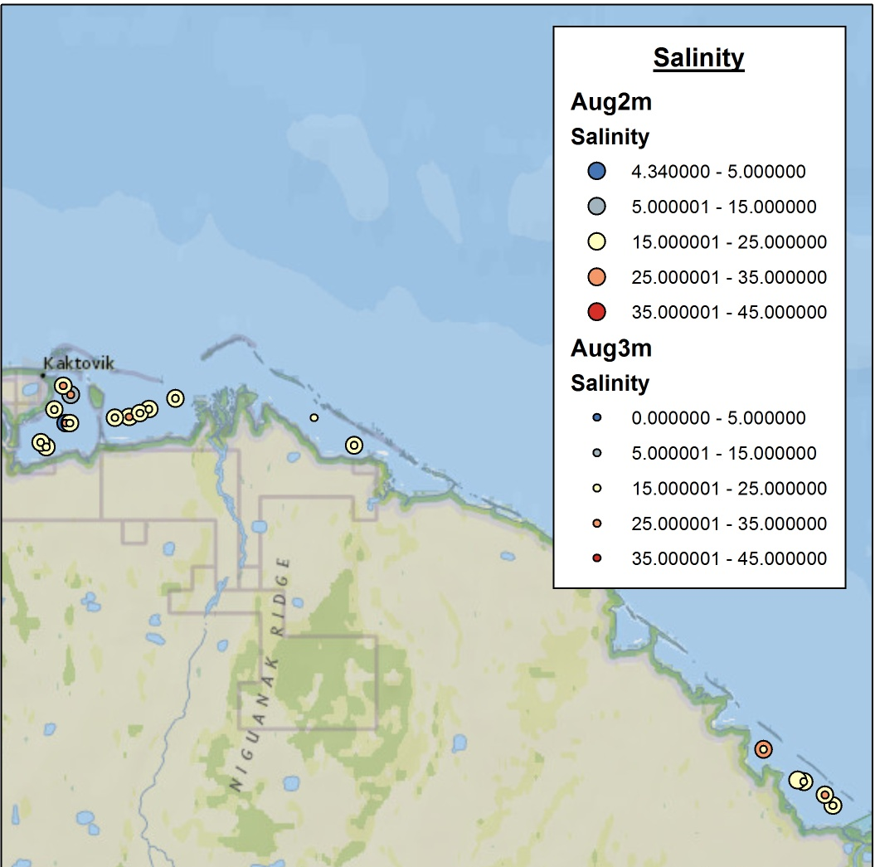
Salinity
2m
3m
April
Normal to High Salinity in April
Fresh water at 2m in June, and some hypersaline at 3m
Brackish to Normal conditions in August

Slide 7
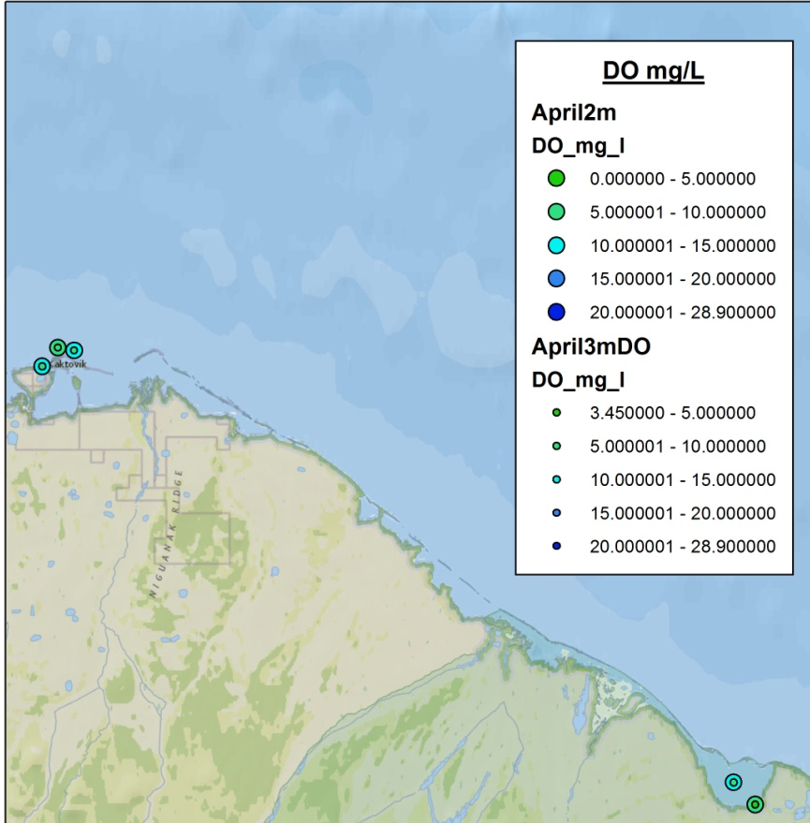
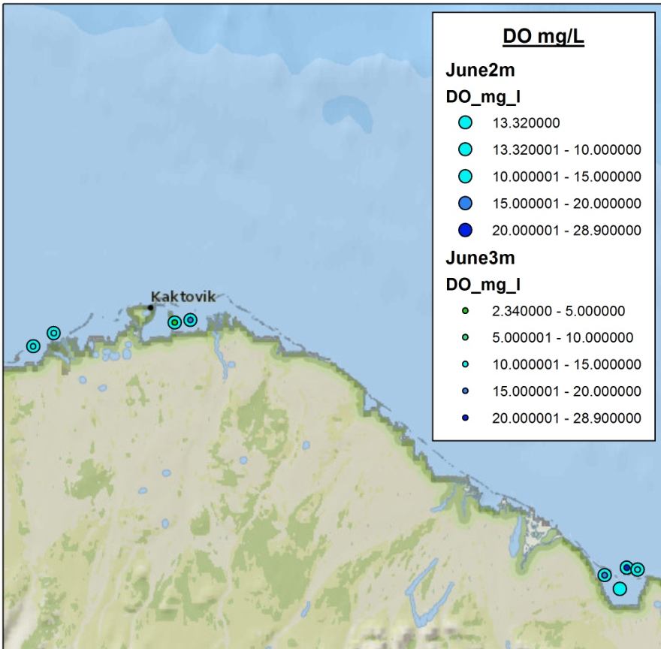
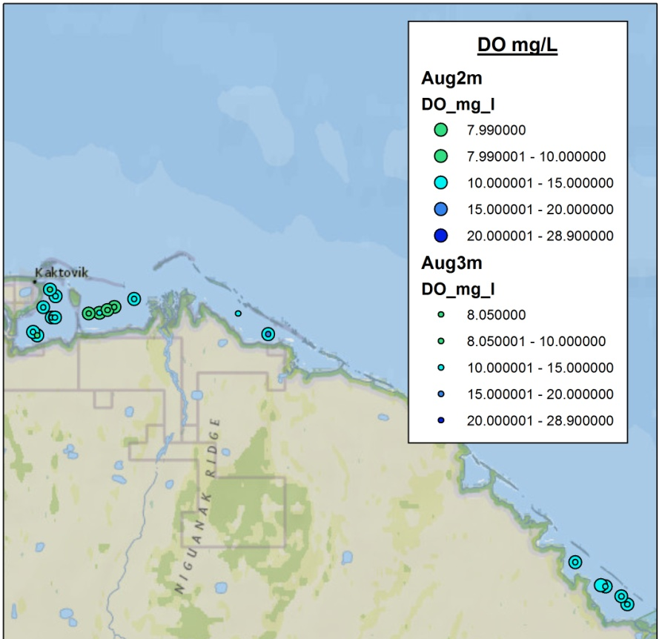
Dissolved Oxygen (mg/L)
DO relatively the same throughout seasons (5-15mg/L)
DO highest in June at 3m (28.9mg/L)

Slide 8
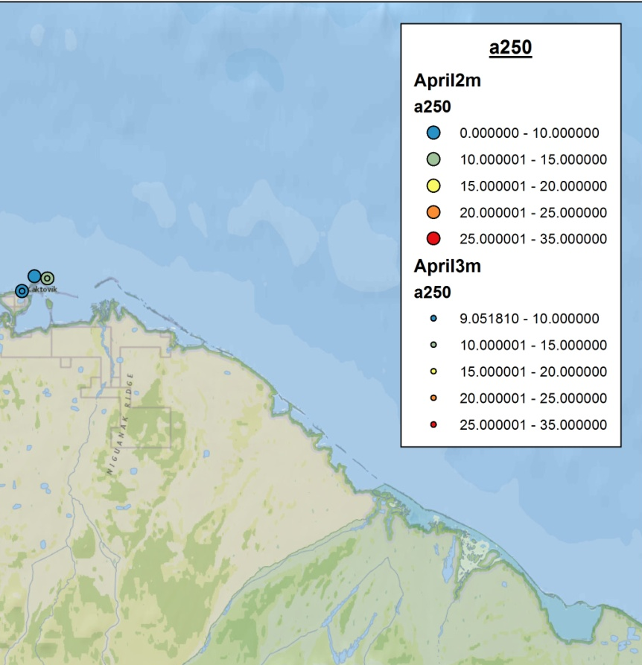
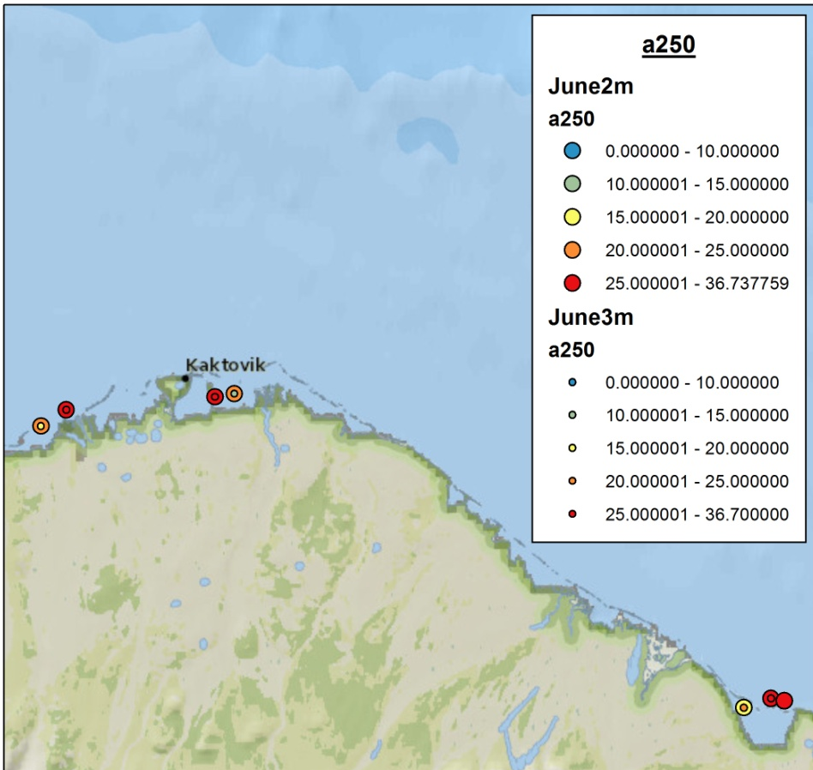
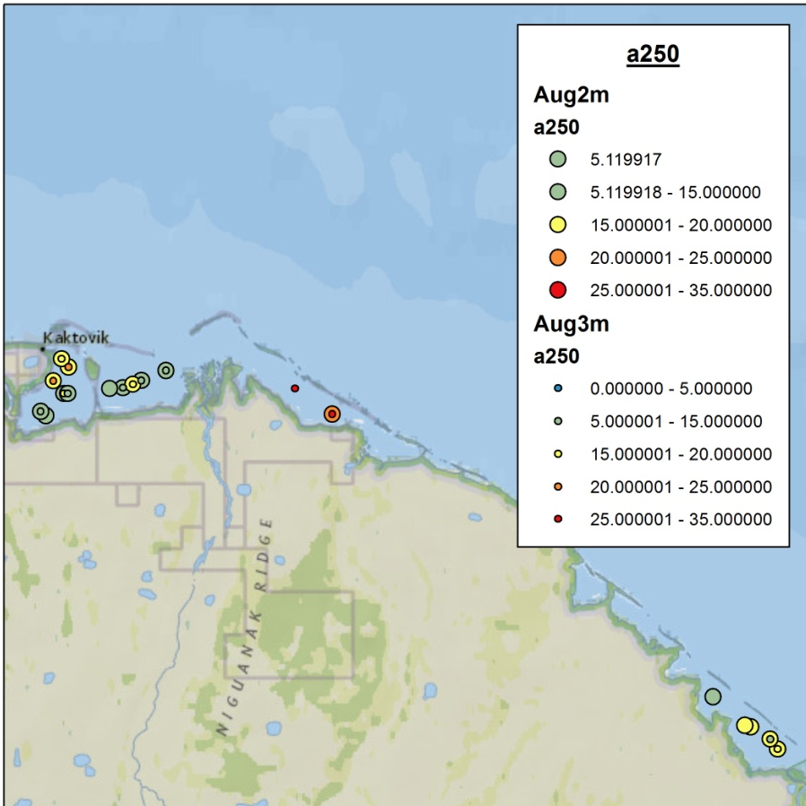
a250 – correlated with DOC
Higher a250 = higher [DOC]
Lowest in April, less DOC
Highest in June, more DOC
Moderate in August

Slide 9
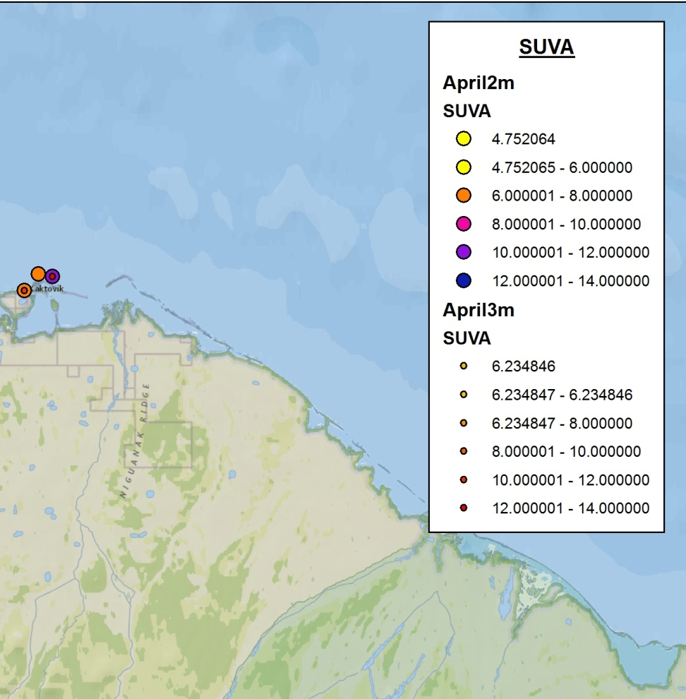
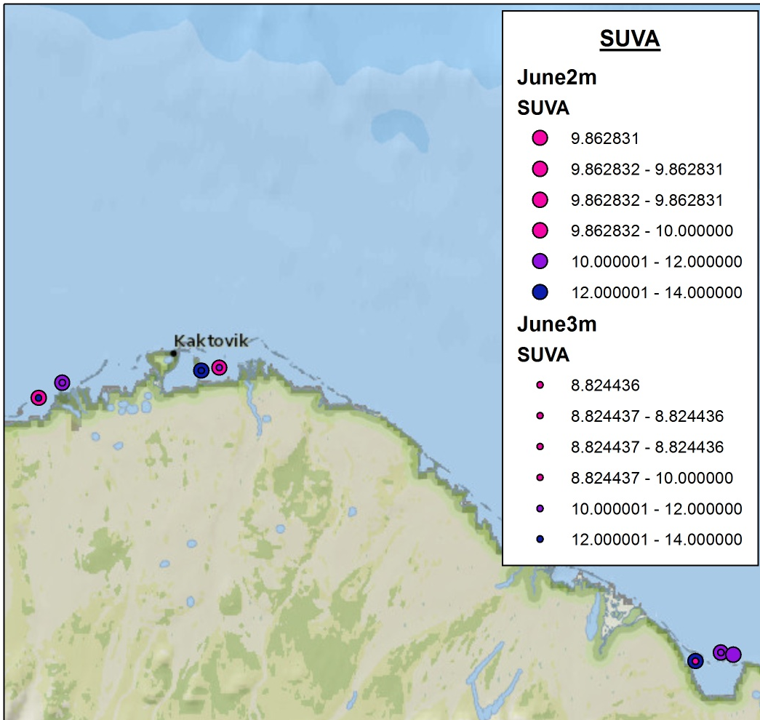
SUVA – Specific UV absorbance
(a254 normalized to DOC)
High SUVA indicates that a large portion of the organics present in the water are aromatic
Lowest in April
Highest in June, more aromatics
(No DOC data for August yet)

Slide 10
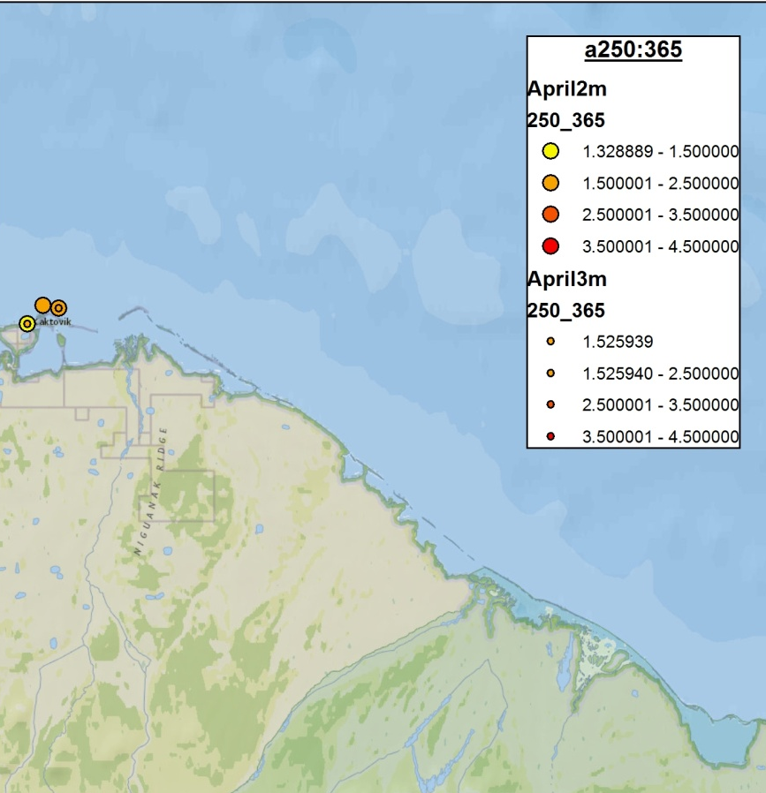
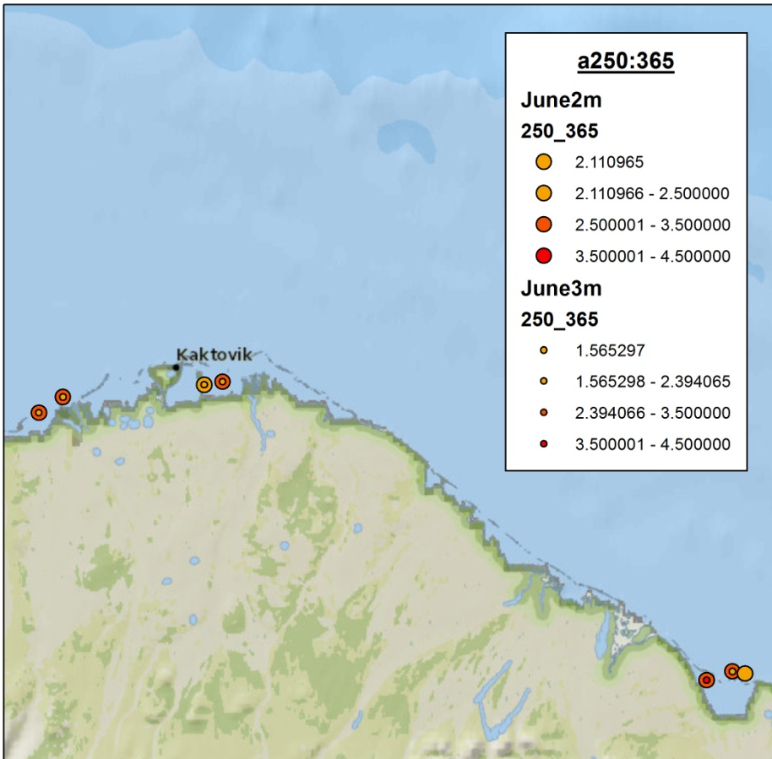
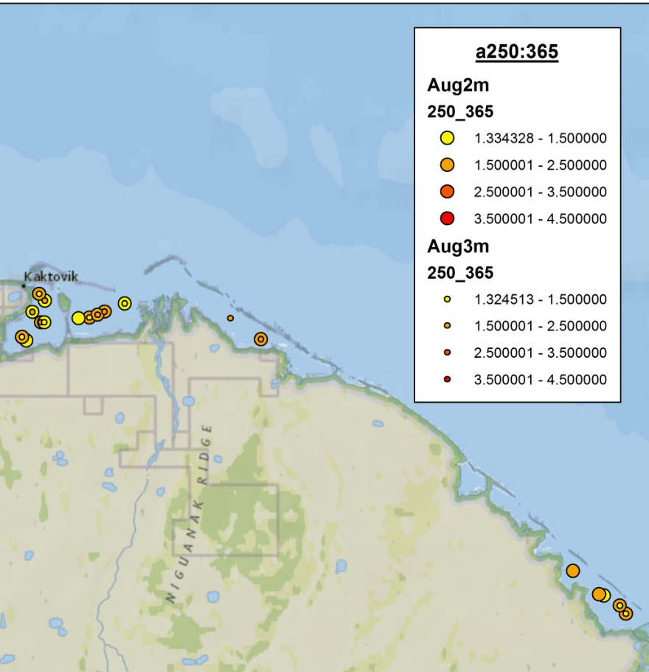
a250:365
Lower a250:365 = higher molecular weight
Due to stronger light absorption by
high-molecular-weight (HMW) CDOM at longer wavelengths
Relatively moderate levels in April and August
Higher levels in June, larger molecular weight

Slide 11
Summary
Salinity – highest in April, and in 3m June waters. June at 2m had the most fresh water
DO – moderate levels throughout seasons, but highest in June
a250, SUVA, a250:365 – Highest levels in June, more organic matter with high molecular weight and aromaticity

Slide 12

Conclusion
Sea-ice in April causes the waters below to be very salty, and have a lower amount of DOC
In June, ice melts and river water flows into the estuary bringing fresh water, nutrients, and organic matter → productivity
  “Spring Freshet”
In August, nutrients are used up and begin to revert back to depleated conditions

