Slide 1
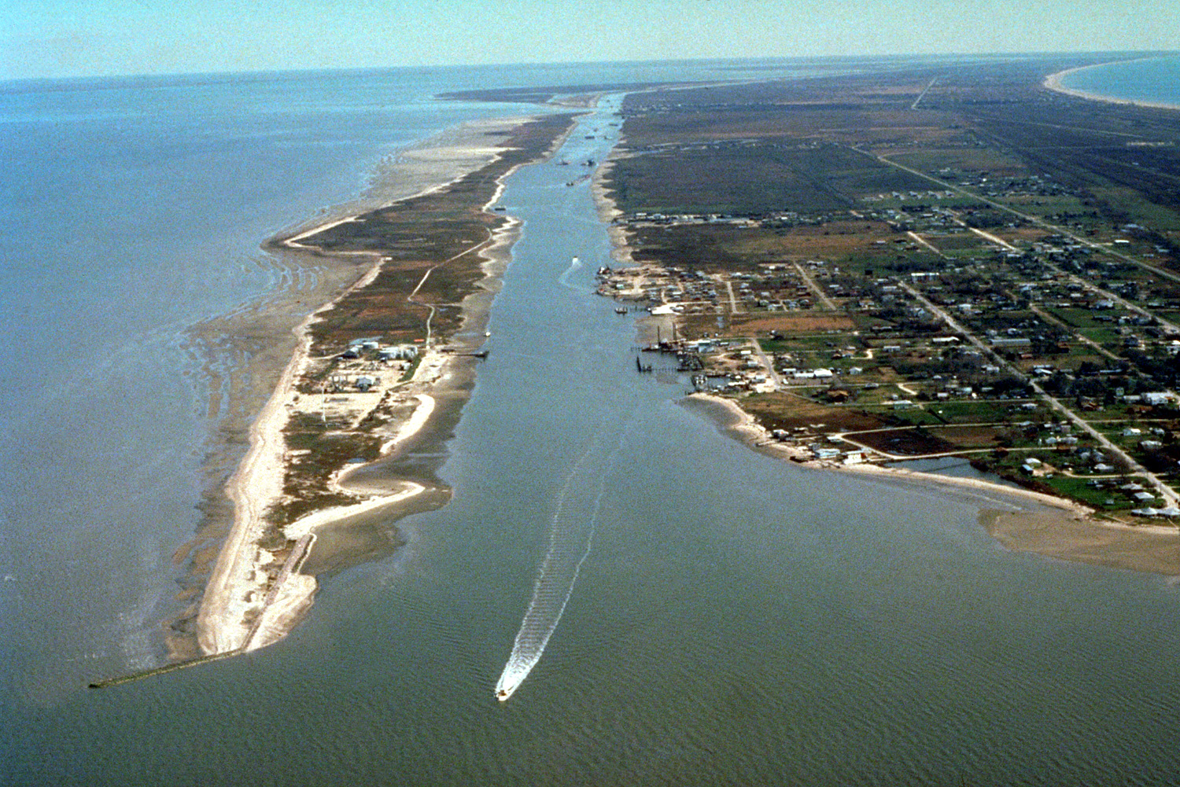
GALVESTON BAY
The Effects of Freshwater Inflow on Water Temperature
David Christiansen
University of Texas at Austin
Notes:
Hi, my name is Dave and I’m going to be talking about the effects of freshwater inflow on water temperature in Galveston Bay

Slide 2
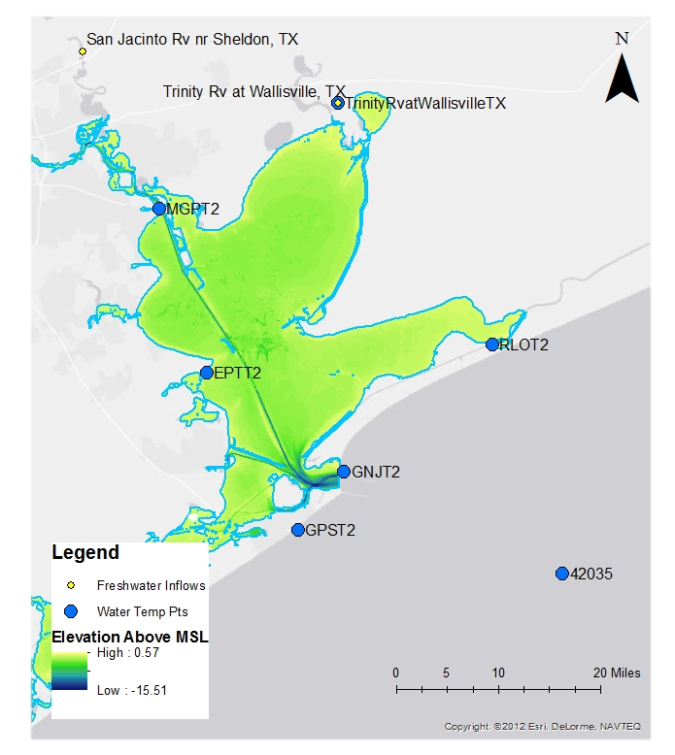
Galveston Bay
Location:
  Southeastern Texas
  20 miles southeast of Houston
Freshwater Inflows
  San Jacinto River
  Trinity River
Why Galveston Bay?
  GoMRI Research
Notes:
First, where is Galveston Bay? Today is Texas day, so obviously it’s somewhere in Texas.
But more specifically it’s in southeastern TX about 20 miles southeast of Houston.
Galveston bay has 2 main freshwater inflows, which are the San Jacinto River (here) flowing in from the Northwest and the Trinity River (here) flowing in from the north.
So, why did I choose Galveston Bay? The project I’m working on for my master’s is funded by the Gulf of Mexico Research Initiative (or GoMRI), and focuses on learning more about how an oil spill (GoMRI is partially funded by BP) would propagate in several bays along the Gulf Coast.
The first bay we are looking at is Galveston, so I thought it would be beneficial to learn as much as I can about the area.

Slide 3
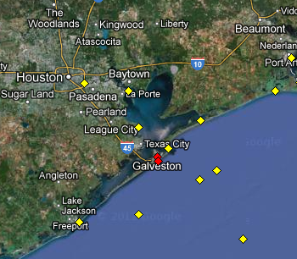
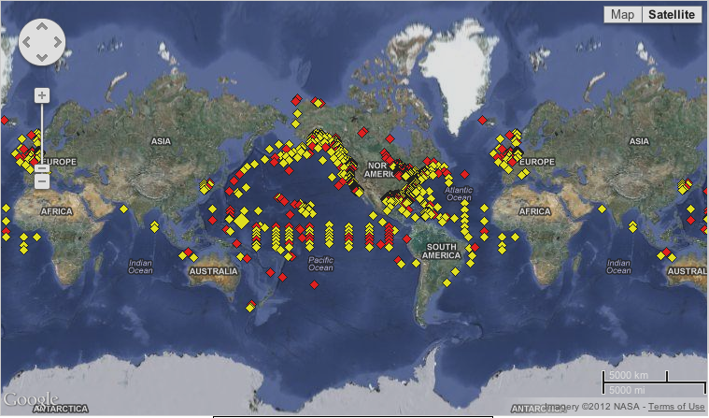
Available Data
NOAA NDBC
  Water Temperature
http://www.ndbc.noaa.gov
Notes:
So first, to be able look at what is happening in the bay, I needed data points in the bay itself.
Looking on NOAA’s website, I found the National Data Buoy Center, which collects data from buoys deployed all over the world (which are shown here).
Zooming in to Galveston Bay, you can see that there are 6 or 7 buoys that might be helpful for me. So looking through the data available at these locations, it seems the only information dealing with the water in Galveston Bay is water temperature. The rest is just meteorological data like wind speed and air temperature.

Slide 4
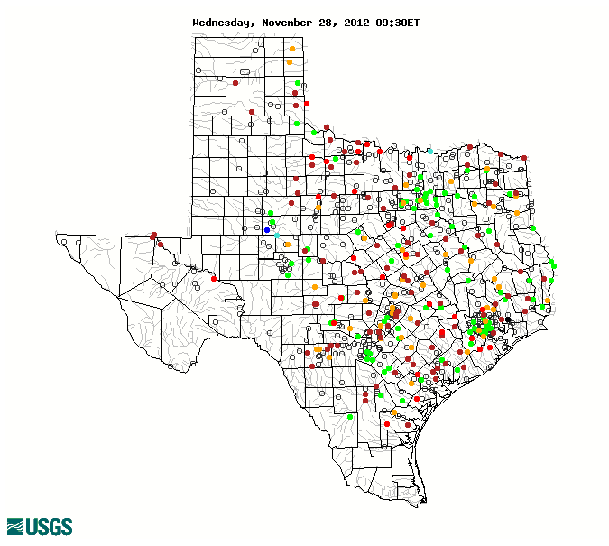
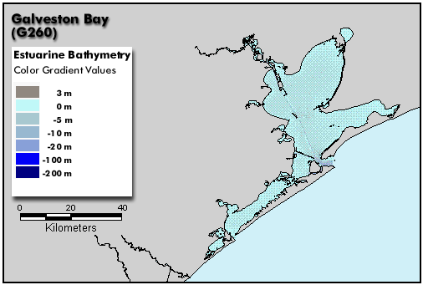
Available Data Cont’d
USGS WaterWatch
  Stream flow
    Height Above Gauge
NOAA Estuarine Bathymetry
  Shape file and DEM
http://waterwatch.usgs.gov
http://estuarinebathymetry.noaa.gov
Notes:
So now that I knew what data was available in the bay, I focused on the main freshwater sources of the bay.
Using USGS’s WaterWatch, I was able to find stream flow data for both the San Jacinto and the Trinity Rivers, and water temperature data for the Trinity River.
Later in the project, it became obvious that I needed some shape file of Galveston Bay (I’ll talk about why this was necessary later). I found a shape file as well as a 30 meter DEM of Galveston Bay on NOAA’s Estuarine Bathymetry webpage. The data which produced these maps was collected and analyzed by the National Ocean Service.

Slide 5
What to do with the data?
Water Temperature Data
Stream Flow Data
Relationship?
Compare high and low inflow conditions
Notes:
After collecting the data that was available to me and thinking about what I could do with that data for a long time, I decided it might be interesting to compare how the water temperature in the bay is affected by the freshwater inflows. More specifically, I wanted to compare the behavior of the bay during a high inflow event to its behavior during a low inflow event. Before I could do that, though, I needed to find out when high and low inflows occurred.

Slide 6
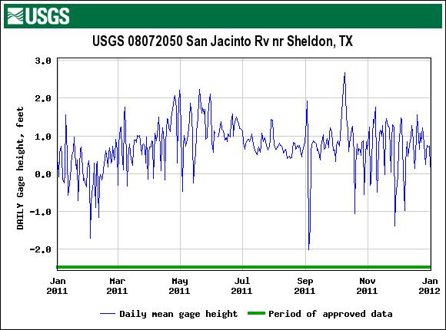
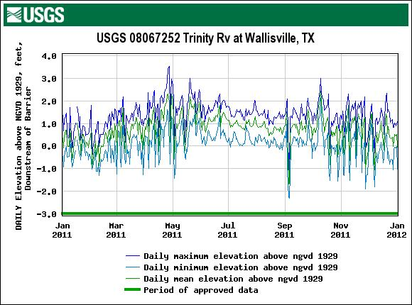
USGS WaterWatch
Two inflows nearly identical for 2011
High Pt: 10/03 – 10/16
Low Pt: 01/27 – 02/09
Images from: http://waterdata.usgs.gov
Notes:
So here we can see two plots, which are gauge height in feet of the San Jacinto River near Sheldon, TX on the left and daily elevation above NGVD 1929 for the Trinity River at Wallisville, TX on the right. Looking at these two plots, I noticed that they were nearly identical for the entire year of 2011. This, along with the fact that the NDBC data set for Galveston Bay was most complete for 2011, led me to focus on 2011.
As a high inflow period, I chose October 3rd to October 16th (indicated by the black boxes here) and for a low period I chose January 27th to February 9th. The reason I chose this period over early September (as you can see here it has a lower flow than the period I picked) is because this time period has a more consistent lower trend, as opposed to the spike in early September. I decided to focus on two week periods centered around the extreme events (they began 7 days before the extreme event and ended 7 days after the event) to try to isolate any effect the events had in the bay.

Slide 7
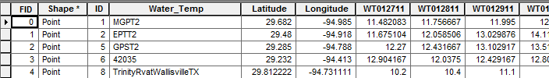
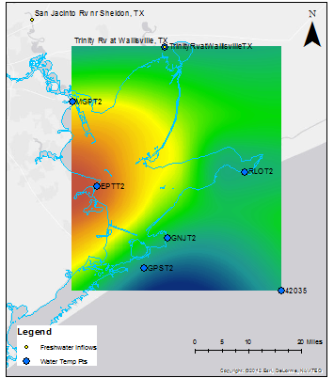
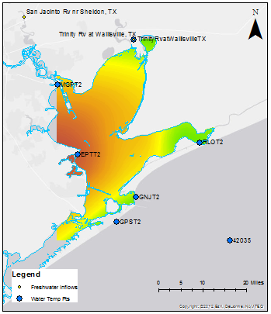
Using GIS
NOAA NDBC Website/Matlab/Excel
Daily Average Water Temperature
8 points around Galveston Bay
ArcMap 10.1
Spline interpolation of Water Temperature for each day
Clip using NOAA footprint of Galveston Bay
Photoscape
Create GIF file
7 days before and after high/low inflow event
Notes:
So taking my 4 weeks of daily averaged water temperature data (2 weeks each for high and low inflow) at each buoy in Galveston bay as well as at the USGS gage station for the Trinity River at Wallisville, I uploaded the points as a shapefile in ArcMap, with 28 fields of water temperature data for each point. This allowed me to interpolate the water temperature across the entire bay for each day. I used spline interpolation because it tended to give the smoothest surface, which made sense for my research because water temperature tends to be smoothly distributed over a water body.
The next step involved clipping the interpolation to show only water temperatures for points that are in the bay (where the water is). This is where having the polygon shapefile of the boundary of the bay came in handy, because I was able to use the clip tool in the Raster Processing toolbox to show only interpolated water temperature values which fell inside this polygon.
Finally, I used a free program called Photoscape to create animated GIF files of the 2 two-week periods I was focusing on, which are shown in the next slide.

Slide 8
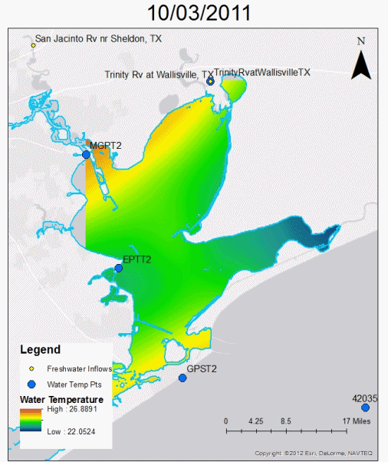
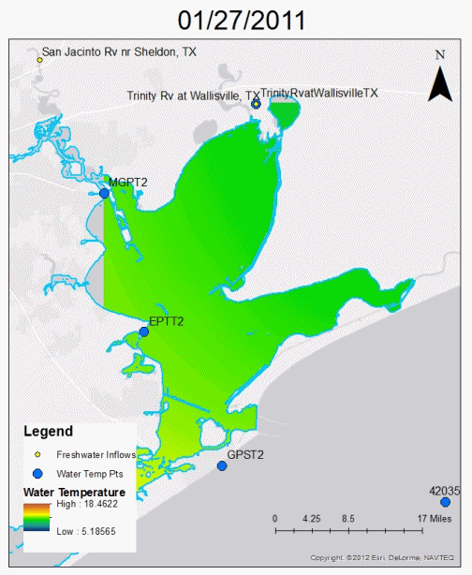


Comparing Water Temp at High and Low Inflow
High Inflow
Low Inflow
Notes:
Here is a comparison of the two time periods, high inflow on the left and low inflow on the right. At the present time, I haven’t spent enough time staring at these movies to see if any differences between the two exist, and this is something that I will discuss in my final report.

Slide 9
Next Steps/Future Work
Determine relationship between high/low inflow and water temperature
  Is there a relationship?
  If so, what patterns can be seen?
Future Work
  Salinity Data
  Multiple year study
Notes:
So this leads me to my next steps and possible future work. As I said, I need to stare at the movies some more to determine if there is any relationship between freshwater inflow and water temperature, and if this relationship changes with high/low inflows.
First I’ll determine if there is any relationship at all, and if so, what patterns I can see when comparing the high and low inflow conditions.
For future work, I think salinity data for the bay would have been much more interesting to look at, because there is a stronger relationship between freshwater inflow and salinity. This data must exist somewhere, it’s probably just a matter of contacting the right agency and talking to the right people. Another thing I thought might be interesting would be to look at multiple years of data to see if common trends throughout time can be found during high inflow and low inflow conditions.

Slide 10
ACKNOWLEDGEMENTS
NOAA National Data Buoy Center
USGS WaterWatch
NOAA National Ocean Service
Notes:
Here are my acknowledgments. I’d like to thank NOAA, USGS, and NOS for making their data public and easy to find.

Slide 11
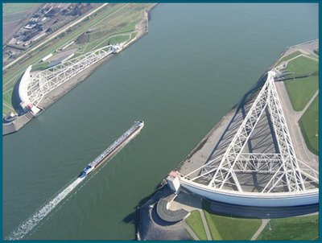
questions?
http://transportbox.blogspot.com/2009/04/april-11-2009-galveston-ike-dike.html
Notes:
And with that, I’ll take any questions you guys might have.

