Slide 1
Implications of Heat Wave on Thermoelectric Generation in Texas
Margaret Cook
November 29, 2012

Slide 2
Introduction and Purpose
Determine the effect of drought and heat wave on the electricity supply for Texas in the next twenty years
Why?
Power plants using water for cooling cannot discharge water that is too hot into their cooling ponds
EPA limits on thermal pollution
If water starts out too hot, power plants can only generate so much electricity before they hit that limit
Hot water means power plants cannot generate to full capacity
Makes the energy supply unreliable
Assessing the risk of reduced operations at thermoelectric power plants will improve planning

Slide 3
The Research is Confined to Plants with Large Withdrawals in the Gulf Coast HUC-2
Only looking at power plants within the Gulf Coast HUC-2 basin
Data available for model
Highest energy generators, industrial users, and populations in Texas
Power plants that withdraw large amounts of water for cooling
Once-through cooling processes
Most effected by heat wave and drought
Confined to available data (only 21 plants)
Notes:
OC Once through with cooling pond(s) or canal(s)
OF Once through, fresh water
OS Once through, saline water
RC Recirculating with cooling pond(s) or canal(s)

Slide 4
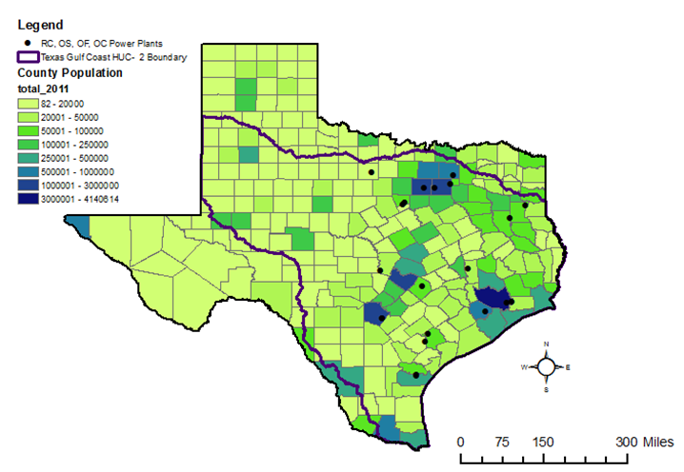
Population Centers in Texas Reside in the Gulf Coast HUC-2

Slide 5
Population Centers in Texas Reside in the Gulf Coast HUC-2

Slide 6
Population Growth in the Next Twenty Years is in Population Centers and the South

Slide 7
Highest Densities Will Still be in Population Centers, HUC-2

Slide 8
Gulf Coast HUC-2 Contains Most of Texas Rivers
Notes:
Also has most of the surface water sources in Texas→ Dam up rivers, create lakes for power plants
Only looking at 21 plants, not all Open and recycled cooling plants in Gulf Coast Basin

Slide 9
OC, OF, OS, RC Plants Represent a Significant Portion of ERCOT Generation and Water Use
Total OC, OF, OS, RC Electricity generation
46% of ERCOT capacity
48% of ERCOT electricity generation
Total OC, OF, OS, RC Water Use
98% of water withdrawal
70% of water consumption
These 21, Electricity generation
21% of ERCOT capacity
46% of ERCOT electricity generation in 2011
These 21, Water Use
59% of water withdrawal
44% of water consumption
Notes:
59% of water consumption = 4.8 trillion gallons/year out of 8.1 trillion

Slide 10
Most Electricity Generation is Done by Few Power Plants

Slide 11
Water Consumption is Spread Between Many Power Plants

Slide 12
Water Withdrawal is Spread Between Many Power Plants

Slide 13
Water Consumption is Much Less than Water Withdrawal
Notes:
Most of water is returned to the river. EPA limit is on water returned to the river.
Might be enough water for a power plant. If too hot, can’t generate. Might be able to generate, but not much.

Slide 14
A Regression Model using Climate Parameters and Heat from the Power Plant Might Predict Future Problems
Use heat dissipated, temperature, wind, dew point to model effluent discharge temperature 20 years into the future
Compare modeled temperatures to discharge permitted temperatures
Determine the amount of energy generation possible
Curtailment
Potential increase
Notes:
Parameters effect heat of the water, ability to evaporate– and cool
I used historical values to predict historical data and then used estimated values to predict future data

Slide 15
In the Future, Texas will still be hot…

Slide 16
Temperature °F

Slide 17
Temperature °F

Slide 18
Temperature °F

Slide 19
Temperature °F

Slide 20
Temperature °F

Slide 21
Temperature °F

Slide 22
Temperature °F

Slide 23
Temperature °F

Slide 24
Temperature °F

Slide 25
Temperature °F

Slide 26
Temperature °F

Slide 27
Temperature °F

Slide 28
Temperature °F

Slide 29
Temperature °F

Slide 30
Temperature °F

Slide 31
Temperature °F

Slide 32
Temperature °F

Slide 33
Temperature °F

Slide 34
Temperature °F

Slide 35
Temperature °F

Slide 36
Temperature °F

Slide 37
Temperature °F

Slide 38
Temperature °F

Slide 39
Temperature °F

Slide 40
Temperature °F

Slide 41
Temperature °F

Slide 42
Temperature °F

Slide 43
Temperature °F

Slide 44
When Texas isn’t completely hot…
Notes:
When Texas isn’t sweltering over the whole state…

Slide 45
Most High Temperatures Occur in the Northeastern Part of the State
Notes:
The heat is centralized in a belt right around where the huge energy generators/water users are

Slide 46
The Same Areas of ERCOT at Risk Now Will be at Risk in the Next Twenty Years

Slide 47
Heat Wave Might Keep Plants from Generating to Capacity
Some power plants will not be able to generate at 2011 levels
ERCOT max demand in August 2011: 68 GW
Curtailment occurs in highest demand areas
Some power plants will be able to generate more than they did in 2011
If demand increases, more issues will occur

Slide 48
Plants Might Not be Able to Generate as much as in 2011
Notes:
Problem– higher populations, but not as much energy (due to heat)

Slide 49
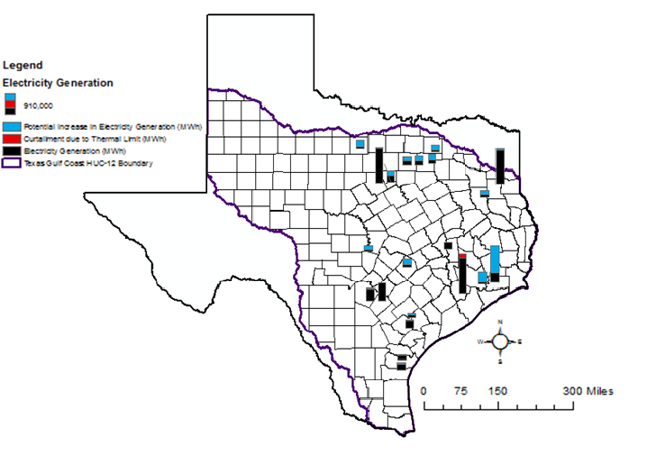
Some Electricity Generation Will Need to be Curtailed, More Can be Generated

Slide 50
Electricity Curtailment and Potential is Near Population Centers

Slide 51
If Capacity is Increased, More Curtailment Will Occur

Slide 52
Conclusion
Some power plants will not be able to generate at 2011 levels
If demand increases, more issues will occur
Some power plants will be able to generate more than they did in 2011
Implications for ERCOT planning, state water planning
More water sources
Reuse, desalination, aquifer recharge
Electricity from other power plants
Notes:
Water to keep up with demand

Slide 53
Questions

