Slide 1
Potential for Solar-Powered Desalination of Brackish Groundwater In Texas
Jill Kjellsson
November 29, 2012

Slide 2
Overview
Background
Data
Methodology
Results
Continuing Efforts

Slide 3
State of Texas: Water
Between 2010 and 2060 ^{[1]}:
  Population: Increase 82%
  Municipal water demand: Increase 71%
  Fresh water supply: Decrease 10%
2.7 billion acre-feet of brackish groundwater in Texas ^{[2]}
Brackish groundwater can be desalinated to meet future needs!
Notes:
from 4.9 to 8.4 million acre-feet
But desalination is energy intensive

Slide 4
State of Texas: Solar radiation
Solar Energy Potential of Texas ^{[3]}:
  900 – 1,300 kWh/m²/year (Winter)
  2,150 – 2,900 kWh/m²/year (Summer)
Drawbacks:
  Intermittent
  Difficult/expensive to store
Can treat water when solar energy is available making stored, treated water a proxy for energy storage!
Notes:
In top 10-15% compared with other locations in the Country.

Slide 5
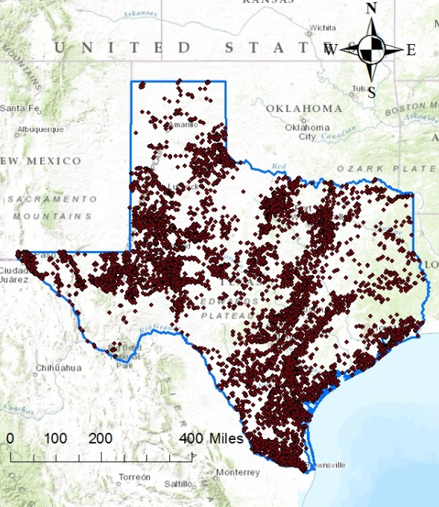
Data
Well Depth Range: 100-12,000 feet
TDS Range: 1,000-30,000 mg/L
Texas Water Development Board (TWDB): Groundwater Database
NREL: National Solar Radiation Database

Slide 6
Methodology
Research Focus: PV-powered Reverse Osmosis
3 Phases:
  Spatial variability of brackish well characteristics
    Depth, TDS
  Spatial variability of solar potential
  Estimation of desalination capacity
Notes:
I narrowed the scope of my research to focus on photovoltaic powered desalination using reverse osmosis.
PV panels because they do not require direct radiation from the sun but can make use of diffuse solar radiation. Diffuse solar radiation is radiation that has been scattered from the direct beam by the atmosphere.
Reverse Osmosis because 80% of desalination in Texas uses reverse osmosis.
The first phase of my research is to determine the spatial variability of brackish well characteristics. Since the power requirement of desalination are related to the depth of the well and the total dissolved solids concentration of the water, I looked at these characteristics.
Second is to determine the spatial variability of solar potential.
Third is to estimate the desalination capacity across Texas.

Slide 7
Results: Spatial Variability of Well Characteristics
Well Depth:

Slide 8
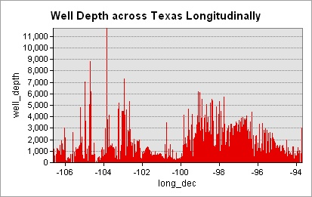
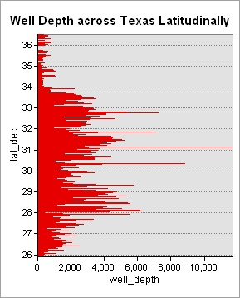
Results: Spatial Variability of Well Characteristics
Well Depth:

Slide 9
Results: Spatial Variability of Well Characteristics
Total Dissolved Solids:
Notes:
Want lower TDS in feed water so that desalination is less energy intensive.

Slide 10
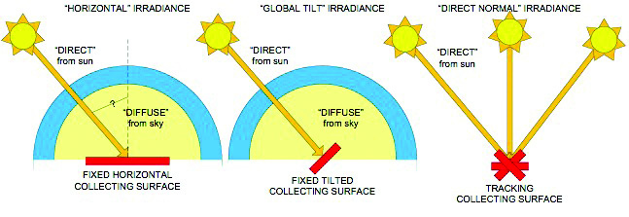
Results: Spatial Variability of Solar Potential
Diffuse vs. Direct Radiation
Global Tilt Radiation
Highest towards West
Notes:
Global Tilt radiation is the total radiation on a tilted or tracking surface, such as photovoltaic panels. Panels that are tilted to the south or use tracking receive more solar radiation than others because they face the sun.

Slide 11

Continuing efforts
To use the following equations for desalination power requirements and solar power generation to determine capacity of desalination across Texas
$P_{desal}=P_{RO}+P_{pumping}$
$P_{desal}=\left(\frac{Q×γ×WD}{ηpump}\right)+\left(Q×0.08×\left({TDS}_{in}−{TDS}_{out}\right)\right)$
$P_{PV}=η_{PV}×Global Tilt Radiation×A_{PV}×365$
Notes:
Typical PV efficiencies are about 15% today. Setting these equations equal and solving for Q, the flow rate, will give me the desalination capacity per PV system of specified area.

Slide 12
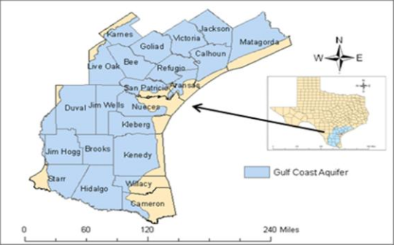
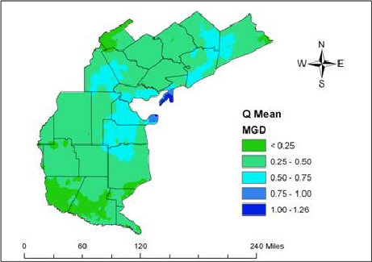
Results of Similar Research using Wind Power (per unit windmill)
(Source: Venkataraman, Kartik et. al. “GIS Based Mapping of Wind-Powered Desalination Potential in South Texas.” American Water Resources Association. March 2012.)
Notes:
One benefit of coupling solar power to desalination over wind is that solar energy generates more power during the hot summer months coinciding with higher water demand Whereas wind peaks during the spring.
Desalination and photovoltaics are not new technologies, but there is a lot of research that can be done on resources to help policy makers make decisions regarding water and energy.

Slide 13
Sources
[1] United States. Texas Water Development Board. “Water For Texas 2012 State Water Plan.” Jan. 2012. Web. <http://www.twdb.state.tx.us/publications/state_water_plan/2012/2012_SWP.pdf>.
[2] "Desalination: Brackish Groundwater." Texas Water Development Board. Water For Texas, Jan. 2012. Web. <http://www.twdb.state.tx.us/publications/shells/Desal_Brackish.pdf>.
[3] Wogan, David M.; Michael Webber; and Alexandre K. da Silva. "A Framework and Methodology for Reporting Geographically and Temporally Resolved Solar Data: A Case Study of Texas." Journal of Renewable and Sustainable Energy (2010). Rpt. in American Institute of Physics, 2010. Web.
Data:
Brackish Groundwater Database. TWDB. 2002. http://wiid.twdb.texas.gov/ims/wwm_drl/viewer.htm?DISCL=1&appno=2
National Solar Radiation Database. NREL. Oct. 2012. http://www.nrel.gov/gis/data_solar.html

Slide 14
Thanks! Any Questions?

