Slide 1
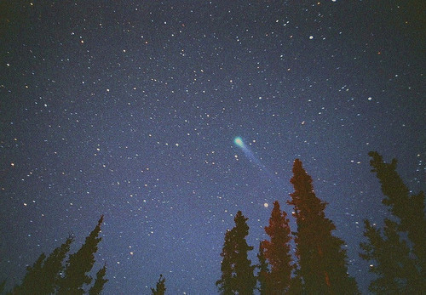
GIS, GRACE, and Groundwater
The Texas Drought of 2011
Arthur Ryzak
CE 394K – Fall 2012
Source: tumblr

Slide 2
Topics of Presentation
GRACE Mission Overview
Data Description
Description of Texas Drought of 2011
GIS Exploration of Drought Using GRACE Data

Slide 3
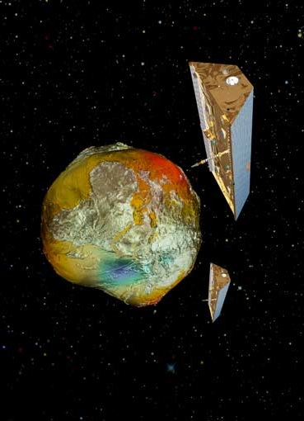
GRACE
Launched in 2002 for a 3 – 5 year mission
Joint Project – NASA and DLR
Scientific Analysis
  UT Center for Space Research (UTSCR)
  German Centre for Geosciences (GFZ)
  NASA Jet Propulsion Laboratory (JPL)
Source: nasa

Slide 4
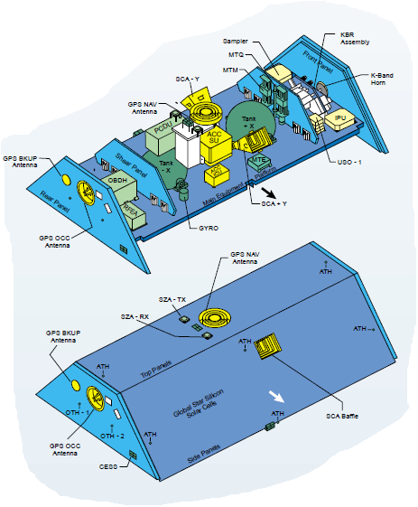
GRACE Components
Ranging System
Accelerometers
GPS System
Star Camera
Solar Array
Propulsion System
Source: Goddard Space Flight Center

Slide 5
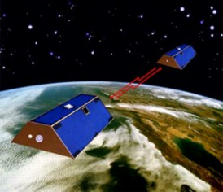
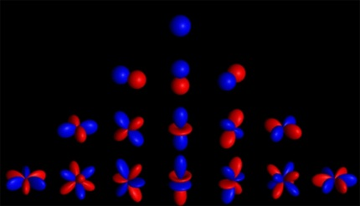
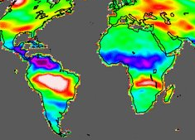

Data Processing Levels
Range Measurements (L1)
Spherical Harmonic Coefficients (L2)
$$∆N\left(θ,λ,t\right)=a\sum_{l=0}^{∞}{\sum_{m=0}^{l}{{\tilde{P}}_{lm}\left(cos\left(θ\right)\right)\left[∆C_{lm}\left(t\right)cos\left(mλ\right)+∆S_{lm}\left(t\right)sin\left(mλ\right)\right]}}$$
Terrestrial Water Storage Change (L3)
Sources: nasa, .trinnov.com

Slide 6
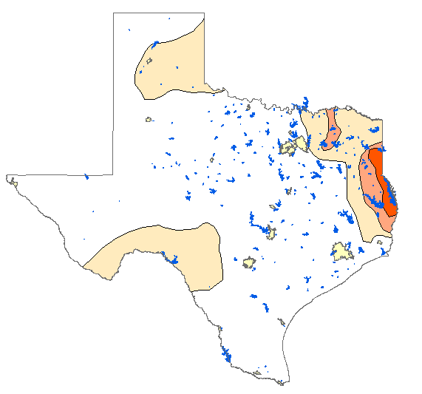
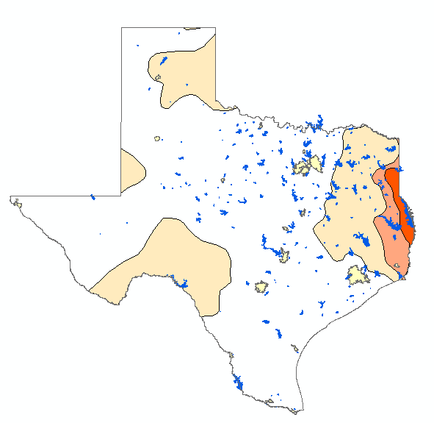
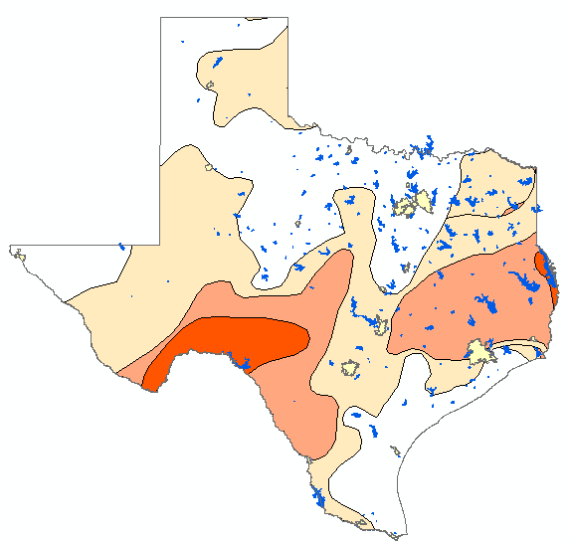
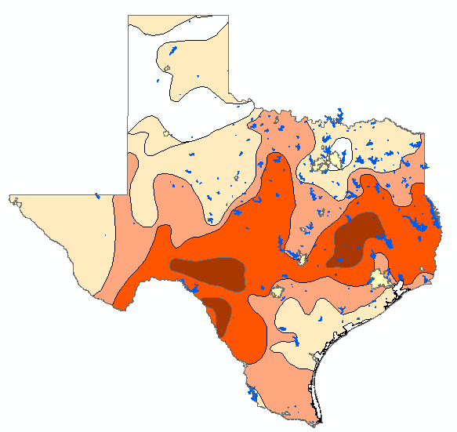
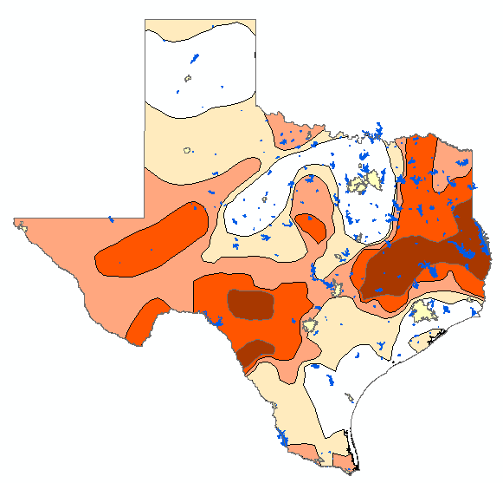
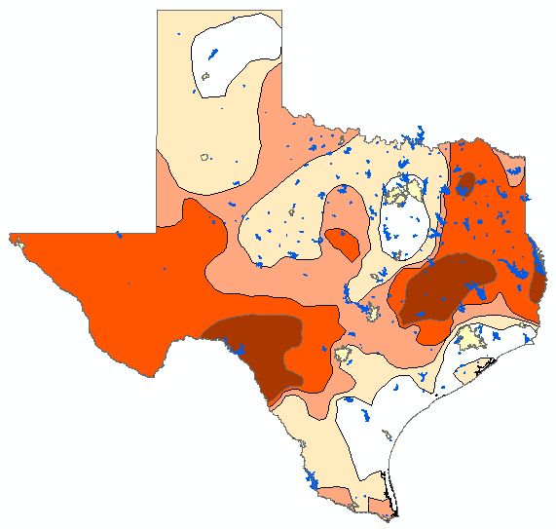
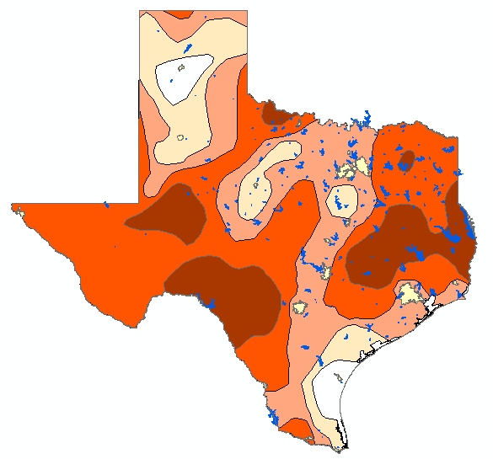
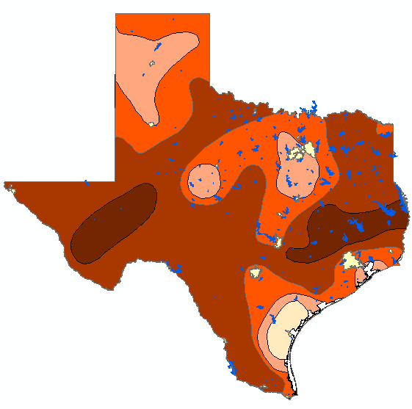
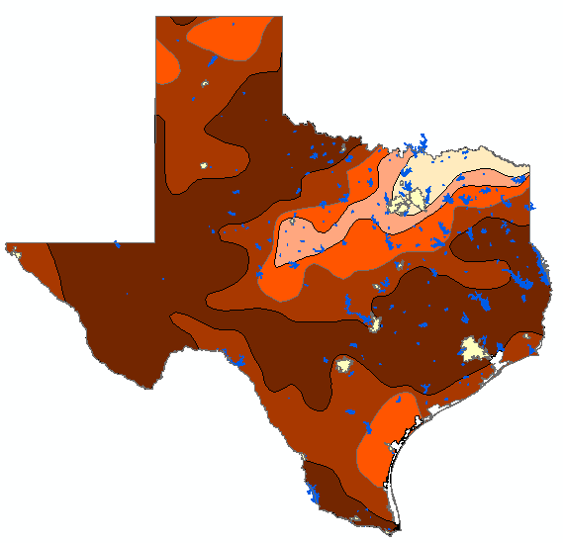
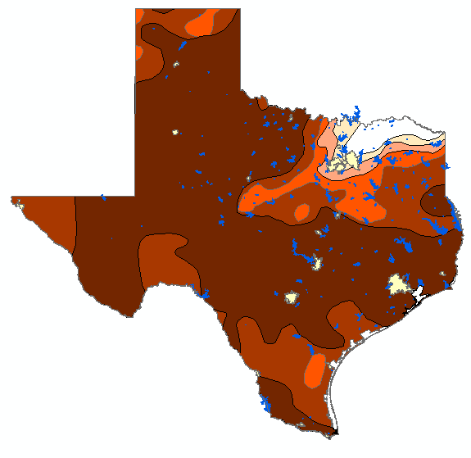
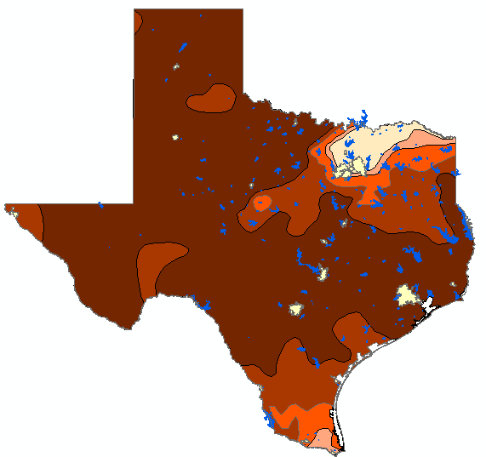
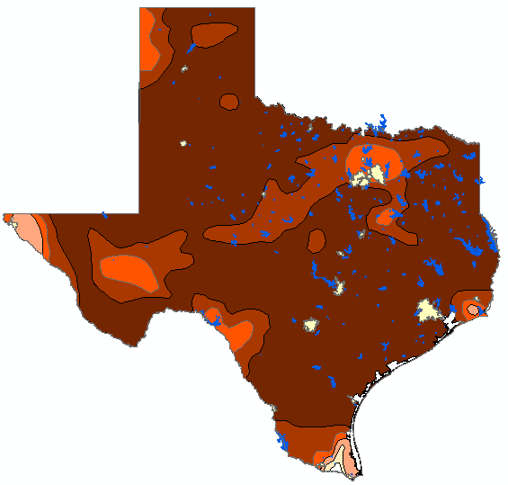
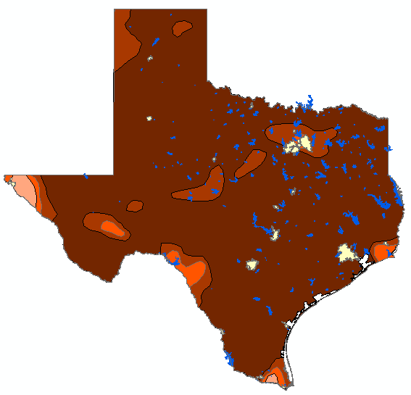
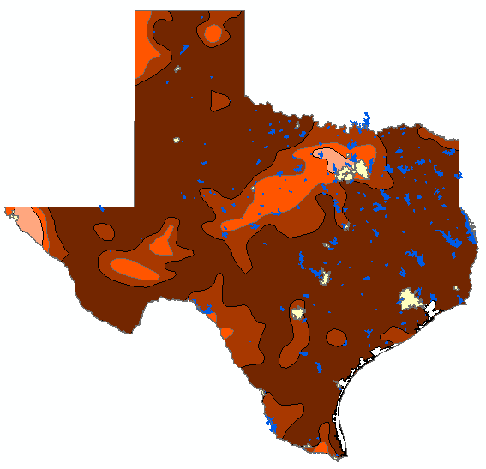
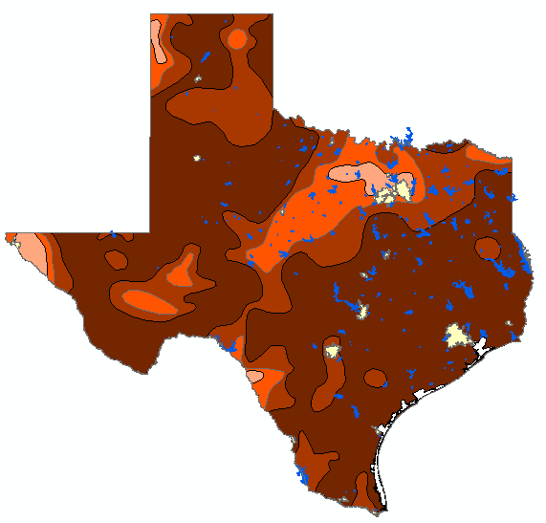
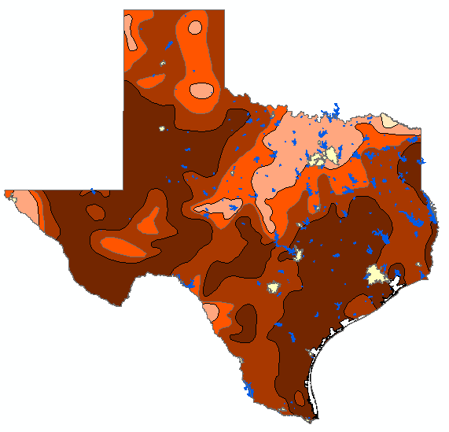
Texas Drought of 2011
Sep – 2010 Oct – 2010 Nov – 2010 Dec – 2010
Jan – 2011 Feb – 2011 Mar – 2011 Apr – 2011 May – 2011 Jun - 2011
Jul – 2011 Aug – 2011 Sep – 2011 Oct – 2011 Nov – 2011 Dec 2011

Slide 7
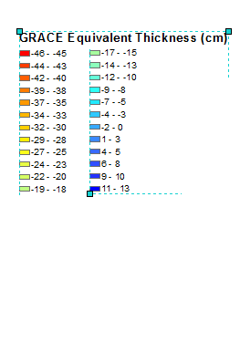
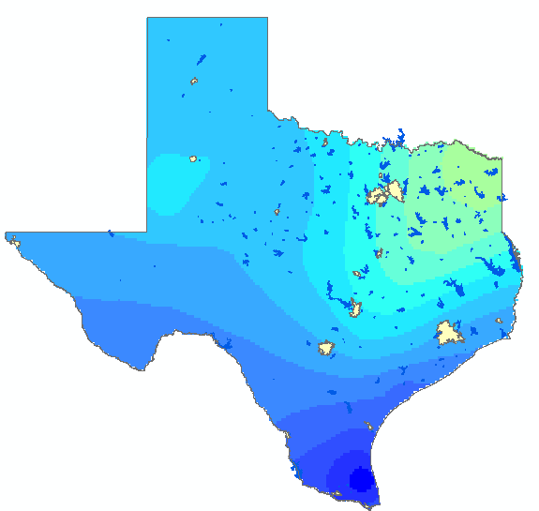
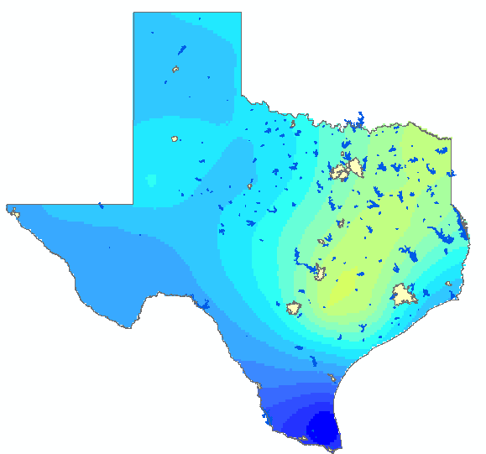
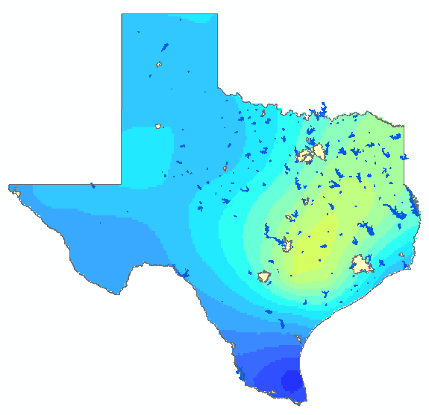
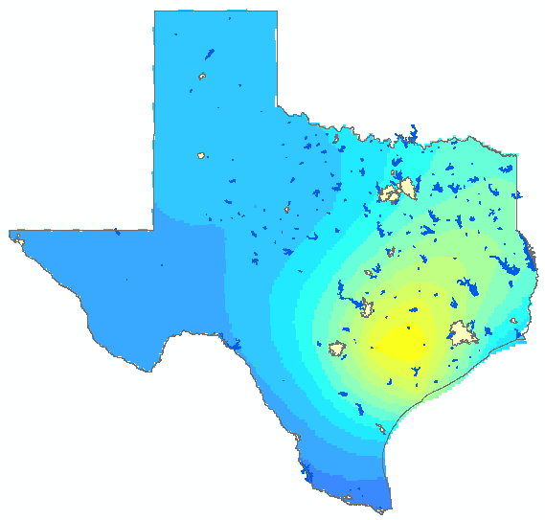
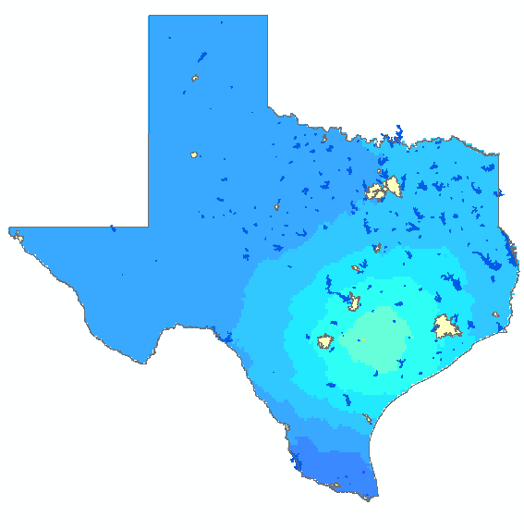
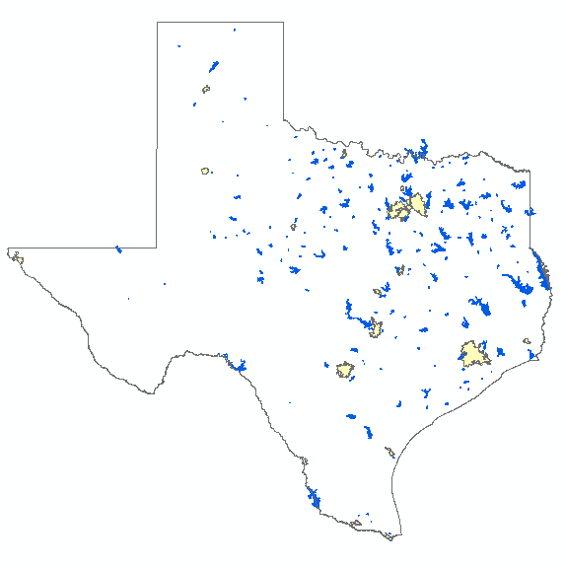
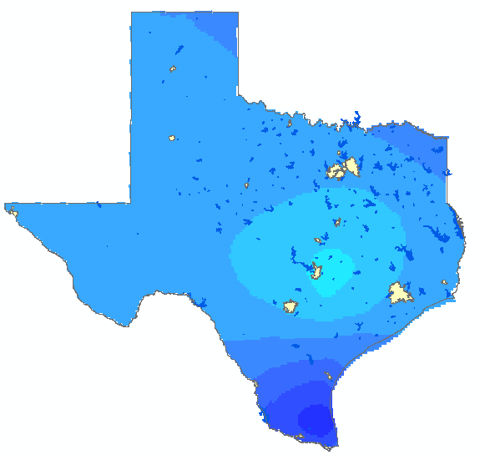
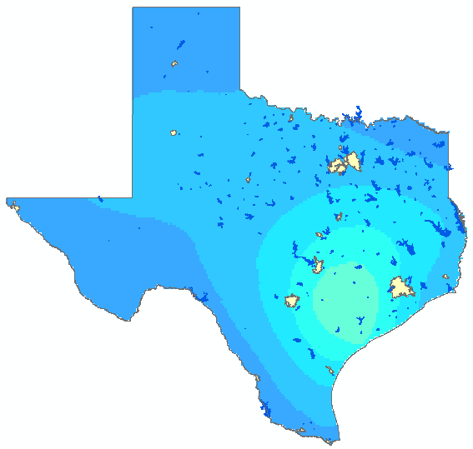
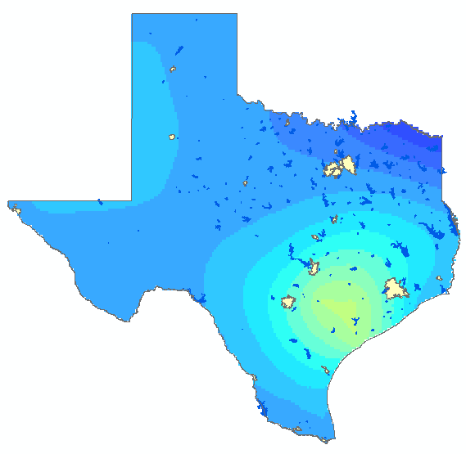

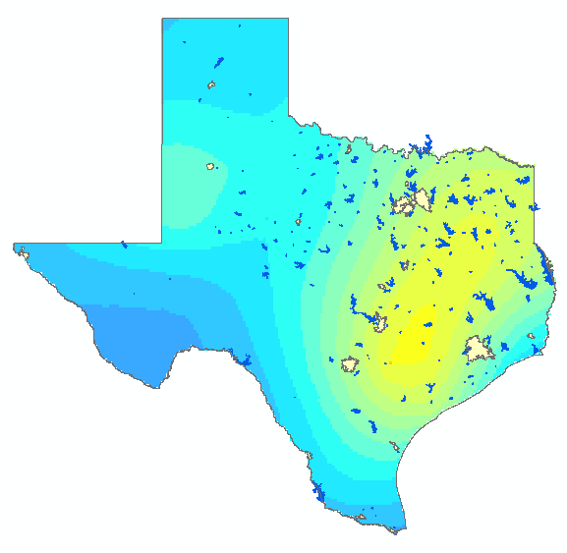
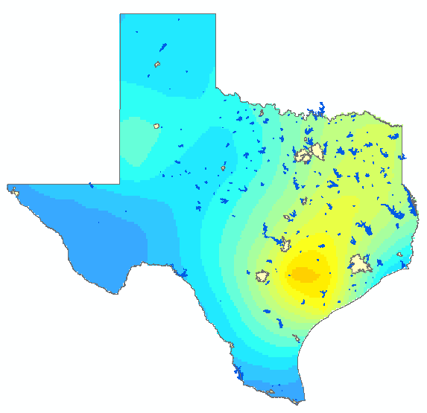
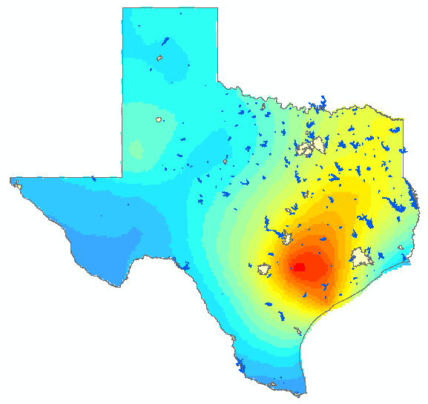
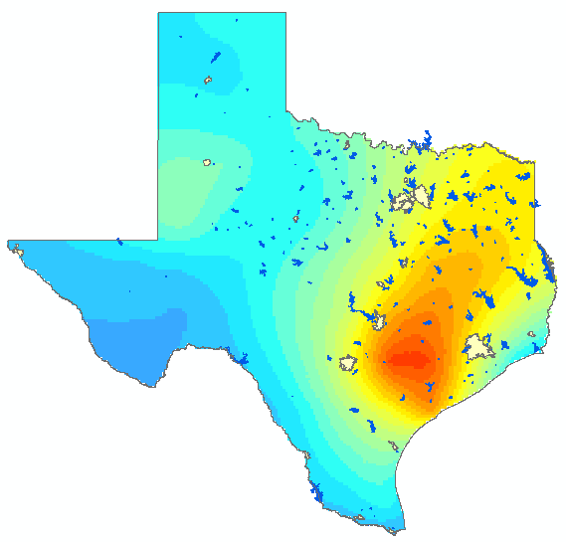
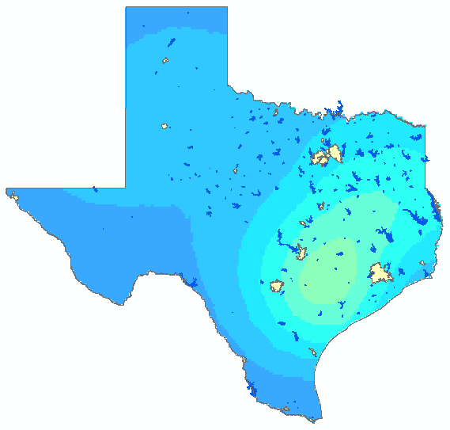
Texas Drought of 2011
Sep – 2010 Oct – 2010 Nov – 2010 Dec – 2010
-3.8 -7.3 -7.3 -7.6
Jan – 2011 Feb – 2011 Mar – 2011 Apr – 2011 May – 2011 Jun - 2011
-3.3 ND -0.9 -4.1 -3.7 ND
Jul – 2011 Aug – 2011 Sep – 2011 Oct- 2011 Nov – 2011 Dec - 2011
-11.7 -11.5 -14.8 --15.4 ND -2.4

Slide 8
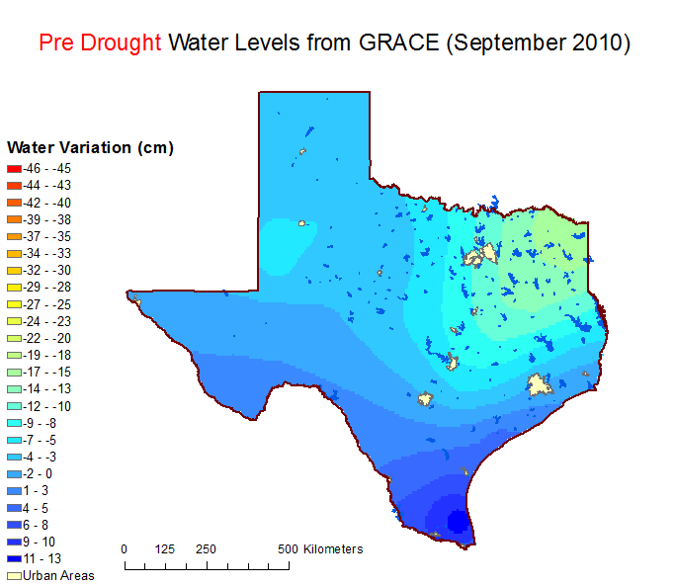
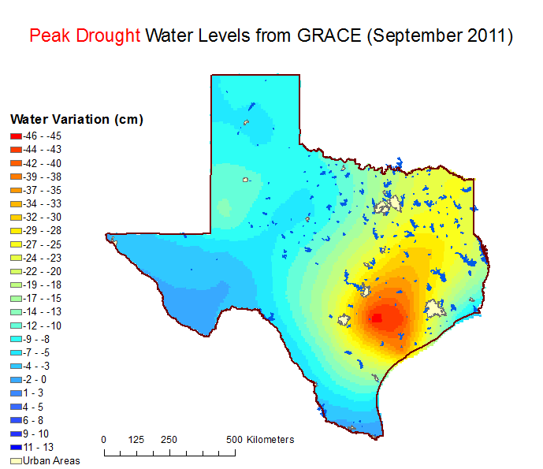
Texas Drought of 2011
Mean Variation = -3.8 cm
Mean Variation = -14.8 cm

Slide 9
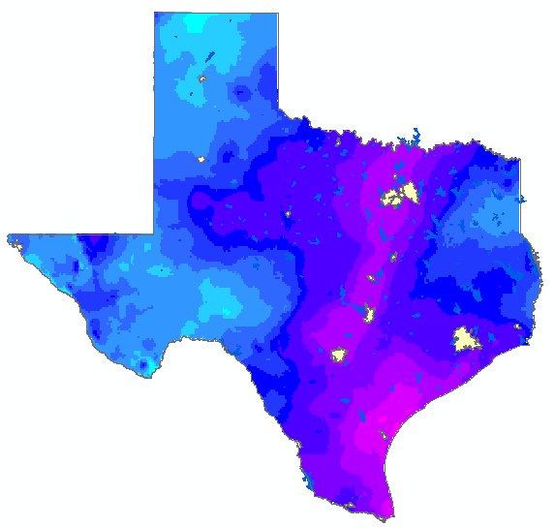
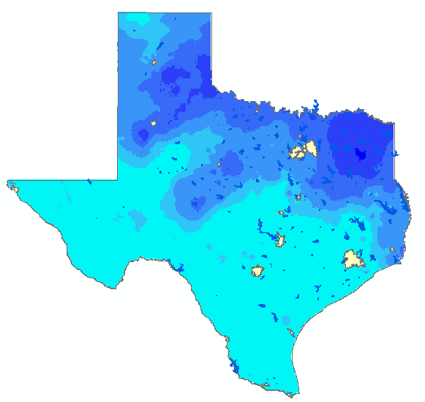
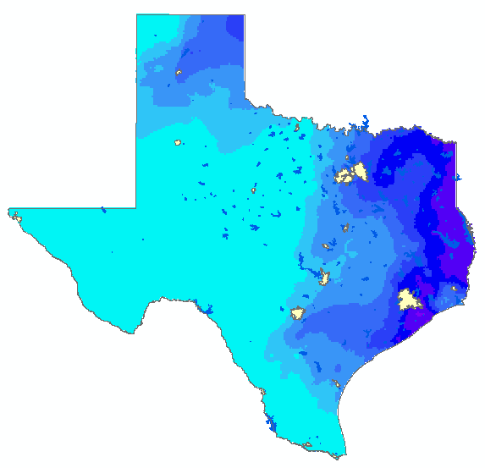
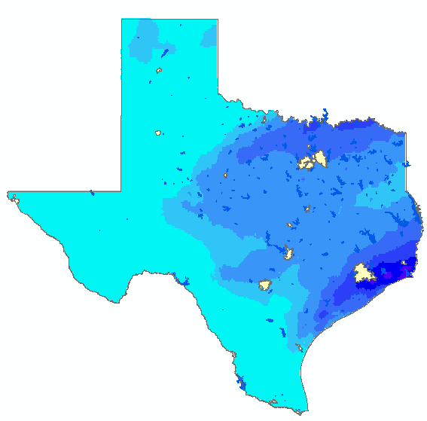
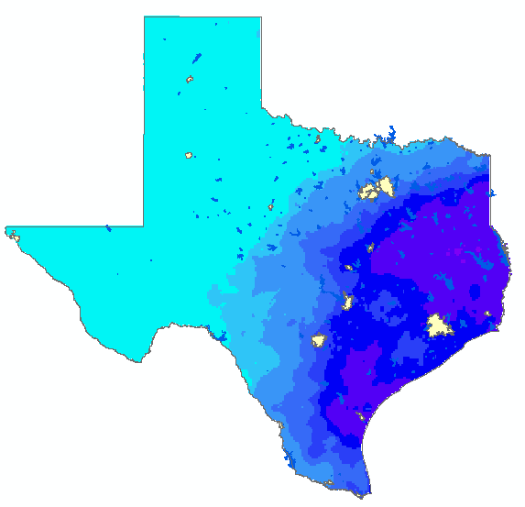
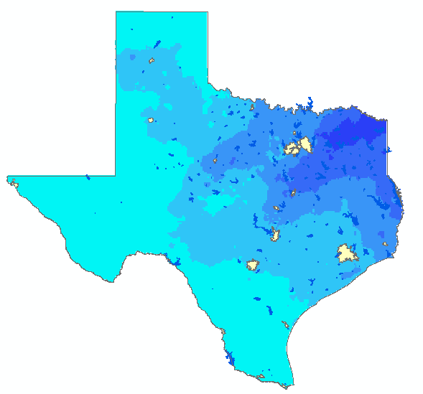
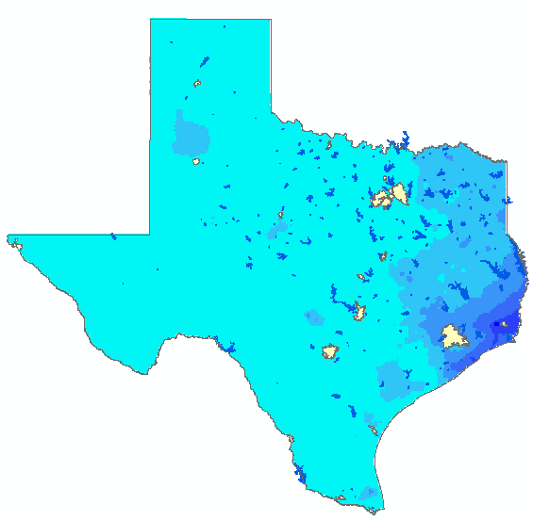
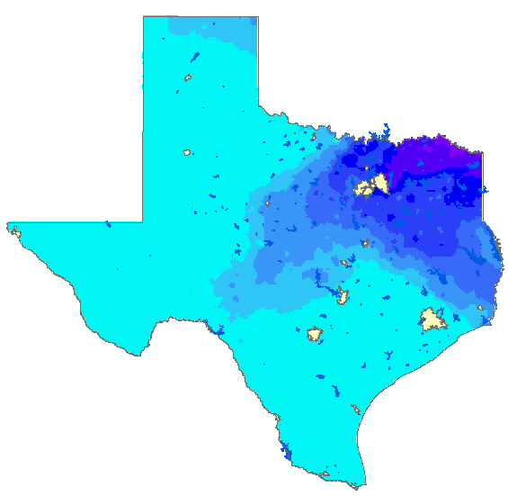
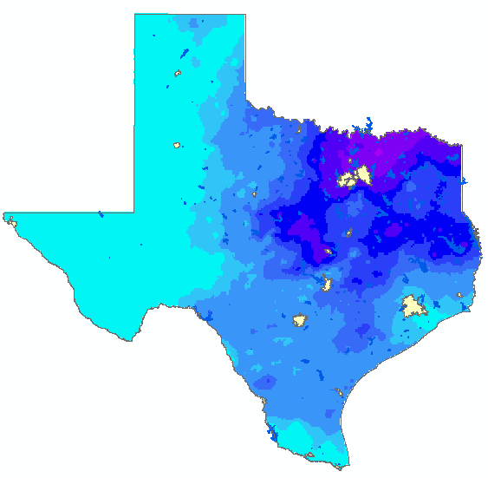
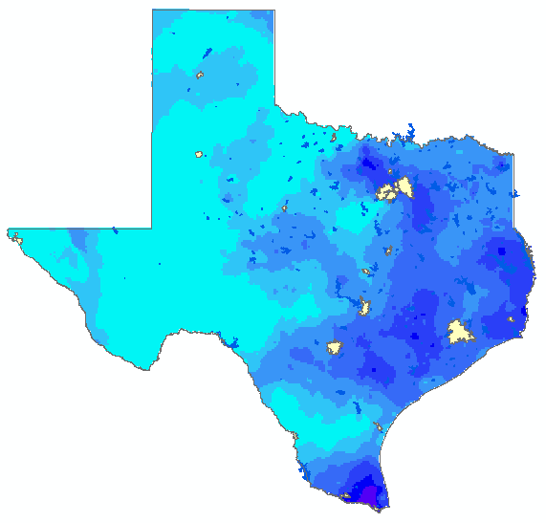
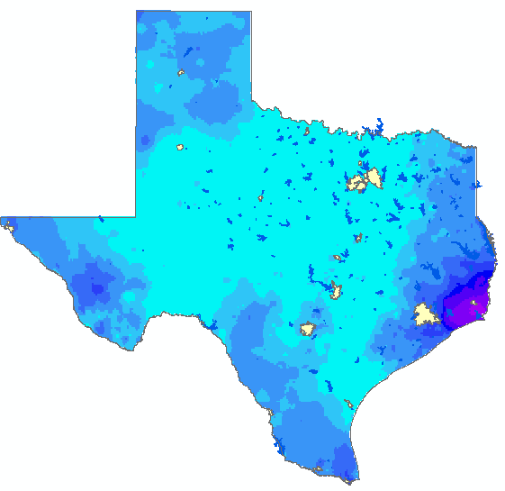





Texas Drought of 2011
Sep – 2010 Oct – 2010 Nov – 2010 Dec – 2010
2011 Total
35.8 cm
=
248 km^3
10.5 2.0 2.5 1.8
Jan – 2011 Feb – 2011 Mar – 2011 Apr – 2011 May – 2011 Jun - 2011
3.9 1.5 0.6 1.7 3.7 2.4
Jul – 2011 Aug – 2011 Sep – 2011 Oct – 2011 Nov – 2011 Dec - 2011
1.7 1.7 2.8 5.6 3.2 7.0

Slide 10
Precip. Oct – Dec
110 km^3
Precip. Dec – Mar
50 km^3

Slide 11

Terrestrial Water Storage Components Measured by GRACE
  Groundwater
  Soil Water
  Surface Water
  Snow / Ice
  Biomass
  Atmosphere
Source: wordpress.com

Slide 12




Unscaled Data
Scaled Data

Slide 13
Conclusions
GRACE data provides a wealth of information.
ArcGIS is a great tool for exploring this data.
?

