Slide 1
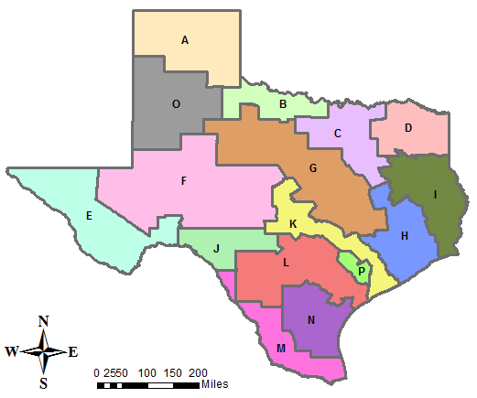
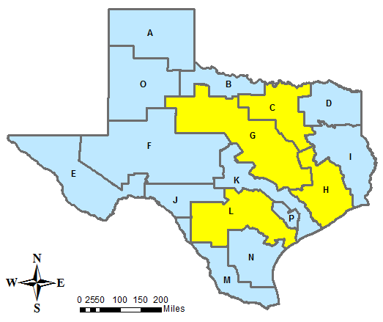
Using ArcGIS to Determine Texas Water Planning Regions with Maximum Conservation Potential
Elizabeth Waite
GIS Water Resources
29 November 2012

Slide 2

Scary Facts
Population in Texas is expected to double by 2060
Municipal water demand in Texas could increase by 3.5 million acre-ft per year by 2060
Limited funding is available for meeting these demands

Slide 3
Prepare! Increase Supply!
New Surface Reservoirs
Groundwater
Conjunctive Use
Desalination
Bush Control
Aquifer Storage & Recovery
Reuse
Decrease Demand!
Conservation
Notes:
Most economic way of increasing water supply is often through conservation.

Slide 4
Objective
Use data from 2012 State Water Plan
to determine Water Planning Regions
with the largest potential to conserve.
Notes:
Want to know which regions have the potential to conserve large quantities of municipal water. Create or supplement water savings plans for these regions.

Slide 5



Data Collection
2012 State Water Plan of Texas
  Texas Water Development Board
  Regional Water Planning Groups
Data Collected:
  Population Projections
  Water Need Projections
  Capital Costs
  Management Strategies
    Conservation
    New Reservoirs
Notes:
Available online

Slide 6
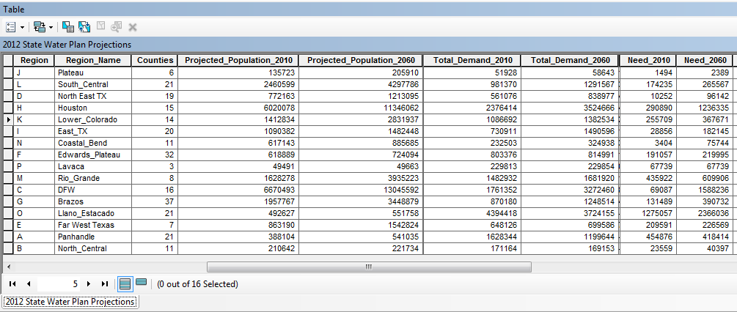
Methodology
Import Data Tables
  Join tables as appropriate

Slide 7
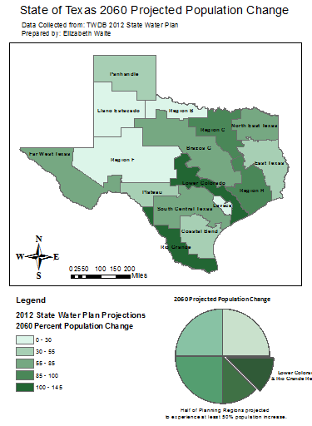
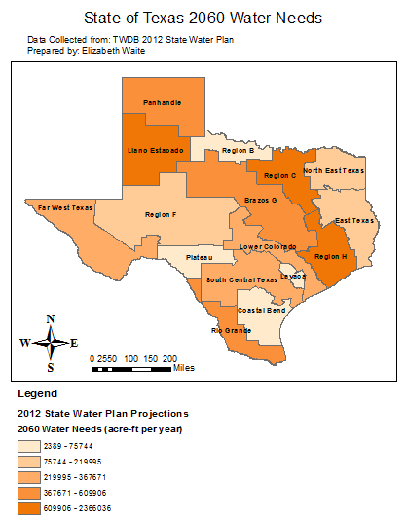
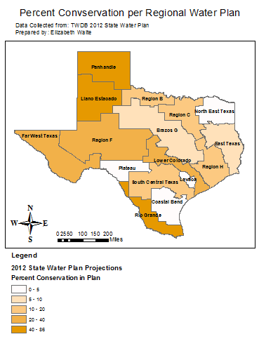
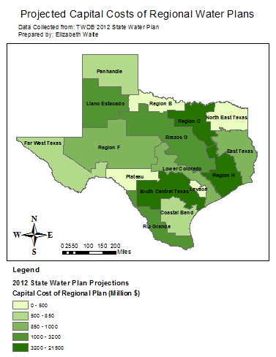
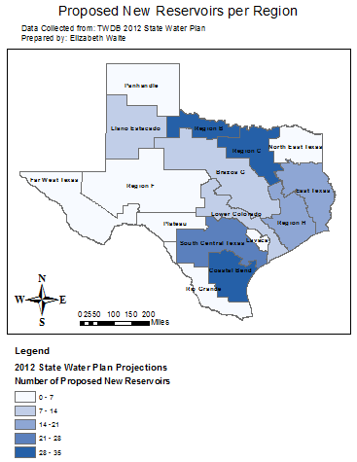
Methodology
Create Layers from Tables
Population
Water Need
Conservation
New Reservoirs
Cost
Notes:
Created a layer for each criteria to evaluate regions by

Slide 8
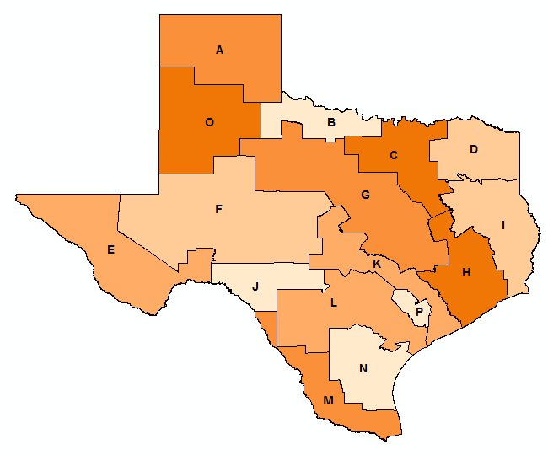
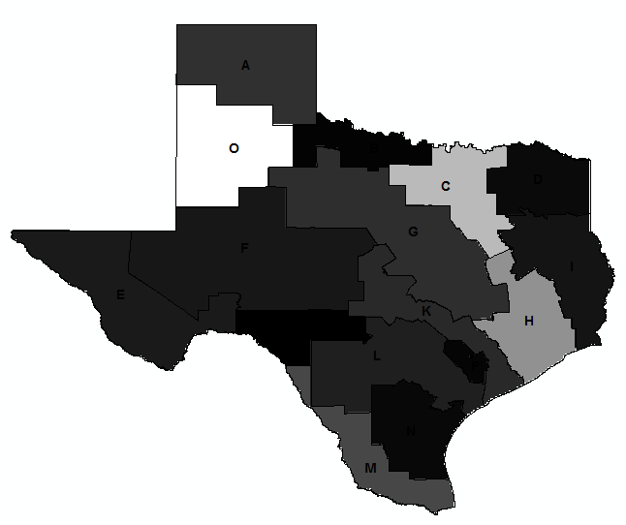
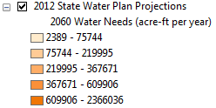

Methodology
Feature to Raster Conversion
Feature
Raster
Feature to Raster Conversion for 2060 Projected Water Need per Planning Region

Slide 9
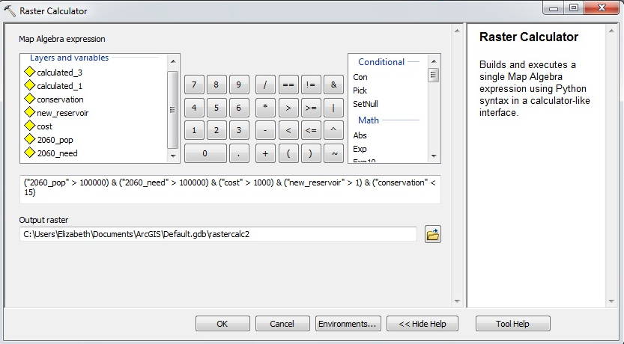
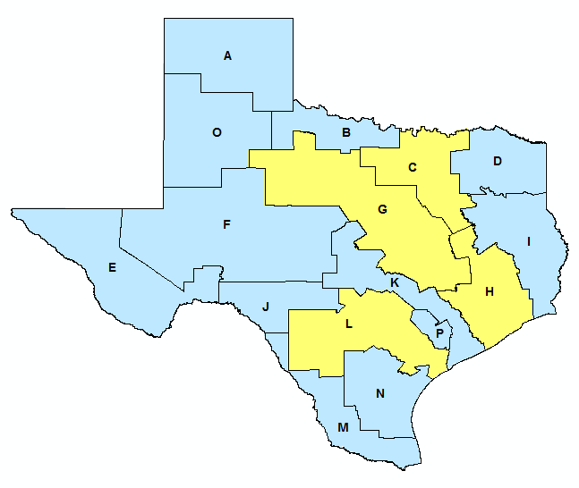
Methodology
Raster Calculator
Population
Cost
Conservation
Water Need
New Reservoirs

Slide 10
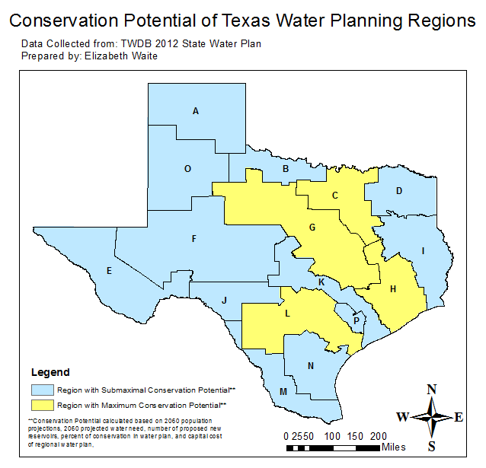
Results
Regions of High
Conservation
Potential:
Region C
Region G
Region H
Region L

Slide 11
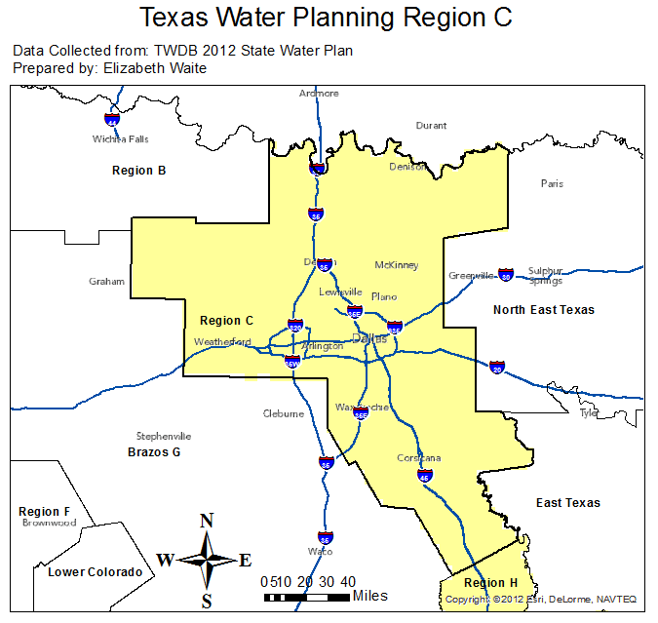
Conclusions & Next Steps
Conservation potential greatest in planning regions with large metropolitan areas.
Further work needs to be done to create & implement suitable conservation management plans.

Slide 12
Questions?
Elizabeth Waite
elizabethwaite@utexas.edu

