Slide 1
Towards a Global Water Information System
David R. Maidment
Center for Research in Water Resources
University of Texas at Austin
14th Congress of the WMO Commission for Hydrology
Geneva, Switzerland | 9 November 2012
Acknowledgements: Fernando Salas, David Arctur University of Texas at Austin

Slide 2
WMO Guide to Hydrological Practices
Guide to Hydrological Practices
Volume I
Hydrology – From Measurement to Hydrological Information
Science and Measurement
Chapter 10
Data Storage, Access, and Dissemination
Guide to Hydrological Practices
Volume II
Management of Water Resources and Application of Hydrological Practices
Application and
Management
Guide to Hydrological Practices . . .
. . . WMO recommendations for National Hydrological Surveys

Slide 3
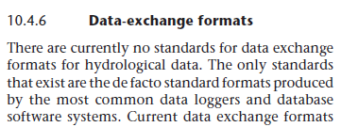
Volume 1, Chapter 10
Guide to Hydrological Practices
Volume I
Hydrology – From Measurement to Hydrological Information
Science and Measurement
Published in 2008
Last section of the last chapter of Volume I . . .
. . . this lecture provides an update since 2008

Slide 4
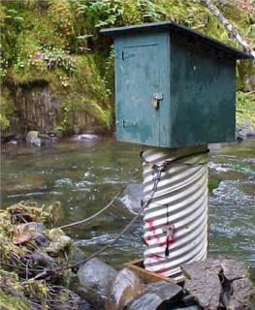
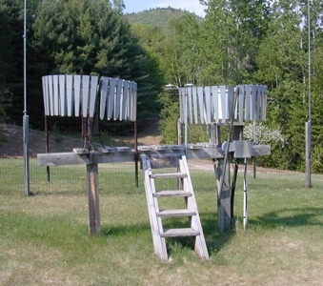
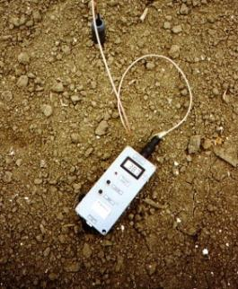
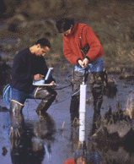
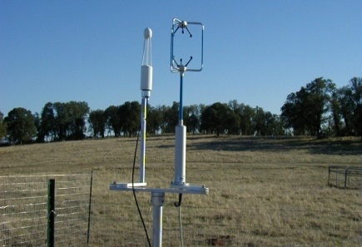
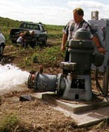
Hydrological Measurement
Water Quantity
Rainfall
Soil Water
Water Quality
Meteorology
Groundwater
Time series data at point locations

Slide 5
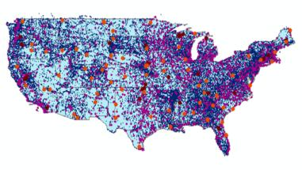
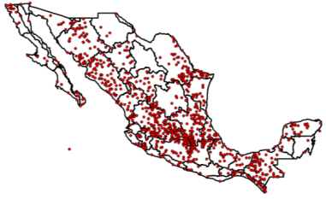
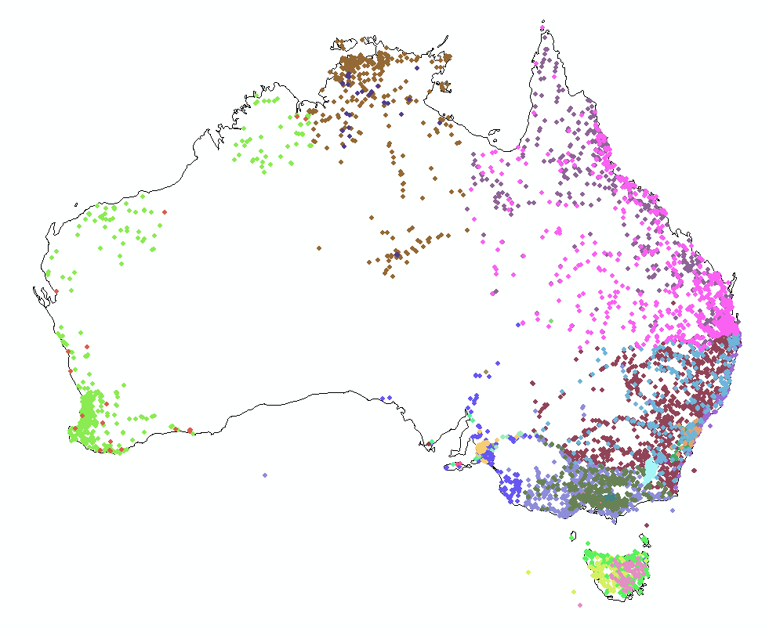
Every Country Collects These Data
WMO does
Global Water
Data Integration
United States
Mexico
Australia
Many kinds of hydrological measurements . . .
. . . this lecture focuses on streamflow

Slide 6
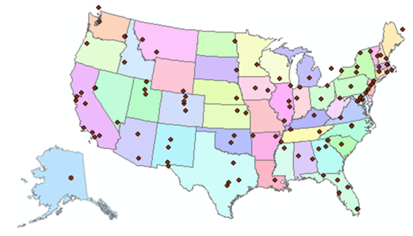
Consortium of Universities for the Advancement of Hydrologic Science, Inc.
www.cuahsi.org
CUAHSI
A consortium representing 125 US universities
Dr. Richard Hooper, President and CEO Presentation to Chy-14 on Wednesday
Supported by the National Science Foundation Earth Science Division
Advances hydrologic science in nation’s universities
Includes a Hydrologic Information System project
Invented WaterML language for water resources time series
Building an academic prototype system

Slide 7
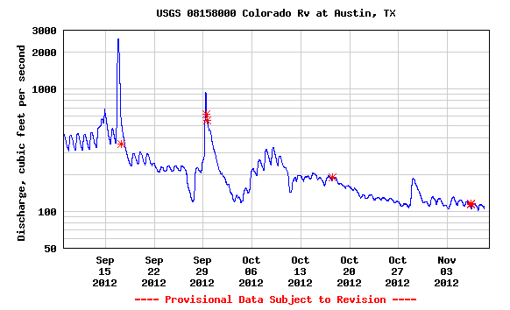
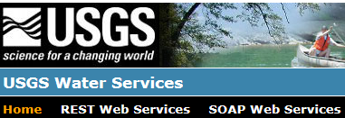
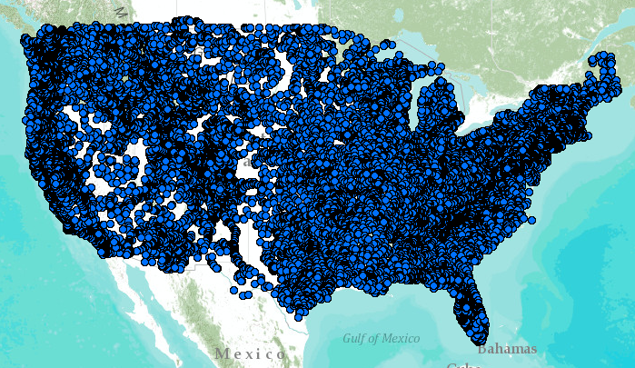
WaterML – the US Geological Survey
Water time series data on the internet
Measurement Standards
Map Standards
24/7/365 service
For daily and real-time data
. . . Operational water web services system for the United States
http://waterservices.usgs.gov/nwis/iv?sites=08158000&period=P1D&parameterCd=00060

Slide 8
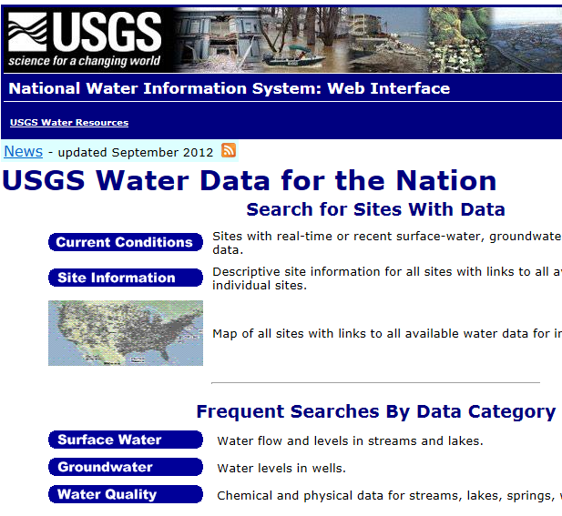
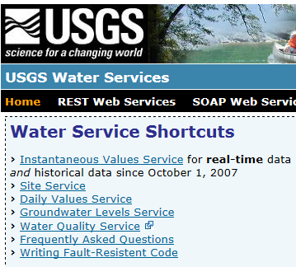
Web Pages and Web Services
Web pages deliver text and images
Web services deliver data encoded in XML
http://water.usgs.gov/
http://waterservices.usgs.gov/

Slide 9
Open Geospatial Consortium
More than 400 companies and agencies globally
. . . Internet data standards for maps and observational data

Slide 10
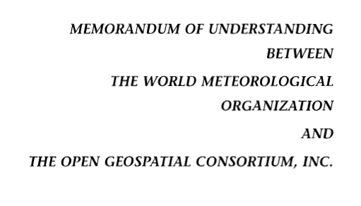
OGC/WMO Hydrology Domain Working Group
4-Year International Effort – WaterML
A time series for one variable at one location
Hydrology Domain Working Group formed
OGC observer at CHy-13
Technical Meetings Each 3 Months Four Interoperability Experiments
(Surface water, groundwater, forecasting)
Annual week-long workshops
Involvement by many countries
November 2009
Acknowledgements: OGC, WMO, GRDC, CUAHSI, BoM/CSIRO, USGS, GSC, Kisters, …….
2008
2009
2010
2011
2012
Notes:
(1) A four-year international effort has been undertaken to reconcile WaterML with international standards;
(2) This effort was initiated with the establishment of an Hydrology Domain Working Group by the Open Geospatial Consortium in September 2008;
(3) An OGC representative attended the WMO Congress of the Commission for Hydrology in 2008
(4) A formal agreement between Secretary General of WMO and President of OGC in 2009 to jointly develop standards for hydrology, climatology, oceanography and climatology;
(5) The joint OGC/WMO Hydrology Domain Working Group was supported by a large work effort, annual week-long workshops, four interoperability experiments for surface and groundwater data exchange, and participation by many countries;
(6) In June 2012, the OGC voted to adopt the revised version, WaterML2 as an international standard for exchange of water resources time series (the first such public standard that has existed);
(7) This Congress to the WMO Commission for Hydrology to whom I am speaking is considering WaterML2 for adoption as an official standard by WMO

Slide 11
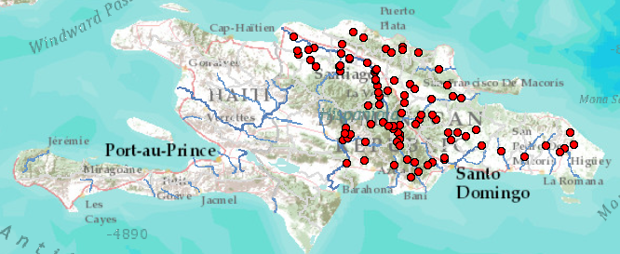
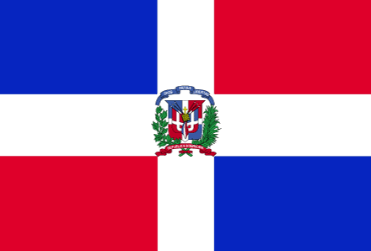
Dominican Republic – An Example
INDRHI (Instituto Nacional de Recursos Hidráulicos) data . . .
. . . converted to WaterML web services at BYU

Slide 12
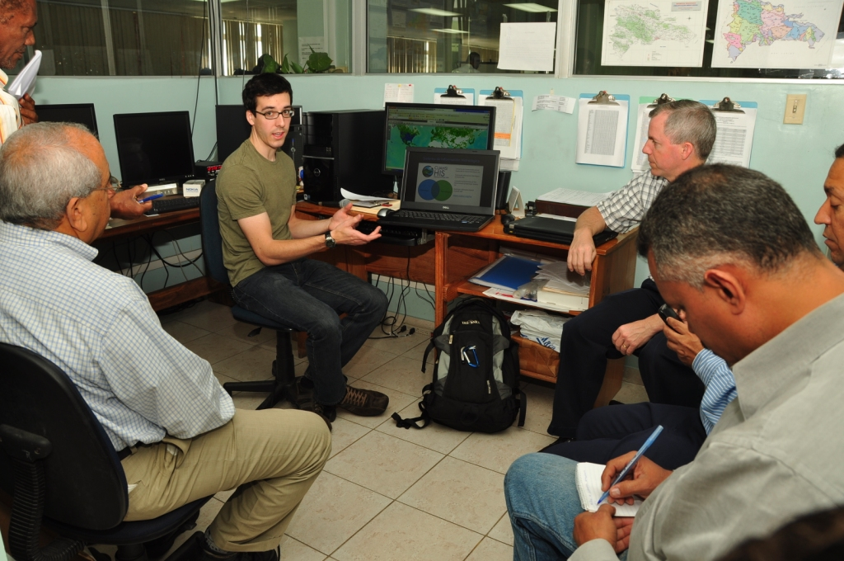
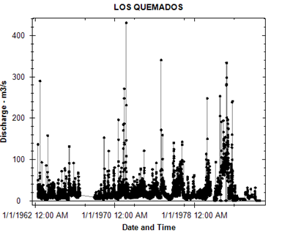
A Voluntary Project Using Free Software
Graduate student and faculty member from BYU . . .
. . . collaborating with technical staff at INDRHI

Slide 13
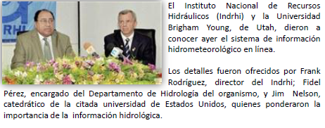
Press Conference for “Online” System
Frank Rodríguez, Director of INDRHI . . .
. . . Jim Nelson, Professor from BYU

Slide 14
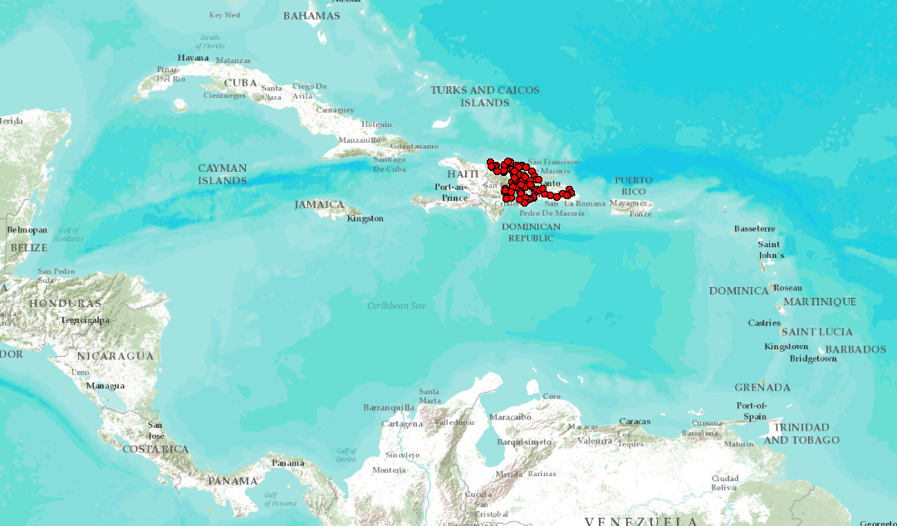
A Leader for the Caribbean Region
INDRHI would like to use their experience as a guide for neighboring countries. . .
. . . perhaps an activity for the CHy-14 Data Operations and Management theme?

Slide 15
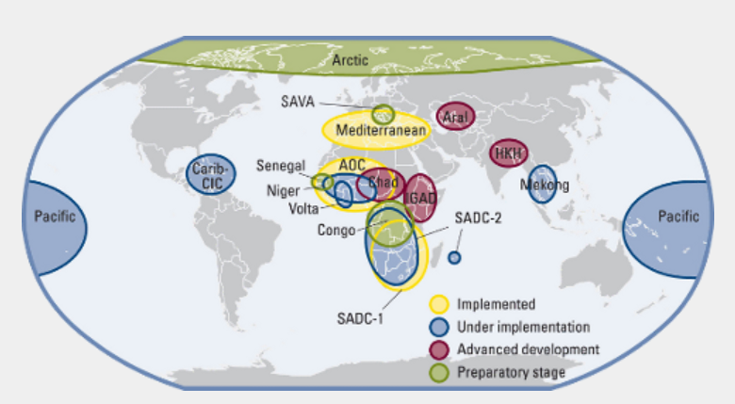
World Hydrological Cycle Observing System
Some projects implemented . . .
. . . Some in development

Slide 16
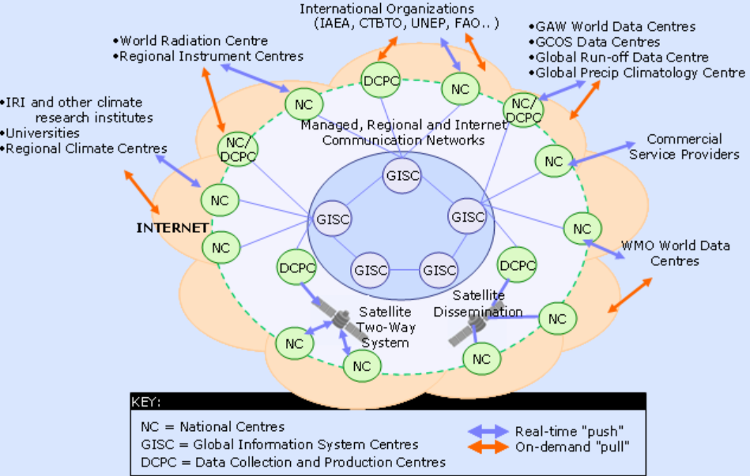
WIS – WMO Information System
Ingests data from National Centers . . .
. . . synthesized globally through communication networks

Slide 17
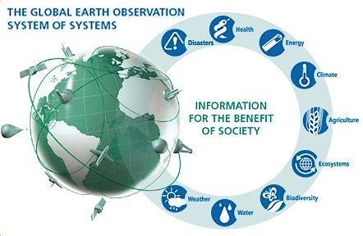
GEOSS – Global Earth Observation System of Systems
Group on Earth Observations (GEO) . . .
. . . located with WMO in Geneva

Slide 18
Geospatial and Temporal Water Data
GEOSS
WIS
Catalogs
Implementation
OGC
WMO
Standards
GIS
Water
Resources
Domains
Maps and time series . . .
. . . interoperability of connected systems

Slide 19
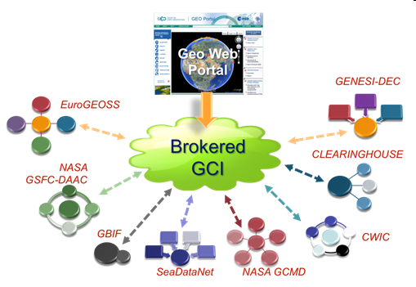
GEOSS and WIS – A Brokered Connection
GEOSS
WIS
Link water observations data . . .
. . . with many other kinds of observational data

Slide 20
Three Categories of Water Services
Catalog
Enable search, discovery, and selection of data
Time Series Services
Metadata
Describe specific collections of data
Catalog
Data
Convey the data
Metadata
Data
A time series data service for one variable at one location . . .
. . . describe and catalog networks of observation sites

Slide 21
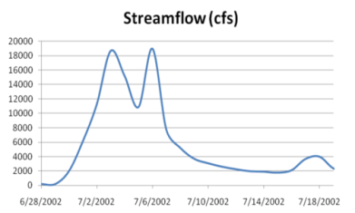
Web Services Stack for Time Series
Catalog Service for the Web with standard metadata: ISO, FGDC, ANZLIC, Dublin Core
Who?
What?
Catalog (CSW)
Time Series Services
Where? When?
Metadata (WFS)
Data (WaterML2)
CSW = OGC Catalog Service for the Web
WFS = OGC Web Feature Service for Maps
Access
Data
Existing OGC Data Services are Adequate . . .
. . . Need to Be Customized for Water Information

Slide 22
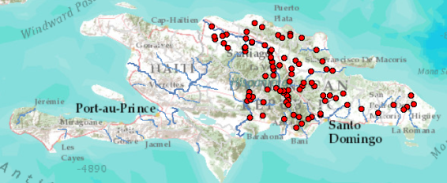
Dominican Republic, GEOSS, and WMO
Volunteered Information
Authoritative information
Catalog
Metadata
Data
WMO Information System. . .
. . . INDRHI – Dominican Republic

Slide 23
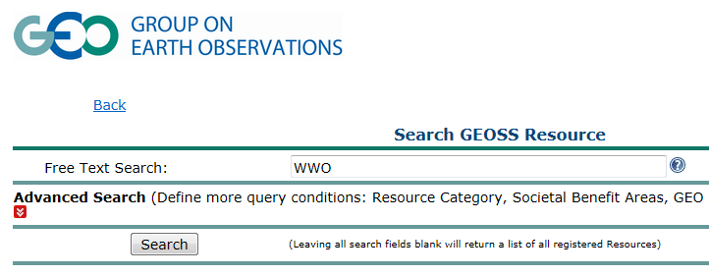
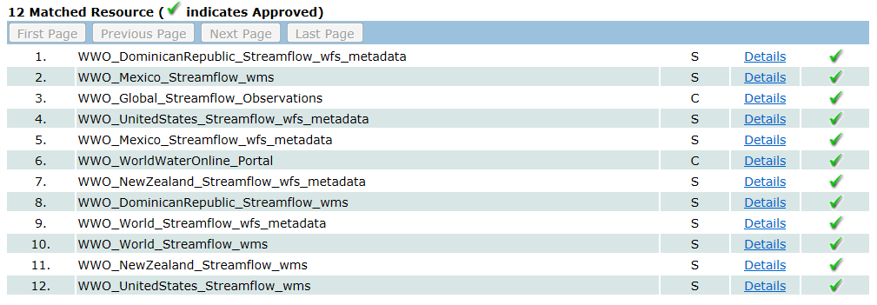
Searching GEOSS Portal
Search for water information
Find streamflow maps for countries
Streamflow map for the Dominican Republic
http://geossregistries.info/geosspub/resource_search_ns.jsp

Slide 24
National Service Stacks – Globally Federated
USA
Dominican Republic
Australia
Mexico
Catalog
GEOSS
WIS
Metadata
Data
GEOSS Indexes Geospatial Data . . .
. . . WIS Indexes Observational Data

Slide 25
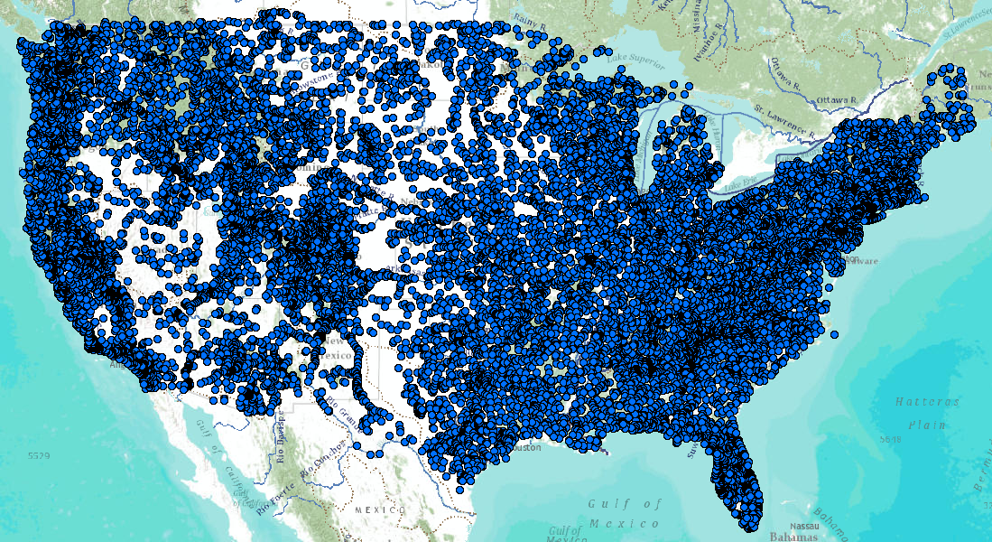
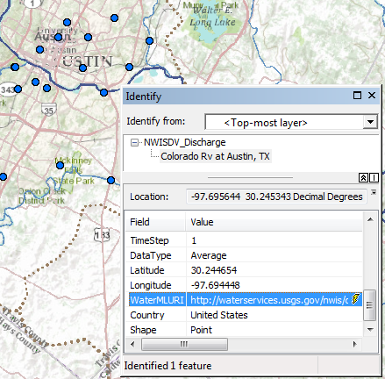
United States Services Stack
Catalog
Metadata
Data
Web Feature Service for Observation Metadata
Colorado River
at Austin, Texas
WaterML time series service for data
An attribute of each mapped observation point . . .
. . . is a web link to the WaterML data service

Slide 26
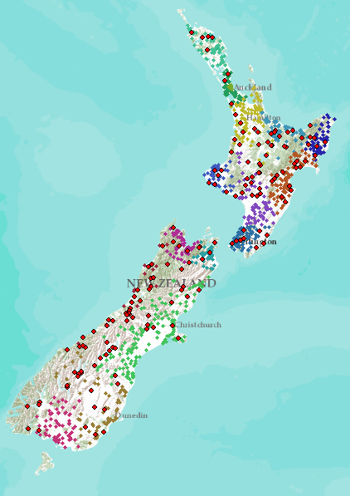
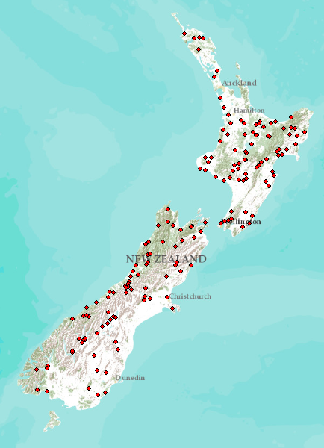
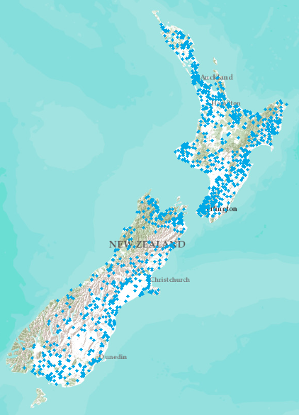
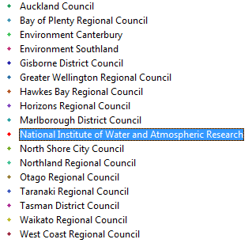
New Zealand
NIWA operates about 20% of 1300 hydrometric stations
Regional authorities operate about 80% of stations
New Zealand
Water Information System
Develop a federated hydrological information infrastructure . . .
. . . linking nationally and regionally collected data

Slide 27
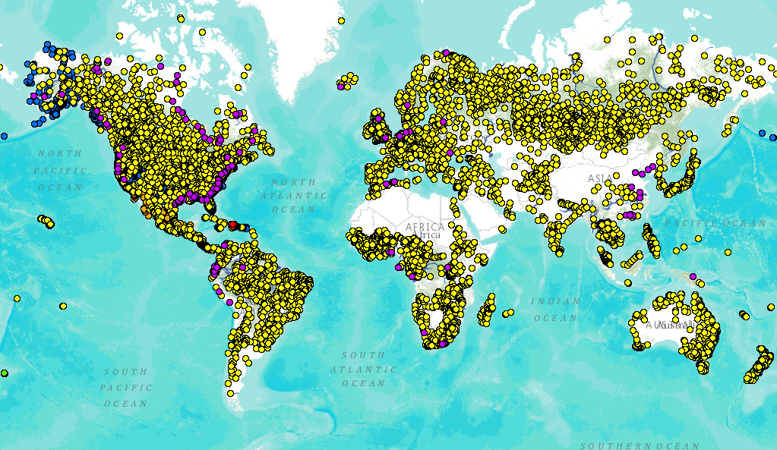
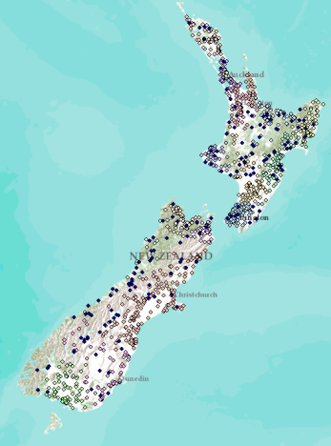
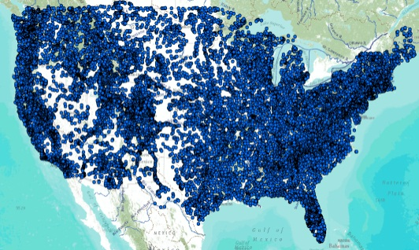
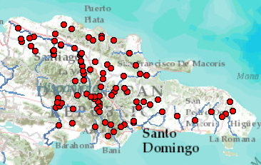
Global Streamflow Services
Building a national system federating regions . . .
. . . builds a global system federating countries
Global Runoff Data Centre
New Zealand
USA
Dominican Republic
http://www.arcgis.com/home/webmap/viewer.html?webmap=87ab07e2aba840828033e80b15fd6727

Slide 28
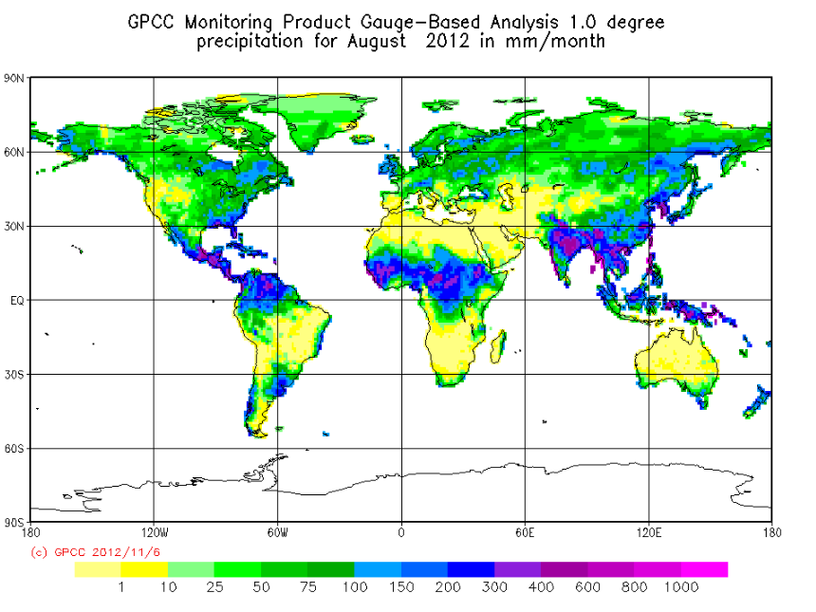
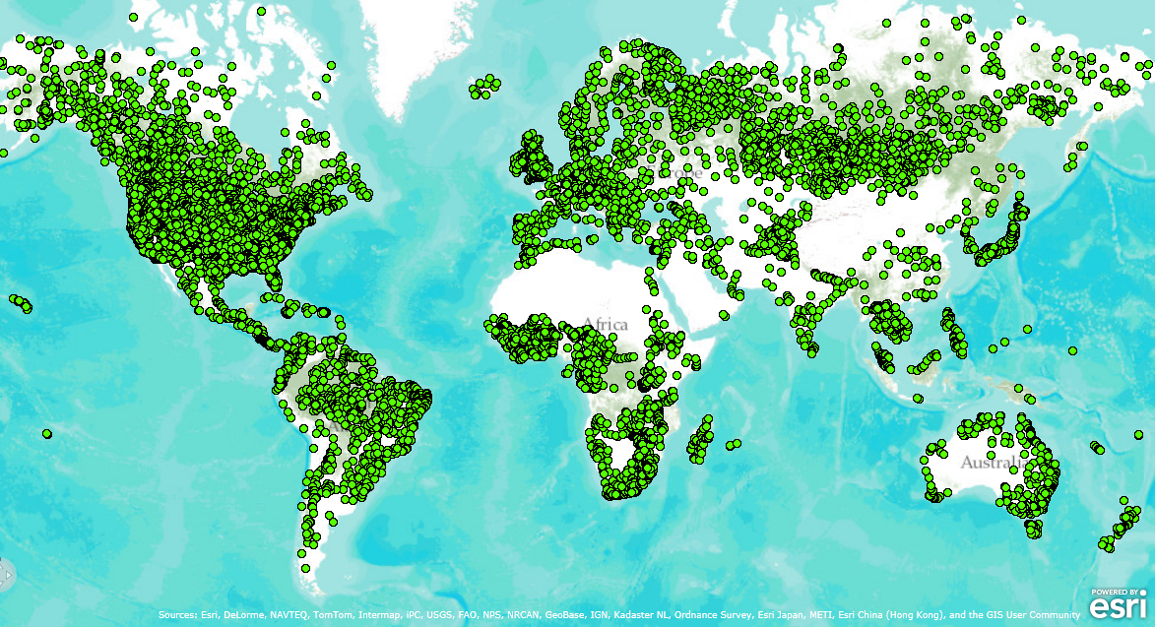
Global Data Centers – Precipitation and Runoff
Collect data from National Hydrological Surveys….
…. using water web services in the future

Slide 29
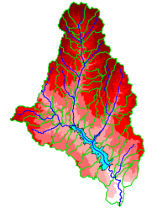
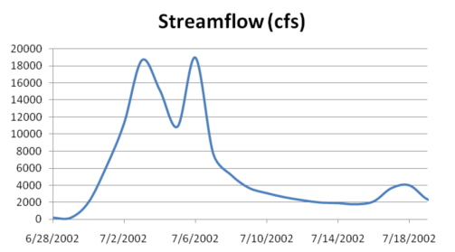
A Key Challenge – Integrating GIS and Water Observations Data
GIS
Water Environment
(Watersheds, streams, gages, sampling points)
Water Observations
The Water Itself
(Flow, water level, precipitation, water quality)

Slide 30
Common Hydrologic Feature Model
Courtesy of Irina Dornblut (GRDC) and Rob Atkinson (CSIRO)

Slide 31
WMO Commission for Hydrology
Technology is there to convey information but agreement is needed as to what information to convey
WMO has been involved in water data for many years
Existing infrastructure is good – we just need to build on it
Both commercial and open source implementation solutions

Slide 32
WMO Guide to Hydrological Practices
Guide to Hydrological Practices
Volume I
Hydrology – From Measurement to Hydrological Information
Science and Measurement
Time Series Services
Chapter 10
Data Storage, Access, and Dissemination
Guide to Hydrological Practices
Volume II
Management of Water Resources and Application of Hydrological Practices
Application and
Management
Chy-14 Theme on Data Operations and Management . . .
. . . possibly work on updating Chapter 10 of Volume I

Slide 33
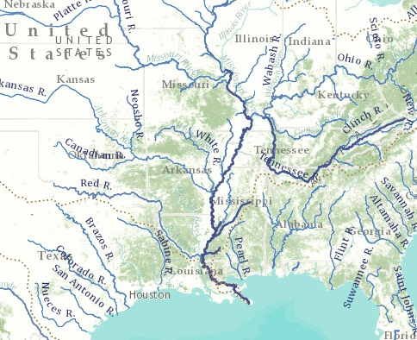
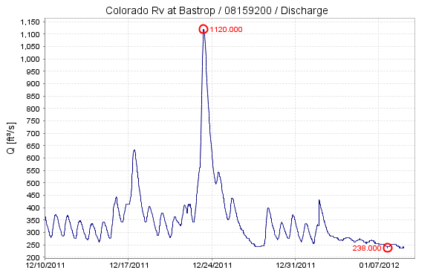
In the Future: World Water Online
Bring together water information for the whole earth
All spatial scales: global, national, regional, local
Both geospatial and temporal information
Linking data and modeling
Everything on the web
. . . a transformation of our world!
An initiative of the University of Texas at Austin . . .
. . . in collaboration with commercial and open source partners

Slide 34
Scales of Application
My house, My well, My ranch
River Basin, Aquifer
Landscape
World
Global
Assessment
Water and Climate
National
Accounting
How much water?
Regional
Management
Solving water problems
Local
Personal
How does this affect me?
A scale-independent information model for maps and observations . . .
. . . more detail as focus narrows

Slide 35
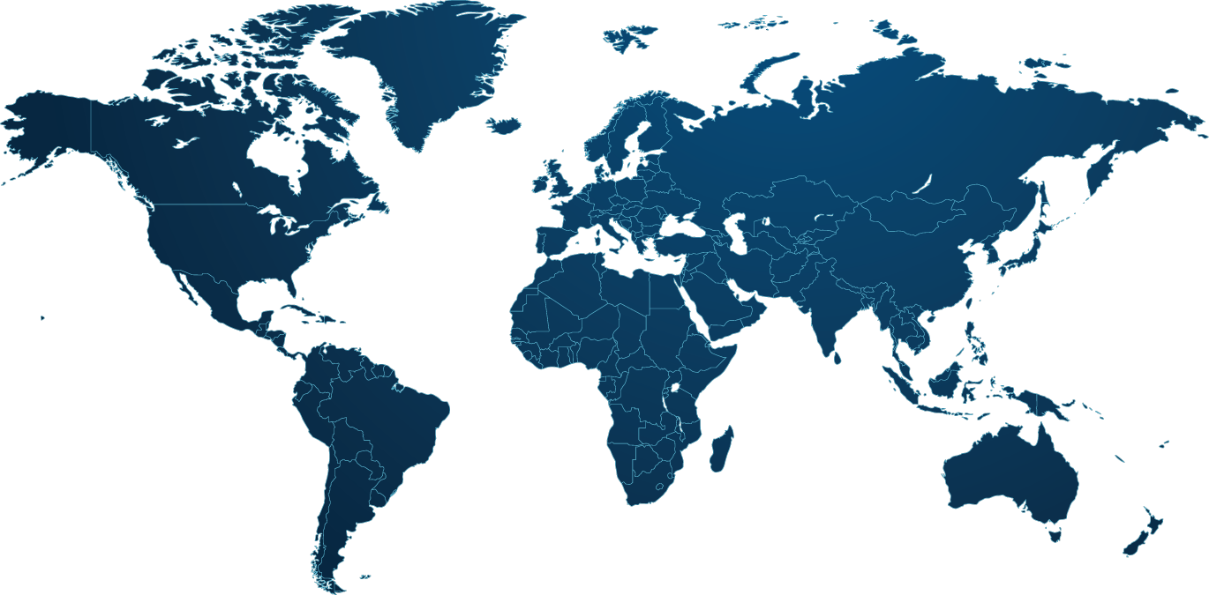
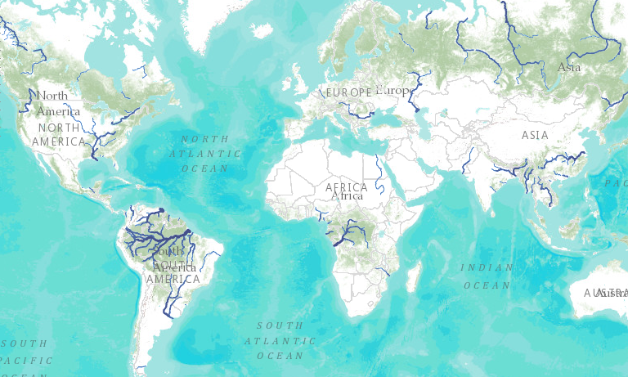
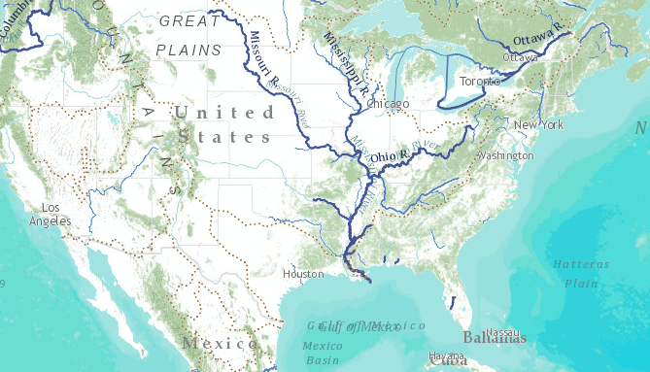
World Hydro Overlay Map
World
United States
Texas
My Home
My Stream

Slide 36
Watershed of My Stream Esri Base Map and Delineation Services
My Stream
My Watershed
Panther Hollow
My home
Delineate the watershed of any stream or river anywhere on earth

Slide 37
Congo River Basin Global river mapping and watershed delineation
World Hydro Overlay Map
River Basin Delineation
Delineate a watershed from any point on a river

Slide 38
World Watershed Explorer – Congo Basin
Watershed characteristics . . .
. . . precipitation, soils, land cover, population

Slide 39
Collecting Water Data Globally (GRACE) Force of gravity responds to changes in water volume. Water is really heavy!
Grace Satellites
Normal
In 2011 Texas lost 100 Km³ of water overall
Texas lost more water volume than Lake Geneva in 2011 drought . . .
. . . and in a few months it returned!

Slide 40
GRACE and Texas Reservoir Water Storage
Normal
In 2011 Texas lost 100 Km³ of water overall
Normal
In 2011 Texas lost 9 Km3 of water from reservoirs
Surface Water Reservoirs
Total water volume stored in 119 surface water reservoirs . . .
. . . closely correlated (R² = 0.8) with GRACE gravity anomaly over Texas

Slide 41
Water Balance for Itaipu Dam in Brazil
GRACE Water Storage (km³)
Parana River Basin
Itaipu Dam Capacity: 29 km³
Average Precipitation (km³)

Slide 42
Flow in the Mississippi River Basin RAPID model, March-May 2008, 3 hour time steps
GIS data describes 1.2 million river reaches . . .
. . . simulate flow in each reach in each time step

Slide 43
World Water Online Hydrology on the web
Watersheds
Global to Local
Maps
Models
Observations
Open Information systems include both commercial and
open source software linked by open standards

Slide 44
World Water Online Linking people everywhere with water data, maps, and models

