Slide 1
Data Sources for GIS in Water Resources by Ayse Irmak, David R. Maidment, and David G. Tarboton
GIS in Water Resources
Fall 2012

Slide 2
Learning Objectives
The hierarchical system of watersheds and basins
Where to obtain data and maps
  National/State/Global Data repositories
  Hydrography
  USGS National Water Information System
  Land Cover
  Elevation
  Soil (Statsgo/Surgo)
  Weather
  Satellite Remote Sensing Data

Slide 3
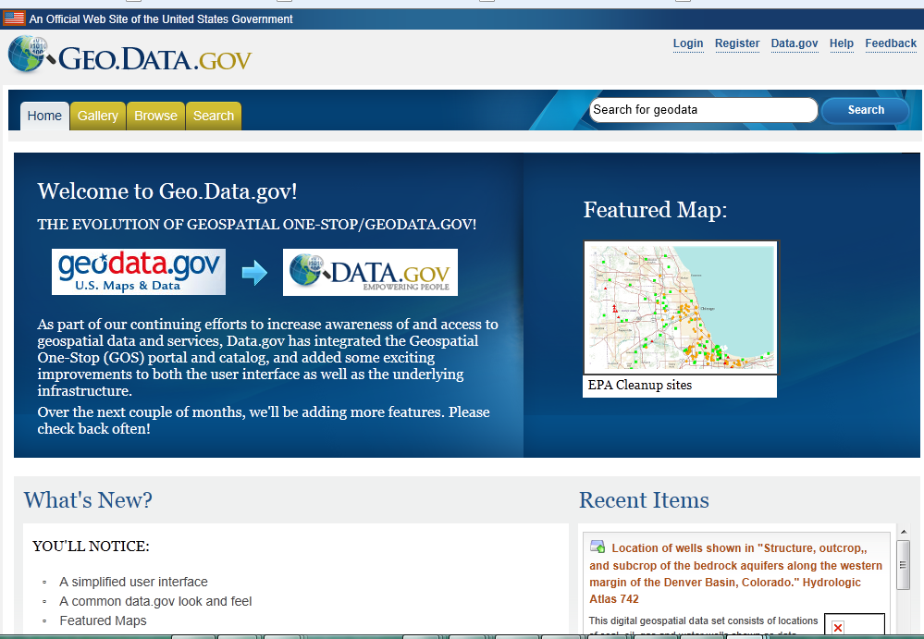
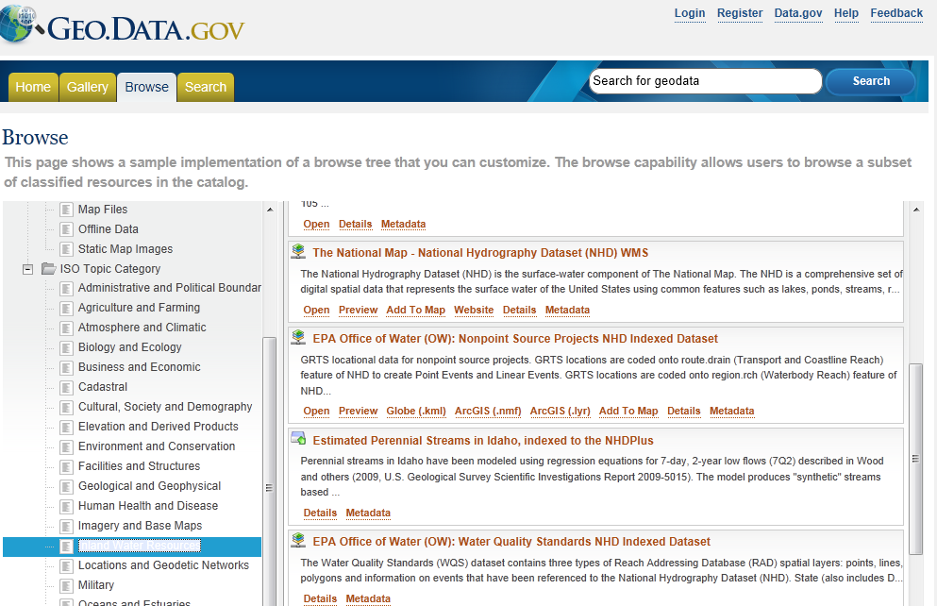
Geo.Data.gov: One Stop shop for links to other data sites
http://geo.data.gov/geoportal/catalog/main/home.page
Open Preview Add To Map Website Details Metadata
National Hydrography Dataset
Inland Water Resources

Slide 4
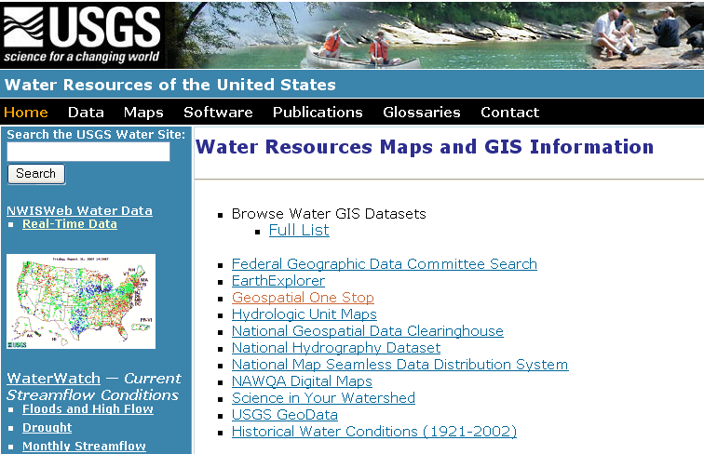
USGS GIS data for Water
http://water.usgs.gov/maps.html

Slide 5
The National Hydrography Dataset (NHD)
Surface-water component of the National map.
Surface water of the United States using common features such as lakes, ponds, streams, rivers, canals, stream gages, and dams.
Polygons are used to represent area features such as lakes, ponds, and rivers;
Lines are used to represent linear features such as streams and smaller rivers;
Points are used to represent point features such as stream gages and dams.
Lines also are used to show the water flow through area features such as the flow of water through a lake.
The combination of lines is used to create a network of water and transported material flow to allow users of the data to trace movement in downstream and upstream directions.
The Watershed Boundary Dataset (WBD) is a companion dataset to the NHD.
WBD defines the perimeter of drainage areas formed by the terrain and other landscape characteristics.

Slide 6
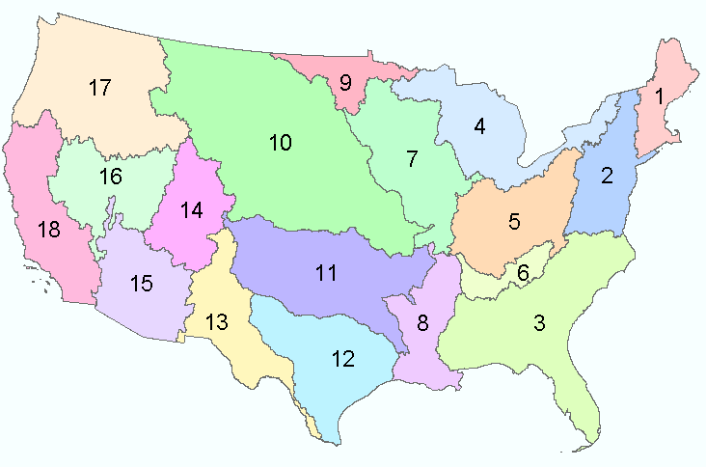
Water Resources Regions of the US
There are 18 water resources regions in the Continental United States
2-digit water resource regions
Region 01 New England
Region 02 Mid-Atlantic
Region 03 South Atlantic-Gulf
Region 04 Great Lakes
Region 05 Ohio
Region 06 Tennessee
Region 07 Upper Mississippi
Region 08 Lower Mississippi
Region 09 Souris-Red-Rainy
Region 10 Missouri
Region 11 Arkansas-White-Red
Region 12 Texas-Gulf
Region 13 Rio Grande
Region 14 Upper Colorado
Region 15 Lower Colorado
Region 16 Great Basin
Region 17 Pacific Northwest
Region 18 California
Region 19 Alaska (Old numbering system)
Region 20 Hawaii
Region 21 Caribbean

Slide 7
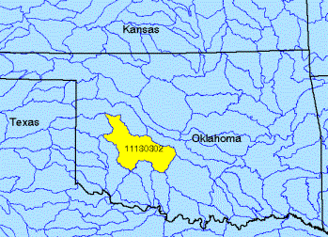
Watersheds of the US
(Every watershed has a unique number!!!)
An eight-digit code uniquely identifies each of the four levels of classification: Hydrologic Unit Code 01080204:
01-Region
0108- The subregion
010802- The accounting Region
01080204- The cataloging unit
8-digit HUC watersheds

Slide 8
Hydrologic Unit Codes - ( HUC)
HUC - 2 REGION Major land areas. The lower 48 states have 18 total, 1 additional
each for Alaska, Hawaii, and the Caribbean. ( 21 Total in US) Called 1st Level - or Watershed 1st Level
HUC - 4 SUBREGION Each Region has from 3 to 30 Subregions. The Missouri River
Region has 30 Subregions. The lower 48 states have 204. ( 222 Total in US). Called 2nd Level
HUC - 6 BASIN Accounting Unit. ( 352 Total in US). Called 3Rd Level
HUC - 8 SUBBASIN Cataloging Unit. The smallest is 448 K Acres (700 mi²). Most
are much larger. National HQ compilations have this as the smallest size unit. ( 2,149 Total in US) Called 4th Level
HUC - 10 WATERSHED Typically from 40 to 250 K Acres (62 to 390 mi²) Called 5 th Level or Watershed 5 th Level.
HUC - 12 SUBWATERSHED Typically from 10 to 40 K Acres (15 to 62 mi²) Called 6 th Level or Watershed 6th Level.

Slide 9
Watershed Hierarchy
Each hydrologic unit is identified by a unique hydrologic unit code (HUC) consisting of two to eight digits based on the four levels of classification in the hydrologic unit system.
Digit #
2
4
6
8 HUC
10
12
NHDPlus
Available
In Progress

Slide 10
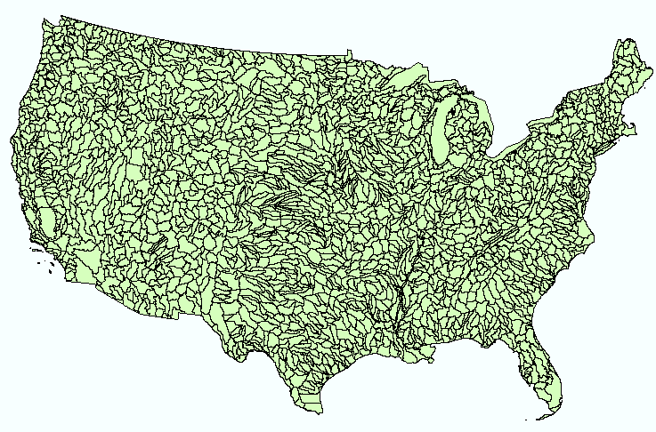
Hydrologic Unit Code Watersheds
~ 2000 HUC 8 for US, about the size of counties

Slide 11
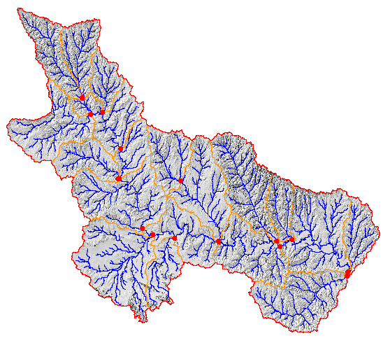
Watershed Boundary Dataset
National Program by USGS and USDA (NRCS)
Boundaries for 10- and 12- digit watersheds
First cut is by automated delineation from NED
Hand checked and edited
10-digit watersheds

Slide 12
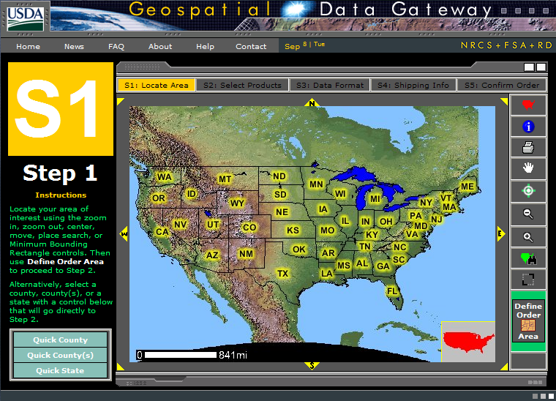
Watershed Boundary DataSet
http://www.ncgc.nrcs.usda.gov/products/datasets/watershed/

Slide 13
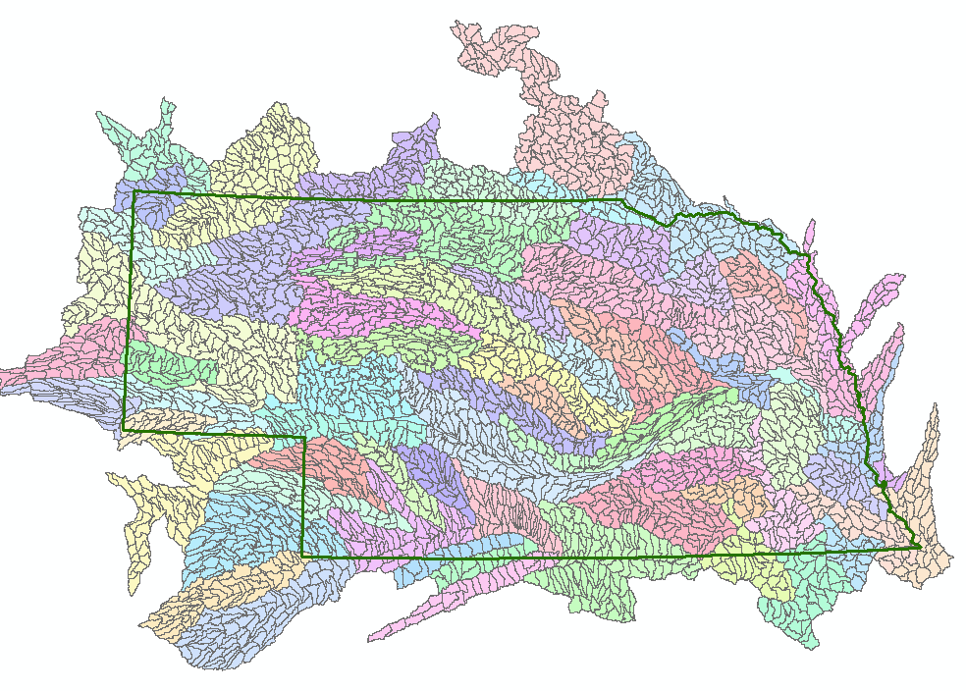
Watershed Boundary Dataset for Nebraska
2990 HUC12 watersheds of average area 39.3 square miles
HUC12:HUC ~ 40:1 watersheds
Notes:
HUCs are important for estimating water supply, water quality, and runoff. They are building blocks of water studies

Slide 14
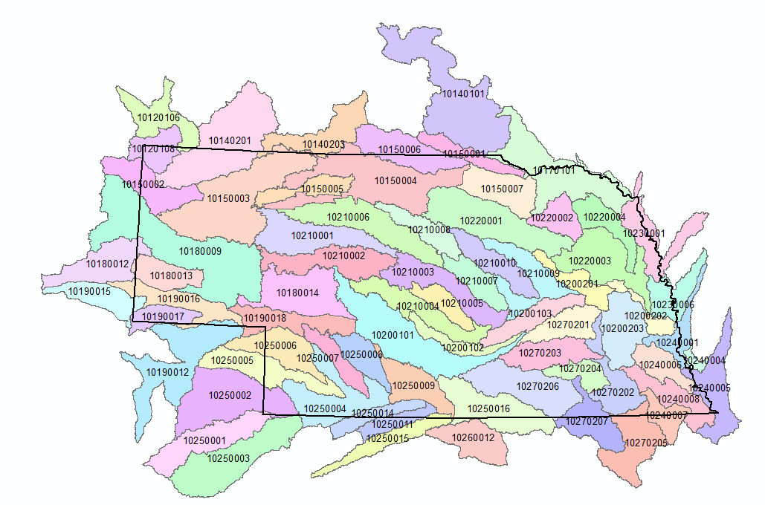
WBD for Nebraska
71 HUC-8 watersheds of average area 1654 square miles

Slide 15
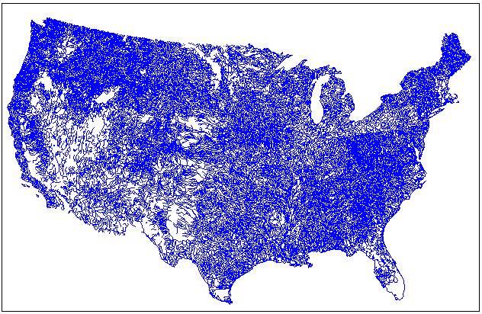
EPA River Reach File 1 (RF1)
EPA uses river reaches to assign water quality information
Hydrologic ordering of reaches so that larger rivers and segment accurately defined along with connectedness and flow direction
In the 1980's, RF1 was used by EPA for performing water quality modeling on whole river basins for all of the hydrologic regions in the United States

Slide 16

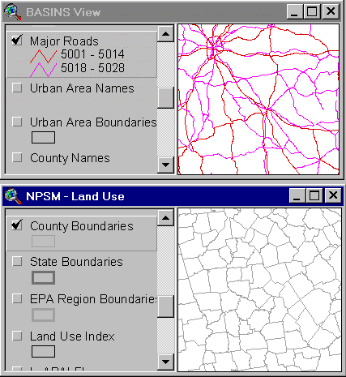
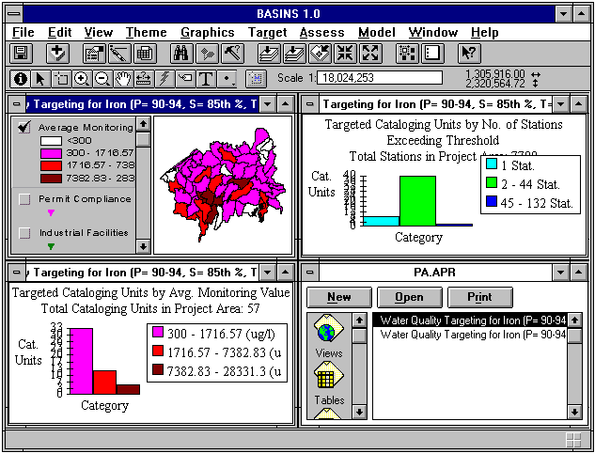

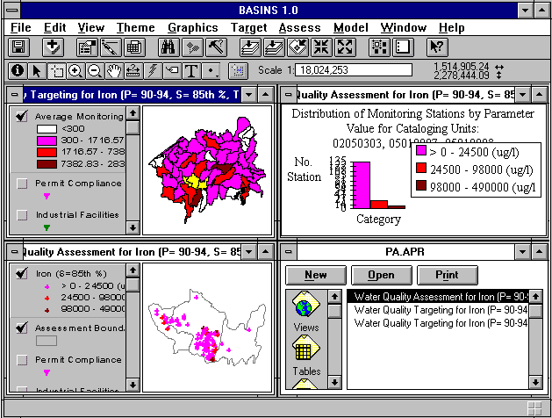

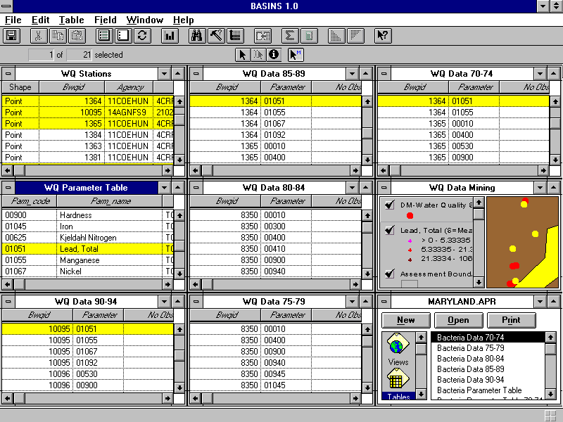
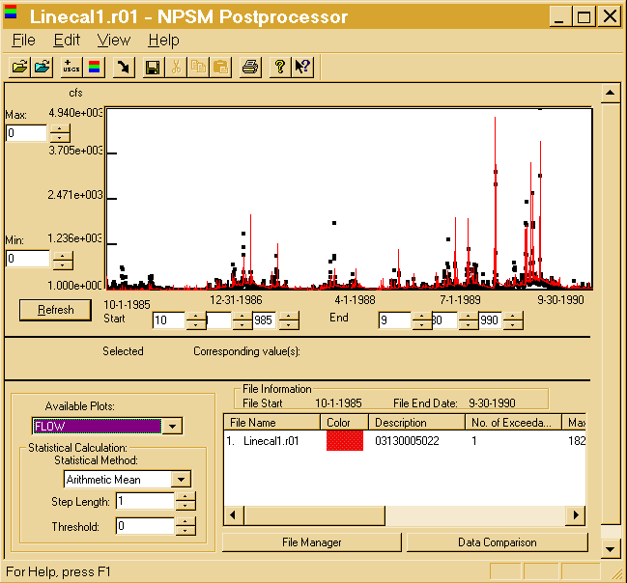
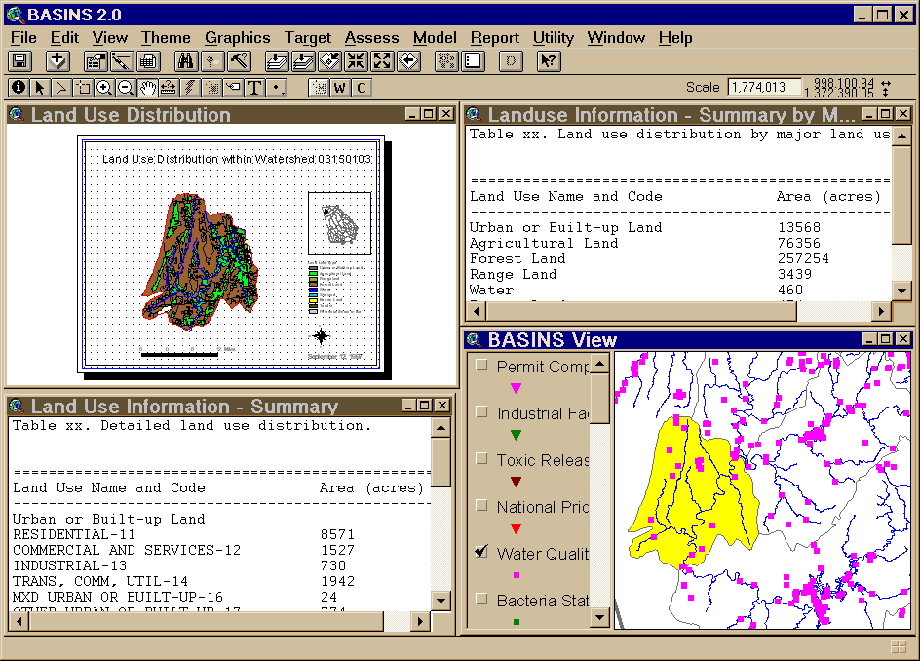
BASINS - Integrating GIS and Water Quality Modeling
Data
Cartographic
Monitoring
Loadings
Tools
Target
Assessment
Data Mining
Reporting
Models
HSPF - NPSM
QUAL2E
TOXIROUTE
Post-Processors
Target
Assess
DM
Decisions
Watershed Management
.
TMDL
.
Source Water Protection
.
Stormwater
State and Local Data
Notes:
Basins is a premier water quality model developd by EPA that heavily uses GIS data

Slide 17

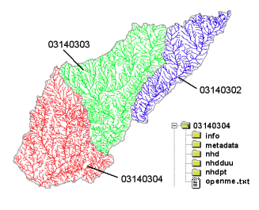
River networks
for 8-digit HUC
watersheds
http://nhd.usgs.gov/

Slide 18
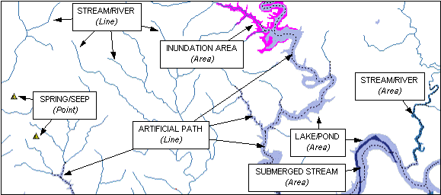

Slide 19

Lower West Fork, Trinity River Basin
HUC = 12030102

Slide 20
NHD River Reaches
412 River Reaches
In Upper West Fork of Trinity Basin

Slide 21
River Reach Codes
Used for river address locations
ReachCode =
12030102000151
ReachCode = 12030102000005
HUC#
Segment#
Location 0.392
on Reach
12030102000005

Slide 22
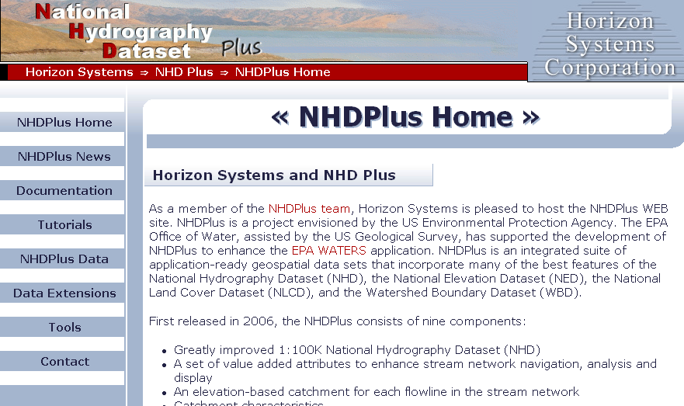
http://www.horizon-systems.com/nhdplus/

Slide 23
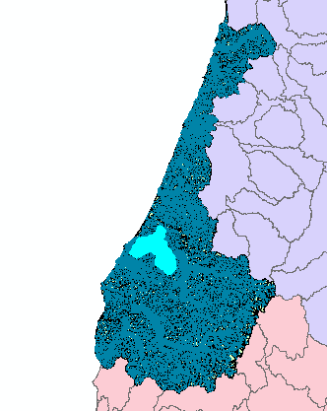
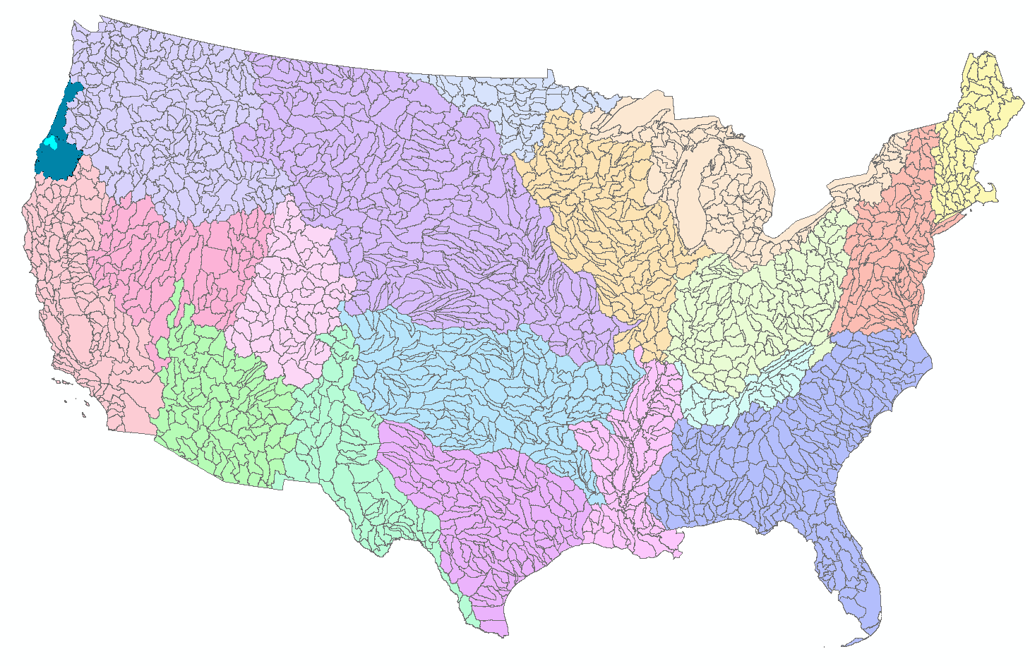
NHDPlus for a Portion of Oregon
http://www.horizon-systems.com/nhdplus/

Slide 24
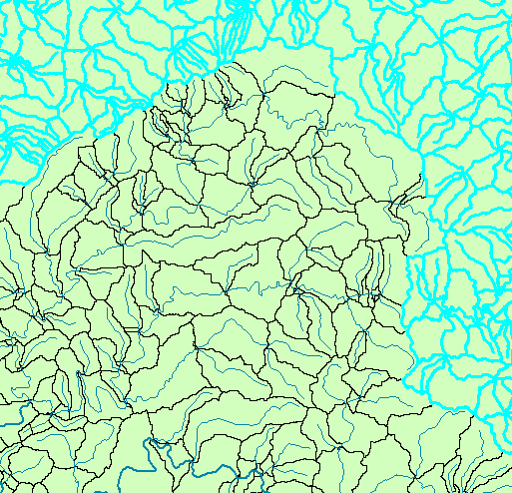
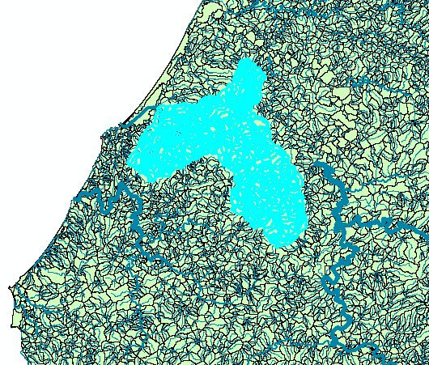
NHDPlus Reach Catchments ~ 3km²
Average reach length = 2km
2.3 million reaches for continental US
About 1000 reach catchments in each 8-digit HUC

Slide 25
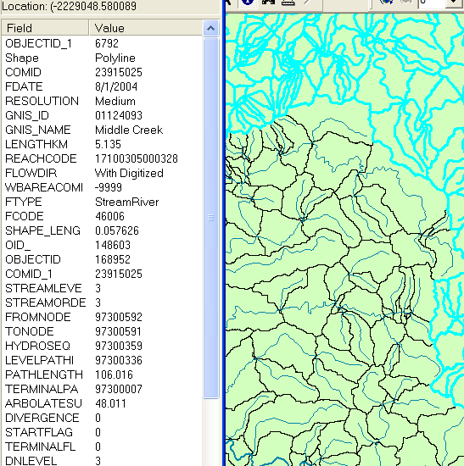
NHDPlus Reach Attributes
Slope
Elevation
Mean annual flow
  Corresponding velocity
Drainage area
% of upstream drainage area in different land uses
Stream order

Slide 26

National Elevation Dataset
http://ned.usgs.gov/
Digital Elevation Model with 1 arc-second (30m) cells
Seamless in 1° blocks for the United States
10 billion data
Derived from USGS 1:24,000 quadrangle sheets
Get the data:
http://nationalmap.gov/viewer.html

Slide 27
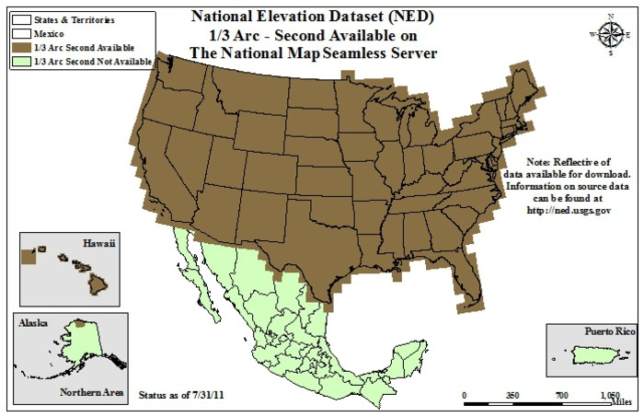
From http://seamless.usgs.gov

Slide 28
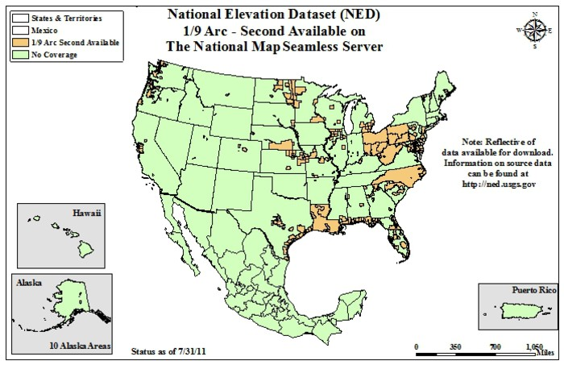
For LIDAR data: Go to http://lidar.cr.usgs.gov/

Slide 29
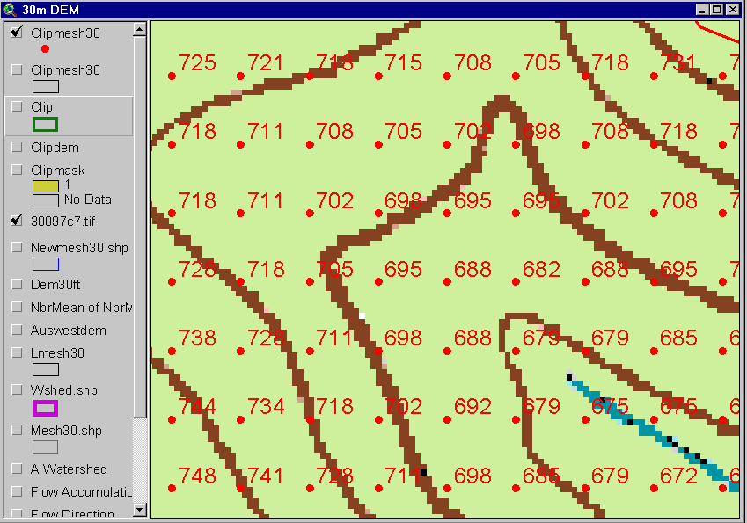
Digital Elevation Model (DEM)
720
720
Contours
740
720
700
680
740
720
700
680

Slide 30
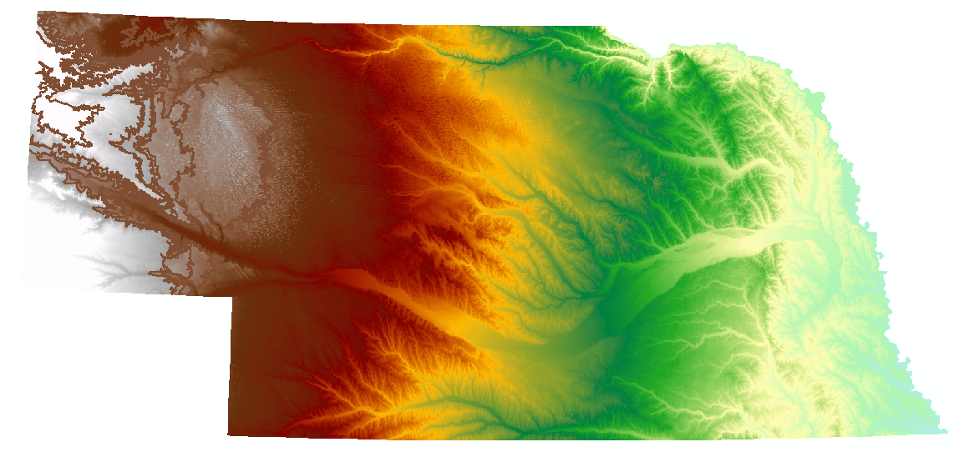
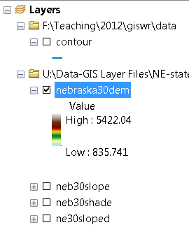
Digital Elevation Model (DEM)-30 meter

Slide 31
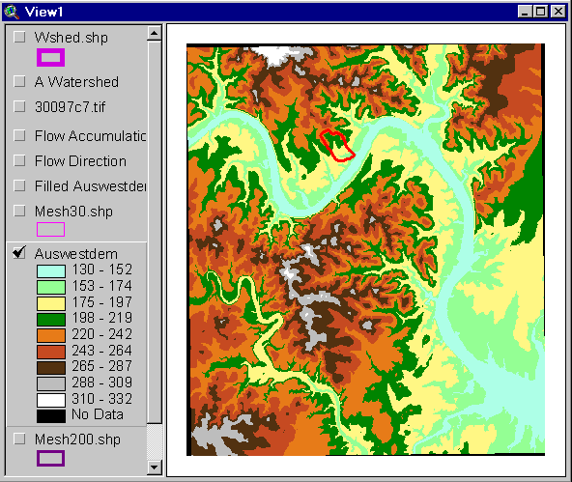
Austin West 30 Meter DEM

Slide 32
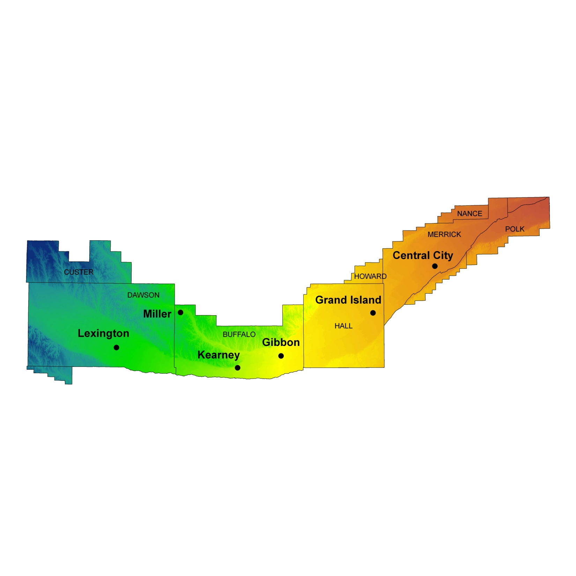
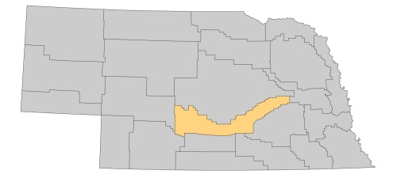
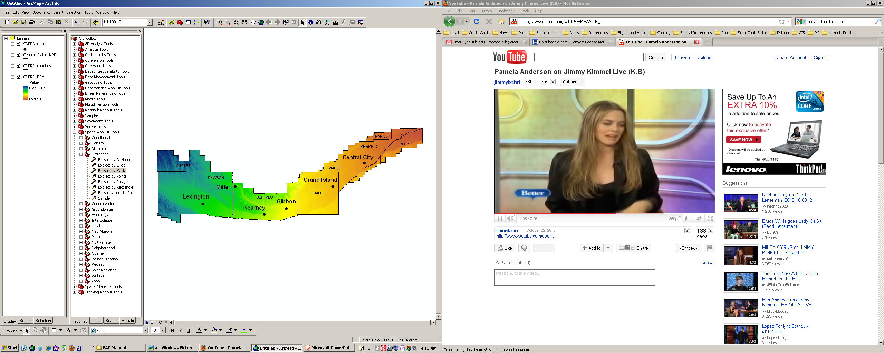

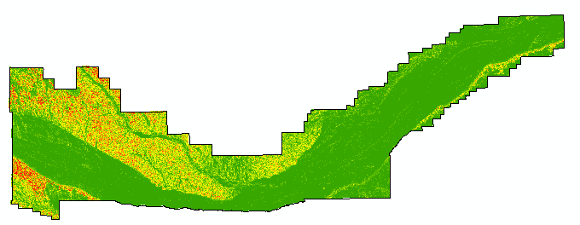

Elevation (m)
Terrain Analysis. DEM derived slope: First derivative of elevation
Slope (percent)

Slide 33
Eight Direction Pour Point Model
ArcGIS raster operations involved in watershed delineation are derived from the premise that “water flows downhill, in doing so, will follow the steepest descent
32
64
128
16
1
8
4
2
Water in a given cell flows one or more of eight adjacent cells in the direction of steepest descent (ArcGIS)

Slide 34
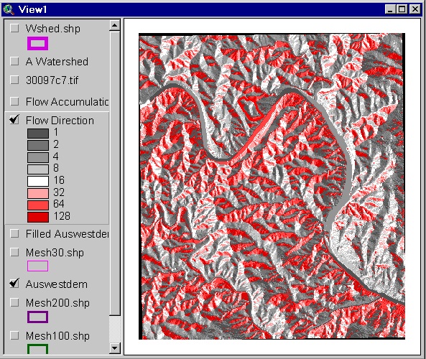
Flow Direction Grid
32
64
128
16
1
8
4
2

Slide 35
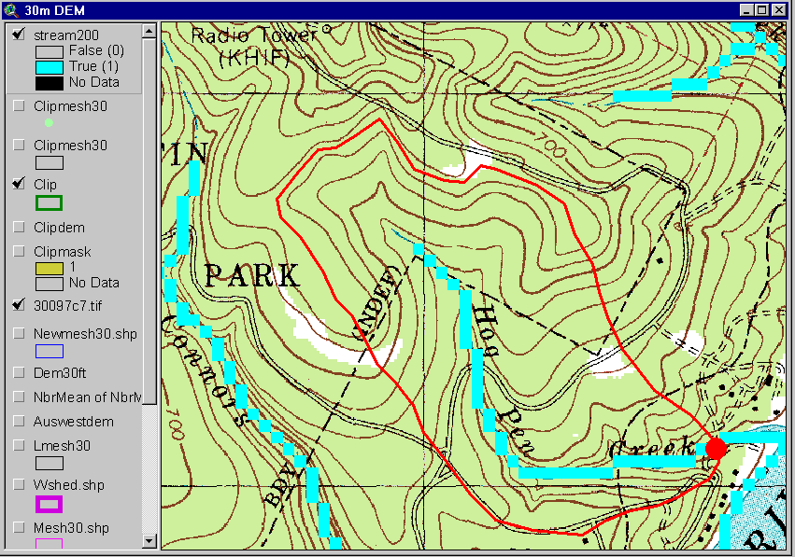
Delineation of Streams and Watersheds on a DEM

Slide 36

http://srtm.usgs.gov/

Slide 37
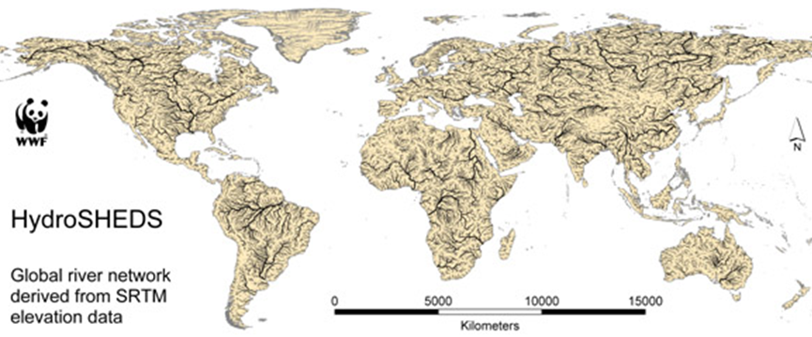
HydroSheds derived from SRTM
http://hydrosheds.cr.usgs.gov/

Slide 38
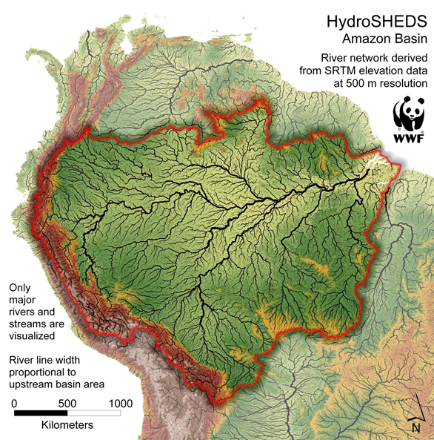

Slide 39
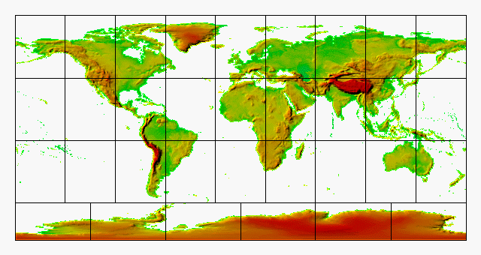
GTOPO30 - 1 km Digital Elevation Model of the Earth
http://eros.usgs.gov/#/Find_Data/Products_and_Data_Available/GTOPO30

Slide 40
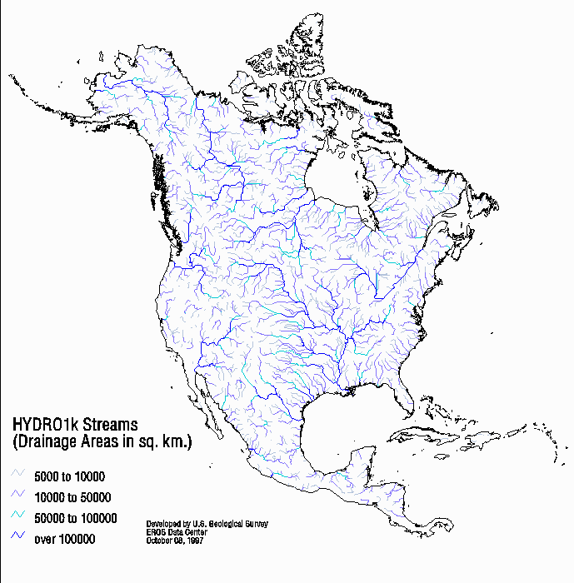
Drainage in North America
Hydro1K is
derived from
GTOPO30
using raster
GIS analysis
http://eros.usgs.gov/#/Find_Data/Products_and_Data_Available/gtopo30/hydro

Slide 41
Soil Data
Natural Resources Conservation Service (NRCS)
National Cartography and Geospatial Center (NCGC)
State Soil Geographic Database-STASGO
Soil Survey Geographic Database- SURGO
http://websoilsurvey.nrcs.usda.gov/app/WebSoilSurvey.aspx
http://www.soils.usda.gov/survey/geography/ssurgo/
http://www.soils.usda.gov/survey/geography/statsgo/

Slide 42

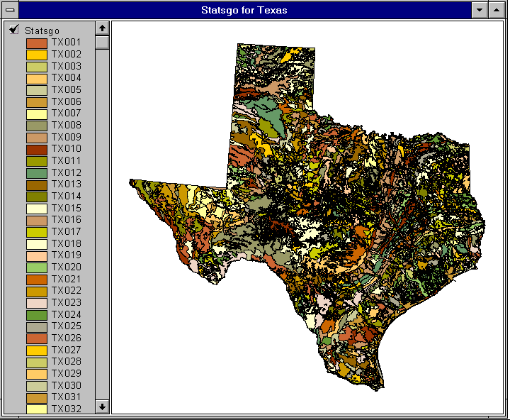

1:250,000 Scale Soil Information
http://www.soils.usda.gov/survey/geography/statsgo/

Slide 43
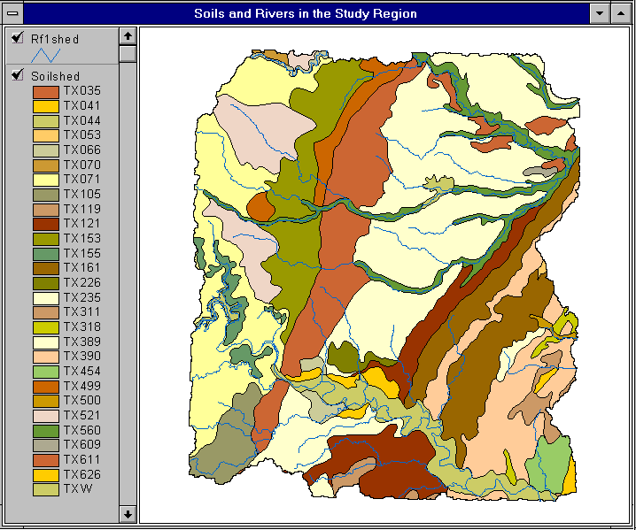

Slide 44
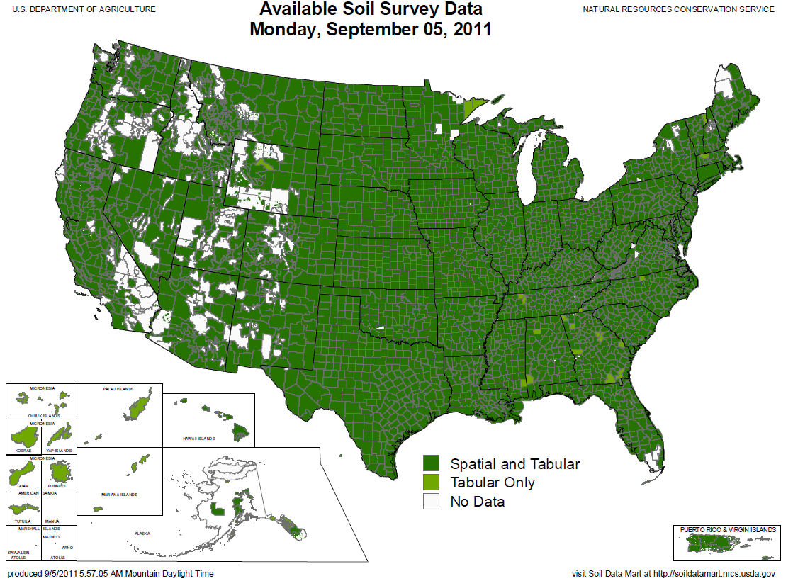
SSURGO:
County Level
Digital Soil Maps
1:24,000 scale
soil information
http://www.soils.usda.gov/survey/geography/ssurgo/

Slide 45
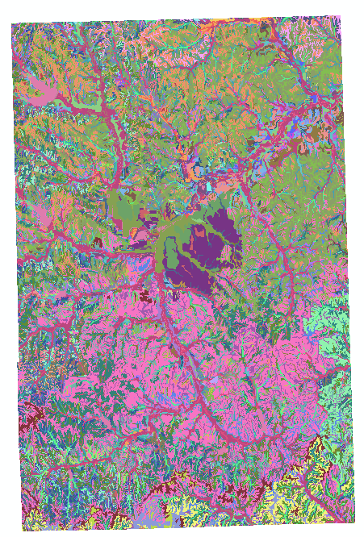
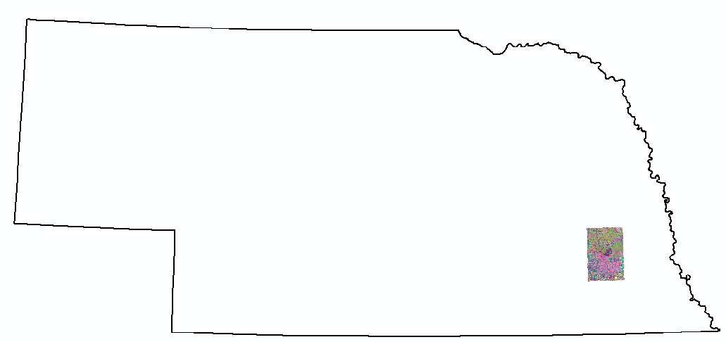
Ssurgo for Lancaster County, NE
96 soil map units described by 18,565 polygons

Slide 46
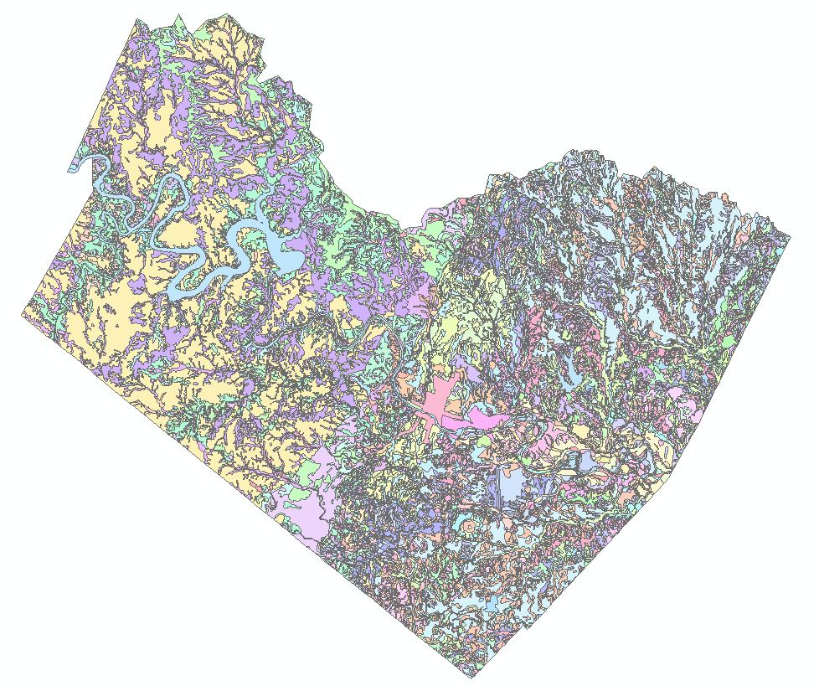
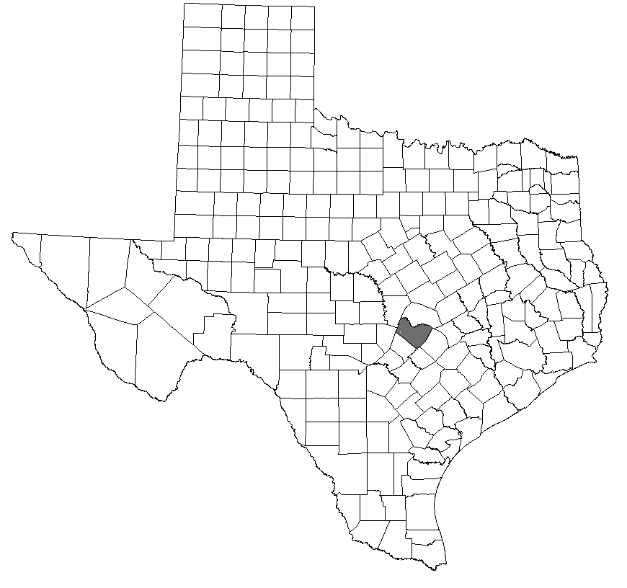
Ssurgo for Travis County
103 soil map units described by 7530 polygons of average area 35.37 ha (87 acres)

Slide 47
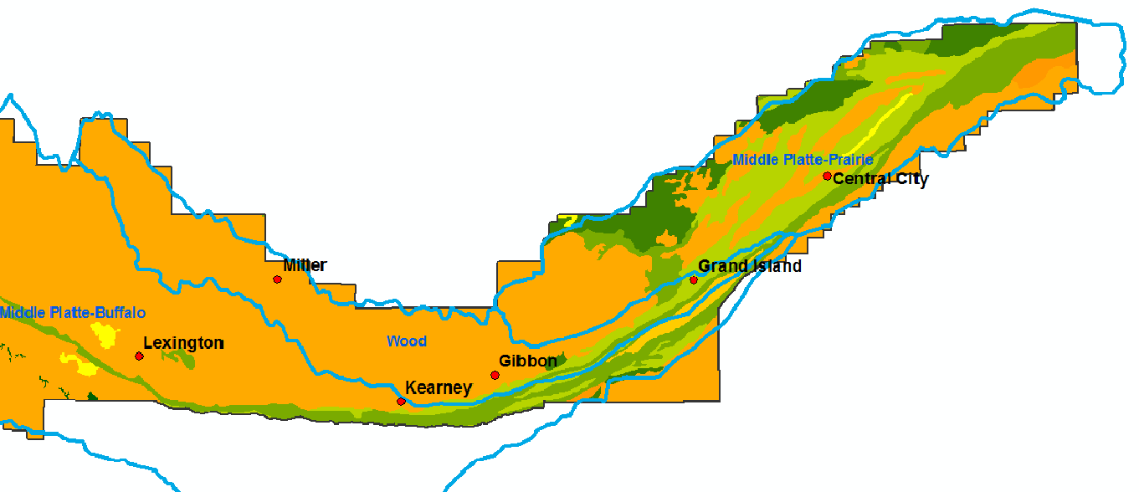
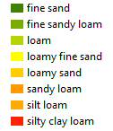


Soil texture
Field capacity (%)

Slide 48

http://landcover.usgs.gov/

Slide 49


National Land Cover Dataset
1992, 2001, and 2006
Get the data:
http://www.mrlc.gov/

Slide 50

http://www.mrlc.gov/finddata.php

Slide 51


National Land Cover Dataset-NLCD 2006

Slide 52


Slide 53


http://www.nationalatlas.gov/atlasftp.html

Slide 54

http://www.ncdc.noaa.gov/oa/ncdc.html

Slide 55


PRISM Mean Annual Precipitation (Oregon State U.)
Historical- Gridded
http://www.wcc.nrcs.usda.gov/climate/prism.html

Slide 56


http://www.daymet.org/
Historical- Gridded Weather data

Slide 57

National Water Information System
Web access to USGS water
resources data in real time
http://waterdata.usgs.gov/usa/nwis/

Slide 58


USGS Water Watch
Web access to USGS water resources data in real time
http://waterdata.usgs.gov/nwis/rt

Slide 59


USGS National Water Information System.
Real-time and Historic Data
  Streamflow and stage
  Groundwater levels
  Water Quality
  Site information
Tabular or Graphical Format

Slide 60

NASA Satellite Data
http://landsatlook.usgs.gov/
http://reverb.echo.nasa.gov
https://lpdaac.usgs.gov/

Slide 61

http://water.weather.gov/ahps/

Slide 62

http://water.weather.gov/ahps/

Slide 63


http://www.wcc.nrcs.usda.gov/snotel/

Slide 64

http://www.cbrfc.noaa.gov

Slide 65

CBRFC SNOTEL Ensemble
http://www.cbrfc.noaa.gov/station/sweplot/sweplot.cgi?tglu1

Slide 66

http://www.arcgis.com

Slide 67



Slide 68

http://gis.utah.gov

Slide 69

Utah Terrain Basemap
To use as a basemap in ArcGIS see instructions at
http://gis.utah.gov/map-services/new-utah-terrain-base-map-and-cached-tile-service-available

Slide 70

Utah GIS Portal Download GIS Data
http://gis.utah.gov/download

Slide 71

http://geology.utah.gov/maps/gis/index.htm

Slide 72

http://www.wrcc.dri.edu/

Slide 73

http://dnr.ne.gov/databank/geospatial.html

Slide 74

http://dnr.ne.gov/databank/spat.html

Slide 75

“National Map” in Nebraska
http://nmviewogc.cr.usgs.gov/viewer.htm?bbox=-104.5,39.5,-95,43.5

Slide 76

http://nebraskaview.unl.edu/neview02.php

Slide 77

http://drought.unl.edu/

