Slide 1
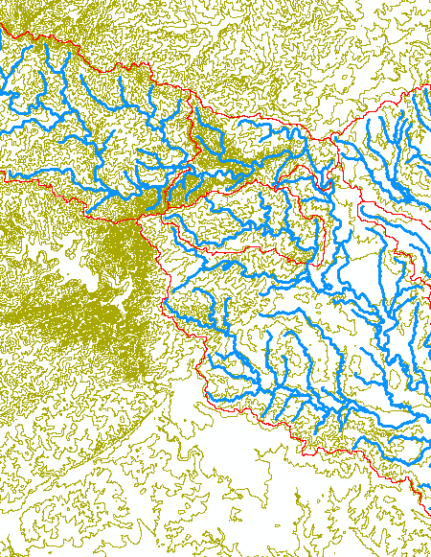
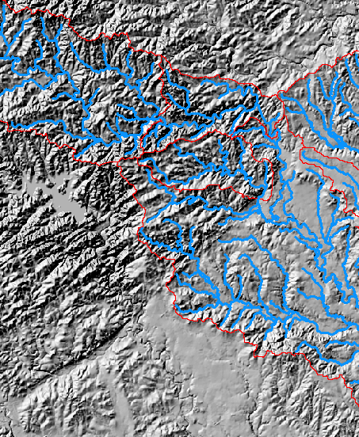
Key Spatial Analysis Concepts from Exercise 3
Contours and Hillshade to visualize topography

Slide 2
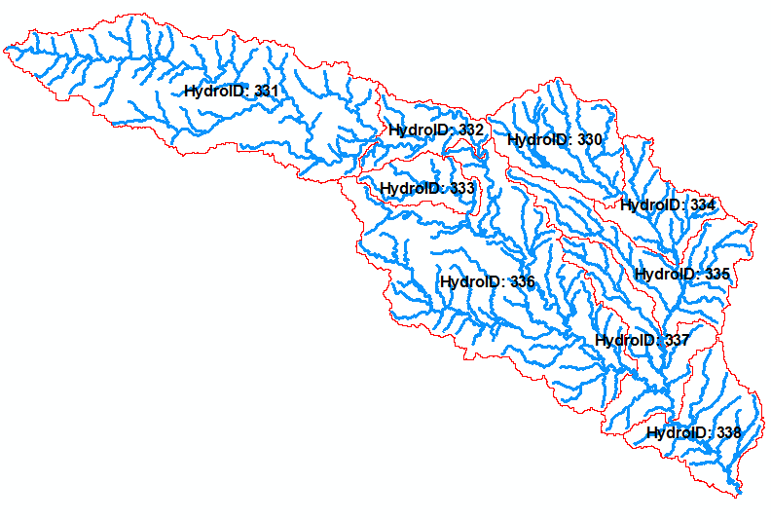
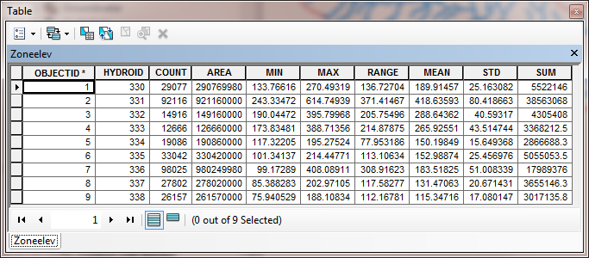
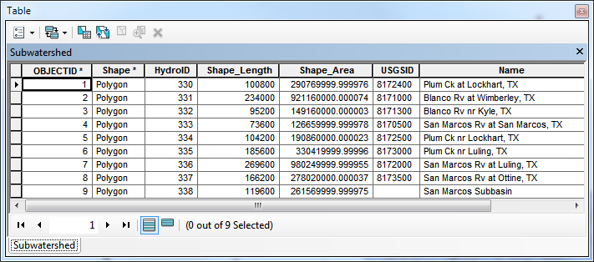
Zonal Average of Raster over Subwatershed
Join

Slide 3
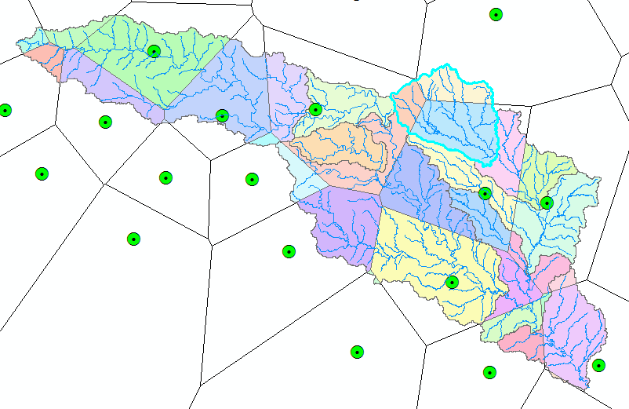
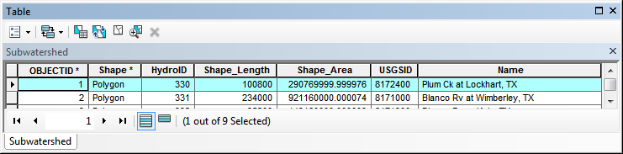
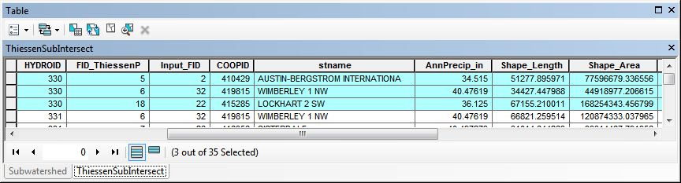
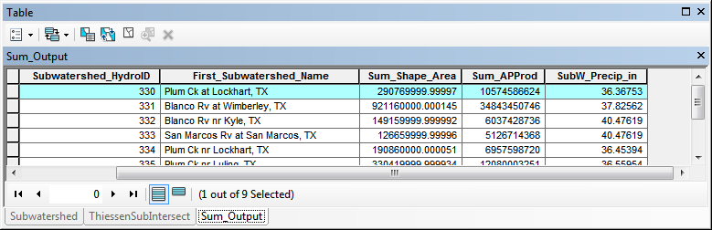
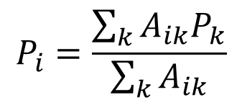
Subwatershed Precipitation by Thiessen Polygons
Thiessen Polygons
Intersect with Subwatersheds
Evaluate A*P Product
Summarize by subwatershed
$$P_{i}=\frac{\sum_{k}{A_{ik}P_{k}}}{\sum_{k}{A_{ik}}}$$

Slide 4
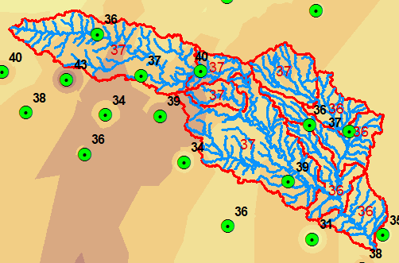
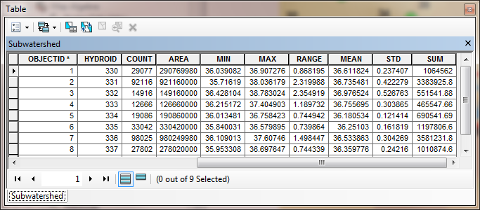
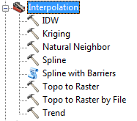
Subwatershed Precipitation by Interpolation
Kriging (on Precip field)
Zonal Statistics (Mean)
Join
Export

Slide 5
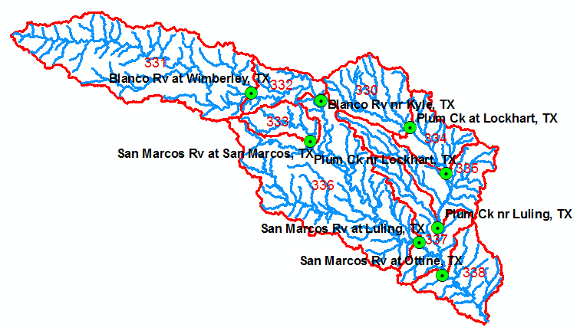
Runoff Coefficients
Interpolated precip for each subwatershed
Convert to volume, P
Sum over upstream subwatersheds in Excel
Runoff volume, Q
Ratio of Q/P
Watershed | HydroID's
Plum Ck at Lockhart, TX | 330
Blanco Rv nr Kyle, TX | 331, 332
San Marcos Rv at Luling, TX | 331,332,333,336

Slide 6
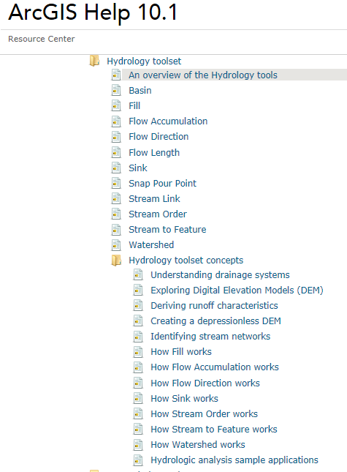
Digital Elevation Model Based Watershed and Stream Network Delineation
Readings
At http://resources.arcgis.com, in the Desktop | Geoprocessing | Tool Reference | Spatial Analyst Toolbox Hydrology Toolset start from “An overview of the Hydrology tools” http://resources.arcgis.com/en/help/main/10.1/index.html#//009z0000004w000000 and read to end of Hydrologic analysis sample applications in the Hydrology toolset concepts section
How to use
Understanding

Slide 7
The Terrain Flow Information Model
Pit removal
Flow direction field derivation
Flow Accumulation
Channels and Watersheds
Raster to Vector Connection

Slide 8
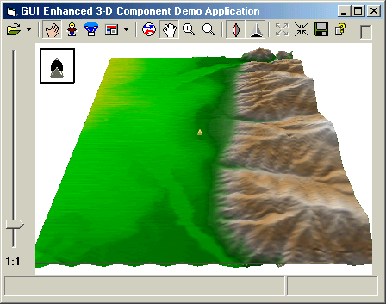

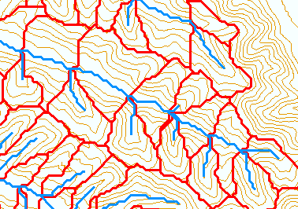
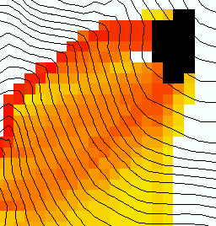
The terrain flow information model for deriving channels, watersheds, and flow related terrain information.
Raw DEM
Pit Removal (Filling)
Channels, Watersheds, Flow Related Terrain Information
Flow Field
Watersheds are the most basic hydrologic landscape elements
Notes:
This slide shows the general model for deriving flow field related derivative surfaces from digital elevation data. The input is a raw digital elevation model, generally elevation values on a grid. This is basic information used to derive further hydrology related spatial fields that enrich the information content of this basic data. The first step is to remove sinks, either by filling, or carving. Then a flow field is defined. This enables the calculation of flow related terrain information. My focus has been on flow related information working within this framework. I try to leave other GIS functionality, like radiation exposure, line of sight analyses and visualization to others. I have distributed my software in ways that it easily plugs in to mainstream systems, such as ArcGIS to enhance ease of use.

Slide 9
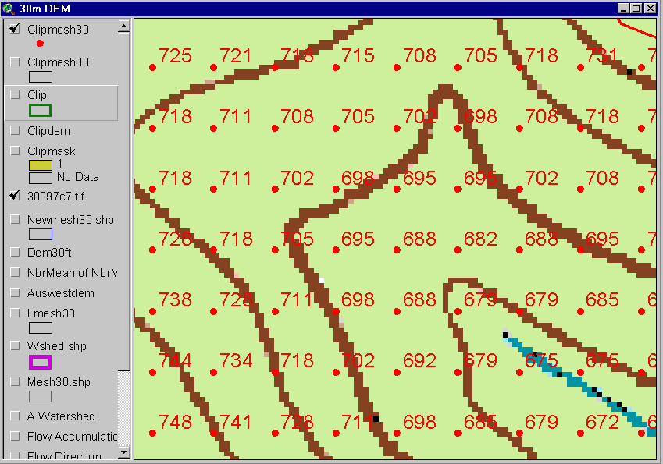
DEM Elevations
720
720
Contours
740
720
700
680
740
720
700
680

Slide 10
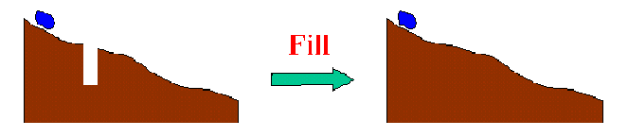
The Pit Removal Problem
DEM creation results in artificial pits in the landscape
A pit is a set of one or more cells which has no downstream cells around it
Unless these pits are removed they become sinks and isolate portions of the watershed
Pit removal is first thing done with a DEM

Slide 11
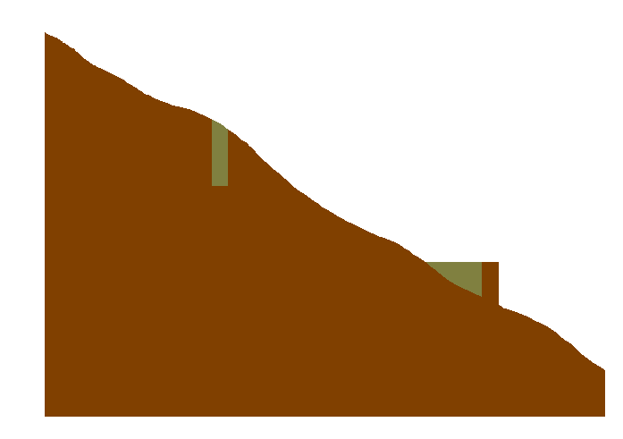

Pit Filling
Increase elevation to the pour point elevation until the pit drains to a neighbor

Slide 12
Pit Filling
Original DEM
Pits Filled
Pits
Pour Points
Notes:
Elevations are filled to that of the pools pour point

Slide 13
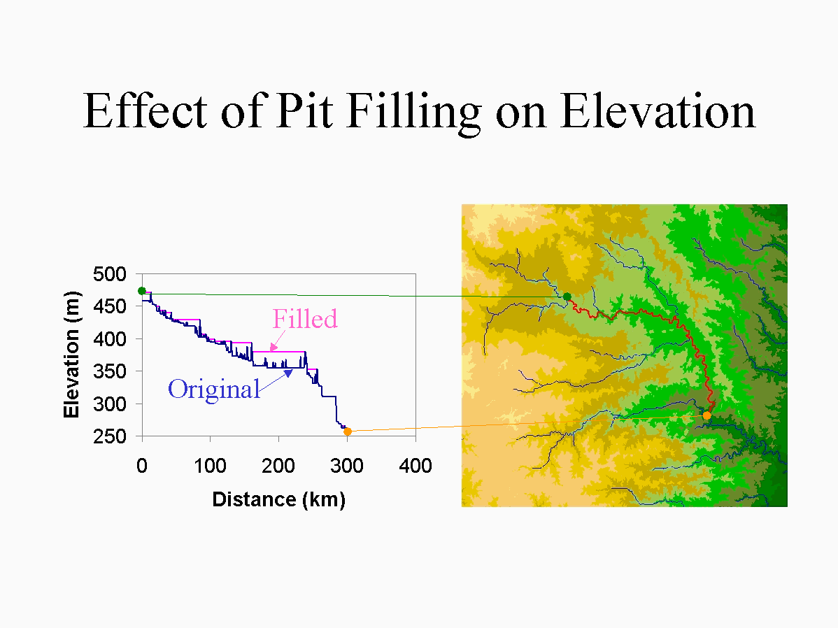

Slide 14
Hydrologic Slope
- Direction of Steepest Descent
30
30
80
74
63
80
74
63
69
67
56
69
67
56
60
52
48
60
52
48
Slope:

Slide 15
Eight Direction (D8) Flow Model
32
64
128
16
1
8
4
2
2
2
4
4
8
1
2
4
8
4
4
1
2
4
8
2
4
4
4
4
1
2
1
4
16

Slide 16
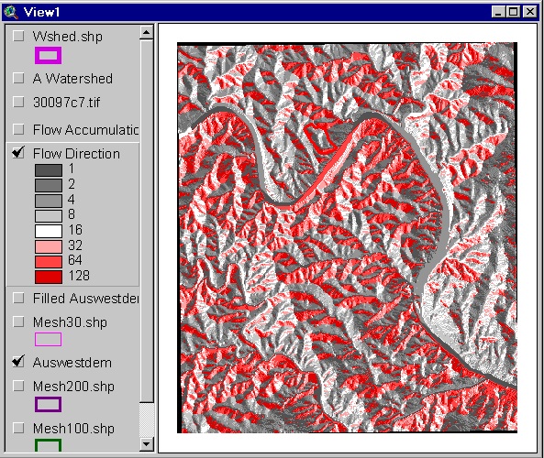
Flow Direction Grid
32
64
128
16
1
8
4
2

Slide 17
Grid Network

Slide 18
Flow Accumulation Grid.
Area draining in to a grid cell
0
0
0
0
0
0
0
0
0
0
0
2
2
2
0
0
2
2
2
0
0
0
10
0
1
0
0
1
0
10
1
0
0
14
0
1
0
0
0
14
0
4
1
19
1
0
4
1
1
19
Link to Grid calculator
ArcHydro Page 72

Slide 19
Stream Network for 10 cell Threshold Drainage Area
Flow Accumulation
> 10 Cell Threshold
0
0
0
0
0
0
0
0
0
0
0
2
2
2
0
0
2
2
2
0
0
0
10
0
1
0
0
1
0
10
1
0
0
14
0
1
0
0
0
14
0
4
1
19
1
0
4
1
1
19

Slide 20
TauDEM contributing area convention.
1
1
1
1
1
1
1
1
1
1
1
3
3
3
1
1
3
3
3
1
1
1
11
1
2
1
1
1
2
11
2
1
1
15
1
2
1
1
1
15
1
5
2
20
2
1
5
2
2
25
The area draining each grid cell includes the grid cell itself.

Slide 21
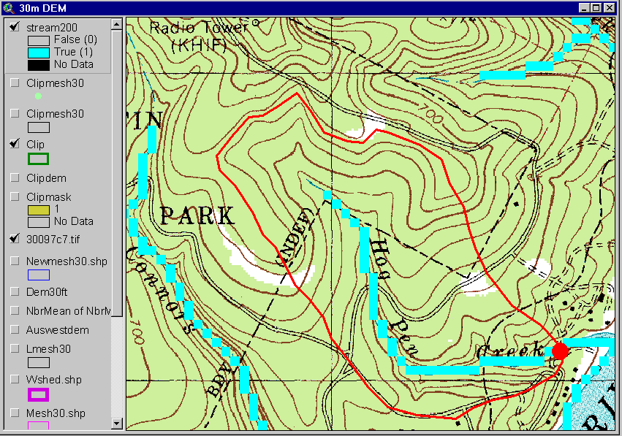
Streams with 200 cell Threshold
(>18 hectares or 13.5 acres drainage area)

Slide 22
Watershed Draining to Outlet

Slide 23
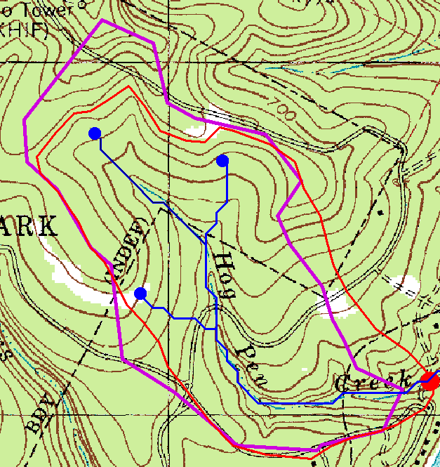
Watershed and Drainage Paths Delineated from 30m DEM
Automated method is more consistent than hand delineation

Slide 24
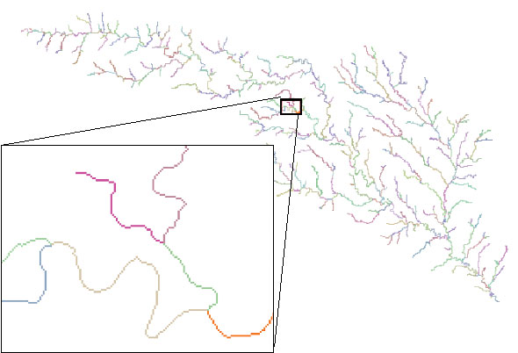
Stream Segments
201
172
202
203
206
204
209
Each link has a unique identifying number
ArcHydro Page 74

Slide 25
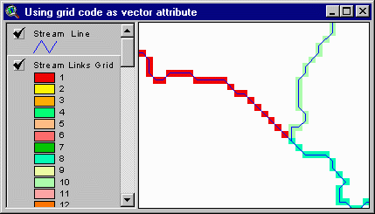
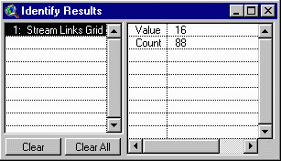
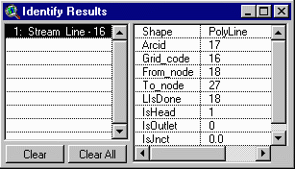
Vectorized Streams Linked Using Grid Code to Cell Equivalents
Vector
Streams
Grid
Streams
ArcHydro Page 75

Slide 26
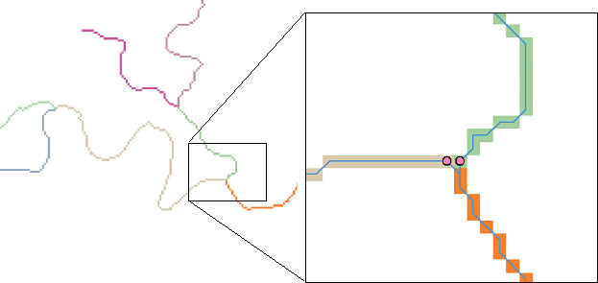
DrainageLines are drawn through the centers of cells on the stream links. DrainagePoints are located at the centers of the outlet cells of the catchments
ArcHydro Page 75

Slide 27
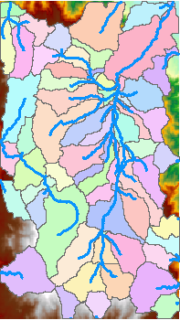
Catchments
For every stream segment, there is a corresponding catchment
Catchments are a tessellation of the landscape through a set of physical rules

Slide 28
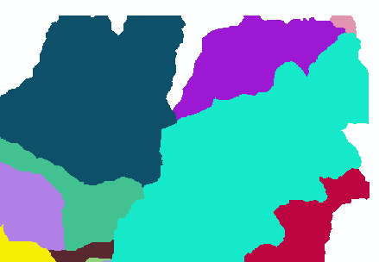
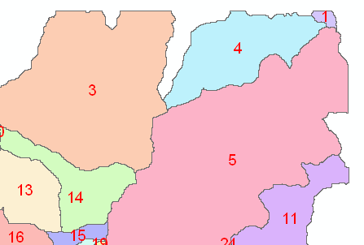
Raster Zones and Vector Polygons
One to one connection
DEM GridCode
Catchment GridID
4
3
5
Raster Zones
Vector Polygons

Slide 29
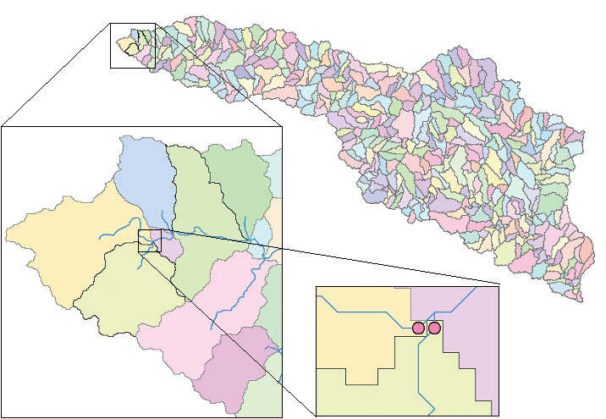
Catchments, DrainageLines and DrainagePoints of the San Marcos basin
ArcHydro Page 75

Slide 30
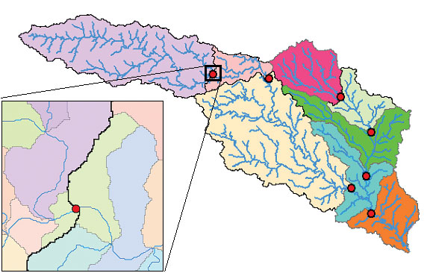
Catchment, Watershed, Subwatershed.
Subwatersheds
Catchments
Watershed
Watershed outlet points may lie within the interior of a catchment, e.g. at a USGS stream-gaging site.
ArcHydro Page 76

Slide 31
Advanced Considerations
Using vector stream information (DEM reconditioning)
Enhanced pit removal
Channelization threshold selection
Computational considerations

Slide 32
“Burning In” the Streams
• Take a mapped stream network and a DEM
• Make a grid of the streams
• Raise the off-stream DEM cells by an arbitrary elevation
increment
• Produces "burned in" DEM streams = mapped streams
+
=

Slide 33
AGREE Elevation Grid Modification Methodology – DEM Reconditioning

Slide 34

Carving
Lower elevation of neighbor along a predefined drainage path until the pit drains to the outlet point

Slide 35
Carving
Original DEM
Carved DEM
Pits
Carve outlets
Notes:
Elevations are filled to that of the pools pour point

Slide 36
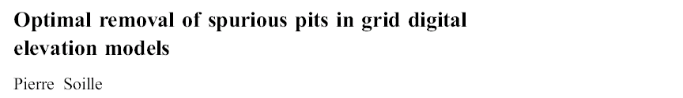
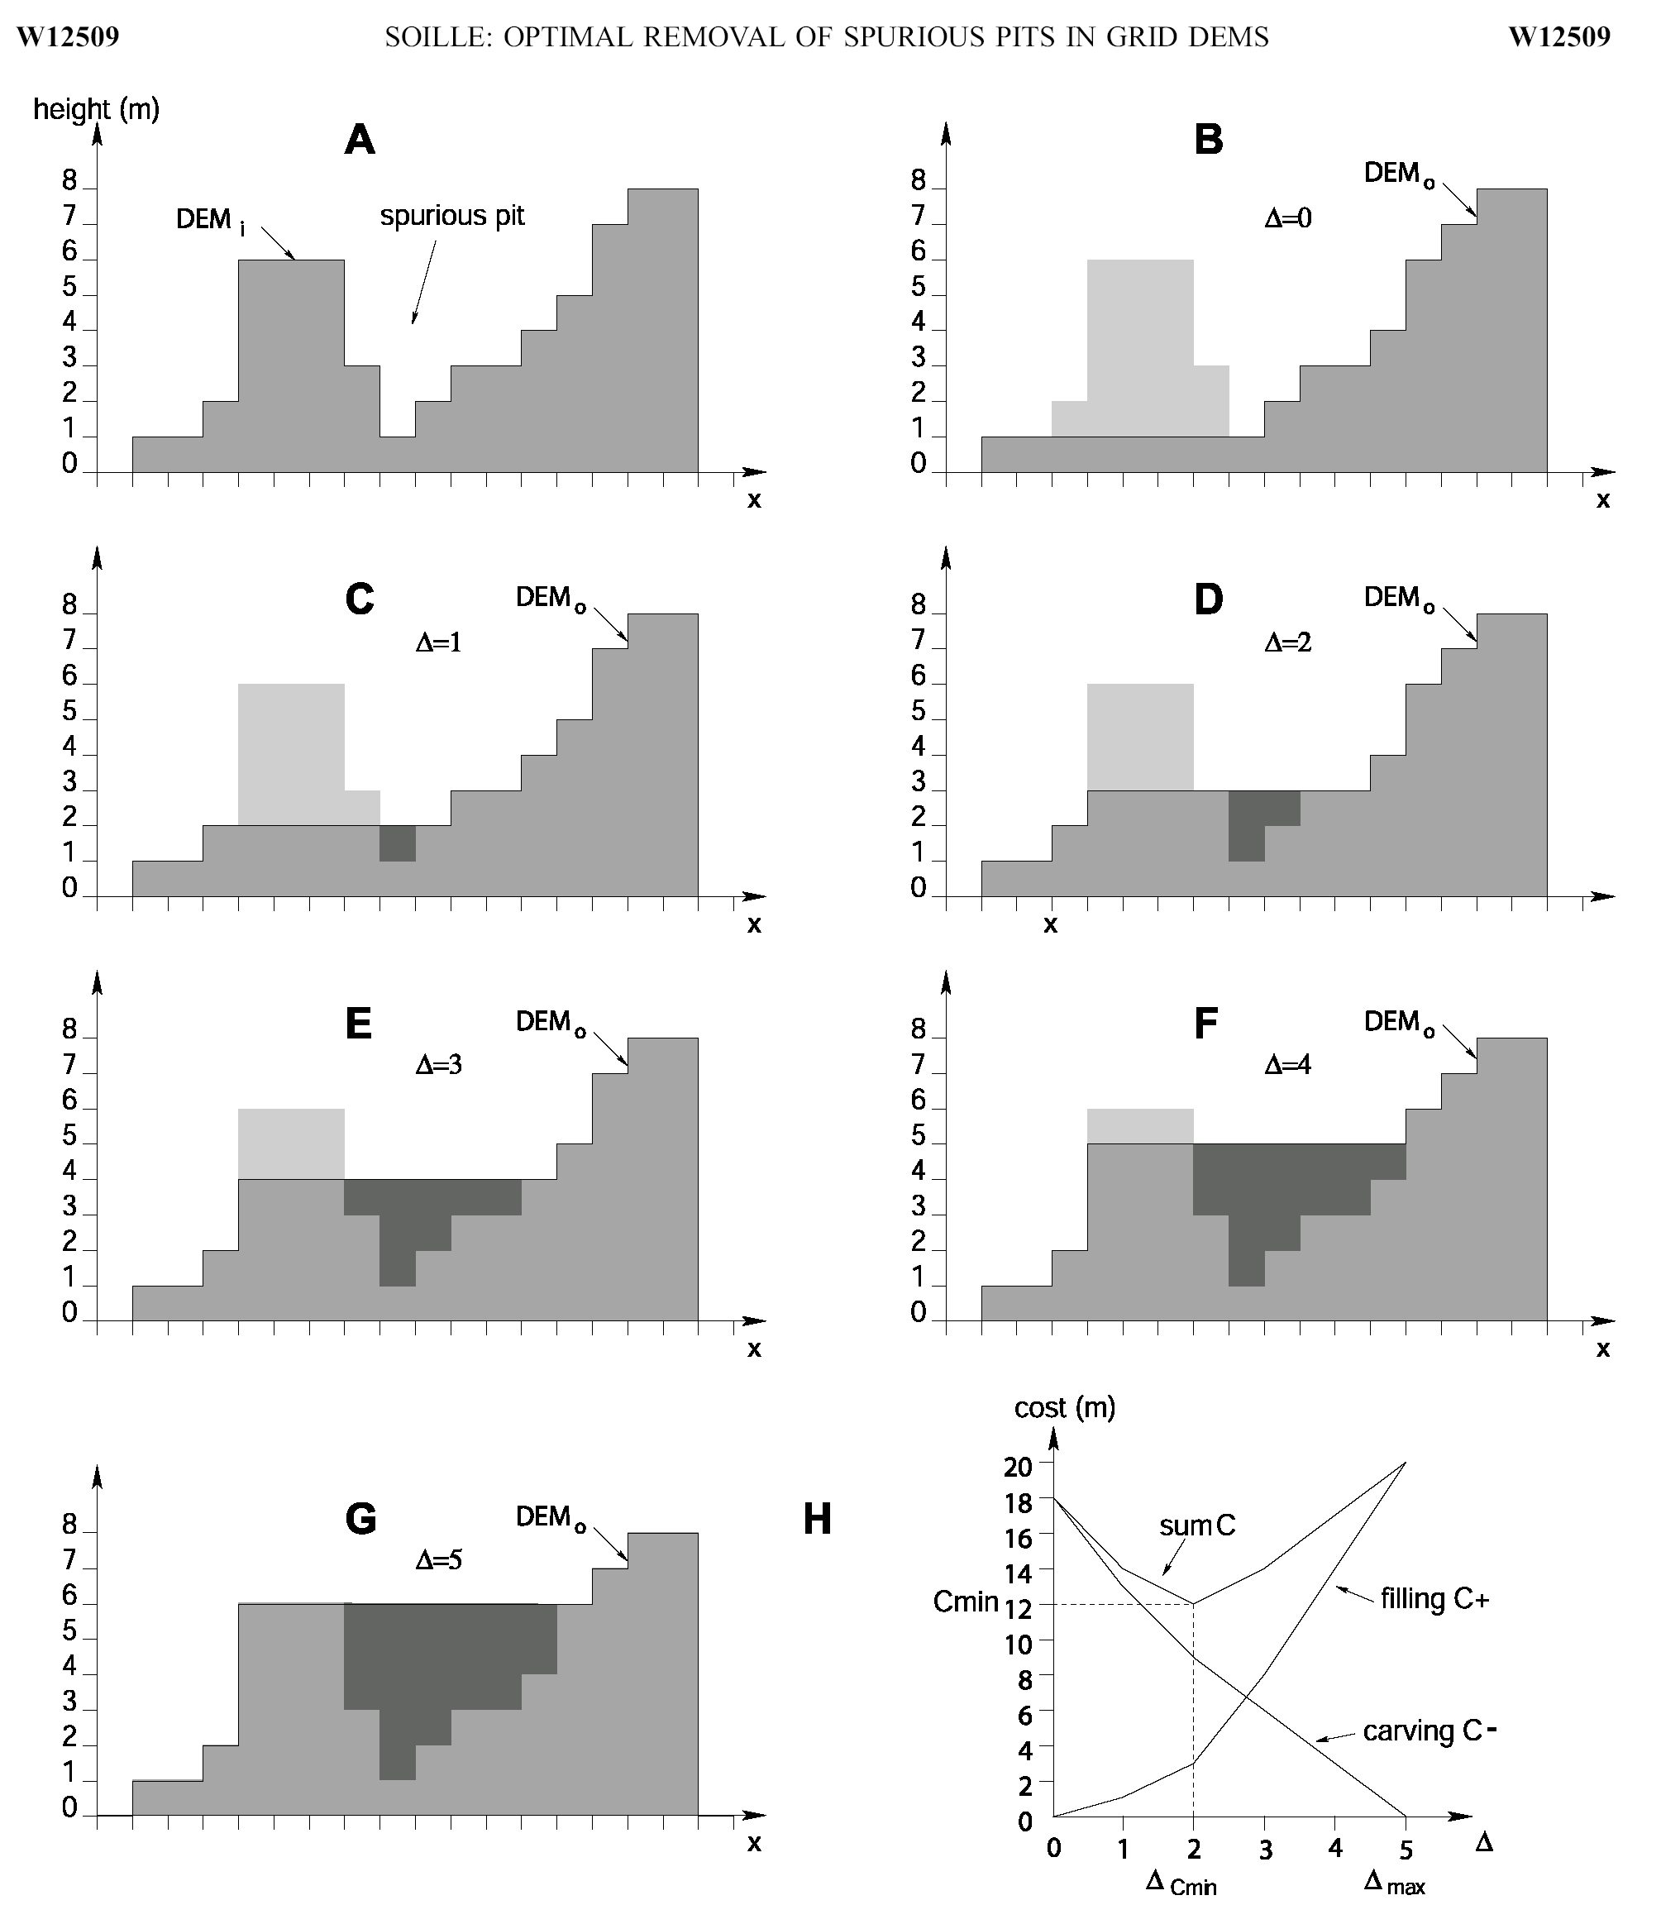
Filling
Minimizing Alterations
Carving

Slide 37
Minimizing DEM Alterations
Original DEM
Optimally adjusted
Carved
Pits
Filled
Notes:
Elevations are filled to that of the pools pour point

Slide 38
How to decide on stream delineation threshold ?
AREA 2
3
AREA 1
12
Why is it important?

Slide 39
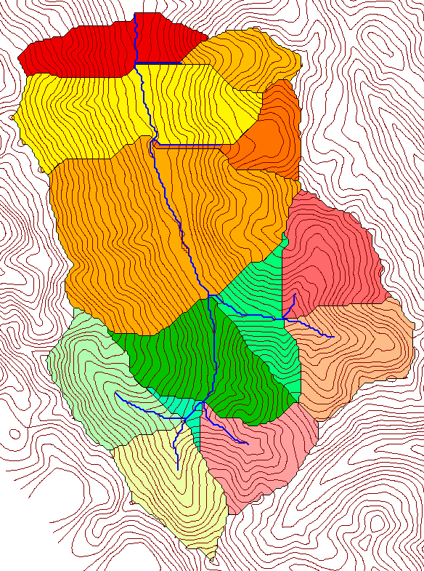
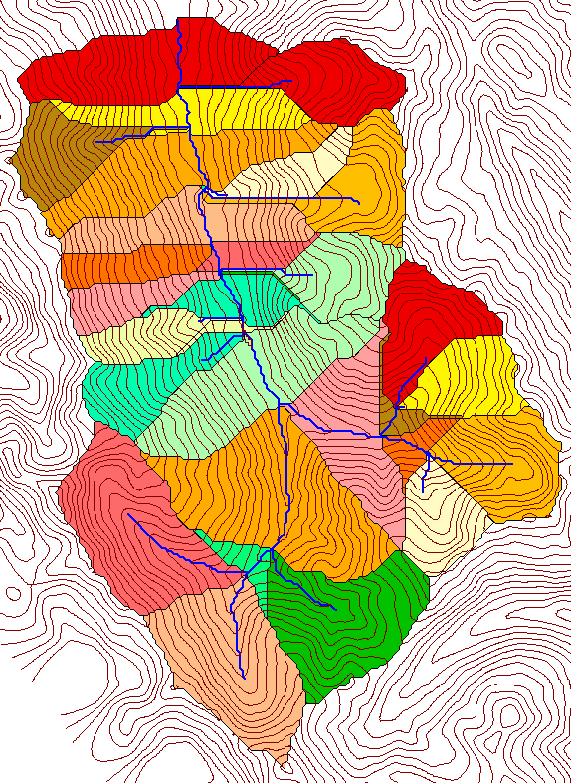
Delineation of Channel Networks and Catchments
500 cell theshold
1000 cell theshold

Slide 40
Hydrologic processes are different on hillslopes and in channels. It is important to recognize this and account for this in models.
Drainage area can be concentrated or dispersed (specific catchment area) representing concentrated or dispersed flow.

Slide 41
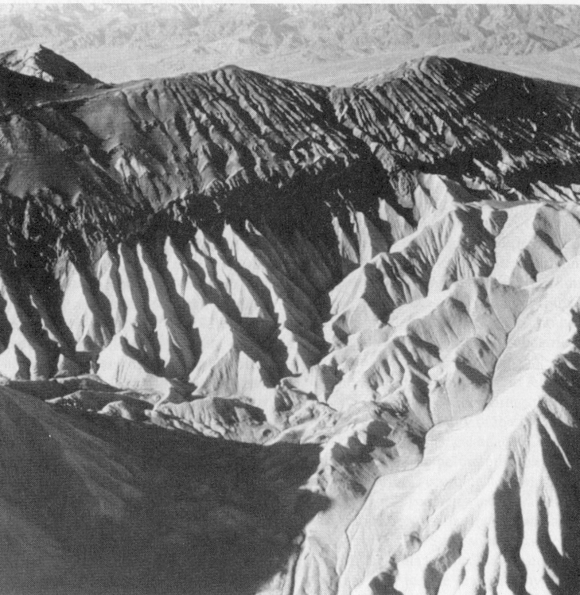
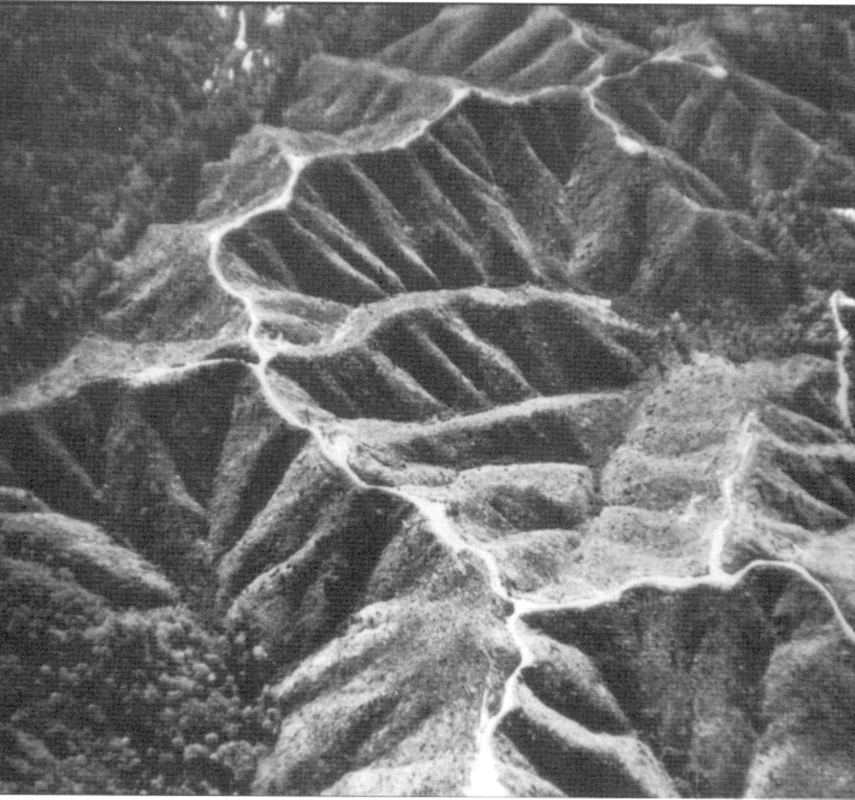
Examples of differently textured topography
Badlands in Death Valley.
from Easterbrook, 1993, p 140.
Coos Bay, Oregon Coast Range.
from W. E. Dietrich

Slide 42
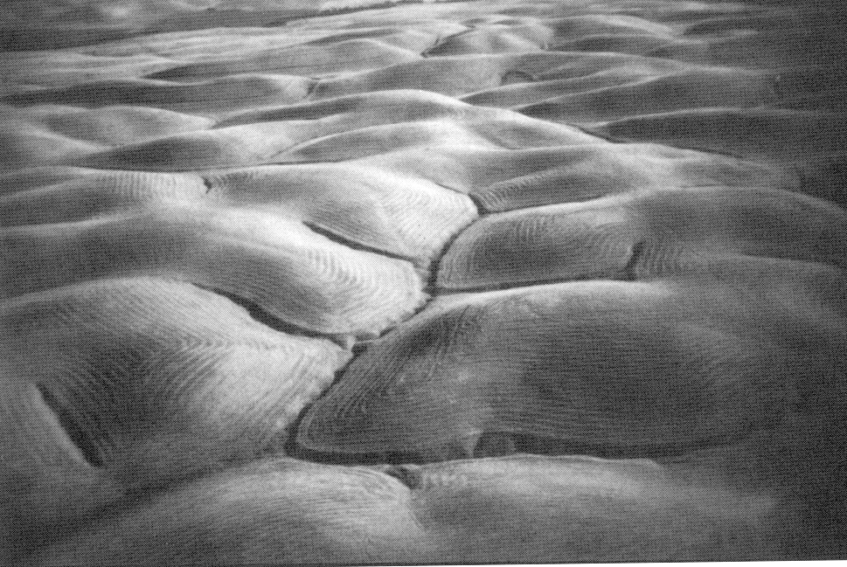
Gently Sloping Convex Landscape
From W. E. Dietrich

Slide 43
Topographic Texture and Drainage Density
Driftwood, PA
Same scale, 20 m contour interval
Sunland, CA

Slide 44
“landscape dissection into distinct valleys is limited by a threshold of channelization that sets a finite scale to the landscape.” (Montgomery and Dietrich, 1992, Science, vol. 255 p. 826.)
Suggestion: One contributing area threshold does not fit all watersheds.
Lets look at some geomorphology.
    Drainage Density
    Horton’s Laws
    Slope – Area scaling
    Stream Drops

Slide 45
Drainage Density
D_{d} = L/A
Hillslope length ≈ 1/2D_{d}
B
B
Hillslope length = B
A = 2B L
D_{d} = L/A = 1/2B
∴ B= 1/2D_{d}
L

Slide 46
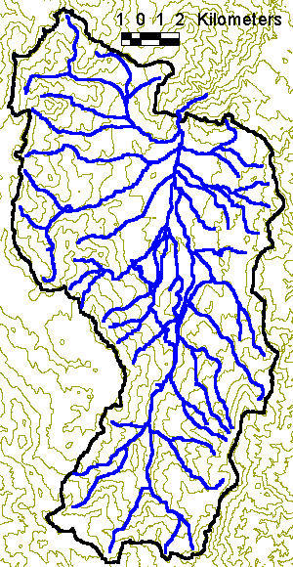
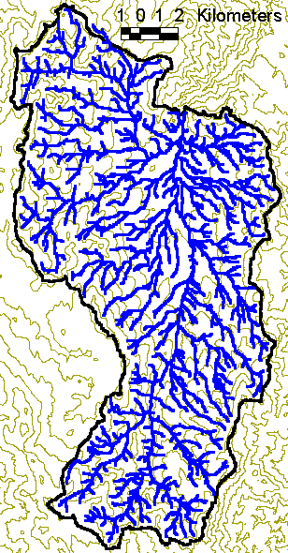
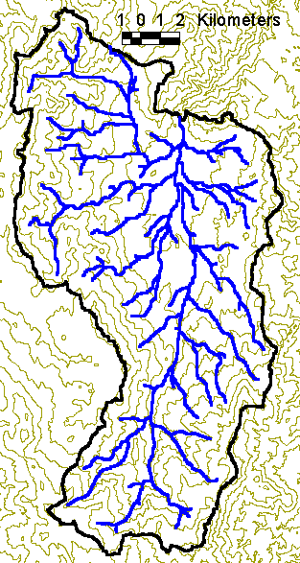
Drainage Density for Different Support Area Thresholds
EPA Reach Files
100 grid cell threshold
1000 grid cell threshold

Slide 47
Drainage Density Versus Contributing Area Threshold

Slide 48
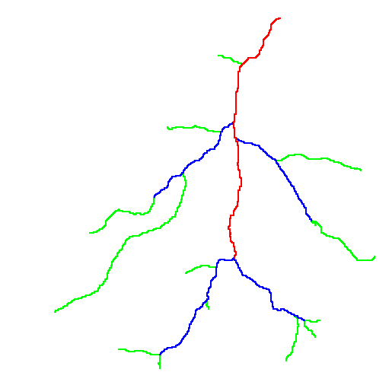
Hortons Laws: Strahler system for stream ordering
1
3
1
2
1
2
1
1
1
1
1
2
2
1
1
1
1
1
1

Slide 49
Length Ratio

Slide 50
Slope Ratio

Slide 51
Constant Stream Drops Law
Broscoe, A. J., (1959), "Quantitative analysis of longitudinal stream profiles of small watersheds," Office of Naval Research, Project NR 389-042, Technical Report No. 18, Department of Geology, Columbia University, New York.

Slide 52
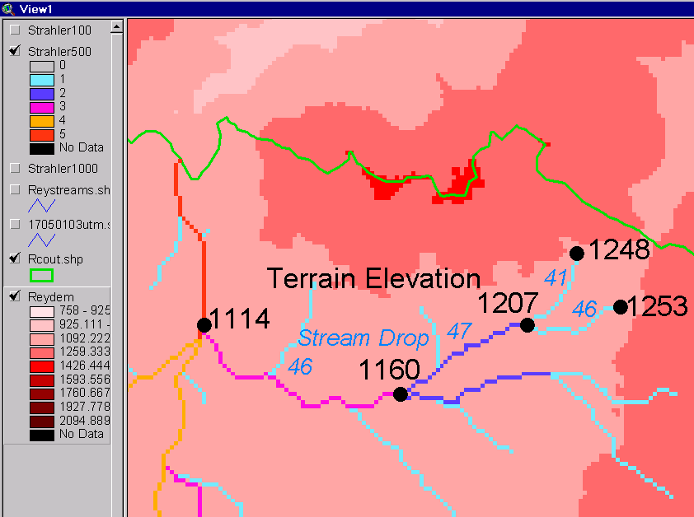
Stream Drop
Elevation difference between ends of stream
Nodes
Links
Single Stream
Note that a “Strahler stream” comprises a sequence of links (reaches or segments) of the same order

Slide 53
Suggestion: Map channel networks from the DEM at the finest resolution consistent with observed channel network geomorphology ‘laws’.
Look for statistically significant break in constant stream drop property as stream delineation threshold is reduced
Break in slope versus contributing area relationship
Physical basis in the form instability theory of Smith and Bretherton (1972), see Tarboton et al. 1992

Slide 54
Statistical Analysis of Stream Drops

Slide 55
T-Test for Difference in Mean Values
0
72
130
T-test checks whether difference in means is large (> 2)
when compared to the spread of the data around the mean values

Slide 56
Constant Support Area Threshold

Slide 57
100 grid cell constant support area threshold stream delineation

Slide 58
200 grid cell constant support area based stream delineation

Slide 59
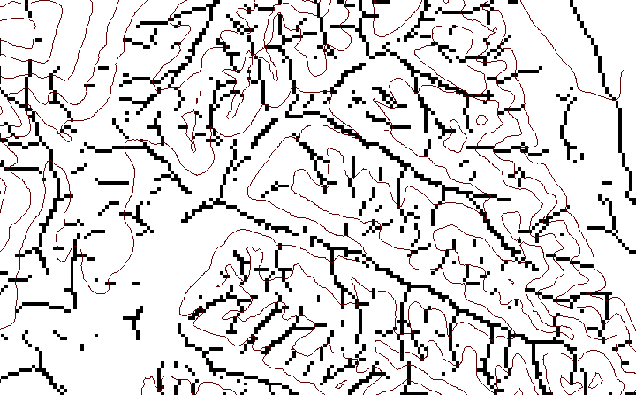
Local Curvature Computation
(Peuker and Douglas, 1975, Comput. Graphics Image Proc. 4:375)
43
48
48
51
51
56
41
47
47
54
54
58

Slide 60
Contributing area of upwards curved grid cells only

Slide 61
Upward Curved Contributing Area Threshold

Slide 62
Curvature based stream delineation

Slide 63
Channel network delineation, other options
4
3
2
5
1
6
7
8
Contributing Area
Grid Order
1
1
1
1
1
1
1
1
1
1
1
4
3
3
1
1
2
2
2
1
1
1
12
1
2
1
1
3
1
1
1
1
2
16
1
1
1
1
3
1
1
3
6
25
2
1
2
2
3
1

Slide 64
Grid network pruned to order 4 stream delineation

Slide 65
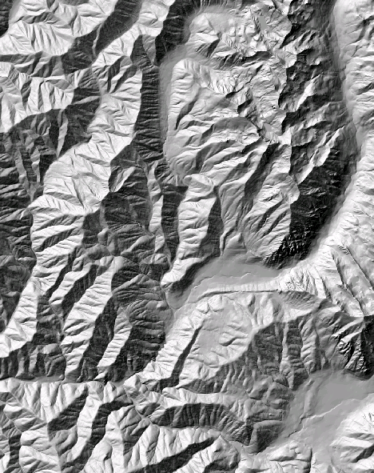
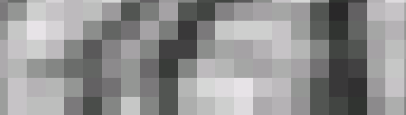


The challenge of increasing Digital Elevation Model (DEM) resolution
1980’s DMA 90 m
10² cells/km²
1990’s USGS DEM 30 m
10³ cells/km²
2000’s NED 10-30 m
10⁴ cells/km²
2010’s LIDAR ~1 m
10⁶ cells/km²

Slide 66

Computational Considerations – A Parallel Programming Approach
Improved runtime efficiency
Capability to run larger problems
Row oriented slices
Each process includes one buffer row on either side
Each process does not change buffer row

Slide 67
Pit Removal: Planchon Fill Algorithm
Initialization
1st Pass
2nd Pass
Planchon, O., and F. Darboux (2001), A fast, simple and versatile algorithm to fill the depressions of digital elevation models, Catena(46), 159-176.

Slide 68
Parallel Scheme
Communicate
Initialize( D,P) Do for all i in P if D(i) > n P(i) ← D(i) Else P(i) ← n endfor Send( topRow, rank-1 ) Send( bottomRow, rank+1 ) Recv( rowBelow, rank+1 ) Recv( rowAbove, rank-1 ) Until P is not modified
D denotes the original elevation.
P denotes the pit filled elevation.
n denotes lowest neighboring elevation
i denotes the cell being evaluated

Slide 69
Improved runtime efficiency
Parallel Pit Remove timing for NEDB test dataset (14849 x 27174 cells ≈ 1.6 GB).
8 processor PC
Dual quad-core Xeon E5405 2.0GHz PC with 16GB RAM
128 processor cluster
16 diskless Dell SC1435 compute nodes, each with 2.0GHz dual quad-core AMD Opteron 2350 processors with 8GB RAM

Slide 70

Capabilities Summary
Capability to run larger problems
 |  | Processors used | Grid size
 |  |  | Theoretcal limit | Largest run
2008 | TauDEM 4 | 1 | 0.22 GB | 0.22 GB
Sept 2009 | Partial implement-ation | 8 | 4 GB | 1.6 GB
June 2010 | TauDEM 5 | 8 | 4 GB | 4 GB
Sept 2010 | Multifile on 48 GB RAM PC | 4 | Hardware limits | 6 GB
Sept 2010 | Multifile on cluster with 128 GB RAM | 128 | Hardware limits | 11 GB
11 GB
6 GB
4 GB
1.6 GB
0.22 GB
Single GeoTIFF file size limit 4GB
At 10 m grid cell size

Slide 71
Summary of Key Processing Steps
[DEM Reconditioning]
Pit Removal (Fill Sinks)
Flow Direction
Flow Accumulation
Stream Definition
Stream Segmentation
Catchment Grid Delineation
Raster to Vector Conversion (Catchment Polygon, Drainage Line, Catchment Outlet Points)

Slide 72
Summary Concepts
The eight direction pour point model approximates the surface flow using eight discrete grid directions
The elevation surface represented by a grid digital elevation model is used to derive surfaces representing other hydrologic variables of interest such as
  Slope
  Flow direction
  Drainage area
  Catchments, watersheds and channel networks

Slide 73
Summary Concepts (2)
Hydrologic processes are different between hillslopes and channels
Drainage density defines the average spacing between streams and the representative length of hillslopes
The constant drop property provides a basis for selecting channel delineation criteria to preserve the natural drainage density of the topography
Generalized channel delineation criteria can represent spatial variability in the topographic texture and drainage density

Slide 74
Are there any questions ?
AREA 2
3
AREA 1
12

