Slide 1
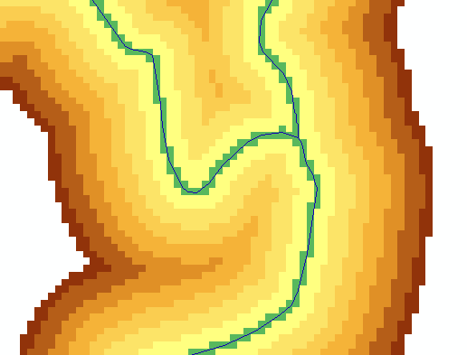
Key Concepts from Exercise 4
DEM Reconditioning as an example of quantitative raster analysis
Vector to Raster
Distance
Raster Calculation
Volume removed analysis
Subtract 10 at all stream grid cells
"smdem" - 10 * “flowLineReclas" - 0.02 * (500 - "distance") * ("distance" < 500)
500
500
Subtract an amount that tapers from 0.02*500=10 when distance is 0, to 0 when distance is 500 from stream
Only do taper when distance is less than 500, otherwise this is 0 and nothing is subtracted
10
10

Slide 2
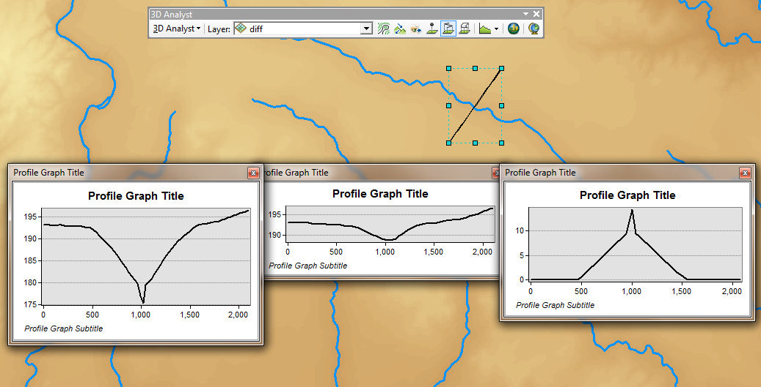
3D Analyst Profiles
smdem
diff
smrecon

Slide 3
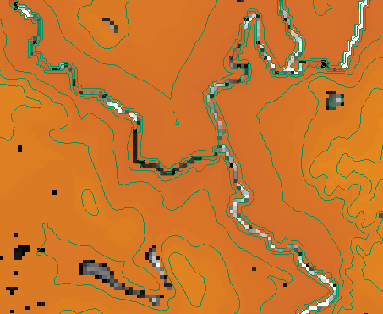
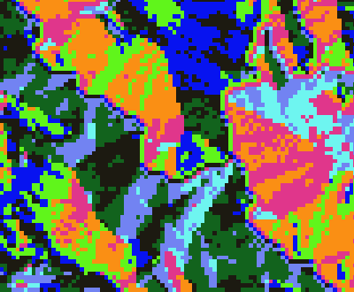
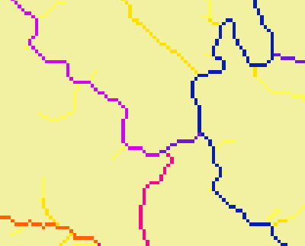
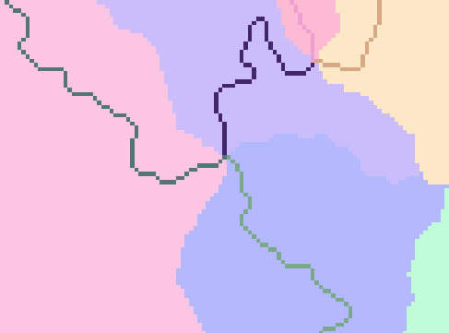
Construct the Analysis Layer
Fill
Flow Direction
Flow Accumulation
Stream Definition
Stream Links
Catchments

Slide 4
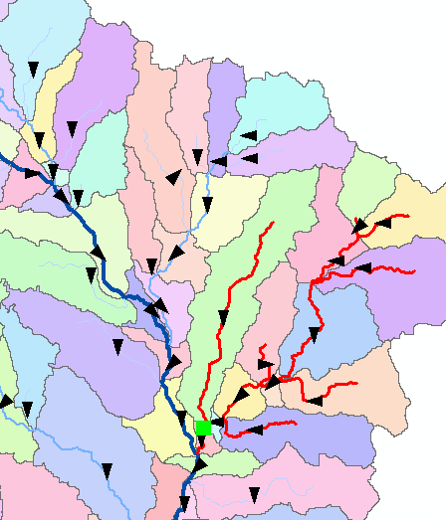
Convert to Vector
Vector streams
Vector catchments
Attribute feature with raster zonal statistics
Geometric Network
Tracing
Selection statistics

Slide 5
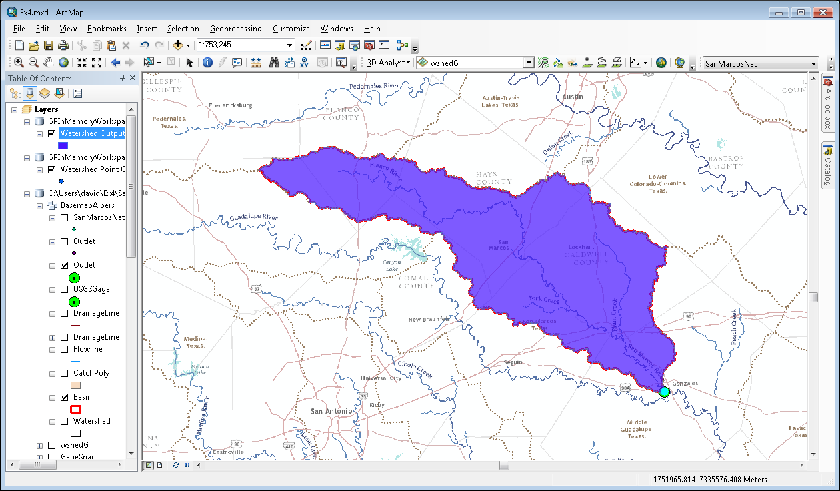
Online Hydro Basemap and Wateshed Delineation Services
Global Hydro Reference Overlay map in AGOL
Watershed delineation from a point as a geoprocessing service

