Slide 1
GIS in Water Resources Concepts from Midterm 2012
David Maidment

Slide 2
Definition of Latitude, φ
m
S
p
O
n
φ
q
r
(1) Take a point S on the surface of the ellipsoid and define there the tangent plane, mn
(2) Define the line pq through S and normal to the
tangent plane
(3) Angle pqr which this line makes with the equatorial
plane is the latitude φ, of point S

Slide 3
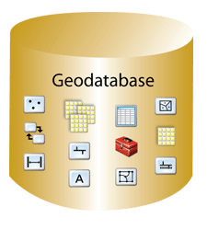
Geodatabase – a store for all types of geospatial information

Slide 4
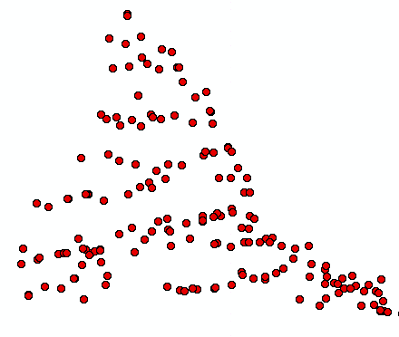
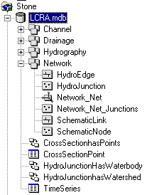
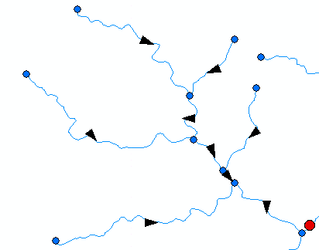
ArcGIS Geodatabase
Workspace
Geodatabase
Feature Dataset
Feature Class
Geometric
Network
Relationship
Object Class

Slide 5
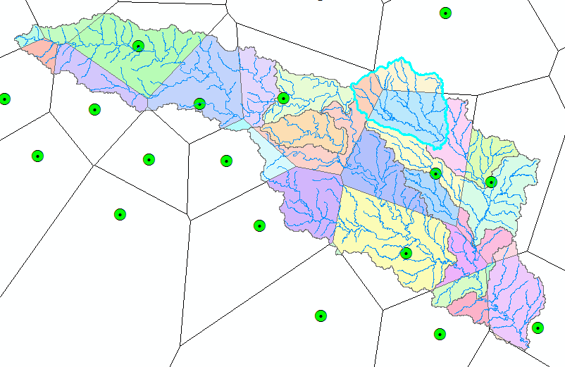
Subwatershed Precipitation by Thiessen Polygons
Thiessen Polygons
Intersect with Subwatersheds
Evaluate A*P Product
Summarize by subwatershed
$$P_{i}=\frac{\sum_{k}{A_{ik}P_{k}}}{\sum_{k}{A_{ik}}}$$

Slide 6
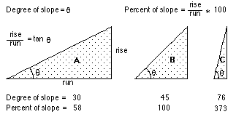
ArcGIS “Slope” tool
a
b
c
d
e
f
g
h
i

Slide 7
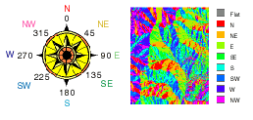
ArcGIS Aspect – the steepest downslope direction

