Slide 1
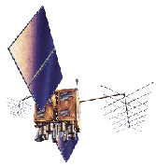
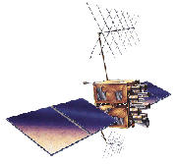
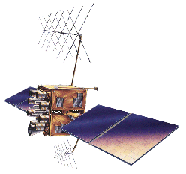

Chpt. 4. Global Positioning System
Introduction to Geospatial Technologies
Network of satellites in orbit to accurately determine one’s position down on the ground

Slide 2
Learning objectives
GPS origins
Finding your location with GPS
Position Measurements
GPS Errors
Differential GPS

Slide 3
The acronym “GPS”
GPS, Department of Defense
NAVSTAR GPS; United State System
Global Navigation Satellite System (GNSS)
Notes:
Accurate way to call GPS

Slide 4
GNSS Systems
NAVSTAR GPS
GLONASS (Russian Systtem)
Galileo (Consortium of European Governments and Industries)
Compass (Chinese version of GPS)
IRNSS (Indian satellite Navigation System)

Slide 5
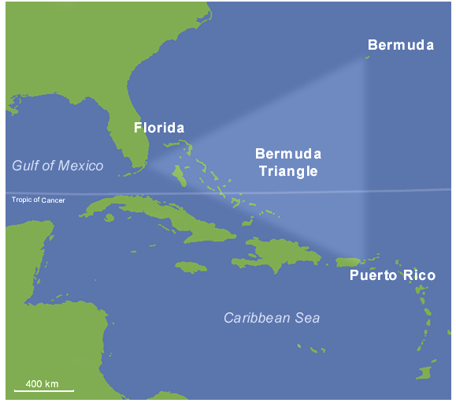
The legend of the Bermuda Triangle !
Notes:
Bermuda Triangle: 1945, five Navy planes took off from their base in Florida on a routine training mission, known as Flight 19. Neither the planes nor the crew were ever seen again.
Thus was a legend born. The Bermuda Triangle is an area roughly bounded by Miami, Bermuda, and Puerto Rico. No one keeps statistics, but in the last century, numerous ships and planes have simply vanished without a trace within the imaginary triangle.
Christopher Columbus wrote in his log about bizarre compass bearings in the area. But the region didn't get its name until August 1964, when Vincent Gaddis coined the term Bermuda Triangle in a cover story for Argosy magazine about the disappearance of Flight 19

Slide 6
Knowing where you are was not always easy!

Slide 7
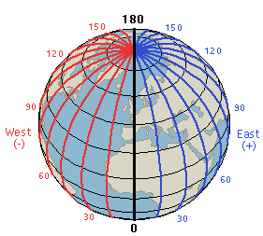
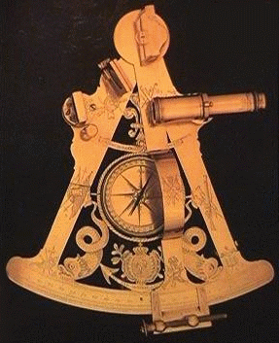
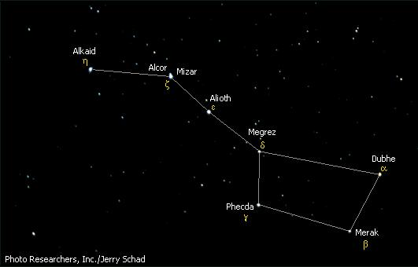
Early Navigation: Measuring Latitude is Easy
Ursa-major
Sextant
Pole star (North Star) at 41 degrees elevation
….Latitude is 41 degrees!
Navigation relied on position of the stars and sun
Navigators could determine their latitude by measuring the sun's angle at noon (i.e., when it reached its highest point in the sky).
North star, in Ursa-major constellation, can tell us Latitude directly by measuring elevation above the horizon. Measuring vertical angle to the NStar
Geographical Latitude is 0 deg at Equator, and 90 deg at the North Pole
Notes:
Navigation during the time of the British ship disaster relied on position of the stars and sun
North star which is in Ursa-major constellation can tell us Latitude directly by measuring elevation above the horizon
Measuring Latitude is easy
Tables tells what time the sun rise at Greenwhich
Difference between actual sunrise and theoretical sunrise is longitude difference. 15 degree longitude per hour difference.
Longitude is much harder to measure because there is no fixed point in the sky like the North Star or the Sun at Noon.
Things keep moving
You can measure longitude with time. The Brittish fleet sunk because there were no good watches/chronometers

Slide 8
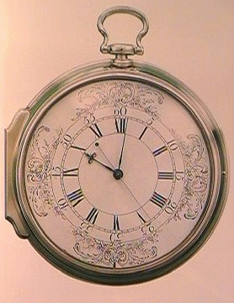
Measuring Longitude is Hard because there is no fixed point in the sky like the North Star or the Sun at Noon
!
A marine chronometer is a clock that is accurate enough to be used as a portable time standard;
Knowing GMT at local noon allows a navigator to use the time difference between the ship's position and the Greenwich Meridian to determine the ship's longitude.
As the Earth rotates at a regular rate, the time difference between the chronometer and the ship's local time can be used to calculate the longitude of the ship relative to the Greenwich Meridian (defined as 0°) using spherical trigonometry
Compare time at Greenwich to local noon.
One hour difference = 15 degrees of longitude.
One second of error is 68 miles!
Notes:
Navigation during the time of the British ship disaster relied on position of the stars and sun
North star which is in Ursa-major constellation can tell us Latitude directly by measuring elevation above the horizon
Measuring Latitude is easy
Tables tells what time the sun rise at Greenwhich
Difference between actual sunrise and theoretical sunrise is longitude difference. 15 degree longitude per hour difference.
Longitude is much harder to measure because there is no fixed point in the sky like the North Star or the Sun at Noon.
Things keep moving
You can measure longitude with time. The Brittish fleet sunk because there were no good watches/chronometers

Slide 9
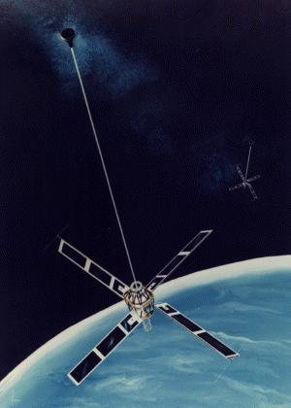
Satellites offered a much better solution
GPS isn't the First Satellite Navigation System!!
Transit by US Navy (1960) – location of seas-going vessels
Naval Research Laboratory Timation Program
Best accuracy 25 meters – up to 6 hours between measurements!
You have to wait to get a fix on your position rather than always knowing where you are
Notes:
Satellites offered a much better solution

Slide 10
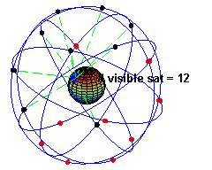
Global Positioning System
First GPS satellite in 1978
24th Satellite in 1993, completing an initial full capacity of satellites
  >$12 billion spent
GPS is overseen and maintained by the 50th Space Wing, a division of US Air Force in Colorado
24 satellites in 12 hour orbits
  12,000 mile (20,200 kilometer) high orbits
Two orbits around Earth every day
4-8 satellites available above 15 degrees from horizon line
  Positions available anywhere in the world, 24/7
Shows example of the number of
satellites visible from a point on Earth
over time
Notes:
GPS satellites circle the earth twice a day in a very precise orbit and transmit signal information to earth. GPS receivers take this information and use triangulation to calculate the user's exact location. Essentially, the GPS receiver compares the time a signal was transmitted by a satellite with the time it was received. The time difference tells the GPS receiver how far away the satellite is. Now, with distance measurements from a few more satellites, the receiver can determine the user's position and display it on the unit's electronic map.

Slide 11
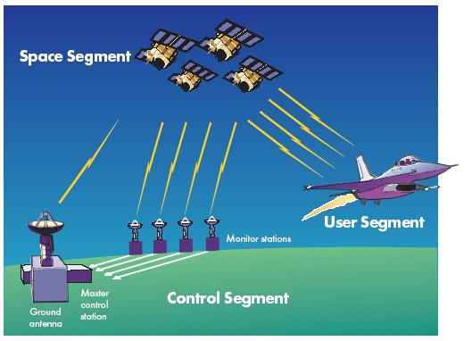
So how does it operate? Three segments of GPS satellite
Relies on 3 separate components, all operating together
1. Space
2. Control
3. User
Notes:
Space segment
24 satellites in ~12 hour orbits about 12,500 miles above the Earth
This is known as the GPS constellation
Satellites have very accurate clocks and very accurate ephemeris information
Ephemeris -- provides position in space at any specific time
Control segment
US Air Force operates the satellites
They update ephemeris information for the satellites
They maintain information on the health of each satellite
They configure the hardware on the satellite -- maybe switch in a backup transmitter, for example
And they check the clocks on the satellites
User Segment
That's us.
Consists of the receivers we use

Slide 12
1. Space segment
    24 satellites in ~12 hour orbits about 12,500 miles above the Earth
    This is known as the GPS constellation
    At any given time, at least four of the satellites are above the local horizon at every location on earth 24 hours a day
    Ephemeris -- provides position in space at any specific time
Shows example of the number of
satellites visible from a point on Earth
over time
Notes:
The GPS is a system of 4 orbiting satellites in medium earth orbits (about 20,000 km) each transmitting a time signal. At any given time, at least four of the satellites are above the local horizon at every location on earth 24 hours a day. When a GPS receiver is activated, the nearest satellites are located and the signals are received from each visible satellite. By decoding the time differences etween the signals from each satellite, combined with data from the satellite itself about its orbit (called ephermeris data) it is possible to solve the three unknowns of latitude, longitude, and elevation. Many receivers can do direct conversion into any of several coordinate systems and datums, and most can download the data directly to a computer. Some GPS equipment can download directly in common GIS formats.
The 24 satellites that make up the GPS space segment are orbiting the earth about 12,000 miles above us. They are constantly moving, making two complete orbits in less than 24 hours. These satellites are travelling at speeds of roughly 7,000 miles an hour.
GPS satellites are powered by solar energy. They have backup batteries onboard to keep them running in the event of a solar eclipse, when there's no solar power. Small rocket boosters on each satellite keep them flying in the correct path.

Slide 13
Space segment: Distance from satellite
Radio waves = speed of light
  Receivers have nanosecond accuracy (0.000000001 second)
All satellites transmit same signal “string” at same time
  Difference in time from satellite to time received gives distance from satellite
The whole thing boils down to those "velocity times travel time" math problems we did in high school!!
"If a car goes 70 miles per hour for two hours, how far does it travel?"
Velocity (70 mph) x Time (2 hours) = Distance (140 miles)

Slide 14
Space segment : Accurate clocks
    Satellites have very accurate clocks and very accurate ephemeris information
Light speed = 186,000 mi./second
  Out of sync by 1/100th of second equals error of 1860 miles!
Atomic clocks (4) aboard each satellite

Slide 15
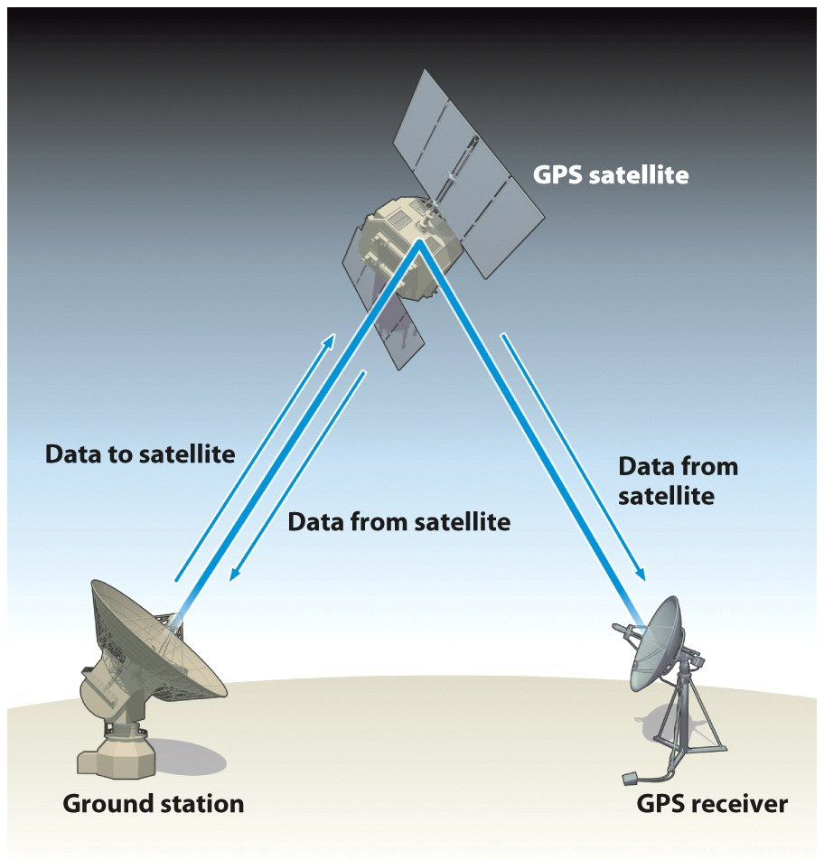
2. Control segment
    US Air Force operates the satellite
    They update ephemeris information for the satellite
    They maintain information on the health of each satellite
    They configure the hardware on the satellite
    They check the clocks on the satellites

Slide 16
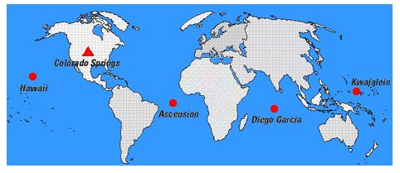
Monitoring stations
Location of the four unmanned stations (circles) and one Master Station (triangle) of the GPS Control Segment

Slide 17
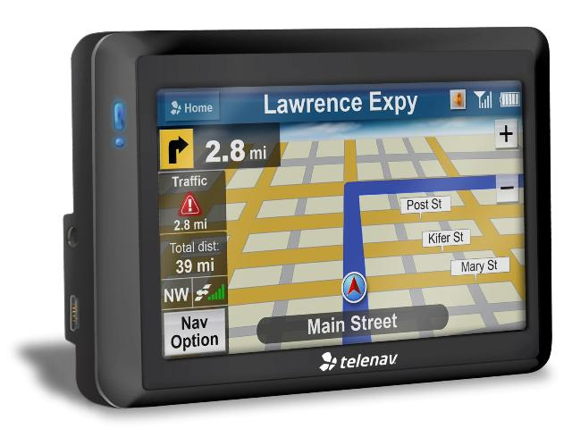
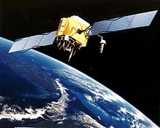
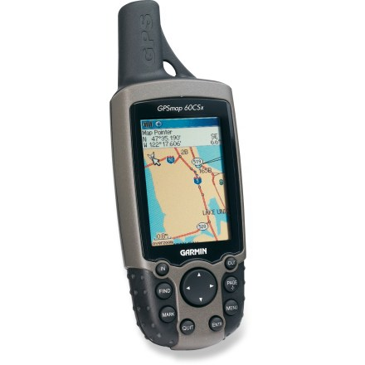
3. User segment-consists of the receivers we use
    How many channels the receiver has (12 channel)
    Single frequency receiver (can pick up L1)
    Dual frequency receiver (L1 and L2)
    Receiver can only receive satellite data, not transmit data back to satellite.
Notes:
> Geospatial Information Technologies Include:
>Global Position System (GPS)
satellite-based tool to find out precisely (with limits) where something or someone is.
Most of you have used GPS to
Find your way somewhere
To measure where you are when you measure or observe something – like crop status or an algae infestation

Slide 18
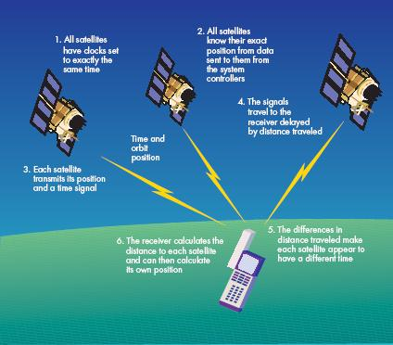
The simple view

Slide 19
Triangulation and Trilateration
Triangulation
  Based on angular measurement
Trilateration
  Based on time
  (or distance)
  GPS is based on Trilateration

Slide 20
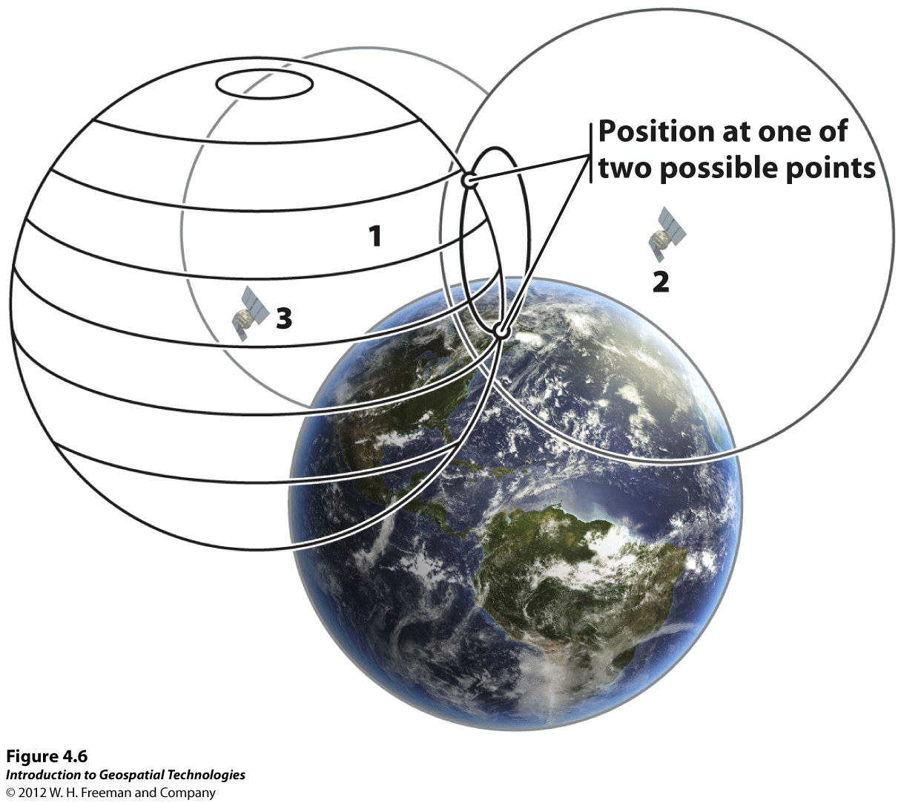

Slide 21



Travel time
Signal leaves at 8:03:02.12
For example: 13,000 some miles
Radio waves travel about 186,000 miles (300,000 km) per second.
Signal arrives at 8:03:02.19

Slide 22
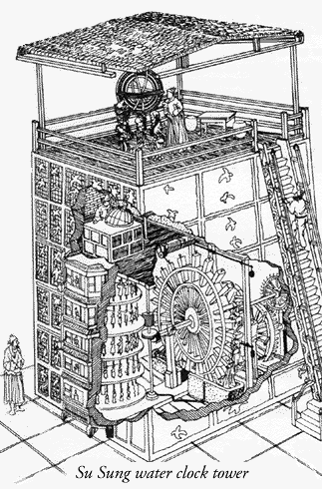
Whoa!
8:03:02.19
7 hundredths of a second difference for the 13,000 mile (i.e. 20,000 km) distance
- 8:03:02.12
0:00:00.07
Takes some really good clocks (i.e. $50,000)!
Notes:
In a sense, the whole thing boils down to those "velocity times travel time" math problems we did in high school. Remember the old: "If a car goes 60 miles per hour for two hours, how far does it travel?"
Velocity (60 mph) x Time (2 hours) = Distance (120 miles)
In the case of GPS we're measuring a radio signal so the velocity is going to be the speed of light or roughly 186,000 miles per second.
The problem is measuring the travel time.

Slide 23
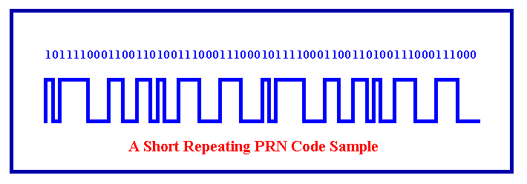
So how do you measure the time difference?
Pseudo-random Noise Code (PRN Code)
PRN Generator
Exactly Synchronized
If we wanted to see just how delayed the satellite's version was, we could start delaying the receiver's version until they fell into perfect sync.
The amount we have to shift back the receiver's version is equal to the travel time of the satellite's version.
PRN Generator
Notes:
The timing problem is tricky. First, the times are going to be awfully short. If a satellite were right overhead the travel time would be something like 0.06 seconds. So we're going to need some really precise clocks. We'll talk about those soon.
But assuming we have precise clocks, how do we measure travel time? To explain it let's use a goofy analogy:
Suppose there was a way to get both the satellite and the receiver to start playing "The Star Spangled Banner" at precisely 12 noon. If sound could reach us from space (which, of course, is ridiculous) then standing at the receiver we'd hear two versions of the Star Spangled Banner, one from our receiver and one from the satellite.
These two versions would be out of sync. The version coming from the satellite would be a little delayed because it had to travel more than 11,000 miles.
If we wanted to see just how delayed the satellite's version was, we could start delaying the receiver's version until they fell into perfect sync.
The amount we have to shift back the receiver's version is equal to the travel time of the satellite's version. So we just multiply that time times the speed of light and BINGO! we've got our distance to the satellite.
That's basically how GPS works.
Only instead of the Star Spangled Banner the satellites and receivers use something called a "Pseudo Random Code" - which is probably easier to sing than the Star Spangled Banner.

Slide 24
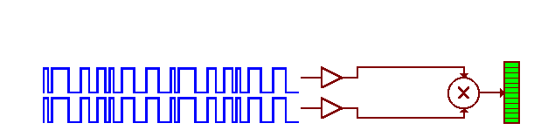
Just compare the two codes!
Measure the time offset to make the two codes align or “correlate”
Now you have an idea of the distance between the two PN generators!

Slide 25
The satellite knows where it is.
Earth (by definition)
Measured Distance
We know the distance from the satellite by the code correlation.
So we know where we are on a big circle (sphere) around the satellite.

Slide 26
Add another satellite
Earth (by definition)
Two dimensional example:
We’re in one of two spots.

Slide 27
Add another satellite
Earth (by definition)
Again: Two dimensions – 3 satellites – we know where we are!

Slide 28
Remember the pesky clock problem?
Earth (by definition)
Satellites have expensive
clocks.
Our receiver doesn’t!
Our clock is “off”.
So our distance is off – but by a constant amount!

Slide 29
Old trick: Add another satellite
Earth (by definition)
What number do we add or subtract from the time correlation to make
everything come together?

Slide 30
Add or subtract the time offset number
Earth (by definition)
Now you got the time.

Slide 31
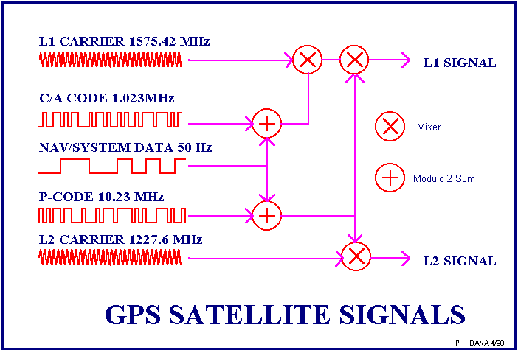
So what do the real signals look like?
The information is sent either C/A (Course Acquisition Code)
or P codes (Precision Code).
The C/A code is broadcast on L1 Carrier Frequency. 1-5 meter accuracy.
P Code – Precision Code is used by the military (L1 and L2).
Notes:
C/A Course Acquisition Code: 1-5 meter accuracy
P Code – Precision Code is used by the military. It is encrypted.
The information is sent either C/A or P codes. The C/A code is broadcast on L1

Slide 32
What can go wrong - sources of Errors
Poor satellite geometry (angle of signal)
Multi-path errors
  Signals bounce off objects before being received
Intended error (military: “Selective Availability”)
  Switched off on May 2, 2000
Earth’s atmosphere: signals slow or speed up

Slide 33
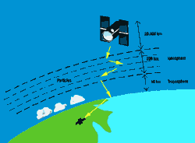
GPS Errors: 1. Earth’s atmosphere
You calculate distance to a satellite by multiplying a signal's travel time by the speed of light.
But the speed of light is only constant in a vacuum...

Slide 34
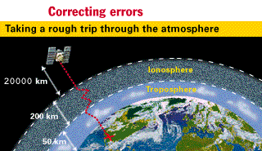
Ionospheric and Atmospheric Delays
Speed of light = 186,000 miles/second in a vacuum
Earth’s atmosphere is heterogeneous
  Can cause signals to slow down or speed up
Eliminated by ‘dual frequency’ receivers
  Low and high frequency
  Low frequency affected more than high frequency
  Receiver evaluates signal and corrects for error
Notes:
There are a couple of ways to minimize this kind of error.
For one thing we can predict what a typical delay might be on a typical day. This is called modeling and it helps but, of course, atmospheric conditions are rarely exactly typical.
Another way to get a handle on these atmosphere-induced errors is to compare the relative speeds of two different signals. This " dual frequency" measurement is very sophisticated and is only possible with advanced receivers.

Slide 35
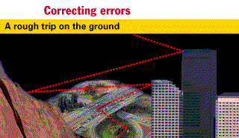
GPS Erros: 2. Multipath Error
The signal may bounce off various local obstructions before it gets to your receiver.
Good receivers use sophisticated signal rejection techniques to minimize this problem.
Notes:
This is called multipath error and is similar to the ghosting you might see on a TV.
Good receivers use sophisticated signal rejection techniques to minimize this problem.

Slide 36
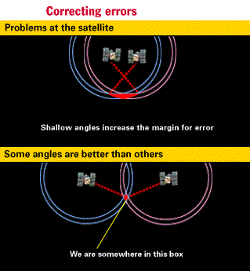
GPS Errors: 3. Geometric Dilution of Precision
Basic geometry itself can magnify these other errors
A principle called Geometric Dilution of Precision or GDOP.
Good receivers determine which satellites will give the lowest GDOP
Notes:
It sounds complicated but the principle is quite simple: there are usually more satellites available than a receiver needs to fix a position, so the receiver picks a few and ignores the rest.
If it picks satellites that are close together in the sky the intersecting circles that define a position will cross at very shallow angles. That increases the gray area or error margin around a position.
If it picks satellites that are widely separated the circles intersect at almost right angles and that minimizes the error region.
Good receivers determine which satellites will give the lowest GDOP.

Slide 37
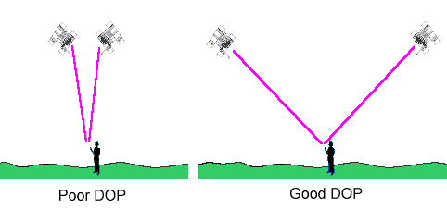
Satellite geometry
Quantified by DOP: Dilution of Precision

Slide 38
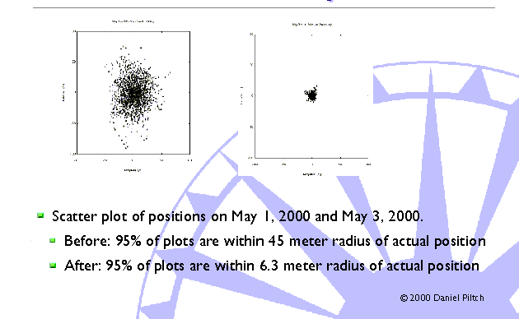
GPS Errors: 4. Selective Availability
Notes:
The images compare the accuracy of GPS with and without selective availability (SA). Each plot shows the positional scatter of 24 hours of data (0000 to 2359 UTC) taken at one of the Continuously Operating Reference Stations (CORS) operated by the NCAD Corp. at Erlanger, Kentucky. On May 2, 2000, SA was set to zero. The plots show that SA causes 95% of the points to fall within a radius of 45.0 meters. Without SA, 95% of the points fall within a radius of 6.3 meters. As illustration, consider a football stadium. With SA activated, you really only know if you are on the field or in the stands at that football stadium; with SA switched off, you know which yard marker you are standing on.

Slide 39
Increased Accuracy using Differential GPS (DGPS)
10 km
Sub meter accuracy
Notes:
Accuracy can be increased to within a few meters (10 meters or better are achievable) by using Differential GPS. DGPS works by using the cooperation of two receivers, one that is stationary and one that is traveling around making position measurements. The stationary receiver measures the timing errors and then provides the traveling receiver with the correct information by radio or other means.

Slide 40
DGPS/Reference Datum System
Raw GPS Data (no corrections) WGS84
Coast Guard Beacons NAD83
Omnistar (North America) NAD83
Omnistar (Outside North America) ITRF2000
WAAS (Wide Area Augmentation System) ITRF2000
SBAS (Satellite Based Augmentation System)

Slide 41
A Caution on Datum
NAD27 (North American Datum 1927)
NAD83 (North American Datum 1983)
WGS84 (World Geodetic System 1984)
ITRF2000 (International Terrestrial Reference Frame 2000)
ITRF 1994, 1996, 1997

Slide 42
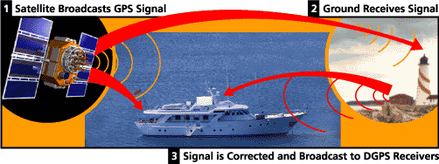
Coast Guard’s DGPS
US Coast Guard set up several reference stations along cost and waterways to aid ships in finding their location and navigation

Slide 43
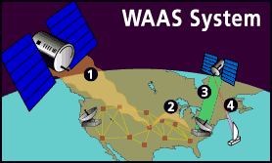
WAAS (Wide Area Augmentation System
New system used by FAA (Federal Aviation Administration) to guide aircraft
25 ground reference stations in US monitor GPS satellites
Low-level geo-synchronous satellites send correction messages to GPS receivers

Slide 44
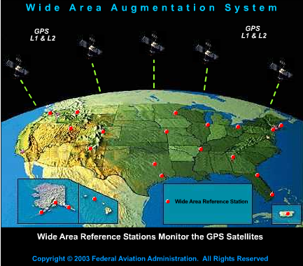
WAAS receive GPS signals and determine if any errors exist
Correction message is prepared and uplinked to a geosynchronous satellite
The message is then broadcast from the satellite on the same frequency as GPS

Slide 45
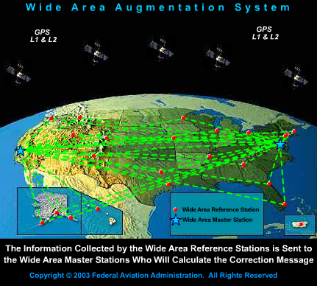

Slide 46
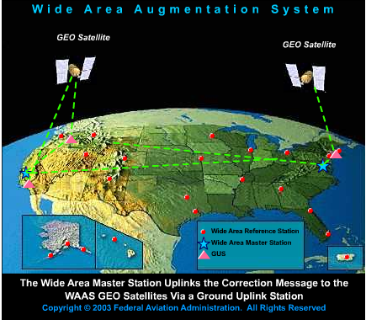

Slide 47
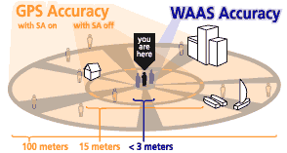
From: http://www.garmin.com/aboutGPS/waas.html

Slide 48

How It Works
The WAAS covers nearly all of the National Airspace System (NAS).
The WAAS provides augmentation information to GPS receivers to enhance the accuracy and reliability of position estimates.
The signals from GPS satellites are received across the NAS at many widely-spaced Wide Area Reference Stations (WRS) sites.
The WRS locations are precisely surveyed so that any errors in the received GPS signals can be detected.
WAAS Satellites calculate position correction information and broadcast the correction signal to Geostationary WAAS satellite
It can only function in US and nearby portions of North America

Slide 49
WAAS
WAAS corrections are valid in:
  United States (including most of Alaska & Hawaii)
  Virgin Islands & Puerto Rico
  Southern Canada
  Parts of Mexico
Not valid in all other areas
  Base stations are too distant
  Plans for future expansion

Slide 50
DGPS Accuracy
Under optimal conditions
  User hand held 2-5 m
  CALMIT units < 1 m
  Survey grade units < .03 m
  Very high precision units ~ .005 m

Slide 51
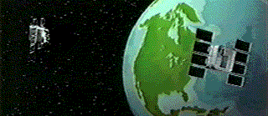
Conclusion
GPS: Global Positioning System
GPS technology has matured
into a resource that goes far
beyond its original
design goals.

