Slide 1
GIS and Hydrologic Modeling
Brushy Creek as an Example
David R. Maidment
GIS in Water Resources
Fall 2012

Slide 2
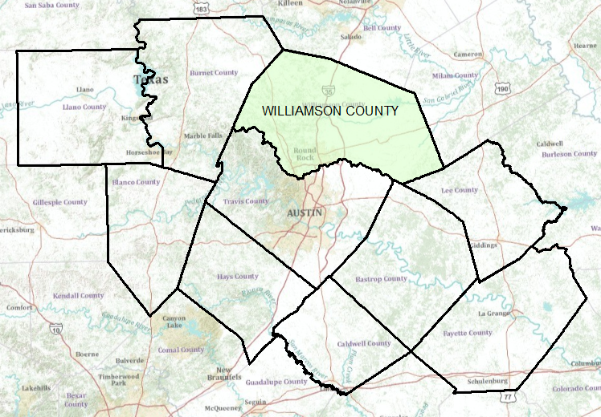
Capital Area Counties

Slide 3
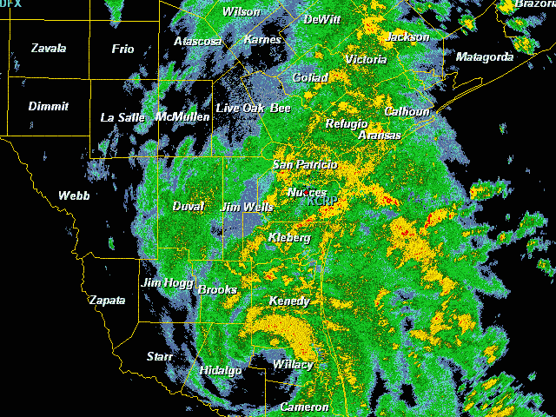
Tropical Storm Hermine,
Sept 7-8, 2010

Slide 4



A homeowner in Cedar Park
“This thing has been condemned by God or somebody, cause you could never sell it….” Howard Hudgeons, who had lived in the Riviera Springs Subdivision for 27 years. “We’re not planning on moving back in”.

Slide 5
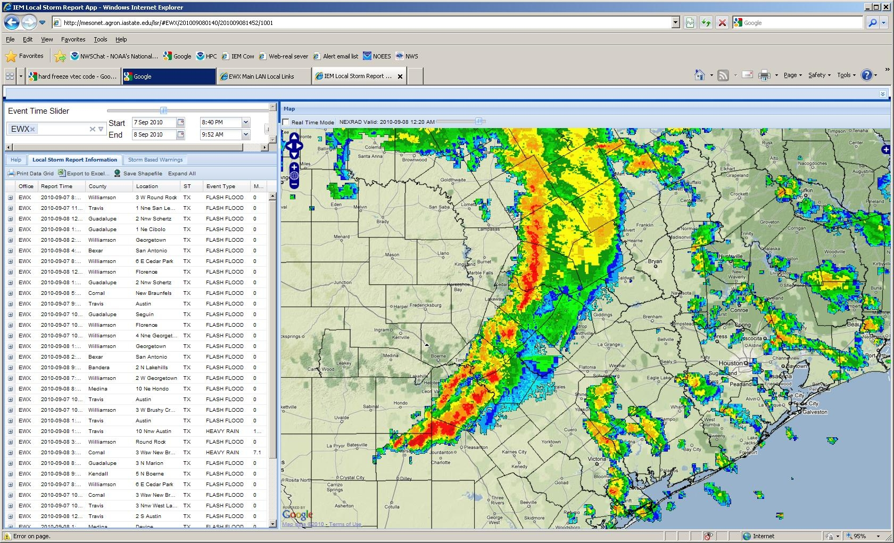

Williamson County
T.S. Hermine Flood Response
Jarred Thomas
Williamson County OEM

Slide 6
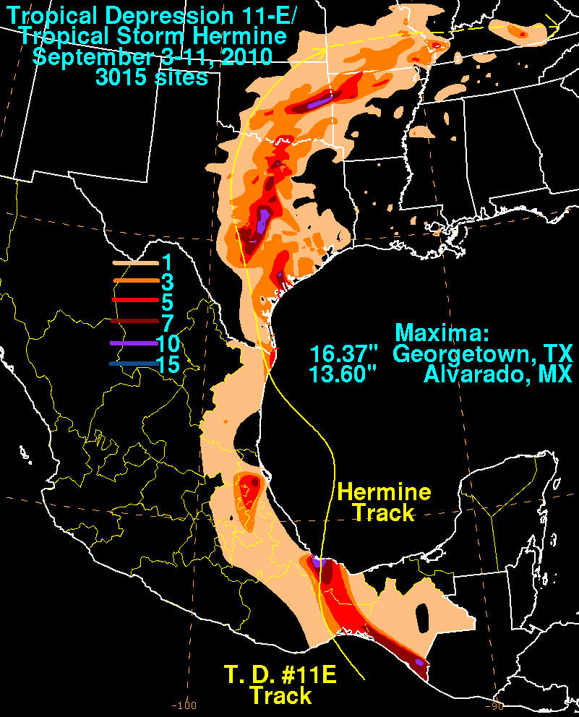
Pre-Incident
State Conference Calls
National Weather Service Forecast
Monitored Storm Track and Activity
Monitored local rainfall totals and water levels at local flood control dams.
Communicated with local emergency managers.

Slide 7

Incident Response
Localized Widespread
Simultaneous Evacuations and Rescues
  By Land
  By Boat
  By Helo
Agencies Engaged (primary rescue)
Florence FD, Cedar Park FD, Leander FD, Sam Bass FD, Round Rock FD, Georgetown FD, Williamson County EMS, HazMat, and Sheriff’s Office, Austin FD (TTF-1) (x2), StarFlight (x3), Texas Parks and Wildlife.

Slide 8
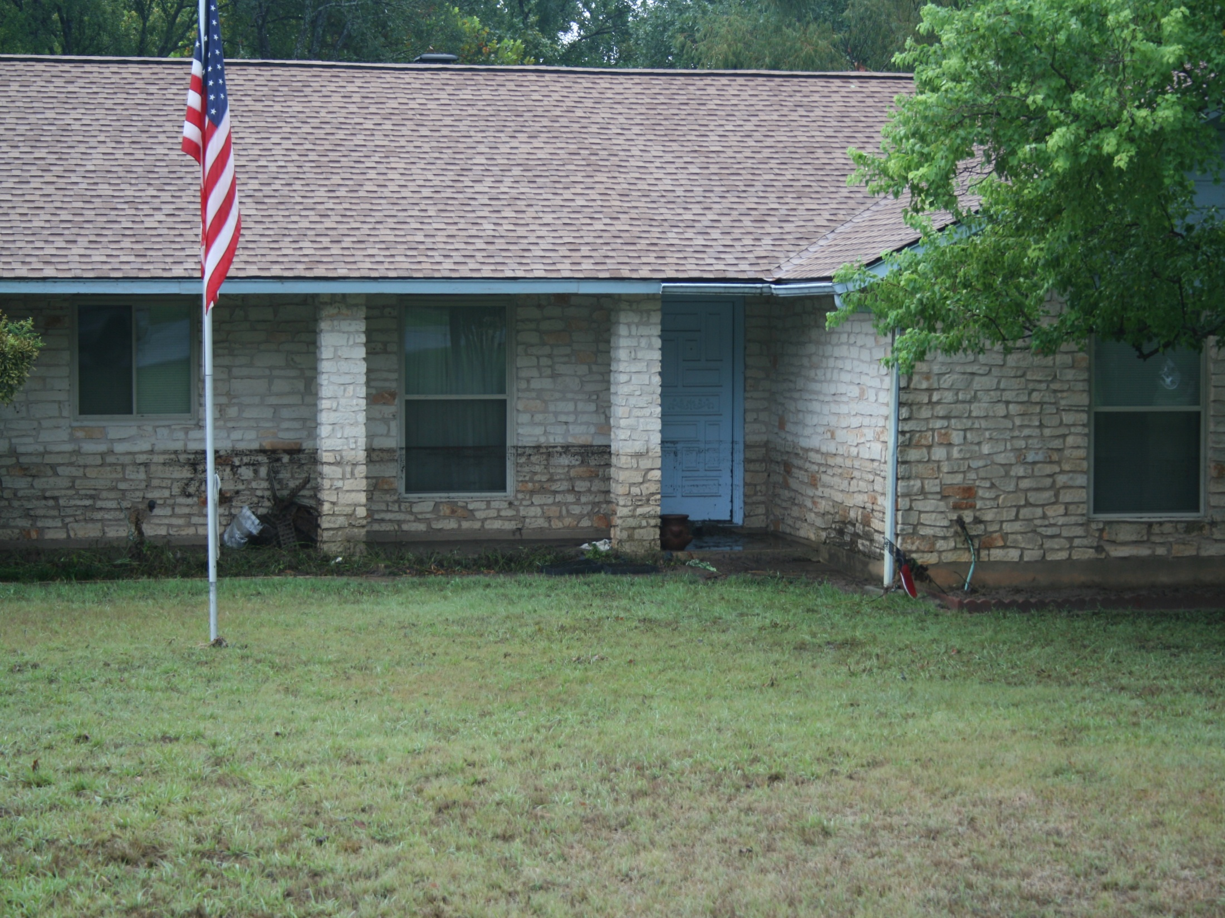
Post-incident

Slide 9
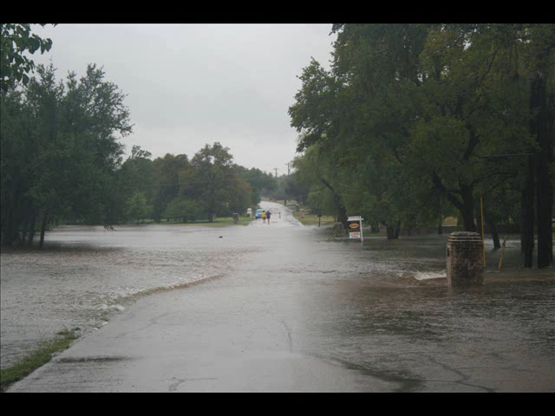

Slide 10
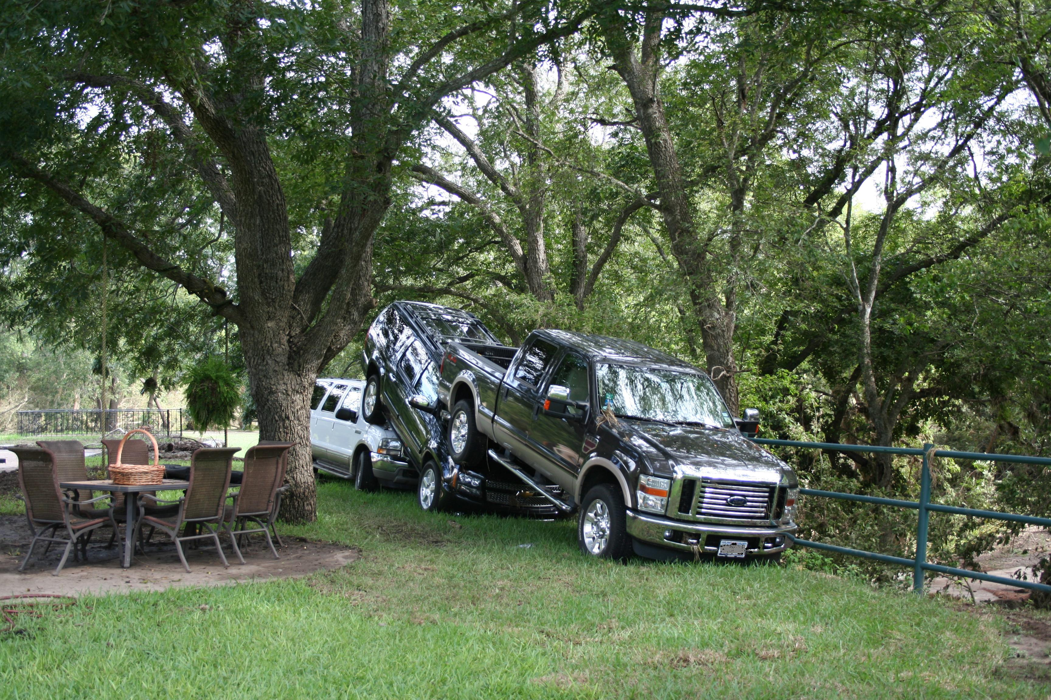
Lessons Learned
Disasters don’t follow the plan and Storms don’t listen to the forecast.
Water is Mightier than the Phone.
Relationships are Key.
  Before and After
You can only monitor so many websites and process so much data.
What You’ve Got is What You’ve Got.

Slide 11
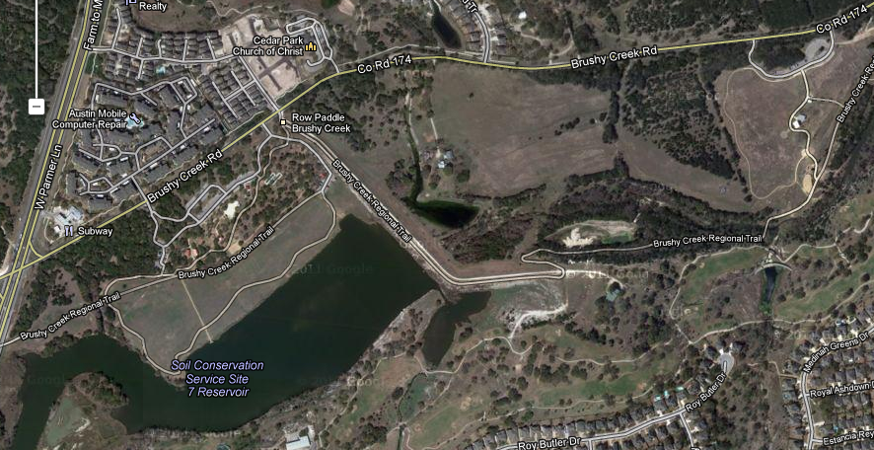
Brushy Creek Rd, Dam 7
Brushy Creek Rd and West Parmer Ln

Slide 12

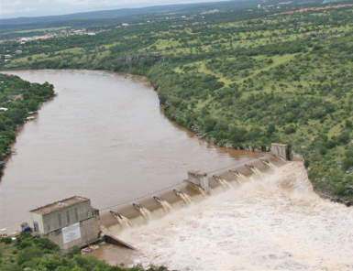
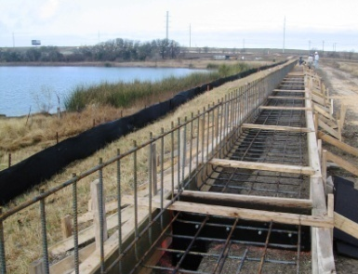
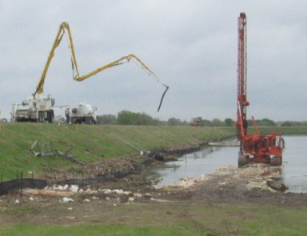

Upper Brushy Creek Water Control & Improvement District

Slide 13
JURISDICTIONAL BOUNDARIES

Slide 14
DRAINAGE AREAS

Slide 15
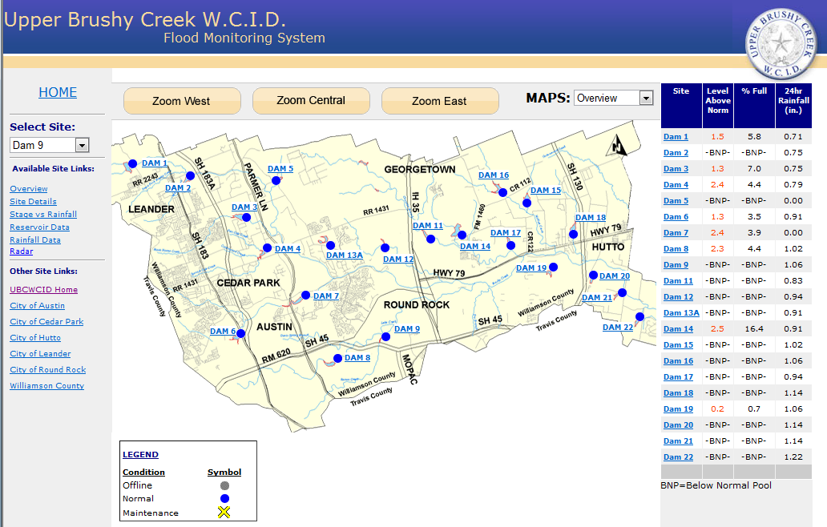
Flood Monitoring System
http://www.ubcwcid.org/Overview/Overview.aspx?id=1

Slide 16
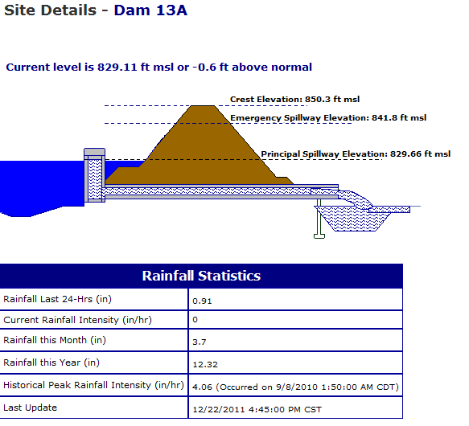
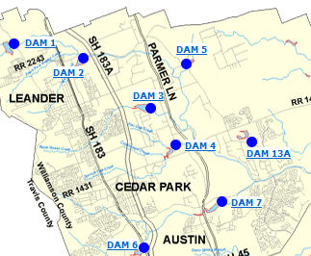
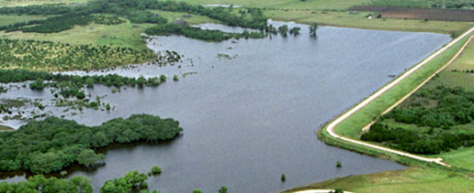
Flood Control Dam

Slide 17
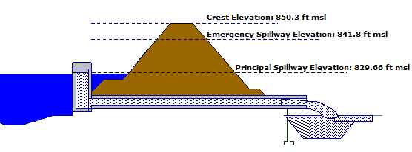
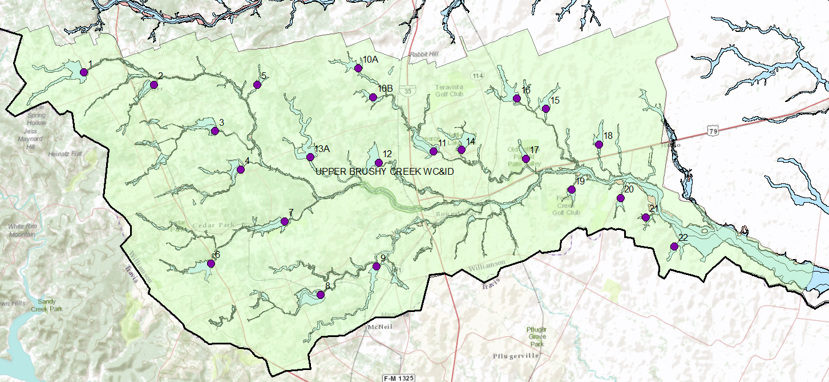
Flood Control Dams
Dam 13A
Flow with a Horizontal Water Surface

Slide 18
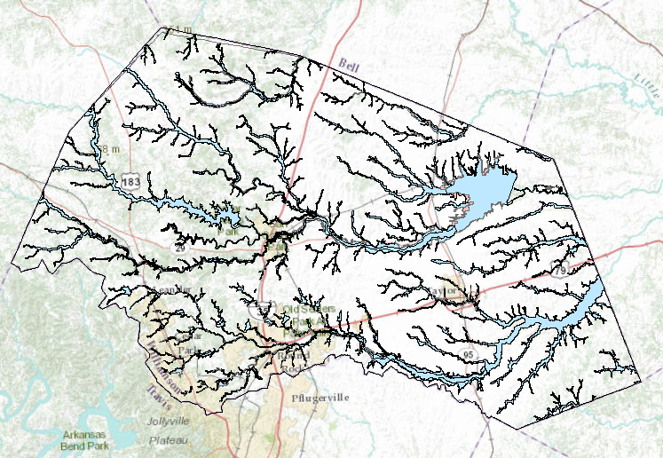
Floodplains in Williamson County
Area of County = 1135 mile²
Area of floodplain = 147 mile²
13% of county in floodplain

Slide 19
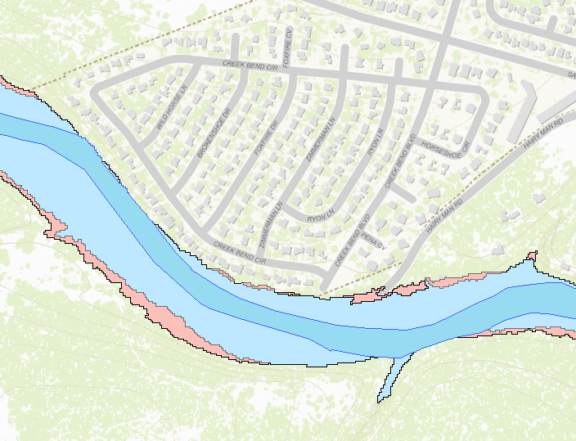

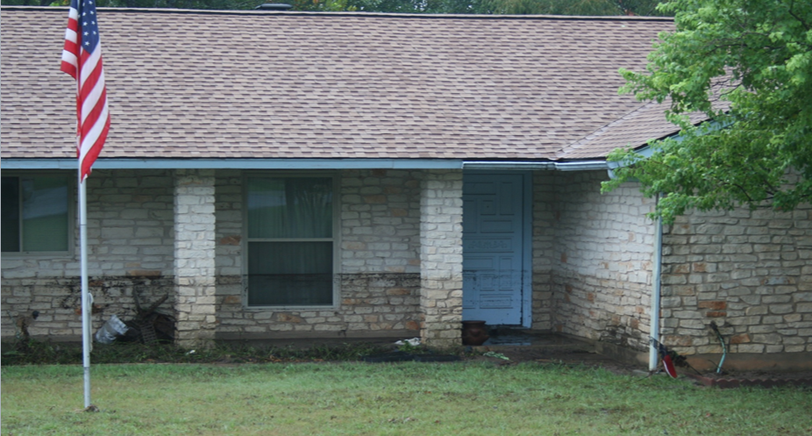

Floodplain Zones
1% chance
< 0.2% chance
Main zone of water flow
Flow with a Sloping Water Surface

Slide 20
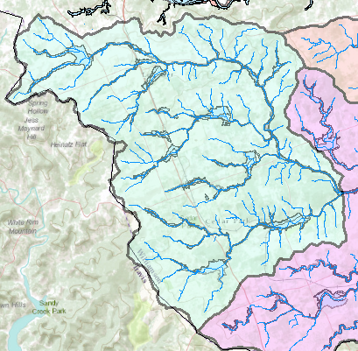
Watershed – Drainage area of a point on a stream
Rainfall
Streamflow
Connecting rainfall input with streamflow output

Slide 21
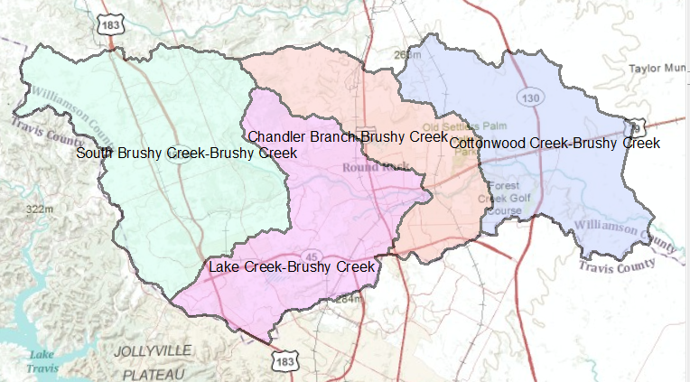
HUC-12 Watersheds for Brushy Creek

Slide 22
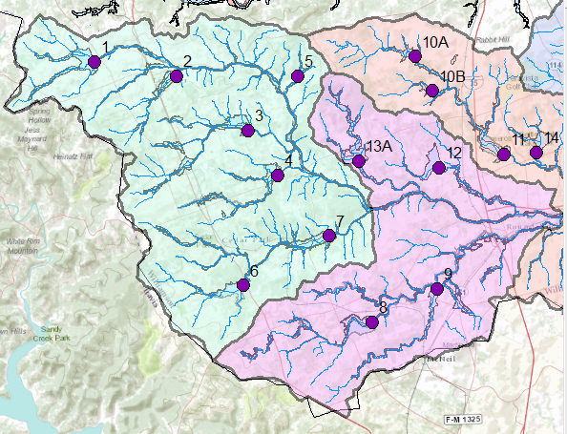
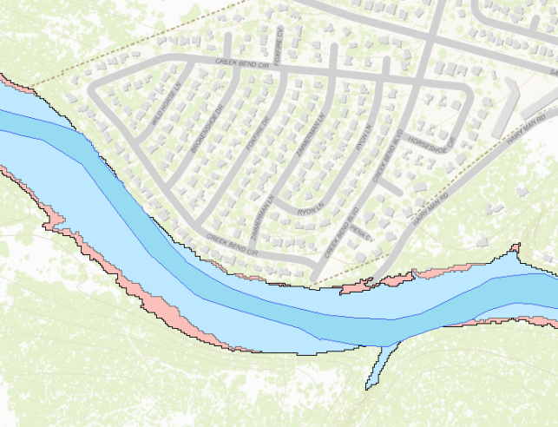
Hydrologic System
We need to understand how all these components function together
Watersheds
Reservoirs
Channels

Slide 23
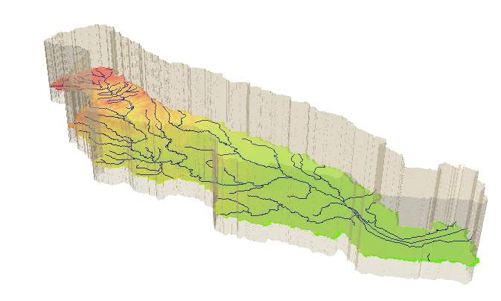
Hydrologic System
Take a watershed and extrude it vertically into the atmosphere
and subsurface, Applied Hydrology, p.7- 8
A hydrologic system is “a structure or volume in space surrounded by a boundary, that accepts water and other inputs, operates on them internally, and produces them as outputs”

Slide 24

Views of Motion
Eulerian view (for fluids – e is next to f in the alphabet!)
Lagrangian view (for solids)
Fluid flows through a control volume
Follow the motion of a solid body
GIS helps to define the control volumes

Slide 25
System Transformation
Inputs, I(t)
Transformation Equation
Q(t) = Ω I(t)
Outputs, Q(t)
A hydrologic system transforms inputs to outputs
Hydrologic Processes
I(t), Q(t)
Hydrologic conditions
I(t) (Precip)
Physical environment
Q(t) (Streamflow)

Slide 26
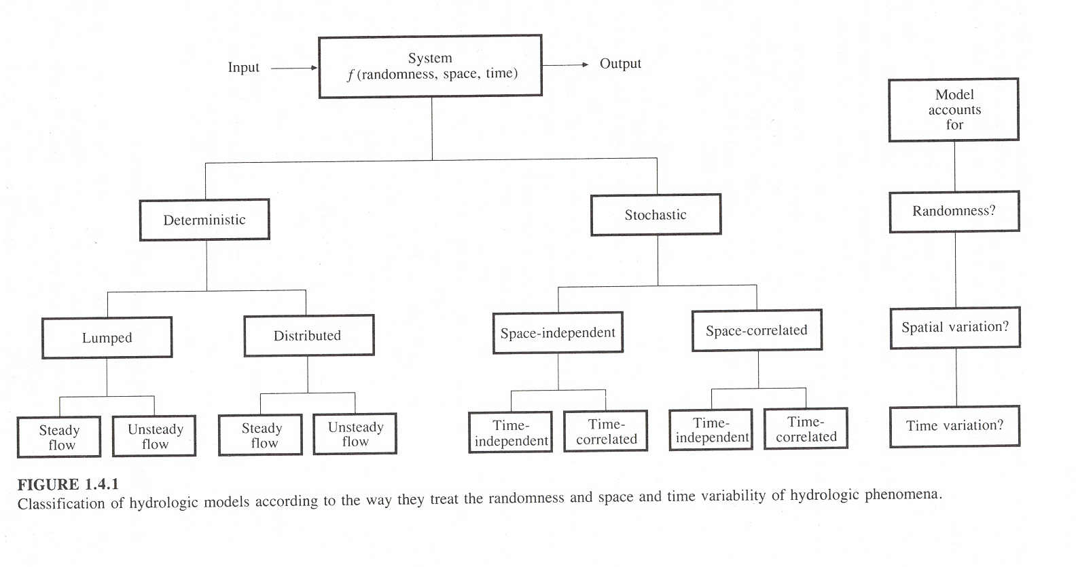
System = f(randomness, space, time)
randomness
space
time
Five dimensional problem but at most we can deal with only two or three dimensions, so which ones do we choose?

Slide 27
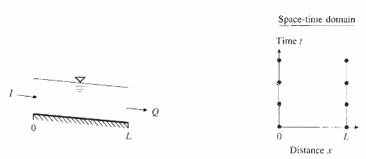
Deterministic, Lumped Steady Flow Model
I = Q
e.g. Steady flow in an open channel

Slide 28
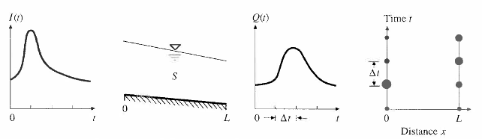
Deterministic, Lumped Unsteady Flow Model
dS/dt = I - Q
e.g. Unsteady flow through a watershed, reservoir or river channel

Slide 29
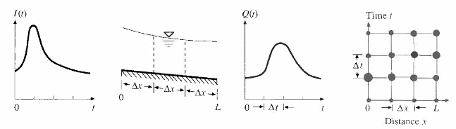
Deterministic, Distributed, Unsteady Flow Model
Stream Cross-section
e.g. Floodplain mapping

Slide 30
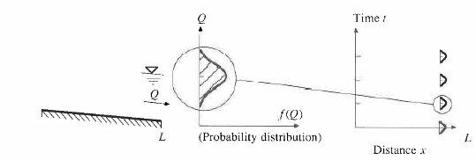
Stochastic, time-independent model
1% chance
< 0.2% chance
e.g. One hundred year flood discharge estimate at a point on a river channel

Slide 31
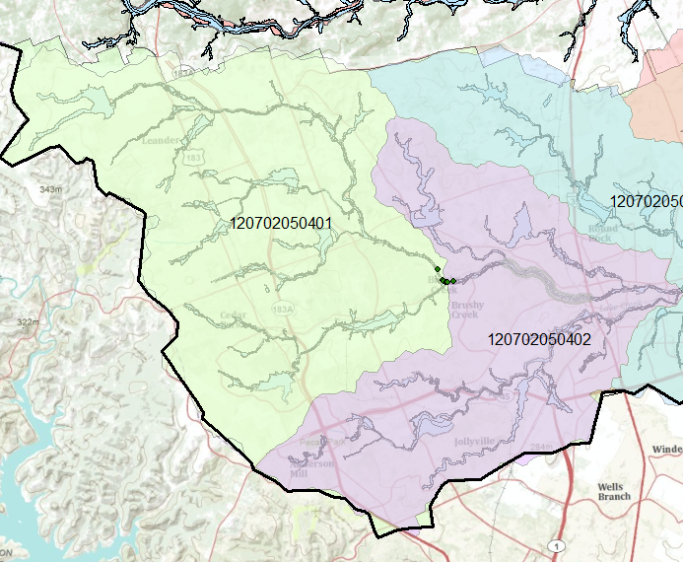
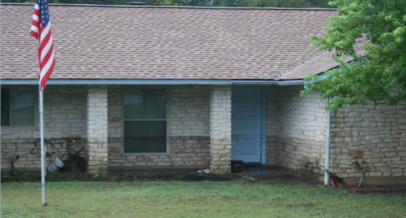
HUC-12 Subwatershed 120702050401
Upper Brushy Creek
Hermine Flooding
Flood Control Dams

Slide 32
Upper Brushy Creek Water Control and Improvement District Dams
Flood Control Dam

Slide 33
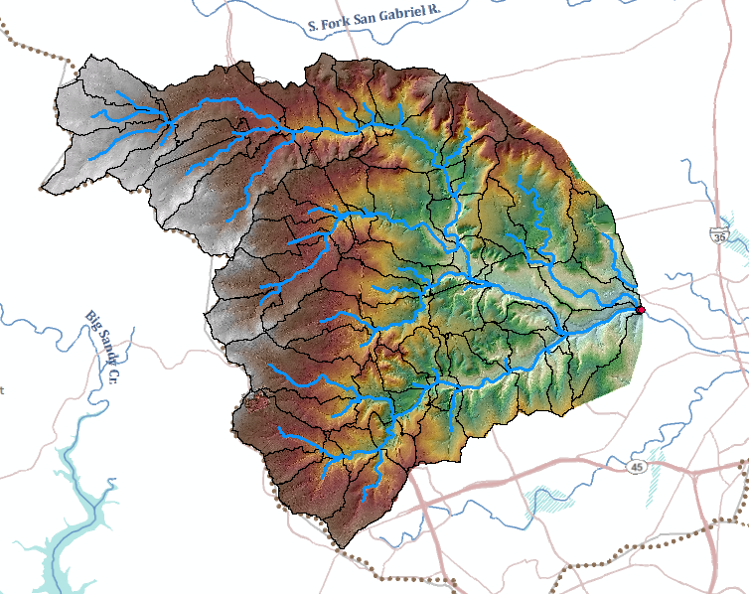
GIS Hydrology Analysis (HEC-GeoHMS) using 10ft DEM derived from LIDAR

Slide 34
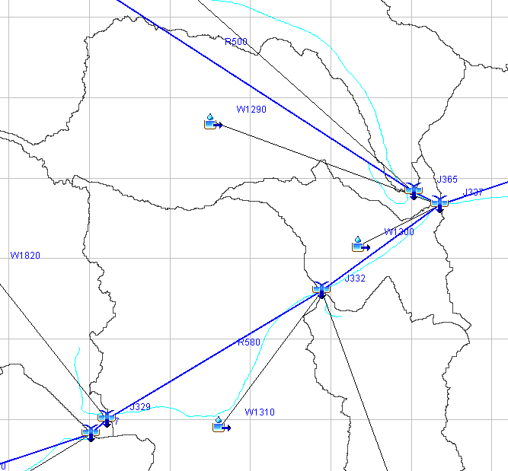
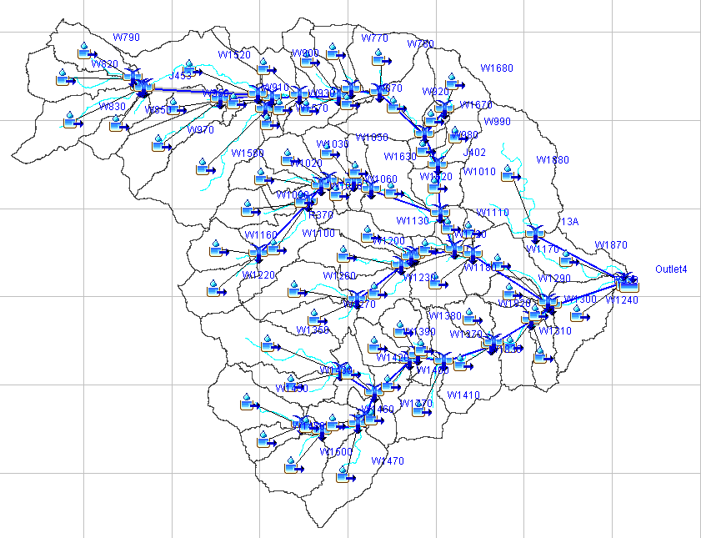
HEC-HMS Model of Brushy Creek
Walsh Dr
Dam 7

Slide 35
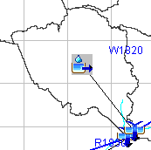
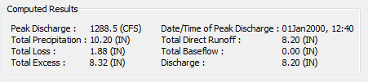
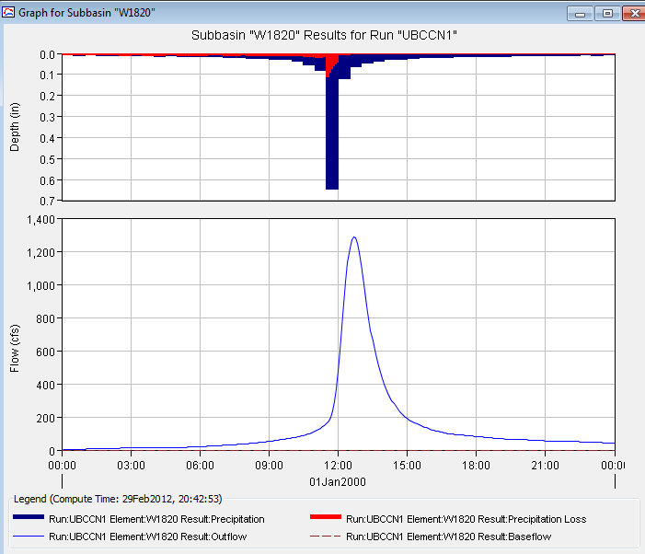
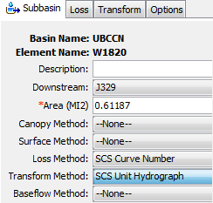
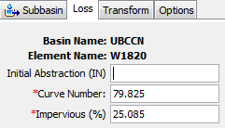
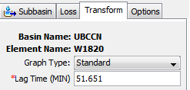
Watershed W1820

Slide 36
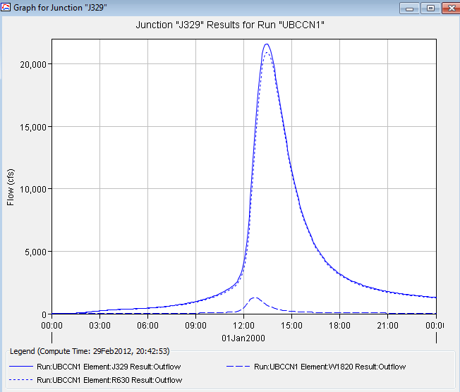
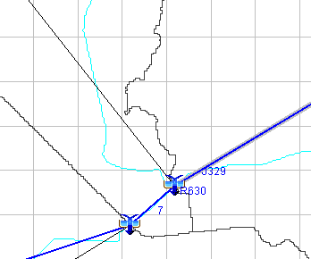
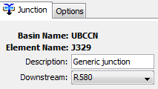
Junction J329
W1820
R580
J329
J329
W1820

Slide 37
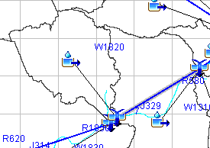

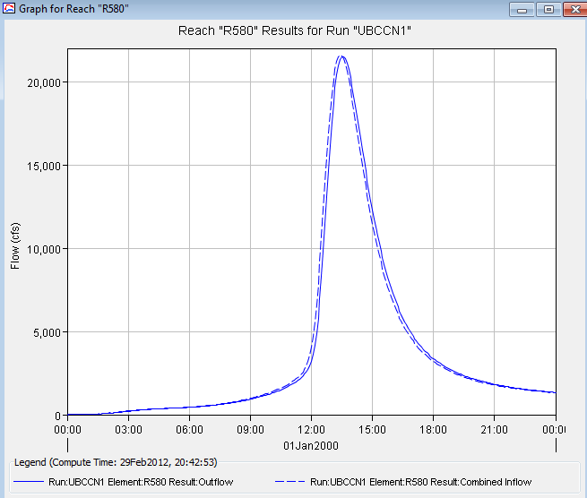
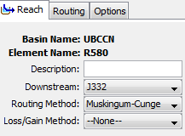
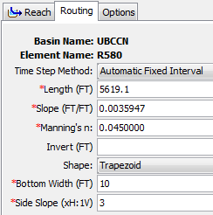
Reach R580

Slide 38
Engineering Hydraulics
Personal – a flooded home

Slide 39
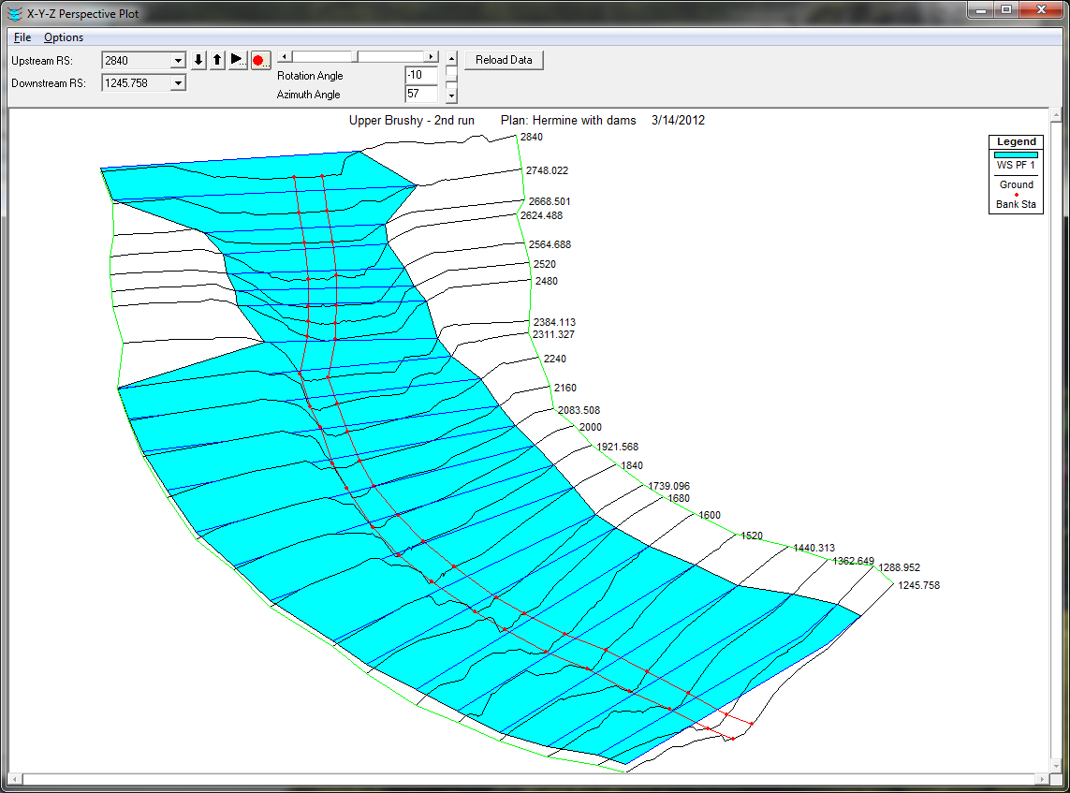
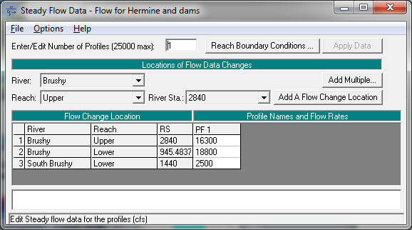

HEC-RAS Flood Water Surface Elevation Model

Slide 40


Flood Inundation

Slide 41

Floodplain Delineation
Notes:
The channel and floodplain are both integral parts of the natural conveyance of a stream. The floodplain carries flow in excess of the channel capacity. The greater the discharge, the greater the extent of inundation. …. Because of its devastating nature, flooding poses serious hazards to human populations in many parts of the world. “The Flood Disaster Protection Act of 1973” required the identification of all floodplain areas in the United States and the establishments of flood-risk zones within those areas.

Slide 42

Reaches and Rivers in Brushy Creek
Upper Brushy
Lower Brushy
South Brushy

Slide 43

HEC-RAS Flood Elevation Model
using 1 ft DEM derived from LIDAR
Cross-Sections for HEC-RAS model

Slide 44


Steady Flow Solution

Slide 45

One-Dimensional Flow Computations
Cross-section
Channel centerline
and banklines
Right Overbank
Left Overbank

Slide 46



Flow Conveyance, K
Left Overbank
Channel
Right Overbank
$$Q=\frac{1.49}{n}AR^{2/3}S_{f}^{1/2}$$
$$or Q=KS_{f}^{1/2}$$
$$K=\frac{1.49}{n}AR^{2/3}$$
$$or K=\frac{1.49}{n}{\frac{A^{5/3}}{P^{2/3}} }^{}$$

Slide 47

Reach Lengths
(1)
Floodplain
L_{ch}
R_{ob}
L_{ob}
Floodplain
(2)
Left to Right looking downstream

Slide 48

Solving Steady Flow Equations
Q is known throughout reach
All conditions at (1) are known, Q is known
Select h₂
compute Y₂, V₂, K₂, S_{f}, h_{e}
Using energy equation (A), compute h₂
Compare new h₂ with the value assumed in Step 2, and repeat until convergence occurs
(A)
h₂
h₁
(2)
(1)
$$S_{f}={\left(\frac{Q}{K}\right)}^{2}$$

Slide 49
Flow Computations
Reach 3
Reach 2
Start at the downstream end (for subcritical flow)
Treat each reach separately
Compute h upstream, one cross-section at a time
Use computed h values to delineate the floodplain
Reach 1

Slide 50

Flood Inundation Map

Slide 51

Flood Impact on Houses

Slide 52


Rain Map to Flood Map
Connect the Models to Real-Time Observations in Brushy Creek

Slide 53


Brushy Creek in ArcGIS Online
http://www.arcgis.com/home/search.html?q=brushy&t=content

