Slide 1
Arc Hydro Groundwater
APPLICATIONS
Norm Jones
Brigham Young University

Slide 2
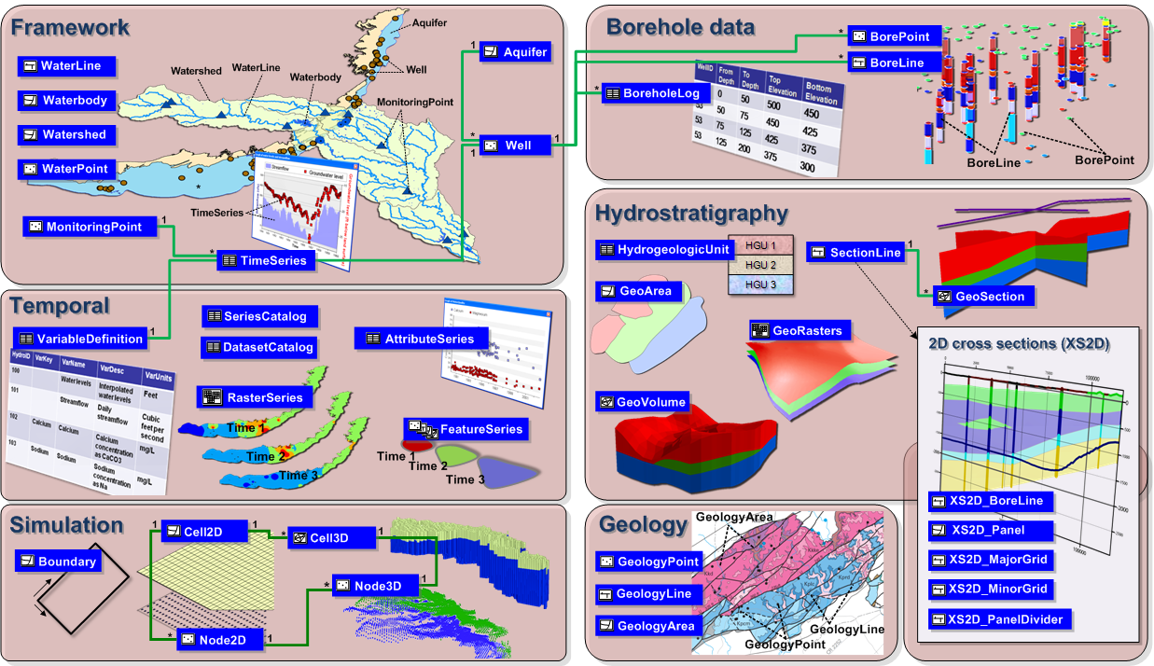
Arc Hydro GW Data Model
Notes:
This is an overview diagram of the AHGW data model.
You can review the different components, talk about what each component is for:
Framework – includes hydrography, monitoring points, wells, aquifers, tables for managing time series (the framework includes a simplified temporal component). – with the framework you can get started on most water resources projects.
Borehole data – description of vertical information recorded along boreholes (hydrostratigraphy, well construction).
Geology – representation of data from geologic maps.
Hydrostratigraphy – building 2D and 3D hydrogeologic models including surfaces, cross sections, volumes.
Temporal – dealing with time varying data – plots, tracks, animations.
Simulation – integration with groundwater simulation models, especially MODFLOW.

Slide 3
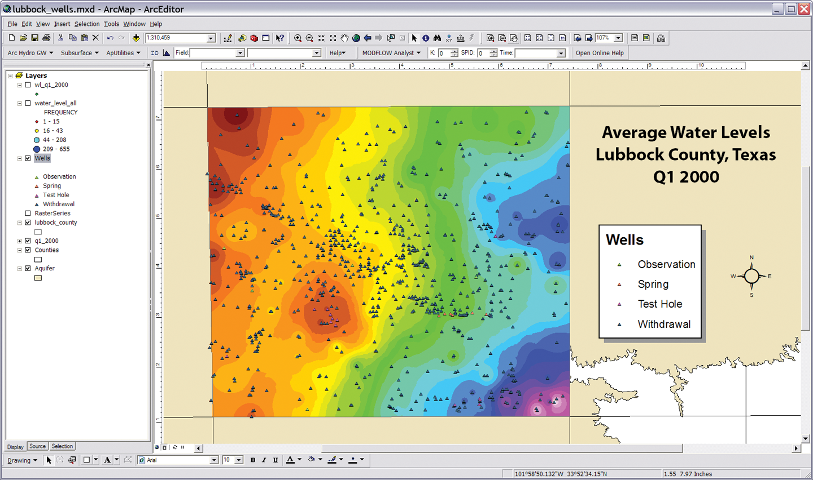
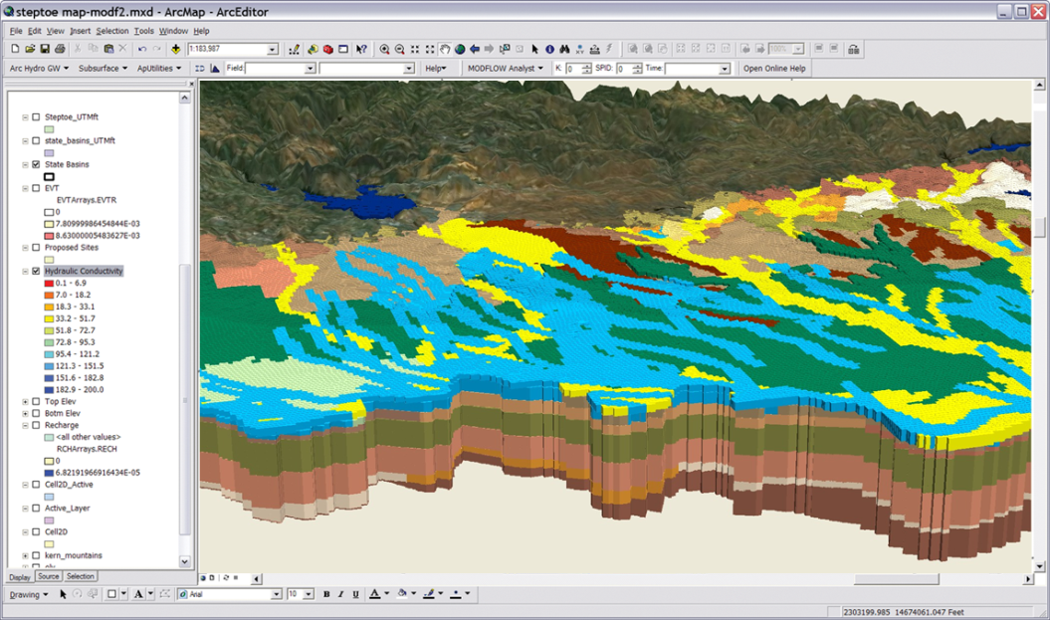
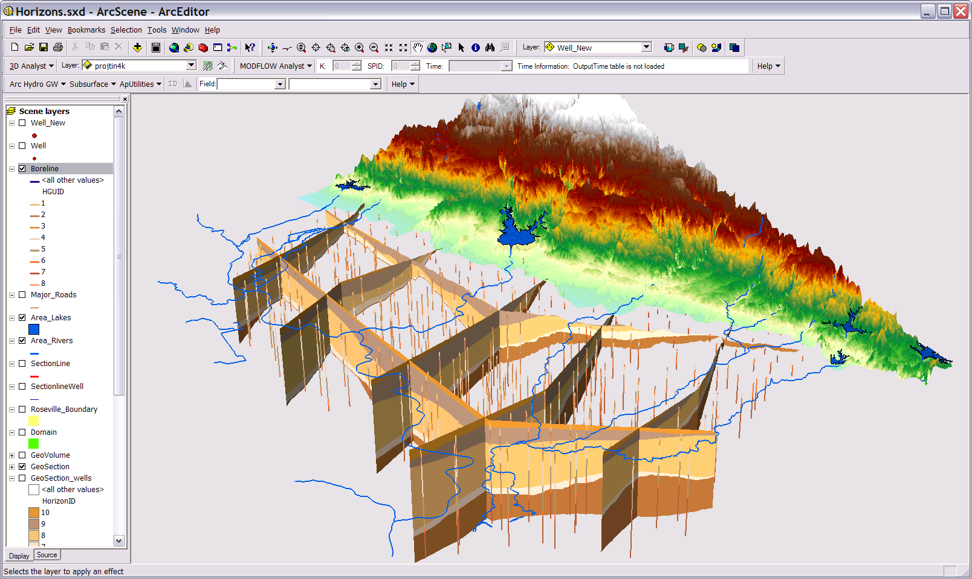
Arc Hydro GW Tools
Groundwater Analyst
MODFLOW Analyst
Subsurface Analyst

Slide 4
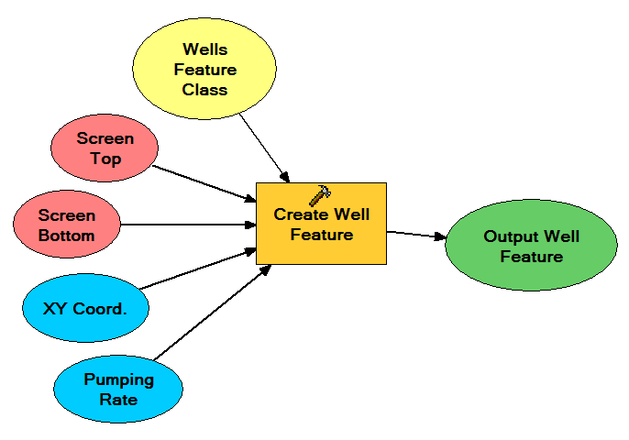
Geoprocessing Tools

Slide 5
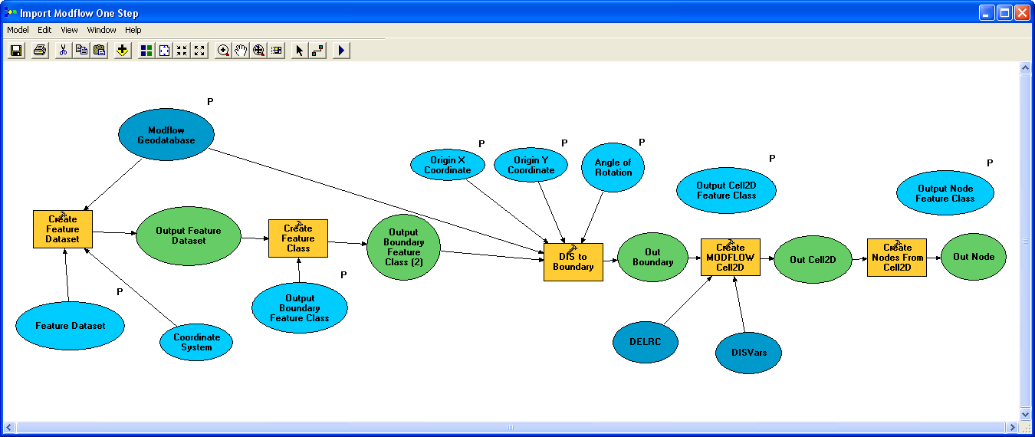
Geoprocessing Tools - Workflows
GP tools enable the development of workflows as models or scripts
Extendable – You can create your own workflows
Leverage low-level tools to create new tools

Slide 6
Automated Well Impact Analysis
Scripting MODFLOW simulations

Slide 7
MODFLOW

Slide 8
Simulation Feature Data Set

Slide 9
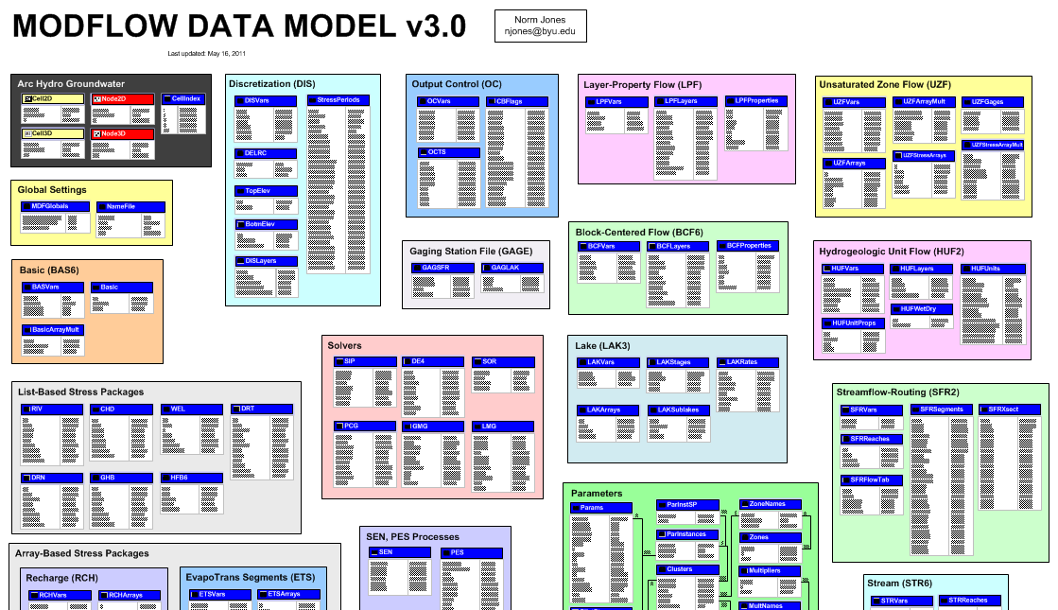
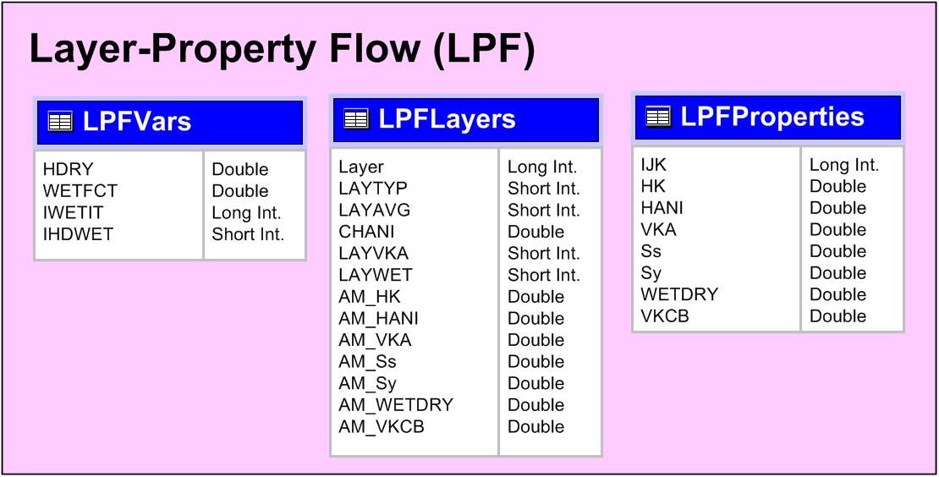
MODFLOW Data Model

Slide 10
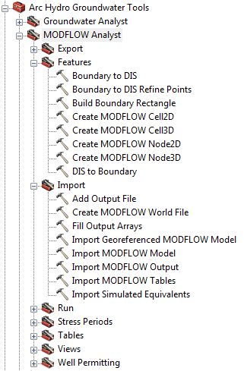
MODFLOW Analyst Tools
Developed as geoprocessing (GP) tools
Classes of tools
  Import
  Export
  Visualization/Map Layers
  Model editing
  Building package input
  Working with transient input/solutions

Slide 11
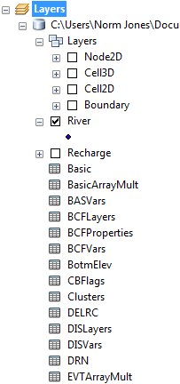
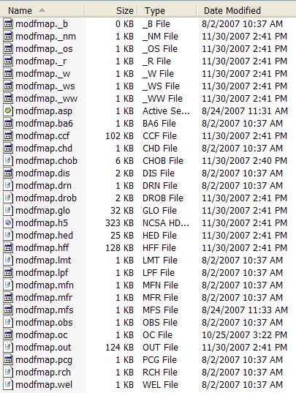
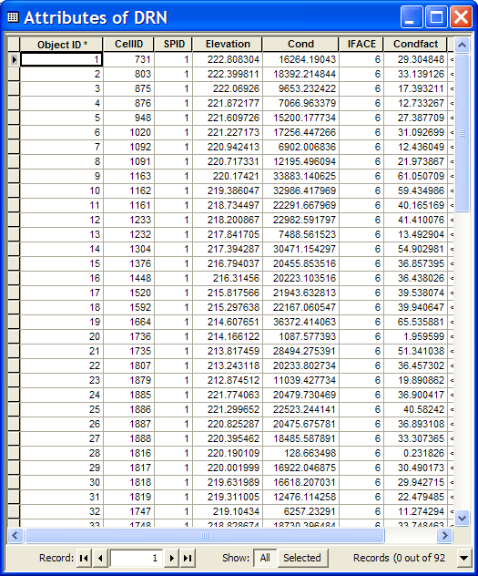
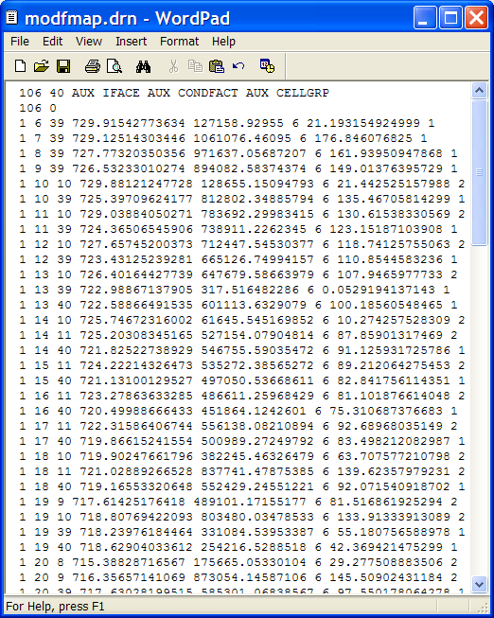
Import MODFLOW Model Tool
INPUT
OUTPUT

Slide 12
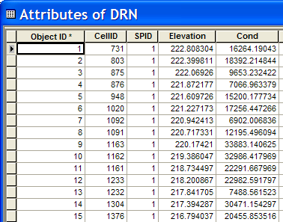
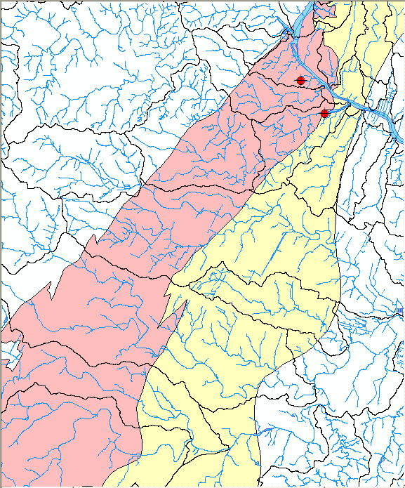
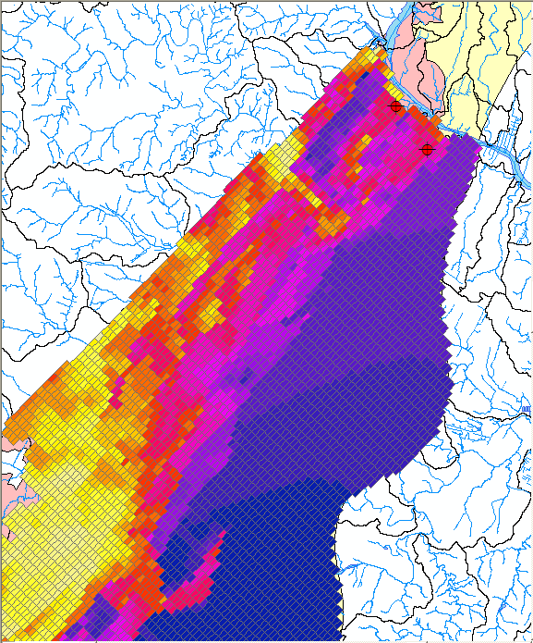
Make MODFLOW Features Tool
+
Or
Cell2D
Node2D
INPUT
OUTPUT

Slide 13
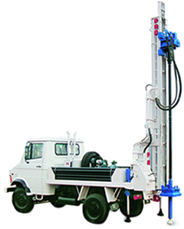
Automated Well Permitting
Calibrated regional model is imported to ArcGIS as a “baseline” model
Candidate wells are added to baseline model using well package.
Impact of new well is analyzed using
MODFLOW
and/or SEAWAT
Notes:
Just an overview of the general well-permitting process. The baseline model is a calibrated regional model used by the agency for impact analysis.
http://westonengineering.com/P7100029.JPG

Slide 14
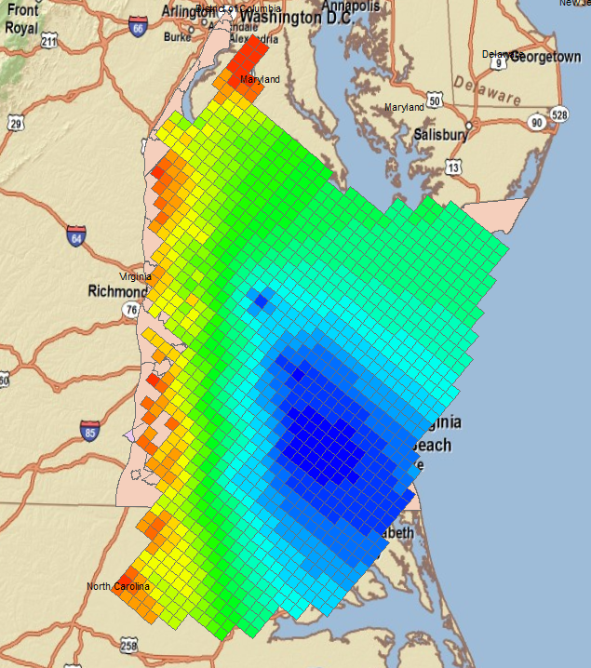
Case Study #1 – Virginia DEQ
Virginia Coastal Plain Model (VCPM)
10-layer MODFLOW model used to analyze impacts of candidate wells
Criteria based on state law
  Potentiometric surface cannot fall below a critical surface (80% drawdown)
  Area of Impact defined by drawdown = 1 ft
Heads for layer 8
Notes:
We have an ongoing contract to do modeling services for the VA-DEQ in support of their well-permitting program. They use a RASA MODFLOW model for the coastal plane region (shown in slide). The permitting process is based on VA state law. The wells are mainly in deep confined aquifers. They can’t let the potentiometric surface to draw down below an elevation called the “critical surface” (80% drawdown between pre-pumping conditions and top of confined aquifer). Also, we compute an “area of impact” defined by the region with drawdown >= 1 ft. The are of impact cannot include any neighboring wells, or a mitigation plan must be developed.

Slide 15
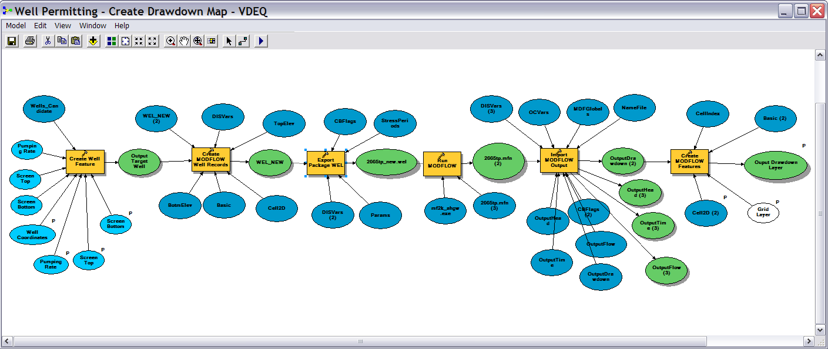
Well Permitting Workflow
Create new well → update well table → export well package file → run MODFLOW → import solution → build drawdown map layer
Notes:
Well permit analysis (impact of a proposed well or change in pumping rate) was traditionally done by manually modifying the model, running the model, and manually analyzing the changes to the model. Using AHGW tools, we developed a series of workflows that fully automated the process.

Slide 16
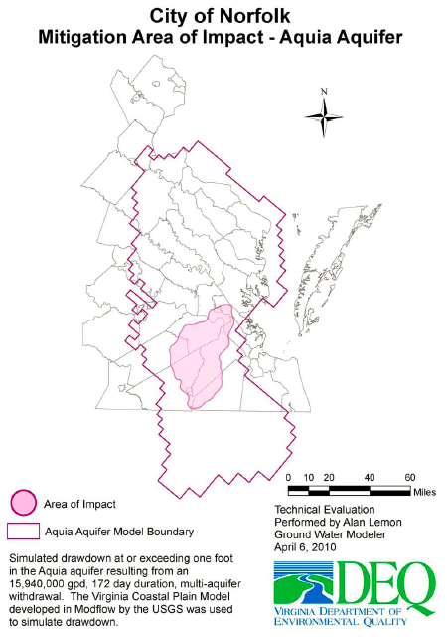
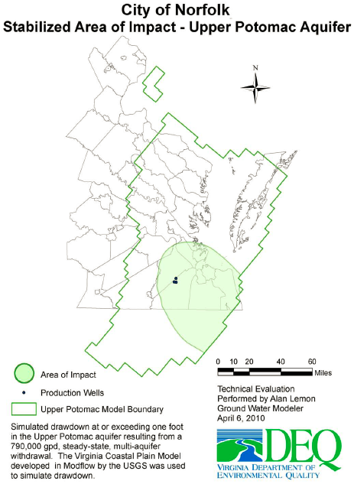
GIS Products
Notes:
While the previous slide was just a hypothetical run, this slide shows some actual maps generated from our process that were included in the modeling reports.

Slide 17
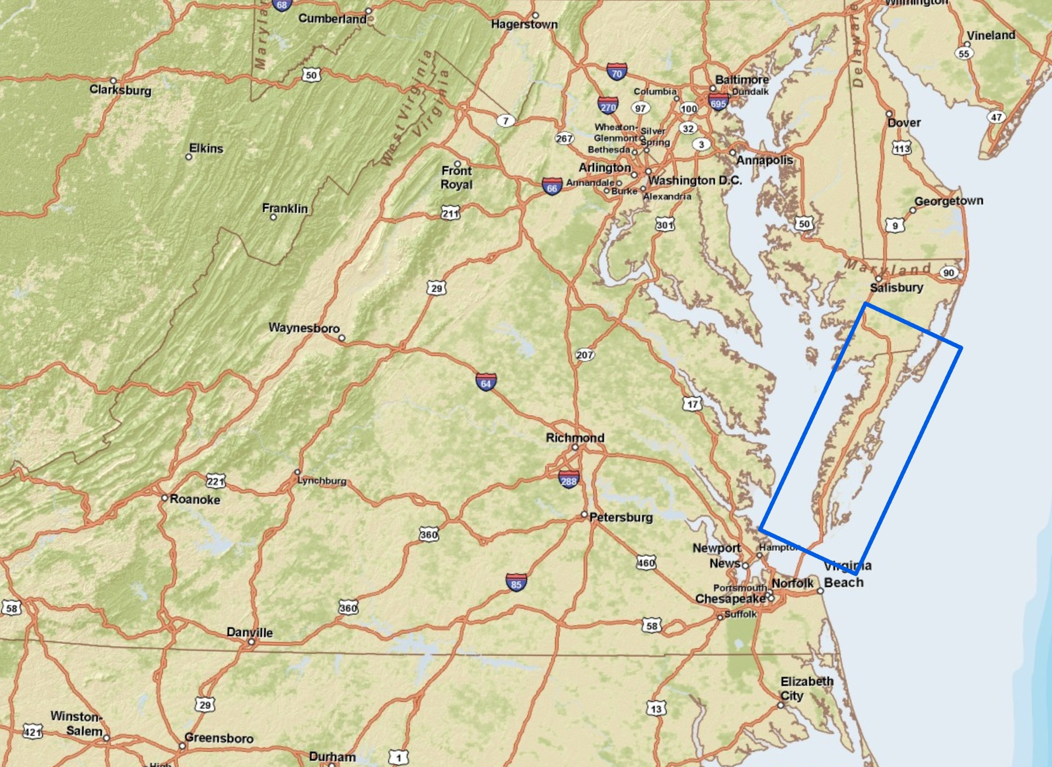
Eastern Shore Model
SEAWAT model (USGS – 2009)
Grid: 370 x 107 x 46
7 hydrogeologic units
50 year simulation
Criteria
Drawdown (same as VCPM)
ΔCl < 0.25 g/L
Notes:
The VESM has 46 layers.
Surficial aquifer -- layers 1, 2
Upper Yorktown-Eastover confining unit -- layers 3-10
Upper Yorktown-Eastover aquifer -- layers 11-18
Middle Yorktown-Eastover confining unit -- layers 19-22
Middle Yorktown-Eastover aquifer -- 23-30
Lower Yorktown-Eastover confining unit -- layers 31-34
Lower Yorktown-Eastover aquifer -- layers 35-42
43-46 - ?? I think these are St.Mary's confining unit
There are 370 rows in the following format (from the North/top): 40 rows of 2000 feet, 300 rows of 1000 feet, and 30 rows of 2000 feet.
There are 102 columns in the following format (from the West/left): 7 columns of 5000 feet, 8 columns of 2000 feet, 60 columns of 1000 feet, 20 columns of 2000 feet, and 7 columns of 5000 feet.
The report documenting its creation (see http://pubs.usgs.gov/sir/2009/5066/ for an abstract and pdf of the report) was published in 2009 and I know that the authors of that report (Ward E. Sanford, Jason P. Pope, and David L. Nelms) were involved in its creation.
Permit issuance is dependent upon:
The requested permit not resulting in any simulated potoentiometic head values below the “critical surface” in any layer in any of the confined aquifers – 3 confined aquifers in the case of the Virginia Eastern Shore Model (VESM), and 9 in the case of the Virginia Coastal Plain Model.
The Area of Influence (AOI) (area representing 1 foot or more of drawdown) cannot intersect any cells where the baseline simulated heads already are below the critical surface.
Further, Aquaveo staff must analyze the potential for adverse changes to water quality. To do so with the VESM we run a baseline SEAWAT simulation for 50 years (starting at 2010) with the requested permittee wells turned off. We run a second SEAWAT simulation with them on. If any cell in the model experiences an increase of chloride concentration of 0.25 g/L then we conclude that there is a potential for adverse water quality changes. The value of 0.25 g/L is the EPA suggested drinking water limit for chloride. We discussed modeling where the interface between potable and non-potable water was using the baseline and added wells simulations. Our original thought was that if the boundary was brought inland past any existing permittees then that would be the criterion. However, after discussion with the DEQ we decided to evalate water quality based upon the first criterion I discussed above because there isn’t sufficient data to establish where the potable interface is to begin with.

Slide 18
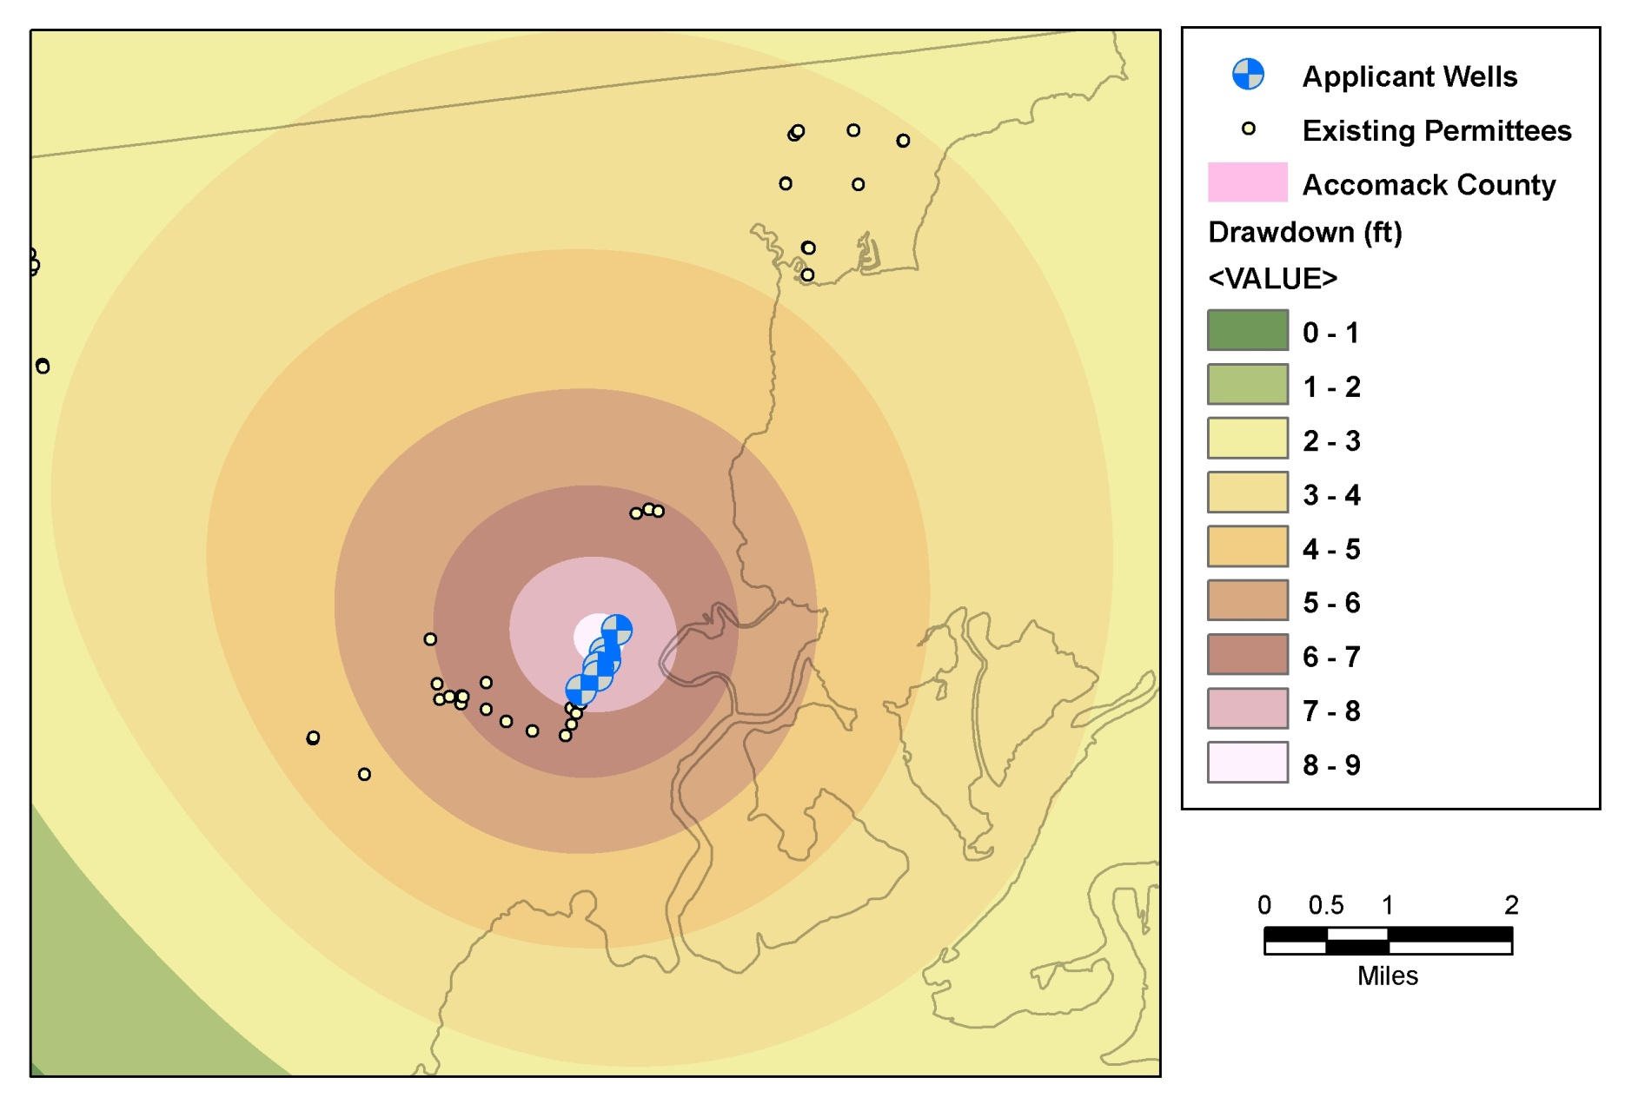
Sample Application
7 wells
Small increase in production
Notes:
The figure above illustrates the drawdown due to a multi-aquifer requested withdrawal in Accomack county using the VESM. The drawdown shown above is from the Lower Yorktown-Eastover aquifer. The Applicant Wells are identified along with all of the existing permitted wells in the area. The applicant will have to supply a mitigation plan dealing with all of the exiting permitted wells within the applicants AOI.
Chincoteague Permit Details:
219,400,000 gallons per year (601,096 average gpd) not to exceed 34,100,000 gallons in any month (1,100,000 average gpd)
DEQ Well # Owner Well # Aquifer % of Withdrawal
100-00945 8 Middle Yorktown-Eastover 24.6% (this will be the only new well)
100-00850 3A Water Table 8.6%
100-00851 3B Water Table 8.6%
100-00852 3C Water Table 8.6%
100-00028 4 Middle Yorktown-Eastover 23.4%
100-00032 5 Middle Yorktown-Eastover 1.6%
100-00320 6 Upper & Middle Yorktown-Eastover 24.6%
Summary of Requested Withdrawal:
The application is for a new permit under the 1992 Ground Water Management Act. The Town has been operating under a 1973 Act Permit (#ES-061). The new application represents a reduction from the previously permitted 1.34 mgd to 0.6 mgd. Current use is 0.5 mgd. The withdrawal is a public water supply to support the residential and commercial connections within the incorporated area as well as some outlying areas. The application represents a change in the well pattern to some degree but this does not appear to significantly change the actual aquifer withdrawal pattern. For example, several wells that have been abandoned in the water table aquifer and one in the Upper Yorktown-Eastover Aquifer were apparently not significant producers anyway.

Slide 19
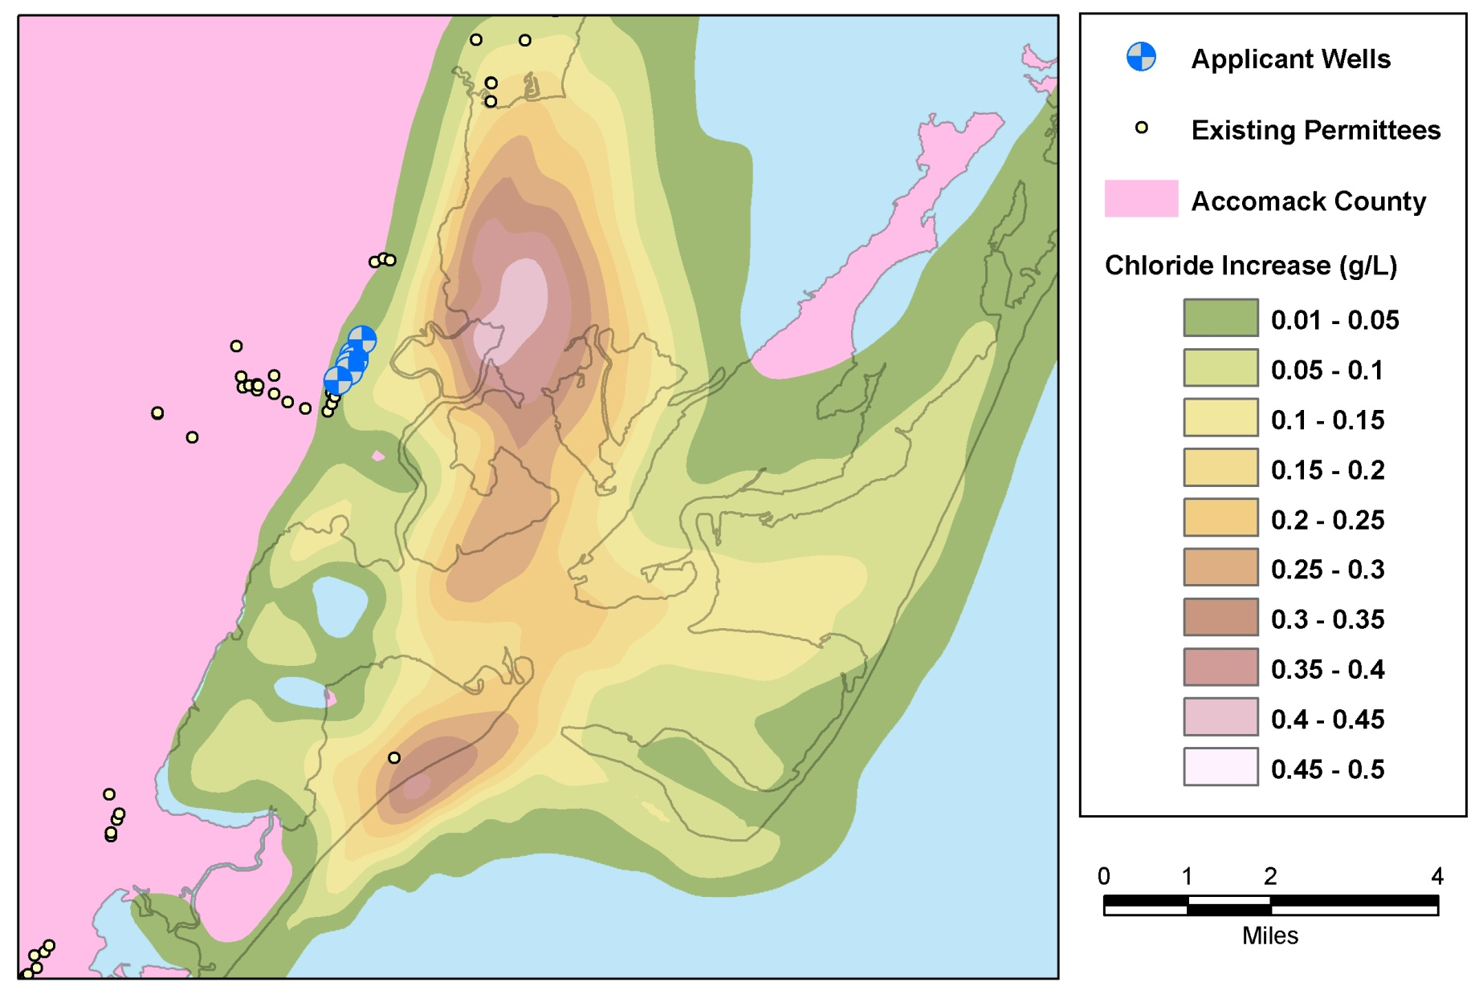
Changes in Chloride Concentration
Notes:
This shows the chloride concentration increase (g/L) for the Lower Yorktown-Eastover aquifer.
At end of 50 years.

Slide 20
MODFLOW in the Cloud
Utah Division of Water Rights Well Impact Simulator

Slide 21
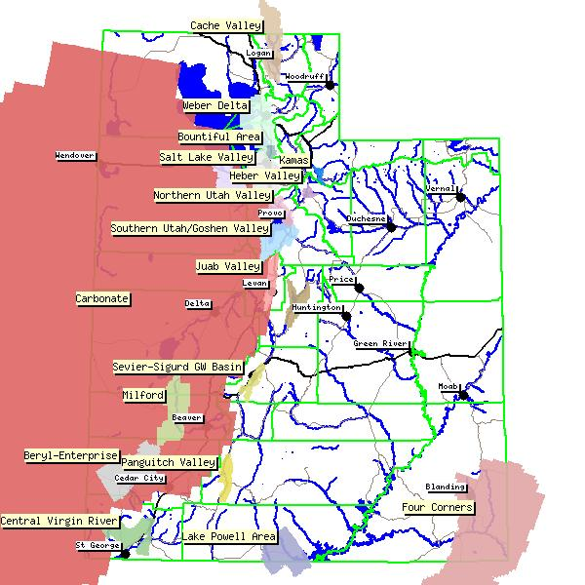
Utah Division of Water Rights
31 MODFLOW models used for impact analysis
Challenges
  Modeling expertise
  Software installation and maintenance
  User error
  Cost

Slide 22



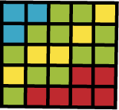





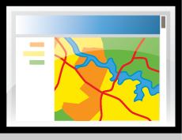
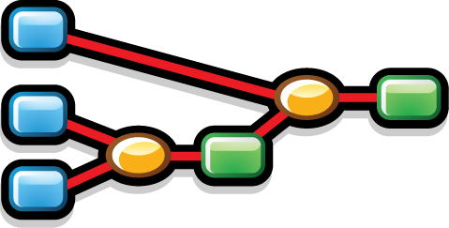

Cloud-Based Solution
Geodatabase
Model Files
Server
GIS Workflow
Web Mapping
UDWR Staff & Decision Makers

Slide 23
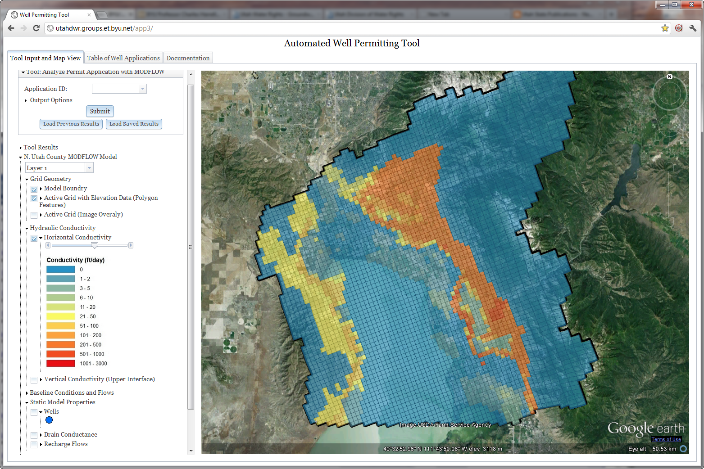
Web Interface
http://utahdwr.groups.et.byu.net/app3/

Slide 24
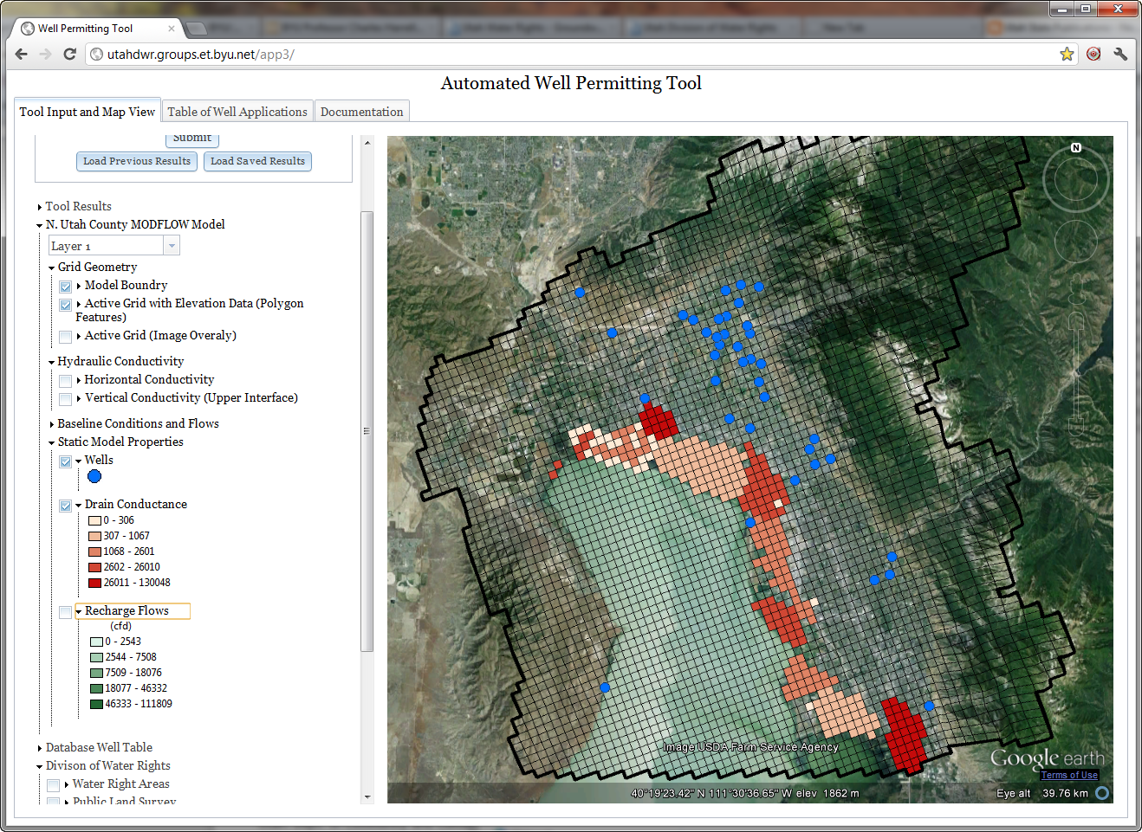
Static Model Data

Slide 25
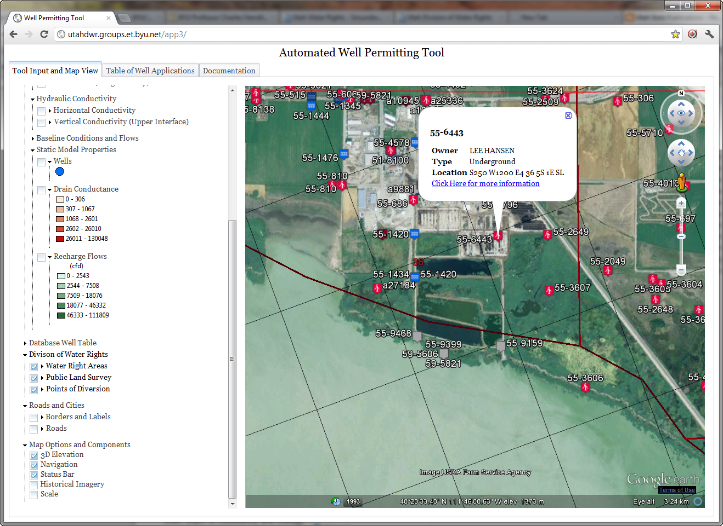
Map Layers from UDWR Server

Slide 26
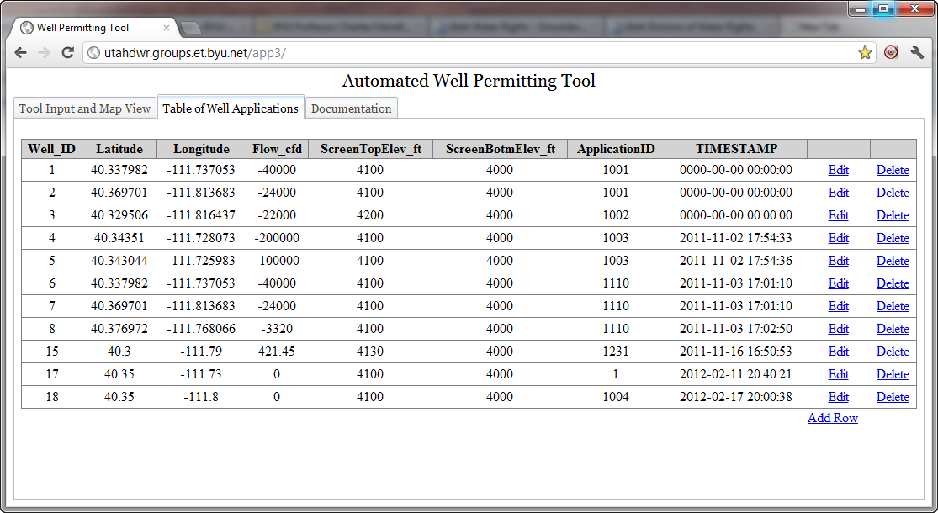
Table of Well Applications

Slide 27
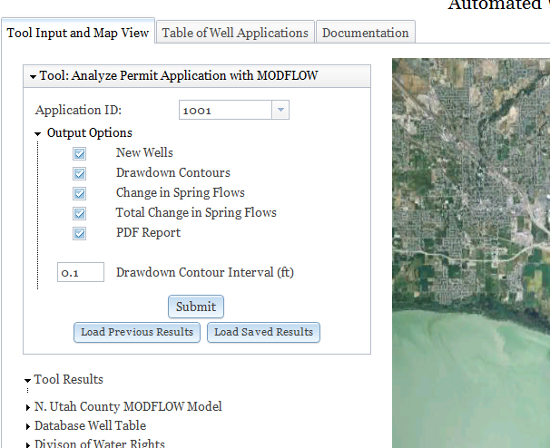
Submitting a Model Run

Slide 28
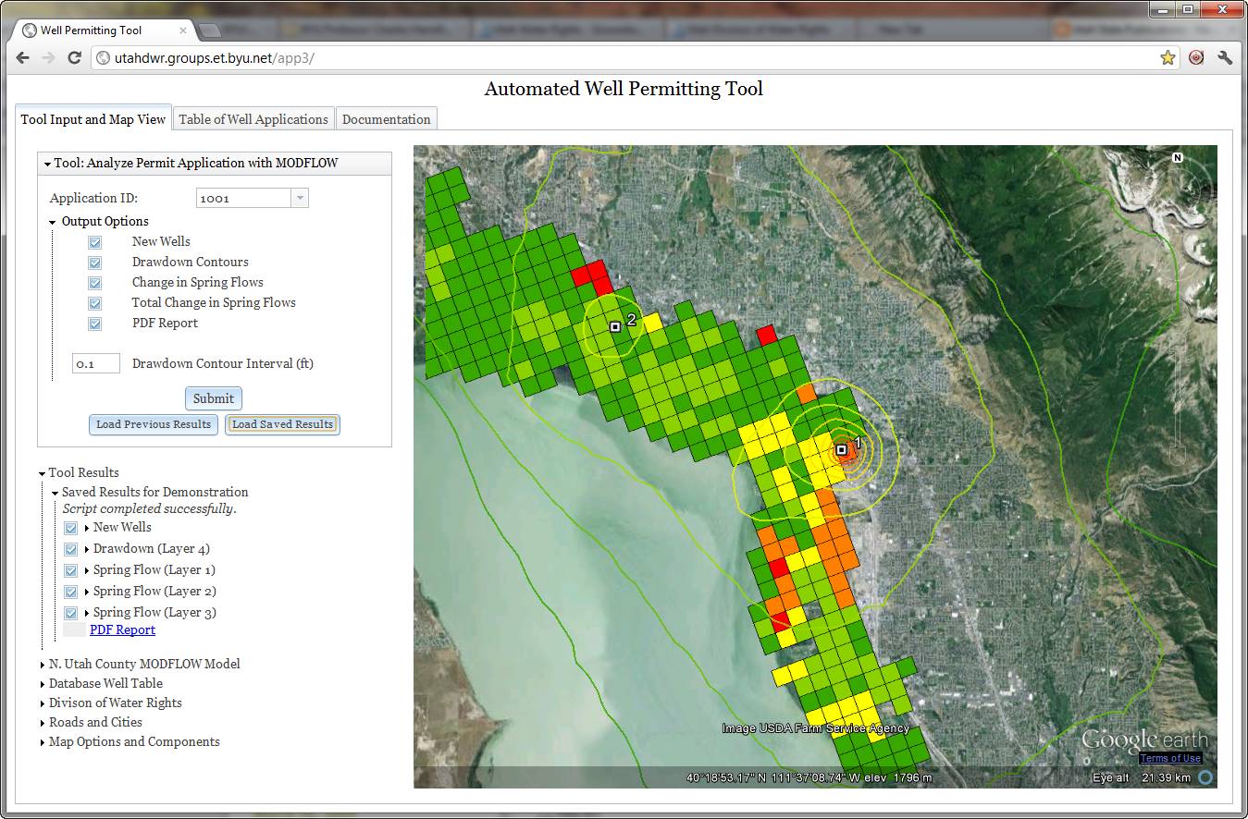
Model Results

Slide 29
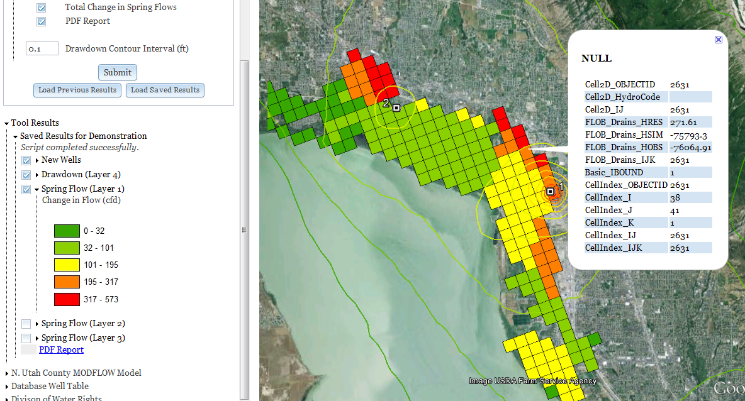
Impact on Springs

Slide 30
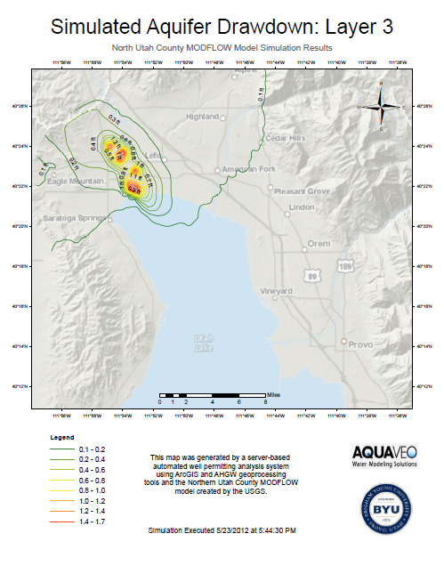
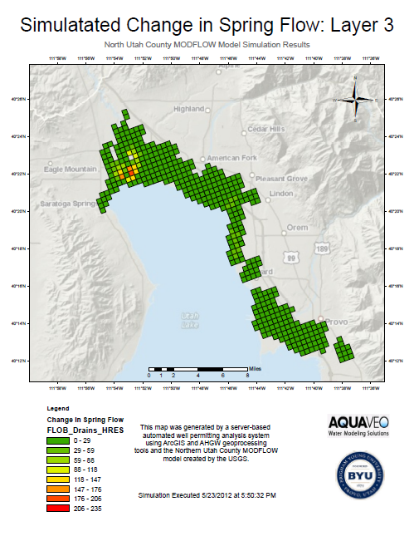
PDF Output

Slide 31
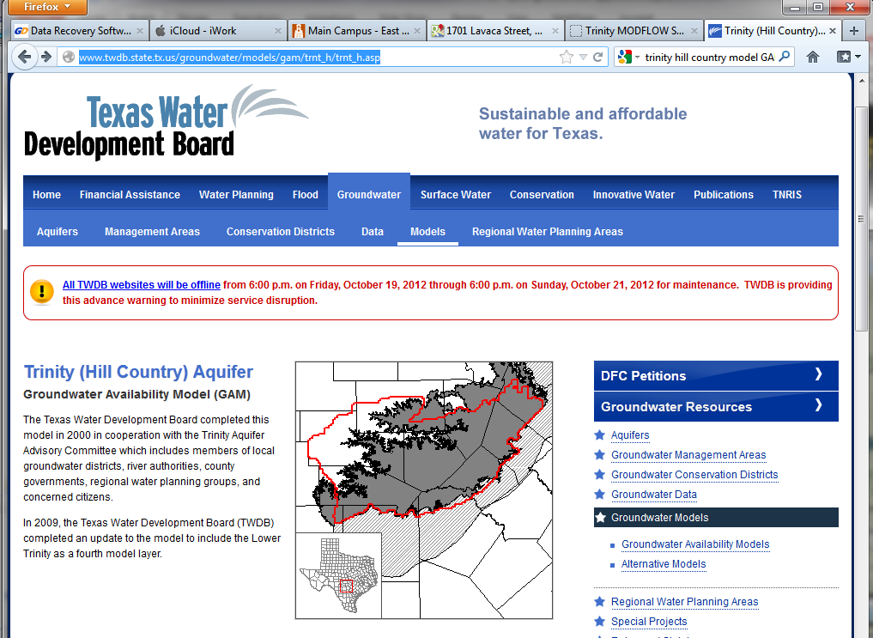
Texas Groundwater Availability Models
Community MODFLOW models for water resource planning and management

Slide 32
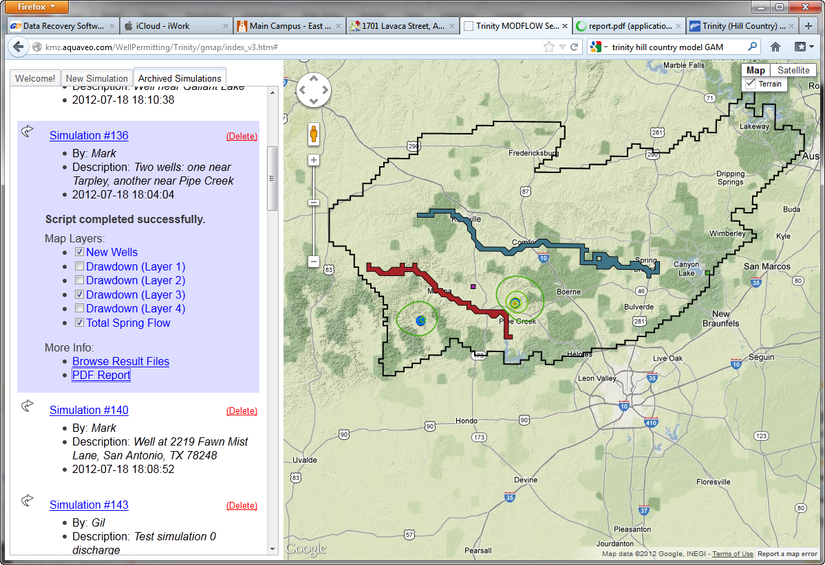
Trinity (Hill Country) Aquifer GAM
Simulation Options:
(a) Reduced recharge
(b) Well impact on water levels and stream flow
http://kmz.aquaveo.com/WellPermitting/Trinity/gmap/index_v3.htm

Slide 33
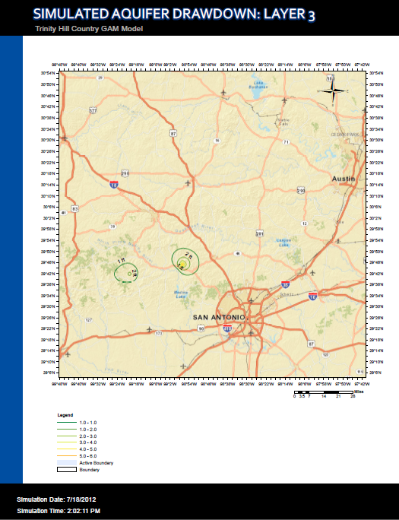
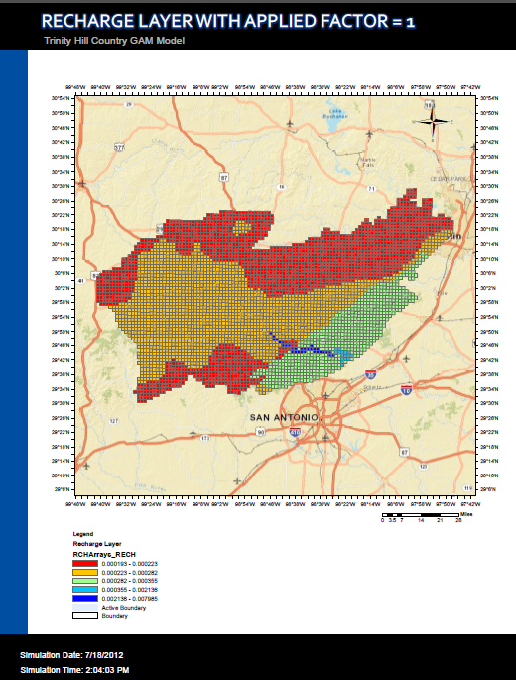
PDF Simulation Report

Slide 34
Water Level Mapping Utility
Cloud-based too for drought impact analysis in Texas

Slide 35







CI-WATER Project
CI-WATER: Cyberinfrastructure to Advance High Performance Water Resource Modeling
Notes:
35

Slide 36
Cloud-Based Water Level Mapping Utility
Detailed maps showing water level changes over time are essential for aquifer management and planning
Water
Level
Mapping
Utility
Water Levels
Drawdown
Depth to GW
Subregion
Date(s)
Inputs
Outputs
TWDB Well Database
Arc Hydro GW Tools
Python-Based Workflow
Google Earth Web Plug-in

Slide 37
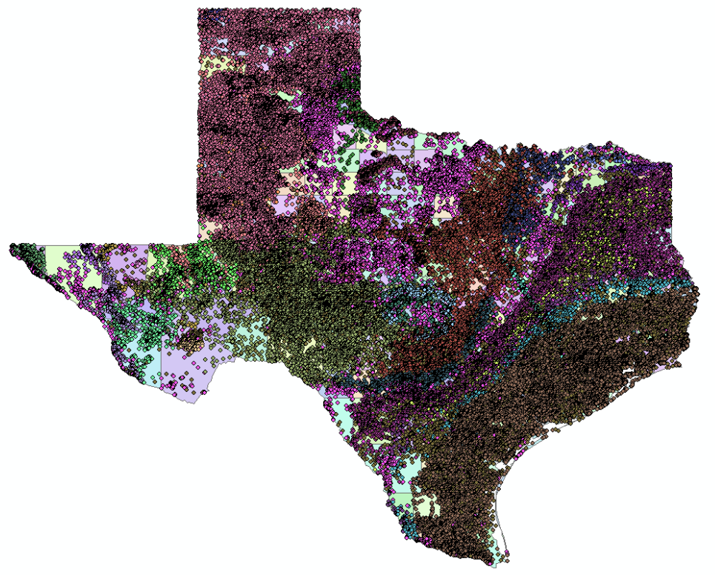
TWDB Well Database
274,904 wells w/meas.
781,864 measurements

Slide 38
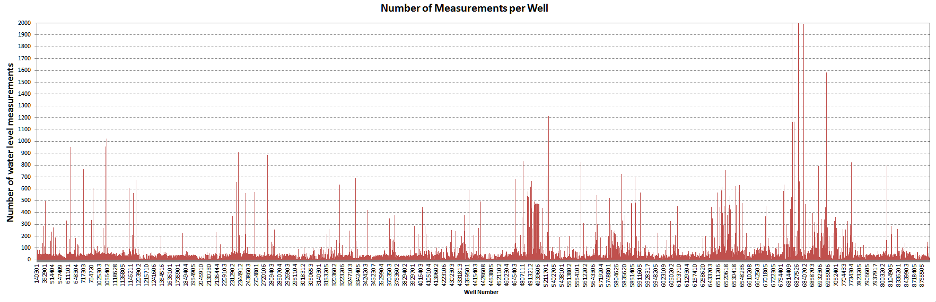
Measurements per Well

Slide 39
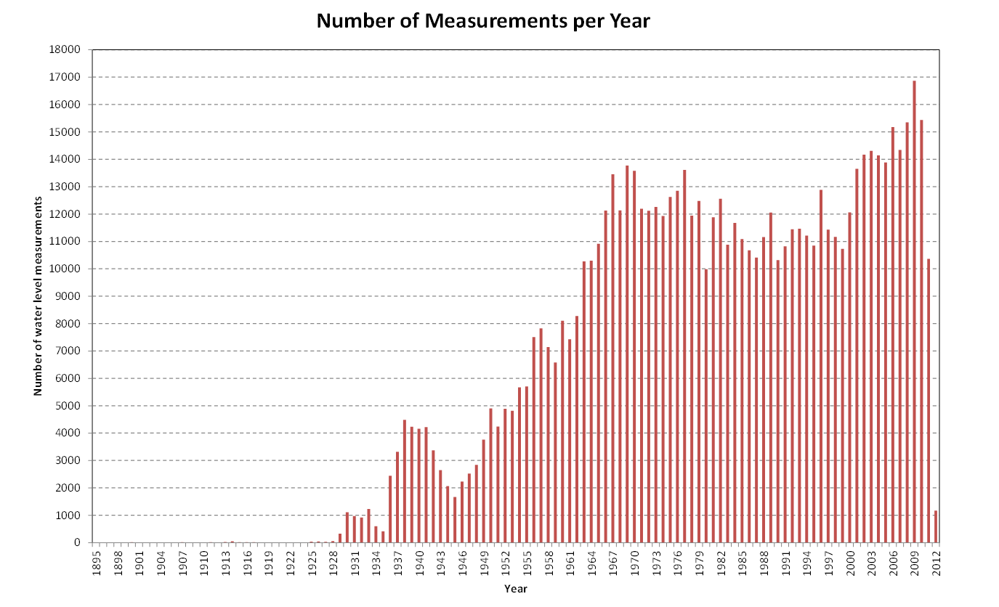
Measurements per Year

Slide 40
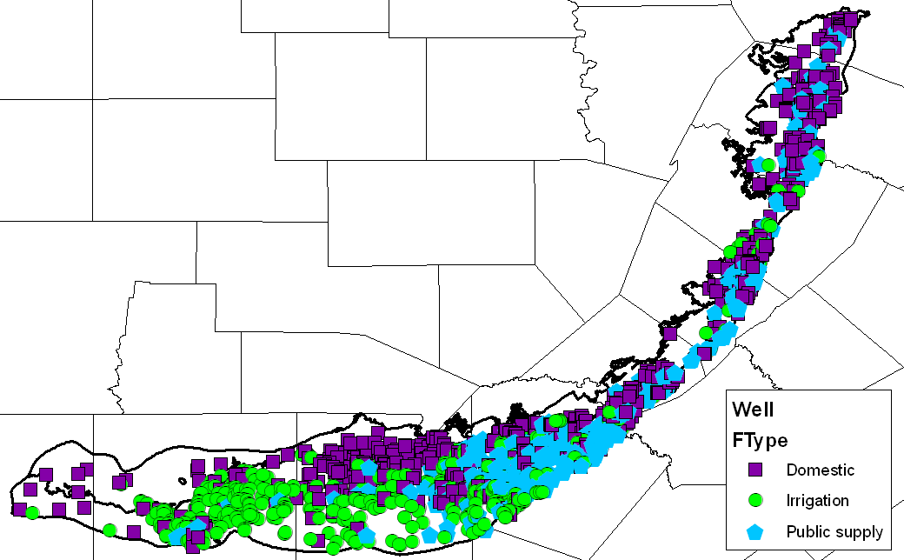
Wells
The Well location is defined as a 2D point in the Well feature class
In the Arc Hydro model we only predefine a set of basic attributes
Wells in the Edwards Aquifer

Slide 41
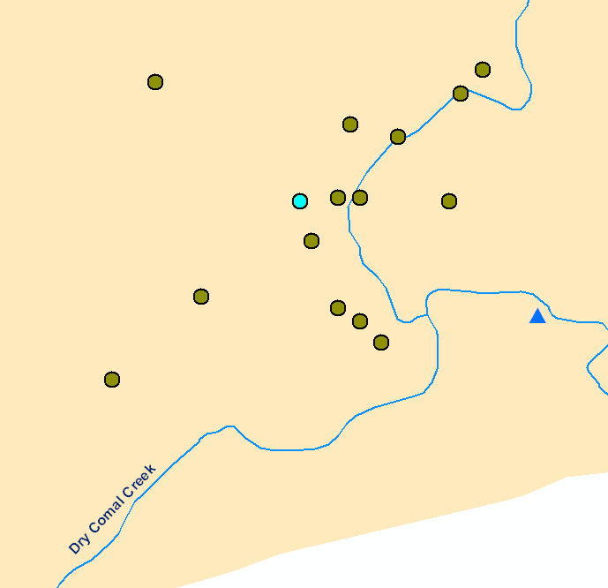
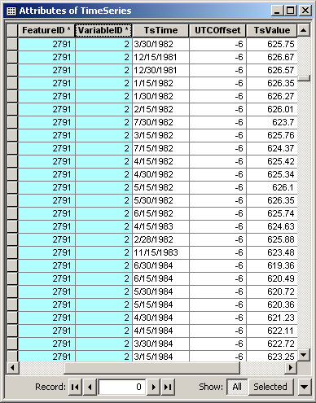
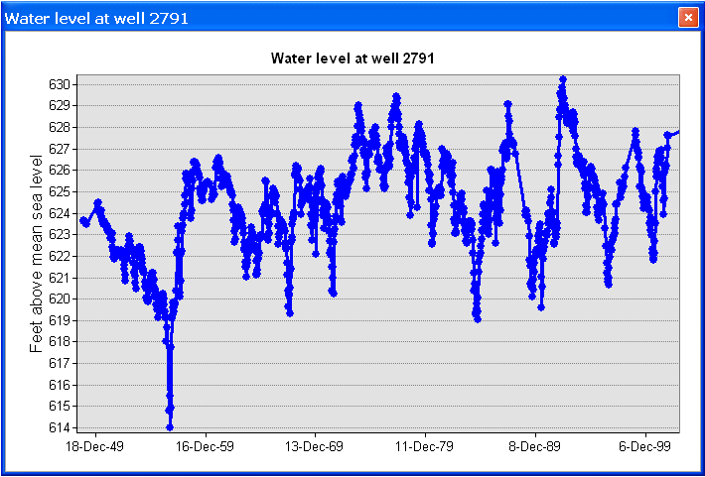
Time Series Processing
FeatureID of the time series = HydroID of the spatial feature (e.g. Well)
Well HydroID = 2791

Slide 42
Workflow Components
Query wells in selected region
Estimate water levels at selected date
Interpolate water levels to raster
Calculate Drawdown & Depth to GW
Archives maps to database
Export rasters to KMZ

Slide 43
Time Series Interpolation
Water levels are measured sporadically
To get a value at each well, we must perform time series interpolation
Z
time

Slide 44
Least Squares Fit
Z
time

Slide 45
Least Squares Fit, n=2
Z
time

Slide 46
Least Squares Fit, Extrapolation
Z
time

Slide 47
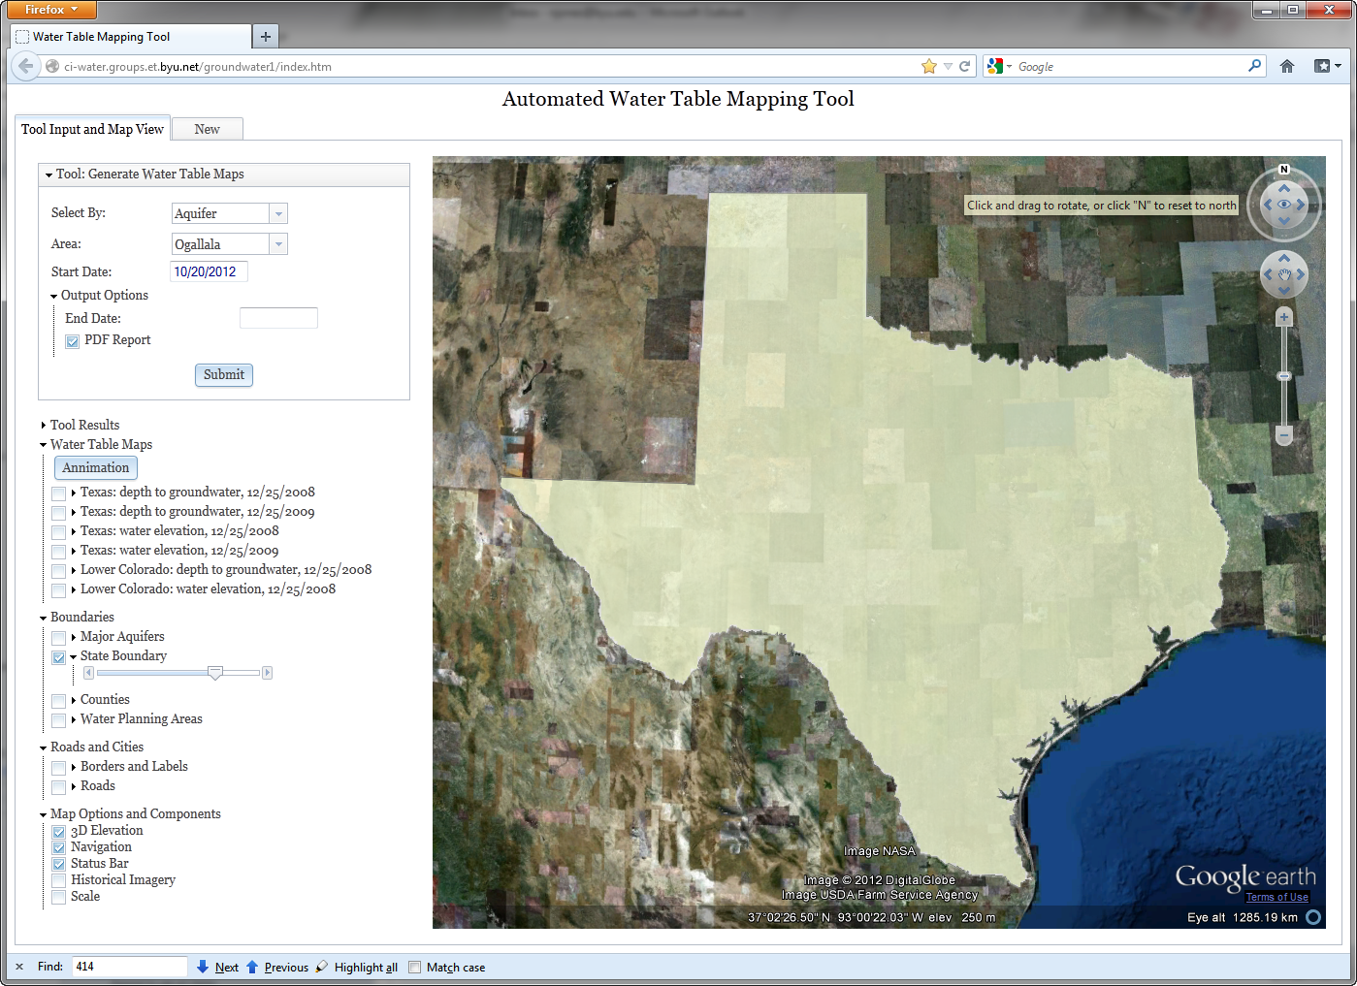
Google Earth
Plug-In
For generating new maps
Archive of existing maps
Static map components
http://ci-water.groups.et.byu.net/groundwater1

Slide 48
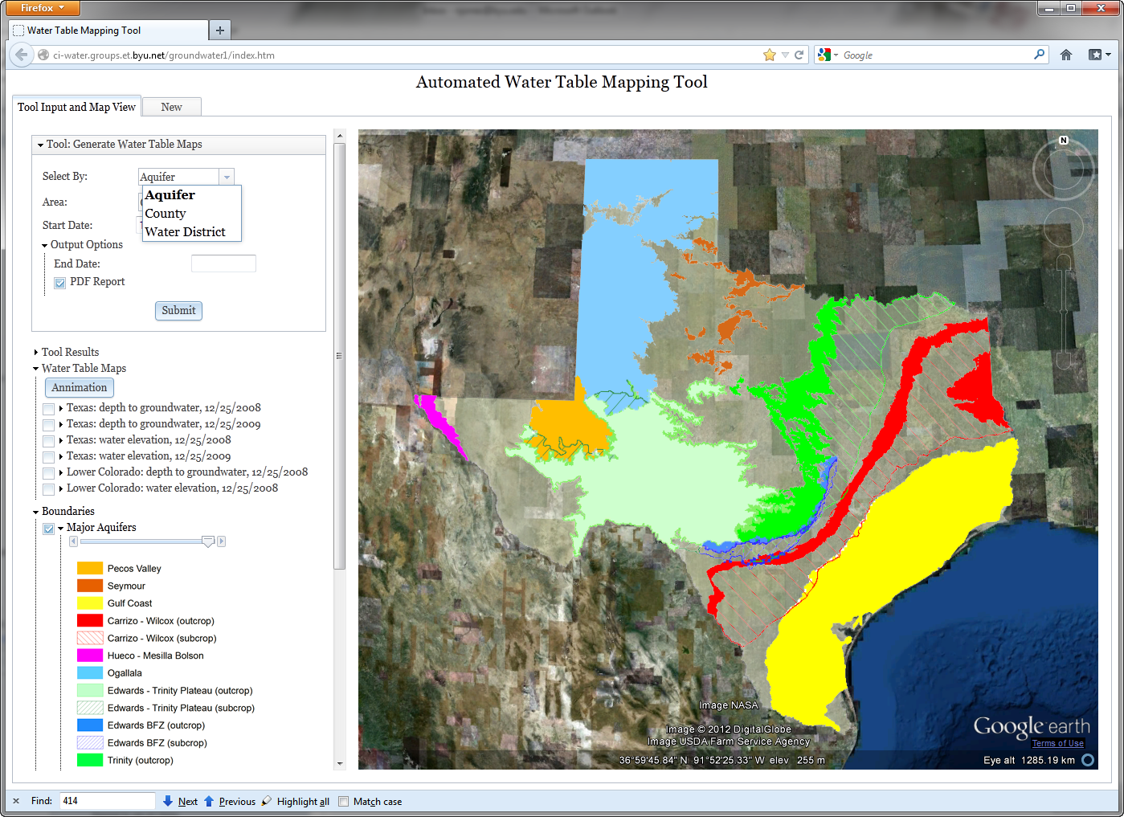
Region Selection

Slide 49

Water Level Map

Slide 50

Depth to GW Map

Slide 51

Depth to GW
Map

Slide 52







Animations
12/25/2000
12/25/2005
12/25/2004
12/25/2001
12/25/1999
12/25/2002
12/25/2003

Slide 53

Thank You
Special Thanks to:
Michael Burns
Scott Christiansen
Gil Strassberg
Alan Lemon
Doug Gallup
This material is partially based upon work supported by the National Science Foundation under Grant
No. 1135482.
Norm Jones
njones@byu.edu

