Slide 1
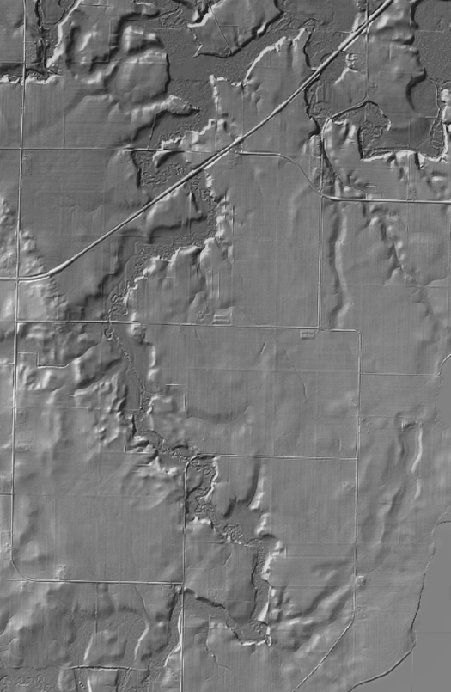
Lidar data in water resources applications
Paola Passalacqua
CE 394K 3 Guest Lecture, November 15th, 2012

Slide 2
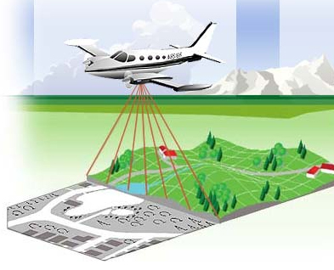
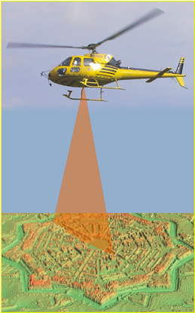
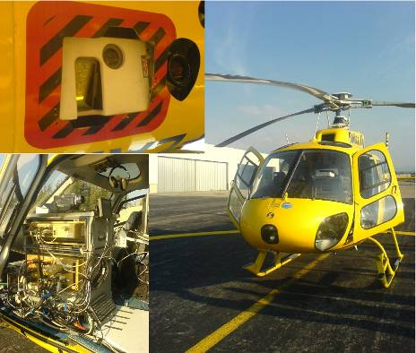
Airborne Lidar
Airborne laser altimetry technology (lidar, Light Detection And Ranging) provides high-resolution topographical data, which can significantly contribute to a better representation of land surface. A valuable characteristic of this technology, which marks advantages over the traditional topographic survey techniques, is the capability to derive a high-resolution Digital Terrain Model (DTM) from the last pulse LiDAR data by filtering the vegetation points (Slatton et al., 2007).
Slide courtesy of Dr. Paolo Tarolli, University of Padova, Italy

Slide 3
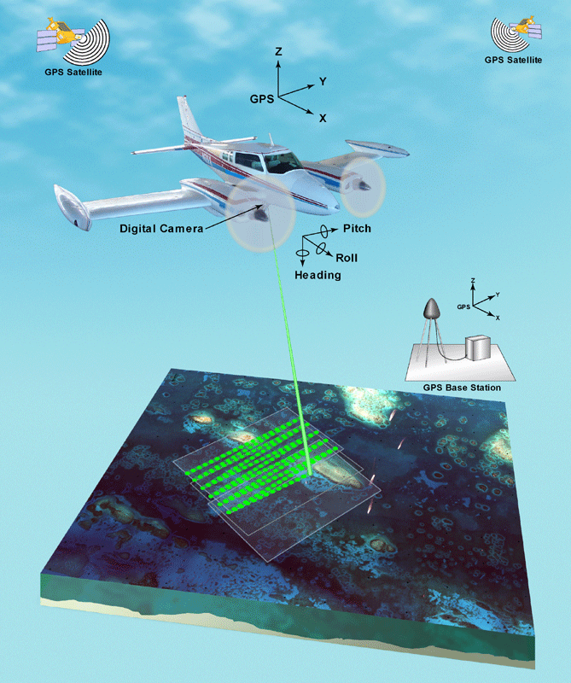
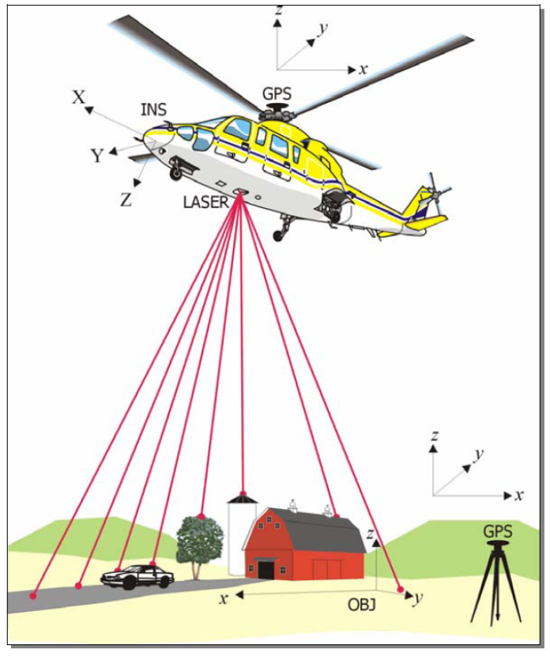
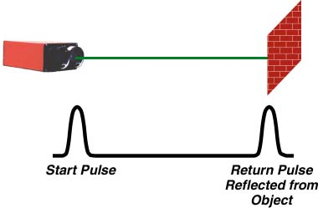
Airborne Lidar
Slide courtesy of Dr. Paolo Tarolli, University of Padova, Italy

Slide 4
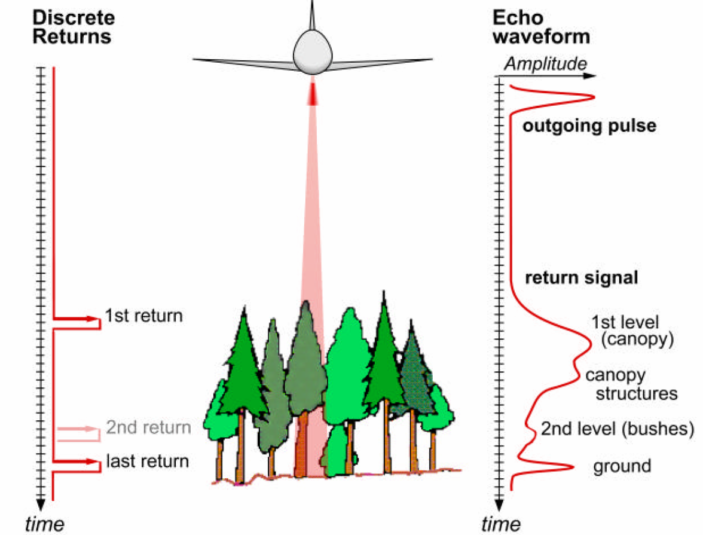
Airborne Lidar
x,y,z
Slide courtesy of Dr. Paolo Tarolli, University of Padova, Italy

Slide 5
Forest canopy
Filter
Processing
First return/
Echo-waveform
DSM
3D Buildings
Raw LIDAR
Multi-Spectral
Filter
Processing
Land cover related
to each vegetation types
Filter
Processing
Last
Return
x,y,z
DTM
TIN
Contour maps
Slide courtesy of Dr. Paolo Tarolli, University of Padova, Italy

Slide 6
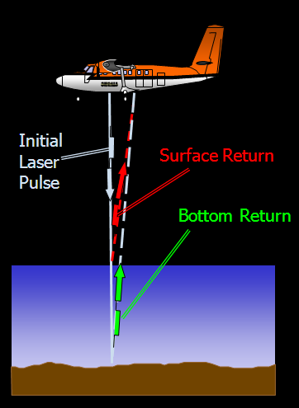
Topographic Lidar
λ = 1064 nm
Green LiDAR
λ = 532 nm + λ =1064 nm
It is important to remember that the deep water surfaces normally do not reflect the signal: however this is not true in case of presence of floating sediments or when using bathymetric lidar. The bathymetric lidar, that is based on the same principles as topographic lidar, emits laser beams in two wavelengths: an infrared (1064 nm) and a green one (532 nm). The infrared wavelength is reflected on the water surface, while the green one penetrates the water and is reflected by the bottom surface or other objects in the water. Due to this reason the bathymetric lidar is also called green lidar.
Slide courtesy of Dr. Paolo Tarolli, University of Padova, Italy

Slide 7
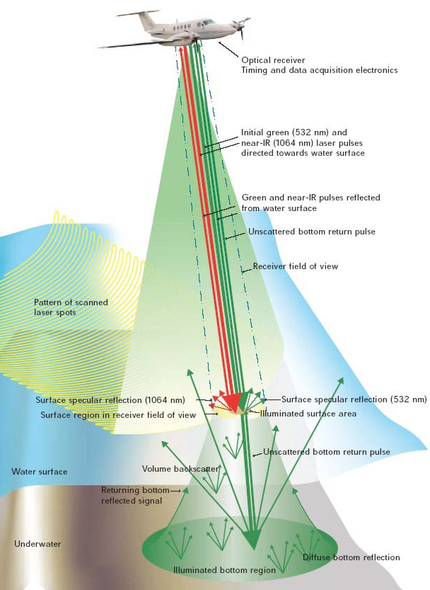
Fonte: www.optech.ca
During optimal environment condition, when the water is clear, the green lidar survey may reach 50 m water depth with an horizontal accuracy of ±2.5 m, and vertical accuracy of ±0.25 m. This technology is growing fast, and some of the first applications in rivers are coming out (Hilldale and Raff, 2008; McKean et al., 2009).
Slide courtesy of Dr. Paolo Tarolli, University of Padova, Italy

Slide 8
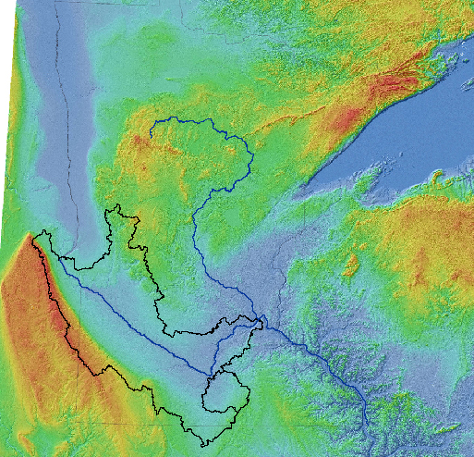
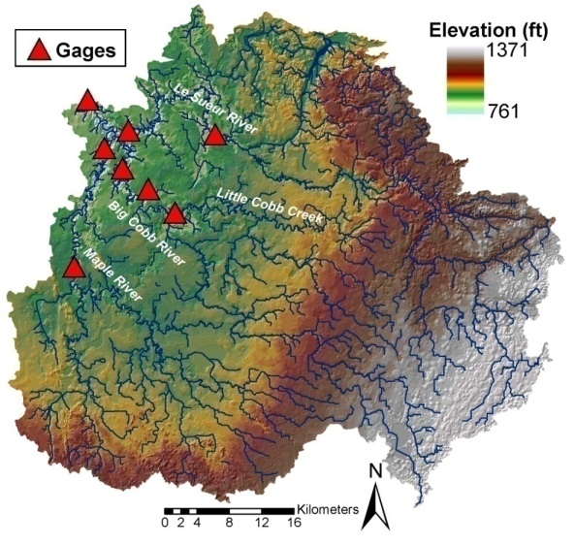
Example 1: Le Sueur River basin
Le Sueur River located in south-central Minnesota, covers an area of 2880 km² (87% row-crop agriculture)
Minnesota
River
Basin
Provides ~ 24%-30% of the TSS entering the Minnesota River
Mississippi River
Lake Pepin
Minnesota River major source of sediment for Lake Pepin (~85% of TSS load)
Le Sueur
Turbidity and related nutrients levels of Lake Pepin are far in excess of EPA standards
State of Minnesota required to determine the sources of pollution and take management and policy actions
NCED Research

Slide 9
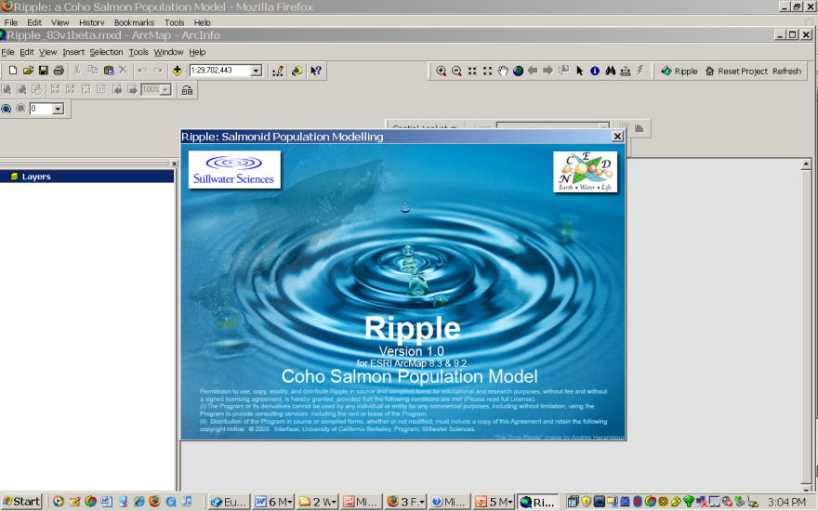
Example 2: Limiting factors analysis of Coho salmon
River networks produce a highly structured pattern of process and morphology downstream.
This structure can be exploited to predict habitat and carrying capacity of species throughout the watershed.
Ripple: spatially explicit model that links quantitatively topography, habitat carrying capacity and population dynamics for an entire watershed.
GEO
MODULE
HAB
MODULE
POP
MODULE
GEO module: uses DEM to compute local slope and drainage area
NCED Research

Slide 10
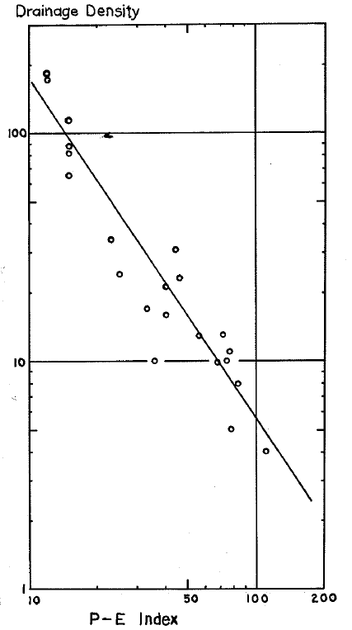
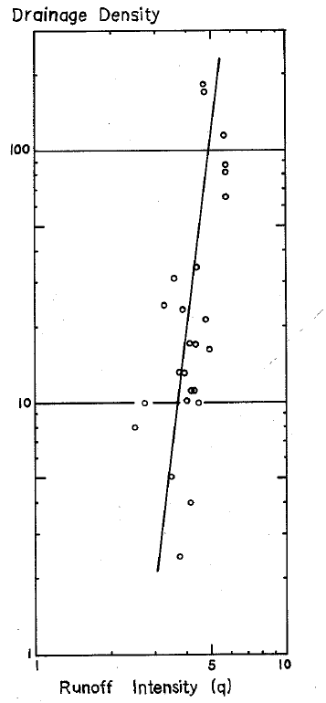
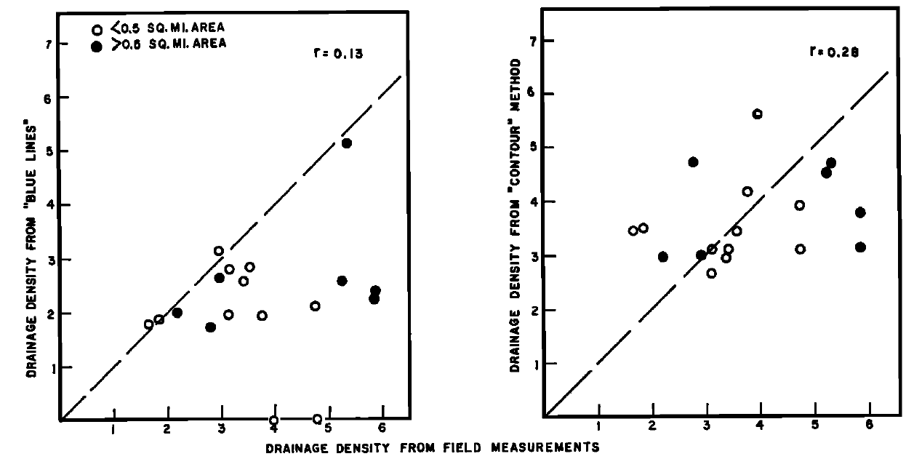
Example 3: Drainage density as a signature of climate
Climate exerts a quantifiable control over the degree of channel dissection
Lithology and relief are important cofactors
Melton, M.A., ONR Tech Report, 1957
The problem of resolution: Strong discrepancy between channels as mapped in the field and as deduced from topographic maps (Morisawa, [1957; 1961]; Schneider [1961]).
Schneider, W.J., J. Geophys. Res., 1961

Slide 11
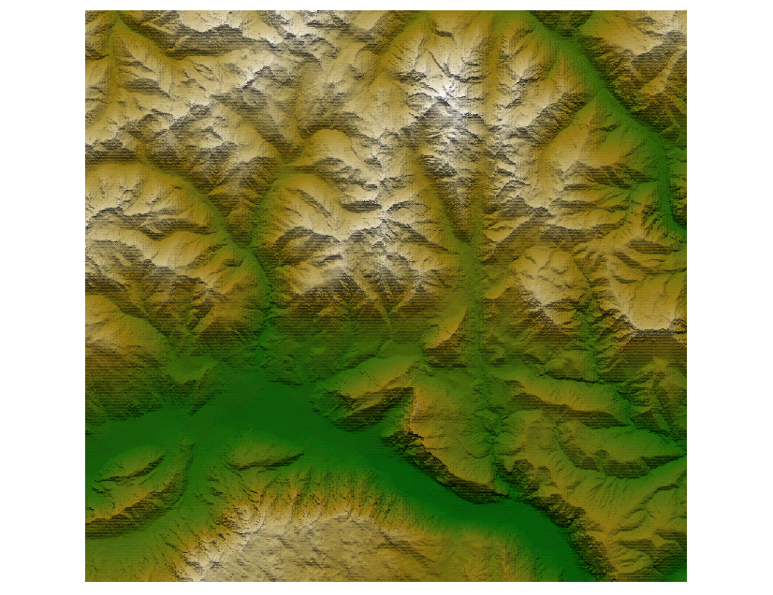
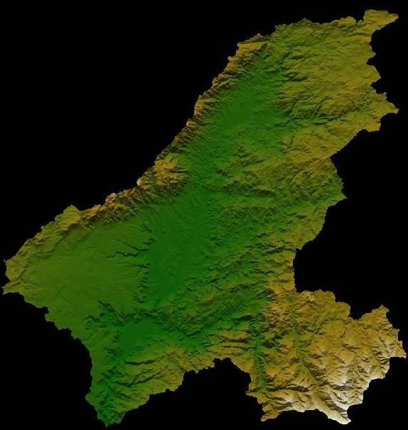
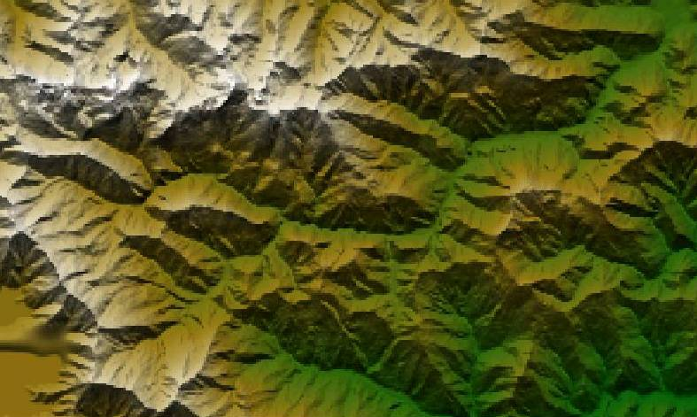
Digital elevation data
Data resolution available until recently 30-100 m.
Grigno basin, Italy
Resolution 30 m x 30 m
Data source: University of Padova
Tirso basin, Italy
Resolution 100 m x 100 m
Data source: University of Padova
Tanaro basin, Italy
Resolution 90 m x 90 m
Data source: University of Padova

Slide 12
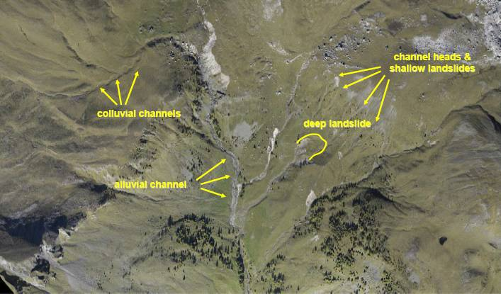
Rio Cordon basin, Selva di Cadore, Italy
Slide courtesy of Dr. Paolo Tarolli, University of Padova, Italy

Slide 13
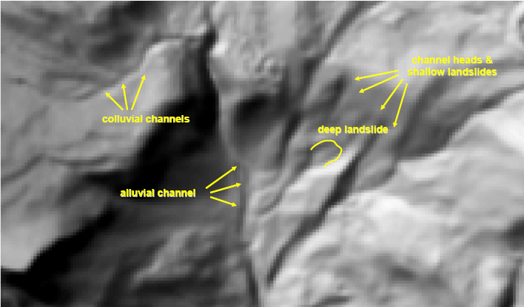
The role of data resolution
DTM 10x10 m
Slide courtesy of Dr. Paolo Tarolli, University of Padova, Italy

Slide 14
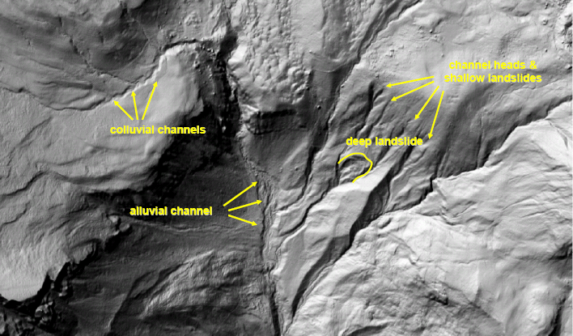
The role of data resolution
DTM 1x1 m
Slide courtesy of Dr. Paolo Tarolli, University of Padova, Italy

Slide 15
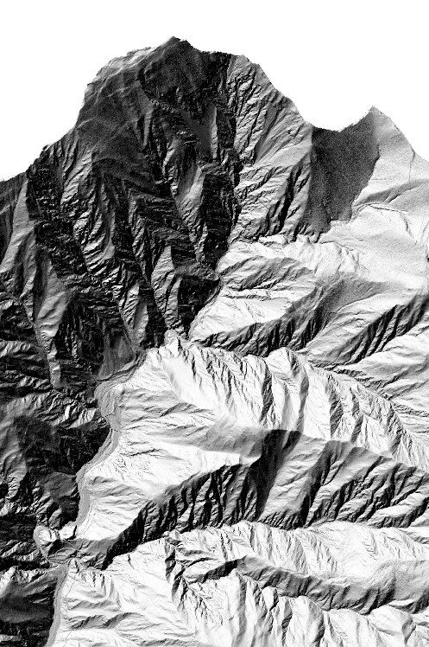
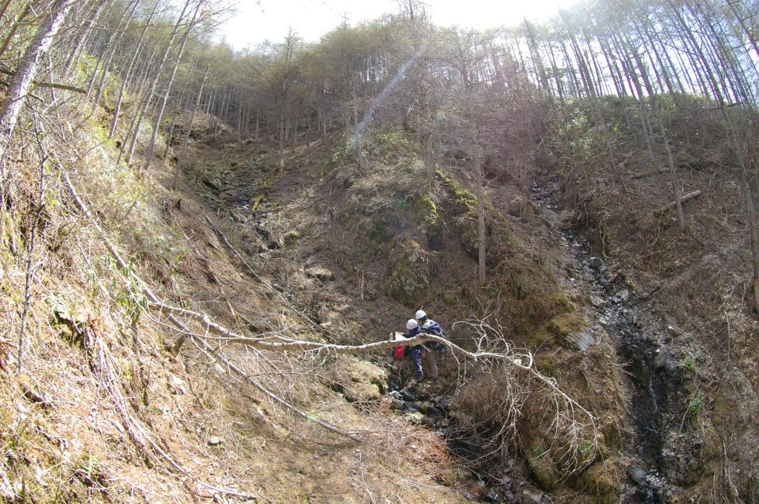
Lidar DTMs: Solving the resolution problem?
Availability of meter and sub-meter resolution topographic data
Topographic patterns can be resolved over large areas at resolutions commensurate with the scale of governing processes
Importance of objective extraction of geomorphic feature
Opportunity to measure drainage density

Slide 16
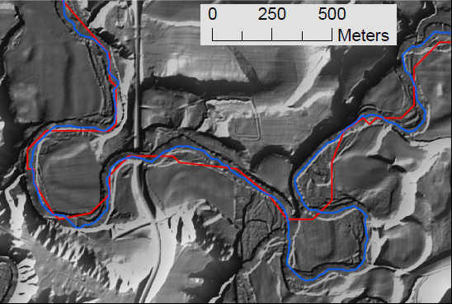
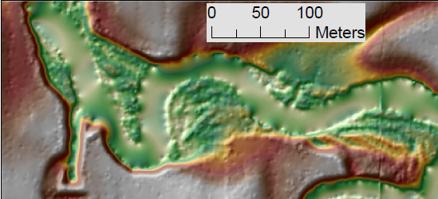
Challenges in geomorphic feature extraction
Channel initiation
Identification of accurate centerline
Presence of roads and bridges
Artificial drainage ditches
Small signal to noise ratio
Identification of channel banks
Measurement of bluffs

Slide 17
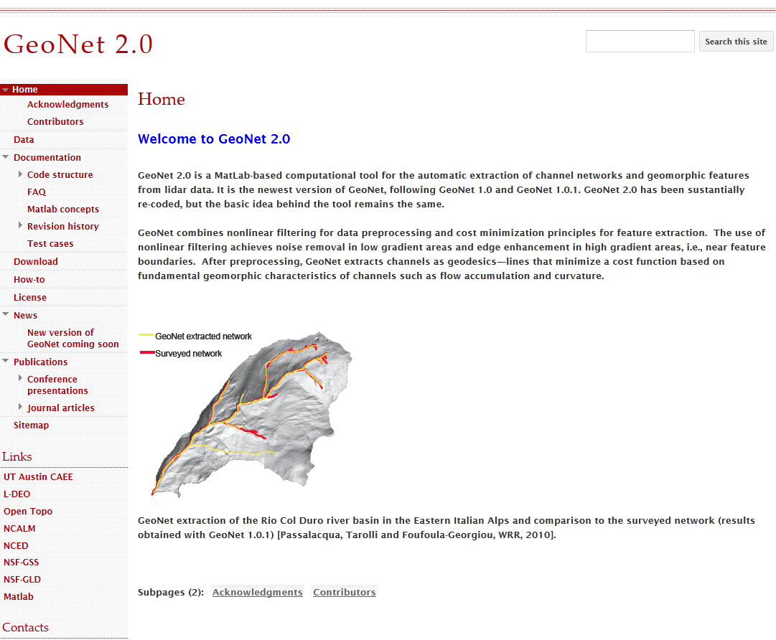
GeoNet: NCED toolbox for channel network extraction

Slide 18
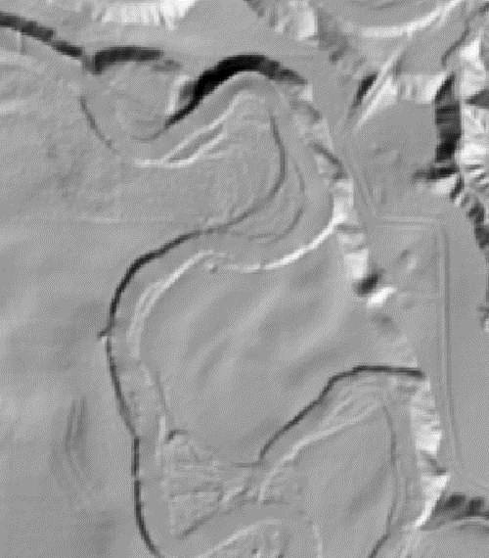
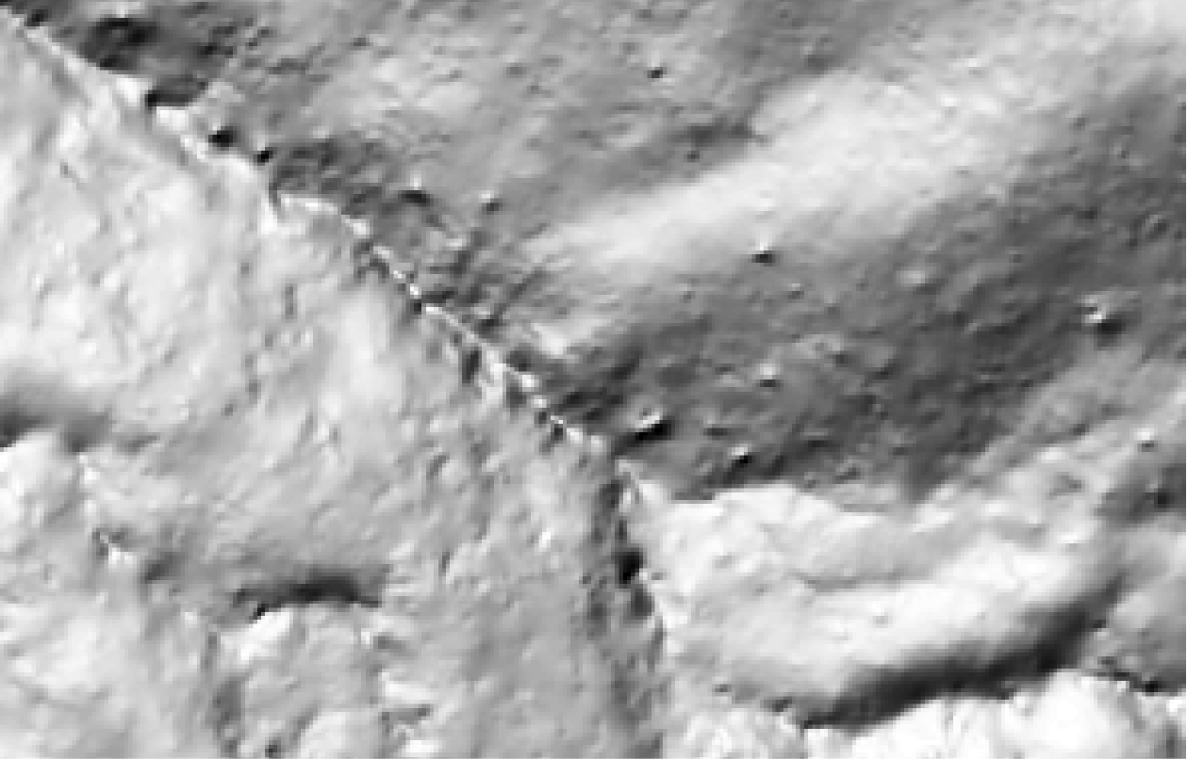
GeoNet: Nonlinear filtering
Nonlinear filtering: Enhance features of interest, while smoothing small scale features. Perona and Malik [1990]
Smooth
Bumps
Keep
Channel

Slide 19
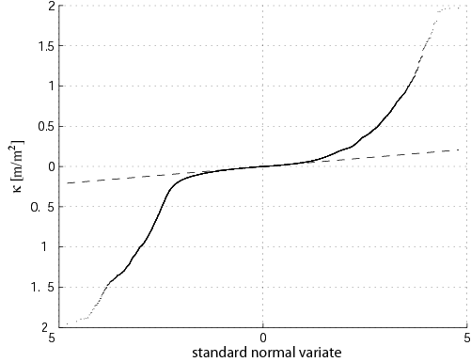
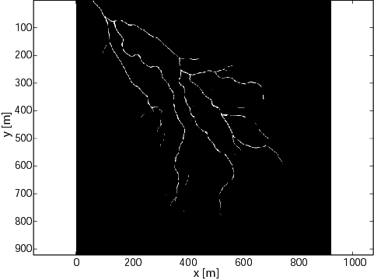
GeoNet: Statistical signature of geomorphic transitions
Skeleton of likely channelized pixels: Set of pixels with curvature above threshold, identified from quantile-quantile plot of curvature.
The deviation of the pdf from Gaussian can be interpreted as transition from hillslope to valley [Lashermes et al,. 2007].

Slide 20
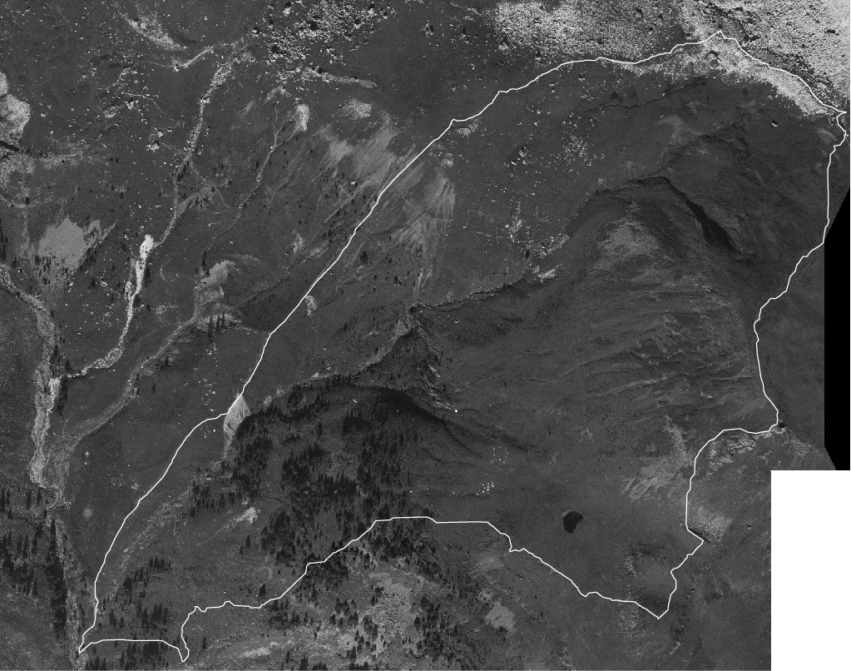
Channel extraction: geodesics
Geodesic minimization: Channels are extracted as paths of minimum cost
The cost function ψ represents the cost of traveling between point a and point b in terms of a function of area (A), slope (S), curvature (κ) and skeleton (Skel):
b
Channel head
Outlet
a

Slide 21
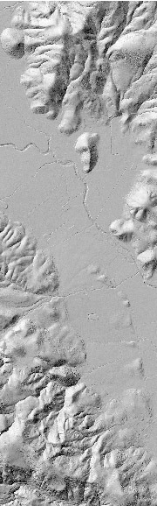
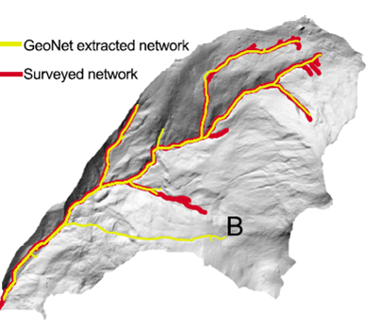
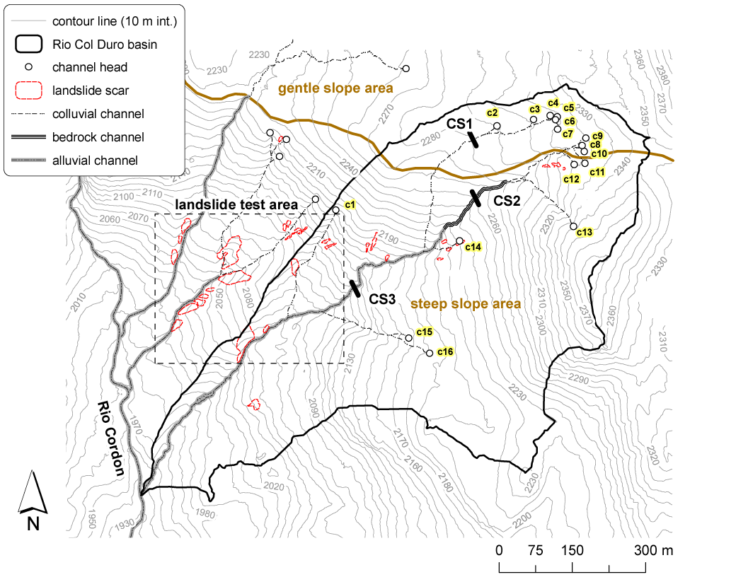
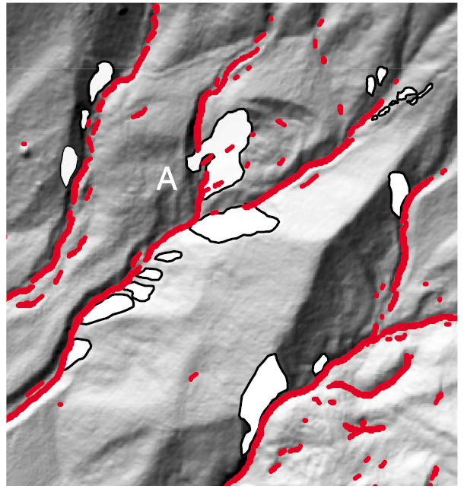
Channel initiation and channel disruptions
Passalacqua, P., P. Tarolli, and E. Foufoula-Georgiou, Water Resour. Res, 2010

Slide 22
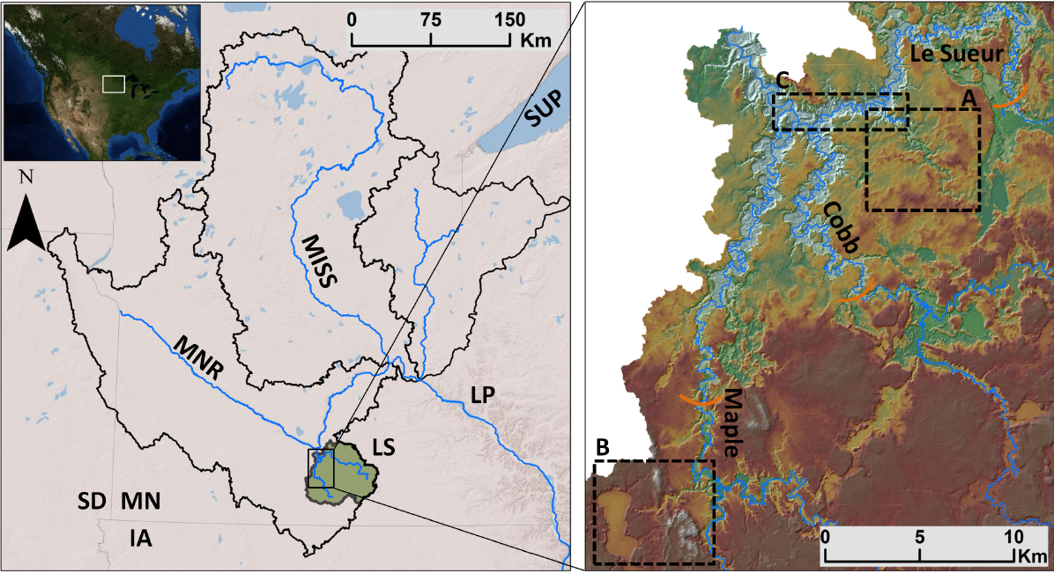
Flat lands and channel morphology
Le Sueur River major source of sediment to the Minnesota River.
Both listed as impaired for turbidity by USEPA.
Need to identify sediment sources

Slide 23
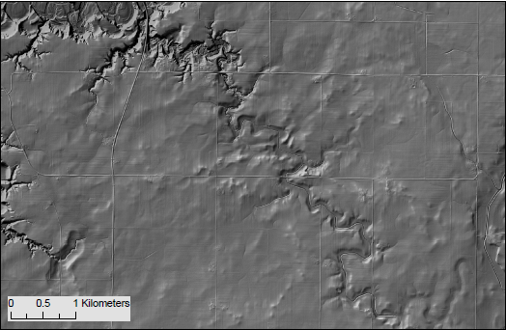
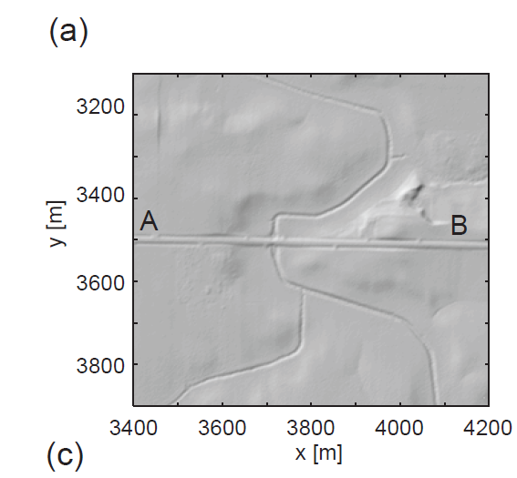
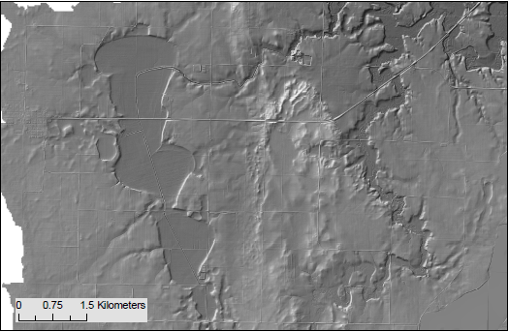
Roads and ditches

Slide 24
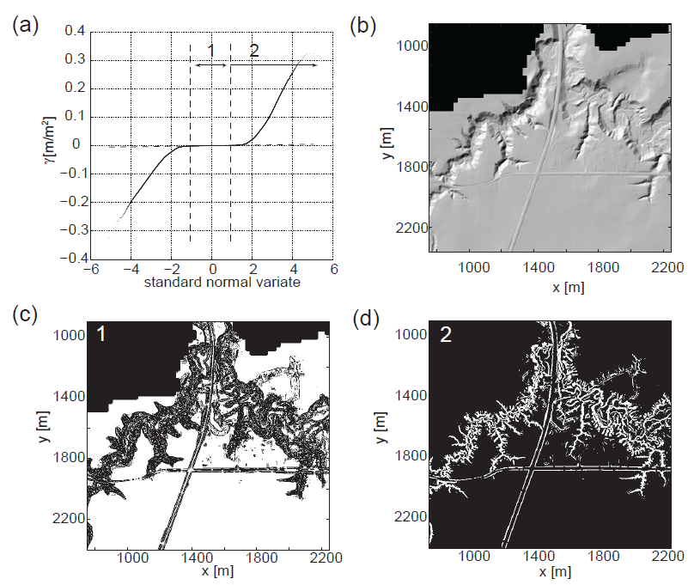
Identification of likely channelized pixels in engineered landscapes
Passalacqua, P., P. Belmont, and E. Foufoula-Georgiou, Water Resour. Res., 2012

Slide 25
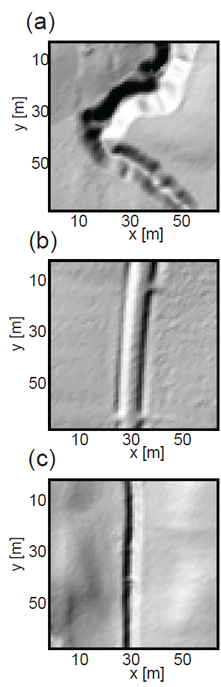
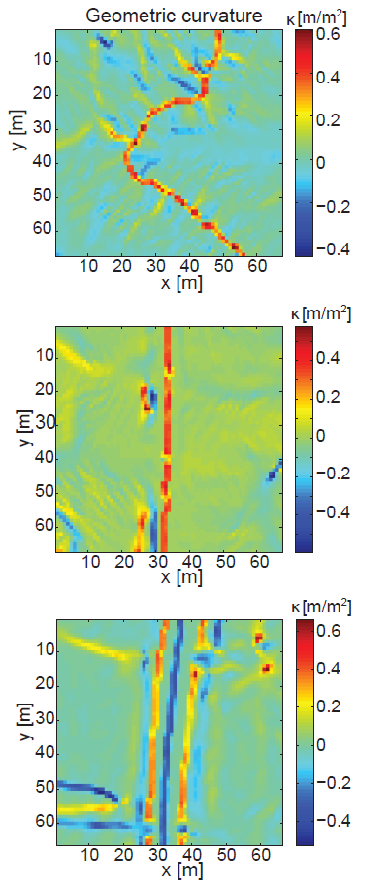
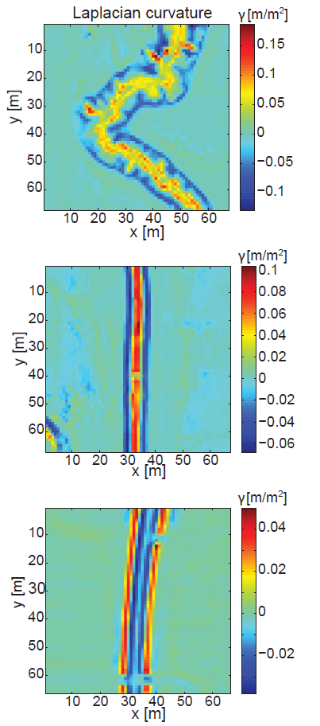


Curvature analysis to distinguish channels and roads
$$κ=∇∙\left(\frac{∇h}{\left|∇h\right|}\right)$$
$$γ=∇^{2}h$$
Passalacqua, P., P. Belmont, and E. Foufoula-Georgiou, Water Resour. Res., 2012

Slide 26
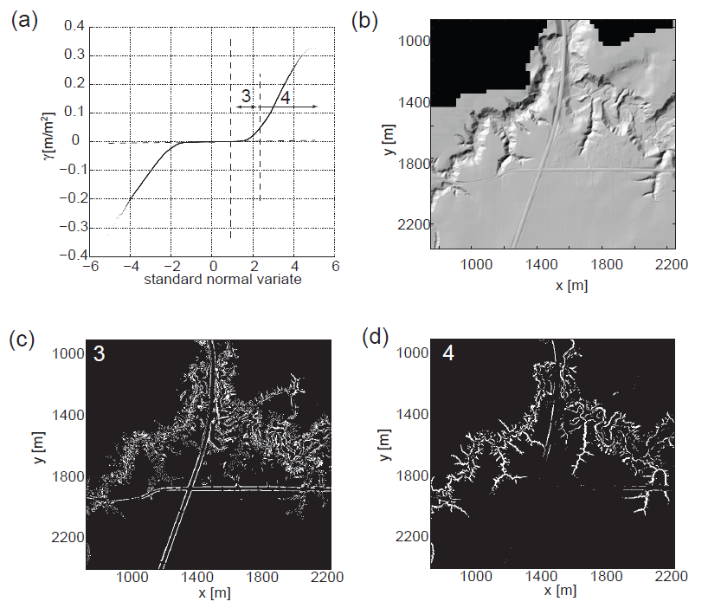
Differentiating natural versus artificial features
Passalacqua, P., P. Belmont, and E. Foufoula-Georgiou, Water Resour. Res., 2012

Slide 27
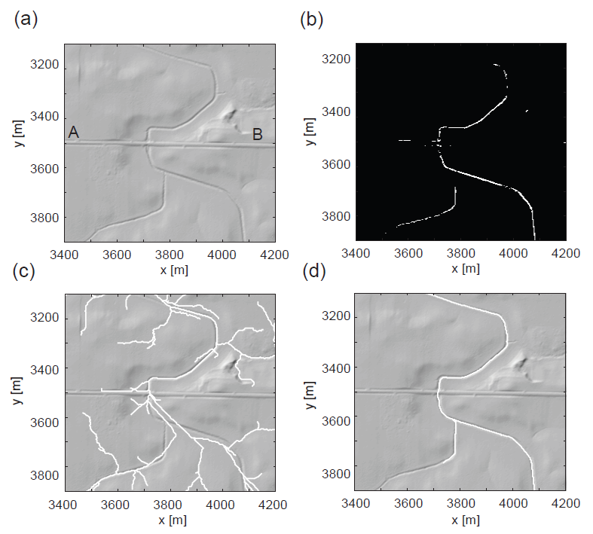
Channel network extraction and bridge crossings
Passalacqua, P., P. Belmont, and E. Foufoula-Georgiou, Water Resour. Res., 2012

Slide 28
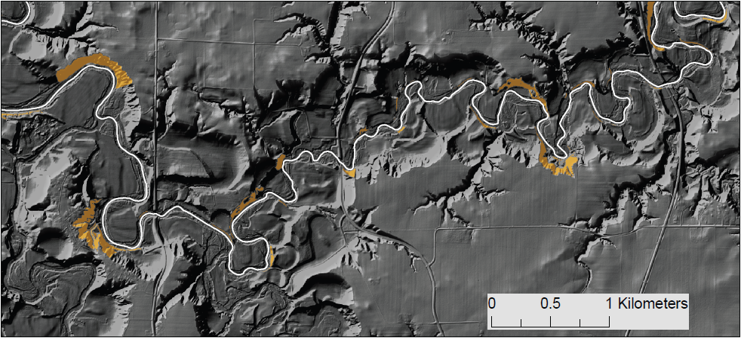
Automatic extraction of channel morphology
Height 60 m
Automatic extraction of channel cross-section
Detection of bank location
Identification of geomorphic bankfull water surface elevation
Measurements of channel width and of bank and bluff height

Slide 29
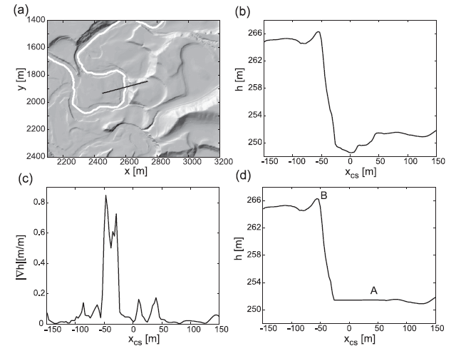
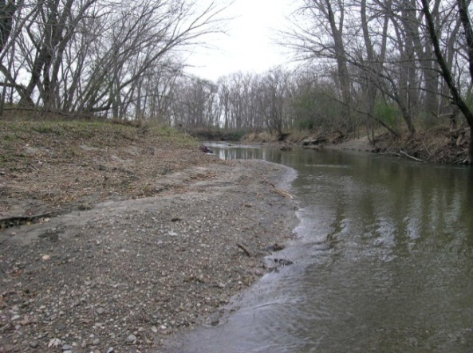

Automatic extraction of channel morphology
Source: P. Belmont
Source: C. Jennings
Passalacqua, P., P. Belmont, and E. Foufoula-Georgiou, Water Resour. Res., 2012

Slide 30

Codependence of vegetation and drainage density
Field mapped channel heads on slope gradient map (Imaizumi et al. [2010]).
GeoNet drainage delineation.

Slide 31


Preliminary results: Codependence of vegetation and drainage density

Slide 32

Preliminary results: Codependence of vegetation and drainage density

Slide 33


Multi-resolution analysis of landscapes to understand landscape forming processes characteristic scales
The first scaling break represents the length scale of the highly convex regions(i.e. the ridges)
The second scaling break represents the hillslope length scale.
Slide courtesy of Harish Sangireddy, UT Austin

Slide 34


Feature extraction from point cloud
Six test sites were studied for testing the methodology.
The data for the test sites was obtained from TNRIS
Slide courtesy of Harish Sangireddy, UT Austin

Slide 35




Feature extraction from point cloud
Site 1 has only streams and surrounding farmlands
dry stream
Slide courtesy of Harish Sangireddy, UT Austin

Slide 36




Feature extraction from point cloud
Site 2 has roads, streams, marshy areas, small culvert and drains by the roadside
stream
marshy area
road
Slide courtesy of Harish Sangireddy, UT Austin

Slide 37




Feature extraction from point cloud
Detects points around the water gaps and maps the geometry of stream properly
stream
Probable floodplain
Slide courtesy of Harish Sangireddy, UT Austin

Slide 38




Feature extraction from point cloud
When the elevation difference is very small in the region, the model identifies all low lying areas as water surfaces
farmland
drain
road
tree
Site 5
Slide courtesy of Harish Sangireddy, UT Austin

Slide 39
Acknowledgements
Work supported by:
NSF EAR-0120914 (NCED)
NSF EAR-0835789
NSF BCS-1063231/1063228 (PIs Stark and Passalacqua)
Collaborators (in random order):
Tien Do Trung, Colin Stark, Guillermo Sapiro, Bill Dietrich, Efi Foufoula-Georgiou, Nachiket Gokhale, Paolo Tarolli, Patrick Belmont , Harish Sangireddy, David Maidment, Yuichi S. Hayakawa, Fumitoshi Imaizumi, Tsuyoshi Hattanji, Lin Zhou.

