Slide 1
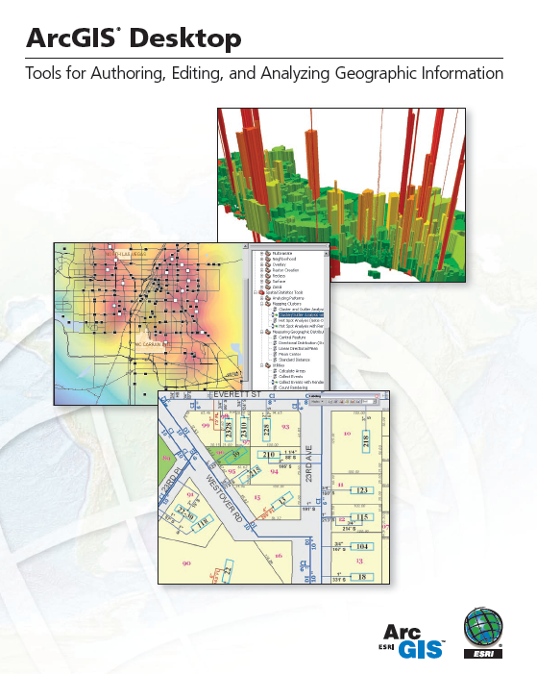
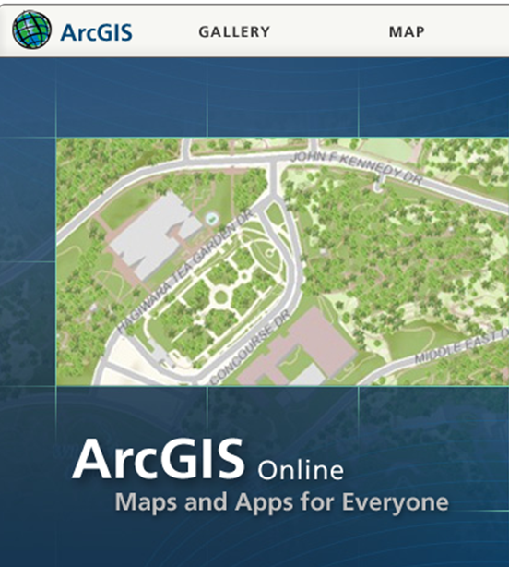
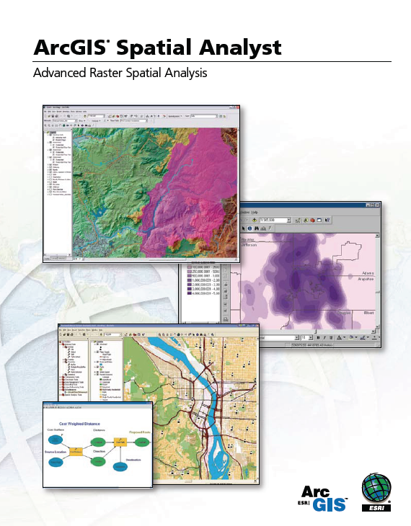
Introduction to ArcGIS Software

Slide 2
Introduction to GIS Software
Conceptual framework of ArcGIS
How data are stored in ArcGIS
ArcGIS Desktop, ArcGIS Server, ArcGIS Online
Extensions of ArcGIS – spatial analyst, 3D analyst

Slide 3
Introduction to GIS Software
Conceptual framework of ArcGIS
How data are stored in ArcGIS
ArcGIS Desktop, ArcGIS Server, ArcGIS Online
Extensions of ArcGIS – spatial analyst, 3D analyst

Slide 4

Jack Dangermond, President, ESRI
http://www.esri.com/about-esri/about/jack_dangermond.html
Article from NY Times:
http://www.nytimes.com/2011/07/10/business/esris-chief-on-tending-his-plants-and-his-company.html?_r=2

Slide 5

Videos: ESRI International User Conference
http://www.esri.com/events/user-conference/agenda/plenary-videos.html
Watch Plenary Session attended by 15,000 people

Slide 6
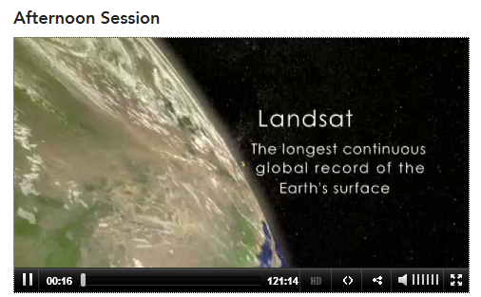
40th Anniversary of Landsat
Beginning of afternoon video …

Slide 7
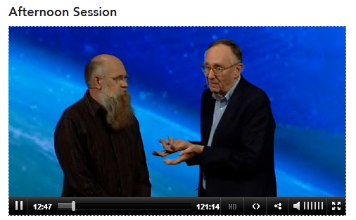
Scott Morehouse
Chief Software Engineer at ESRI
… after the video about LandSat

Slide 8
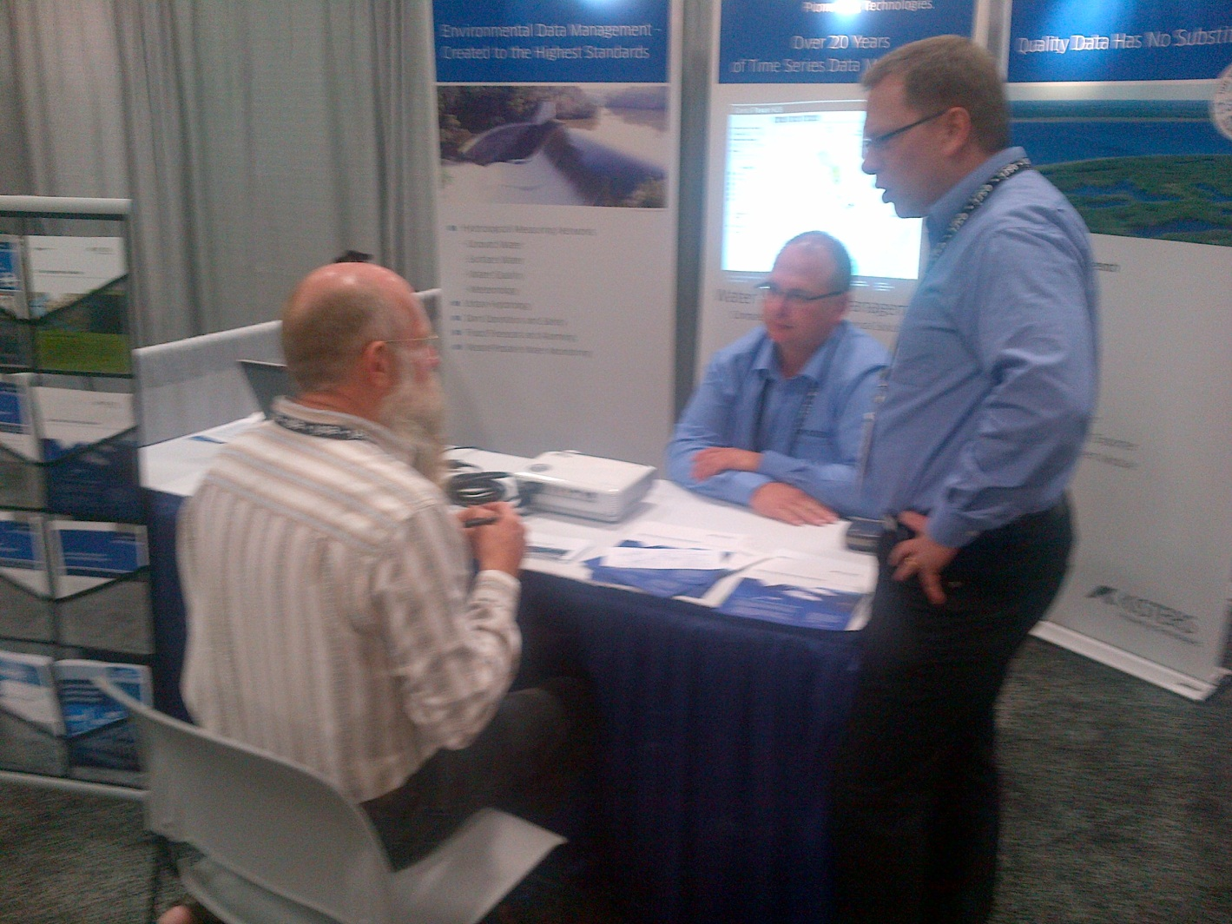
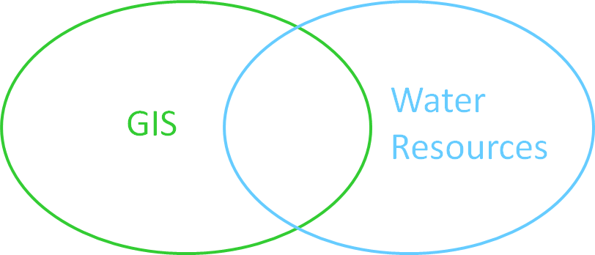
ESRI and Kisters
Geospatial and Time Series Data
Next 11 slides are from Jack Dangermond

Slide 9





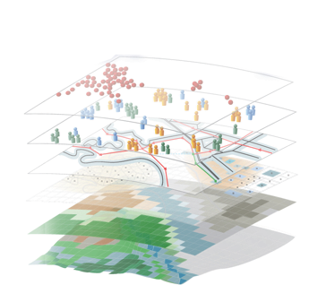


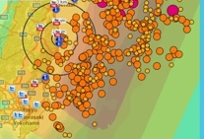

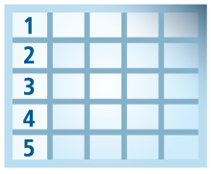
Geospatial Systems Are Helping Us Understand
Understanding
Sharing and Collaboration
Knowledge
Information
Integration
Mapping
Data
. . . Helping Us Make Better Decisions

Slide 10



Good GeoInformation Products Require Good Design
Understanding Issues
Appropriate Data
Analysis & Manipulation
. . . And A Compelling Graphic Design
Good Products Help Us Understand . . .
. . . And Support Action

Slide 11
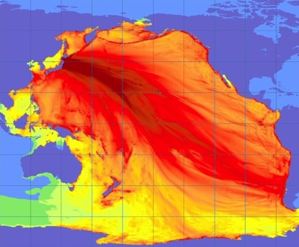
Good Information Products Are Timely
Tsunami Forecast
Help Us Understand . . .
. . . And Support Action

Slide 12
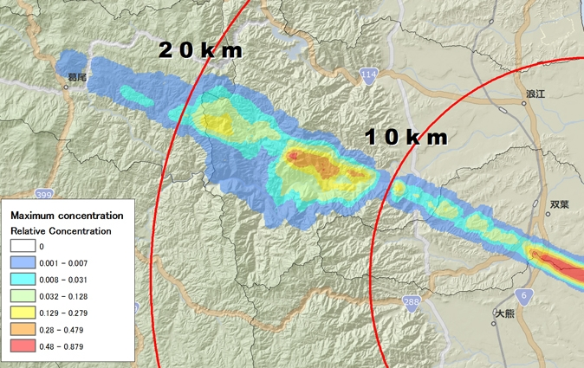
Good Information Products Disseminate Knowledge . . .
Fukushima Radiation Exposure
Help Us Understand . . .
. . . And Support Action

Slide 13
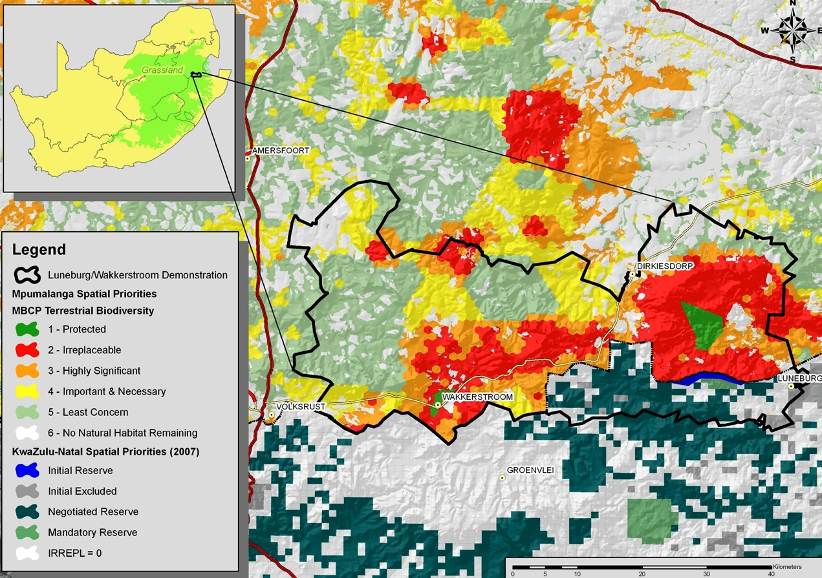
Good Information Products Communicate Importance
Suitability For Conservation
Help Us Understand . . .
. . . And Support Action

Slide 14
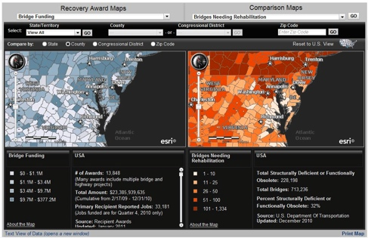
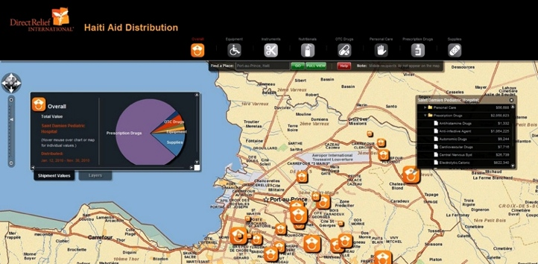
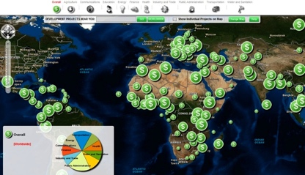
Good Information Products Show Status
Government Expenditures vs. Need
Situation Awareness
Haiti AID Funding
CGI Grants
Help Us Understand . . .
. . . And Support Action

Slide 15
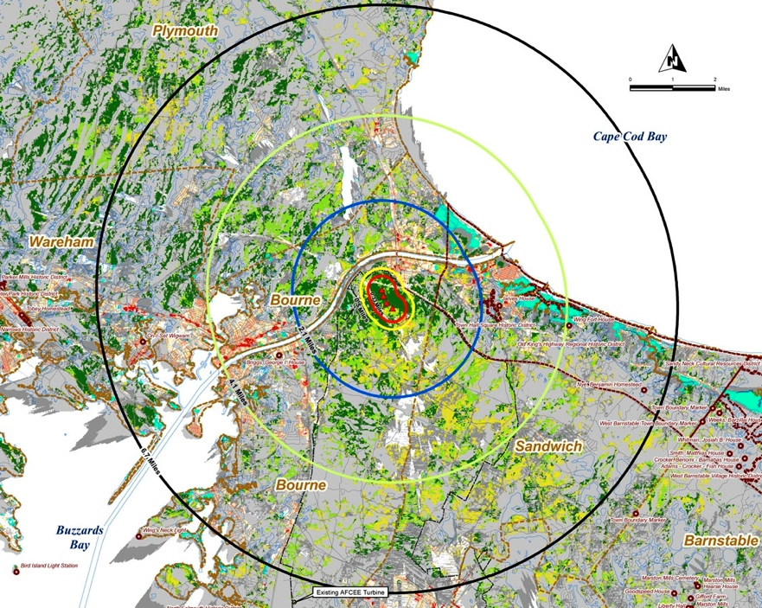
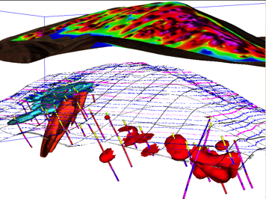
Good Information Products Support Decision Making
Wind Turbine Suitability
Hydrocarbons
Help Us Understand . . .
. . . And Support Action
Leveraging Spatial Analysis

Slide 16
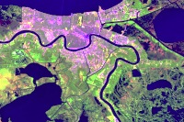
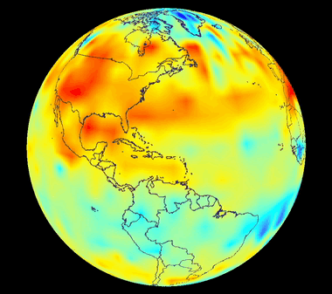
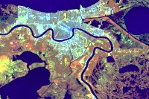
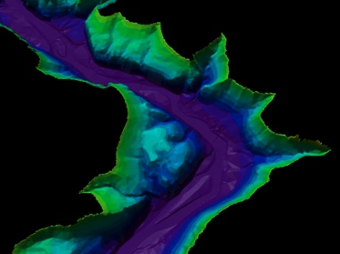
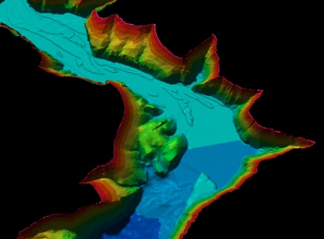
Good Information Products Illustrate Change
Urbanization – Landsat
Temperature
Sedimentation
Help Us Understand . . .
. . . And Support Action

Slide 17
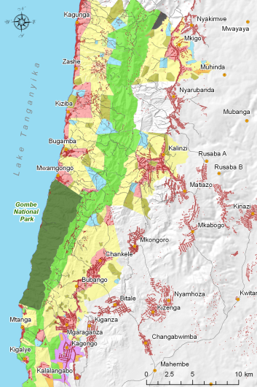
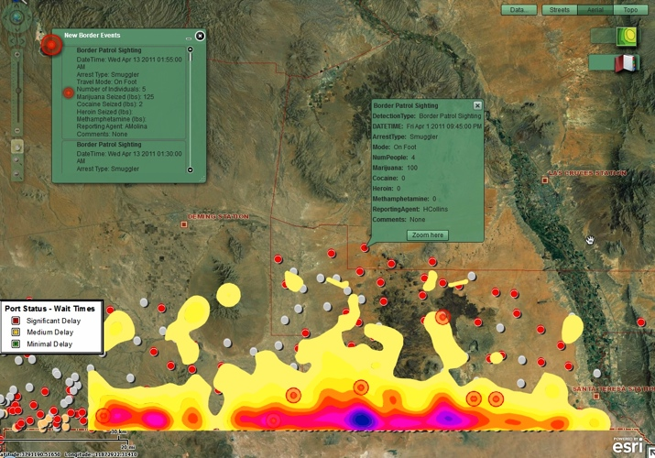
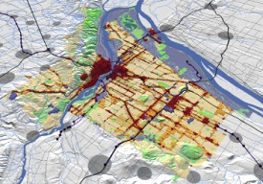
Good Information Products Can Show The Future
Gombe, Tanzania
Texas Border
CGI Grants
Oregon
Help Us Understand . . .
. . . And Support Action

Slide 18

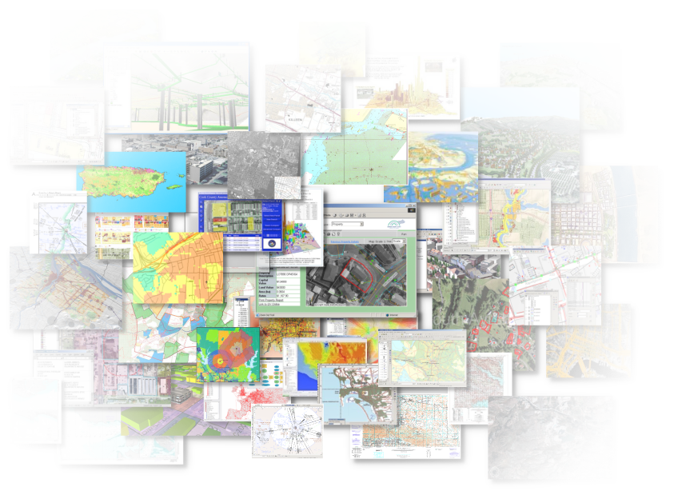

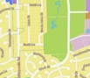

Good GeoInformation Products
Provide Timely Information
Disseminate Knowledge
Communicate Importance
Show Status and Performance
Support Decision Making
Illustrate Change
Show The Future
Effectively Telling a Story . . .
Helping Us Understand . . .
. . . And Make Better Decisions

Slide 19
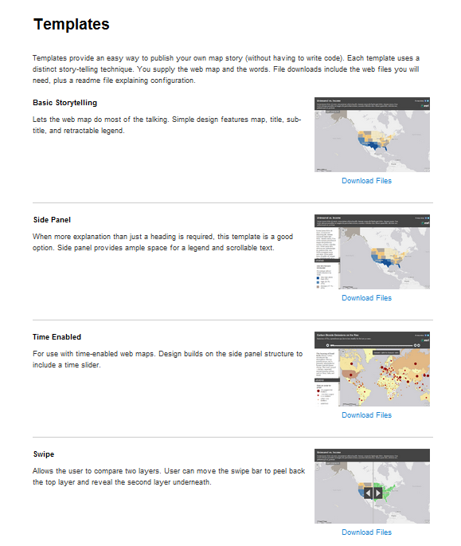
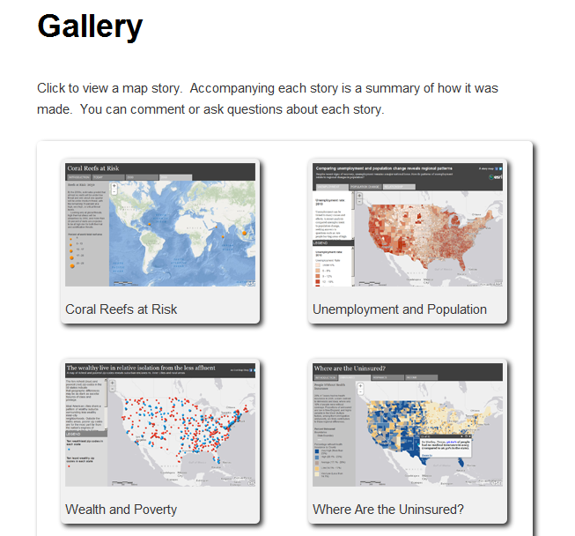
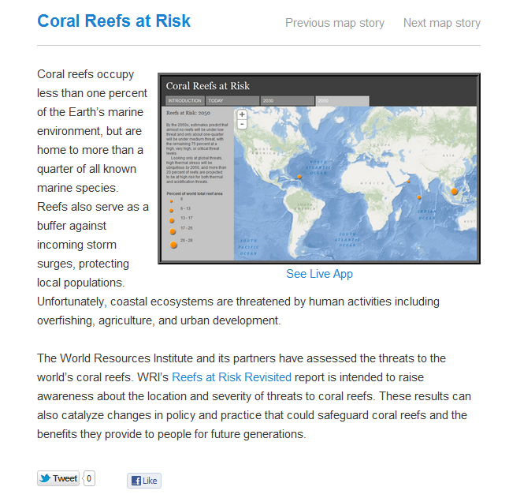
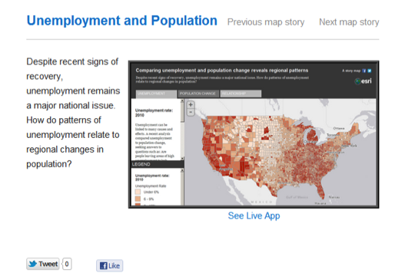
Storytelling With Maps
An Old Discipline, Needing To Be Applied With Today’s Technology
Templates
Galleries
Maps
storymaps.esri.com

Slide 20
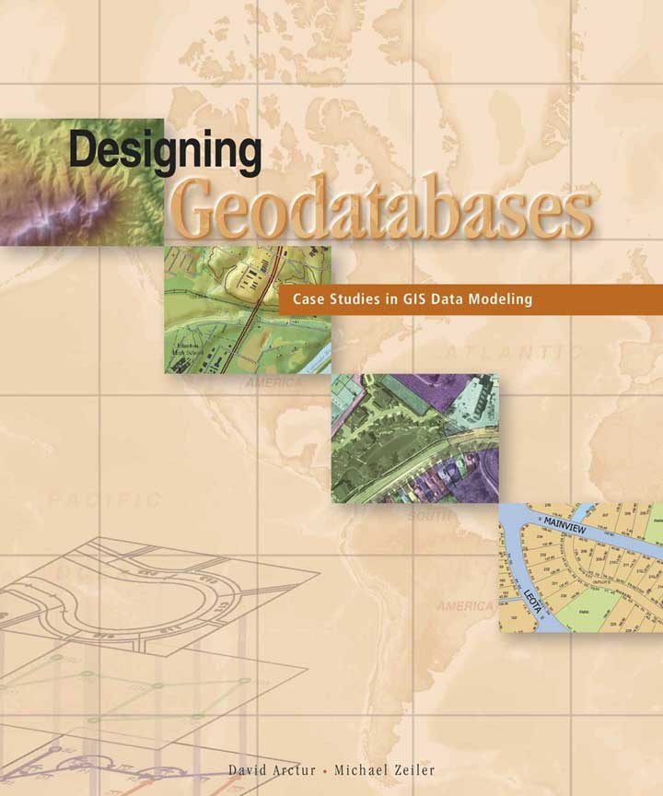
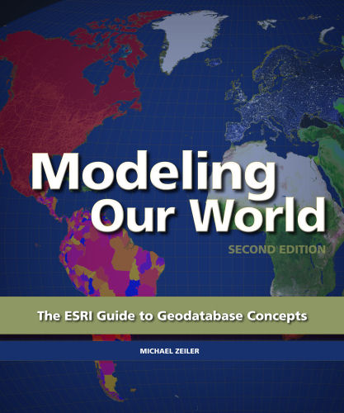
Reference Books: http://esripress.esri.com/
David Arctur, Michael Zeiler, ESRI Press, 2004
Michael Zeiler, ESRI Press, 2010

Slide 21

Geodesign
Leverage geographic information, to produce designs that more closely follow natural systems

Slide 22



HydroDesign
Leverage geospatial and temporal information to design sustainable homes, communities, industries and societies with respect to their dependence on water

Slide 23
ESRI Online Reference Materials
ArcGIS summary: http://www.esri.com/library/brochures/pdfs/arcgis.pdf
ArcGIS Desktop summary: http://www.esri.com/library/brochures/pdfs/arcgis-desktop.pdf
Spatial Analyst summary: http://www.esri.com/library/brochures/pdfs/spatialanalystbro.pdf
ESRI Virtual Campus – provides online training http://campus.esri.com/

Slide 24
Introduction to GIS Software
Conceptual framework of ArcGIS
How data are stored in ArcGIS
ArcGIS Desktop, ArcGIS Server, ArcGIS Online
Extensions of ArcGIS – spatial analyst, 3D analyst

Slide 25
Geographic Data Models
All geographic information systems are built using formal models that describe how things are located in space. A formal model is an abstract and well-defined system of concepts. A geographic data model defines the vocabulary for describing and reasoning about the things that are located on the earth. Geographic data models serve as the foundation on which all geographic information systems are built.
Scott Morehouse, Preface to “Modeling our World”, First Edition

Slide 26
ESRI GIS Development
Arc/Info (coverage model)
Versions 1-7 from 1980 – 1999
Arc Macro Language (AML)
ArcGIS (geodatabase model)
Version 8.0, …, 10.1 from 2000 – Python scripting
ArcView (shapefile model)
Versions 1-3 from 1994 – 1999
Avenue scripting language

Slide 27
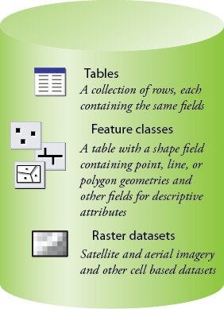
Common Geospatial Information Types
Image: Michael Zeiler, ESRI

Slide 28
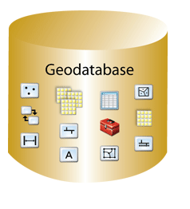
Geodatabase – a store for all types of geospatial information

Slide 29
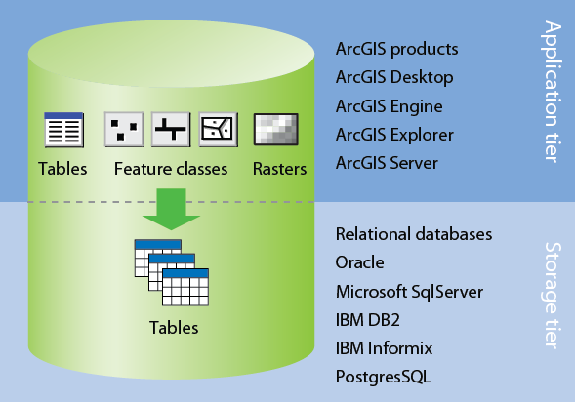
Application and Storage Tiers
Image: Michael Zeiler, ESRI

Slide 30
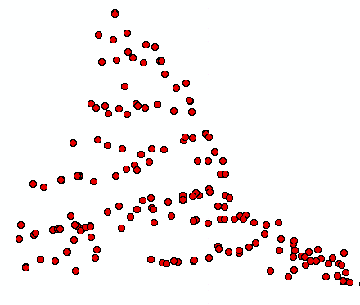
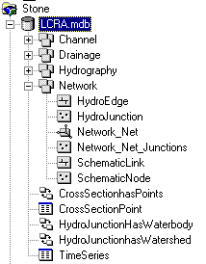
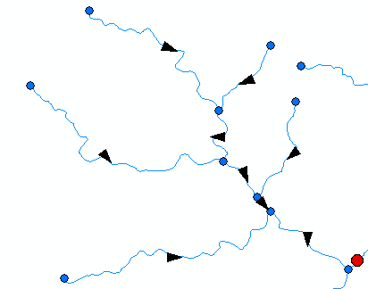
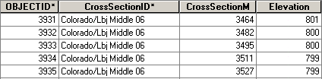
ArcGIS Geodatabase
Workspace
Geodatabase
Feature Dataset
Feature Class
Geometric
Network
Relationship
Object Class

Slide 31
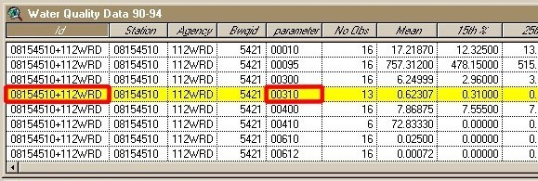
Object Class
An object class is a collection of objects in tabular format that have the same behavior and the same attributes.
An object class is a table that has a unique identifier (ObjectID)
for each record

Slide 32
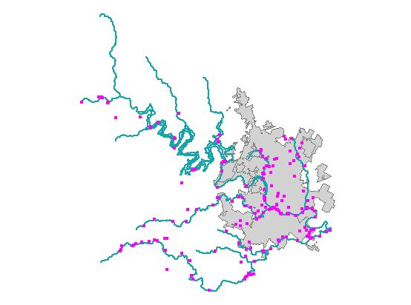
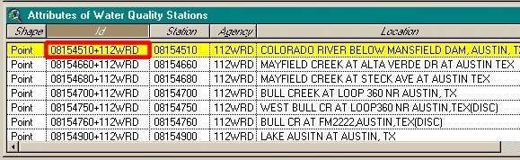
Feature Class
A feature class is a collection of geographic objects in tabular format that have the same behavior and the same attributes.
Feature Class = Object class + spatial coordinates

Slide 33
Relationship
A relationship is an association or link between two objects in a database.
A relationship can exist between spatial objects (features in feature classes), non-spatial objects (objects in object classes), or between spatial and non-spatial objects.

Slide 34
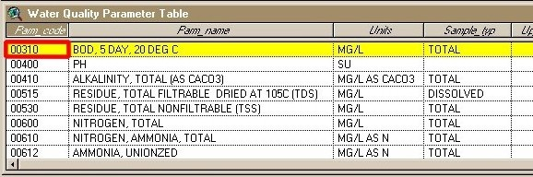
Relationship
Relationship between non-spatial objects
Water
Quality
Data
Water
Quality
Parameters

Slide 35
Relationship
Relationship between spatial and non-spatial objects
Water quality data
(non-spatial)
Measurement station
(spatial)

Slide 36
Introduction to GIS Software
Conceptual framework of ArcGIS
How data are stored in ArcGIS
ArcGIS Desktop, ArcGIS Server, ArcGIS Online
Extensions of ArcGIS – spatial analyst, 3D analyst

Slide 37
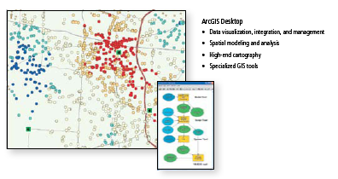
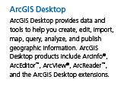
ArcGIS Desktop

Slide 38
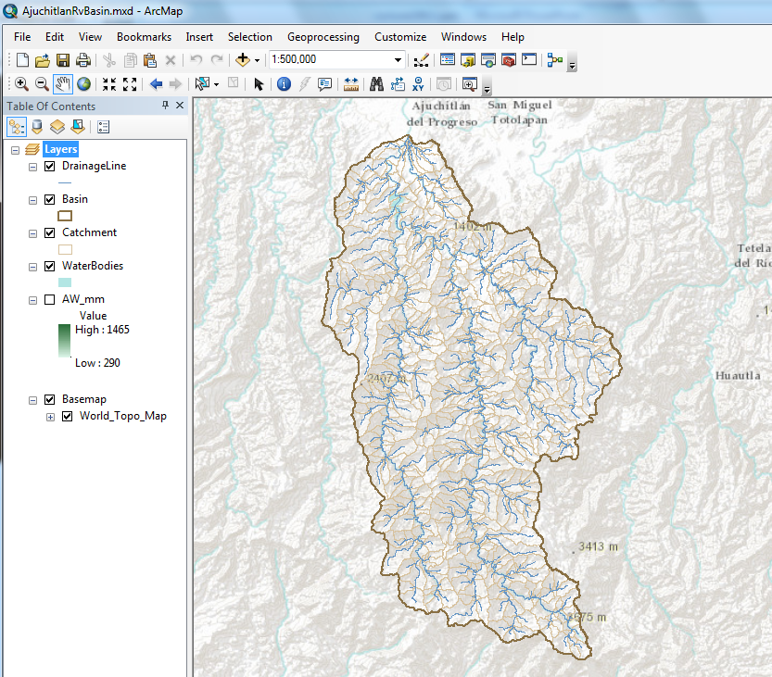
ArcMap – primary work interface

Slide 39
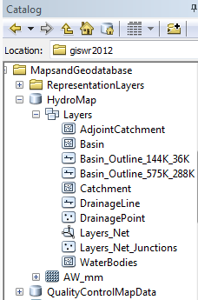
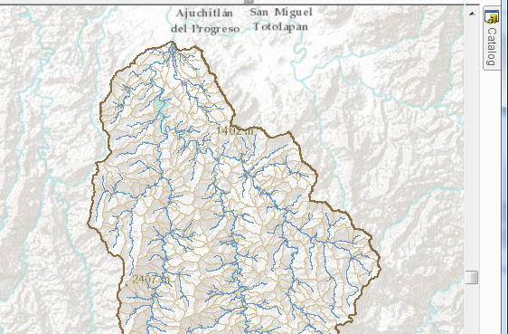
Arc Catalog – view the geodatabase

Slide 40

ArcToolbox – processing functions

Slide 41

Geo-Processing
Toolbox tools linked together using the model builder to automate data processing

Slide 42



ArcGIS Server

Slide 43















Web-centered GIS
ArcGIS
Online

Slide 44









An Integrated Systems Approach
ArcGIS
Online
ArcGIS
Desktop
ArcGIS
Server

Slide 45
Introduction to GIS Software
Conceptual framework of ArcGIS
How data are stored in ArcGIS
ArcGIS Desktop, ArcGIS Server, ArcGIS Online
Extensions of ArcGIS – spatial analyst, 3D analyst

Slide 46

Spatial Analyst
Analysis of land surface terrain as a grid
Key means of defining drainage areas and connectivity to stream network

Slide 47

Grid Datasets
Cellular-based data structure composed of square cells of equal size arranged in rows and columns.
The grid cell size and extension (number of rows and columns), as well as the value at each cell have to be stored as part of the grid definition.
Number of columns
Cell size
Number of rows

Slide 48


Grid Datasets
Grid datasets

Slide 49

Image Datasets
Digital Orthophotos and satellite imagery
Image datasets

Slide 50

3-D Analyst
Analysis of land surface terrain as triangulated irregular network (TIN)
Visualization in 3-D using Arc Scene
Stream channel of Pecan Bayou, TX

Slide 51


TIN Datasets
TIN datasets
Points and breaklines from which a TIN is constructed.

